Slide 1
Point Set Registration: Coherent Point Drift
David Baumgärtel
Computer Vision: Objectrecognition
Prof. Ommer
SS 2014

Slide 2
Motivation
http://en.wikipedia.org/wiki/Point_set_registration#mediaviewer/File:Cpd_fish_rigid.gif

Slide 3
Goal: Alignment of two point sets. Desirable Properties: (1) Ability to accurately model the transformation (2) Ability to handle possibly high dimensionality (3) Robustness to noise, outliers, missing points

Slide 4
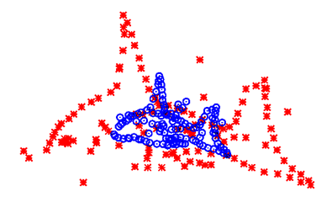
Idea: Consider the alignment as a probability density estimation problem. One point set is a true data set. (red) The other set represents Gaussian Mixture Model centroids. (blue)

Slide 5
Fit the GMM centroids to the data by maximizing the likelihood.

Slide 6
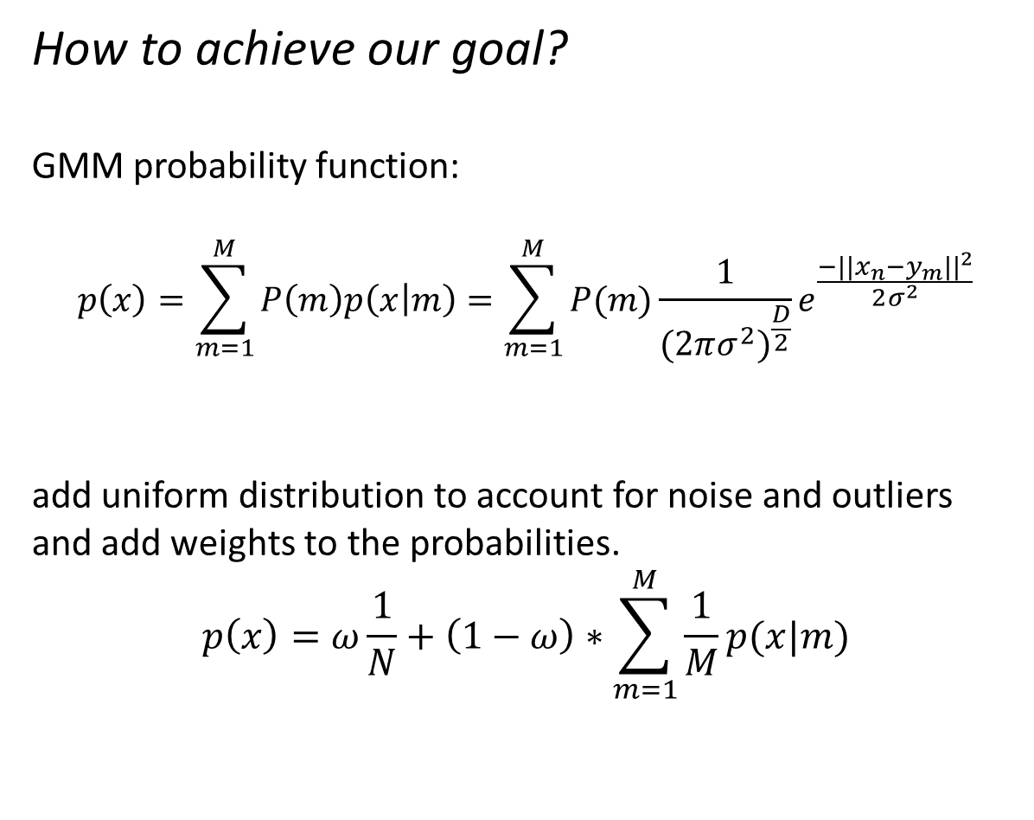
How to achieve our goal? GMM probability function: $$p\left(x\right)=\sum_{m=1}^{M}{P\left(m\right)p\left(x | m\right)=\sum_{m=1}^{M}{P(m)}}\frac{1}{{(2πσ^{2})}^{\frac{D}{2}}}e^{\frac{−||x_{n}−y_{m}||^{2}}{2σ^{2}}}$$ add uniform distribution to account for noise and outliers and add weights to the probabilities. $$p\left(x\right)=ω\frac{1}{N}+\left(1−ω\right)∗\sum_{m=1}^{M}{\frac{1}{M}p(x|m)}$$

Slide 7
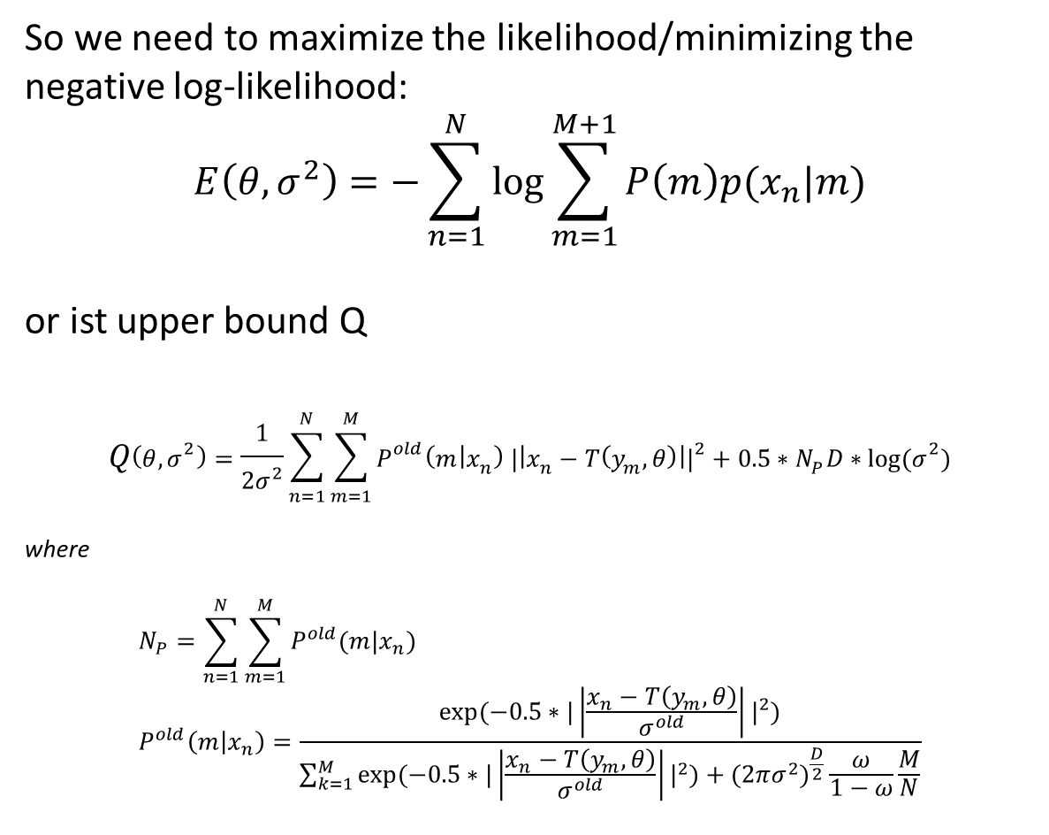
So we need to maximize the likelihood/minimizing the negative log-likelihood: $$E\left(θ,σ^{2}\right)=−\sum_{n=1}^{N}{log⁡}\sum_{m=1}^{M+1}{P\left(m\right)p(x_{n}|m)}$$ or ist upper bound Q $$Q\left(θ,σ^{2}\right)=\frac{1}{{2σ}^{2}}\sum_{n=1}^{N}{\sum_{m=1}^{M}{P^{old}\left(m | x_{n}\right) |\left|x_{n}−T\left(y_{m},θ\right)\right||^{2}+{0.5∗N}_{P}D∗log⁡(σ^{2})}}$$ where $$N_{P}=\sum_{n=1}^{N}{\sum_{m=1}^{M}{P^{old}(m|x_{n})}} \\ P^{old}\left(m | x_{n}\right)=\frac{exp⁡(−0.5∗|\left|\frac{x_{n}−T\left(y_{m},θ\right)}{σ^{old}}\right||^{2})}{\sum_{k=1}^{M}{exp⁡(−0.5∗|\left|\frac{x_{n}−T\left(y_{m},θ\right)}{σ^{old}}\right||^{2})+(2πσ^{2})^{\frac{D}{2}}\frac{ω}{1−ω}\frac{M}{N}}}$$

Slide 8
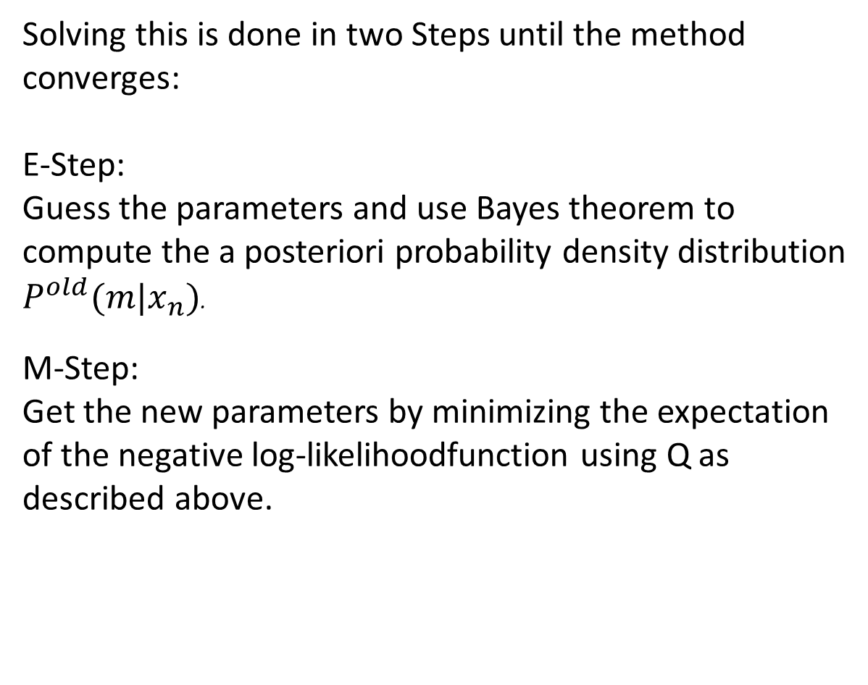
Solving this is done in two Steps until the method converges: E-Step: Guess the parameters and use Bayes theorem to compute the a posteriori probability density distribution $P^{old}(m|x_{n})$. M-Step: Get the new parameters by minimizing the expectation of the negative log-likelihoodfunction using Q as described above.

Slide 9
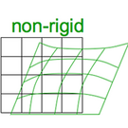

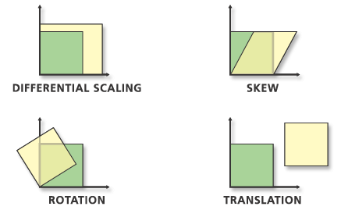
But what is T? T is our point transformation we search. We know 3 Types:
Rigid | Affine | Non-Rigid

Slide 10
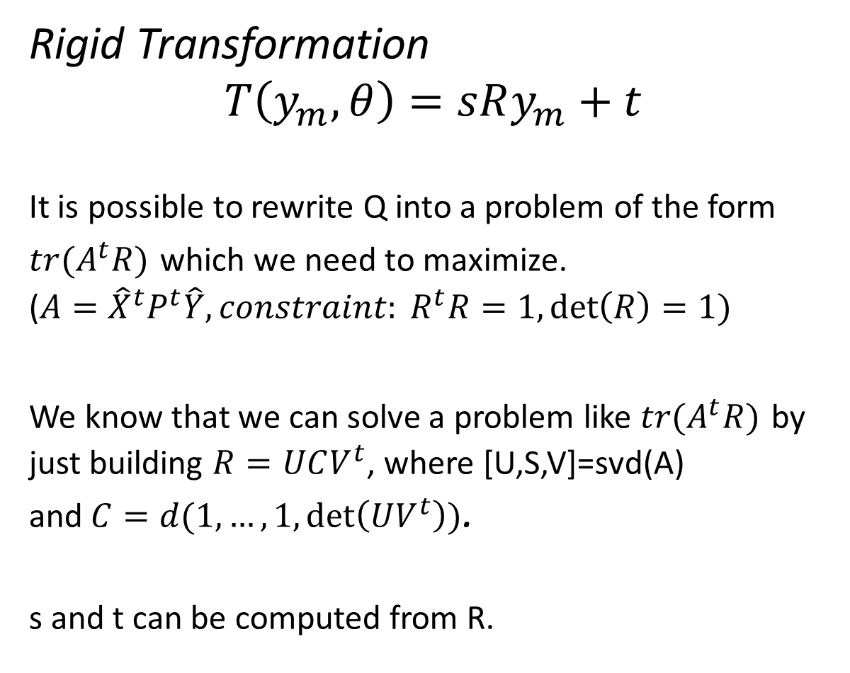
Rigid Transformation $$T\left(y_{m},θ\right)=sRy_{m}+t$$ It is possible to rewrite Q into a problem of the form $tr(A^{t}R)$ which we need to maximize. ($A={\hat{X}}^{t}P^{t}\hat{Y}, constraint: R^{t}R=1,\det\left(R\right)=1)$ We know that we can solve a problem like $tr(A^{t}R)$ by just building $R=UCV^{t}$, where [U,S,V]=svd(A) and$C=d(1,…,1,\det\left(UV^{t}\right))$. s and t can be computed from R.

Slide 11
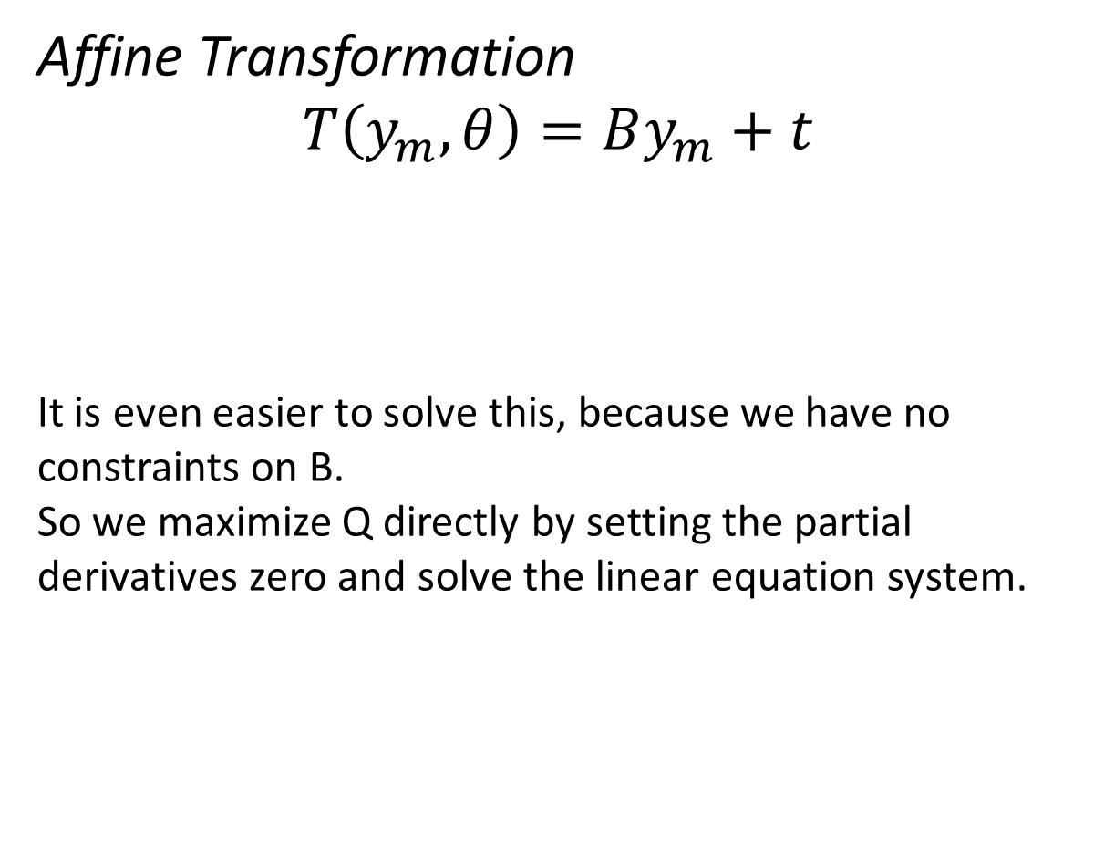
Affine Transformation $$T\left(y_{m},θ\right)=By_{m}+t$$ It is even easier to solve this, because we have no constraints on B. So we maximize Q directly by setting the partial derivatives zero and solve the linear equation system.

Slide 12
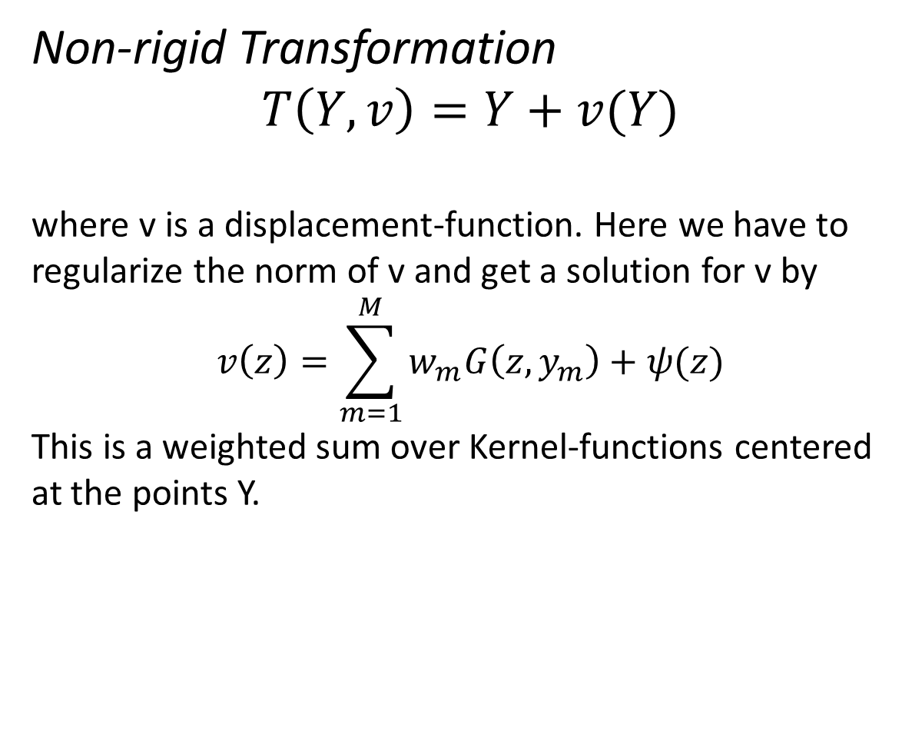
Non-rigid Transformation $$T\left(Y,v\right)=Y+v(Y)$$ where v is a displacement-function. Here we have to regularize the norm of v and get a solution for v by $$v\left(z\right)=\sum_{m=1}^{M}{w_{m}G\left(z,y_{m}\right)+ψ(z)}$$ This is a weighted sum over Kernel-functions centered at the points Y.

