Slide 1
Part 5.

Slide 2
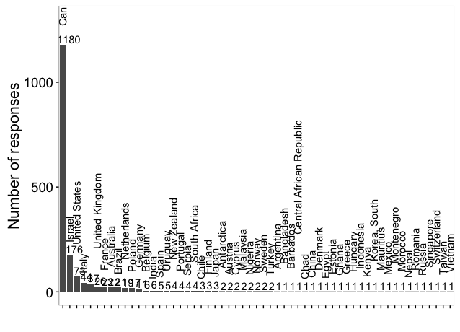

Slide 3
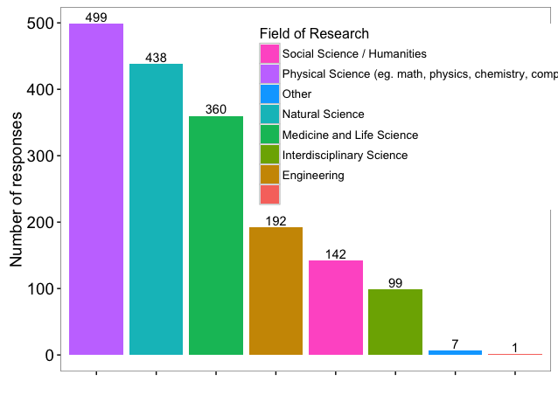
Field of research? - All

Slide 4
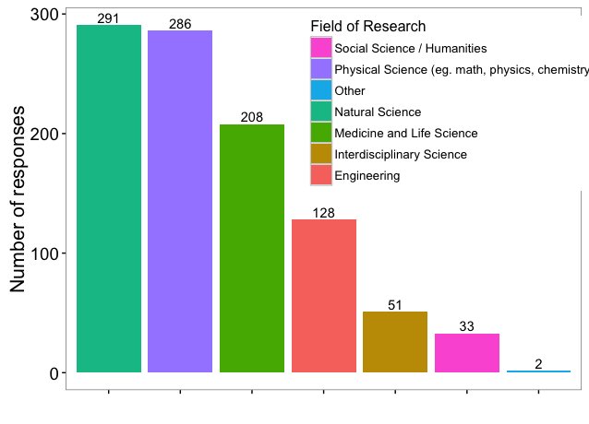
Field of research? - Canada

Slide 5
Part 1.

Slide 6
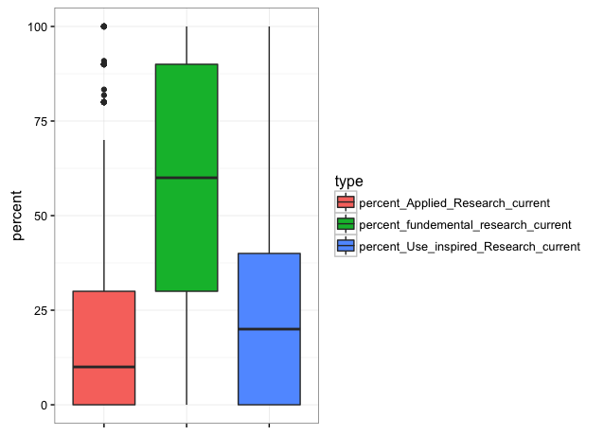
What type is your current research?

Slide 7
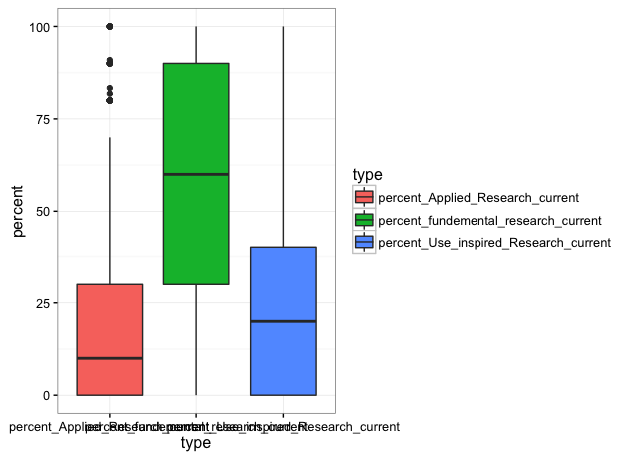
What type is your current research? - Canada

Slide 8
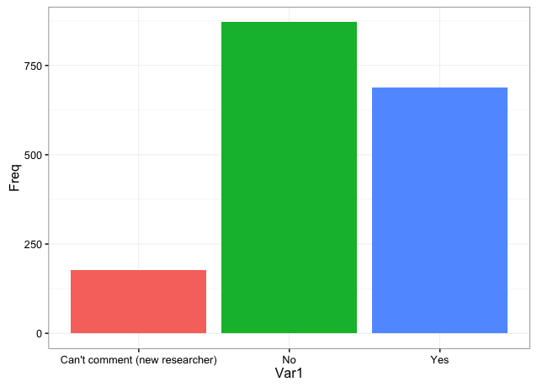
Change in type in the past 10 yrs? -All

Slide 9
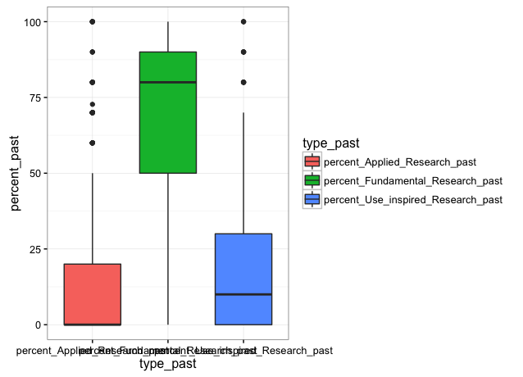
What type was your past research? - Canada

Slide 10
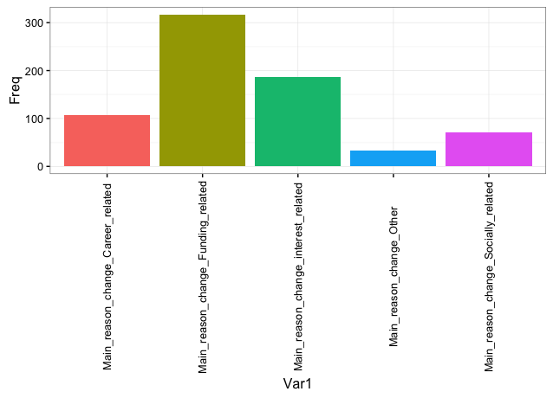
What was your main reason for change? - Canada

Slide 11
Part 4

Slide 12
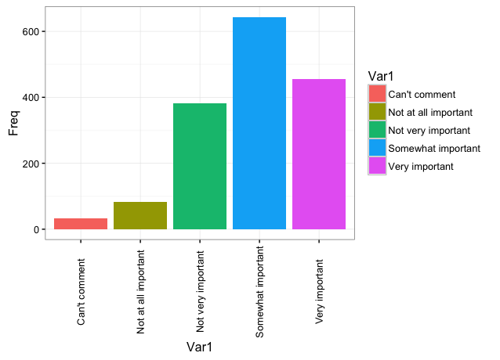
In your opinion, how important is fundamental research to the government in your country of work? - Canada

Slide 13
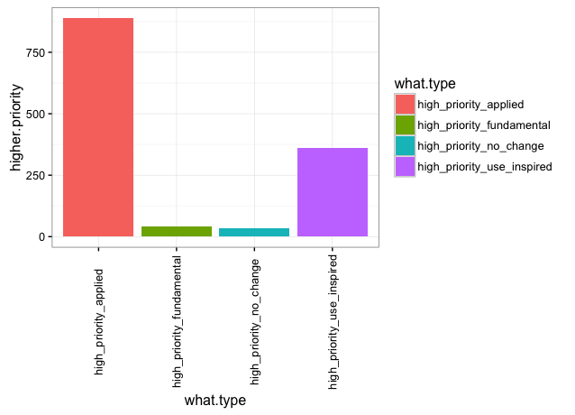
In the past 10 yrs, have any type(s) of research become a higher priority for the government in your country of work? - Canada

Slide 14
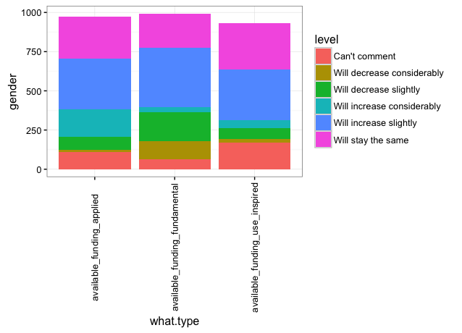
Do you think the availability of research funding will change in your county of work in the next 5 yrs? - Canada

Slide 15
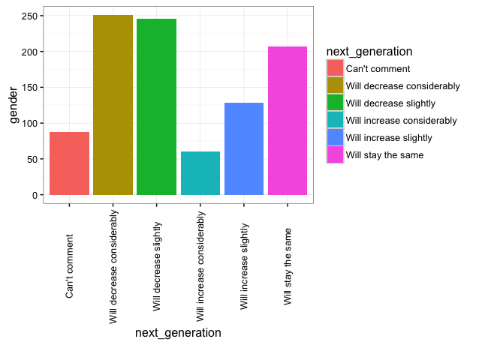
Do you think changes in funding availability in your country of work will influence the likelihood of the next generation to pursue careers in research? - Canada

Slide 16
Part 2.

Slide 17
Part 3.

