Slide 1



GPU Fluid Simulation
Neil Osborne
School of Computer and Information Science, ECU
Supervisors:
Adrian Boeing
Philip Hingston

Slide 2
Introduction
Project Aims
Why GPU (Graphics Processing Unit)?
Why SPH (Smoothed Particle Hydrodynamics)?
Smoothed Particle Hydrodynamics
GPU Architecture
Implementation
Results & Conclusions

Slide 3
Project Aims
Implement SPH fluid simulation on GPU
Identify GPU optimisations
Compare CPU vs. GPU performance

Slide 4
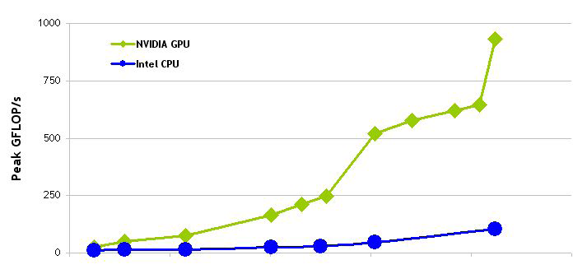
Why GPU
(Graphics Processing Unit)?
Affordable and available
Enable interactivity
Parallel data processing on GPU
GT200
G80
Ultra
G92
G80
3.2 GHz
Harpertown
G71
3.0 GHz
Core2 Duo
G70
NV35
NV40
NV30
Jan Jun Apr Jun Mar Nov May Jun
2003 2004 2005 2006 2007 2008
© NVIDIA Corporation 2008
Notes:
Parallel task vs. parallel data processing

Slide 5
Why SPH
(Smoothed Particle Hydrodynamics)?
SPH can be applied to many applications concerned with fluid phenomena–
  aerodynamics
  weather
  beach erosion
  astronomy
Compute intensive
Same operations required for multiple particles
Maps well to GPU implementation

Slide 6



Smoothed Particle Hydrodynamics (SPH)
SPH is an interpolation method for particle systems
Distributes quantities in a local neighbourhood of each particle, using radial symmetrical smoothing kernels
rj(1)
Acceleration (x, y, z)
Velocity (x, y, z)
Position (x, y, z)
Mass
rj(2)
r
Density
Pressure
Viscosity
h
(r-rj(4)) →
rj(3)
rj(4)
Notes:
r = our particle
rj = neighbour particle
h = smoothing radius

Slide 7
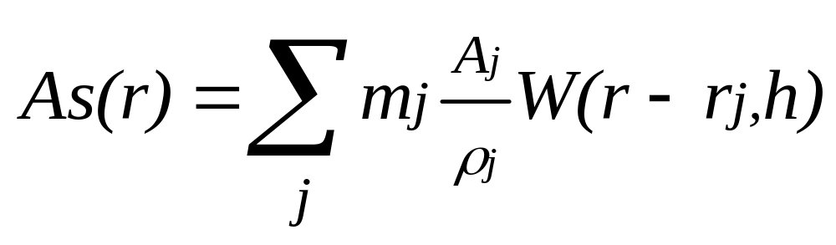
Smoothed Particle Hydrodynamics (SPH)
Our SPH equations are derived from Navier - Stokes equations which describe the dynamics of fluids
As(r) is interpolated by a weighted sum of contributions from all neighbour particles
Scalar quantity at location r
Field quantity at location j
Mass of particle j
Smoothing kernel with core radius of h
Density at location j
Notes:
As(r) is interpolated by a weighted sum of contributions from all particles

Slide 8

VIDEO: SPH implementation

Slide 9
GPU:
Architecture
More transistors are devoted to data processing rather than data caching
and flow control
Control
ALU
ALU
ALU
ALU
Cache
DRAM
CPU
DRAM
GPU
Each Multiprocessor contains a number of processors
© NVIDIA Corporation 2008

Slide 10
GPU:
Grid structure
Host (PC)
  Runs application code
  Calls Device kernel functions serially
Device (GPU)
  Executes kernel functions
Grid
  Can have 1D or 2D arrangement of Blocks
Block
  Can have 1D, 2D, or 3D arrangement of Threads
Thread
  Executes its portion of the code
Host
Device
Kernel 1
Grid 1
x
y
Block
(0,0)
Block
(1,0)
Block
(2,0)
Block
(3,0)
Block
(0,1)
Block
(1,1)
Block
(2,1)
Block
(3,1)
Kernel 2
Grid 2
x
y
Block (1,1)
Thread
(0,0)
Thread
(1,0)
Thread
(2,0)
Thread
(3,0)
Thread
(4,0)
Thread
(0,1)
Thread
(1,1)
Thread
(2,1)
Thread
(3,1)
Thread
(4,1)
© NVIDIA Corporation 2008
Notes:
Host/Device relationship
kernel to grid structure

Slide 11
GPU:
Memory
Shared
  Low latency
  (RW) access by all threads in block
Local
  Unqualified variables
  (RW) access by a thread
Global
  High latency – not cached
  (RW) access by all threads
Constant
  Cached in Global
  (RO) access by all threads
Grid
Block (0,0)
Block (1,0)
Shared Memory
Shared Memory
Registers
Registers
Registers
Registers
Thread (0,0)
Thread (1,0)
Thread (0,0)
Thread (1,0)
Local
Memory
Local
Memory
Local
Memory
Local
Memory
Global
Memory
Constant
Memory
Texture
Memory
© NVIDIA Corporation 2008

Slide 12
Implementation:
Main Operations
Create data structures on Host to hold data values
Allocate Device memory to store our data
Copy data from Host to Device memory
clear_step()
Reset densities and accelerations
}
update_density()
Calculate densities & pressure
sum_density()
Loop until user aborts
update_force()
Calculate viscosities & accelerations
collision_detection()
Detect potential collisions
particle_integrate()
Calculate velocities and positions
Copy data from Device memory to Host
Render particles using graphics engine
CPU & GPU
Free allocated Device memory
GPU only

Slide 13
Implementation:
Versions
4 software implementations
  CPU
  GPU V1 – 2D Grid, Global memory access
  GPU V2 – 1D Grid, Global memory access
  GPU V3 – 1D Grid, Shared memory access

Slide 14
Implementation:
CPU - Nested Loop
C Function
void compare_particles(int n){
int i,j;
for (i = 0; i < n; i++){
for (j = 0; j < n; j++){
if (i == j)
continue;
statements;
}
}
}
void main(){
int nparticles = 2048;
compare_particles(nparticles);
}
Notes:
Adding in pictures of ‘idx’ 0…10.
Vs gpu where blockidx and threadidx change differently

Slide 15
Implementation:
GPU V1- 2D Grid, Global Memory Access
CUDA kernel
__global__ void compare_particles(float *pos){
int i = blockIdx.x * blockDim.x + threadIdx.x;
int j = blockIdx.y * blockDim.y + threadIdx.y;
if (i != j){
statements;
}
}
void main(){
int nparticles = 2048;
int blocksize = 32;
int dimBlock(blocksize);
dim3 Grid2D(nparticles/blocksize, nparticles);
compare_particles<<<Grid2D, dimBlock>>>(idataPos);
}

Slide 16
Implementation:
GPU V1- 2D Grid, Global Memory Access
Grid2D
x
y
2048 / 32 =
64 blocks
0
32
32
32
32
32
32
32
32
Each thread compares its own particle
data in Global memory…
1
n-1
All threads in all rows
compare their own particle
data in Global memory…
Global Memory
idataPos
0
1
n-1

Slide 17
Implementation:
GPU V1- 2D Grid, Global Memory Access
Grid2D
x
y
2048 / 32 =
64 blocks
0
32
32
32
32
32
32
32
32
1
…with the particle data
(associated with the block row)
in global memory.
n-1
Global Memory
idataPos
0
1
n-1

Slide 18
Implementation:
GPU V2- 1D Grid, Global Memory Access
CUDA kernel
__global__ void compare_particles(float *pos, int n){
int i = blockIdx.x * blockDim.x + threadIdx.x;
int j;
for (j = 0; j < n; j++){
if (i != j){
statements;
}
}
}
void main(){
int nparticles = 2048;
int blocksize = 32;
int dimBlock(blocksize);
dim3 Grid1D(nparticles/blocksize);
compare_particles<<<Grid1D, dimBlock>>>(idataPos,N);
}

Slide 19
Implementation:
GPU V2- 1D Grid, Global Memory Access
Grid1D
x (i)
2048 / 32 =
64 blocks
32
32
32
32
32
32
32
32
Each thread compares its own particle
data in Global memory…
Global Memory
idataPos
0
1
n-1

Slide 20
Implementation:
GPU V2- 1D Grid, Global Memory Access
Grid1D
x (i)
2048 / 32 =
64 blocks
32
32
32
32
32
32
32
32
…with the first particle data in global memory
Global Memory
idataPos
0
1
n-1

Slide 21
Implementation:
GPU V2- 1D Grid, Global Memory Access
Grid1D
x (i)
2048 / 32 =
64 blocks
32
32
32
32
32
32
32
32
Each thread compares its own particle
data in Global memory
Global Memory
idataPos
0
1
n-1

Slide 22
Implementation:
GPU V2- 1D Grid, Global Memory Access
Grid1D
x (i)
2048 / 32 =
64 blocks
32
32
32
32
32
32
32
32
…with the second particle data in global memory.
etc…
Global Memory
idataPos
0
1
n-1

Slide 23
Implementation:
GPU V3- 1D Grid, Shared Memory Access
CUDA kernel
__global__ void compare_particles(float *pos, int n){
int i = blockIdx.x * blockDim.x + threadIdx.x;
__shared__ float posblock[32*3];
__shared__ float accelblock[32*3];
__shared__ float velblock[32*3];
__shared__ float densblock[32];
__shared__ float pressblock[32];
__shared__ float massblock[32];
//Copy global to shared statements here
int j;
for (j = 0; j < n; j++){
if (i != j){
statements;
}
}
}

Slide 24
Implementation:
GPU V3- 1D Grid, Shared Memory Access
void main(){
int nparticles = 2048;
int blocksize = 32;
int dimBlock(blocksize);
dim3 Grid1D(nparticles/blocksize);
compare_particles<<<Grid1D, dimBlock>>>(idataPos,N);
}

Slide 25
Implementation:
GPU V3- 1D Grid, Shared Memory Access
Grid1D
x (i)
2048 / 32 =
64 blocks
32
32
32
32
32
32
32
32
Shared memory
Each Block copies
associated particle
data for its
32 threads into
Shared memory
Global Memory
idataPos
0
1
n-1

Slide 26
Implementation:
GPU V3- 1D Grid, Shared Memory Access
Grid1D
x (i)
2048 / 32 =
64 blocks
32
32
32
32
32
32
32
32
Shared memory
Data in shared memory is compared to the first particle data in global memory.
Calculations involving particles are quicker
Global Memory
idataPos
0
1
n-1

Slide 27
Implementation:
GPU V3- 1D Grid, Shared Memory Access
Grid1D
x (i)
2048 / 32 =
64 blocks
32
32
32
32
32
32
32
32
Shared memory
Data in shared memory is compared to the second particle data in global memory.
Global memory accesses reduced.
Global Memory
idataPos
0
1
n-1

Slide 28
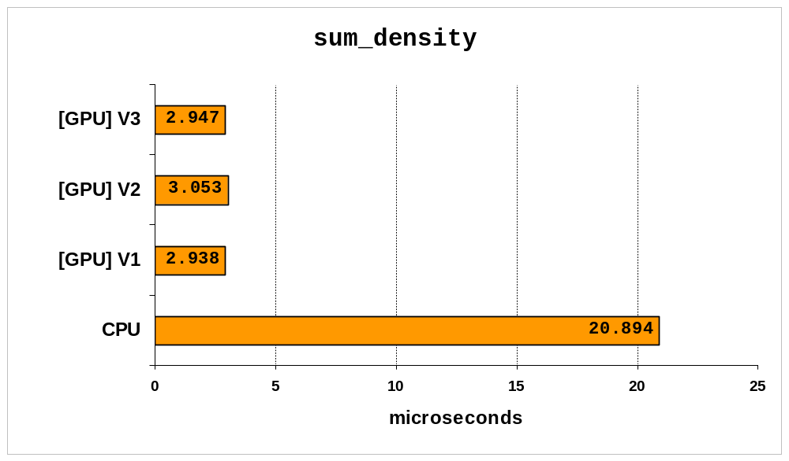
Results:
Kernel Timings (2048 particles)

Slide 29
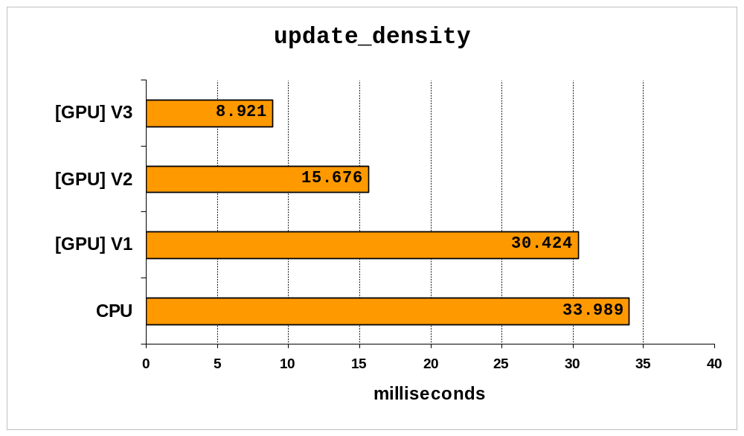
Results:
Kernel Timings (2048 particles)

Slide 30
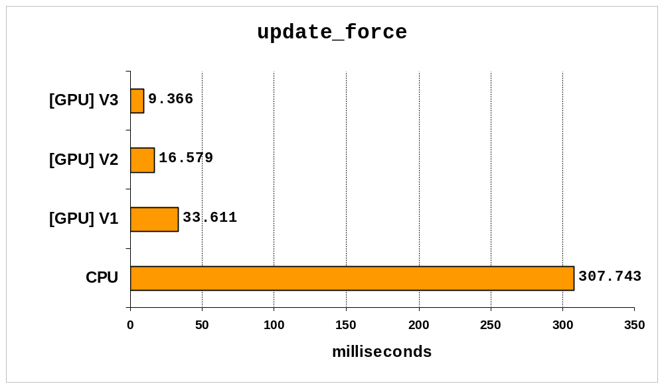
Results:
Kernel Timings (2048 particles)

Slide 31
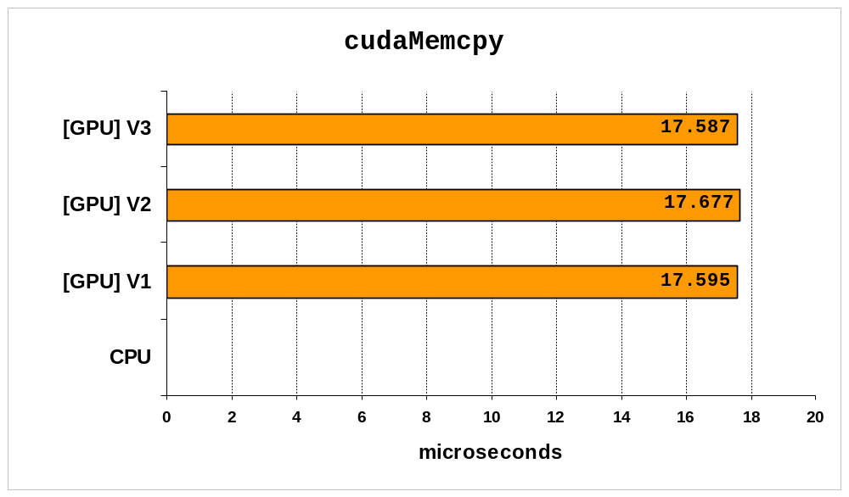
Results:
Kernel Timings (2048 particles)

Slide 32
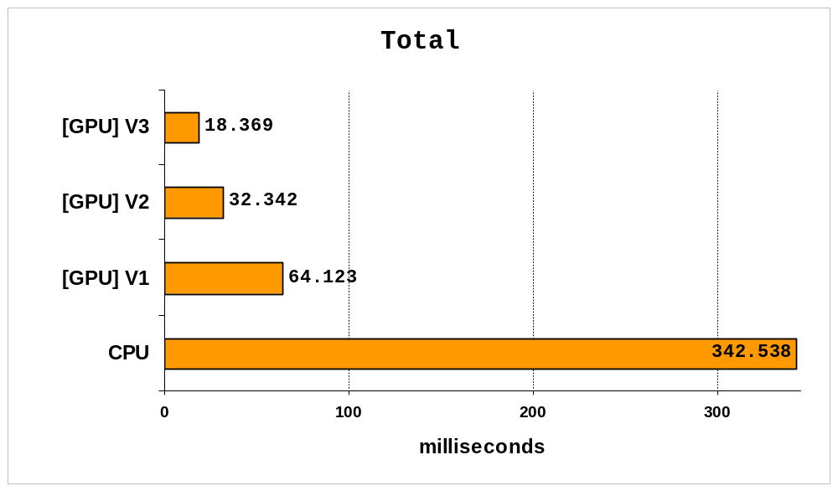
Results:
Kernel Timings (2048 particles)

Slide 33
Results:
Performance comparison
Function/Kernel | CPU time | GPU time | GPU speedup
clear_step | 49.751 microseconds | 6.79 microseconds |  7.3 faster
update_density | 33.989 milliseconds | 8.921 milliseconds |  3.8 faster
sum_density | 20.894 microseconds | 2.947 microseconds |  7.1 faster
update_force | 307.743 milliseconds | 9.366 milliseconds |  32.8 faster
collision_detection | 501.478 microseconds | 19.952 microseconds |  25.1 faster
particle_integrate | 234.191 microseconds | 34.454 microseconds |  6.8 faster
Total | 342.538 milliseconds | 18.369 milliseconds |  18.6 faster

Slide 34
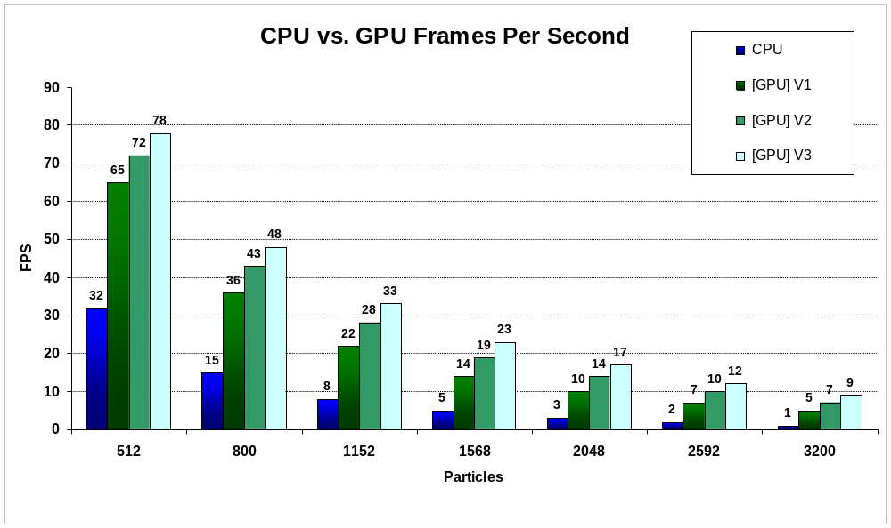
Results:
Frames Per Second

Slide 35
VIDEO of final GPU prog.

Slide 36
Results:
Summary
CPU –
  Slowest
  Low FLOPs
  No parallel data processing
GPU V1
  Slow
  Too many threads
  Memory access issues

Slide 37
Results:
Summary
GPU V2–
  Faster
  Better balance of threads
  Global memory slows results
GPU V3-
  Fastest
  Same thread balance
  Shared memory improves results

Slide 38
Conclusions
For parallel data, compute intense applications, GPU out-performs CPU
The highly parallel nature of SPH fluid simulation is a good fit for GPU
The optimal code for this simulation – 1D grid using shared memory
The benefits of shared memory must be balanced against internal mem-copy overheads.
Optimized code is complex and can introduce errors – original code may become unrecognisable.

Slide 39
Future Work
Direct Rendering from GPU
  OpenGL interfaces
  Direct3D interfaces
Spatial Subdivision
  Uniform Grid (finite)
  Hashed Grid (infinite)
0
1
2
3
5
4
4
5
6
7
3
1
2
8
9
10
11
0
12
13
14
15

Slide 40

Questions
?

Slide 41
Acknowledgements
Muller M., Charypar D., Gross M., (2003), Particle-Based Fluid Simulation
for Interactive Applications. Eurographics Symposium on Computer
Animation 2003.
SPH Survival Kit. [n.d.] Retrieved December, 2008, from
http://www.cs.umu.se/kurser/TDBD24/VT06/lectures/
Optimized Spatial Hashing for Collision Detection of Deformable
Objects. Teschner M., Heidelberger B., Muller M., Pomeranets D.,
Gross M. Retrieved February, 2009, from
http://www.beosil.com/download/CollisionDetectionHashing_
VMV03.pdf
NVIDIA_CUDA_Programming_Guide_2.1.pdf. NVIDIA Retrieved
February, 2009, from
http://sites.google.com/site/cudaiap2009/materials1/extras/
online-resources

Slide 42
Appendix

Slide 43
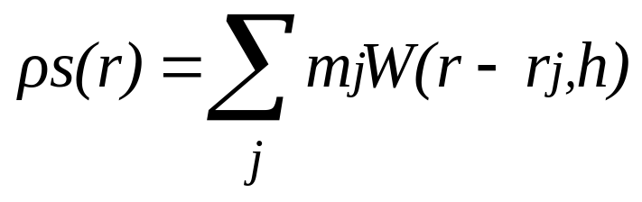
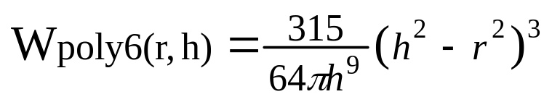
SPH Equations
Density
Smoothing kernel
mj = mass of particle j
r - rj = distance between particles
h = smoothing length

Slide 44
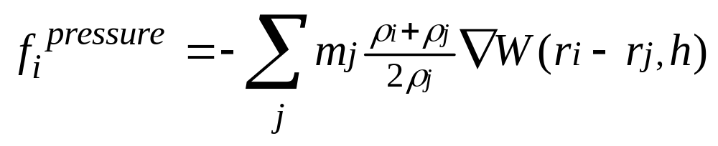
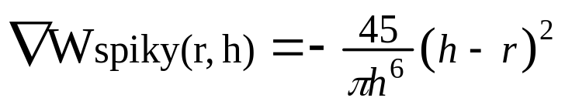
SPH Equations
Pressure
mj = mass of particle j
pj = density of particle j
pi = density of particle i
ri - rj = distance between particles
h = smoothing length
Smoothing kernel

Slide 45
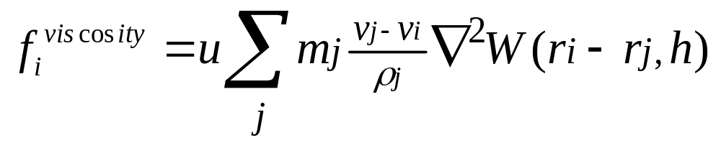
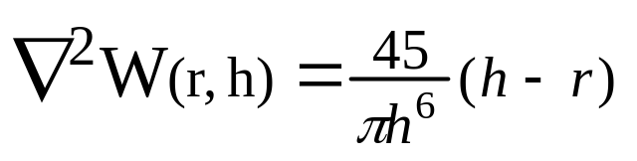
SPH Equations
Viscosity
  Particle i checks neighbours in terms of its own moving frame of reference
  i is accelerated in the direction of the relative speed of the environment
mj = mass of particle j
vj = velocity of particle j
vi = velocity of particle i
pj = density of particle j
ri - rj = distance between particles
h = smoothing length
Smoothing kernel

Slide 46
Implementation:
Development Environment
Software
  MS Windows XP (SP3)
  MS Visual Studio 2005 Express (SP1)
  Irrlicht 1.4.2 (Graphics Engine)
  Nvidia CUDA 2.0
    CUDA (Compute Unified Device Architecture)
    A scalable parallel programming model and software environment for parallel computing
    Minimal extensions to familiar C/C++ environment
  Nvidia CUDA Visual Profiler 1.1.6
Notes:
CPU video

Slide 47
Implementation:
Development Environment
Hardware
  CPU: Intel Core 2 Duo E8500 (3.16Ghz)
  Mainboard: Intel DP35DP (P35 chipset)
  Memory: 3GB DDR2 800MHz
  Graphics Card: Nvidia GTX9800
    GPU frequency 675 MHz
    Shader clock frequency 1688 MHz
    Memory clock frequency 1100 MHz
    Memory bus width 256 bits
    Memory type GDDR3
    Memory quantity 512 MB
Notes:
Reference picture!

Slide 48
Implementation:
Host Operations - code
// create data structure on host
float *posData;
posData = new float[NPARTICLES*3];
// allocate device memory (particle positions)
float* idataPos;
cudaMalloc( (void**) &idataPos, sizeof(float)*NPARTICLES*3);
// copy data from host to device
cudaMemcpy(idataPos, posData, sizeof(float)*NPARTICLES*3, cudaMemcpyHostToDevice);
// execute the kernel
increment_pos<<< dimGrid, dimBlock >>>(idataPos);
// copy data from device back to host
cudaMemcpy(posData, idataPos, sizeof(float)*NPARTICLES*3, cudaMemcpyDeviceToHost);
// free device memory
cudaFree(idataPos);
Notes:
Replace with block flow diagram.

Slide 49
Implementation:
CPU - Nested Loop
C Function
void compare_particles(int n){
int i,j;
for (i = 0; i < n; i++){
for (j = 0; j < n; j++){
if (i == j)
continue;
statements;
}
}
}
void main(){
int nparticles = 2048;
compare_particles(nparticles);
}
Notes:
Adding in pictures of ‘idx’ 0…10.
Vs gpu where blockidx and threadidx change differently

Slide 50
Implementation:
GPU V1- 2D Grid, Global Memory Access
CUDA kernel
__global__ void compare_particles(float *pos){
int i = blockIdx.x * blockDim.x + threadIdx.x;
int j = blockIdx.y * blockDim.y + threadIdx.y;
if (i != j){
statements;
}
}
void main(){
int nparticles = 2048;
int blocksize = 32;
int dimBlock(blocksize);
dim3 Grid2D(nparticles/blocksize, nparticles);
increment_gpu<<<Grid2D, dimBlock>>>(idataPos);
}

Slide 51
Implementation:
GPU V2- 1D Grid, Global Memory Access
CUDA kernel
__global__ void compare_particles(float *pos, int n){
int i = blockIdx.x * blockDim.x + threadIdx.x;
int j;
for (j = 0; j < n; j++){
if (i != j){
statements;
}
}
}
void main(){
int nparticles = 2048;
int blocksize = 32;
int dimBlock(blocksize);
dim3 Grid1D(nparticles/blocksize);
compare_particles<<<Grid1D, dimBlock>>>(idataPos,N);
}

Slide 52
Implementation:
GPU V3- 1D Grid, Shared Memory Access
CUDA kernel
__global__ void compare_particles(float *pos, int n){
int i = blockIdx.x * blockDim.x + threadIdx.x;
__shared__ float posblock[32*3];
__shared__ float accelblock[32*3];
__shared__ float velblock[32*3];
__shared__ float densblock[32];
__shared__ float pressblock[32];
__shared__ float massblock[32];
//Copy global to shared statements here
int j;
for (j = 0; j < n; j++){
if (i != j){
statements;
}
}
}

Slide 53
Implementation:
GPU V3- 1D Grid, Shared Memory Access
void main(){
int nparticles = 2048;
int blocksize = 32;
int dimBlock(blocksize);
dim3 Grid1D(nparticles/blocksize);
compare_particles<<<Grid1D, dimBlock>>>(idataPos,N);
}

Slide 54
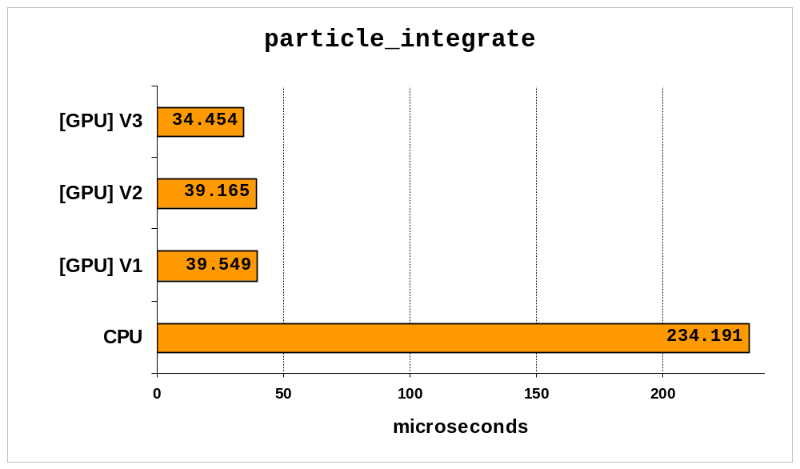
Results:
Kernel Timings (2048 particles)

Slide 55
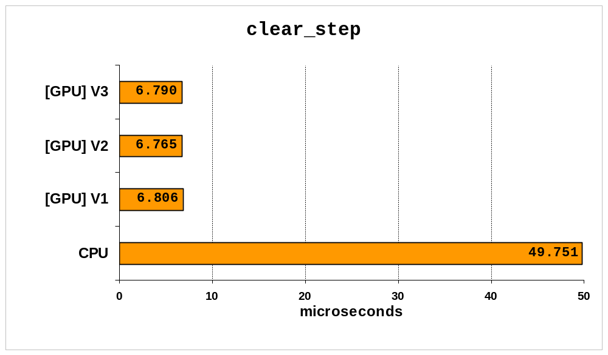
Results:
Kernel Timings (2048 particles)

Slide 56
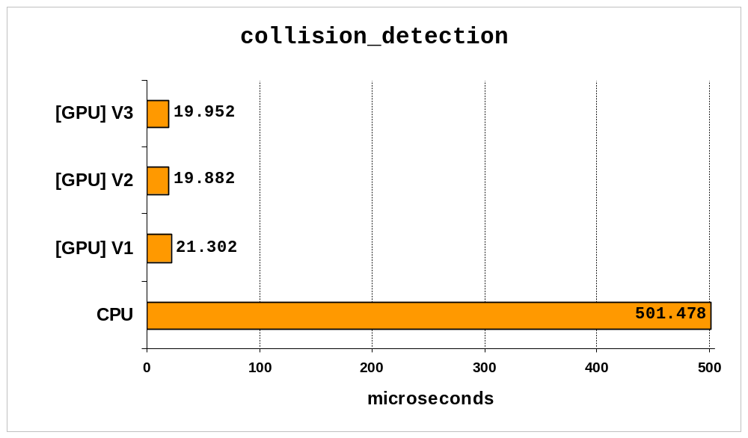
Results:
Kernel Timings (2048 particles)

Slide 57
Further Work:
Uniform Grid
Particle interaction requires finding neighbouring particles – O(n²) comparisons
Solution: use spatial subdivision structure
Uniform grid is simplest possible subdivision
Divide world into cubical grid
(cell size = particle size)
Put particles in cells
Only have to compare each particle with the particles in the same cell and in neighbouring cells
Notes:
Performance advantage of VBO’s.

Slide 58
Further Work :
Grid using sorting
Unsorted list
(Cell id, Particle id)
0: (4,3)
1: (6,2)
2: (9,0)
3: (4,5)
4: (6,4)
5: (6,1)
Sorted by
Cell id
0: (4,3)
1: (4,5)
2: (6,1)
3: (6,2)
4: (6,4)
5: (9,0)
array
(cell, index)
(0,-)
(1,-)
(2,-)
(3,-)
(4,0)
(5,-)
(6,2)
(7,-)
(8,-)
(9,5)
(10,-)
…
(15,-)
0
1
2
3
5
4
4
5
6
7
3
1
2
8
9
10
11
0
12
13
14
15
Density Array
index
0
1
2
3
4
5
.
.
.
.
.
n-1
values for particle..
3
5
1
2
4
0
Notes:
Performance advantage of VBO’s.

Slide 59
Further Work:
Spatial Hashing (Infinite Grid)
We may not want particles to be constrained to a finite grid
Solution: use a fixed number of grid buckets, and store particles in buckets based on hash function of grid position
Pro: Allows grid to be effectively infinite
Con: Hash collisions (multiple positions hashing to same bucket) causes inefficiency
Choice of hash function can have big impact
Notes:
Performance advantage of VBO’s.

Slide 60
Further Work:
Hash Function
__device__ uint calcGridHash(float3 *Pos)
{
const uint p1 = 73856093; // some large primes
const uint p2 = 19349663;
const uint p3 = 83492791;
int n = p1*Pos.x ^ p2*Pos.y ^ p3*Pos.z;
n %= numBuckets;
return n;
}

Slide 61
Further Work:
Direct Rendering
Sending data back to the host for rendering by the Irrlicht graphics engine is costly in time.
Solution: make further use of GPU rendering capabilities –
  OpenGL interoperability
  Direct3D interoperability
  Texture memory
Notes:
Performance advantage of VBO’s.

