Slide 1
Module 4
Creating Forms to Collect and Validate User Input
Notes:
This course requires an internet connection to download components from NuGet within Microsoft Visual Studio, to download source files for labs and demos. If there is no internet connection, modify the course to be delivered from a disconnected student device.
20480C
4: Creating Forms to Collect and Validate User Input

Slide 2
Module Overview
Creating HTML5 Forms Validating User Input by Using HTML5 Attributes Validating User Input by Using JavaScript
Notes:
If students are familiar with earlier versions of HTML, they will find that HTML5 builds on their existing knowledge and offers refinements and improvements to forms input.
20480C
4: Creating Forms to Collect and Validate User Input

Slide 3
Lesson 1: Creating HTML5 Forms
Declaring a Form in HTML5 HTML5 Input Types and Elements HTML5 Input Attributes
Notes:
Students should be familiar with forms in previous versions of HTML, so do not spend too long on this lesson (10 minutes). Concentrate on the new features available in HTML5.
20480C
4: Creating Forms to Collect and Validate User Input

Slide 4
Declaring a Form in HTML5
Use an HTML5 form to gather user input:
<form name="userLogin" method="post" action="login.aspx">
<fieldset>
<legend>Enter your log in details:</legend>
<div id=”usernameField” class="field">
<input id="uname" name="username" type="text"
placeholder="First and Last Name" />
<label for="uname">User's Name:</label>
</div>
<div id="passwordField" class="field">
<input id="pwd" name="password" type="password"
placeholder="Password" />
<label for="pwd">User's Password:</label>
</div>
</fieldset>
<input type="submit" value="Send" />
</form>
Notes:
Emphasize the difference in purpose between the name and id attributes for input controls. Highlight the best practices for specifying the various elements in a form that enable them to be styled and processed more easily.
20480C
4: Creating Forms to Collect and Validate User Input

Slide 5
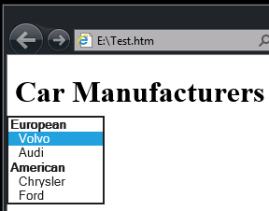
HTML5 Input Types and Elements
HTML5 defines a wide range of new input types and elements, but not all are widely implemented
<select id="carManufacturer" name="carManufacturer">
<optgroup label="European">
<option value="volvo">Volvo</option>
<option value="audi">Audi</option>
</optgroup>
<optgroup label="American">
<option value="chrysler">
Chrysler</option>
<option value="ford">
Ford</option>
</optgroup>
</select>
Notes:
Not all of the new input types are functional in Microsoft Edge, although checkbox and file both work, so you might wish to demonstrate them. Also call out the password and email input types, because these are used in the lab.
The datalist, textarea, and select elements are all available in Microsoft Edge.
Note that HTML5 places emphasis on the data being gathered, not the control being used to collect it.
There is a <button> element, but it produces varying results in different browsers and its use is discouraged. Encourage students to use <input type="button" /> instead.
Inputs can be placed outside of forms in HTML5, provided that the input’s form attribute is set to the id of the form to which it belongs. However, it is better to place the inputs inside the container form element because it keeps them together and makes the web page easier to maintain.
20480C
4: Creating Forms to Collect and Validate User Input

Slide 6
HTML5 Input Attributes
Input attributes modify the behavior of input types and forms to provide better feedback and usability:
autofocus
autocomplete
required
pattern
placeholder
many other input type-specific attributes
Notes:
Concentrate on the attributes that are commonly accepted and that are required for the lab (the attributes listed on the slide). However, do not go into detail because this is the purpose of the next lesson.
20480C
4: Creating Forms to Collect and Validate User Input

Slide 7
Lesson 2: Validating User Input by Using HTML5 Attributes
Principles of Validation Ensuring that Fields are Not Empty Validating Numeric Input Validating Text Input Styling Fields to Provide Feedback
Notes:
By the end of this lesson, ensure that students fully understand the need for client-side validation of forms data and how it differs from server-side validation.
20480C
4: Creating Forms to Collect and Validate User Input

Slide 8
Principles of Validation
User input can vary in accuracy, quality, and intent
Client-side validation improves the user experience
Server-side validation is still necessary
Notes:
Emphasize the defense-in-depth approach for building robust web applications. Treat all user input with suspicion, only pass data to a server that appears to be valid, and validate the data comprehensively on the server.
20480C
4: Creating Forms to Collect and Validate User Input

Slide 9
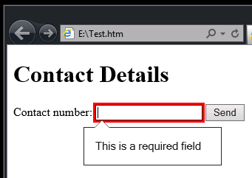
Ensuring that Fields are Not Empty
Use the required attribute to indicate mandatory fields
The browser checks that they are filled in before submitting the form
<input id="contactNo" name="contactNo" type="tel" placeholder="Enter your mobile number" required="required" />
Notes:
Emphasize that the way in which Microsoft Edge highlights missing mandatory fields is purely a feature of the browser and is not specified by any standards.
20480C
4: Creating Forms to Collect and Validate User Input

Slide 10
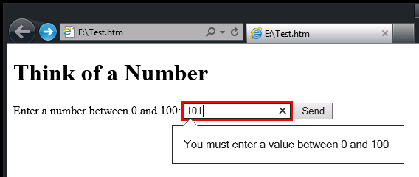
Validating Numeric Input
Use the min and max attributes to specify the upper and lower limit for numeric data
<input id="percentage" type="number" min="0" max="100" />
Notes:
20480C
4: Creating Forms to Collect and Validate User Input

Slide 11
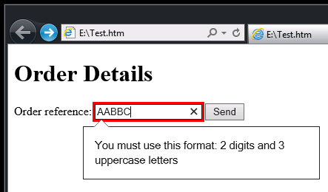
Validating Text Input
Use the pattern attribute to validate text-based input by using a regular expression
<input id="orderRef" name="orderReference" type="text"
pattern="[0-9]{2}[A-Z]{3}" title="2 digits and 3 uppercase letters" />
Notes:
Use a pattern for simple pattern matching only. Regular expressions can become complex and difficult to maintain. It is also very difficult to express more than one pattern. In these cases, it may be better to perform the validation by using JavaScript code, as described in the next lesson.
20480C
4: Creating Forms to Collect and Validate User Input

Slide 12
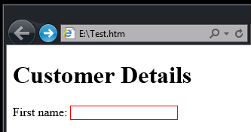
Styling Fields to Provide Feedback
Use CSS to style input fields
Use the valid and invalid pseudo-classes to detect fields that have passed or failed validation
input {
border: solid 1px;
}
input:invalid {
border-color: #f00;
}
input:valid {
border-color: #0f0;
}
Notes:
Emphasize to students that by default, different browsers may handle input that is not valid in different ways. Use styles to provide consistency that is independent of the browser.
On the slide, point out that the CSS styles fields containing invalid data with a red border and fields with valid data have a green border.
20480C
4: Creating Forms to Collect and Validate User Input

Slide 13
Lesson 3: Validating User Input by Using JavaScript
Handling Input Events Validating Input Ensuring that Fields are Not Empty Providing Feedback to the User Demonstration: Creating a Form and Validating User Input
Notes:
Emphasize that the new forms input types and attributes in HTML5 can reduce the amount of JavaScript that a developer needs to write to validate data, but do not eliminate the requirement altogether; many types of validation are better suited to JavaScript code than to HTML5.
20480C
4: Creating Forms to Collect and Validate User Input

Slide 14
Handling Input Events
Catch the submit event to validate an entire form
Return true if the data is valid, false otherwise
The form is only submitted if the submit event handler returns true
Catch the input event to validate individual fields on a character-by-character basis
If the data is not valid, display an error message by using the setCustomValidity function
If the data is valid, reset the error message to an empty string
Notes:
Students may have seen the onsubmit attribute written by using camel casing as onSubmit. Either casing will work in HTML5. XHTML is case sensitive and all lowercase letters should be used if compatibility is important.
The lab catches the input event and calls setCustomValidity rather than using the submit event. Highlight that this type of validation is very fine-grained, but can lead to performance problems if the validation logic takes too long to run.
20480C
4: Creating Forms to Collect and Validate User Input

Slide 15
Validating Input
Use JavaScript code to emulate unsupported HTML5 input types and attributes in a browser:
<form id="scoreForm" … onsubmit="return validateForm();" > <div id="scoreField" class="field" >
<input id="score" name="score" type="number" />
</div>
</form>
function isAnInteger( text ){
const intTestRegex = /^\s*(\+|-)?\d+\s*$/;
return String(text).search(intTestRegex) != -1;
}
function validateForm()
{
if( ! isAnInteger(document.getElementById('score').value))
return false; /* No, it’s not a number! Form validation fails */
return true;
}
Notes:
On the slide, the top section is an HTML form, and the bottom section is the JavaScript code that validates the scoreField field.
20480C
4: Creating Forms to Collect and Validate User Input

Slide 16
Ensuring that Fields are Not Empty
Use JavaScript code to ensure that a required field does not contain only whitespace:
<form id="scoreForm" … onsubmit="return validateForm();" >
<div id="penaltiesField" class="field" >
<input id="penalties" name="penalties" type="text" />
</div>
</form>
function isSignificant( text ){
const notWhitespaceTestRegex = /[^\s]{1,}/;
return String(text).search(notWhitespaceTestRegex) != -1;
}
function validateForm() {
if( ! isSignificant(document.getElementById(‘penalties’).value))
return false; /* No! Form validation fails */
return true;
}
Notes:
Emphasize that the required attribute in HTML5 does not ensure that the user enters non-whitespace characters.
20480C
4: Creating Forms to Collect and Validate User Input

Slide 17
Providing Feedback to the User
Provide visual feedback to the user by defining styles and dynamically setting the class of an element:
.validatedFine {
border-color: #0f0;
}
.validationError {
border-color: #f00; }
function validateForm() {
const textbox = document.getElementById("penalties");
if( ! isSignificant(textBox.value)) {
textbox.className = "validationError";
return false; /* No! Form validation fails */
}
textbox.className = "validatedFine";
return true;
}
Notes:
Recall that when using HTML5 input types and attributes, you can use the valid and invalid pseudo classes in CSS to detect which fields are valid and which are not. Styling fields dynamically by using CSS enables a developer to customize this approach, and if necessary provide different styling to highlight different types of validation errors (missing mandatory field, not a valid date, age too low, and so on).
Note that it is possible for an element to have many classes applied to it, so in a real-word example this code would be more sophisticated in order to add and remove the class gracefully.
20480C
4: Creating Forms to Collect and Validate User Input

Slide 18
Demonstration: Creating a Form and Validating User Input
In this demonstration, you will learn about the tasks that you will perform in the lab for this module.
Notes:
Demonstration Steps
You will find the steps in the “Demonstration: Creating a Form and Validating User Input“ section on the following page: https://github.com/MicrosoftLearning/20480-Programming-in-HTML5-with-JavaScript-and-CSS3/blob/master/Instructions/20480C_MOD04_DEMO.md.
20480C
4: Creating Forms to Collect and Validate User Input

Slide 19
Lab: Creating a Form and Validating User Input
Exercise 1: Creating a Form and Validating User Input by Using HTML5 Attributes Exercise 2: Validating User Input by Using JavaScript
Estimated Time: 60 minutes
Notes:
You will find the high-level steps on the following page: https://github.com/MicrosoftLearning/20480-Programming-in-HTML5-with-JavaScript-and-CSS3/blob/master/Instructions/20480C_MOD04_LAB_MANUAL.md.
You will find the detailed steps on the following page: https://github.com/MicrosoftLearning/20480-Programming-in-HTML5-with-JavaScript-and-CSS3/blob/master/Instructions/20480C_MOD04_LAK.md.
Exercise 1: Creating a Form and Validating User Input by Using HTML5 Attributes
In this exercise, you will create an HTML form that collects conference attendee registration information.
You will select the correct input types for each piece of data collected by the form. You will then enhance the input with additional attributes to improve the user experience and to add validation. For example, the first input item should automatically receive the focus when a page loads. Also, most of the input items are mandatory, the password must be sufficiently complex to improve security, and the form must prevent the submission of incomplete or invalid data. Finally, you will run the application, view the Register page, and then verify that form validation happens correctly.
Exercise 2: Validating User Input by Using JavaScript
The conference registration form requires that the values in the Choose a Password and Confirm your Password boxes match. You cannot implement this type of validation by using HTML5 attributes. In this exercise, you will extend the registration form validation by using JavaScript. In addition, you will write code to style any input that is not valid to attract the user’s attention.
You will implement a function to compare the two passwords and display an error message when the passwords do not match. Then you will add input event listeners for the password inputs, which call the password comparison function. You will test this feature to ensure that a user cannot submit a form with passwords that do not match.
Next, you will add a CSS style to highlight input elements that are not valid (some browsers such as Microsoft Edge already highlight them with a red border, but other browsers might not implement this feature by default). You will run the application, open the Register page, and then verify that the application highlights the invalid elements.
20480C
4: Creating Forms to Collect and Validate User Input

Slide 20
Lab Scenario
The delegates who want to attend ContosoConf will need to register and provide their details. You have been asked to add a page to the ContosoConf website that implements an attendee registration form.
The server-side code already exists to process the attendee data. However, the registration page performs minimal validation and is not user-friendly. You have decided to add client-side validation to the form to improve the accuracy of the registration data entered by attendees and to provide a better user experience.
Notes:
20480C
4: Creating Forms to Collect and Validate User Input

Slide 21
Module Review and Takeaways
Review Questions
Notes:
Review Questions
Question
If you define a field with an HTML5 input type that is not supported by the user's browser, the field does not appear on the form when the browser displays it. True or False?
( )False
( )True
Answer
(√)False
Feedback
Unsupported HTML5 input types are displayed as ordinary text fields if the type is not supported by the browser. This enables the form to work, although any data entered will require additional validation to ensure that it conforms to the requirements of the application.
Question
If you perform validation in the browser, is it necessary to perform the same validation checks in the server code that processes the data, or is this additional processing redundant?
Answer
You should always validate data at the server regardless of whether it has already been validated by the browser.
Feedback
If the validation performed by the browser depends on HTML5 input types and attributes, there is no guarantee that the browser supports these items. Additionally, if the validation depends on JavaScript code, the user may have disabled this feature in their browser.
The data submitted to a server may come from a source other than the web page, and may not have been validated.
20480C
4: Creating Forms to Collect and Validate User Input

Slide 22
Notes:
Question
You should always use the input event to validate data that a user enters into a field, in preference to the submit event of the form. True or False?
( )False
( )True
Answer
(√)False
Feedback
The input event fires every time the user presses a key in a field, but the submit event fires once when the form is submitted. The two events lend themselves to different forms of validation. Use the input event to validate data on a character-by-character basis as the user enters it, and use the submit event to cross-check data across the form when the user has finished entering all data. Avoid performing too much processing in a handler for the input event because it can make a web page run slowly, which adversely affects the user’s experience.
20480C
4: Creating Forms to Collect and Validate User Input

