Slide 1
Module 11
Creating Advanced Graphics
Notes:
This course requires an internet connection to download components from NuGet within Microsoft Visual Studio, to download source files for labs and demos. If there is no internet connection, modify the course to be delivered from a disconnected student device.
20480C
11: Creating Advanced Graphics

Slide 2
Module Overview
Creating Interactive Graphics by Using SVG Drawing Graphics by Using the Canvas API
Notes:
Graphics is a very broad and encompassing subject, and it would be very easy to spend several hours covering the topics in this area. However, this module is scheduled to last no more than an hour, so remain focused and stick to the basics as they are described by the topics in this module. Refer students who require more information to additional reading.
20480C
11: Creating Advanced Graphics

Slide 3
Lesson 1: Creating Interactive Graphics by Using SVG
What is SVG? Creating SVG Graphics Drawing Circles and Ellipses Drawing Complex Shapes Specifying Fill Styles and Stroke Styles Using Gradients and Patterns Drawing Graphical Text Transforming SVG Elements Demonstration: Using Scalable Vector Graphics (SVG) Transformations and Events
Notes:
SVG is very powerful API, but it is also very low level. This lesson concentrates on the core syntax and features of SVG. In the real world, students are likely to use drawing tools and other utilities that can generate the SVG elements as output, and import the resulting content into their websites.
20480C
11: Creating Advanced Graphics

Slide 4
What is SVG?
SVG enables you to draw 2D vector graphics
It defines XML elements to represent a wide range of shapes
SVG uses a "retained mode" model
The objects tree is kept in memory
Rendering speed depends on the number of elements
You can perform the following operations on SVG-related elements:
Access elements through DOM
Style elements with CSS
Handle user-interaction events
Notes:
The key points to mention in this topic are that SVG is scalable and vector-based (hence its name). This enables a developer to define graphics that automatically scale to the user's device, but at the cost of the time and memory required to perform the necessary calculations.
Highlight how the model is fully programmable, enabling a developer to write JavaScript code that can control the way in which an image responds to user input and apply styling.
20480C
11: Creating Advanced Graphics

Slide 5
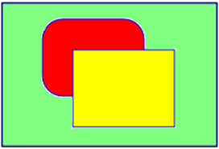
Creating SVG Graphics
Use an <svg> element and embed child elements that define the graphics:
Style SVG elements by using CSS:
<svg xmlns="http://www.w3.org/2000/svg">
<rect x="50" y="50" width="100" height="75"
rx="20" ry="20" fill="red" stroke="blue" />
<rect x="75" y="75" width="100" height="75"
fill="yellow" stroke="blue" />
</svg>
<style type="text/css">
svg {
border: 2px solid darkblue;
background-color: lightgreen;
width: 300px;
height: 200px;
}
</style>
Notes:
Emphasize that SVG graphics consist of a small number of fundamental shapes to which the developer can apply effects and styles.
Note that the file Allfiles\Mod11\Democode\SvgShapes.html contains a copy of many of the SVG examples shown in this lesson. If time allows, open this file by using Notepad and show the code for each example, then display the file in Microsoft Edge so that students can see the results.
20480C
11: Creating Advanced Graphics

Slide 6
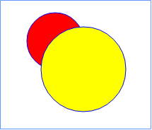
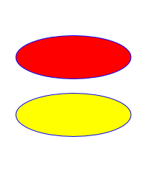
Drawing Circles and Ellipses
To draw circles:
To draw ellipses:
<circle cx="120" cy="80" r="40"
stroke="blue" fill="red" />
<circle cx="160" cy="120" r="60"
stroke="blue" fill="yellow" />
<ellipse cx="150" cy="60" rx="110" ry="30"
stroke="blue" fill="red" />
<ellipse cx="150" cy="140" rx="110" ry="30"
stroke="blue" fill="yellow" />
Notes:
Mention that the order of graphical child elements in the <svg> element determines the Z-order in which they appear; later elements appear in front of earlier elements.
20480C
11: Creating Advanced Graphics

Slide 7
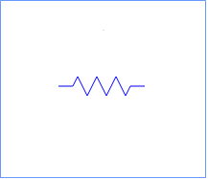
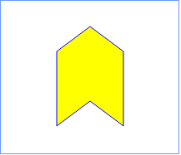
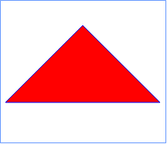
Drawing Complex Shapes
To draw a polyline:
To draw a polygon:
To draw a path:
<polyline points="105 100, 120 100, 125 90, 135 110, 145 90, …
fill="none" stroke="blue" />
<polygon points="110 70, 150 40, 190 70, 190 160, 150 130, 110 160"
fill="yellow" stroke="blue" />
<path d="M 150 50 L 250 150 L 50 150 Z"
fill="red" stroke="blue" />
Notes:
The <path> element is particularly powerful. The commands enable a developer to draw almost any shape or curve. However, do not go into detail, but instead refer students who require more information to the additional reading highlighted in the topic.
20480C
11: Creating Advanced Graphics

Slide 8
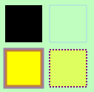
Specifying Fill Styles and Stroke Styles
You can set the fill style or stroke style for an element
stroke="color"
fill="color"
stroke-opacity="opacity-fraction"
fill-opacity="opacity-fraction"
stroke-width="width"
fill-rule="nonzero" | "evenodd"
stroke-dasharray="dash-gap series"
Notes:
Point out that the results of the example code fragments shown in the notes are displayed on the slide.
20480C
11: Creating Advanced Graphics

Slide 9
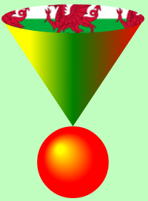
Using Gradients and Patterns
You can define a linear or radial gradient for shapes
Patterns can specify image files
<polygon points="50,50 250,50 150,200" fill="url(#gradient1)" />
<ellipse cx="150" cy="50" rx="100" ry="20" fill="url(#wales)" />
<circle cx="150" cy="250" r="50" fill="url(#gradient2)" />
Notes:
Do not go into detail on these elements; just point out that they are available and that developers can use them to create an amazing range of effects. However, remind students that complex SVG effects can be processor intensive, so a web page that uses them might incur a performance hit, resulting in slower response times to user actions. Remind students that not all users will necessarily be running a web browser on a -powerful computer that can quickly perform complex arithmetic.
20480C
11: Creating Advanced Graphics

Slide 10

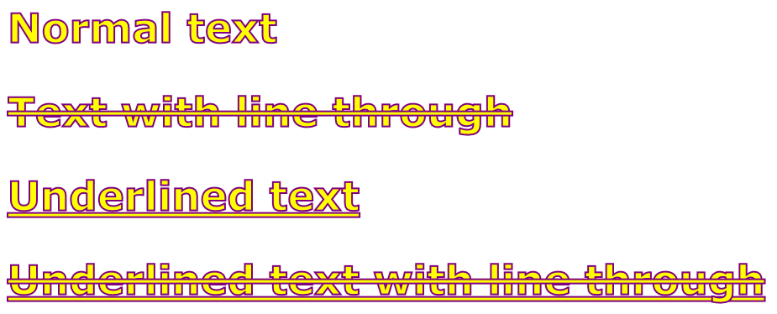
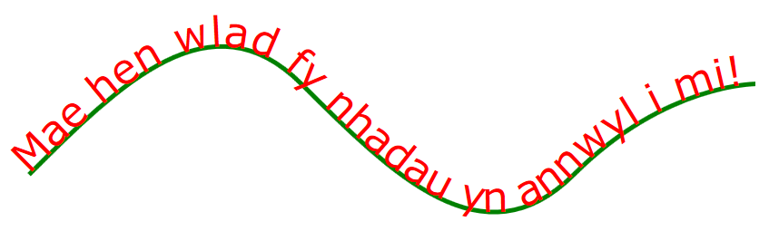
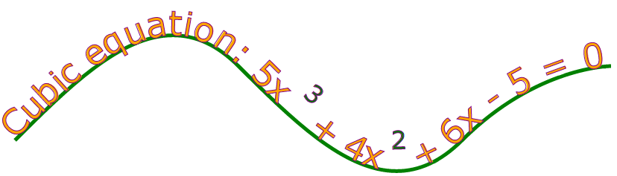
Drawing Graphical Text
<text x="20" y="100">
Simple text
</text>
To draw text:
Use the following elements to achieve additional text effects:
<linearGradient>, <radialGradient>, <pattern>
<textPath>
<tspan>
Notes:
Highlight that drawing basic text is very simple, and that attributes are available to decorate the text.
Again, emphasize that complex styling can result in browser performance degradation.
Mention the use of the <g> element inside an <svg> element to group shapes together.
20480C
11: Creating Advanced Graphics

Slide 11
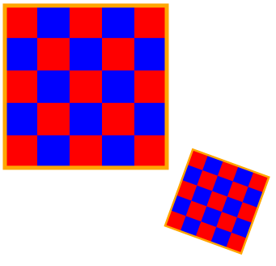
Transforming SVG Elements
To transform SVG elements, set the transform attribute to a transformation function
To perform a transformation on several elements enclose elements in a <g> element, and transform the <g>
rotate(angle, cx, cy)
translate(dx, dy)
scale(sx, sy)
skewX(angle)
skewY(angle)
Notes:
Keep this topic brief. The demonstration that follows provides more detail and examples, and enables students to see how to transform SVG elements.
SVG also describes how to perform animations. However, SVG animations are not supported by Microsoft Edge. To animate elements on a web page, use CSS animations; these are described in module 12, "Animating the User Interface".
20480C
11: Creating Advanced Graphics

Slide 12
Demonstration: Using Scalable Vector Graphics (SVG) Transformations and Events
In this demonstration, you will see how to:
Transform SVG elements
Handle events on SVG elements
Notes:
The HTML document has two buttons that enable you to demonstrate transformations and events. There is a separate <svg> element for each part of the demonstration. When you click one of the buttons on the page, the page uses the DOM to locate the appropriate <svg> element for that part of the demonstration.
When you click the Transformations button, the web page displays two rectangles. The first rectangle is not transformed. The second rectangle has three transformations applied to it: a translation, a scale, and a skew in the X direction.
When you click the Events button, the web page displays two <path> shapes representing Alaska and Hawaii. The onmousedown event is handled on each shape, to display a message box when the user clicks on the shape. The web page also defines a CSS rule that changes the color of the shape when the user hovers over the shape with the mouse.
Demonstration Steps
You will find the steps in the “Demonstration: Using Scalable Vector Graphics (SVG) Transformations and Events“ section on the following page: https://github.com/MicrosoftLearning/20480-Programming-in-HTML5-with-JavaScript-and-CSS3/blob/master/Instructions/20480C_MOD11_DEMO.md
20480C
11: Creating Advanced Graphics

Slide 13
Lesson 2: Drawing Graphics by Using the Canvas API
What is the Canvas API? Using the Canvas API Drawing Paths Using Gradients and Patterns Transforming Shapes Demonstration: Performing Transformations by Using the Canvas API Demonstration: Creating Advanced Graphics
Notes:
Mention that the Canvas API is a programmatic interface, compared to the more declarative style of SVG.
20480C
11: Creating Advanced Graphics

Slide 14
What is the Canvas API?
The Canvas API enables you to draw onto a bitmap area
Immediate mode: "fire and forget"
It does not remember what you drew last
JavaScript APIs and drawing primitives
Simple API: 45 methods, 21 attributes
Rectangles, lines, fills, arcs, Bezier curves, …
No DOM support
A canvas is a "black box"
Notes:
Emphasize that Canvas is a programmatic API and that other than the <canvas> element, the DOM has no knowledge of the items that comprise the graphics on a canvas.
20480C
11: Creating Advanced Graphics

Slide 15
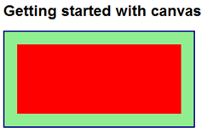
Using the Canvas API
Create a <canvas> element
Define styles for the <canvas> element
Write JavaScript code to draw on the canvas
<h1>Getting started with canvas</h1>
<canvas id="myCanvas">No canvas support</canvas>
canvas {
border: 2px solid darkblue;
background-color: lightgreen;
}
var canvas = document.getElementById('myCanvas');
var context = canvas.getContext('2d');
context.fillStyle = "red";
context.fillRect(20, 20, canvas.width - 40, canvas.height - 40);
Notes:
The basic API is very simple: get a reference to a <canvas> element, and then get a drawing context. Use the drawing context to draw and fill shapes and lines on the canvas.
Emphasize that CSS styling only applies to the <canvas> element itself; you cannot use CSS to style the elements drawn on a canvas.
20480C
11: Creating Advanced Graphics

Slide 16
Drawing Paths
Use a path to draw a complex shape
Use the beginPath, moveTo, lineTo, and closePath functions to define the shape
Draw the shape by using the stroke function
Specify the style by using the strokeStyle function
Fill the shape by using the fill function
Specify the style by using the fillStyle function
Notes:
As before, these functions are relatively straightforward. If time allows, walk students through the code in the notes so that the students can see how to use each function in context.
20480C
11: Creating Advanced Graphics

Slide 17

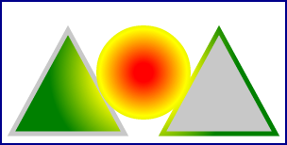

Using Gradients and Patterns
To fill a shape with a gradient:
To fill a shape with a pattern:
var grad = ctx.createLinearGradient(x1, y1, x2, y2);
var grad = ctx.createRadialGradient(startCx, startYy, startRad,
endCx, endCy, endRad);
grad.addColorStop(fraction1, color1);
grad.addColorStop(fraction2, color2);
…
ctx.fillStyle = grad;
var image = document.getElementById("anImageElement");
var pattern = ctx.createPattern(image, "repeat");
ctx.fillStyle = pattern;
Notes:
The code in the notes provides a more complete example; the code on the slide just shows the highlights.
20480C
11: Creating Advanced Graphics

Slide 18
Transforming Shapes
To rotate the canvas context:
To translate the canvas context:
To scale the canvas context:
To adjust the current transformation matrix:
To set a new transformation matrix:
ctx.rotate(clockwiseAngleInRadians);
ctx.translate(deltaX, deltaY);
ctx.scale(xScaleMultiple, yScaleMultiple);
ctx.transform(scaleX, skewX, scaleY, skewY, translateX, translateY);
ctx.setTransform(scaleX, skewX, scaleY, skewY, translateX, translateY);
Notes:
The demonstration that follows provides an example showing how to use these functions.
20480C
11: Creating Advanced Graphics

Slide 19
Demonstration: Performing Transformations by Using the Canvas API
In this demonstration, you will see how to use the Canvas API to:
Perform simple transformations
Perform matrix transformations
Notes:
When you click the Separate Transformations button, the web page invokes the demoSeparateTransformations() function. This function invokes separate transformation functions on the two-dimensional context. Explain these functions. Also point out the save() and restore() function calls, which save the initial context and then restore it at the end of the drawing operations.
When you click the Matrix Transformations button, the web page invokes the demoMatrixTransformations() function. This function performs a composite relative transformation on the coordinate system, by using the transform() function. The code also contains a commented-out call to setTransform(), to show how to perform an absolute transformation. Explain the difference between transform() and setTransform().
Demonstration Steps
You will find the steps in the “Demonstration: Performing Transformations by Using the Canvas API“ section on the following page: https://github.com/MicrosoftLearning/20480-Programming-in-HTML5-with-JavaScript-and-CSS3/blob/master/Instructions/20480C_MOD11_DEMO.md.
20480C
11: Creating Advanced Graphics

Slide 20
Demonstration: Creating Advanced Graphics
In this demonstration, you will learn about the tasks that you will perform in the lab for this module.
Notes:
Demonstration Steps
You will find the steps in the “Demonstration: Creating Advanced Graphics“ section on the following page: https://github.com/MicrosoftLearning/20480-Programming-in-HTML5-with-JavaScript-and-CSS3/blob/master/Instructions/20480C_MOD11_DEMO.md.
20480C
11: Creating Advanced Graphics

Slide 21
Lab: Creating Advanced Graphics
Exercise 1: Creating an Interactive Venue Map by Using SVG Exercise 2: Creating a Speaker Badge by Using the Canvas API
Estimated Time: 60 minutes
Notes:
You will find the high-level steps on the following page: https://github.com/MicrosoftLearning/20480-Programming-in-HTML5-with-JavaScript-and-CSS3/blob/master/Instructions/20480C_MOD11_LAB_MANUAL.md.
You will find the detailed steps on the following page: https://github.com/MicrosoftLearning/20480-Programming-in-HTML5-with-JavaScript-and-CSS3/blob/master/Instructions/20480C_MOD11_LAK.md.
Exercise 1: Creating an Interactive Venue Map by Using SVG
In this exercise, you will create an interactive conference venue map.
First, you will complete the partially completed SVG mark-up of the venue map. Next, you will add interactive styling to the SVG by using Cascading Style Sheets (CSS). Then, you will handle SVG element click events to display extra information about the conference rooms. Finally, you will run the application, view the Location page, and then verify that the venue map is interactive.
Exercise 2: Creating a Speaker Badge by Using the Canvas API
In this exercise, you will use the Canvas API to draw the elements of a conference speaker’s badge.
First, you will create a canvas element on the speaker badge page. Next, you will write the JavaScript code to implement methods that draw parts of the badge. Finally, you will run the application and test the speaker badge page.
20480C
11: Creating Advanced Graphics

Slide 22
Lab Scenario
The conference organizers would like a venue map displayed on the website. Conference attendees will use the map to find out more about the rooms of the conference facility. Therefore, the map should be interactive, responding to mouse clicks. The floor plans are available in a vector format, so they can be displayed in a resolution-independent format.
Conference speakers need badges with their photo, name, and ID. The ID is in the form of a barcode to make it easy for security personnel to scan and verify the holder’s identity before allowing backstage access. You have been asked to create a web page that enables a speaker to create a badge.
Notes:
20480C
11: Creating Advanced Graphics

Slide 23
Module Review and Takeaways
Review Questions
Notes:
Review Questions
Question
Which of the following statements about SVG is false?
( )Option 1: You can use SVG to draw complex shapes, and fill them with gradients and patterns.
( )Option 2: SVG elements are parsed by the browser when the page is first loaded, and they are then discarded from memory.
( )Option 3: You can create SVG elements dynamically by using DOM functions such as document.createElement().
( )Option 4: You can handle events on SVG elements.
( )Option 5: SVG elements must be enclosed in an <svg> container element on a web page.
Answer
(√) Option -2: SVG elements are parsed by the browser when the page is first loaded, and they are then discarded from memory.
Feedback
Option 2 is false, because SVG elements are retained in the DOM tree; they are not discarded after the page is loaded.
Question
When might you consider using the Canvas API instead of using SVG?
Answer
The Canvas API is appropriate if you want to create a static graphical image that does not need to support user interactions. The Canvas API can also be more efficient in terms of rendering speed for complex graphical images.
20480C
11: Creating Advanced Graphics

