Slide 1
Module 13
Implementing Real-time Communication by Using WebSockets
Notes:
This course requires an internet connection to download components from NuGet within Microsoft Visual Studio, to download source files for labs and demos. If there is no internet connection, modify the course to be delivered from a disconnected student device.
20480C
13: Implementing Real-time Communication by Using WebSockets

Slide 2
Module Overview
Introduction to WebSockets Using the WebSocket API
Notes:
Explain to students that this module concentrates on the client-side use of WebSockets in a webpage by using JavaScript. It does not describe how to create a WebSocket server.
20480C
13: Implementing Real-time Communication by Using WebSockets

Slide 3
Lesson 1: Introduction to WebSockets
The Problem of Web-based Real-time Communications What is a WebSocket?
Notes:
This is a short lesson, but it is worth taking time to make sure that students understand the issues involved in establishing a real-time, bi-directional communications channel between a webpage and a web server.
The practical details of how to use the WebSockets API are covered in lesson 2, so save the technical details and discussions until then.
20480C
13: Implementing Real-time Communication by Using WebSockets

Slide 4
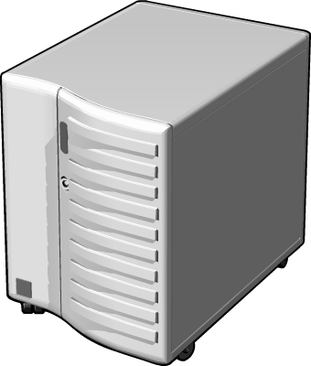
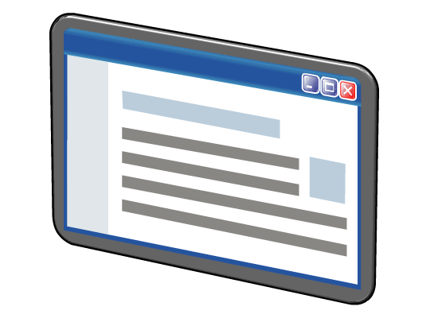
The Problem of Web-based Real-time Communications
Common techniques for implementing real-time communications include:
Continuous polling
Long polling
Real-time communication solutions between webpage and server have two main issues
Additional HTTP headers increase message size
HTTP is not full-duplex
Notes:
Highlight the issues associated with the continuous polling approach (overhead of repeatedly establishing and closing a network connection) and the long polling approach (limited network resources on a server, possibly resulting in clients being denied a connection).
Also describe why HTTP is not the ideal network protocol for sending small messages, due to the overhead that it imposes (real-time communications often are “chatty”) and the fact that it only operates in half-duplex mode. On the slide, point out that each exchange between the web browser acting as the client and the server involves opening two channels: one to send a message from a client to a server, and another for the server to send a message back to the client.
20480C
13: Implementing Real-time Communication by Using WebSockets

Slide 5
What is a WebSocket?
WebSockets are a solution for implementing real-time bidirectional communications on the web
RFC6455 defines the ws and wss protocols
The WebSockets API defines a JavaScript API for code running in a browser
Notes:
Highlight how RFC6455 defines a more suitable protocol for exchanging data, based on the sockets protocol. On the slide, point out that the arrows connecting the client and the server are now double-ended, indicting bi-directional communications over the same channel.
According to some analysis performed by the Kaazing Corporation, using WebSockets in preference to continuous polling or long polling could reduce the size of HTTP header traffic by a factor of 500 to 1,000, and reduce network latency in a web application by a factor of three.
WebSocket-enabled web applications are only supported on Internet Information Services 8 and later due to the number of changes in the HTTP stack that they require.
20480C
13: Implementing Real-time Communication by Using WebSockets

Slide 6
Lesson 2: Using the WebSocket API
Connecting to a Server by Using a WebSocket Sending Messages to a WebSocket Receiving Messages From a WebSocket Demonstration: Performing Real-time Communication by Using WebSockets
Notes:
This is the practical part of the module. The WebSocket API is fundamentally very simple (at least as far as client applications are concerned). The only real complications arise in defining the format of the data to use in the messages that are exchanged; the client and the server must agree on this format so that they can parse messages correctly.
20480C
13: Implementing Real-time Communication by Using WebSockets

Slide 7
Connecting to a Server by Using a WebSocket
The WebSocket object contains the functionality required to communicate with a server through a WebSocket
Establish a connection by creating a new WebSocket:
Check that the socket was opened successfully before using it:
Use the close() function to terminate the connection:
var socket =
new WebSocket('ws://websocketserver.contoso.com/bookings');
socket.onopen = function() {
alert("Connection to server now open!");
…
};
socket.close();
Notes:
The WebSocket object provides the abstraction around socket-based communication. Emphasize that communication is asynchronous; the WebSocket API provides events that a developer should use to track the state of the connection.
20480C
13: Implementing Real-time Communication by Using WebSockets

Slide 8
Sending Messages to a WebSocket
Use the send() function to send messages to a server
Use the bufferedAmount property to determine:
If there is a backlog before sending
If the message has been sent
Handle the error event to determine whether an error has occurred
Messages can be text, binary, or array data
var message = …;
socket.send(message);
Notes:
Emphasize that the send operation is asynchronous; the data is buffered and has not been fully transmitted until the bufferedAmount property of the WebSocket object drops to zero. Handling the error event to detect whether there were any failures during transmission is an important point.
You may want to expand further on Blob, ArrayBuffer and ArrayBufferView objects based on comments in the lecture room. Check out https://www.khronos.org/registry/typedarray/specs/latest/ for the ArrayBuffer and ArrayBufferView objects.
20480C
13: Implementing Real-time Communication by Using WebSockets

Slide 9
Receiving Messages From a WebSocket
The message event fires when a message is received from a server:
Examine event.type to determine whether the message is text or binary
Read event.data to retrieve the message
Before receiving a message, set the binaryType property of the WebSocket object to indicate the expected format for binary data
socket.onmessage = function(event) {
if (event.type == "Text") {
handleTextMessage(event.data);
} else {
handleBinaryMessage(socket.binaryType, event.data);
}
};
Notes:
The binaryType property of the WebSocket object requires careful explanation. Explain that this property specifies how the browser should present binary data to the message event when it is received.
20480C
13: Implementing Real-time Communication by Using WebSockets

Slide 10
Demonstration: Performing Real-time Communication by Using WebSockets
In this demonstration, you will learn about the tasks that you will perform in the lab for this module.
Notes:
Demonstration Steps
You will find the steps in the “Demonstration: Performing Real-time Communication by Using WebSockets“ section on the following page: https://github.com/MicrosoftLearning/20480-Programming-in-HTML5-with-JavaScript-and-CSS3/blob/master/Instructions/20480C_MOD13_DEMO.md.
20480C
13: Implementing Real-time Communication by Using WebSockets

Slide 11
Lab: Performing Real-time Communication by Using WebSockets
Exercise 1: Receiving Messages from a WebSocket Exercise 2: Sending Messages to a WebSocket Exercise 3: Handling Different WebSocket Message Types
Estimated Time: 90 minutes
Notes:
You will find the high-level steps on the following page: https://github.com/MicrosoftLearning/20480-Programming-in-HTML5-with-JavaScript-and-CSS3/blob/master/Instructions/20480C_MOD13_LAB_MANUAL.md.
You will find the detailed steps on the following page: https://github.com/MicrosoftLearning/20480-Programming-in-HTML5-with-JavaScript-and-CSS3/blob/master/Instructions/20480C_MOD13_LAK.md.
Exercise 1: Receiving Messages from a WebSocket
In this exercise, you will review the new Live page and JavaScript. You will write JavaScript that creates a WebSocket and connect the socket to the server. Then you will handle messages received from the WebSocket. You will parse the JSON serialized messages into objects that contain new questions to display on the page. Finally, you will run the application, view the Live page and verify that it displays the questions sent by the socket server.
Exercise 2: Sending Messages to a WebSocket
In this exercise, you will create a message object that contains a question to ask. You will serialize this message and send it to the server by using the WebSocket. Then you will run the application, view two concurrent instances of the Live page, and verify that asking questions results in them being displayed on the page in both instances.
Exercise 3: Handling Different WebSocket Message Types
In this exercise, you will add a link next to each question to enable a student to report the question as inappropriate. Then you will handle messages from the server instructing the page to remove a question; this process will involve handling different types of messages. Finally, you will run the application, view the Live page, and verify that clicking the link causes the question to be removed.
20480C
13: Implementing Real-time Communication by Using WebSockets

Slide 12
Lab Scenario
During conference sessions, attendees may wish to ask questions. Distributing microphones among members of the audience can be problematic and slow, so you have been asked to add a page to the website that enables attendees to submit questions. Speakers can either respond immediately or later, depending on the nature of the questions and the session.
On the website, all questions must be displayed in real-time without reloading the page, so that all attendees and the speaker can see what has been asked. To support this requirement, a WebSocket server has been created. You need to update the web application to send the details of questions to the socket server, and also to receive and display questions submitted by other attendees.
The WebSocket server is implemented by using ASP.NET and C#. The details of how this server works are outside the scope of this lab.
Conference organizers are concerned about people asking inappropriate questions. Therefore, a back-end moderation system is also being developed. Conference attendees should be able to report a question that they think is inappropriate. Administrators can then mark this question for removal. The WebSocket server will transmit a message to all connected clients, and the webpage must be updated to remove the question.
Notes:
20480C
13: Implementing Real-time Communication by Using WebSockets

Slide 13
Module Review and Takeaways
Review Questions
Notes:
Review Questions
Question
WebSocket clients send and receive data over an HTTP connection. True or False?
( )False
( )True
Answer
(√)False
Feedback
The RFC6455 WebSocket protocol specification defines the WebSockets (ws) transport, which describes a more compact format suitable for quickly sending and receiving messages between a client application and a server. A WebSocket client uses an HTTP connection to initiate a connection request to a server, but when the connection is made, a new channel is established between the client and the server that uses the WebSocket transport.
Question
How does a client create a connection to a WebSocket server?
( )Option 1: The client uses the open() function of the WebSocket object and specifies the URL of the server.
( )Option 2: The client uses the connect() function of the WebSocket object and specifies the URL of the server.
( )Option 3: WebSockets use a stateless protocol similar to HTTP. A client application simply specifies the address of the server as a parameter of the send() function of the WebSocket object. A connection is automatically established while the message is sent and then closed.
( )Option 4: The client creates a new WebSocket object and specifies the URL of the server.
( )Option 5: The client has to wait until the server responds to send a message that grants it permission to connect
20480C
13: Implementing Real-time Communication by Using WebSockets
(More notes on the next slide)

Slide 14
Notes:
Answer
(√) Option -4: The client creates a new WebSocket object and specifies the URL of the server.
Feedback
The WebSocket constructor expects the URL of the server as a parameter. The URL should specify the endpoint that the server is listening on, and use the ws or wss scheme. For example:
const socket = new WebSocket('ws://contoso.websocketserver.com/bookings');
20480C
13: Implementing Real-time Communication by Using WebSockets

