Slide 1
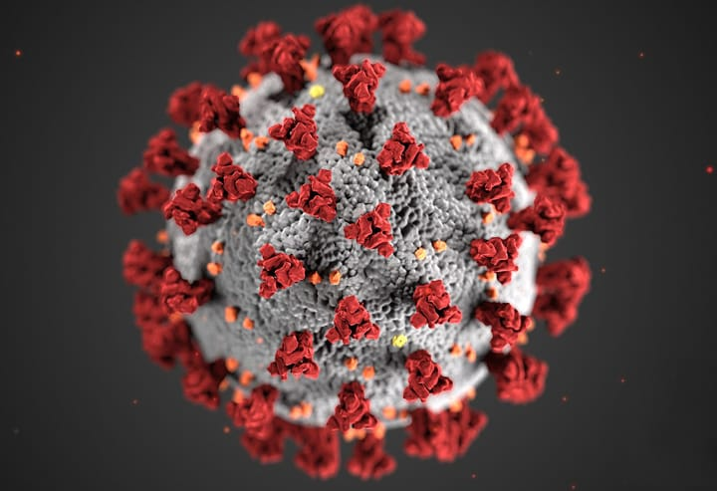
COVID-19 over time
Group 11
Lukas Baur, Kevin Hall, David Cincotta, Shardool Pathak, Steven Yean
Group 11
Lukas Baur, Kevin Hall, David Cincotta, Shardool Pathak, Steven Yean

Slide 2
COVID-19: Other tools
Group 11
Lukas Baur, Kevin Hall, David Cincotta, Shardool Pathak, Steven Yean

Slide 3

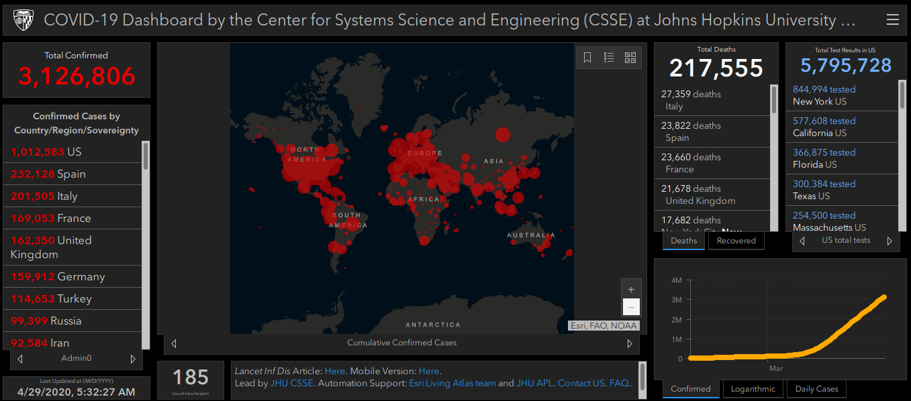
COVID-19: Other tools
Group 11
Lukas Baur, Kevin Hall, David Cincotta, Shardool Pathak, Steven Yean

Slide 4

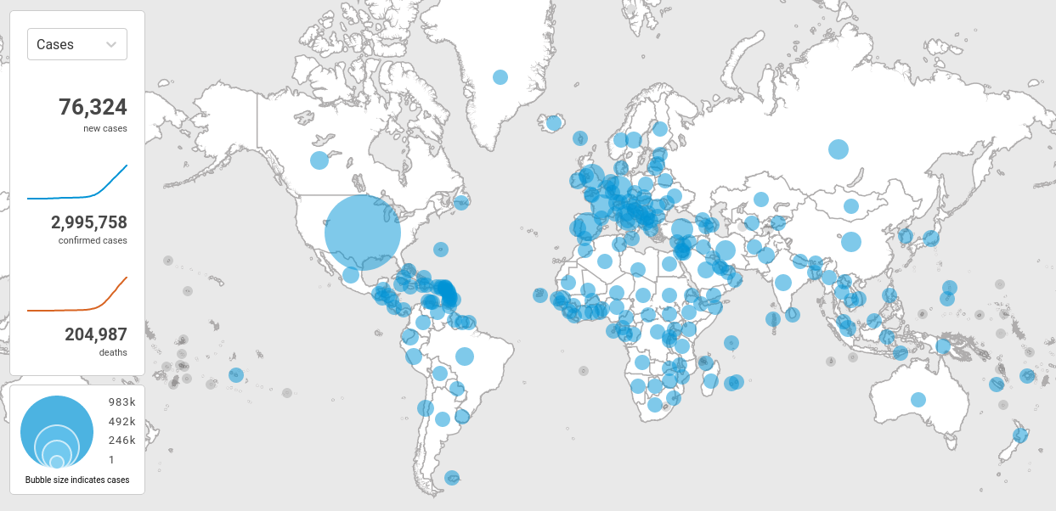
COVID-19: Other tools
Group 11
Lukas Baur, Kevin Hall, David Cincotta, Shardool Pathak, Steven Yean

Slide 5
COVID-19: Other tools
Weaknesses
Group 11
Lukas Baur, Kevin Hall, David Cincotta, Shardool Pathak, Steven Yean

Slide 6
COVID-19: Other tools
Weaknesses
- current situation only
Group 11
Lukas Baur, Kevin Hall, David Cincotta, Shardool Pathak, Steven Yean

Slide 7
COVID-19: Other tools
Weaknesses
- current situation only
- difficult relative comparisons
Group 11
Lukas Baur, Kevin Hall, David Cincotta, Shardool Pathak, Steven Yean

Slide 8
COVID-19: Other tools
Comparison issue
Group 11
Lukas Baur, Kevin Hall, David Cincotta, Shardool Pathak, Steven Yean

Slide 9
COVID-19: Other tools
Comparison issue
>
>
Group 11
Lukas Baur, Kevin Hall, David Cincotta, Shardool Pathak, Steven Yean

Slide 10
COVID-19: Other tools
Comparison issue
>
>
Group 11
Lukas Baur, Kevin Hall, David Cincotta, Shardool Pathak, Steven Yean

Slide 11
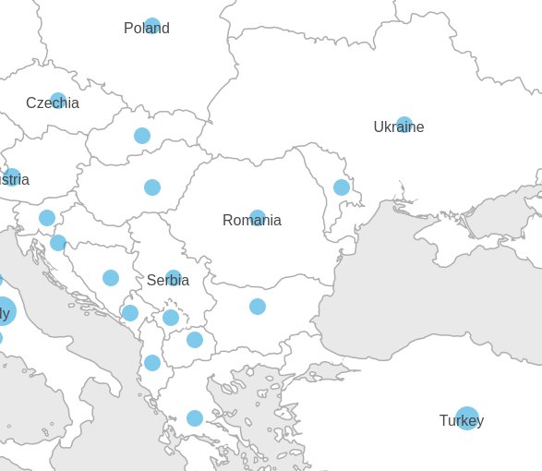
COVID-19: Other tools
Comparison issue
>
>
Group 11
Lukas Baur, Kevin Hall, David Cincotta, Shardool Pathak, Steven Yean

Slide 12

COVID-19: Structure
Data (raw)
Group 11
Lukas Baur, Kevin Hall, David Cincotta, Shardool Pathak, Steven Yean

Slide 13
COVID-19: Structure
Data (raw)
Data Layer
pre-processing
Group 11
Lukas Baur, Kevin Hall, David Cincotta, Shardool Pathak, Steven Yean

Slide 14
COVID-19: Structure
Data (raw)
Data Layer
pre-processing
UI
Controller
User
Group 11
Lukas Baur, Kevin Hall, David Cincotta, Shardool Pathak, Steven Yean

Slide 15
COVID-19: Demo
Group 11
Lukas Baur, Kevin Hall, David Cincotta, Shardool Pathak, Steven Yean

