Slide 1
How to predict a salary for any US city
Baurjan Safi, DSI-5
General Assembly DC

Slide 2
Plan of Presentation
Data Source and Data Set
Other Data
Identification of Key Factors
Visuals and Rationale
Model and Scores
Words and Importance

Slide 3
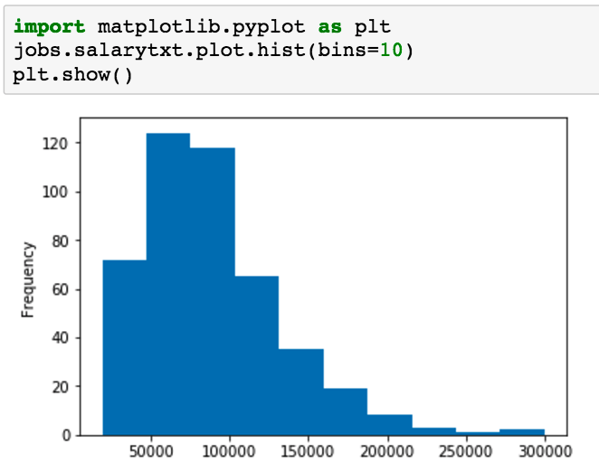
Data Source and Data Set
Web-site: www.indeed.com
Cities: 25
15 160 records, of them:
8490 unique records
6237 unique job titles
3034 companies ( ~ 3 jobs per company)
447 records with salaries (5.25%)
Salary range [$19,200 - $300,000*]
* Simple Data Scientist at Intellipro Group, San Francisco, CA
Job Summary “…work with data engineers and other stakeholders in data products pipeline to enable automation of the data-driven products...”

Slide 4
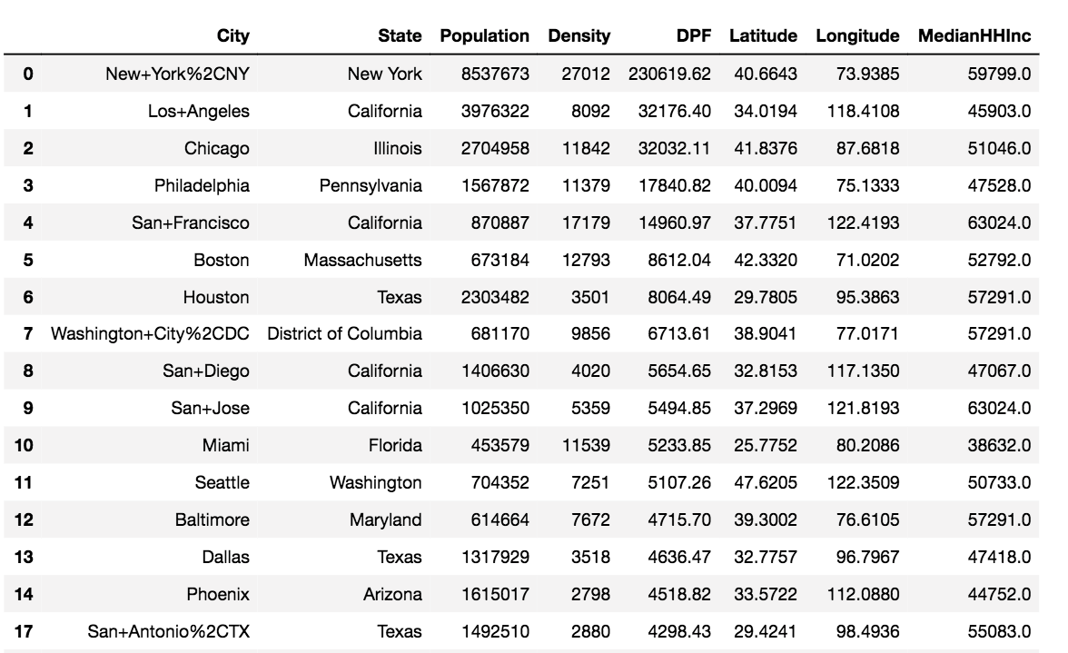
Other Data
City statistics:
300 cities
Population
Density
Latitude
Longitude
Median Household Income

Slide 5
Identification of Key Factors
Population
Location
Density
Density x Population Factor
Median Household Income
Average City Salary
National Median Salary
Words
State

Slide 6
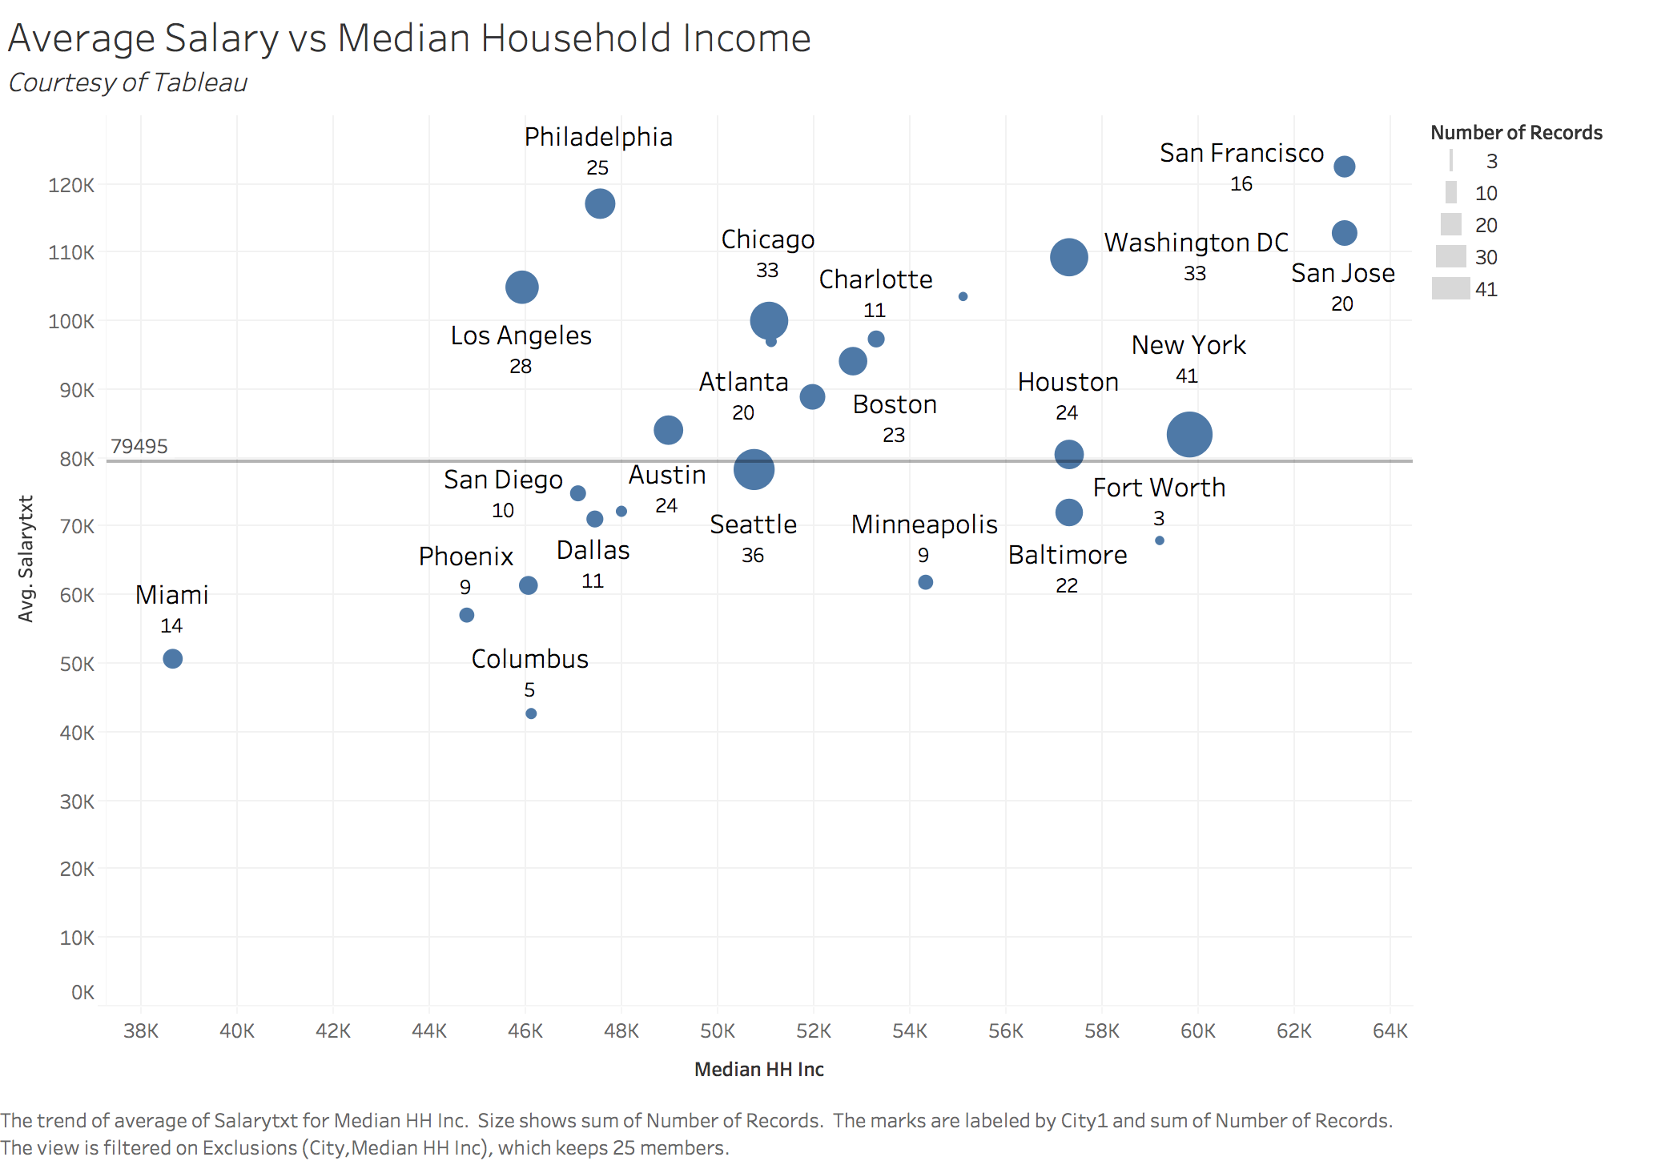
Identification of Key Factors

Slide 7
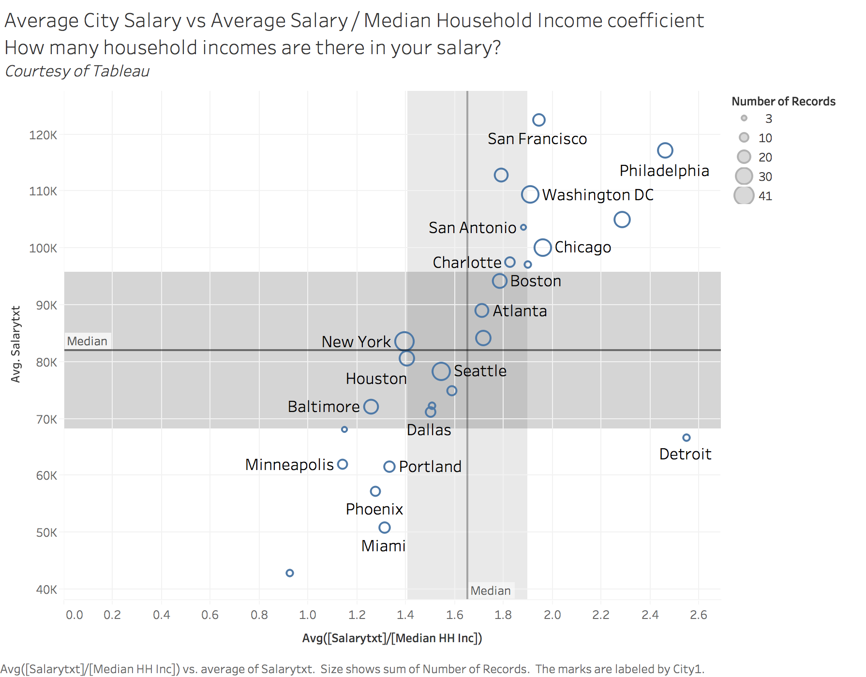
Identification of Key Factors

Slide 8
Model and Scores
Final Variables:
Coefficient of Salary vs Median Household Income
Population
Density
Words of Job Title (by presence of “president, senior, supervisor”
Words of Summary (unique 1800 words)
Number of Categories:
10
4
3
2

Slide 9
Importance of Variables
Number of Categories | Salary to MHHI | Population | Density | MgrDummy
10 | 0.808 | 0.072 | 0.094 | 0.026
4 | 0.847 | 0.057 | 0.063 | 0.033
3 | 0.838 | 0.06 | 0.068 | 0.034
2 | 0.923 | 0.02 | 0.028 | 0.029

Slide 10
Models and Scores
Number Of categories | StratKFolds | Random Forest | RF with words | Bagging Classifier
10 | 0.654 | 0.638 | 0.44 | 0.641
4 | 0.794 | 0.801 | 0.723 | 0.796
3 | 0.863 | 0.863 | 0.81 | 0.857
2 | 0.926 | 0.931 | 0.926 | 0.931

Slide 11
Words and Importance
words | importance
data | 0.143575
scientist | 0.066311
research | 0.058424
analysis | 0.057210
analytics | 0.052634
experience | 0.046657
scientists | 0.042868
looking | 0.040034
analyze | 0.034816
science | 0.030636

Slide 12
Summary and Questions
The most important variable – Salary / City Median Household Income
The most accurate prediction model – Random Forest
The most predictive variable split – two categories
The best number of folds in Stratified K-fold – 10
Questions?

