Slide 1


Persistence-Boost Quant Model with ETFs
Friday, November 24, 2017

Slide 2
The Idea

Slide 3
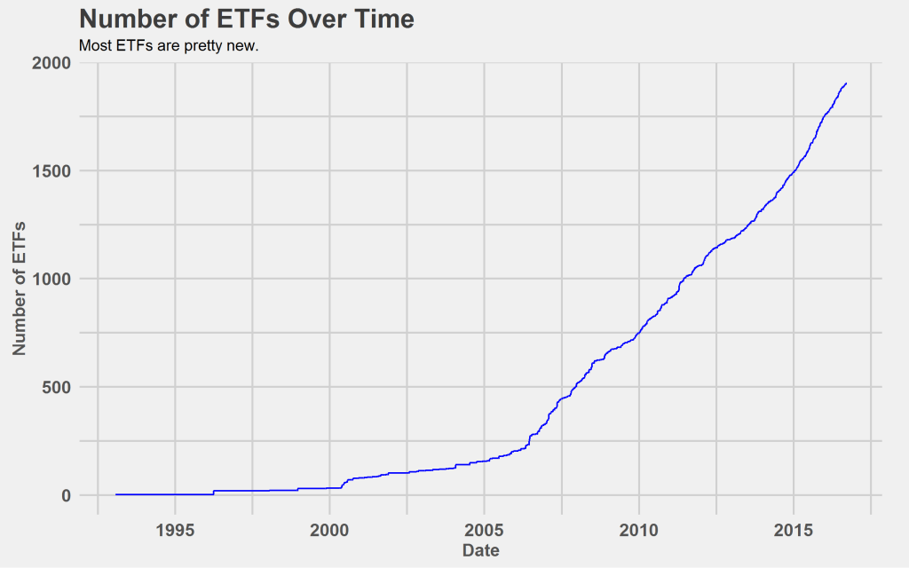
Motivation
ETF as an asset class has grown tremendously in number and size in the past decade
It enjoys the same market accessibility, quantitativeness and liquidity as equity, but at the same time suffers much less from trading noise and idiocyncratic events than individual stocks do
→ Ideal for machine to learn (or AI as popularly renamed)

Slide 4
Motivation
Moreover, ETFs are likely to exhibit periodicity in their return cycle driven by the sectors, the investment styles or smart beta strategies whose underlying structures they are trying to replicate (insert the periodic chart)
These periodic signals are hard for traditional algorithms and factors (features in the machine learning world) to capture
But a newly and rapidly developing set of techniques from Pure Mathematics offers the potential “killer feature”

Slide 5
The Data

Slide 6
Raw Data (description)
ETF as an asset class has grown tremendously in size and analytic data in the past decade
It enjoys the same market accessibility, quantitativeness and systematicality as equity, but at the same time suffers much less from trading noise and idiocyncratic events than individual stocks do
→ Ideal for machine (or AI as popularly renamed)

Slide 7
Raw Data (distribution)
ETF as an asset class has grown tremendously in size and analytic data in the past decade
It enjoys the same market accessibility, quantitativeness and systematicality as equity, but at the same time suffers much less from trading noise and idiocyncratic events than individual stocks do
→ Ideal for machine (or AI as popularly renamed)

Slide 8
Features
ETF Descriptors
ETF Quantitative Factors
XGBoost Model Integrations
TDA Persistence Landscapes

Slide 9
Features
ETF
描述性特征
ETF
量化特征
XGBoost 模型
迭代
TDA
持续性
峰群特征

Slide 10
The Model

Slide 11
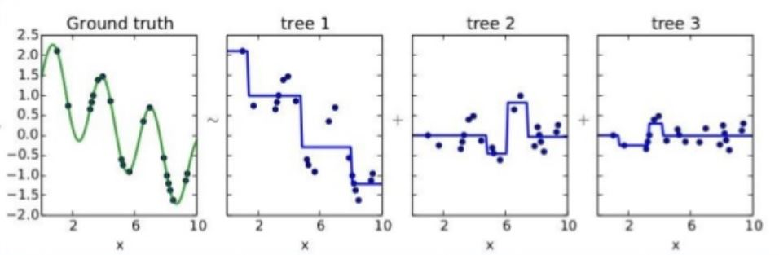
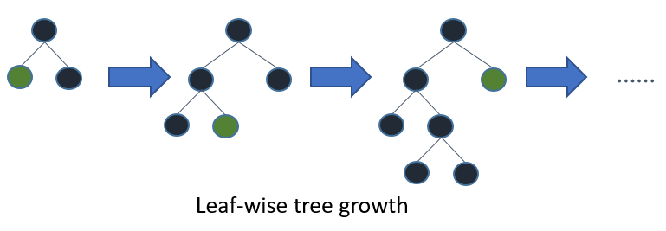
Introducing XGBoost
Tree-based
Transparent and whitebox as regression vs. deep neural networks
Free from normalisation/standardisation of the features vs. regression
Kagglers’ love (used by 17 out of 29 winners)

Slide 12
The Result

Slide 13
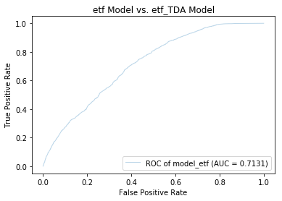
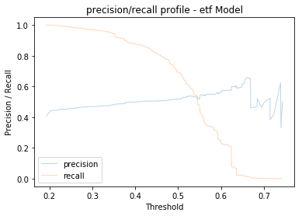
Precision, Recall, Area under Curve (auc) and Their Friends

Slide 14
The Model 2.0

Slide 15
TDA in a Nutshell
ETF as an asset class has grown tremendously in size and analytic data in the past decade
It enjoys the same market accessibility, quantitativeness and systematicality as equity, but at the same time suffers much less from trading noise and idiocyncratic events than individual stocks do
→ Ideal for machine (or AI as popularly renamed)

Slide 16
TDA Applications (paper on time series classification)
ETF as an asset class has grown tremendously in size and analytic data in the past decade
It enjoys the same market accessibility, quantitativeness and systematicality as equity, but at the same time suffers much less from trading noise and idiocyncratic events than individual stocks do
→ Ideal for machine (or AI as popularly renamed)

Slide 17
Features 2.0
ETF as an asset class has grown tremendously in size and analytic data in the past decade
It enjoys the same market accessibility, quantitativeness and systematicality as equity, but at the same time suffers much less from trading noise and idiocyncratic events than individual stocks do
→ Ideal for machine (or AI as popularly renamed)

Slide 18
The Result 2.0

Slide 19
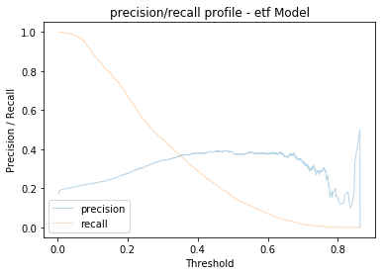
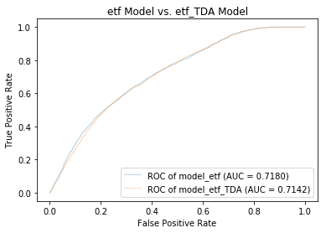
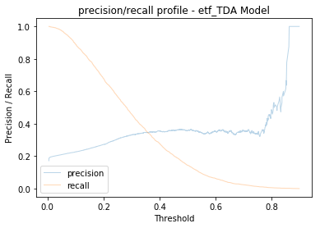
Result (score)

Slide 20
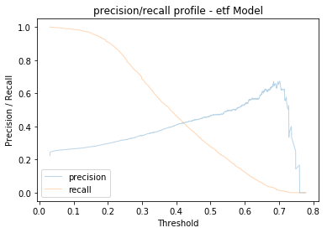
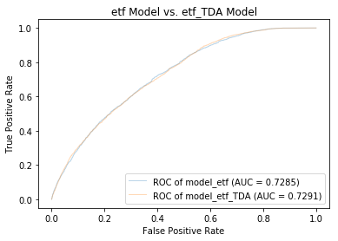
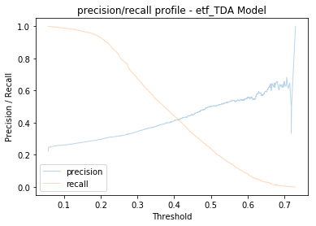
Result (score)

Slide 21
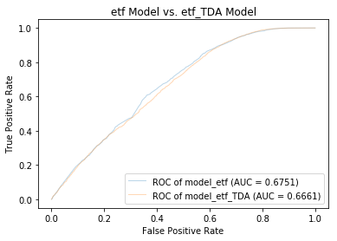
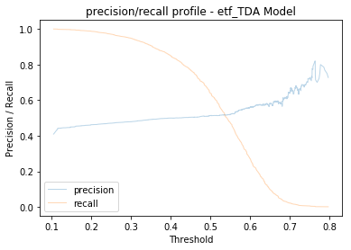
Result (score)

Slide 22
Result (case study)
Here we zoom and take a close look of how an ETF is rated highly by the model trained with TDA killer features

Slide 23
The Next Step

Slide 24
Wrap up
ETF as an asset class has grown tremendously in size and analytic data in the past decade
It enjoys the same market accessibility, quantitativeness and systematicality as equity, but at the same time suffers much less from trading noise and idiocyncratic events than individual stocks do
→ Ideal for machine (or AI as popularly renamed)

Slide 25
Next Step
Backtesting investment strategies based on current model
Buy and hold the ETFs with score higher than the threshold (95%) for max 1 month
During the month, cash out whenever a holding ETF’s return reaches the cut off return (4%)
Cash out at the end of the month, buy and hold new set of ETF from the recalibrated model
Data 2.0: ← fund flow data, volume data, ratio data, ETF analytics data
Further iterations (reinforcement learning?)

Slide 26
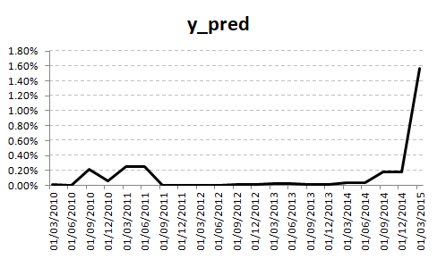
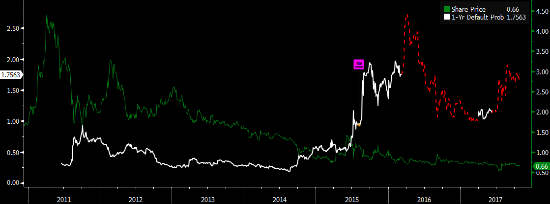
Case Study 1: MIE (model_sp vs. DRSK)
Spike of dp @model_sp
Spike of dp @DRSK
2015

Slide 27
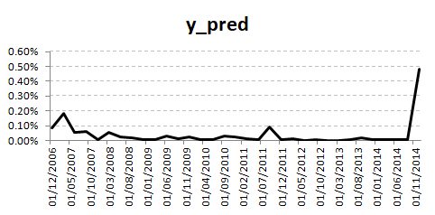
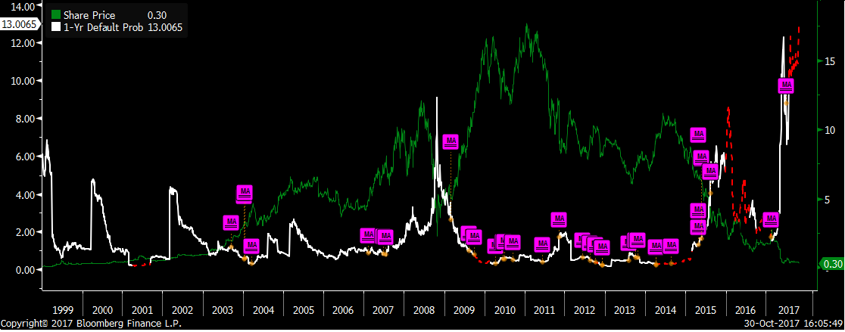
Case Study 2: Noble Group (model_sp vs. DRSK)
Spike of dp @model_sp
Spike of dp @DRSK
2014

Slide 28
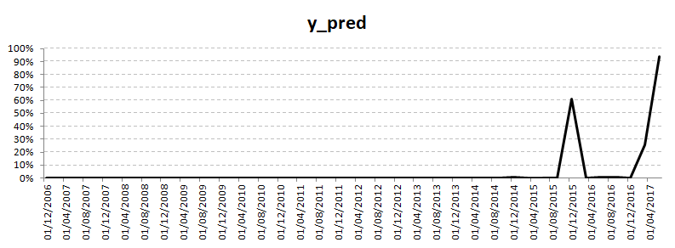
Case Study 2: Noble Group (model_sp vs. DRSK)
Spike of dp @model_sp
Spike of dp @DRSK
2014

Slide 29
Conclusion
We further test the S&P sample data in the following 3 aspects, where they are all demonstrating significant advantage over existing benchmark (Bloomberg data & Bloomberg DRSK model):
Data Availability/Data Quality: data fields from S&P are mostly available, whereas fields from Bloomberg are largely missing, especially bad for bonds defaulted.
Prediction Power (model trained by S&P data vs. model trained by Bloomberg data): model trained by S&P data outperform the one trained by Bloomberg data substantially (99% vs. 83%) in terms of AUC score.
Prediction Timing (S&P model vs. Bloomberg DRSK model): given the limited sample size and a very small subset of all the available fields/features from S&P dataset, the model built from S&P can still forecast earlier warning than Bloomberg DRSK model as case-studied by the two recent troubled bonds from different issuers.

