Slide 1

Persistence-Boost Quant Model with ETFs
Saturday, 12 May 18

Slide 2
Persistence-Boost Quant Model with ETFs
Saturday, 12 May 18

Slide 3
The Idea

Slide 4
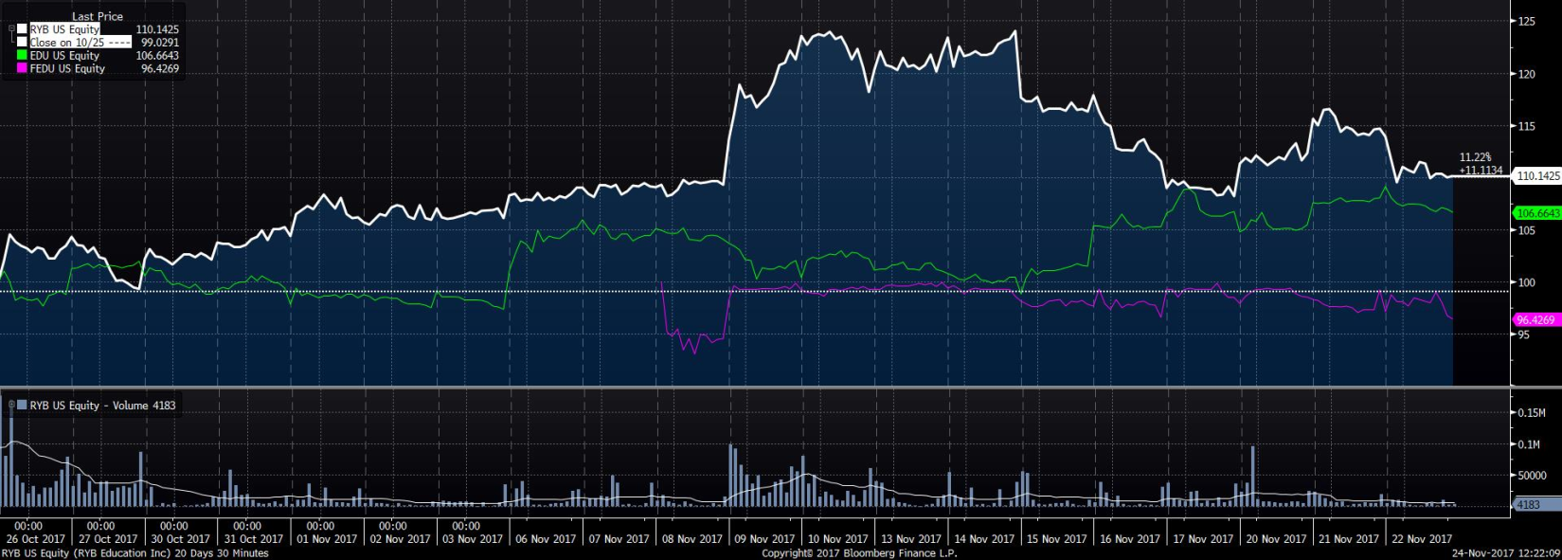
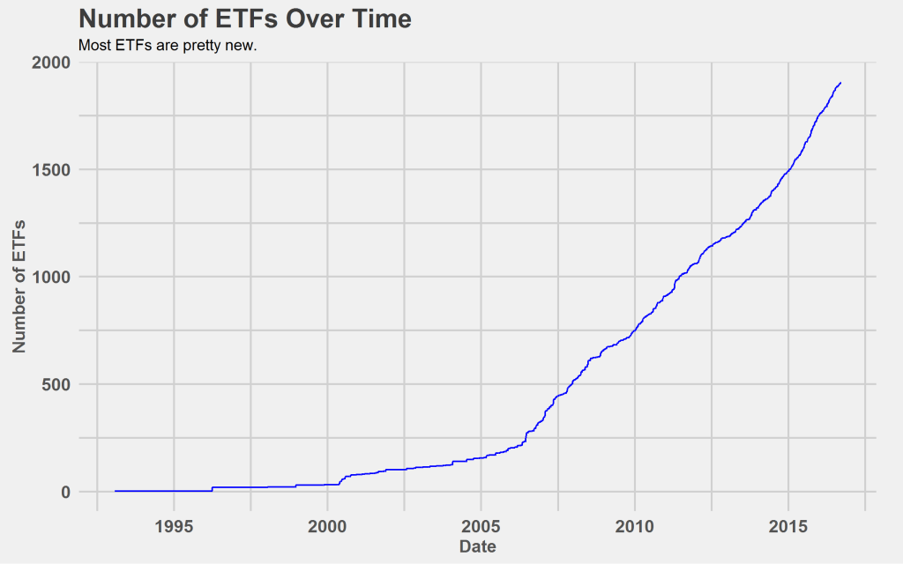
Motivation

Slide 5
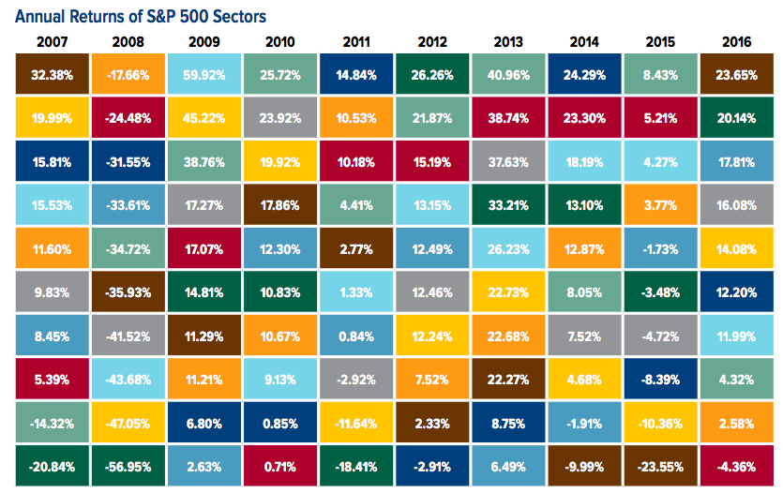
Motivation
Moreover, ETFs are likely to exhibit periodicity in their return cycle driven by the sectors, the investment styles or smart beta strategies whose underlying structures they are trying to replicate
These periodic signals are hard for traditional algorithms and factors (features in the machine learning world) to capture
But a newly and rapidly developing set of techniques from Pure Mathematics offers the potential “killer feature”

Slide 6
The Data

Slide 7
Feature Engineering
ETF Descriptors
ETF Quantitative Factors
XGBoost Model Integrations
ETF Statistical Factors

Slide 8
The Model

Slide 9
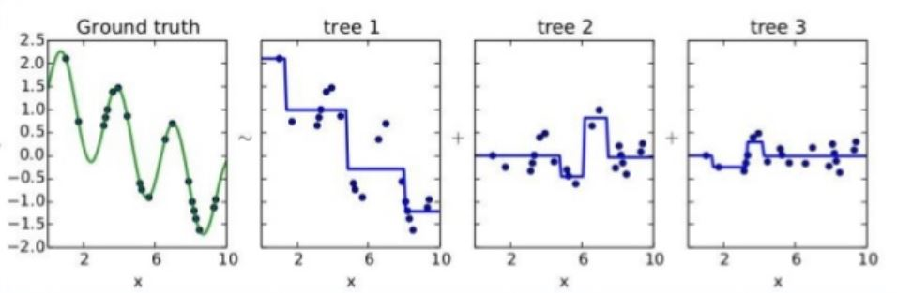
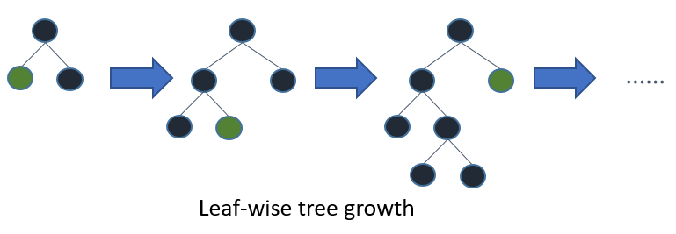
Introducing XGBoost
Tree-based
Transparent and whitebox as regression vs. deep neural networks
Free from normalisation/standardisation of the features vs. regression
Kagglers’ love (used by 17 out of 29 winners)

Slide 10
The Result

Slide 11
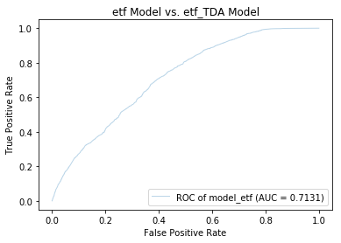
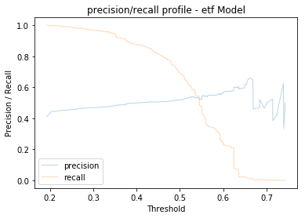
Precision, Recall, Area under Curve (auc) and Their Friends

Slide 12
The Model 2.0

Slide 13
TDA in a Nutshell

Slide 14
TDA Applications

Slide 15
Feature Engineering 2.0
ETF Descriptors
ETF Quantitative Factors
XGBoost Model Integrations
TDA Persistence Landscapes
ETF Statistical Factors

Slide 16
The Result 2.0

Slide 17
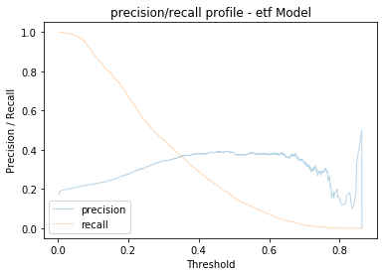
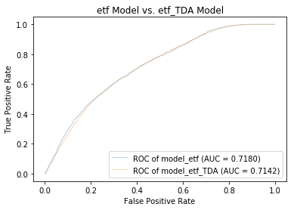
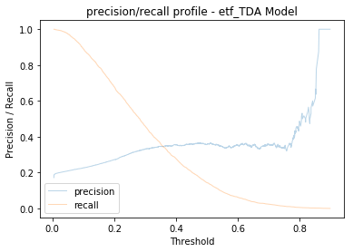
Result (score)

Slide 18
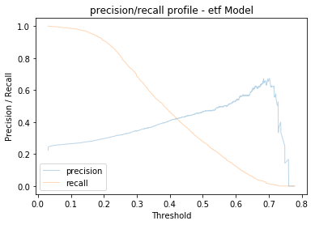
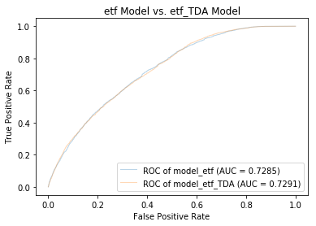
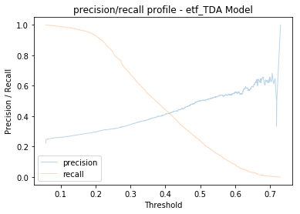
Result (score)

Slide 19
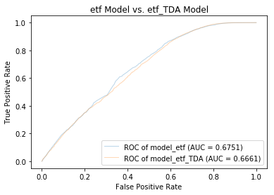
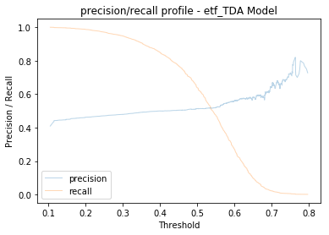
Result (score)

Slide 20
The Next Step

Slide 21
Next Step
Backtesting investment strategies based on current model
Buy and hold the ETFs with score higher than the threshold (95%) for max 1 month
During the month, cash out whenever a holding ETF’s return reaches the cut off return (4%)
Cash out at the end of the month, buy and hold new set of ETF from the recalibrated model
Data 2.0: ← fund flow data, volume data, ratio data, ETF analytics data
Further iterations (reinforcement learning?)

