Slide 1
TDA-Augmented ETF Strategy
Tan Li

Slide 2
Content
Part I - How
Motivation & Result
Model & Feature Engineering
Data Prep
Parameters
Part II – Why
Result
Feature Engineering
Data Prep
Parameters
Part III – What Next?
Strategy
Backtesting & Validation
Further Analysis & Optimisation

Slide 3
Part I 1. Motivation & Result

Slide 4
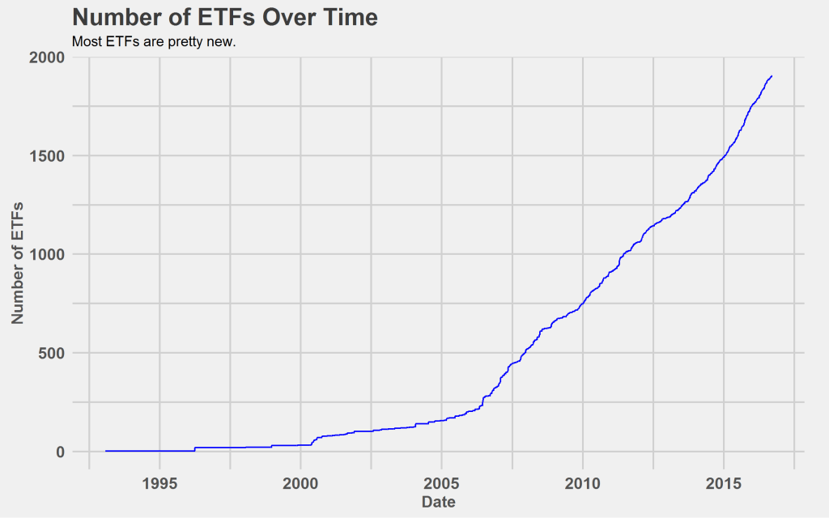
Motivation – Why ETF
ETF as an asset class has grown tremendously in number and size in the past decade
It enjoys the same market accessibility, quantitativeness and liquidity as equity, but at the same time suffers much less from trading noise and idiocyncratic events (e.g. corp actions) than individual stocks
→ Ideal for machine to learn (or AI as popularly renamed)

Slide 5
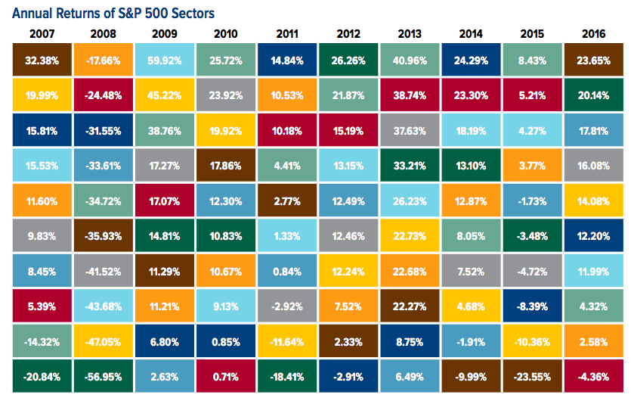
Motivation – Why ETF
Moreover, ETFs are likely to exhibit periodicity in their return cycle driven by the sectors, the investment styles or smart beta strategies whose underlying structures they are trying to replicate
These periodic signals are hard for traditional algorithms and factors (features in the machine learning world) to capture
TDA may offer the potential “killer feature”

Slide 6
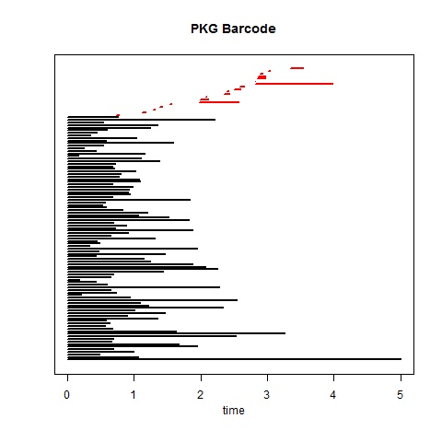
Motivation – Why TDA
Persistence Barcode captures the cycles: example 1

Slide 7
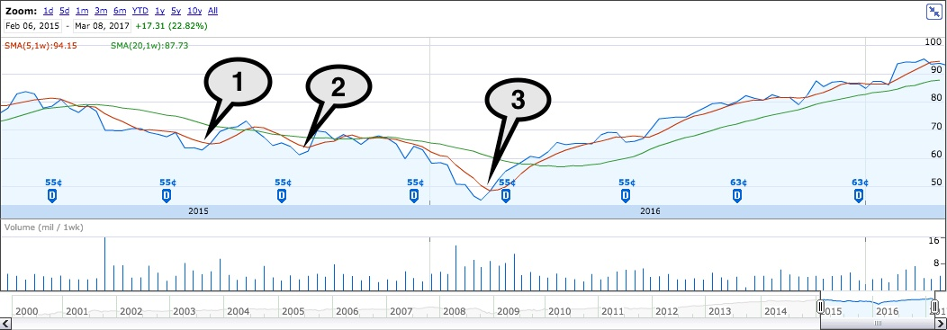
Motivation – Why TDA
Persistence Barcode captures the cycles: example 1

Slide 8
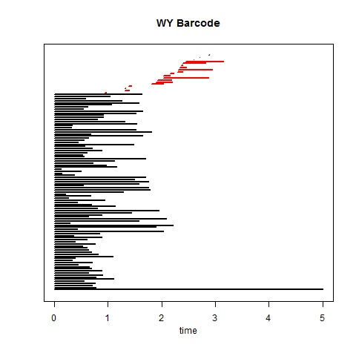
Motivation – Why TDA
Persistence Barcode captures the cycles: example 2

Slide 9
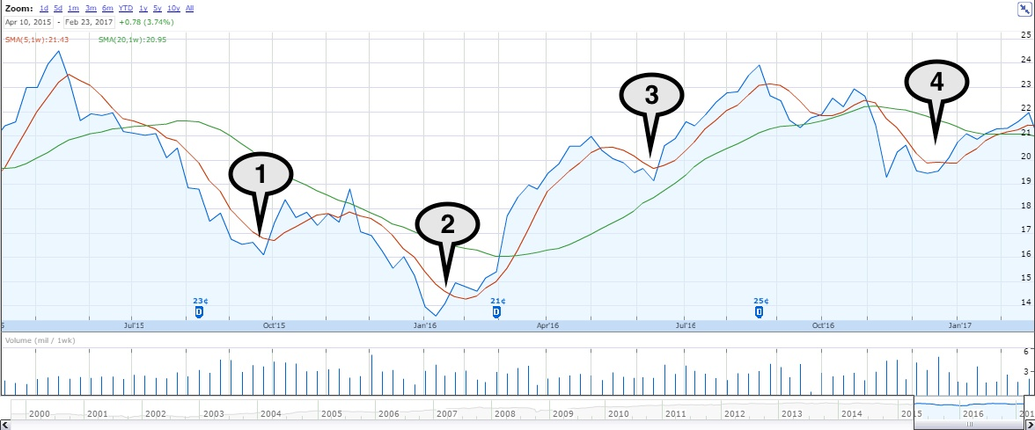
Motivation – Why TDA
Persistence Barcode captures the cycles: example 2

Slide 10
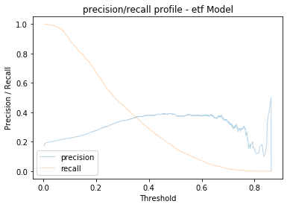
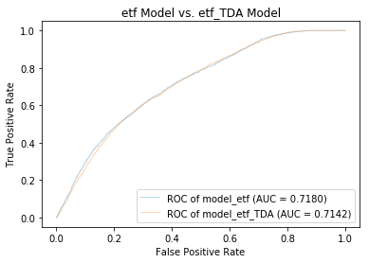
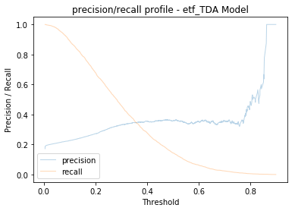
Result: AUC on a par, TDA model is consistently superior in picking performing ETFs at high confidence level across different data input (blue curve in bottom right vs. top right)

Slide 11
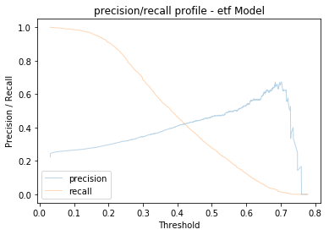
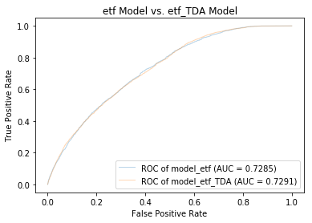
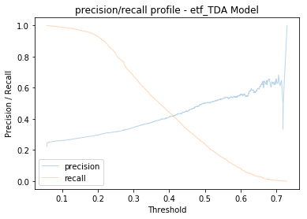
Result: AUC on a par, TDA model is consistently superior in picking performing ETFs at high confidence level across different data input (blue curve in bottom right vs. top right)

Slide 12
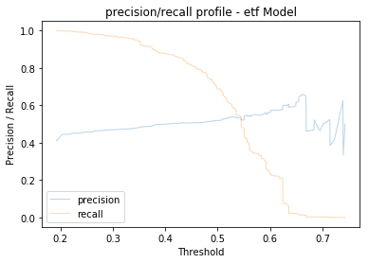
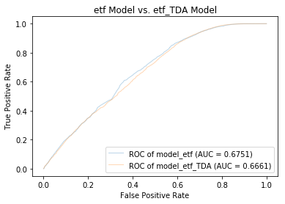
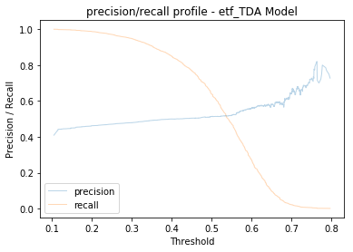
Result: AUC on a par, TDA model is consistently superior in picking performing ETFs at high confidence level across different data input (blue curve in bottom right vs. top right)

Slide 13
Part I 2. Model & Feature Engineering

Slide 14
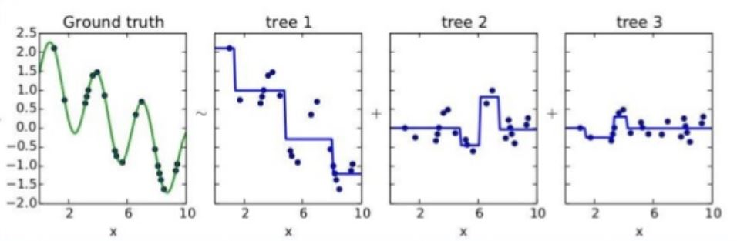
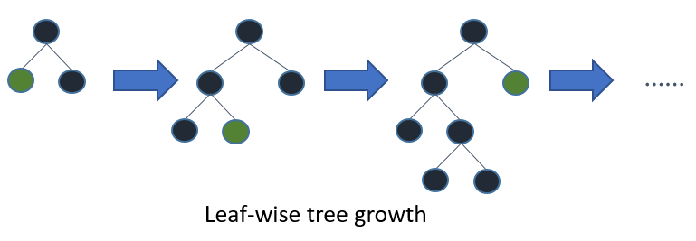
XGBoost Model
Best Results vs. SVM vs. CNN vs. Regression
Tree-based
Transparent and whitebox as regression vs. deep neural networks
Free from normalisation/standardisation of the features vs. regression
Kagglers’ love (used by 17 out of 29 winners)

Slide 15
Model without TDA features
ETF Descriptors
XGBoost Model Integrations
ETF Quantitative Factors
ETF Statistical Factors

Slide 16
Model with TDA features
ETF Descriptors
ETF Quantitative Factors
XGBoost Model Integrations
ETF Statistical Factors
TDA Persistence Landscapes

Slide 17
Part I 3. Data Prep

Slide 18
Raw Data
Time Period: c. 10 years (540 weeks) of weekly data (27/4/2007 - 25/8/2017)
Number of ETFs: 1578 of different life spans from the US exchanges
The raw ETF Data consists of two sources:
ETF Price Data
ETF Descriptive Data: static descriptors of each ETF, e.g. issuer, expense etc.
Any ETF with life span < 60 weeks (1 year + 8 weeks) is removed from start

Slide 19
Data Prep: X & Feature Engineering
52 weeks as a batch window size, 4 as stride size – e.g. the sample of 1578 ETFs between “27/4/2007” and “18/4/2008” form the 1st batch, the sample of 1578 ETFs between between “27/4/2007 + 4 weeks” and “18/4/2008 + 4 weeks” form the 2nd batch, so on so forth
Rebase – the first date of each batch in the Price Data to be 100
12 “factor” features out of the price data source
Momemtum (5)
Max range (4)
Volatility (3)
100 TDA features out of the persistent landscape matrix

Slide 20
Data Prep: y – predication/target
The last 4 weeks of each batch is the raw data to construct the y column – the prediction target of binary form (1 for positive, 0 for negative)
To be positive: one of the weekly return out of the 4 weeks> 4%
To be negative: all weekly returns < 4%

Slide 21
Data split
Training dataset: the first 60% of the entire data time window, e.g. for a dataset window of 540 weeks, the training data will come from the 1st 324 weeks
Validation dataset: the middle 20% of the entire data time window, e.g. for a dataset window of 540 weeks, the validation data will come from the middle 108 weeks
Testing dataset: the last 20% of the entire data time window, e.g. for a dataset window of 540 weeks, the testing data will come from the last 108 weeks

Slide 22
Part I 4. Parameters

Slide 23
Data Prep Parameters
Data
th = 60 (min number of non-trivial prices for an input ETF)
w = 52 (batch window size)
s = 4 (stride size)
n = (number of batches)
TH_y = 0.04 (y positive threshold)
Training, Validation and Testing dataset split: 60:20:20
Model
Max dept = 5
Number of default iteration = 100
Early stop? Manual

Slide 24
Part II

Slide 25
Part II 1. Result

Slide 26
Why such result?
It’s only my best guess for now without digging into the names/ETFs what were scored highly for each test
By just looking at the threshold probability (black dotted line on the next page) the TDA model starts outperforming (in terms of precision): it was similar before the thresholds (which explains the muted edge when only looking at AUC), and only spiked at the last few high probability predictions, which suggest the TDA features added additional signal to the model only for a few ETFs/names that possesses/carries such signal during the testing window; for the test cases where TDA model wasn’t outperforming, could it then be that the signal was lost in the testing window? (next page)

Slide 27
Why such result?

Slide 28
Part II 2. Feature Engineering

Slide 29
Why the y
To maximise the power of TDA as I understand it, it’s best to apply on cases where there exists sufficient time window for the data points to revolve along, which should be in the unit of month or quarter (currently set as 1 year of data per batch);
consequently, when design the prediction target “y”, it should be best to allow some “optionality” over certain “execution” window, so it’s also practical to pick the best performing point to cash in/take profit, hence the max(week 1, week 2, week 3, week 4) definition of “y”

Slide 30
Why the 12 factor features?
It doesn’t have to
And I didn’t trial too many variations/combinations of it; the thinking behind is just that this is my starting point/benchmark, as long as the features + TDA shows superiority, it’s good to get from here
I also initially added PCA factors, however, they do not add value/predictive power even just for a factor model trained with above factor features

Slide 31
Why 100 TDA features?
It basically ranges out the full persistent landscape spectrum for 0 and 1 dimension homology
This “brute force” “feature engineering” as iterated from the prior simply statistical summary of the PL, e.g. mean and std. which turned out to be very indifferent from the model trained without TDA

Slide 32
Why ETF descriptive features?
It actually helps to have this static data (“Signal Post” blog has some discussion on that
See the next page for feature contribution to the prediction

Slide 33
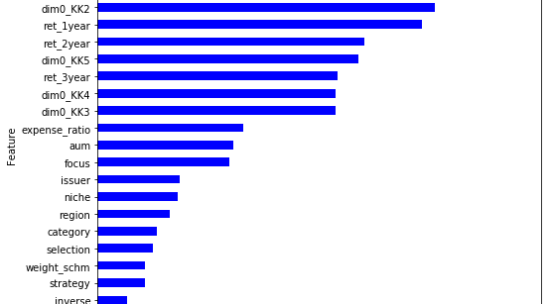
Feature Importance: TDA Model

Slide 34
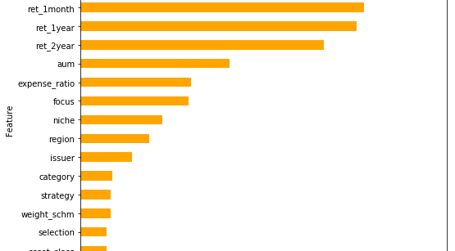
Feature Importance: Model

Slide 35
Part II 3. Data Prep

Slide 36
Why such data preparation?
Weekly data frequency to “sync” with my intention of maximising “TDA” signals, where I fear higher frequency might noise it up too much even for the short term periodicities if there are such things at all, or simply trading-driven noise
10 years of history data to cover enough crisis period (beginning prior to the GFC)

Slide 37
Part II 4. Parameters

Slide 38
Why such parameters?
4% threshold for target “y” is flexible, however, I did not see better result if varied it to 3% or 2%, so just to be greedy, why not higher?
Similarly for window size, currently 52 weeks, I also tested 26 weeks, 39 weeks, similar outcome
For model specification: why depth = 5? Again, I tried = 10, = 20, didn’t make material difference apart from adding non-necessary complexity
iteration number = 100, this is also a default choice, the early stop is manual which might be a challenge when it comes to back-test where we will automate the ETF selection process (and hence automate early stop)

Slide 39
Part III 1. Strategy

Slide 40
Strategy
1. Portfolio Construction: top 10 ETFs by prob
2.
In the next 4 weeks
Loop through each ETF in the portfolio each week
Is
the ETF ret
> 4%
Yes
Sold into Cash
No
Yes
Any new ETF
conf. prob
> TH?
No
Replace the old ETF
with the new one
Hold until
next rebalance time

Slide 41
Part III 2. Back-test & Validation

Slide 42
Project Plan
Understand the current codebase (Tan, Olivier & Devraj) – 1d
Modularise and migrate the current codebase all into R
Block 0: Sketch the skeleton and placeholders (Tan) – 1d
Block 1: ELT Modules (Olivier) - ?d
Block 2: Feature Engineering Modules (Olivier) - ?d
Block 3: Model Training/Validation/Constructing Modules (Olivier) - ?d
Block 4: Analysis/Utility Modules (Olivier) - ?d
Replicate the results in R (Tan & Olivier) – 1w
Code up the backtesting modules
Block 1: Strategy Modules (Fund Selector Module, Portfolio Construction/Rebalance Module) (Tan & Olivier) – 1w
Block 2: Main Module to Backtest → Integrate all the above (Olivier) - ?d
Block 3: Analysis/Utility/Visualisation Modules (Tan & Olivier) -1w
Performance Attribution/Rationalisation (Tan & Devraj) – 1w

Slide 43
Part III 3. Further Analysis & Optimisation

