Slide 1
Manufacturing Unit Management System
The application is deployed to heroku with git.
Link: https://dbms-spring.herokuapp.com
By: Bavanya

Slide 2
Has a single use case
1
The application is developed for a single manufacturing unit.
The user of the application is the owner of the unit.
Authentication is mandatory to access the web content.

Slide 3
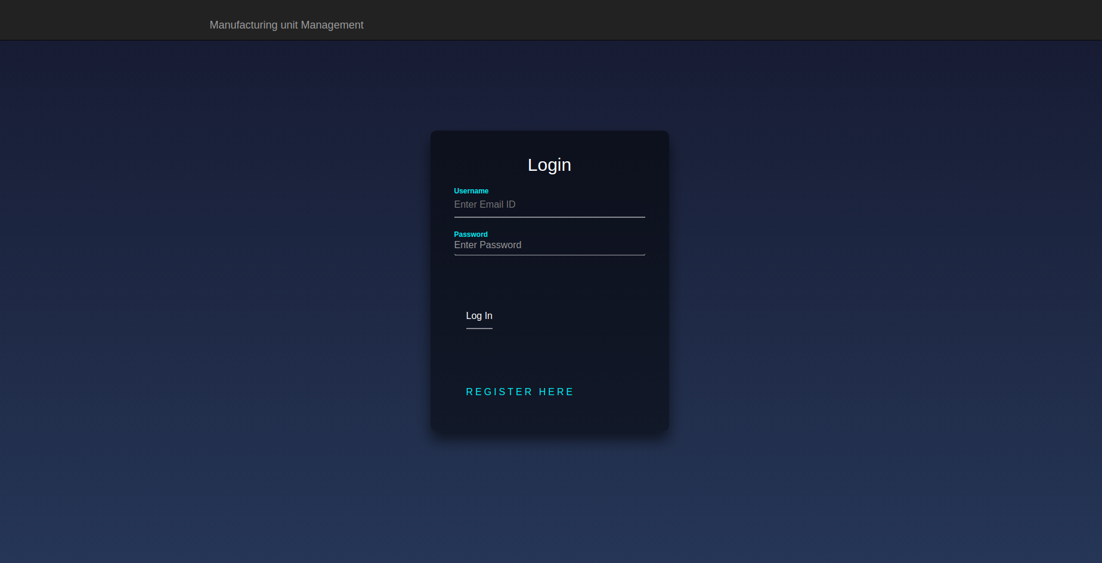
Authentication

Slide 4
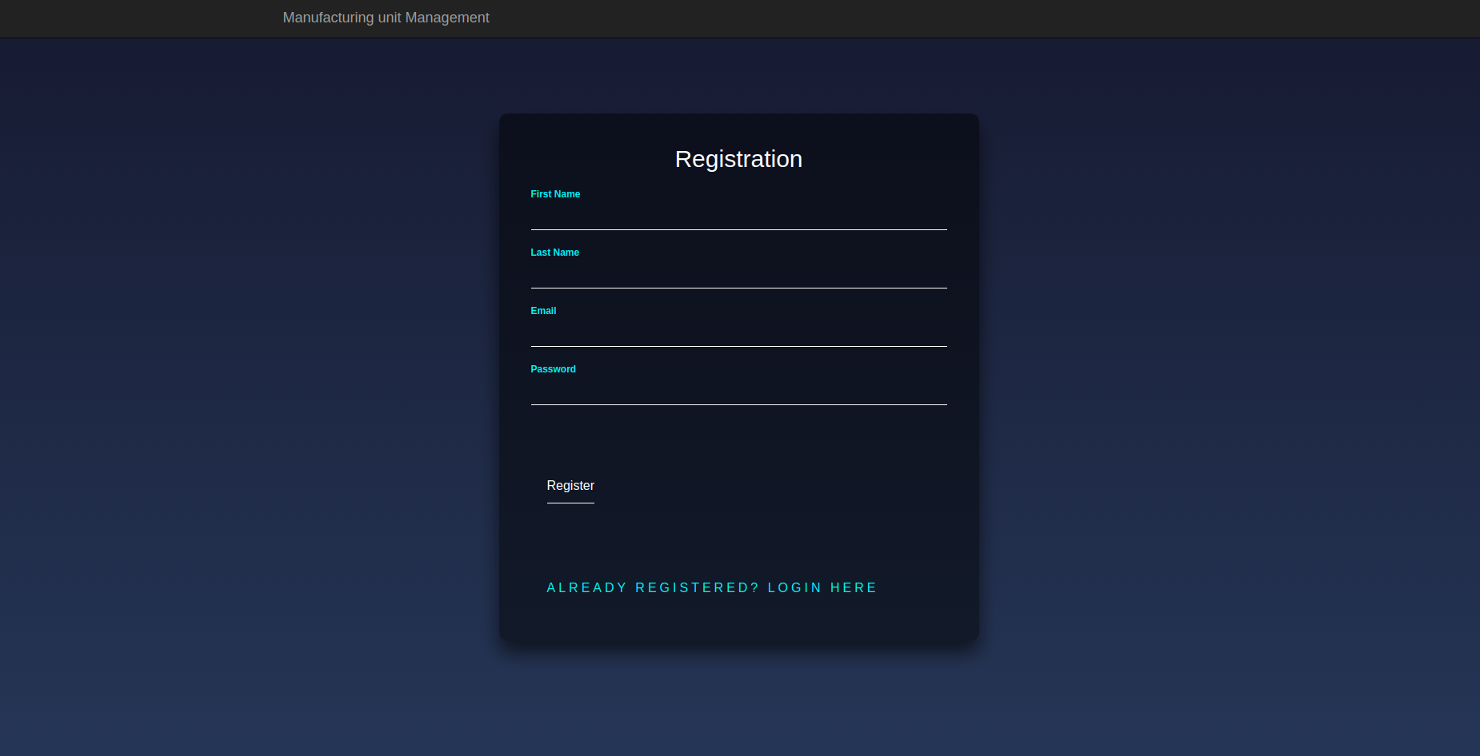
Registration

Slide 5
How is it going to help my client
One place store and retrieval for all the data of the manufacturing unit.
Seamless storage as against physical records.
Convenient
overwriting.

Slide 6
Content of the application include
Items
Raw Materials
Clients
Pieces
Suppliers
Employees

Slide 7
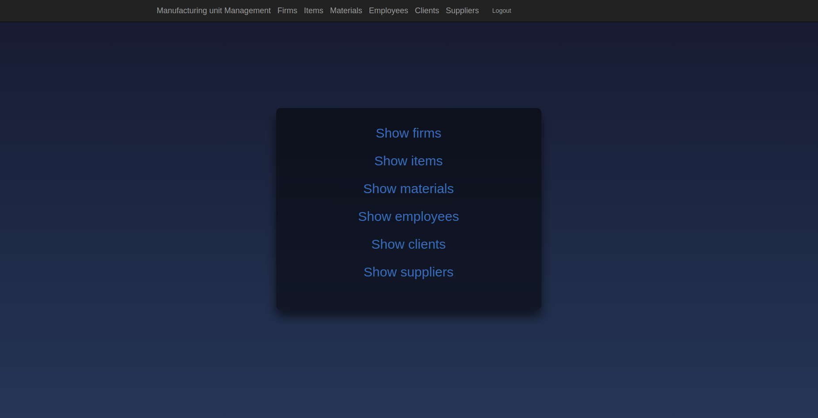
Index page

Slide 8
Items and Raw materials
Add
Update
View all
Delete
Search using keyword
View details of specific object

Slide 9
Logics for items and raw materials
1. When an item or a raw material is registered, it's quantity is set to zero automatically.
2. There is no provision for the user to enter the quantity while registering.
3. During the registration of a sale transaction of an item, the inventory count of the item is automatically decreased by the number of units of that item sold.
4. During the registration of a purchase transaction of a raw material, the availability count of that raw material is automatically increase by the number of units of the raw material purchased.

Slide 10
Edge case logics Implemented
1. Each item can have more than one raw material requirements.
2. All the required raw materials to manufacture an item all listed in the page dedicated to that item.
3. Can remove or add a raw material in the requirement list for an item only if that raw material is registered in the application.
4. Logic is written such that same raw material cannot be added as the requirement for an item more than once.

Slide 11
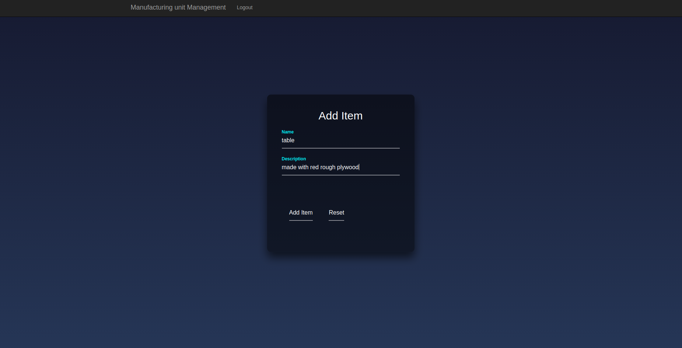
Add Item
Add Item and Reset options
Regex checks
for name and description

Slide 12
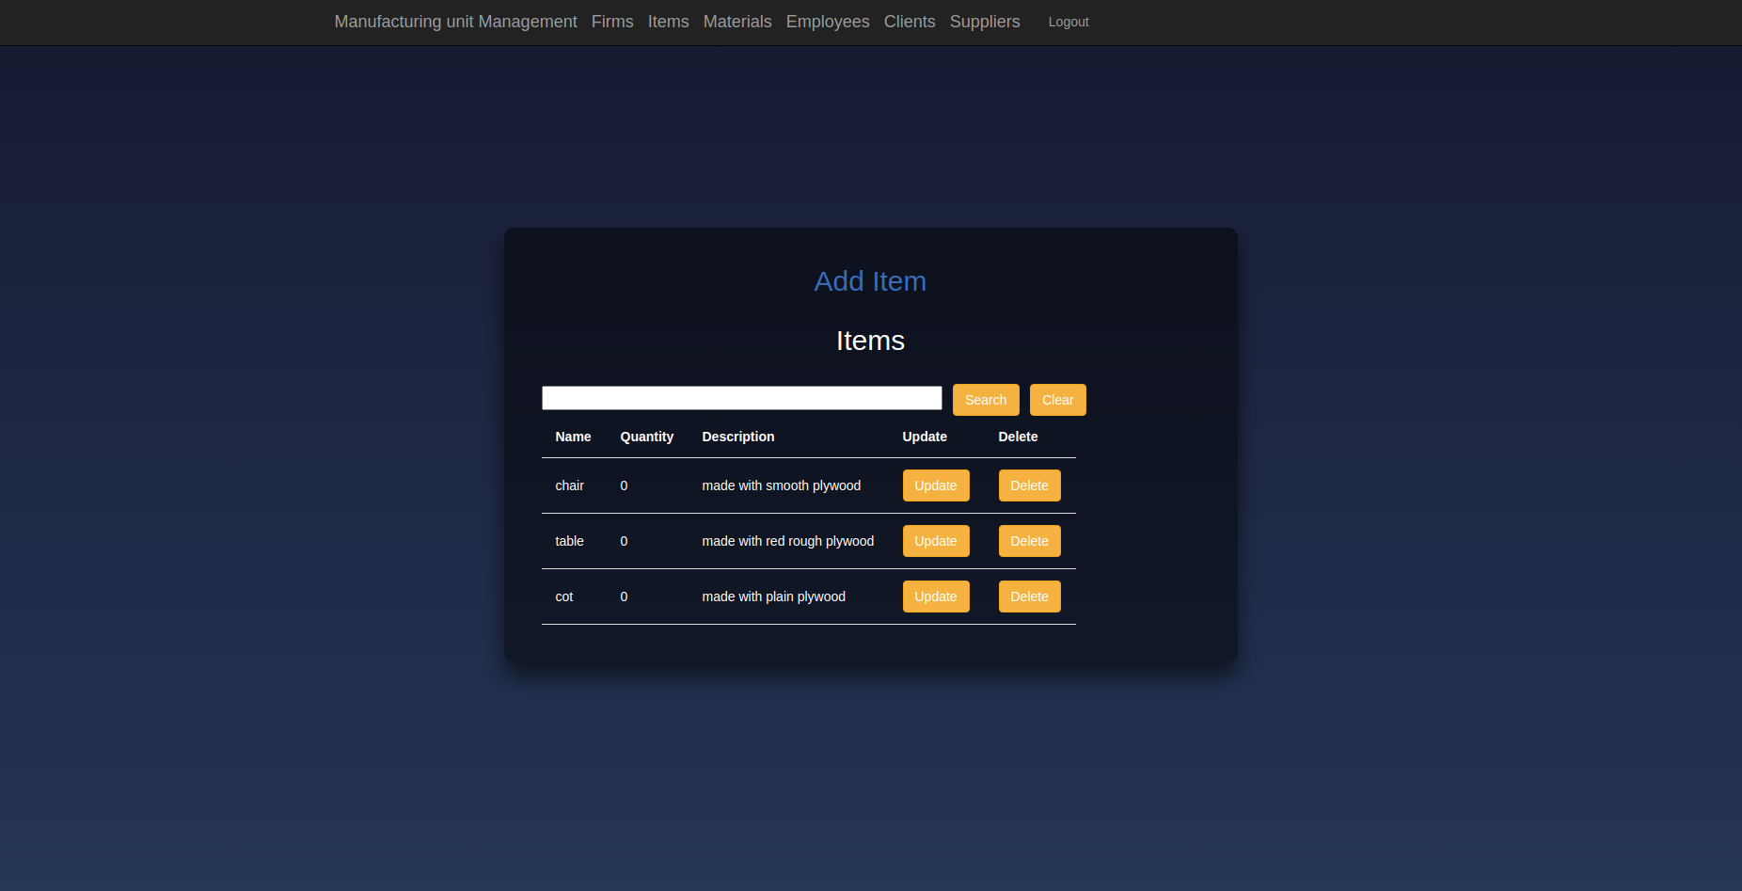
All Items
Search and Reset options
Update and Delete options
Add Item options

Slide 13
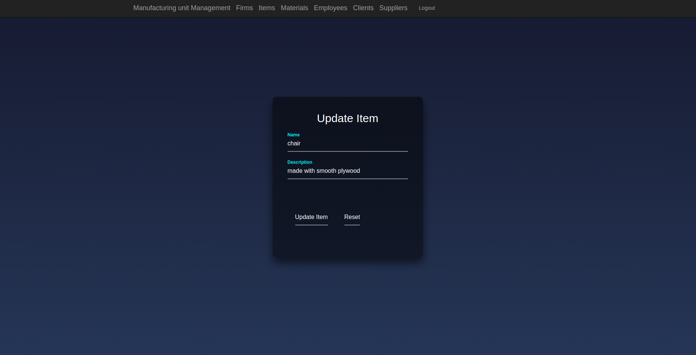
Update Item
Update Item and Reset options
Regex checks
for name and description

Slide 14
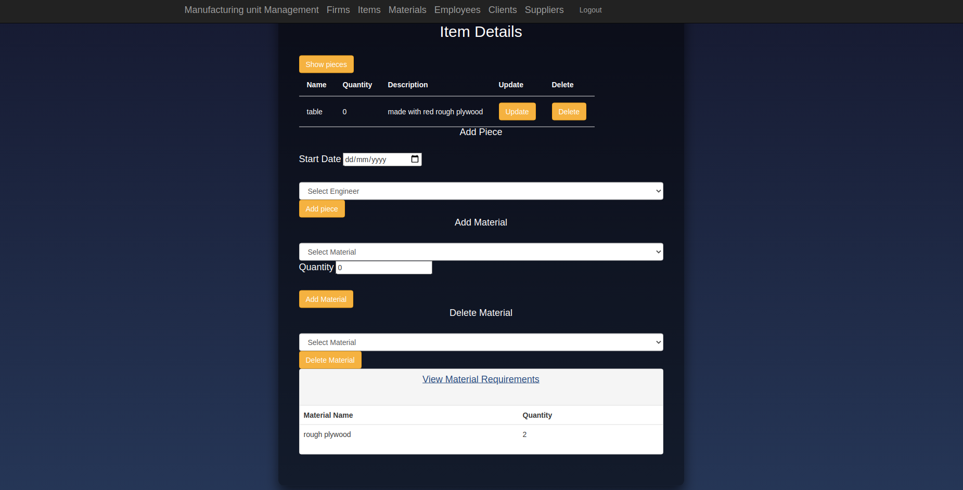
Specific
Item's
Page
Add and delete the requirement for a raw material
update and delete the item.
More on show pieces and add a piece later

Slide 15
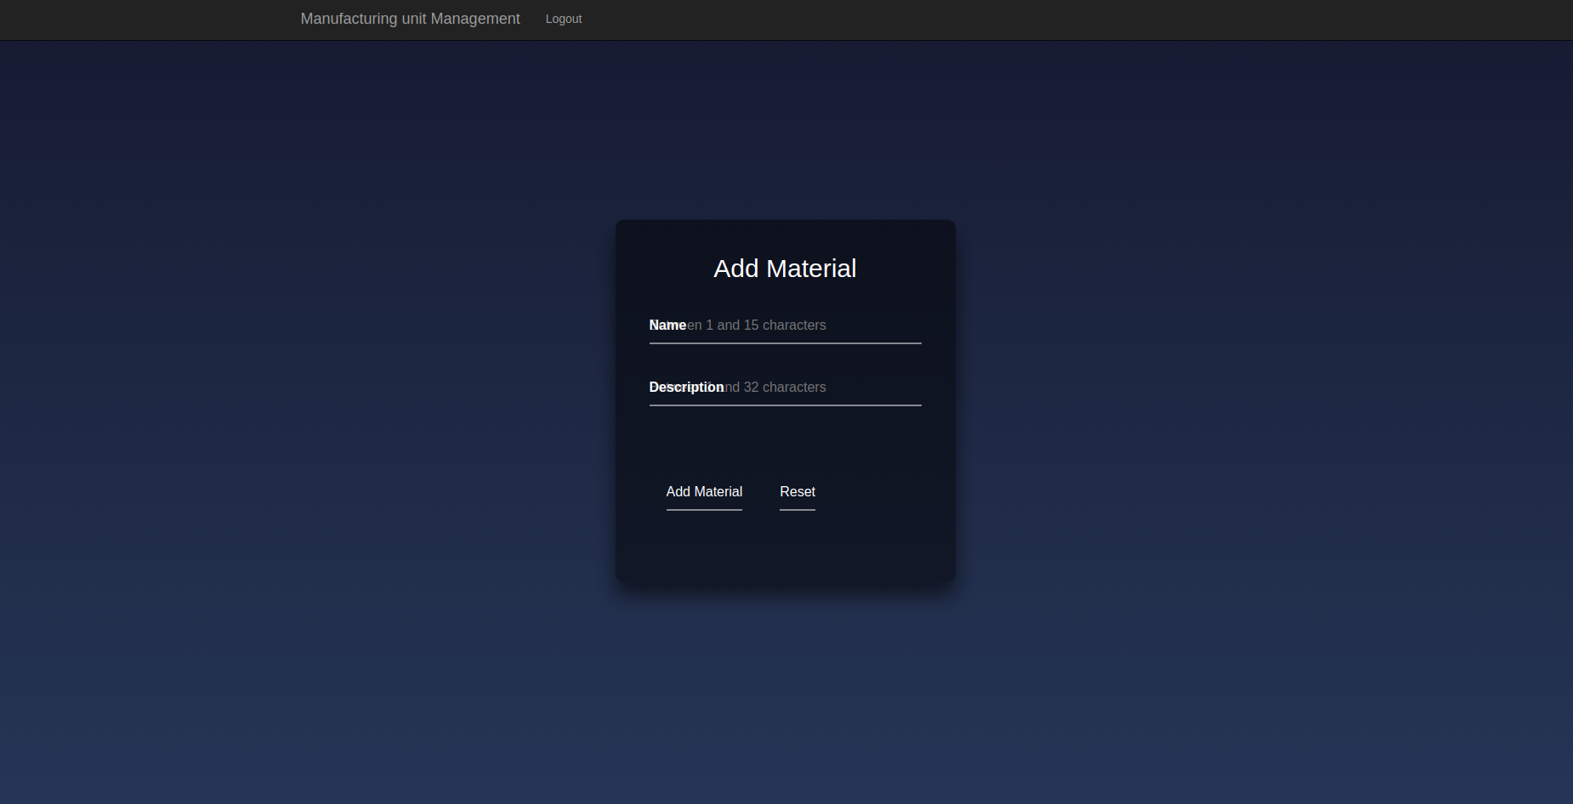
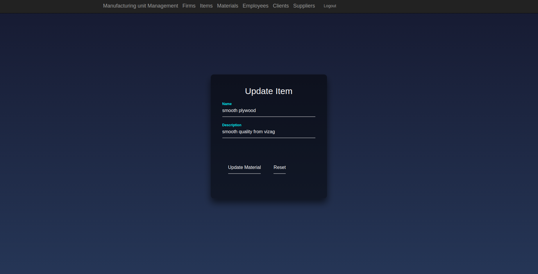
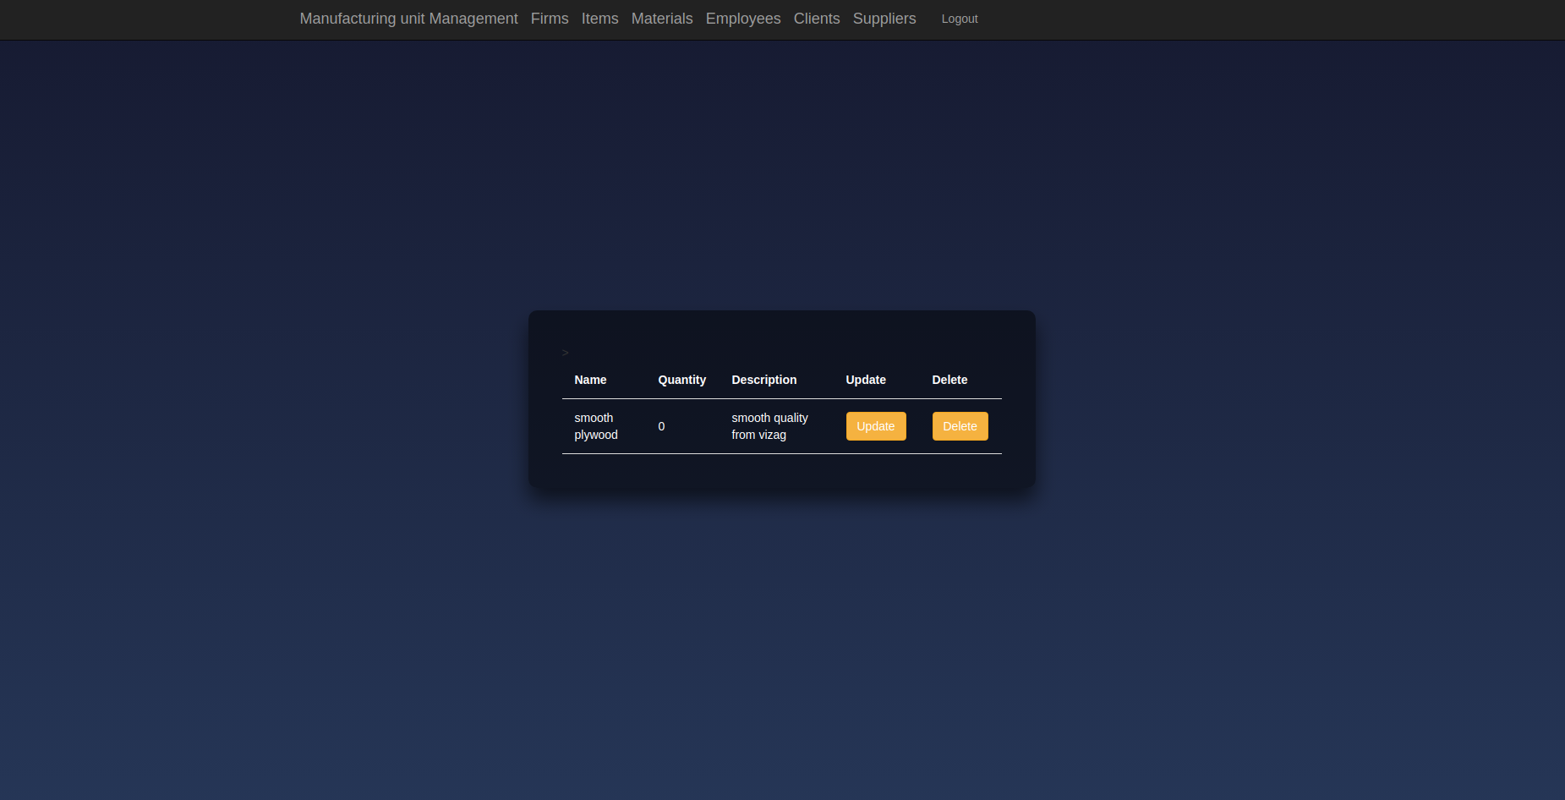
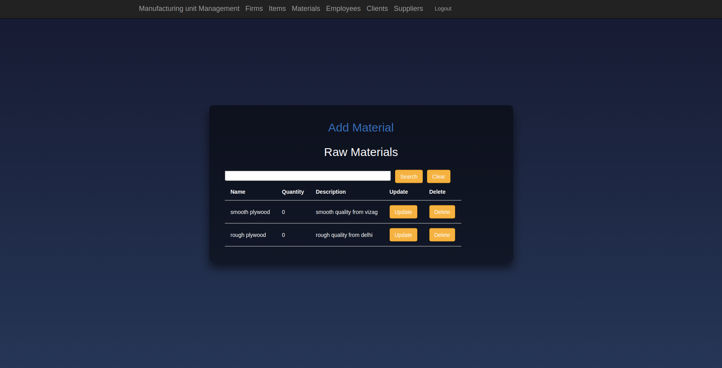
Similarly the following three functionalities are implemented:
1. Add raw material.
2. Update a raw material.
3. Listing all raw materials registered.
4. Specific raw material.

Slide 16
Employees
Add with bank details
Show all
Update
NOTE: Design choice
Did not create another relation of the employee's designation and the salary as my client has stated that the salary is not fixed as per the designation.
Show details of specific employee
Search with keyword

Slide 17
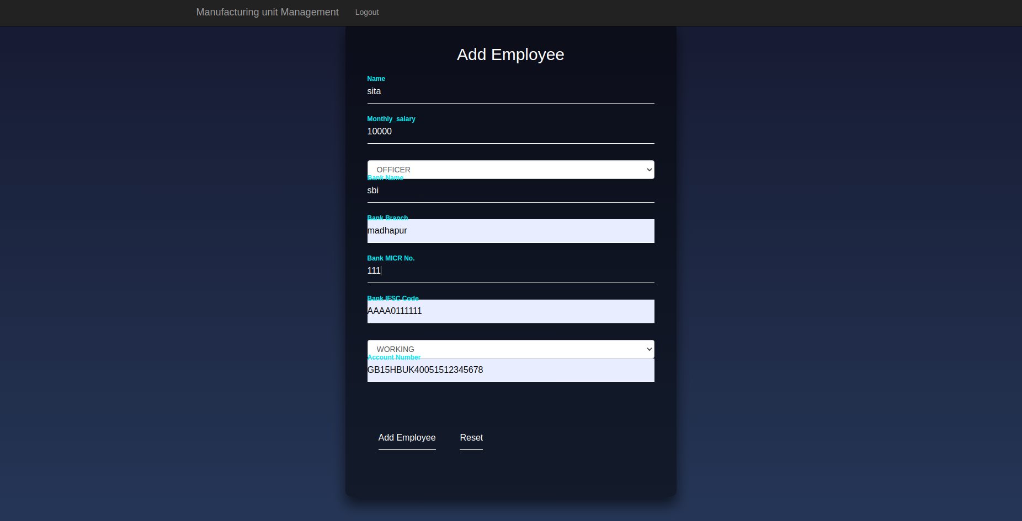
Add
employee
Add and Reset options
Regex checks for all the fields
Dropdown for designation and Status of the employee

Slide 18
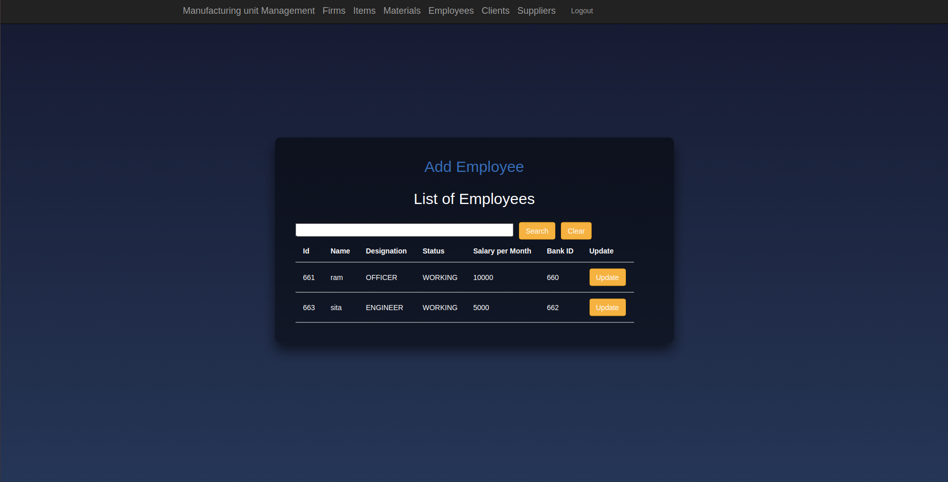
All
Employees
Update an Employee's details option
Search and reset options
Add Employee option

Slide 19
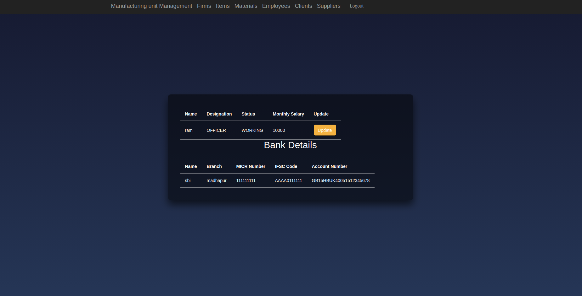
Specific
Employee
Update the Employee's details option.
Display bank details.
Display other details.

Slide 20
Pieces
Add a piece
Update a piece
View all pieces of an item

Slide 21
Specific
Item's
Page
Show pieces button
Add a piece button

Slide 22
Logics for pieces
1. A piece of an item will be added only if the condition that:
For all the required raw materials for the manufacturing of that item:
the quantity available should be greater than or equal to the required amounts.
2. When a piece is added for an item:
a) The engineer making the piece is linked.
b) The start date of manufacturing is added.
c) The status of the piece is automatically set as INPROGRESS.
d) The quantities of the materials used are automatically decreased in the
materials relation.
e) NOTE: But the quantity of the item in the inventory is not increased YET!

Slide 23
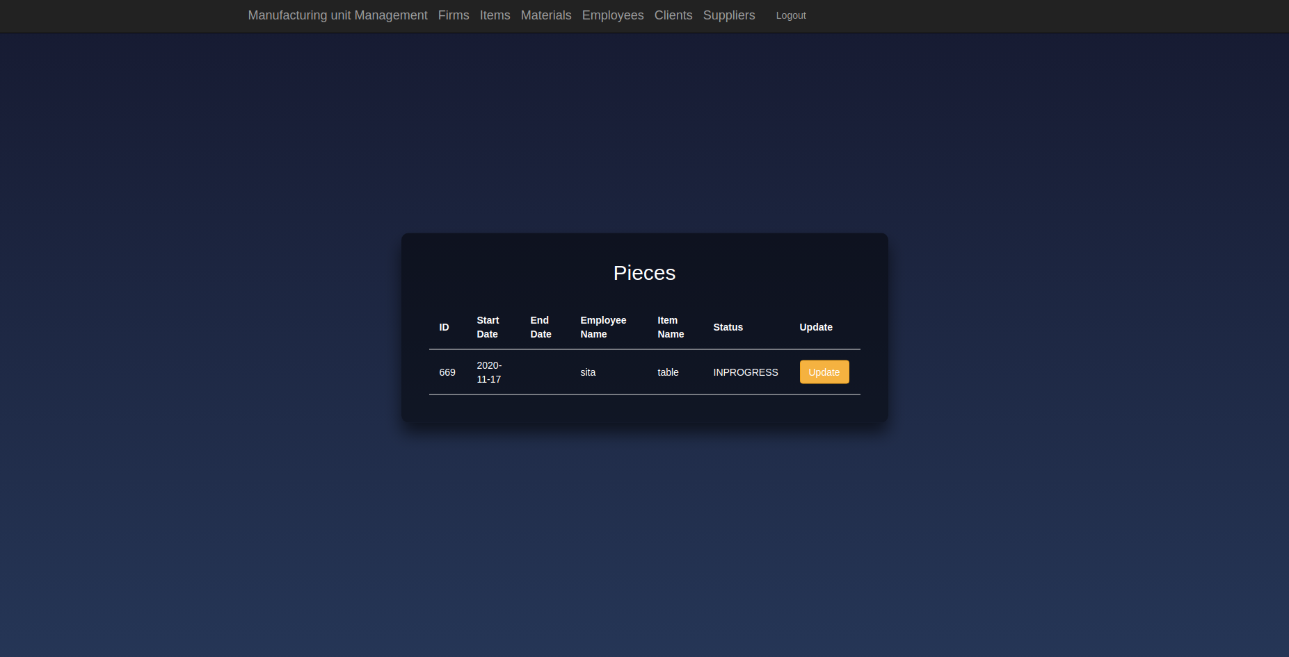
All pieces
of an Item
The end date.
The status
Update Button.

Slide 24
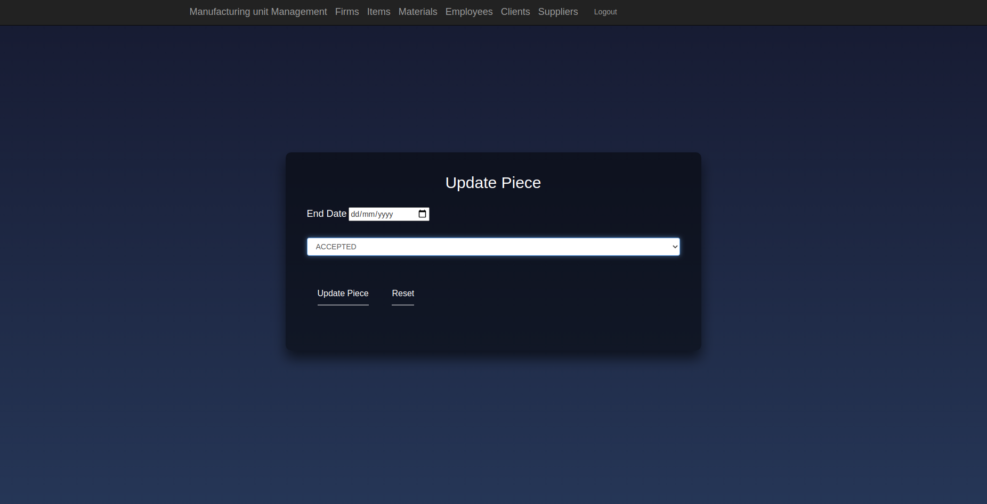
Update
Piece
The end date.
The status options:
1. ACCEPTED
2. REJECTED
3. SOLD
Update and reset buttons.

Slide 25
Logic for the update piece
1. If the status of the piece was previously
a) SOLD: The update is not done in the database even if the form is submitted.
b) ACCEPTED and now changed to:
i) REJECTED or SOLD: The inventory count of the item to which the piece belongs to is decremented.
b) REJECTED and now changed to:
i) ACCEPTED: The inventory count of the item to which the piece belongs to is incremented.
ii) SOLD: Only the status is changed and the inventory count is intact.
b) INPROGRESS and now changed to:
i) ACCEPTED: The inventory count of the item to which the piece belongs to is incremented.
ii) SOLD or REJECTED: Only the status is changed and the inventory count is intact.

Slide 26
Clients and Suppliers
Add
Update
Add a project or a purchase for a specific contact
View all
Search using keyword
View details of specific contact

Slide 27
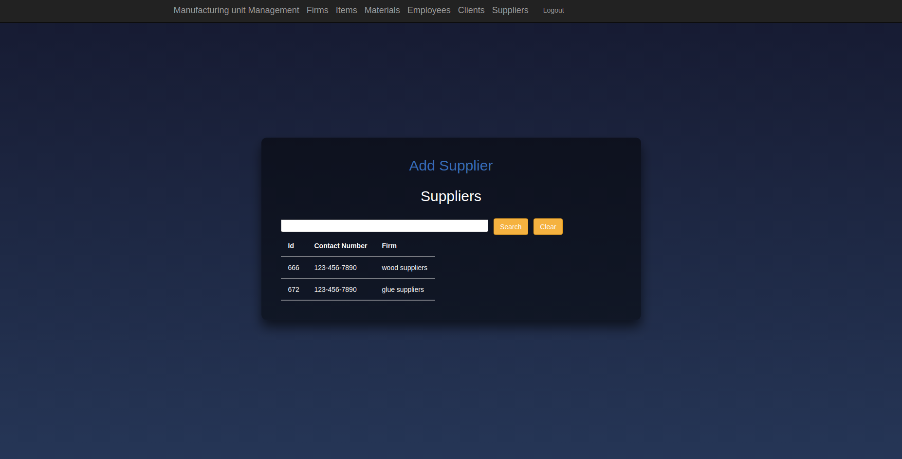
Show
Suppliers
Search and
reset buttons.
List of all the suppliers
Add a supplier option.

Slide 28
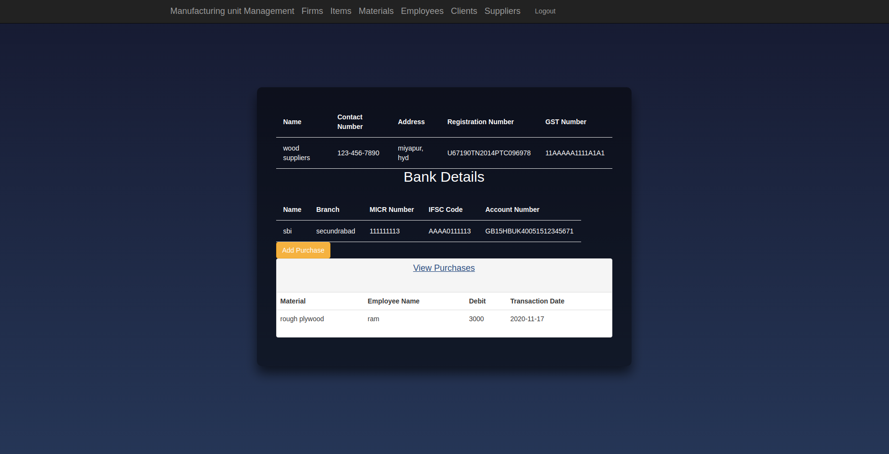
Specific
Supplier
The supplier firm details
The purchase list from the suppliers
Add purchase option.
The bank details of the supplier

Slide 29
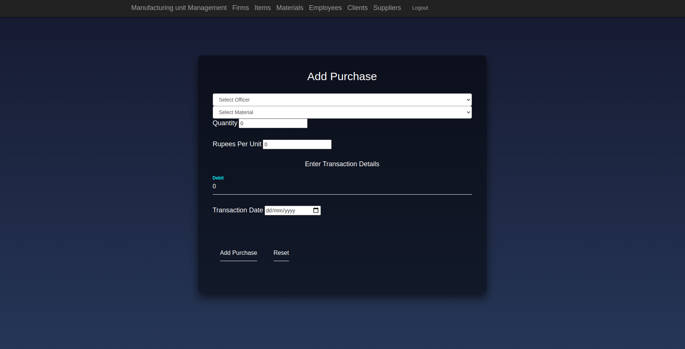
Add
purchase
Add purchase and reset options
Dropdowns to select officers and materials
Rupees per unit of material
Debit and date

Slide 30
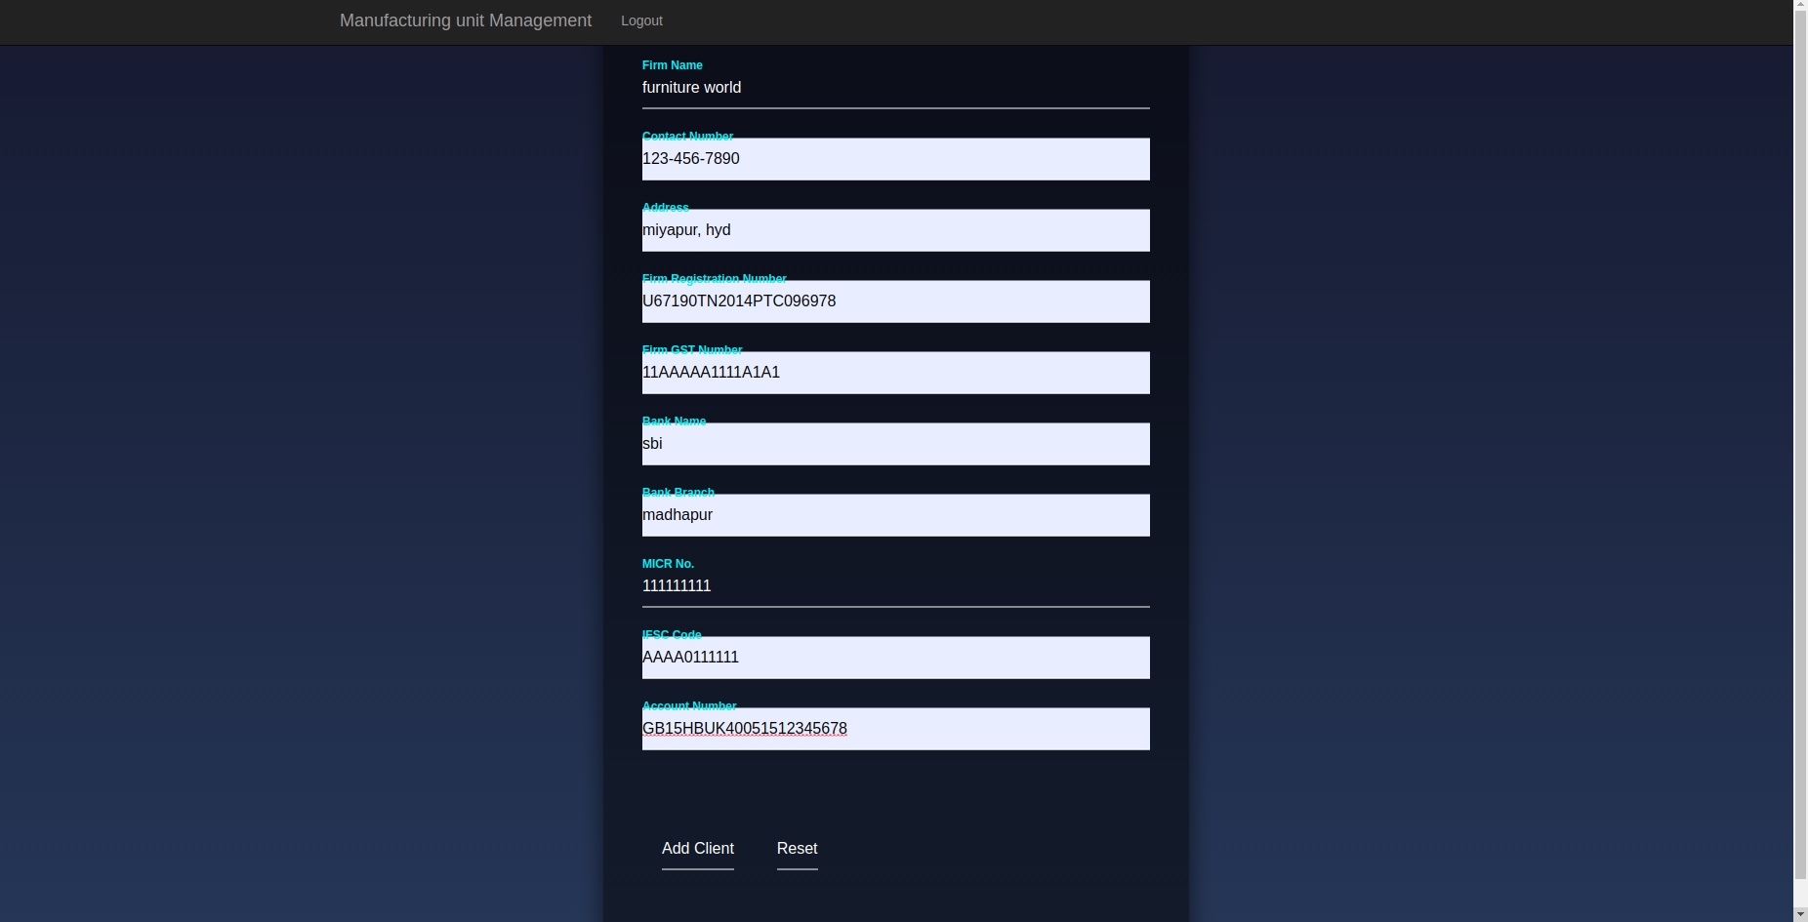
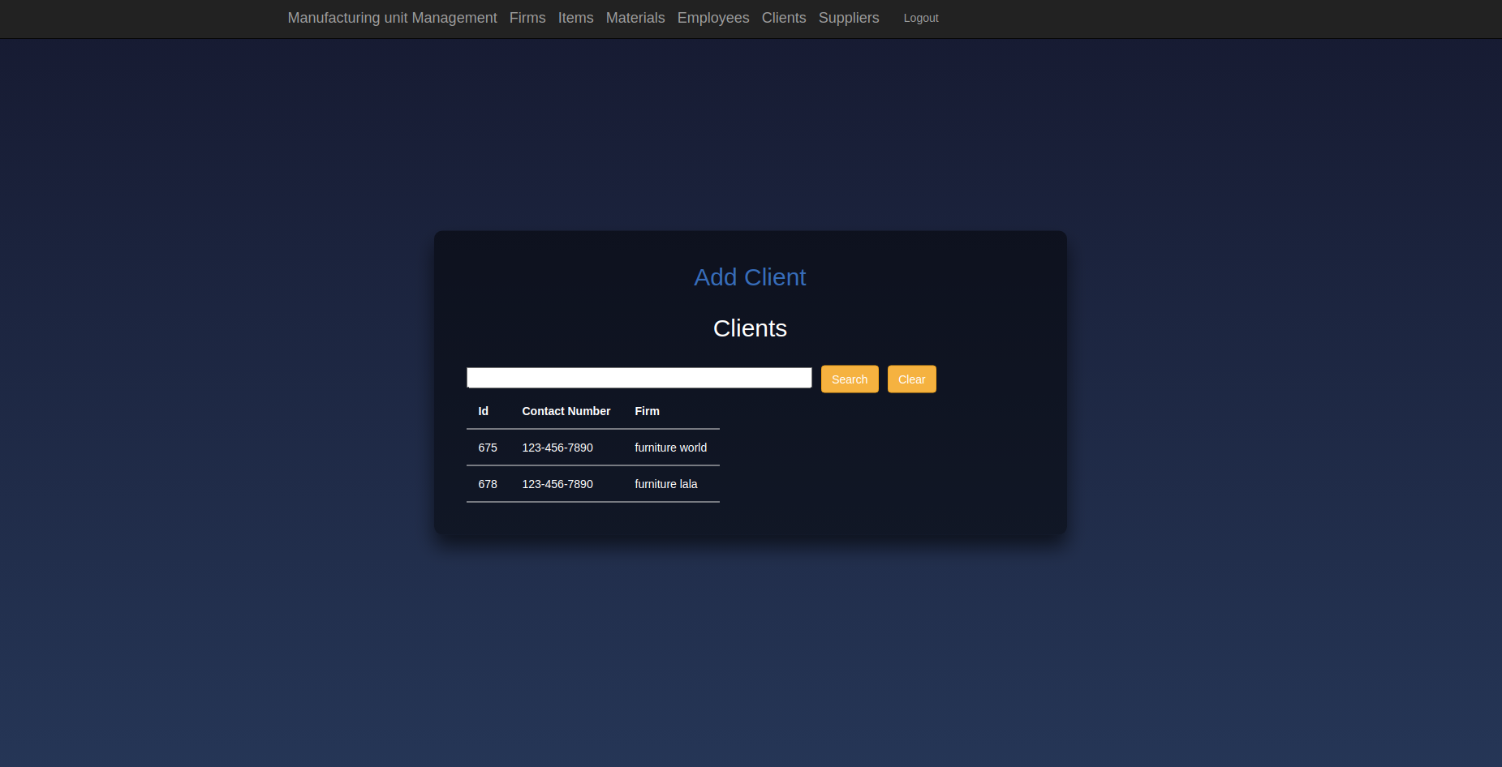
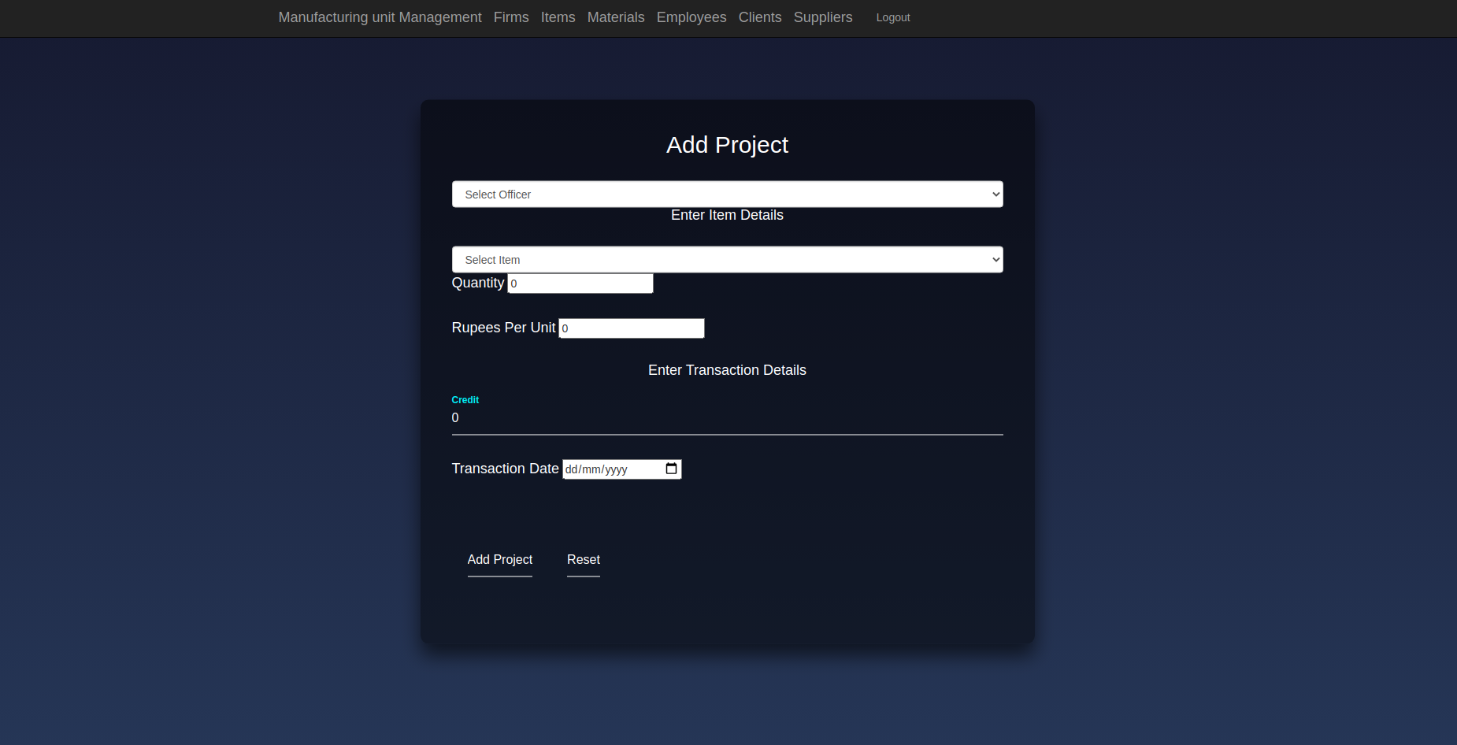

Similarly the following four functionalities are implemented:
1. Add Client
2. List all clients
3. Specific client's page with the list of the projects received from them.
4. Add a project.

Slide 31
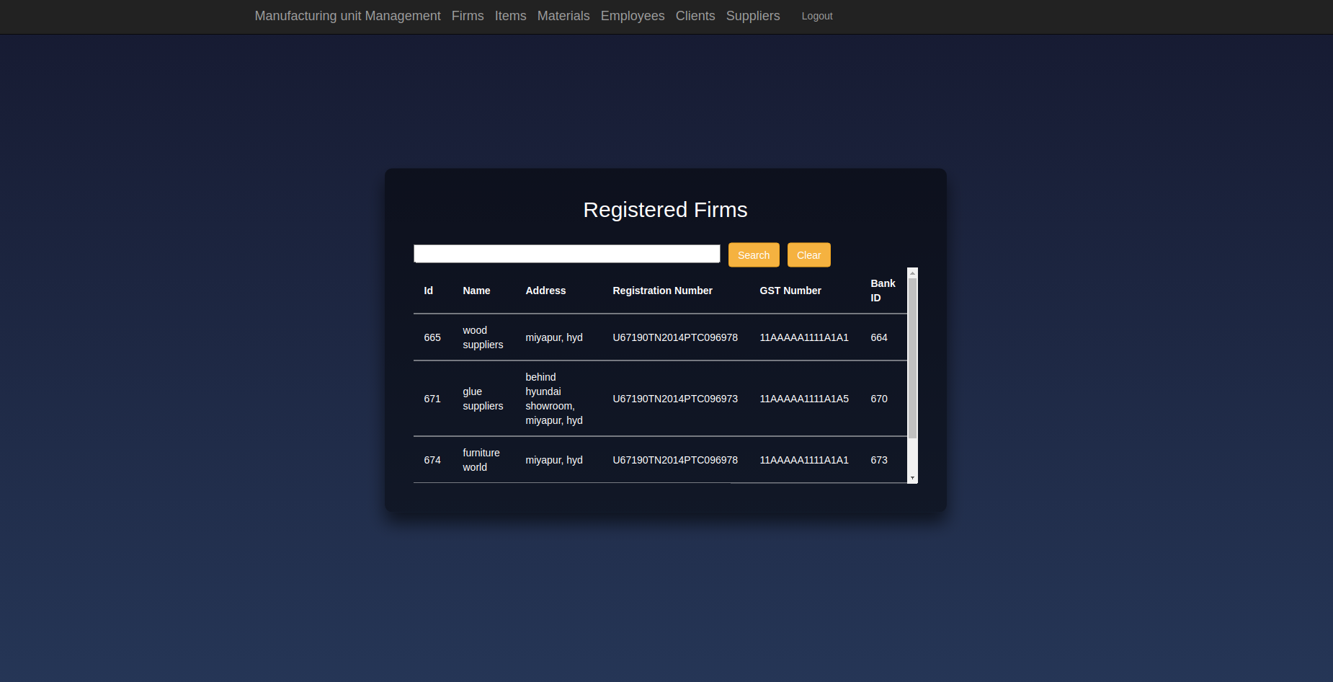
Firms
All the firms are listed for ready access of the information of the firms associated with the manufacturing unit

Slide 32
Other Points
1.Scroll bar for the tables,
in case the list floods out from the card.
2. Responsive functionality where the list of purchases from the supplier or the list of orders
received from the client are displayed
are managed in real time with data toggle.
3. Regex checks implemented in the forms.
4. deployed the application on heroku with postgresql.
5. Calendar implemented with type="date" in <input> tag in the forms.
6. Only the engineers are shown to select from the dropdowns for the piece addition and similarly, only officers are shown in the dropdowns for the project or the purchase operation.
7. Only the materials in the requirement list of an item are shown in the dropdown for the deletion of material requirement for an item.

Slide 33
Thank You

Slide 35
Thank You
 |  | B | C
Yellow | 10 | 20 | 7
Blue | 30 | 15 | 10
Orange | 5 | 24 | 16

Slide 36
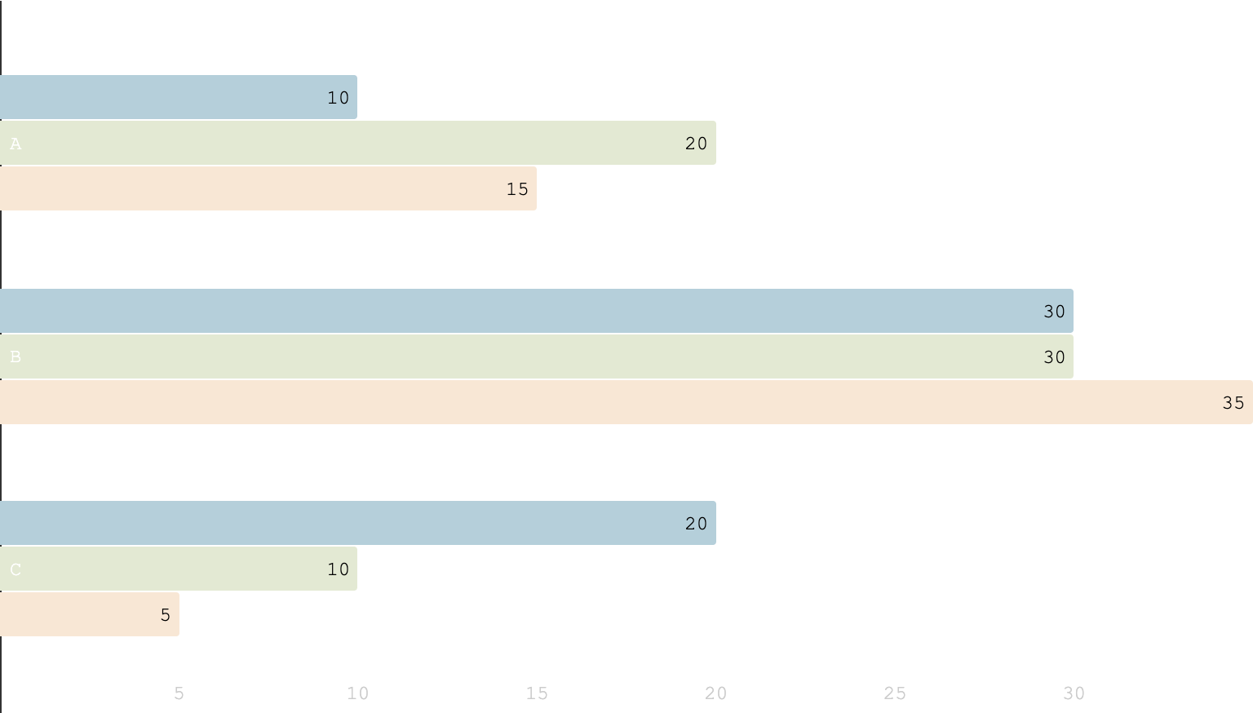
You can insert graphs from Excel or Google Sheets

Slide 37
SlidesCarnival icons are editable shapes. This means that you can:
Resize them without losing quality.
Change fill color and opacity.
Change line color, width and style.
Isn’t that nice? :) Examples:
Find more icons at slidescarnival.com/extra-free-resources-icons-and-maps

Slide 38
Diagrams and infographics

