Slide 1

Software Fault Detection using Isolation Forest and Deep learning
Bavanya, Btech (3), 18075034
Swati, Btech(3), and 18075060
Under the Guidance of
Dr. Amrita Chaturvedi
Department of Computer Science and Engineering
INDIAN INSTITUTE OF TECHNOLOGY (BHU)
VARANASI- 221005, INDIA
BTP Project Report Presentation (B.Tech/IDD CSE 2021)

Slide 2
Introduction
Related Works
Proposed Approach
Experimental Details
Results and Analysis
Conclusions
Introduction
Software Fault Detection using
isolation forest and deep learning
What is software ?
Software is a set of instructions .
Used to:
operate a computer
execute specific tasks.
Without software, most computers would be useless.
Why fault detection is important in softwares?
For an effective working and growth of software ,it is highly desirable to reduce software defects.
1/7

Slide 3
Introduction
Related Works
Proposed Approach
Experimental Details
Results and Analysis
Conclusions
Related Works
Different papers proposed models for software fault detection like:
CNN [1][4]
Attention based RNN [2]
Convolutional RNN with self Attention [3]
Different clustering algorithms [6]
Different regression techniques [5]
Genetic programming [7]
Our observations and motivation:
We didn't come across the following work in the related papers:
Treating this as an outlier detection problem.
Cross version regression on promise dataset.
2/7

Slide 4
Introduction
Related Works
Proposed Approach
Experimental Details
Results and Analysis
Conclusions
Proposed Approach
For predicting faulty data points in the dataset.
Anomaly detection using Isolation Forest.
(To detect faulty data points which we are considering as outliers)
Different deep learning models:
(To predict the no. of bugs associated with each data point)
Artificial Neural Network
Convolution Neural Network
RNN (Experimented with 3 different architectures)
LSTM (Experimented with 3 different architectures)
Gated Recurrent Unit
Ensemble of the best performing models.
Models in the ensemble are decided based on the experiments using the above models with different feature engineering methods.
3/7

Slide 5
Introduction
Related Works
Proposed Approach
Experimental Details
Results and Analysis
Conclusions
Proposed Approach
Feature Engineering and metrics
We have used the following feature engineering concepts:
Min Max scaling (for stable learning process)
Random oversampling and SMOTE (to increase the weight of minority class)
SVD, PCA and Info gain (for dimensionality reduction)
Metrics considered for evaluation are:
FPA (Fault-percentile-average)
CLC (Cumulative lift chart)
Accuracy
3/7

Slide 6
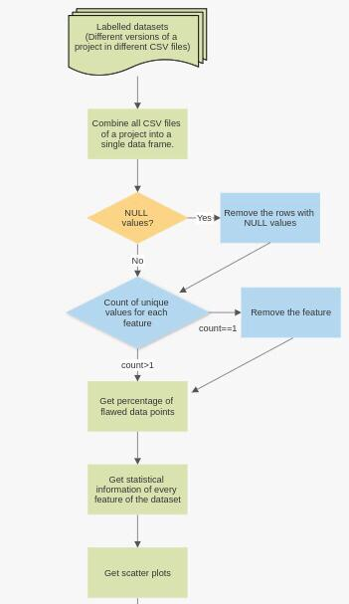
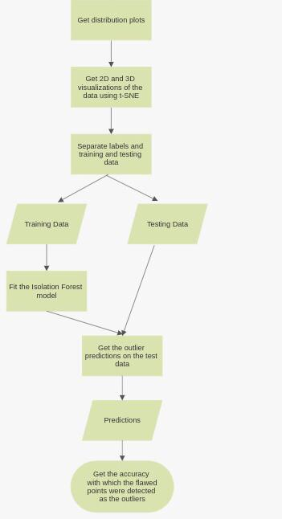
Introduction
Related Works
Proposed Approach
Experimental Details
Results and Analysis
Conclusions
Proposed Approach
Anomaly Detection
The detailed flow chart
of the entire experiment is
given:
In detailed explanation
will be given in the
Experimental Details
section later.
4/7

Slide 7
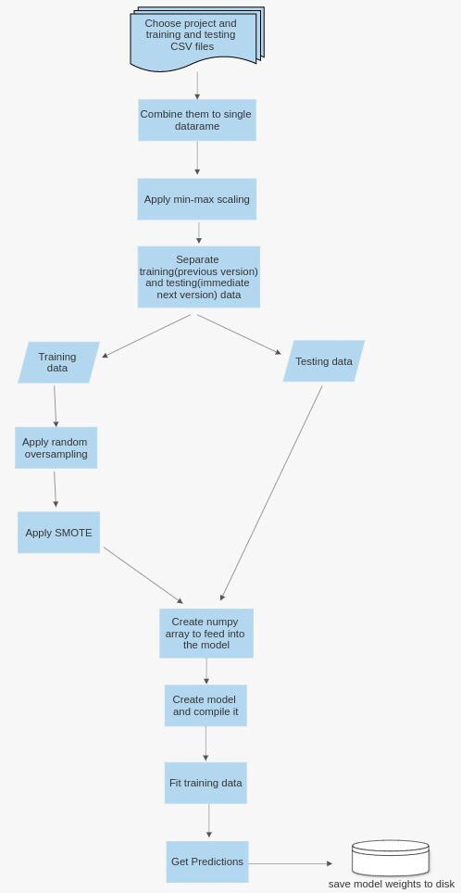
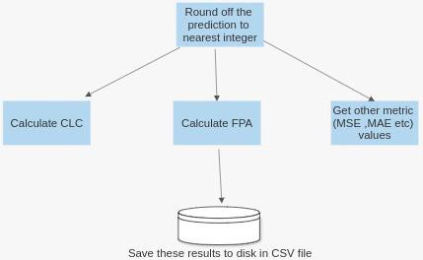
Introduction
Related Works
Proposed Approach
Experimental Details
Results and Analysis
Conclusions
Proposed Approach
Regression
using deep learning
The detailed flow chart
of the entire experiment is
given:
In detailed explanation
will be given in the
Experimental Details
section later.
4/7

Slide 8
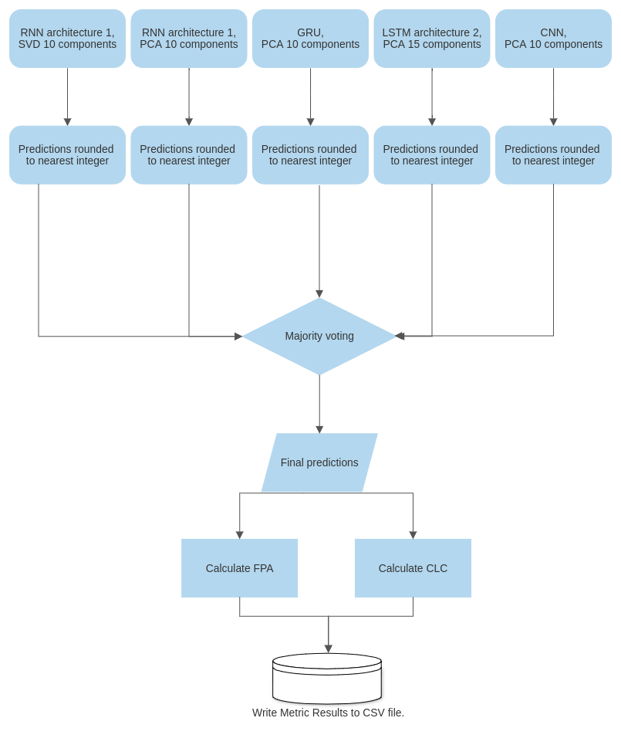
Introduction
Related Works
Proposed Approach
Experimental Details
Results and Analysis
Conclusions
Proposed Approach
Regression
using deep learning
Description of the models in
ensemble are given in
Experimental Details section later.
4/7

Slide 9
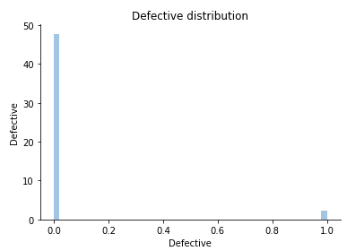
Introduction
Related Works
Proposed Approach
Experimental Details
Results and Analysis
Conclusions
Experimental Details
Anomaly Detection
Dataset
Dataset has:
40 features
Label column (faulty/not faulty)
Idea
Instead of treating it as a binary classification problem,
Remove the labels
Use Isolation Forest to detect outliers(faulty points).
Exploratory data analysis and preprocessing.
Null values were checked.
Percentage of faulty data points was found: 4.71%.
Labels were removed from the dataset.
Unnecessary features were removed (those which had only single value for all the data points).
Scatter plots and distribution plots were obtained and analysed.
4/7

Slide 10
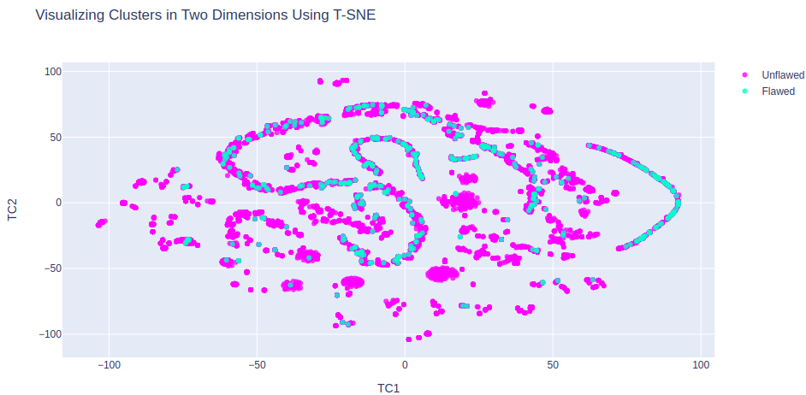
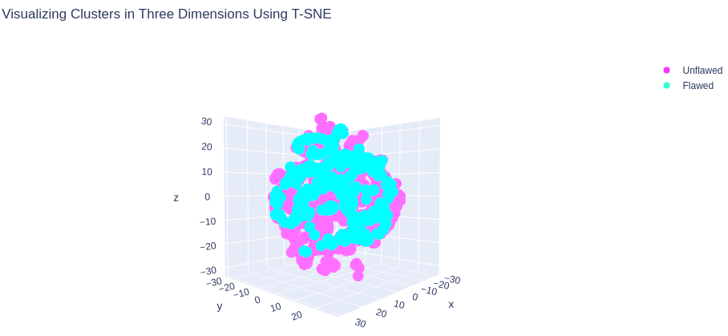
Experimental Details
Introduction
Related Works
Proposed Approach
Experimental Details
Results and Analysis
Conclusions
Anomaly Detection
Visualization
3D and 2D visualizations of the data points were obtained using t-SNE.
Reason for choosing not to reduce features:
In the visualizations we see that the faulty points(which we are planning to consider as outliers) aren't much distinctive after excessive dimensionality reduction
The visualizations obtained are:
4/7

Slide 11
Introduction
Related Works
Proposed Approach
Experimental Details
Results and Analysis
Conclusions
Experimental Details
Anomaly Detection
Model
Training and Testing data was split at 4:1 ratio.
Isolation forest is fit on the training and testing data and outliers are detected.
To evaluate our Idea
To understand how effectively the model was able to detect the faulty data points as the outliers,
We know the faulty and non faulty data points of the test data before itself.(Since our dataset was labelled before preprocessing.)
So we found out the accuracy with which the data points were detected to be inliers(non faulty) and outliers(faulty).
4/7

Slide 12
Experimental Details
Introduction
Related Works
Proposed Approach
Experimental Details
Results and Analysis
Conclusions
Regression using deep learning
Dataset and idea
20 Features
Label column (count of bugs corresponding to a data point.)
Exploratory data analysis
Dataset had no null values.
All the 20 features were informative.
Feature Scaling
Min Max scaling was performed on the dataset before all the experiments.
Feature selection techniques
Experiments were performed without any and with the following techniques :
SVD with 10 and 15 components.
PCA with 10 and 15 components.
Info Gain
4/7

Slide 13
Experimental Details
Introduction
Related Works
Proposed Approach
Experimental Details
Results and Analysis
Conclusions
Regression using deep learning
Oversampling and SMOTE
Since we took cross version datasets for training and testing, we applied oversampling and SMOTE to balance and increase the size of the datasets.
Model building
We used MSE(mean squared error) as our loss function and models were trained to 100 epochs.
We have developed:
9 different models with
3 different architectures of LSTM
3 different architectures of RNN and
single architecture each of GRU, ANN and CNN.
Determined top 4 best performing models among above and performed majority voting to get predictions.
4/7

Slide 14
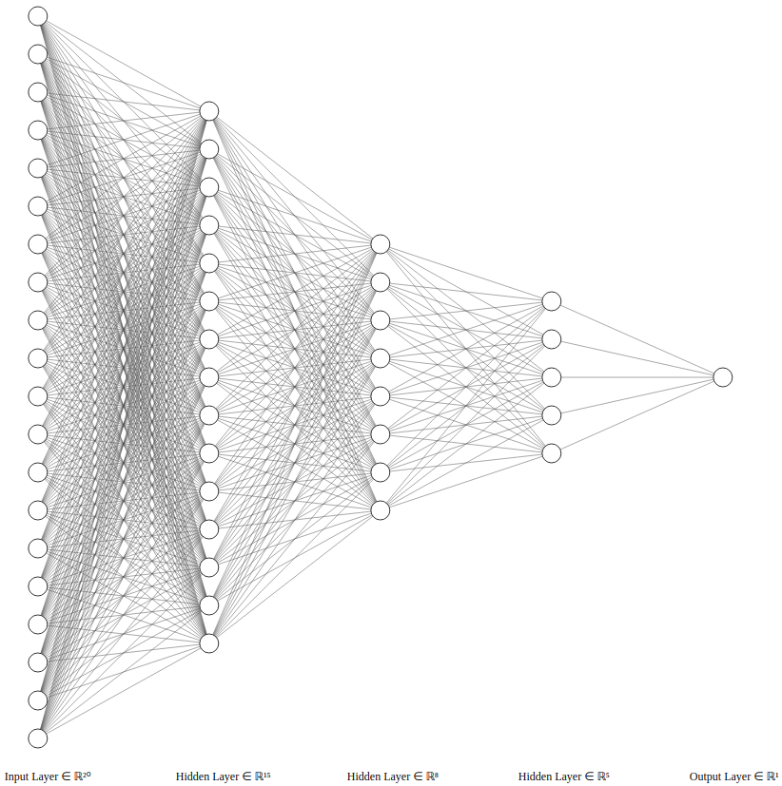
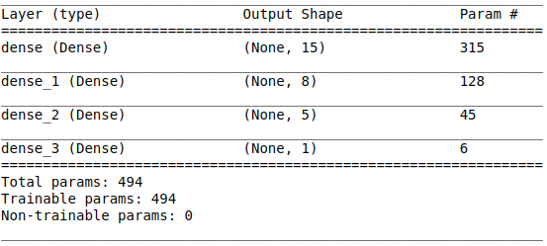
Experimental Details
Introduction
Related Works
Proposed Approach
Experimental Details
Results and Analysis
Conclusions
Regression using deep learning
ANN architecture
4/7

Slide 15
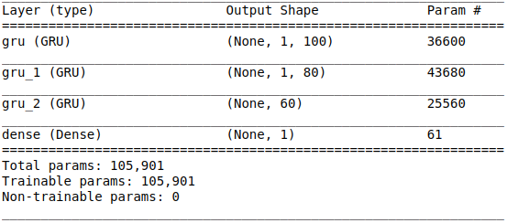
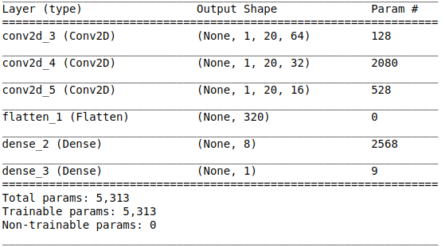
Experimental Details
Introduction
Related Works
Proposed Approach
Experimental Details
Results and Analysis
Conclusions
Regression using deep learning
GRU architecture
CNN architecture
4/7

Slide 16
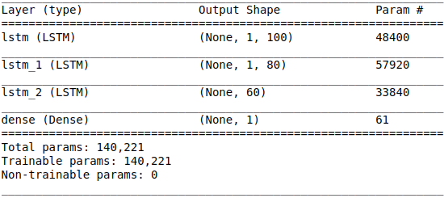
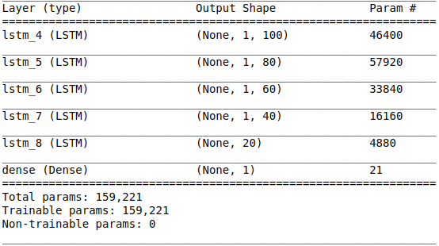
Experimental Details
Introduction
Related Works
Proposed Approach
Experimental Details
Results and Analysis
Conclusions
Regression using deep learning
LSTM architectures
LSTM architecture 1
LSTM architecture 2
4/7

Slide 17
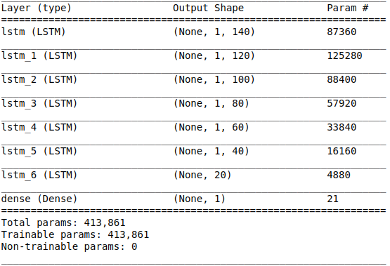
Experimental Details
Introduction
Related Works
Proposed Approach
Experimental Details
Results and Analysis
Conclusions
Regression using deep learning
LSTM architectures
LSTM architecture 3
4/7

Slide 18
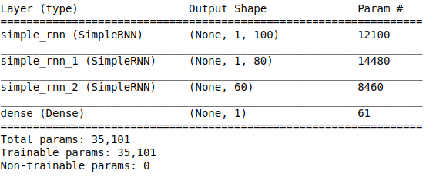
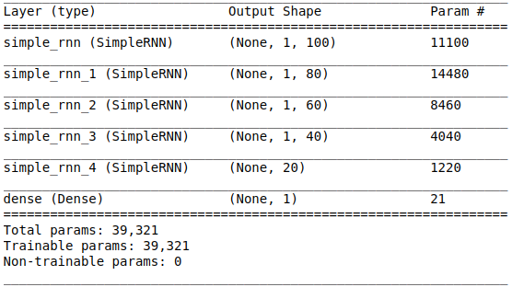
Experimental Details
Introduction
Related Works
Proposed Approach
Experimental Details
Results and Analysis
Conclusions
Regression using deep learning
RNN architectures
RNN architecture 1
RNN architecture 2
4/7

Slide 19
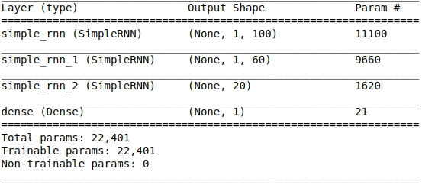
Experimental Details
Introduction
Related Works
Proposed Approach
Experimental Details
Results and Analysis
Conclusions
Regression using deep learning
RNN architectures
RNN architecture 3
4/7

Slide 20
Experimental Details
Introduction
Related Works
Proposed Approach
Experimental Details
Results and Analysis
Conclusions
Regression using deep learning
Majority Voting Ensemble designed consisting of the following:
RNN architecture 1 and PCA 10
components.
RNN architecture 1 and SVD 10
components.
GRU PCA 10 components.
LSTM architecture 2 and PCA 15
components.
4/7

Slide 21
Experimental Details
Introduction
Related Works
Proposed Approach
Experimental Details
Results and Analysis
Conclusions
Regression using deep learning
Post Processing
Rounded off the predictions to nearest integer as the results are supposed to be whole numbers.
In ensemble, determined the no of bugs by majority voting. If each model gave different value for a data point, prediction of RNN model of architecture 1 is taken.
Evaluating the models
We calculated the FPA and CLC and recorded the MSE(mean squared error) test and train loss for all the models.
Saving weights and Results
Saved the results to csv files and saved the weights to disk.
4/7

Slide 22
Results and Analysis
Introduction
Related Works
Proposed Approach
Experimental Details
Results and Analysis
Conclusions
Anomaly Detection
The accuracy obtained (explained earlier) was 87.7%.
Regression using deep learning
In few experiments, the FPA and CLC were obtained to be NAN because all the prediction values were found to be zero after rounding off.
STEP 1: Obtained results for the 9 models taking ant1.3 for training and ant1.4 for testing.
STEP 2: Determined top 4 best performing models from STEP 1.
STEP 3: Created ensemble of top 4 and trained and tested the ensemble and individual 4 models with 2 approaches:
Approach 1: Train on only immediate previous version and test on next version.
Approach 2: Train on all previous versions and test on latest version.
5/7

Slide 23
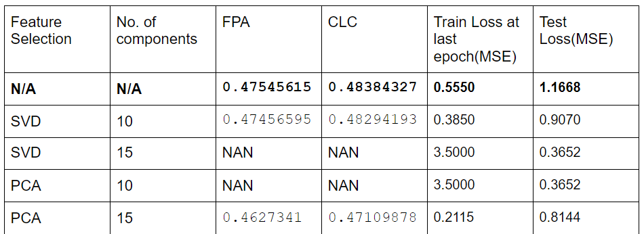
Results and Analysis
Introduction
Related Works
Proposed Approach
Experimental Details
Results and Analysis
Conclusions
STEP 1: Obtained results for the 9 models taking ant1.3 for training and ant1.4 for testing.
The performance of different models are as follows:
ANN (ant1.3 for training and ant1.4 for testing)
5/7

Slide 24
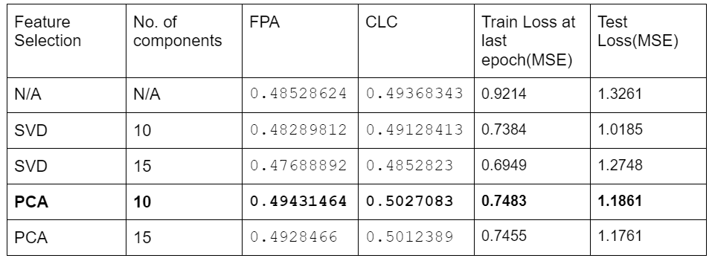
Introduction
Related Works
Proposed Approach
Experimental Details
Results and Analysis
Conclusions
Results and Analysis
GRU (ant1.3 for training and ant1.4 for testing)
5/7

Slide 25
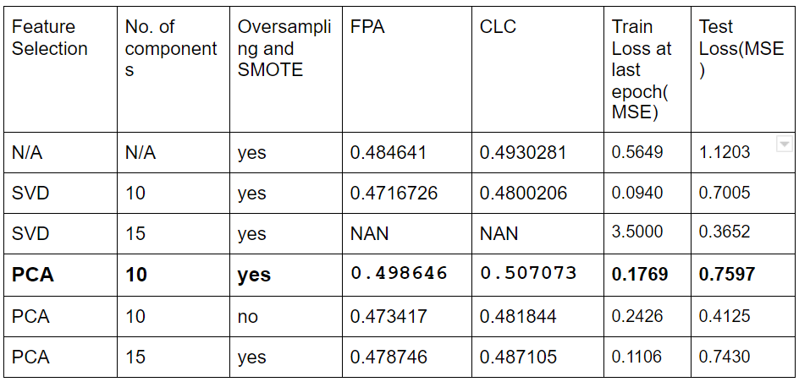
Results and Analysis
Introduction
Related Works
Proposed Approach
Experimental Details
Results and Analysis
Conclusions
CNN (ant1.3 for training and ant1.4 for testing)
5/7

Slide 26
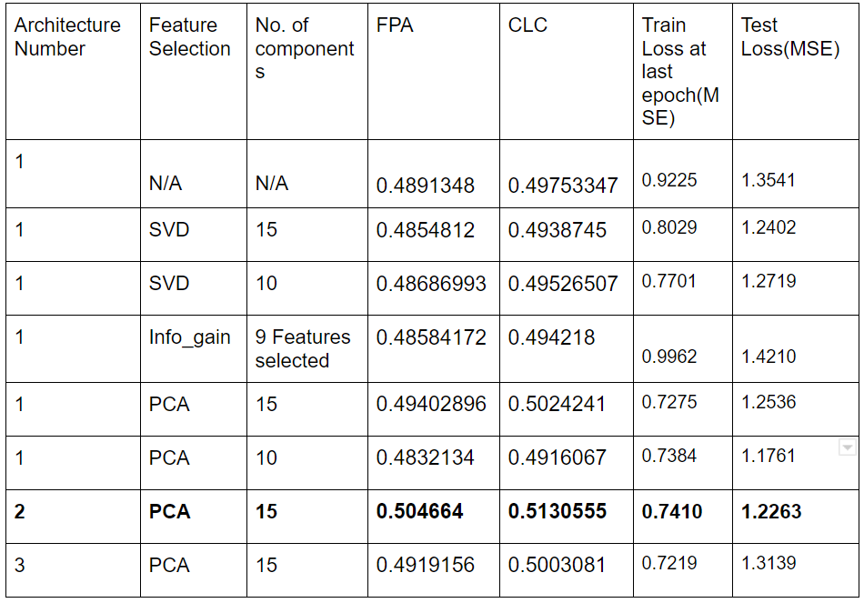
Results and Analysis
Introduction
Related Works
Proposed Approach
Experimental Details
Results and Analysis
Conclusions
LSTM (ant1.3 for training and ant1.4 for testing)
5/7

Slide 27
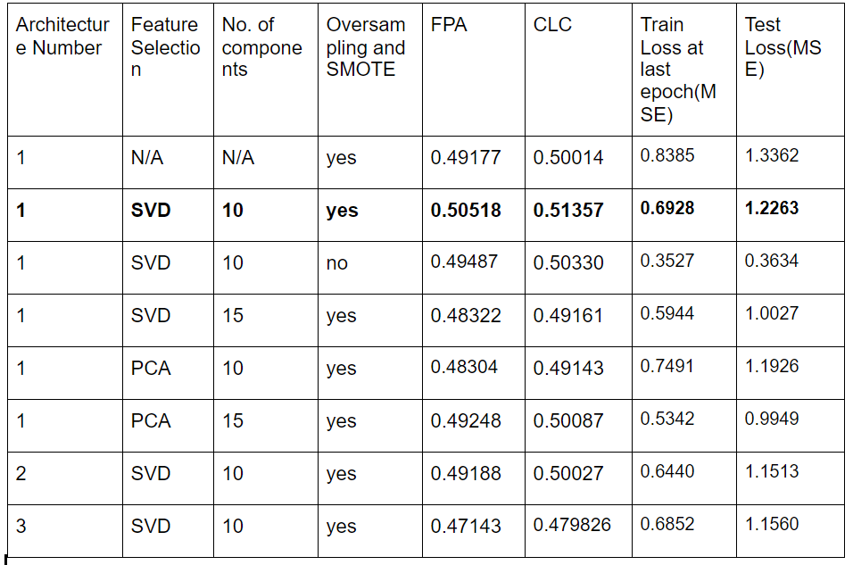
Results and Analysis
Introduction
Related Works
Proposed Approach
Experimental Details
Results and Analysis
Conclusions
RNN (ant1.3 for training and ant1.4 for testing)
5/7

Slide 28
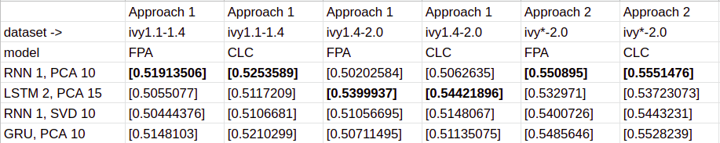
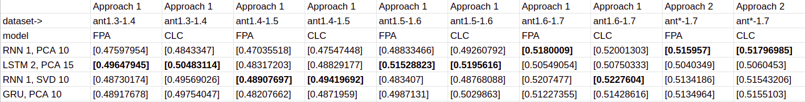
Results and Analysis
Introduction
Related Works
Proposed Approach
Experimental Details
Results and Analysis
Conclusions
STEP 3 a): Results of top 4 individual models on all datasets. (Both Approach 1 and 2 are included in the tables).
5/7

Slide 29
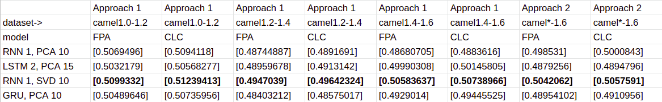
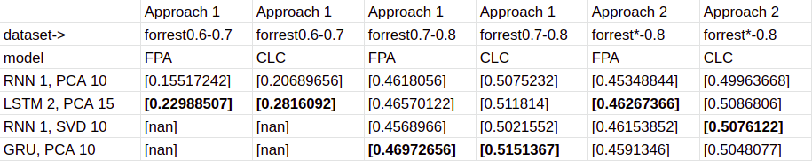
Results and Analysis
Introduction
Related Works
Proposed Approach
Experimental Details
Results and Analysis
Conclusions
STEP 3 a): Results of top 4 individual models on all datasets. (Both Approach 1 and 2 are included in the tables).
5/7

Slide 30
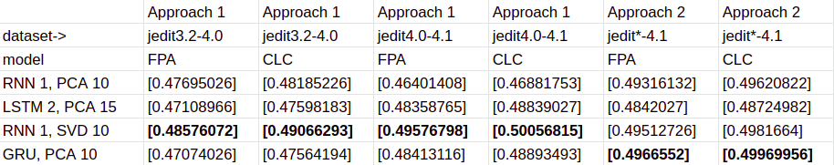
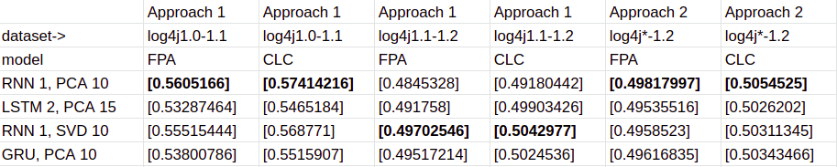
Results and Analysis
Introduction
Related Works
Proposed Approach
Experimental Details
Results and Analysis
Conclusions
STEP 3 a): Results of top 4 individual models on all datasets. (Both Approach 1 and 2 are included in the tables).
5/7

Slide 31
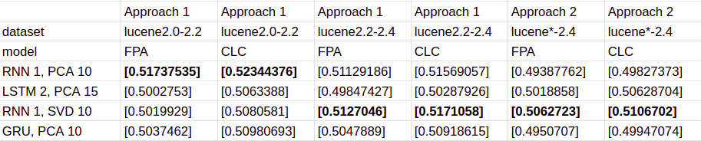
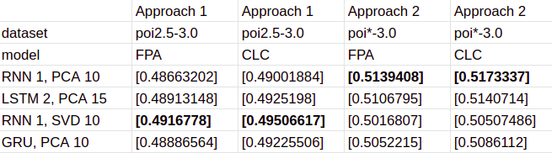
Results and Analysis
Introduction
Related Works
Proposed Approach
Experimental Details
Results and Analysis
Conclusions
STEP 3 a): Results of top 4 individual models on all datasets. (Both Approach 1 and 2 are included in the tables).
5/7

Slide 32
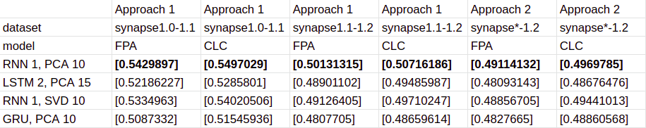
Results and Analysis
Introduction
Related Works
Proposed Approach
Experimental Details
Results and Analysis
Conclusions
STEP 3 a): Results of top 4 individual models on all datasets. (Both Approach 1 and 2 are included in the tables).
5/7

Slide 33
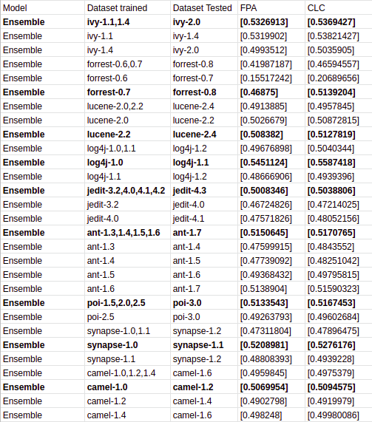
Results and Analysis
Introduction
Related Works
Proposed Approach
Experimental Details
Results and Analysis
Conclusions
STEP 3 b): Results of ensemble on all datasets. (Both Approach 1 and 2 are included in the tables).
5/7

Slide 34
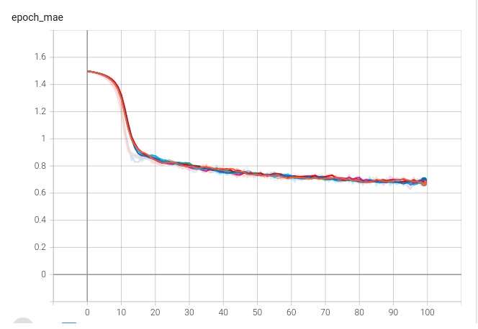
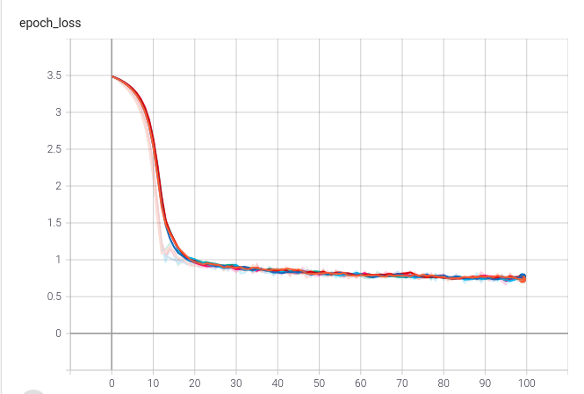
Introduction
Related Works
Proposed Approach
Experimental Details
Results and Analysis
Conclusions
Conclusions
The best performing individual model was:
RNN of architecture 1.
After oversampling and smote.
With Min Max scaling.
SVD and 10 components selected.
The MSE and MAE curves of training are:
MAE Curve MSE Curve
6/7

Slide 35
Introduction
Related Works
Proposed Approach
Experimental Details
Results and Analysis
Conclusions
Conclusions
ANN performed the worst among different models.
Reason:
This model had relatively less neurons per layer
Absence of memory blocks.
Experiments which gave all the predictions to be zero gave:
The second least MSE test loss.
Highest MSE train loss.
Nan values for FPA and CLC.
So, taking FPA and CLC as the evaluation metrics was better.
Future Work
Instead of using the PROMISE dataset, build ASTs and extract keywords which hold the semantic info of the code and build RNN regression model to predict number of bugs.
6/7

Slide 36
Introduction
Related Works
Proposed Approach
Experimental Details
Results and Analysis
Conclusions
References
[1] Jian Li, Pinjia He, Jieming Zhu, and Michael R. Lyu,”Software
Defect Prediction via Convolutional Neural Network”, 2017
[2] Guisheng Fan , 1,2 Xuyang Diao , 1 Huiqun Yu , 1 Kang Yang , 1 and
Liqiong Chen,”Software Defect Prediction via Attention-Based
Recurrent Neural Network” ,2019.
[3] Xia Xue 1,2 , Jun Feng 1,3, Yi Gao 1 , Meng Liu 1 , Wenyu Zhang 4,5, Xia
Sun 1, and Aiqi Zhao 1 and Shouxi Guo “Convolutional Recurrent
Neural Networks with a Self-Attention Mechanism for Personnel
Performance Prediction”,2019.
7/7

Slide 37
Introduction
Related Works
Proposed Approach
Experimental Details
Results and Analysis
Conclusions
References
[4] Cong Pan 1,2 , Minyan Lu 1,2,, Biao Xu 1,2 and Houleng Gao 1,2,
“ An Improved CNN Model for Within-Project Software Defect
Prediction “ ,2019.
[5] M. Fernández-Delgado 1 , M.S. Sirsat a , E. Cernadas a , S. Alawadi a ,
S. Barro a , M. Febrero-Bande b,”An extensive experimental survey
of regression methods”,2019.
[6] Ning Lia,d, Martin Shepperdb , Yuchen Guoc ,”A Systematic Review
of Unsupervised Learning Techniques for Software Defect
Prediction”, 2018 .
[7] Santosh S. Rathore1 · Sandeep Kumar1,”An empirical study of
some software fault prediction techniques for the number of
faults prediction” ,2016
7/7

