Slide 1

Software Fault Detection
Bavanya, Btech (3), 18075034
Swati, Btech(3), and 18075060
Under the Guidance of
Dr. Amrita Chaturvedi
Department of Computer Science and Engineering
INDIAN INSTITUTE OF TECHNOLOGY (BHU)
VARANASI- 221005, INDIA
BTP Project Report Presentation (B.Tech/IDD CSE 2021)

Slide 2
Introduction
Related Works
Proposed Approach
Experimental Details
Results and Analysis
Conclusions
Introduction
Software Fault Detection
What is software ?
Software is a set of instructions or programs used to operate a computer and execute specific tasks.Software tells a computer how to function.Without software, most computers would be useless.
Why fault detection is important in softwares?
Effective detection of software faults is an important activity of software development process. Defect detection is an important activity during software development process.For a software development project ,it is highly desirable to reduce software defects.The main goal of building program patterns is to find software defects.
1/7

Slide 3
Introduction
Related Works
Proposed Approach
Experimental Details
Results and Analysis
Conclusions
Related Works
Different papers proposed models for software fault detection like:
CNN
Attention based RNN
Convolutional RNN with self Attention
Different clustering algorithms
SVM
Different regression techniques
ANN
Functional link ANN
Radial basis function network
Genetic programming
But we didn't come across Isolation forest model for unsupervised classification and very little work has been done in cross version software fault detection. So, we chose to work in these areas.
2/7

Slide 4
Introduction
Related Works
Proposed Approach
Experimental Details
Results and Analysis
Conclusions
Related Works
Our Base paper is "Ridge and Lasso Regression Models for Cross-Version Defect Prediction" by Xiaoxing Yang and Wushao Wen.
It is mentioned in the paper that FPA and CLC metrics is consistent in evaluation a ranking.
Six machine learning methods were used for cross version software fault detection in this paper. They are:
Lasso regression
Linear regression
Negative binomial regression
Principal component regression
Random forest
Learning-to-rank approach
2/7

Slide 5
Introduction
Related Works
Proposed Approach
Experimental Details
Results and Analysis
Conclusions
Proposed Approach
Initially we have explored Software fault detection of an unlabelled dataset as an Anomaly detection problem and later we have build different deep learning architectures for predicting faulty data points in the software fault prediction dataset.
Different models used are :
Isolation Forest
Artificial Neural Network
Convolution Neural Network
Recurrent Neural Network
Long Short Term Memory
Gated Recurrent Unit
3/7

Slide 6
Introduction
Related Works
Proposed Approach
Experimental Details
Results and Analysis
Conclusions
Proposed Approach
Feature Engineering and metrics
We have used the following feature engineering concepts:
Min Max scaling
Oversampling
SMOTE
SVD
PCA
Feature selection using Info gain
Metrics considered for evaluation are:
FPA
CLC
Accuracy
3/7

Slide 7
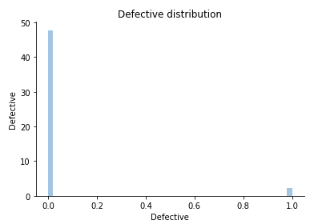
Introduction
Related Works
Proposed Approach
Experimental Details
Results and Analysis
Conclusions
Experimental Details
Anomaly Detection
Exploratory data analysis and preprocessing.
Null values were checked.
Percentage of faulty data points was found: 4.71%.
Labels were removed from the dataset.
Unnecessary features were removed (those which had only single value for all the data points).
Scatter plots and distribution plots were obtained and analysed.
Visualization
3D and 2D visualizations of the data points were obtained using t-SNE.
4/7

Slide 8
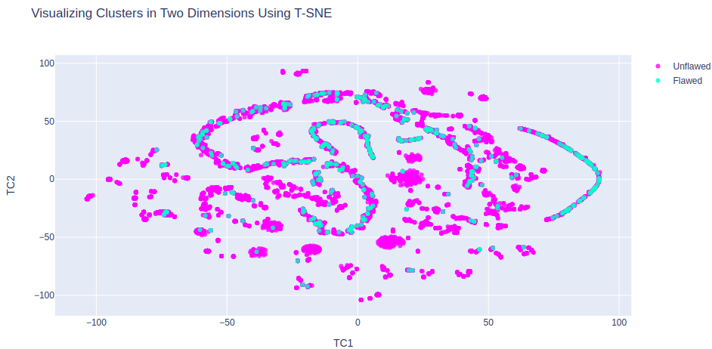
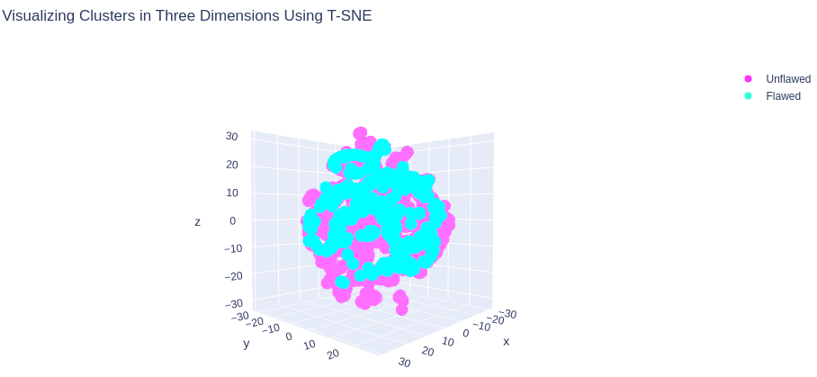
Introduction
Related Works
Proposed Approach
Experimental Details
Results and Analysis
Conclusions
Experimental Details
Anomaly Detection
Prediction
Training and Testing data was split at 4:1 ratio.
Isolation forest is fit on the training and testing data and predictions are obtained.
Accuracy of the model was calculated using the formula for accuracy after finding out true positives, true negatives and total samples count. It was obtained to be 87.7%
4/7

Slide 9
Introduction
Related Works
Proposed Approach
Experimental Details
Results and Analysis
Conclusions
Experimental Details
Regression using deep learning
Feature Scaling
Min Max scaling was performed on the dataset before all the experiments.
Feature selection techniques
Few experiments were done without applying any feature selection and
the following techniques have been applied during other experiments:
SVD with 10 and 15 components.
PCA with 10 and 15 components.
Info Gain
4/7

Slide 10
Introduction
Related Works
Proposed Approach
Experimental Details
Results and Analysis
Conclusions
Experimental Details
Regression using deep learning
Oversampling and SMOTE
Since we took cross version datasets for training and testing, we applied oversampling and SMOTE to balance and increase the size of the datasets.
Model building
Loss function was MSE and models were trained to 100 epochs.
Post Processing
Rounded off the predictions to nearest integer as the results are supposed to be whole numbers.
Saving weights and Results
Saved the results to csv files and saved the weights to disk.
4/7

Slide 11
Introduction
Related Works
Proposed Approach
Experimental Details
Results and Analysis
Conclusions
Results and Analysis
Anomaly Detection
The accuracy obtained for anomaly detection using Isolation forest was 87.7%.
Regression using deep learning
We have developed 9 different models and tried 3 different architectures of LSTM, 3 different architectures of RNN and single architecture each of GRU, ANN and CNN.
In few experiments, the FPA and CLC were obtained to be NAN because all the predictions were found to be zero after rounding off.
5/7

Slide 12
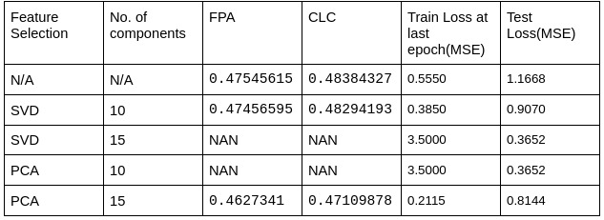
Introduction
Related Works
Proposed Approach
Experimental Details
Results and Analysis
Conclusions
Results and Analysis
The performance of different models are as follows:
ANN
5/7

Slide 13
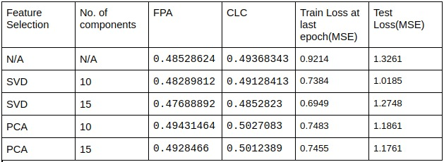
Introduction
Related Works
Proposed Approach
Experimental Details
Results and Analysis
Conclusions
Results and Analysis
GRU
5/7

Slide 14
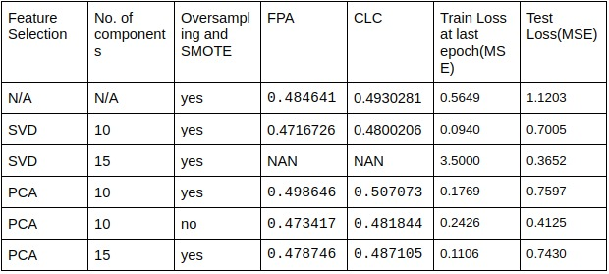
Introduction
Related Works
Proposed Approach
Experimental Details
Results and Analysis
Conclusions
Results and Analysis
CNN
5/7

Slide 15
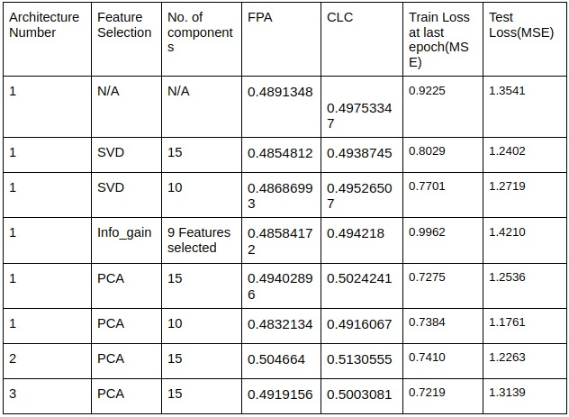
Introduction
Related Works
Proposed Approach
Experimental Details
Results and Analysis
Conclusions
Results and Analysis
LSTM
5/7

Slide 16
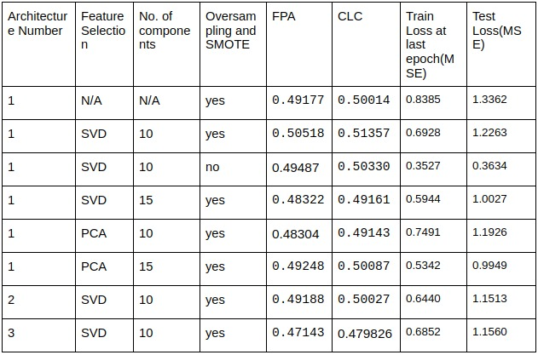
Introduction
Related Works
Proposed Approach
Experimental Details
Results and Analysis
Conclusions
Results and Analysis
RNN
5/7

Slide 17
Introduction
Related Works
Proposed Approach
Experimental Details
Results and Analysis
Conclusions
Conclusions
The best performing case was:
RNN of architecture 1.
After oversampling and smote.
With Min Max scaling.
SVD and 10 components selected.
ANN performed the least among different models and the remaining 4 models gave results almost
close to each other
Taking FPA and CLC as metric for evaluation was the best because the experiments which gave all the predictions to be zero gave the second least MSE test loss and highest MSE train loss.
6/7

Slide 18
Introduction
Related Works
Proposed Approach
Experimental Details
Results and Analysis
Conclusions
References
C.-P. C. Ko-Li Cheng and C.-P. Chu,”Software fault detection using program
patterns”2011 IEEE 2nd International Conference on Software Engineering and Service Science, 2011.
L O. H. W. P. K. Nitesh V. Chawla, Kevin W. Bowyer, ”SMOTE: Synthetic
Minority Over-sampling Technique”, 2002.
W. W. Xiaoxing Yang, Ridge and Lasso Regression Models for Cross-Version Defect Prediction, vol. 67 NO.3, 2018.
J. Schmidhuber, ”Deep learning in neural networks: An overview” 2014.
7/7

Slide 19
Introduction
Related Works
Proposed Approach
Experimental Details
Results and Analysis
Conclusions
References
X. L. Hamza Turabieha, Majdi Mafarja, ”Iterated feature selection algorithms with layered recurrent neural network for software fault prediction” , 2019.
S. W. N. T. T. V. G. Hoa Khanh Dam, Trang Pham and A. Ghose,”A deep tree-based model for software defect prediction” , 2018.
B. X. Cong Pan, Minyan Lu and H. Gao,”An Improved CNN Model for Within-Project Software Defect Prediction”, 2019.
K. M. T. F. T. Liu and Z. Zhou,”Isolation Forest,” 2008 Eighth IEEE International Conference on Data Mining , 2008.
7/7

