Slide 1

Features from Abstract Syntax Trees vs Object-Oriented metrics for Software Bug Count Prediction (using Deep Learning)
Bavanya, Btech (4), 18075034
Swati, Btech(4), and 18075060
Under the Guidance of
Dr. Amrita Chaturvedi
Department of Computer Science and Engineering
INDIAN INSTITUTE OF TECHNOLOGY (BHU)
VARANASI- 221005, INDIA
BTP Project Report Presentation (B.Tech/IDD CSE 2021)

Slide 2
Introduction
Related Works
Proposed Approach
Experimental Details
Results and Analysis
Conclusions
Introduction
Features from Abstract Syntax Trees vs Object-Oriented metrics for Software Bug Count Prediction (using Deep Learning)
Software Bug Count Prediction
Systems modelled to predict the number of bugs in each file in the source code of any software project. Aid in prioritizing the tasks in the testing phase.
Object-Oriented metrics (OO Metrics)
Measure internal quality attributes of a class. (like lines of code, no. of public methods etc.)
Features from Abstract Syntax Trees (ASTs)
Keywords that summarize the syntax and semantics of a class.
1/7

Slide 3
Introduction
Related Works
Proposed Approach
Experimental Details
Results and Analysis
Conclusions
Related Works
Regression techniques for software bug count prediction.
Ridge and Lasso regression[1]
Adaboost[2]
Negative Binomial Regression[3], Decision Tree Regression[4]
Layered LSTM for multi-class classification for bug count prediction[5].
Binary classification using a tree-structured LSTM trained on features extracted from file-level ASTs for detection of the presence of bugs[6].
Attention-based RNN[7] and CNN[8] trained on features extracted from ASTs.
Our observations and motivation:
We didn't come across the following work in the related papers:
Deep Learning for regression to predict the count of bugs.
Features from Abstract Syntax Trees to predict the count of bugs.
2/7

Slide 4
Introduction
Related Works
Proposed Approach
Experimental Details
Results and Analysis
Conclusions
Proposed Approach
Experiments were conducted for following two research questions:
1. RQ-1: Does a deep learning model perform better than traditional machine learning techniques in predicting the count of bugs in software modules using regression?
Our Approach: Trained a layered LSTM and CNN on OO metrics and compared the results with previously trained machine learning models and MLP(on OO metrics).
2. RQ-2: Does a deep learning model trained on features extracted from ASTs perform better than a deep learning model trained on Object-Oriented metrics for bug count prediction using regression?
Our Approach: Trained our layered LSTM and CNN on both OO metrics and features from ASTs and compared the results of the four experiments.
3/7

Slide 5
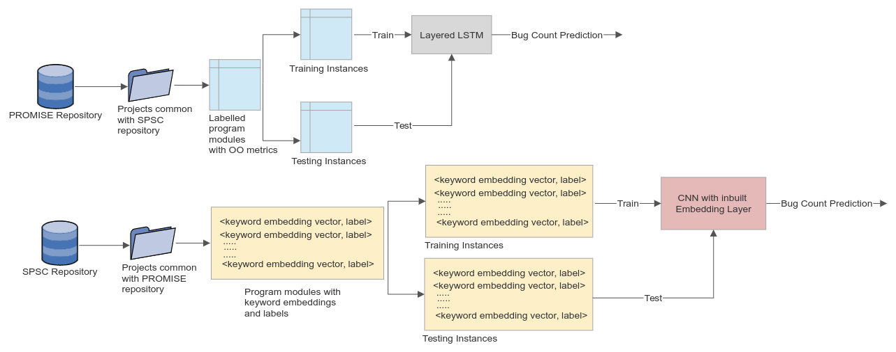
Introduction
Related Works
Proposed Approach
Experimental Details
Results and Analysis
Conclusions
Proposed Approach
Detailed workflow
Layered LSTM trained on OO metrics.
CNN trained on features from ASTs
The workflow will be similar for a Layered LSTM trained on features from ASTs and CNN trained on OO metrics.
3/7

Slide 6
Introduction
Related Works
Proposed Approach
Experimental Details
Results and Analysis
Conclusions
Experimental Details
About the Datasets used:
Object-Oriented metrics (OO Metrics).
Each instance of a project corresponds to a code file of the project.
The bug count label and 20 specific OO metrics for each software project class.
Project Name | Version | No. of modules | No. of faulty modules | % of faults
ant | 1.7 | 745 | 166 | 22.28
camel | 1.2 | 608 | 216 | 35.53
camel | 1.4 | 872 | 145 | 16.63
camel | 1.6 | 965 | 188 | 19.48
xalan | 2.4 | 723 | 110 | 15.33
xalan | 2.5 | 803 | 387 | 48.25
xalan | 2.6 | 885 | 411 | 46.5
xerces | 1.3 | 502 | 68 | 13.71
4/7

Slide 7
Abbreviation | Dataset Features | Description
CBO | Coupling between objects | counts the number of other classes to which a class is coupled with.
RFC | Response for a class | counts the number of external and internal classes.
LCOM | Lack of cohesion in methods | measures dissimilarity of methods in a class.
LCOM3 | Lack of cohesion in methods 3 | variant of LCOM, measures the complexity and reusability of a class.
NOC | Number of children | counts the number of descendants of a class.
DIT | Depth of inheritance | measures the number of ancestor classes.
WMC | Weighted methods per class | counts the number of methods in a class weighted by complexity.
Ca | Afferent couplings | counts how many other classes use a given class.
Ce | Efferent Couplings | counts the number of classes. a class is dependent upon.
NPM | Number of public methods | counts the number of public methods in a class.
DAM | Data Access Metric | the number of private methods divided by the total number of methods.
MOA | Measure of Aggregation | counts the number of abstract data types in a class.
MFA | Measure of Functional Abstraction | the number of inherited methods divided by the total number of methods accessible by its member functions.
CAM | Cohesion Among Methods of Class | based upon the parameters in a method.
AMC | Average Method Complexity | counts the average size of method in a class.
LOC | Line of Code | counts the number of lines of source code.
CBM | Coupling Between Methods | counts the newly added functions with which inherited based methods are coupled.
IC | Inheritance Coupling | it is based upon inheritance-based coupling.
Max_cc | Max McCabe’s cyclomatic complexity | highest cyclomatic measures of the methods in a class.
Avg_cc | Average McCabe’s cyclomatic complexity | average of the cyclomatic measures of the methods in a class.

Slide 8
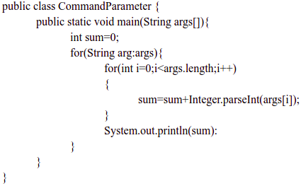
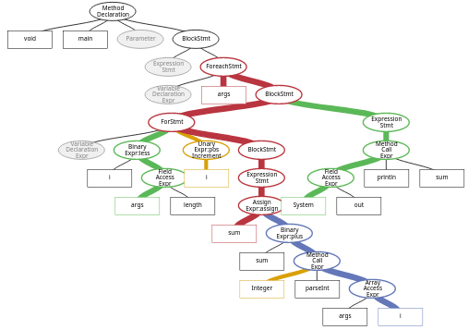
Introduction
Related Works
Proposed Approach
Experimental Details
Results and Analysis
Conclusions
Experimental Details
About the Datasets used:
Features extracted from ASTs.
For the left sample Java program, the AST generated is in the right.
4/7

Slide 9
Introduction
Related Works
Proposed Approach
Experimental Details
Results and Analysis
Conclusions
Experimental Details
Formal Parameter | ForStatement
Basic Type | AssertStatement
Interface Declaration | BreakStatement
CatchClauseParameter | Continue Statement
ClassDeclaration | ReturnStatement
MethodInvocation | Throw Statement
SuperMethodInvocation | SynchronizedStatement
MemberReference | TryStatement
ConstructorDeclaration | SwitchStatement
Reference Type | BlockStatement
Method Declaration | TryResource
Variable Declarator | CatchClause
IfStatement | SwitchStatementCase
WhileStatement | ForControl
Do Statement
Special node types selected
from the ASTs
4/7

Slide 10
Introduction
Related Works
Proposed Approach
Experimental Details
Results and Analysis
Conclusions
Experimental Details
About the Datasets used:
Features extracted from ASTs.
For the left sample Java program, the tokens extracted are in the right.
CommandParameter | int
main | i
args | i
String | length
int | i
sum | block
for | sum
String | sum
arg | parselnt
args | args
block | i
for | printin
forControl | sum
4/7

Slide 11
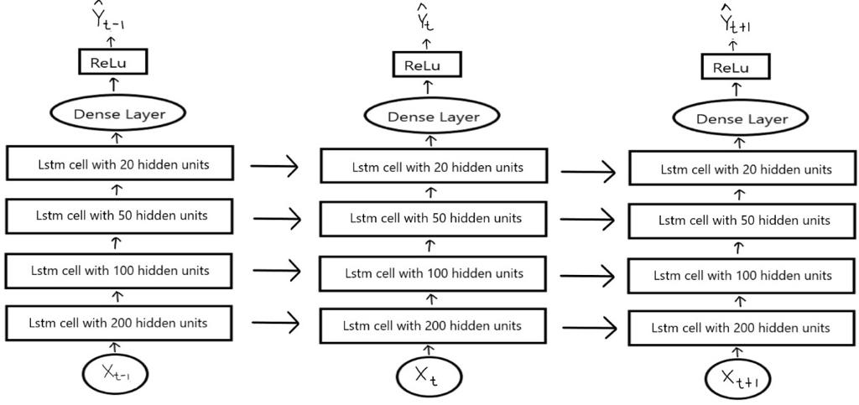
Introduction
Related Works
Proposed Approach
Experimental Details
Results and Analysis
Conclusions
Experimental Details
Architecture of the proposed layered LSTM model:
Drop out rate of 0.2 is considered for the layer with 50 hidden units
4/7

Slide 12
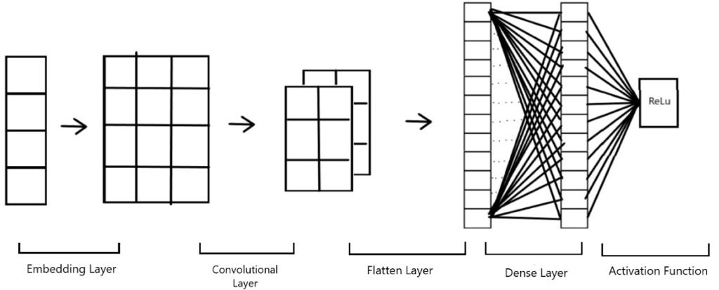
Introduction
Related Works
Proposed Approach
Experimental Details
Results and Analysis
Conclusions
Experimental Details
Architecture of the proposed CNN model:
Even the convolutional layer used the ReLu activation function. For the convolutional layer, we took the kernel size as 2.
4/7

Slide 13


Introduction
Related Works
Proposed Approach
Experimental Details
Results and Analysis
Conclusions
Experimental Details
Performance measures:
Mean Absolute Error (MAE):
Absolute mean of the errors in the predictions compared with the labels.
Will not capture whether the prediction value is greater or lesser than the label.
Mean Relative Error (MRE):
Average ratio of the absolute error to the actual label.
Useful when dealing with labels that are large numerical values.
4/7

Slide 14
Introduction
Related Works
Proposed Approach
Experimental Details
Results and Analysis
Conclusions
Results and Analysis
Justification of RQ-1 (Trained a layered LSTM and CNN on OO metrics and compared the results with previously trained machine learning models and MLP(on OO metrics).)
MAE Results comparison
 | Linear Regression | MLP | DT Regression | Genetic Programming | -ve Binomial Regression | 0-inflated Poisson Regression | Our LSTM model | Our CNN model
ant1.7 | 0.38 | 0.53 | 0.39 | 0.61 | 0.97 | 1.37 | 0.506 | 3.322
camel1.2 | 1.07 | 0.98 | 1.01 | 1.02 | 0.94 | 0.81 | 1.146 | 1.505
camel1.4 | 0.48 | 0.63 | 0.43 | 0.62 | 0.84 | 0.66 | 0.523 | 0.378
camel1.6 | 0.67 | 0.92 | 0.63 | 0.7 | 0.93 | 0.84 | 0.648 | 1.352
xalan2.4 | 0.23 | 0.33 | 0.25 | 0.23 | 1.18 | 0.92 | 0.313 | 2.582
xalan2.5 | 0.54 | 0.75 | 0.56 | 0.49 | 0.79 | 0.78 | 0.611 | 2.833
xalan2.6 | 0.53 | 0.63 | 0.52 | 0.68 | 1.01 | 1.06 | 0.654 | 1.187
xerces1.3 | 0.56 | 0.74 | 0.34 | 0.46 | 1.24 | 0.96 | 0.483 | 3.009
5/7

Slide 15
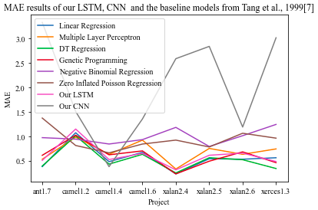
Introduction
Related Works
Proposed Approach
Experimental Details
Results and Analysis
Conclusions
Results and Analysis
Justification of RQ-1 (Trained a layered LSTM and CNN on OO metrics and compared the results with previously trained machine learning models and MLP(on OO metrics).)
MAE Results comparison
5/7

Slide 16
Introduction
Related Works
Proposed Approach
Experimental Details
Results and Analysis
Conclusions
Results and Analysis
Justification of RQ-1 (Trained a layered LSTM and CNN on OO metrics and compared the results with previously trained machine learning models and MLP(on OO metrics).)
MRE Results comparison
 | Linear Regression | MLP | DT Regression | Genetic Programming | -ve Binomial Regression | 0-inflated Poisson Regression | Our LSTM model | Our CNN model
ant1.7 | 0.2 | 0.27 | 0.2 | 0.4 | 0.88 | 1.1 | 0.191 | 1.34
camel1.2 | 0.61 | 0.51 | 0.56 | 0.6 | 0.6 | 0.57 | 0.299 | 0.375
camel1.4 | 0.27 | 0.38 | 0.24 | 0.41 | 0.73 | 0.5 | 0.127 | 0.134
camel1.6 | 0.4 | 0.64 | 0.35 | 0.41 | 0.78 | 0.68 | 0.193 | 0.624
xalan2.4 | 0.12 | 0.22 | 0.14 | 0.16 | 1.08 | 0.81 | 0.181 | 0.302
xalan2.5 | 0.39 | 0.51 | 0.4 | 0.34 | 0.55 | 0.56 | 0.399 | 1.186
xalan2.6 | 0.33 | 0.36 | 0.3 | 0.45 | 0.71 | 0.6 | 0.315 | 0.843
xerces1.3 | 0.39 | 0.5 | 0.2 | 0.33 | 1.16 | 0.77 | 0.122 | 0.474
5/7

Slide 17
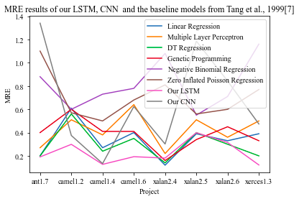
Introduction
Related Works
Proposed Approach
Experimental Details
Results and Analysis
Conclusions
Results and Analysis
Justification of RQ-1 (Trained a layered LSTM and CNN on OO metrics and compared the results with previously trained machine learning models and MLP(on OO metrics).)
MRE Results comparison
5/7

Slide 18
Introduction
Related Works
Proposed Approach
Experimental Details
Results and Analysis
Conclusions
Results and Analysis
Justification of RQ-2 (Trained our layered LSTM and CNN on both OO metrics and features from ASTs and compared the results of the four experiments.)
MAE and MRE Results comparison
 | MAE |  |  |  | MRE
 | Trained on Object-Oriented Metrics (OO) |  | Trained on Features from ASTs |  | Trained on Object-Oriented Metrics (OO) |  | Trained on Features from ASTs
 | Our LSTM model | Our CNN model | Our LSTM model | Our CNN model | Our LSTM model | Our CNN model | Our LSTM model | Our CNN model
ant1.7 | 0.506 | 3.322 | 0.594 | 0.391 | 0.191 | 1.34 | 0.214 | 0.115
camel1.2 | 1.146 | 1.505 | 0.975 | 0.816 | 0.299 | 0.375 | 0.435 | 0.168
camel1.4 | 0.523 | 0.378 | 0.639 | 0.598 | 0.127 | 0.134 | 0.18 | 0.149
camel1.6 | 0.648 | 1.352 | 0.934 | 0.657 | 0.193 | 0.624 | 0.283 | 0.124
xalan2.4 | 0.313 | 2.582 | 0.3 | 0.384 | 0.181 | 0.302 | 0.183 | 0.176
xalan2.5 | 0.611 | 2.833 | 0.71 | 0.658 | 0.399 | 1.186 | 0.509 | 0.264
xalan2.6 | 0.654 | 1.187 | 0.723 | 0.669 | 0.315 | 0.843 | 0.468 | 0.382
xerces1.3 | 0.483 | 3.009 | 0.432 | 0.421 | 0.122 | 0.474 | 0.166 | 0.134
5/7

Slide 19
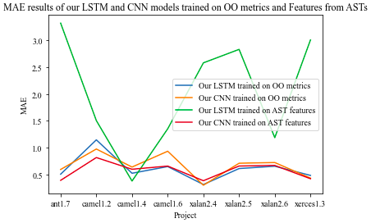
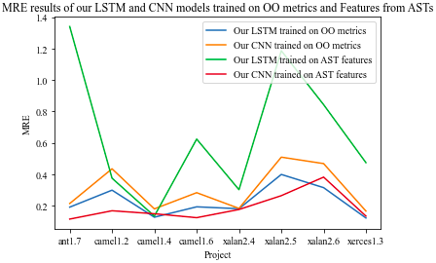
Introduction
Related Works
Proposed Approach
Experimental Details
Results and Analysis
Conclusions
Results and Analysis
Justification of RQ-2 (Trained our layered LSTM and CNN on both OO metrics and features from ASTs and compared the results of the four experiments.)
MAE and MRE Results comparison
5/7

Slide 20
Introduction
Related Works
Proposed Approach
Experimental Details
Results and Analysis
Conclusions
Conclusions
Deep learning models for bug count prediction using regression are better than a few machine learning models like
zero-inflated Poisson Regression
-ve Binomial Regression and
comparable to Genetic programming.
However, other machine learning models like Linear Regression and DT Regression are better performing than deep learning models like LSTM and CNN.
Features extracted from ASTs are better suited for CNN models than Object-Oriented metrics.
It is recommended to prefer Object-Oriented metrics to train LSTM models for Software Bug Count prediction through regression.
6/7

Slide 21
Introduction
Related Works
Proposed Approach
Experimental Details
Results and Analysis
Conclusions
Conclusions
Threats to Validity
Source projects taken were written in Java. Hence, may not validate our models when applied to projects written in other languages like C, C++ and Python.
The quality of our results is based on the quality of the datasets used.
The number of modules in each dataset is not the same for the PROMISE dataset and the SPSC dataset, which might add a systematic bias in our results.
We cannot validate the evaluation results of other metrics.
6/7

Slide 22
Introduction
Related Works
Proposed Approach
Experimental Details
Results and Analysis
Conclusions
Conclusions
Future Work
Other deep learning models like RNN and Deep Belief Networks for software bug count detection using regression.
Other code representation techniques like codeBERT[8] developed by Microsoft to get better embeddings of the keywords extracted from the ASTs.
Another extension to using codeBERT could be to use GraphCodeBERT[9] and compare the two techniques for the bug count prediction problem
6/7

Slide 23
Introduction
Related Works
Proposed Approach
Experimental Details
Results and Analysis
Conclusions
References
[1] X. Yang and W. Wen, “Ridge and Lasso Regression Models for Cross-Version Defect Prediction,” IEEE Trans. Reliab., vol. 67, no. 3, pp. 885–896, 2018.
[2] L. Yu, “Using Negative Binomial Regression Analysis to Predict Software Faultsௗ: A Study of Apache Ant,” I.J. Inf. Technol. Comput. Sci., vol. 4, no. 8, pp. 63–70, 2012.
[3] Santosh Singh Rathore and Sandeep Kumar. 2016. A Decision Tree Regression based Approach for the Number of Software Faults Prediction. SIGSOFT Softw. Eng. Notes 41, 1 (January 2016), 1–6. DOI:https://doi.org/10.1145/2853073.2853083
[4] Sushant Kumar Pandey, Anil Kumar Tripathi, BCV-Predictor: A bug count vector predictor of a successive version of the software system, Knowledge-Based Systems,
Volume 197, 2020, 105924, ISSN 0950-7051.
7/7

Slide 24
Introduction
Related Works
Proposed Approach
Experimental Details
Results and Analysis
Conclusions
References
[5] Dam, Hoa & Pham, Trang & Ng, Shien & Tran, Truyen & Grundy, John & Ghose, Aditya & Kim, Taeksu & Kim, Chul-Joo. (2018). A deep tree-based model for software defect prediction.
[6] Fan, Guisheng & Diao, Xuyang & Yu, Huiqun & Yang, Kang & Chen, Liqiong. (2019). Software Defect Prediction via Attention-Based Recurrent Neural Network. Scientific Programming. 2019. 1-14. 10.1155/2019/6230953.
[7] Pan, Lei & Lu, Jingyan & Xu, Longfei & Gao,. (2019). An Improved CNN Model for Within-Project Software Defect Prediction. Applied Sciences. 9. 2138. 10.3390/app9102138.
[8]Feng, Z., Guo, D., Tang, D., Duan, N., Feng, X., Gong, M., … Zhou, M. (2020, November). CodeBERT: A Pre-Trained Model for Programming and Natural Languages. Findings of the Association for Computational Linguistics: EMNLP 2020, 1536–1547. doi:10.18653/v1/2020.findings-emnlp.139.
7/7

Slide 25
Introduction
Related Works
Proposed Approach
Experimental Details
Results and Analysis
Conclusions
References
[9] Guo, D., Ren, S., Lu, S., Feng, Z., Tang, D., Liu, S., … Zhou, M. (2021). GraphCodeBERT: Pre-training Code Representations with Data Flow. arXiv [cs.SE]. Opgehaal van http://arxiv.org/abs/2009.08366.
THANK YOU
7/7

