Slide 1
IBM AI ENGINEERING COURSE PROJECT
RxAuth AI
Evidence-grounded prior authorization intelligence
A human-in-the-loop AI engineering prototype for specialty pharmacy workflows
Bavely S. Tawfik
Python • scikit-learn • OpenCV • Pydantic • reproducible evaluation
August 2026
Notes:
Opening: RxAuth AI is an evidence-grounded prior-authorization intelligence prototype. It is designed as an IBM AI Engineering course project and as a portfolio system that can grow from classical machine learning into retrieval-augmented generation and controlled agentic workflows. The central idea is simple: every important answer must be traceable, uncertainty must be explicit, and a human remains responsible for the final action.

Slide 2
01 / PROJECT OVERVIEW
Executive summary
One project demonstrating the complete AI engineering lifecycle
01
02
03
The problem
The solution
Current proof
Prior-authorization packets are document-heavy, policy-dependent, and vulnerable to missing or ambiguous evidence.
Ingest and classify documents, match patient evidence to policy criteria, expose gaps, and enforce provenance before review.
Phase 1.5 includes typed ingestion, a leakage-resistant ML baseline, an end-to-end case spine, tests, and reports.
PROJECT THESIS
Use probabilistic AI for interpretation; use deterministic code for explicit rules; route uncertainty to a human.
RxAuth AI | IBM AI Engineering course project
2
Notes:
The project addresses administrative preparation, not clinical decision-making. The implemented Phase 1.5 foundation spans data generation, PDF and image ingestion, a classical text classifier, confidence-based review routing, deterministic criteria evaluation, provenance, groundedness checks, and automated testing. The roadmap adds deep learning, extraction, policy retrieval, and constrained generation without changing the safety contract.

Slide 3
02 / PROBLEM
Why prior authorization needs intelligence, not just automation
The bottleneck is evidence completeness and traceability before submission
Patient packet
Multiple document types
Payer policy criteria
Human reviewer
Fragmented inputs
Policy translation
Trust gap
Clinical notes, labs, prescriptions, referrals, insurance cards, histories, forms, and miscellaneous correspondence.
Natural-language requirements must become explicit checks while preserving payer, version, page, and source text.
A confident-sounding answer is not enough; reviewers need evidence, citations, missing-data flags, and calibrated uncertainty.
RxAuth AI | IBM AI Engineering course project
3
Notes:
The work happens across heterogeneous documents and a separate policy source. A useful system cannot merely summarize. It must identify which requirement is being evaluated, select the right patient evidence, normalize values, determine when a rule can be computed, and show the reviewer where each result came from. This is why RxAuth AI treats provenance and uncertainty as product features, not afterthoughts.

Slide 4
03 / RESPONSIBLE AI
Scope and safety guardrails
The portfolio version is administrative decision-support using synthetic data only
IN SCOPE
OUT OF SCOPE
Prepare a case for human review
Diagnose, prescribe, or recommend treatment
Classify and organize synthetic documents
Approve or deny medical necessity
Match evidence to explicit policy criteria
Use real PHI in the public portfolio
Flag missing, ambiguous, or low-confidence evidence
Infer live member benefit status from policy text
Preserve source provenance end to end
Submit autonomously to a payer
Human review is mandatory: model output never becomes submission-ready by itself.
RxAuth AI | IBM AI Engineering course project
4
Notes:
These boundaries are important for both responsible AI and honest course evaluation. The public project uses fully synthetic identities and documents. It does not make a clinical decision or claim production validity. A future commercial deployment would require a separate HIPAA-ready architecture, access controls, encryption, auditing, retention policy, and governance.

Slide 5
04 / SYSTEM DESIGN
End-to-end AI workflow
A linear reviewer-facing flow with controlled intelligence inside each stage
1 Ingest
2 Classify
3 Extract
4 Retrieve policy
5 Structure criteria
6 Match evidence
7 Groundness gate
8 Human review
IMPLEMENTED NOW
Typed ingestion + classification + deterministic matching + provenance gate
RxAuth AI | IBM AI Engineering course project
5
Notes:
The top-level workflow stays intentionally linear. In Phase 1.5, the implemented path covers typed ingestion, classification, deterministic matching on a synthetic case fixture, and a structural groundedness gate. Extraction, public payer-policy RAG, criteria extraction, and generated drafting are roadmap stages. This separation prevents the presentation from overstating what the current code does.

Slide 6
05 / DATA ENGINEERING
Typed entities make provenance enforceable
Important state lives in validated structures, not only inside prompts
Case
Document
Evidence
payer • medication • indication • documents
type • confidence • page count
normalized value • confidence • source span
Policy
Criterion
Evaluation
version • effective date • criteria
operator • expected value • policy source
five-state result • evidence IDs • explanation
Provenance contract: document + page + source text + confidence + method
RxAuth AI | IBM AI Engineering course project
6
Notes:
Pydantic models define the major entities and validate their contracts. Evidence includes a normalized value plus provenance. Policy criteria preserve source text and page. Evaluations record the selected evidence IDs, result state, confidence, method, explanation, and both policy and patient sources. This design supports testability, auditability, and later model versioning.

Slide 7
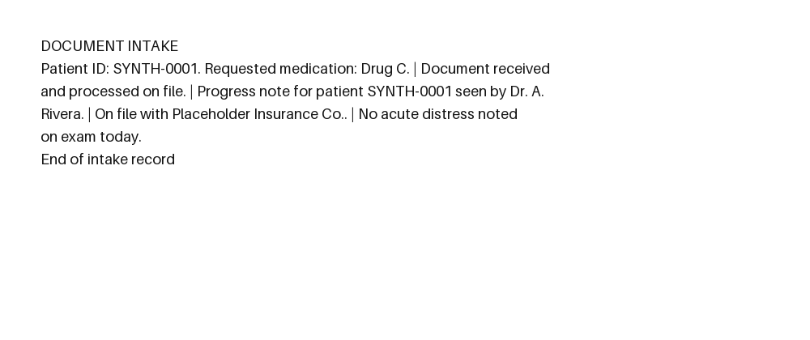
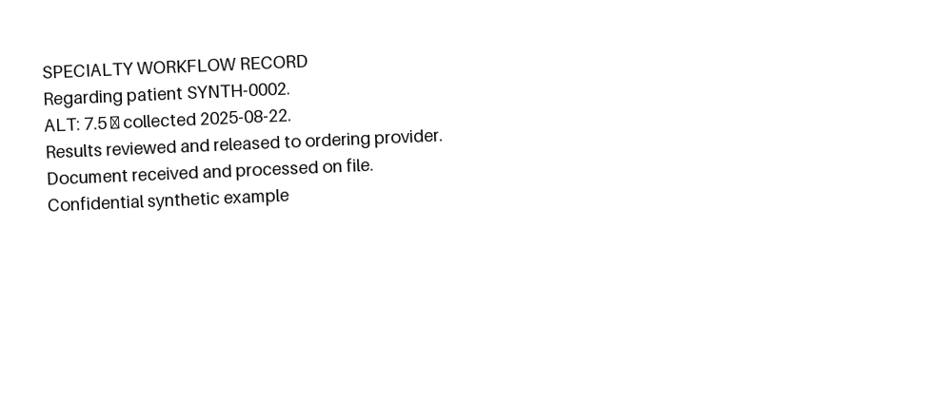
06 / INGESTION
From files to page-level text
One typed contract for text, text-bearing PDF, and scanned-image paths
Decode / parse
Grayscale
Denoise
Deskew
Otsu threshold
OCR adapter
32
0.000
Rendered benchmark
Measured honestly
16 text-bearing PDFs + 16 scan-like images. Degradations include clean, rotated, blurred, low-contrast, and noisy variants.
PDF mean character error rate: 0.000. Image preprocessing: 100%. OCR character accuracy: not reported without a configured runtime.
RxAuth AI | IBM AI Engineering course project
7
Notes:
The ingestion layer supports UTF-8 text, Markdown, text-bearing PDFs through pypdf, and image files through OpenCV preprocessing. Every page records text, extraction method, confidence, and page number. Scanned PDFs without a text layer fail explicitly instead of becoming empty evidence. The benchmark reports what is measured and explicitly withholds OCR text accuracy until an OCR runtime is configured.

Slide 8
07 / EXPERIMENT DESIGN
Synthetic dataset with leakage-resistant splits
Cases and template families are mutually exclusive across partitions
336
48
48
48
TRAIN
VAL
TEST
CHALLENGE
480 documents • 8 balanced classes • 10 template families • deterministic seed 42
Primary test
Challenge set
Leakage defense
Held-out family 08 is the scientific comparison point. The vectorizer is fit on training data only.
Family 09 adds unseen framing, cross-class noise, and deterministic OCR-like corruption.
The loader rejects overlapping case IDs or template-family IDs before training.
RxAuth AI | IBM AI Engineering course project
8
Notes:
The classifier corpus contains 480 fully synthetic documents across eight classes. The split is grouped by both case and template family to reduce memorization through repeated templates. Families zero through six train the model, family seven is validation, family eight is the primary test, and family nine is a harder challenge set used for robustness analysis rather than model selection.

Slide 9
08 / MACHINE LEARNING
Classical baseline: TF-IDF + logistic regression
A fast, interpretable benchmark before introducing a transformer
TF-IDF features unigrams + bigrams
Balanced logistic regression
Class probability + review route
Document text
Feature design
Training design
Decision policy
Lowercase English text, stop-word removal, 1–2 grams, minimum document frequency 2, sublinear term frequency.
Balanced class weights, maximum 1,000 iterations, random state 42, training split only.
A 0.65 confidence threshold routes uncertain predictions to human review; it is not clinically validated.
RxAuth AI | IBM AI Engineering course project
9
Notes:
The baseline is deliberately classical. TF-IDF turns unstructured text into sparse unigram and bigram features. Logistic regression estimates class probabilities across eight document types. The model is easy to train, serialize, inspect, and compare against a future transformer. The review threshold is operational for this synthetic benchmark and should not be described as clinically validated.

Slide 10
09 / RESULTS
Classifier performance: strong test, harder challenge
Macro F1 is the primary balanced metric; all values come from reproducible reports
93.6%
97.9%
91.6%
0.004
ms / document
CPU batch inference
TEST CONFUSION: 1 / 48
Validation
Test
Challenge
RxAuth AI | IBM AI Engineering course project
10
Notes:
The grouped test macro F1 is 0.979 and test accuracy is also 0.979, with one medication-history document classified as a prior-authorization request. The harder challenge set drops to 0.916 macro F1 and contains four failures. Batch inference latency is approximately 0.004 milliseconds per document on CPU in the report. These are synthetic-corpus results, not production claims.

Slide 11
10 / EVALUATION
Accuracy is not the same as confidence quality
Calibration and review-routing reveal the next engineering priority
97.9%
56.1%
0.418
68.8%
Test accuracy
Mean confidence
Calibration error
Review routing
Correct class prediction on the grouped held-out test set.
Average maximum probability despite strong accuracy.
10-bin expected calibration error; lower is better.
Predictions below the 0.65 threshold.
Engineering interpretation
The classifier is often correct but under-confident. Probability calibration and threshold selection matter more next than chasing a higher headline accuracy.
RxAuth AI | IBM AI Engineering course project
11
Notes:
This slide is the most important evaluation lesson. Accuracy alone would suggest the model is nearly finished, but mean confidence is only 0.561, expected calibration error is 0.418, and 68.8 percent of test and challenge documents route to review. The next step should include calibration analysis and threshold tradeoffs, not simply a more complex model.

Slide 12
11 / CORE INTELLIGENCE
Criteria-to-evidence matching uses a five-state contract
Deterministic rules first; ambiguity is represented instead of guessed
SATISFIED
NOT SATISFIED
MISSING
AMBIGUOUS
HUMAN REVIEW
Policy rule
Structured criterion
Evidence
At least 12 weeks of Drug A
operator: >= expected: 12 weeks
Drug A used for 16 weeks
16 >= 12 → SATISFIED • deterministic • confidence 0.93
RxAuth AI | IBM AI Engineering course project
12
Notes:
Matching is the core intelligence layer. It finds typed evidence, rejects low-confidence extraction, checks unit compatibility, performs explicit numeric and outcome comparisons in Python, and returns one of five states. If evidence says several months where a number is required, the result is ambiguous and routes to a reviewer instead of being converted into a fabricated duration.

Slide 13
12 / END-TO-END DEMO
One synthetic case, six policy criteria
PA-DEMO-001 proves the workflow spine and reviewer-ready traceability
4 SATISFIED
1 MISSING
1 AMBIGUOUS
ID | Policy requirement | Result | Patient evidence
C1 | Diagnosis documented | SATISFIED | clinical_note.pdf p.1
C2 | ≥ 12 weeks prior therapy | SATISFIED | medication_history.pdf p.2
C3 | Inadequate response | SATISFIED | medication_history.pdf p.2
C4 | A1c below 8.0 | SATISFIED | lab_report.pdf p.1
C5 | Screening document | MISSING | No evidence found
C6 | Recent course duration | AMBIGUOUS | “several months”
GROUNDEDNESS GATE: PASS
RxAuth AI | IBM AI Engineering course project
13
Notes:
The demo case has five detected documents and six policy criteria. Four are supported, one required screening document is missing, and one duration is ambiguous because the source says several months. Every supported criterion includes the patient document, page, source span, policy page, method, and confidence. The structural groundedness gate passes.

Slide 14
13 / TRUSTWORTHY AI
Groundedness gate before reviewer display
No supported claim may exist without patient evidence and a policy source
Policy source present?
Patient source present when support is claimed?
Criterion evaluation
PASS / FAIL
Current gate
Future gate
Human control
Structural groundedness: validates evidence IDs, patient provenance, and policy provenance for each result.
Semantic claim verification for generated text, citation correctness, conflicting evidence, and unsupported-claim rate.
Missing or ambiguous data becomes a visible review task. No autonomous submission is allowed.
RxAuth AI | IBM AI Engineering course project
14
Notes:
Today, the groundedness gate verifies the structural contract. Supported or not-satisfied claims must cite patient evidence, and every evaluation must retain its policy source. When generated drafting is added, the same gate interface can expand to semantic faithfulness checks, citation correctness, conflict detection, and unsupported-claim scoring.

Slide 15
14 / ENGINEERING DISCIPLINE
Reproducible, testable, and honest by design
The repository is organized as an installable Python 3.12 package
21 PASS
seed 42
3 reports
Automated tests
Reproducibility
Evaluation artifacts
Pipeline states, policy mismatches, unit conflicts, classifier persistence, split isolation, rendering, and ingestion.
Locked environment, deterministic seed, generated manifests, CLI entry points, and versionable report artifacts.
Classifier report, ingestion report, structured end-to-end case JSON, and persisted trusted model bundle.
Vectorizer fit on training split only; challenge set excluded from model selection
Errors and calibration are reported alongside headline performance
Synthetic-only scope and unmeasured OCR accuracy are stated explicitly
RxAuth AI | IBM AI Engineering course project
15
Notes:
A course project should demonstrate engineering practice, not only a notebook result. The repository includes CLI commands, locked dependencies, deterministic dataset generation, persisted artifacts, typed models, and 21 passing tests in the current run. Reports include error cases and calibration. The project also documents limitations, including synthetic-only validity and unavailable OCR accuracy.

Slide 16
15 / COURSE ALIGNMENT
How RxAuth AI maps to IBM AI Engineering learning goals
Each course block unlocks a concrete project capability and measurable deliverable
IBM learning block | RxAuth AI deliverable | Status
Python / data | Typed ingestion, preprocessing, manifests | Implemented
Machine Learning | TF-IDF + logistic regression benchmark | Implemented
Deep Learning | Transformer classifier vs. same benchmark | Next
Computer Vision / NLP | OCR and evidence extraction with confidence | Partial / next
LLM applications + RAG | Public payer-policy retrieval and criteria extraction | Roadmap
AI agents | Controlled state graph and review checkpoints | Roadmap
Model evaluation | F1, calibration, routing, latency, groundedness | Implemented / expands
RxAuth AI | IBM AI Engineering course project
16
Notes:
This is not a disconnected set of course exercises. Python and data engineering produce the ingestion layer. Classical machine learning produces the baseline. Deep learning will be evaluated against the same data contract. Computer vision and NLP support extraction. RAG will retrieve public policy, and an explicit state graph will orchestrate controlled stages. Evaluation remains first-class at every layer.

Slide 17
16 / ROADMAP
From Phase 1.5 to a portfolio-ready V1
Advance only when each layer has a defensible evaluation boundary
M0
P1
P1.5
P2
P3
V1
Workflow spine
ML baseline
Ingestion + hardening
Transformer comparison
Extraction + policy RAG
Controlled agent + UI
Done
Done
Current
Next
Roadmap
Roadmap
Model selection rule: same splits, same metrics, same reporting contract—then compare quality, calibration, latency, size, and deployment cost.
RxAuth AI | IBM AI Engineering course project
17
Notes:
The immediate next step is a small transformer classifier trained on the exact same split and evaluated with the same contract. It should be compared on macro F1, robustness, calibration, review routing, latency, and artifact size. Later phases add confidence-aware extraction, public payer-policy retrieval, criteria extraction, controlled generation, and a reviewer interface.

Slide 18
17 / CONCLUSION
What this project demonstrates
Questions?
A course project can be technically rigorous, domain-aware, and honest about its limits
1 End-to-end thinking
2 Evaluation maturity
3 Responsible design
Data contracts, preprocessing, training, evaluation, inference, decision logic, trust gates, and human review form one coherent system.
Grouped splits, challenge data, calibration, review routing, latency, failure cases, and explicit non-claims show scientific discipline.
Synthetic data, administrative scope, source provenance, deterministic rules, and no autonomous submission reduce avoidable risk.
Build an AI system that can prove where every important answer came from.
RxAuth AI | IBM AI Engineering course project
18
Notes:
The takeaway is not that a synthetic baseline solves prior authorization. The achievement is a defensible engineering foundation: typed data, leakage-resistant experimentation, explicit uncertainty, deterministic business logic, source grounding, human review, and reproducible reports. That foundation makes later deep learning and generative AI work measurable rather than decorative.

Slide 19
APPENDIX A
Reproduce the demo and benchmarks
All commands run from the repository root
uv sync --group dev
uv run rxauth-build-dataset
uv run rxauth-benchmark-ingestion
uv run rxauth-train-classifier
uv run rxauth-milestone0
uv run pytest
Expected: 21 tests pass
Outputs: reports/*.md + case JSON
No real PHI
RxAuth AI | IBM AI Engineering course project
19
Notes:
These commands rebuild the synthetic datasets, run ingestion and classifier benchmarks, execute the end-to-end case, and run the tests. The primary artifacts are reports/classifier_baseline.md, reports/ingestion_benchmark.md, and reports/case_PA-DEMO-001.json.

Slide 20
APPENDIX B
Evidence behind this presentation
Every metric and design claim maps to a repository artifact
README.md
docs/phase-1.5.md
reports/classifier_baseline.md
Project thesis, scope, architecture, IBM course mapping, roadmap, and security posture.
Typed ingestion contract, grouped split design, current outcomes, and next step.
Accuracy, macro F1, confidence, calibration, routing, latency, confusion matrix, failures.
reports/ingestion_benchmark.md
reports/case_PA-DEMO-001.json
tests/
Rendered corpus size, PDF character error rate, preprocessing success, OCR non-claim.
Six criteria, statuses, explanations, confidence, policy source, and patient evidence.
Executable checks for matching behavior, ingestion, dataset contracts, and classifier persistence.
RxAuth AI | IBM AI Engineering course project
20
Notes:
This appendix provides the audit trail for the presentation. The deck intentionally uses only repository-backed metrics and labels future capabilities as roadmap items. This source map makes it easy for an instructor to verify each technical claim.

