Slide 1
Automation Testing Framework for browser stack demo Website
A Comparative Study of TestNG and Cucumber (BDD)

Slide 2
Introduction
Objective: Automate end-to-end testing for bstackdemo.com
This project demonstrates end-to-end test automation for an e-commerce platform
Implemented both TestNG and Cucumber frameworks to understand their strengths
Integrated CI/CD pipeline using Jenkins for automated test execution
Tools Used: Selenium WebDriver, Java, Maven, Jenkins, Apache POI

Slide 3
Project Significance
Why This Matters: Real-world automation comparison
TestNG provides robust test management and data-driven capabilities
Cucumber enables collaboration between technical and non-technical teams
Industry Relevance: These are among the most in-demand automation skills in the QA job market.
Learning Outcome: Gained hands-on experience in designing hybrid automation frameworks for scalable testing*

Slide 4
TestNG Framework
Structure: Used the Page Object Model (POM) for neat code.
Data Handling: Read test data from Excel sheets.
Tests: Included login, cart, checkout, and error tests etc..
Control: Tests run in a set order using priorities.

Slide 5
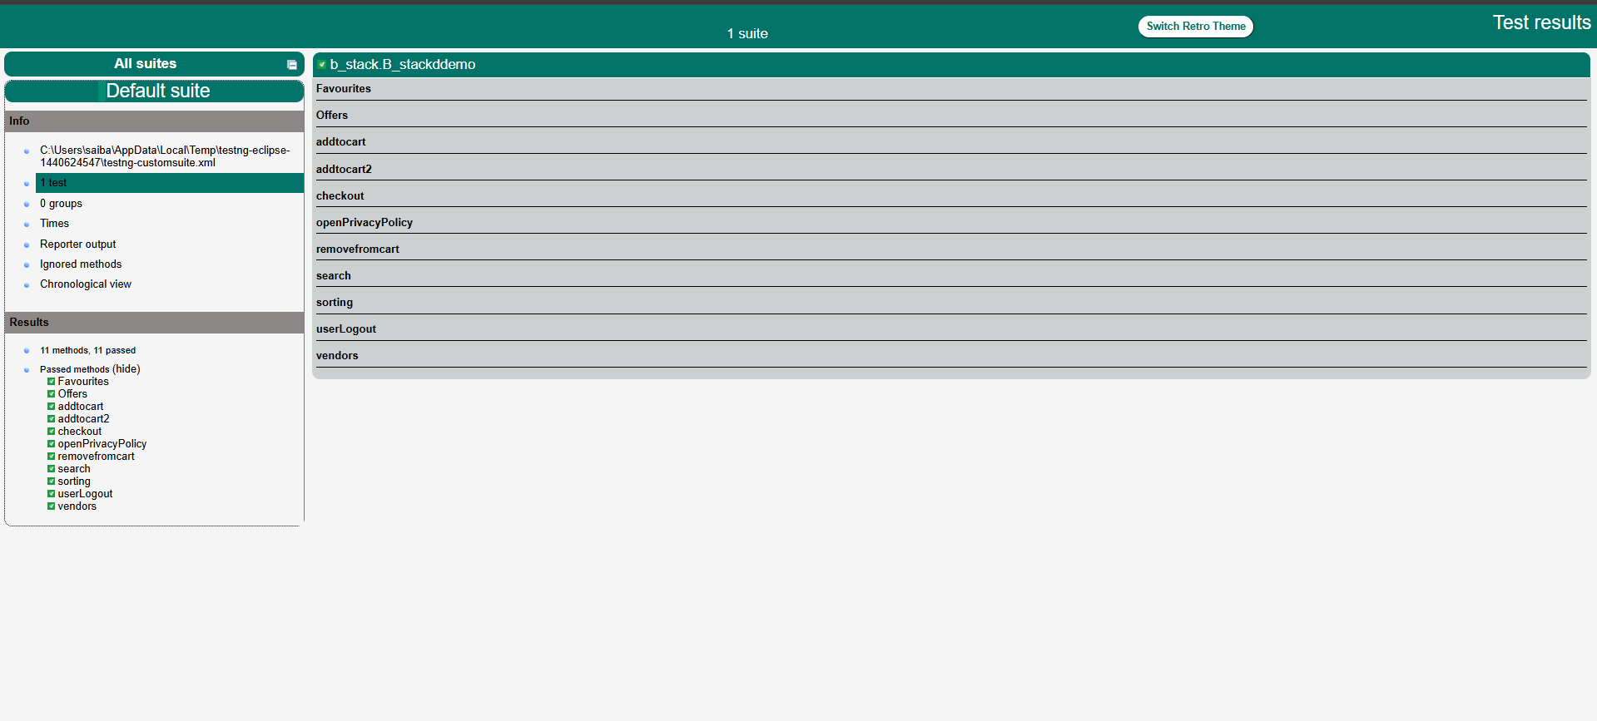
Output

Slide 6
Cucumber BDD Framework
Scenarios: Wrote tests in simple English (Gherkin).
Collaboration: Easy for non-technical people to read and understand.
Reuse: Used the same POM code as in TestNG(Changes made only for search and checkout using Scenario Outline).
Data Tests: Used examples table to test with different inputs.

Slide 7
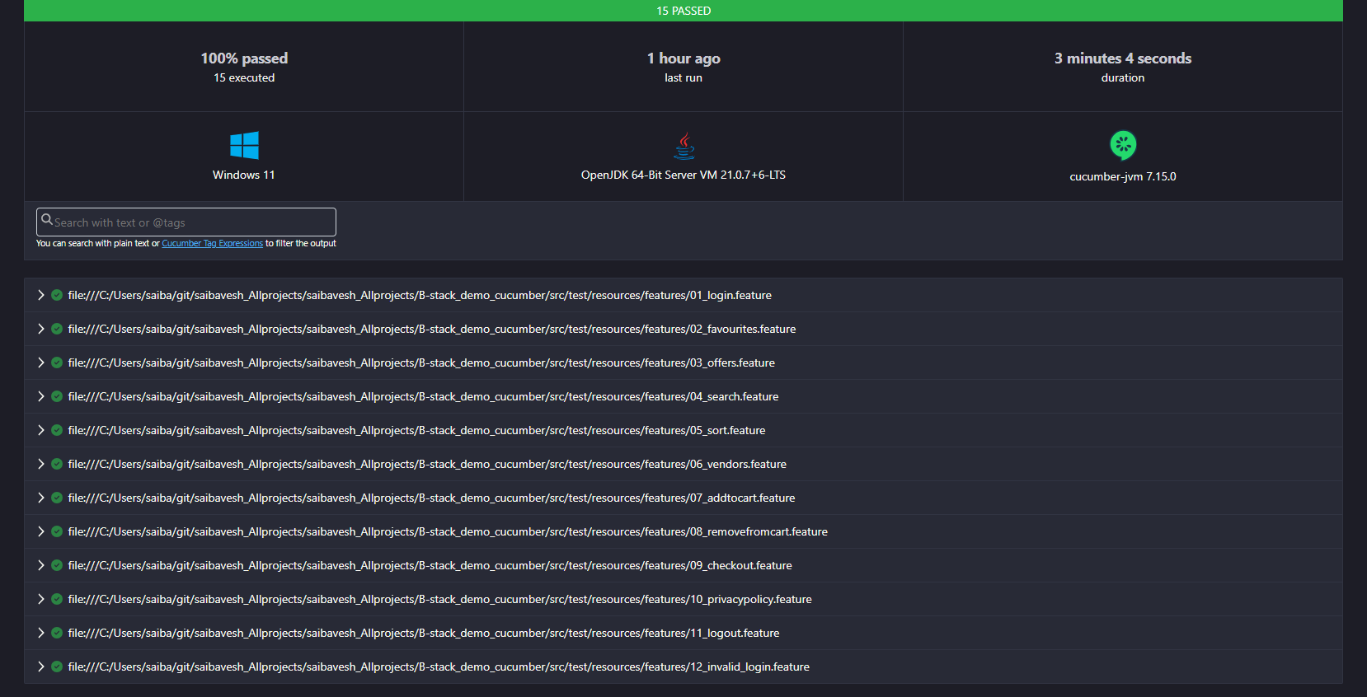
Output

Slide 8
TestNG vs Cucumber
TestNG: Good for coders, complex tests, and data from Excel.
Cucumber: Good for teams, clear test descriptions, and examples in tables.
Choice: Depends on who writes and reads the tests.
Similar: Both work well with Selenium and Jenkins.

Slide 9
Jenkins Integration
Automation: Jenkins runs tests automatically.
Setup: Made separate jobs for TestNG and Cucumber.
Command: Used mvn clean test to run all tests.
Reports: Jenkins shows logs and results after each run.

Slide 10
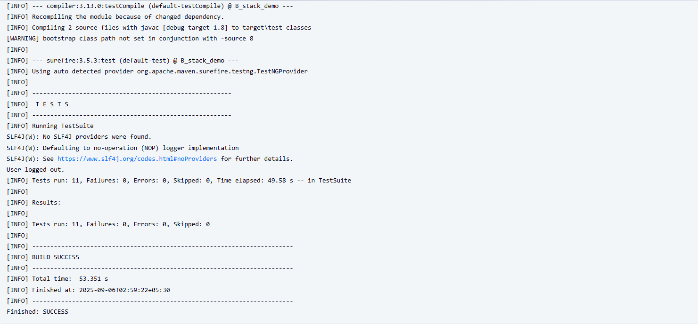
Output – TestNG(Maven)
.

Slide 11
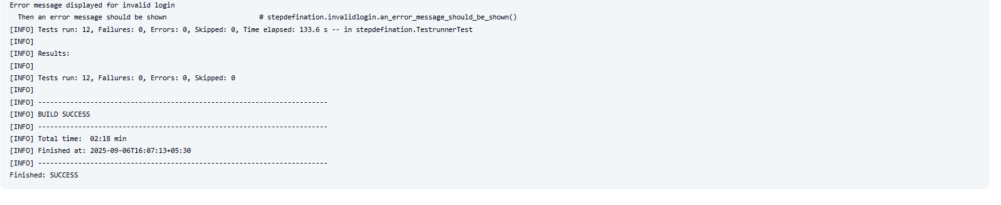
Output – Cucumber(Maven)
.

Slide 12
Problems & Solutions
Dynamic Elements: Used waits to make sure elements load.
Excel Data: Used Apache POI to read from Excel files.
Popup Errors: Used JavaScript click when normal click failed.
Sync Issues: Added explicit waits for slow-loading pages.

Slide 13
What I Achieved
Coverage: Automated 15+ user flows on the website.
Reliability: Tests are consistent and reduce manual effort.
Reuse: Shared code between both frameworks.
CI/CD Ready: Tests can run automatically in Jenkins.

Slide 14
Conclusion
TestNG: Better for technical teams and data-driven tests.
Cucumber: Better for teamwork and clear test language.
Both Work: You can choose based on your project’s needs.
Jenkins: Essential for running tests again and again.

Slide 15
What’s Next?
More Browsers: Test on Firefox, Edge, etc.
Mobile Tests: Use Appium for phone/tablet testing.
Docker: Run tests in containers for better scaling.

Slide 16
Thank you!

