Slide 1

REACT js Project Presentation
Project Title: Pharmacy Management System
Course: ReactJS
Student Name : Bavisharmi K
Roll No: 24BIT106
Department : Information Technology
Mentor / Guide : Mr. Aravind

Slide 2
Introduction
Pharmacy Management System is a web application
Used to manage medicines, billing, and records
Reduces manual work and errors
Fast and user-friendly system

Slide 3
Objectives
To digitize pharmacy operations
To manage medicine details easily
To generate bills quickly
To improve efficiency and accuracy

Slide 4
TECHNOLOGIES USED
Frontend: React
Routing: React Router
Build Tool: Vite
Languages: HTML, CSS, JavaScript

Slide 5
SYSTEM ARCHITECTURE
Component-based structure
Pages connected using routing
Data handled inside components
Simple and modular design

Slide 6
Medicines Management
Add new medicines
View medicine list
Update medicine details
Delete medicines

Slide 7
Billing System
Select medicines
Calculate total price
Generate bill
Fast and accurate billing

Slide 8
Advantages
Saves time
Reduces manual errors
Easy to use
Organized data management

Slide 9
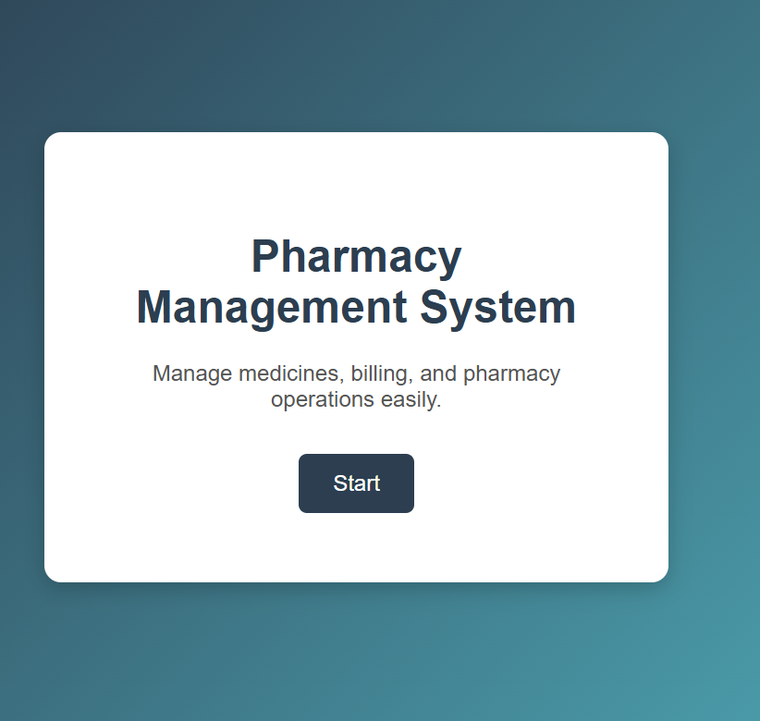
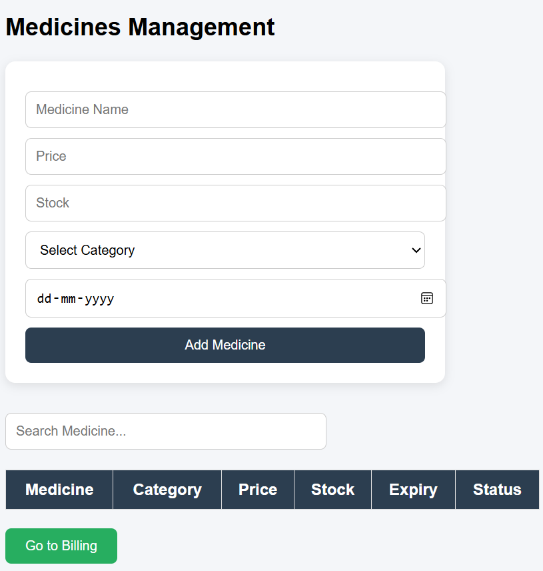
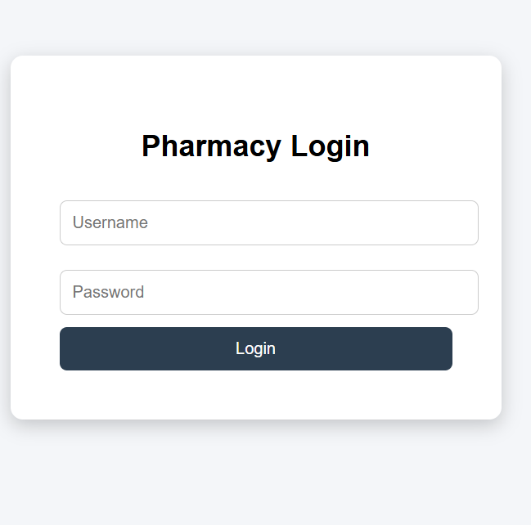
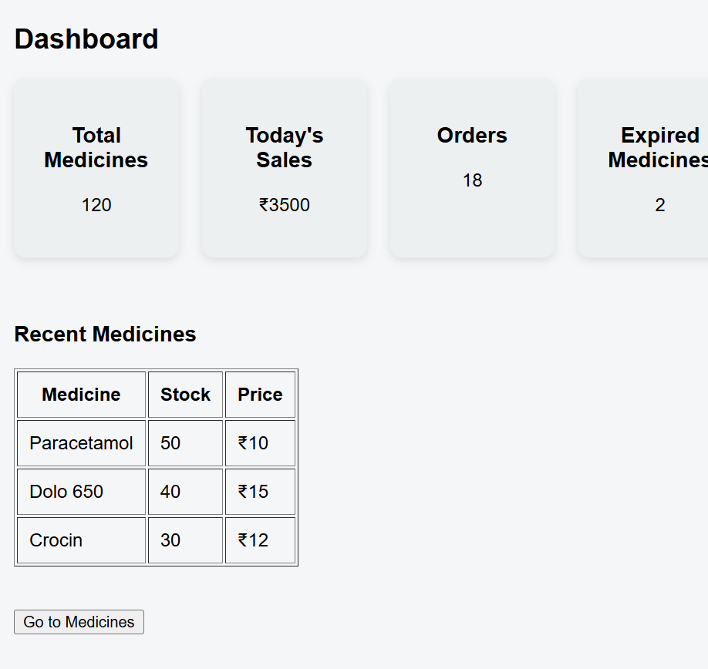
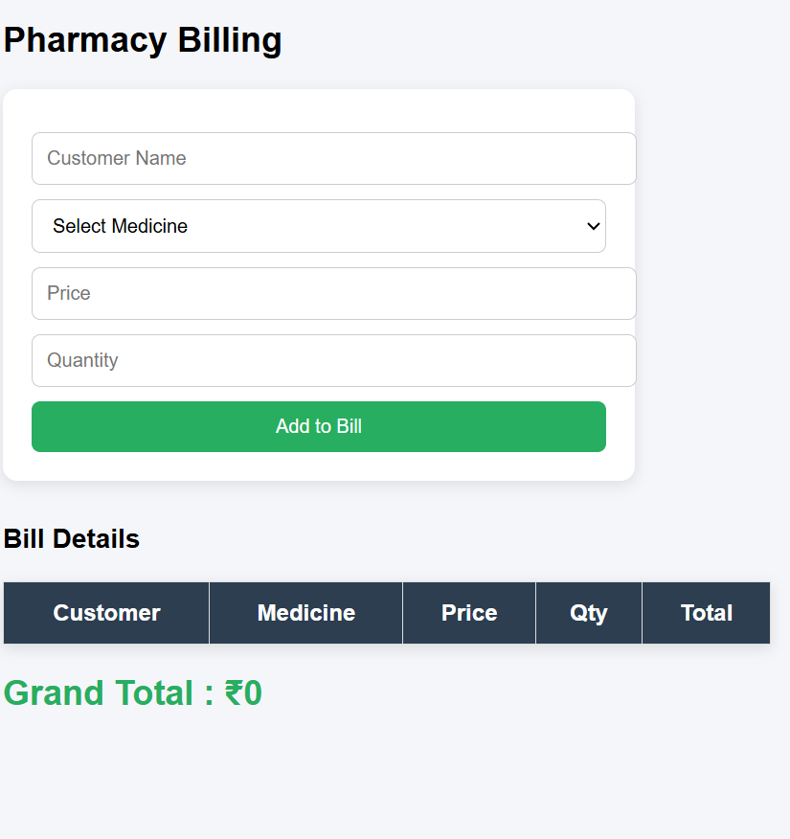
Output Screens

Slide 10
Conclusion & Future Scope
Project improves pharmacy workflow
Can be extended with:
Database integration
Online payment system
Stock alerts
Reports generation

Slide 11
Thank You

