Slide 1
Touch? Live
DJ Panel -- Training Guide
Control the crowd from your browser
touch-irl.com/dj

Slide 2
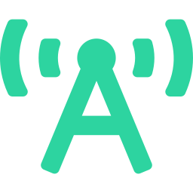
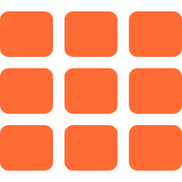

What is the DJ Panel?
The DJ Panel is a browser-based control room where you manage your audience's phone screens in real-time during live events.
How it works
1
Log in at /dj
Broadcast
Create a session
2
Send animations, colors, and effects to every connected phone
3
Share the link or QR
32 Animations
4
Audience joins with phones
From pulse and fire to multi-phone alignment effects
5
You control their screens
Crowd Control
Zones, calibration, positioning, and coordinated light shows

Slide 3

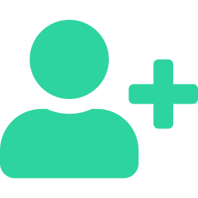
Step 1: Login / Sign Up
Access the DJ Panel at touch-irl.com/dj
Log In
Sign Up
Google Sign-In
One-click login with your Google account
Email + Password
Use the same credentials as your Touch? account
Forgot Password?
Enter email and click to receive a reset link
Required fields:
DJ / Artist Name
Your stage name shown to audience
Email Address
Used for login and notifications
Password (min 6 chars)
Birthdate (18+ required)
Age verification is mandatory

Slide 4
Step 2: Create Your Session
Event Pricing Tiers
Session Setup
Session Name
Name your event (e.g. "Sunset Festival 2026")
Venue Frequency
Select Hz slot (18000-19800). Default: 19200 Hz
Each slot avoids interference with nearby DJs
Free
$100
Up to 10 people
11 - 500 people
$1,000
$2,000
501 - 5,000
5,000+
Tier limits the max connected devices per event. Server enforces the cap.

Slide 5
The Main Interface
Stats Bar
9 Control Drawers
Devices, BPM, Time
1. Venue Map -- Bird's eye crowd view
2. Master Controls -- Kill, Flash, Music Sync
3. Color & BPM -- Palette and tempo
4. Animations -- 32 visual effects
5. Show Mode -- 50+ choreographed shows
6. Zones -- Split audience into zones
7. Calibration -- Sound distance measurement
8. Positioning -- Depth, Mesh, GPS, Compass
9. Raffle -- Random winner picker
Stage Preview
Live animation preview with logo
Aquarium
Audience count visualization
Activate Button
Start / Stop broadcasting
9 Control Drawers
All expandable sections below

Slide 6

Broadcasting & Stage Preview
Activate Button
Sharing with Audience
Press the big circle button to start broadcasting.
When active:
- Ultrasonic signal emits from your speakers
- Share URL and QR code appear
- Audience phones connect automatically
When you activate broadcasting:
QR Code
A QR code appears that audience can scan. Display it on a big screen or project it.
Share URL
Copy the direct link and share via social media, SMS, or announce it verbally.
Ultrasonic Signal
Your phone continuously emits an ultrasonic tone. Nearby phones with Touch? open detect it and auto-join.
Stage Preview
Live preview of what audience sees.
Shows your DJ logo, artist name, session name, and the current animation in real-time.
Upload a custom logo for branding.

Slide 7


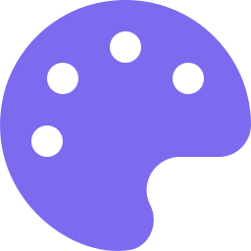
Animations & Colors
Free Animations (19)
Plus Animations (13)
Pulse, Fire, Ocean, Strobe, Rainbow, Laser, Confetti, Electric, Solid, Connect, Mirror, Spectrum, Waveform, Plasma, Starfield, Bars, Rain, Ripple, Heartbeat
Mosaic Wave, Giant Heart, Fire Wall, Text Scroll, Infinite Tunnel, Crosslines, Smoke, Glitch, Tunnel, Bubbles, Cascade, Lava, Vortex
Requires Plus subscription to unlock
Color & BPM Controls
12 color presets + custom color picker. BPM slider (60-200) with presets at 80, 100, 128, 140, 174. Animation speed control from 0.5x to 3x. Auto Cycle mode rotates through animations automatically.

Slide 8



Shows & Quick Actions
Quick Actions
Show Mode (50+ Shows)
FLASH
Instant white flash on all phones
PULSE / BLACKOUT / SOLID / STROBE
One-tap effect changes
CONFETTI / RAINBOW
Celebratory crowd moments
Pre-choreographed light shows that sync across all phones.
Standard: Wave, Heart, Stadium, Countdown...
Advanced: Scanner, Pixel Rain, DNA Helix, MEGA SHOW
Split Mode: Battle, Cross Wave, Chase
Drone Library: 12 aerial formation patterns
Kill Switch
Live Text
Emergency button that immediately blacks out all connected devices. Press again to restore. Use if anything goes wrong.
Type a message and it scrolls across all audience phones in real-time. Great for announcements, shoutouts, or song titles.

Slide 9
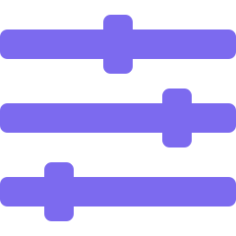





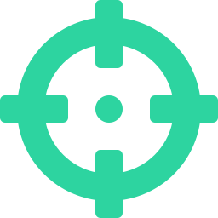
Zones & Positioning
Zone Control
Position Mapping
Split the crowd into separate color zones.
Zone Count: 1, 2, 4, 6, or 8 zones
Alternate Mode
Devices cycle through zones: 1-2-1-2-1-2...
Half Split Mode
Left half = zone 1, right half = zone 2, etc.
Depth Scan
Ultrasonic pulse measures distance from stage
Mesh Scan
Phones discover neighbors via short chirps
GPS
Request GPS coordinates (outdoor events)
Compass Cal
Set stage direction for left-right positioning
Sound Calibration
Press "Calibrate Now" to emit a short ultrasonic burst from your speakers. Each phone in the audience detects the pulse via microphone, measures the time delay, and calculates its distance from the stage (speed of sound = 343 m/s). Results appear as front-to-back positions on your position map.

Slide 10
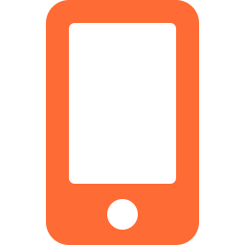
DJ Profile & Badges
Your DJ Profile
Multi-Phone Alignment
Show Counter
Tracks how many events you've done. Increments automatically when you stop broadcasting.
Verified Badge
Paid identity verification. Confirms you as a professional DJ. Shows a green "Verified" badge next to your name.
Plus Badge
Subscription that unlocks 13 premium animations including multi-phone alignment effects.
Plus-only animations where people align their phones side-by-side to form one continuous image across multiple screens:
Mosaic Wave -- flowing color wave
Giant Heart -- heart across all screens
Fire Wall -- wall of fire
Text Scroll -- scrolling text banner
Infinite Tunnel -- tunnel perspective

Slide 11

Venue Map & Raffle
Venue Map
Raffle
Bird's-eye view of your audience with real-time device positions.
Scene Presets:
House Party (~20), Club (~200), Festival (~2k), Arena (~15k), Stadium (~50k)
Features:
Zoomable canvas, venue shape selection, device count overlay, simulation mode for testing.
Pick a random winner from connected audience devices.
One button to start.
Great for giveaways, prizes, or picking someone to come on stage.
Operator Integration
The DJ Panel is also embedded inside the Operator event console. Changes in one are reflected in the other -- same code, same features. Operators access it as a module within their event dashboard.

Slide 12
Touch? Live
Pro Tips
Quick Reference
Test with 2-3 phones before the event to check your frequency slot
Use Auto Cycle during warmup, switch to manual for key moments
Flash + Blackout combo creates dramatic drops
Run Calibration early so position features work during the show
Keep your phone plugged in -- continuous ultrasonic output drains battery
Display the QR code on a projector for easy audience join
Zone mode with 4 zones creates the best visual waves
URL
touch-irl.com/dj
Animations
32 total
Shows
50+ choreographed
Zones
Up to 8
Free tier
10 devices
Max tier
Unlimited
Control the crowd.

