Slide 1

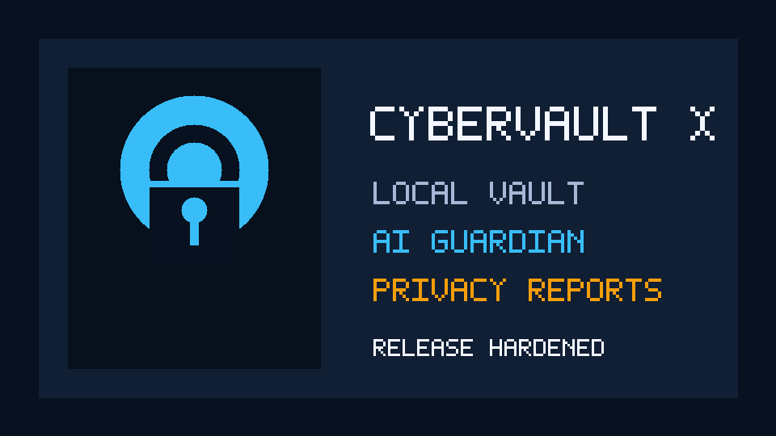
CyberVault X
Secure Password Manager with Local Encryption at Rest
CET334 - Cryptographic Algorithms & Protocols
Local-first
AES-GCM
PBKDF2
AI-style Local Security Coach
Professional release package: source code, tests, final report, presentation deck, and live demo plan.

Slide 2
CyberVault X
v5.7.2
Problem & market need
Password reuse turns one leaked account into many compromised accounts.
The user problem
The security problem
The academic problem
People save many passwords, reuse weak patterns, and rarely know which accounts are risky.
A plaintext or weak vault becomes a single point of failure. The vault must protect secrets even if the database is copied.
The project must prove real cryptographic implementation, working code, documentation, and live demo readiness.
100+
0
1
20/20
online accounts per user
cloud uploads required
local encrypted vault
target presentation grade

Slide 3
CyberVault X
v5.7.2
Solution overview
CyberVault X is a local encrypted password manager with security intelligence built around the vault.
Encrypted Vault
Security Center
AI-style Local Security Coach
AES-GCM encrypted credential fields stored locally in SQLite.
Weak, reused, breached, stale, and metadata risk analysis.
Local deterministic advisor that turns findings into priority actions.
Proof Center
Report Package
Release Ready
Verifies encrypted schema, audit chain, backup preview, and report package hashes.
Privacy-safe executive report, audit log, AI summary, and manifest.
Tests, build script, preflight checks, final report, and presentation deck.

Slide 4
CyberVault X
v5.7.2
Architecture
UI
Manager
Services
Crypto
SQLite
Tkinter screens
Dialogs
Demo flow
Vault actions
Settings
Auth state
Backup
Reports
AI-style Local Security Coach
Proof checks
AES-GCM
PBKDF2
SHA hashes
Encrypted rows
History
Audit log
✓
Service separation keeps crypto/database logic reusable if UI is migrated to PyQt5.
✓
All vault analysis is local; no raw secrets are sent to external services.
✓
Release preflight validates structure, docs, dependency readiness, and breach-list format.

Slide 5
CyberVault X
v5.7.2
Cryptographic workflow
Master password
PBKDF2-SHA256
AES-GCM
AAD binding
SQLite
Never stored directly
Derives vault key
Encrypts fields
Credential + field context
Nonce/cipher pairs
Why this matters
Demo proof
The database can be copied, but encrypted credential fields remain protected without the master password. AES-GCM also rejects tampered ciphertext.
Security Proof Center checks encrypted schema, AAD migration status, audit-chain validity, and report integrity.

Slide 6
CyberVault X
v5.7.2
Core requirement coverage
Encrypted Password Vault
AES-GCM field encryption, local SQLite, encrypted history
Master Password
PBKDF2-SHA256, policy validation, unlock throttling
Generator
Configurable length/classes, entropy feedback, presets
Offline Demo Breach-Subset Check
Offline SHA1 dataset with local lookup
Strength Analysis
Weak/reused/breached/stale score and recommendations

Slide 7
CyberVault X
v5.7.2
Product-grade upgrades
AI-style Local Security Coach
Security Proof Center
Tamper evidence
Local advisor: priority queue, attacker view, fix path, business impact, and projected score gain.
One place to prove crypto posture, audit-chain validity, backup preview, and report verification.
Audit events use previous-hash and event-hash linkage to expose log modification.
Encrypted backup
Report package
Release preflight
Preview restore impact, handle duplicates, rollback on failure, and keep backup metadata versioned.
Exports HTML reports, AI summary, manifest hashes, and local signature verification.
Validates docs, tests, structure, dataset format, and presentation assets before packaging.

Slide 8
CyberVault X
v5.7.2
Testing & validation
Testing proves that the app is more than a UI demo.
✓
AES-GCM backup roundtrip and wrong-passphrase failure
Commands
✓
AAD blocks encrypted-field swaps between records/fields
python -m pytest -q tests
python tools/release_preflight.py
build_release.bat
✓
Backup import rolls back if validation fails mid-transaction
✓
Report package verifier detects tampered artifacts
✓
AI-style Local Security Coach payloads are redacted and privacy-safe
✓
Release preflight checks final submission assets
pass/fail
automated proof

Slide 9
CyberVault X
v5.7.2
Live demo path
01
Create or unlock vault
06
Generate replacement password
02
Create Assessment Workspace
07
Run Security Proof Center
03
Dashboard health score
08
Export and verify report package
04
Security Center findings
09
Encrypted backup preview
05
Generate AI-style Local Security Coach plan
10
Panic lock
Goal: show encryption, analysis, proof, reports, and safe failure handling in one smooth story.

Slide 10
CyberVault X
v5.7.2
Honest limitations
Breach database
Runtime memory
Local manifest integrity signature
Bundled file is a small offline demo subset. Future: custom import wizard or HIBP k-anonymity.
Python cannot fully guarantee string zeroization. Auto-lock and clipboard clearing reduce exposure.
HMAC provides local manifest integrity. Future: Ed25519 public verification key for independent proof.
GUI toolkit
Commercial-style academic readiness
Screenshots
Tkinter improves portability. Service layers allow future PyQt5 migration if required.
Commercial-style academic prototype. Future production version needs external audit, installer signing, and secure-memory hardening.
Real screenshots must be captured on the Windows demo machine after building the EXE.

Slide 11
CyberVault X
v5.7.2
Final submission package
What the instructor receives
Grade mapping
✓
Source code with clear folders and requirements files
✓
Automated tests and release preflight script
8
4
✓
Final PDF report and markdown source
functionality
code/docs
✓
PowerPoint presentation deck
✓
README, security model, privacy, limitation, and demo docs
5
3
✓
GitHub plan showing team contribution split
✓
Windows EXE and screenshots after local build
presentation
Q&A

Slide 12
CyberVault X
Local encryption. Practical security. Demo-ready proof.
Q&A
Prepared answers cover AES-GCM, PBKDF2, AAD, offline demo breach-subset detection, AI-style Local Security Coach privacy, Tkinter choice, and project limitations.

