Slide 1
Electric Vehicles Data Analysis
- Mehar Singh Bawa

Slide 2
Objectives
Analyzing Charging Efficiency, CO₂ Emissions, and Environmental Impact.
The project explores the economic benefits and sales trends of Electric Vehicles (EVs) compared to traditional gasoline vehicles.
Evaluate how charging infrastructure development influences EV adoption rates to optimize future investments.

Slide 3
Dataset Description and References
Primary Datasets:
U.S. Department of Energy FuelEconomy Dataset (fueleconomy.gov)
IEA Global EV Data Explorer (iea.org)
Kaggle Electric Vehicle Population (kaggle.com)
Fact Tables:
VehicleInfo - Make, Model, Year
EVSales – RegionSold, SalesAmount, Quantity sold
FuelEconomy - MPG ratings, Annual Fuel Costs, CO₂ per mile
EVPerformance - Electric range, Charge times
EVInfrastructure – ChargeType, ChargePointLocation, NumberOfChargingPoints
Emissions - SmartWay, Smog Ratings

Slide 4
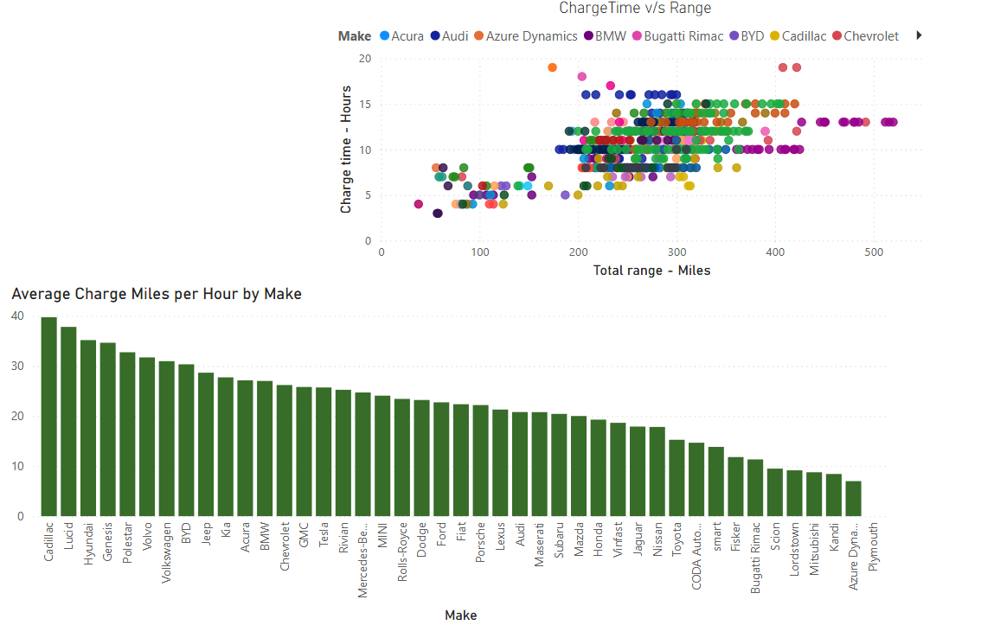
Q: Which EV brands offer the most efficient charging

Slide 5
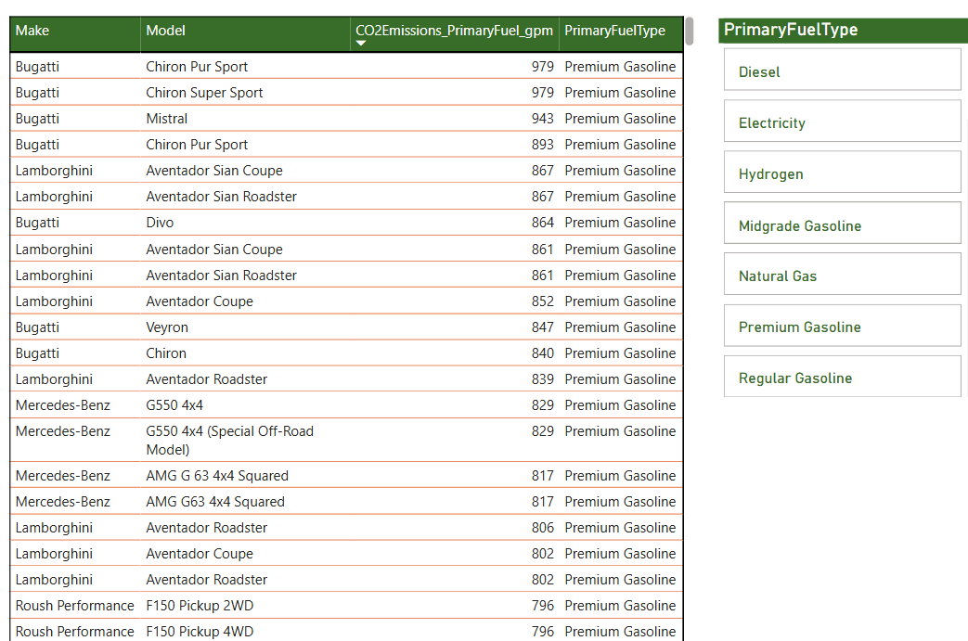
Q: Which models exhibit the highest CO₂ emissions per mile?
High CO₂ emitters are concentrated among luxury and high-performance gasoline vehicles.
CO₂ emissions measured in grams per mile (g/mi), representing the rate of greenhouse gas output per mile traveled.

Slide 6
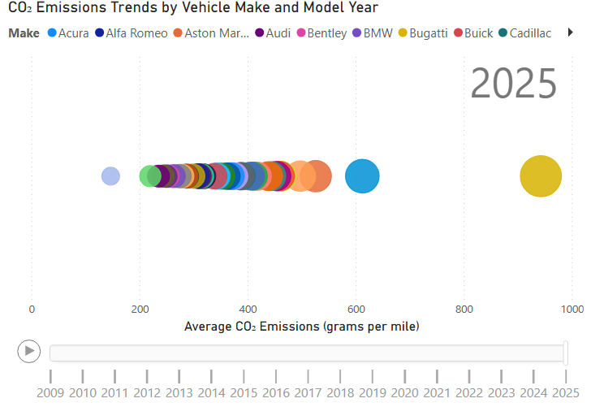
Q: How have average vehicle CO₂ emissions changed over time, across different manufacturers?
While many brands remain in the 300–500 g/mi range, certain luxury makers like Bugatti continue to push that number much higher — even close to 1000 grams per mile in 2025 — making them major contributors to long-term emissions impact.

Slide 7
EV Economic and Sales Standpoint
Data Granularity Levels Across Our Model
Tables | Granularity
VehicleInfo, FuelEconomy, EVPerformance | VehicleID-Year
EVSales, EVSalesShare | Region-Year-VehicleType
YearTable | Year
Region | Region Name
• Vehicle-Level Granularity:
All economic analysis is at the vehicle configuration level, uniquely defined by VehicleID and ModelYear.
• Region-Level Granularity:
All market penetration and EV share metrics are evaluated per region, year, and EV type, allowing macro and global level comparison.

Slide 8
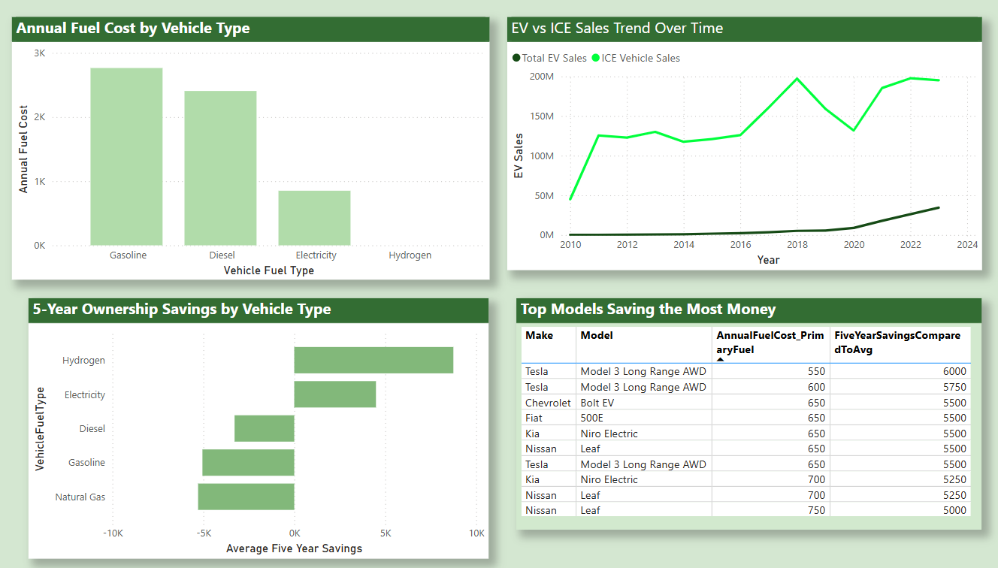
Q: Are EVs Economically Better Over Time?
Compares Electric Vehicles (EVs) to Internal Combustion Engine (ICE) vehicles based on fuel costs and ownership savings.

Slide 9
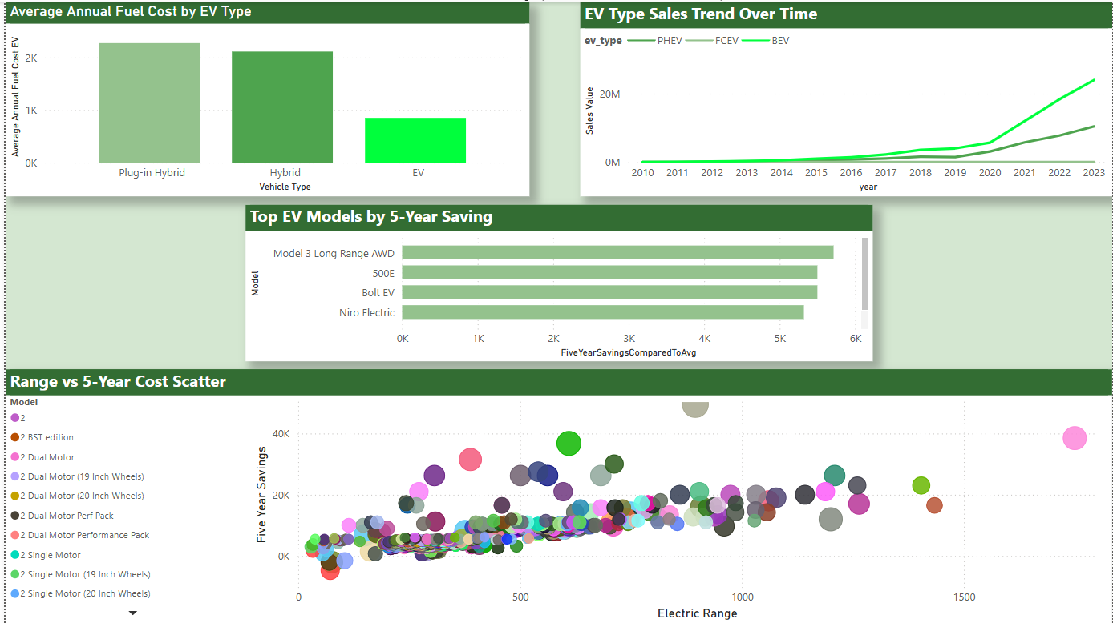
Q: Which EV Type Offers Best Return? And Which Models?
Analyzes different EV types (BEV, PHEV, Hybrid) to identify which offers the best economic return. Also, highlights specific EV models offering the highest five-year ownership cost savings.

Slide 10
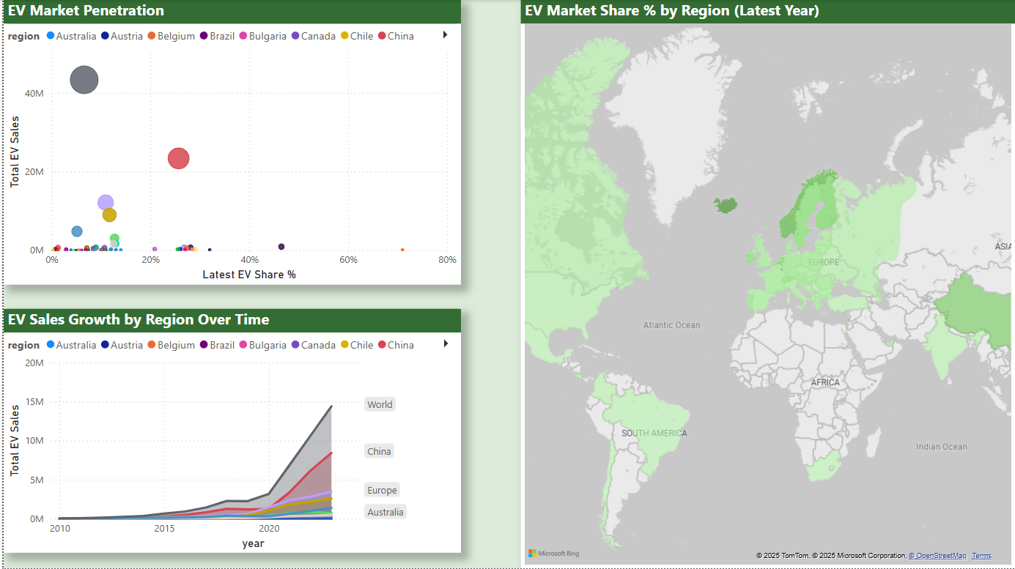
Q: Which Regions Are Emerging as the Most Economically Viable EV Markets?
Investigates regional EV adoption trends and market. Highlights the most promising regions for future EV investment.

Slide 11
EV Economic and Sales Standpoint
Key Results
Electric Vehicles provide a compelling economic advantage over traditional ICE vehicles.
Battery Electric Vehicles (BEVs) lead the EV market in terms of both cost savings and market growth.
Tesla Model 3, Chevrolet Bolt EV, and Nissan Leaf emerged as top models with the best savings.
Regional market analysis suggests that China, Norway, and Europe represent the most promising opportunities for EV adoption and investment.

Slide 12
EV Infrastructure and Future
Data Granularity Levels Across Our Model
Tables | Granularity
EVPerformance | EVPrice-Range-Efficiency-Brand
EVInfrastrucure | Region-Year-ChargeType
Calendar | Year
Region | Region Name
• Infrastructure Table:
Measures such as Yearly Charging Point Growth, Fast Charge Ratio, Fast Charger, Sum of Charging Points.
• Region-Level Granularity:
All market penetration and EV share metrics are evaluated per region, year, and Charging Point type, allowing macro and global level comparison.

Slide 13
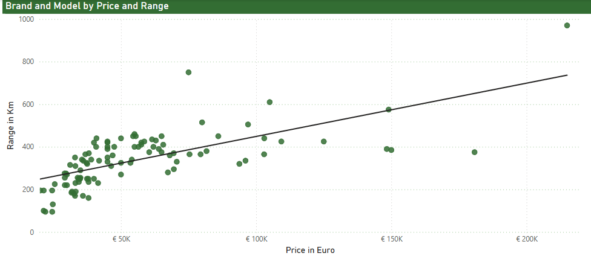
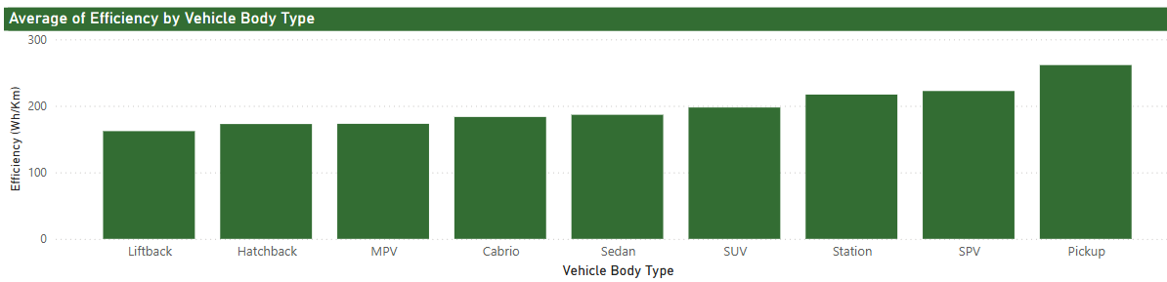
Q: How does EV performance vary by price and which brands offer the best value?
Tesla delivers exceptional range across both premium and mid-price segments, outperforming rivals at similar price points—demonstrating superior battery technology
Compact body types (Hatchbacks, Liftbacks) achieve the best efficiency (<170 Wh/km), while SUVs and luxury sedans are least efficient (>200 Wh/km)

Slide 14
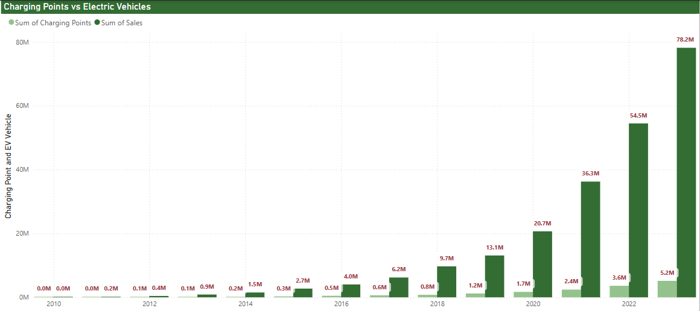
Q: How do annual EV sales correlate with new charging points installed each year?
EV sales and charging point installations show parallel growth trajectories

Slide 15
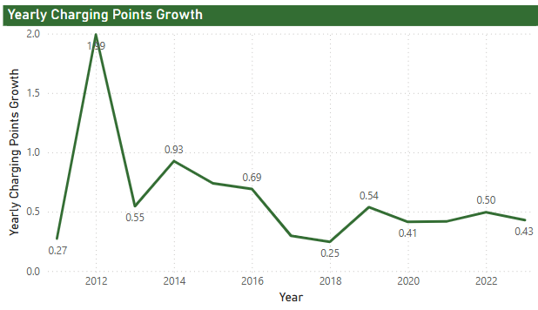
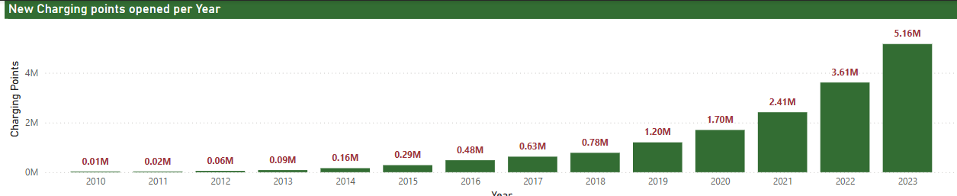
Q: How many charging points were opened in each year and what was YoY growth?
Line chart highlights fluctuating growth rates, with the highest surge in 2012 (199%) and stabilization to 43.5% by 2023 as the market matures.
The chart below shows yearly installations of EV charging points, peaking in 2023 with 5.16M new units, reflecting accelerating global infrastructure development.

Slide 16
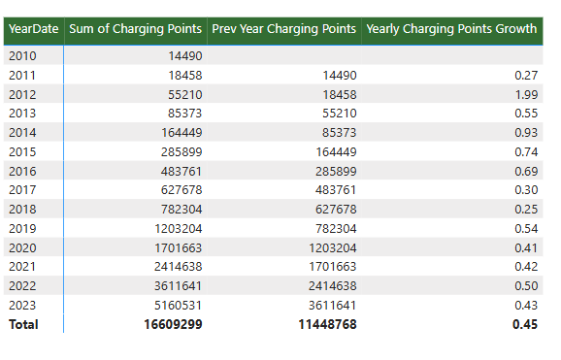
EV Infrastructure

Slide 17
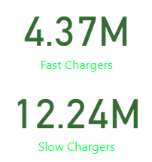
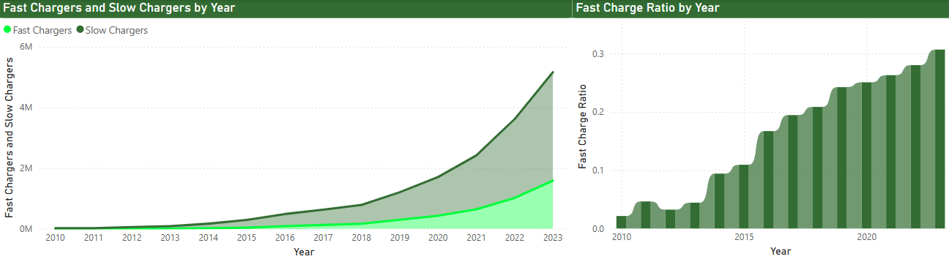
Q: How has the ratio of fast EV charging points yearly, and what growth patterns emerge?
The fast-to-slow charger ratio steadily rose from 0.02 (2010) to 0.3 (2023), reflecting prioritization of fast-charging networks to meet long-distance travel demands.
While slow chargers still lead in volume, the accelerating fast-charger ratio reveals strategic investments to reduce EV adoption barriers.

Slide 18

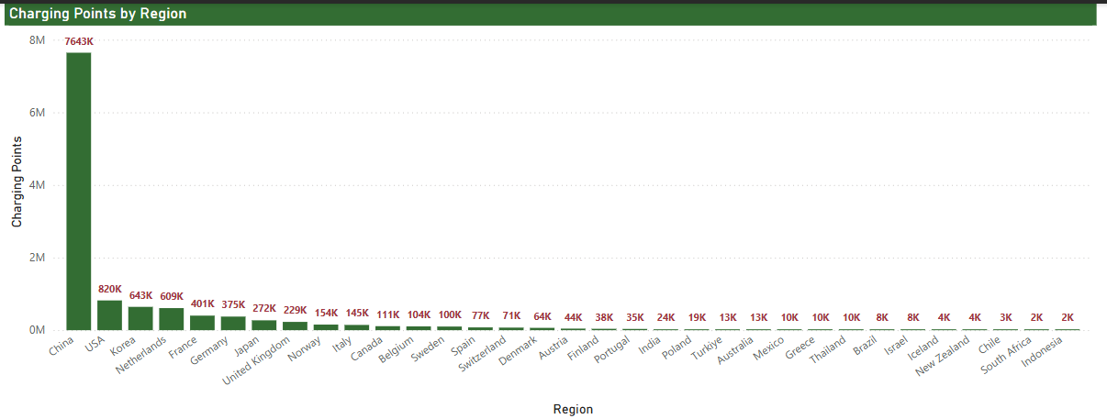
Q: What is the total number of charging points in each region, and which 5 countries have the highest counts?
China dominates global EV infrastructure with 7.6M charging points—10x more than the USA (820K)—revealing stark regional disparities in adoption readiness
Top 5 countries representing 85% of global charging infrastructure.

Slide 19

EV Infrastructure
Below bubble world map highlight Asia's outsized density versus scattered distribution in the other regions.

Slide 20
Thank You. QnA?

