Slide 1

Phoenix Inventors
05-01 Dr. Wu
Ash "Recordist" Ryan, Alexander "Assembler" Washington, William "Electric" Carroll, Richard "Coder" Carter

Slide 2
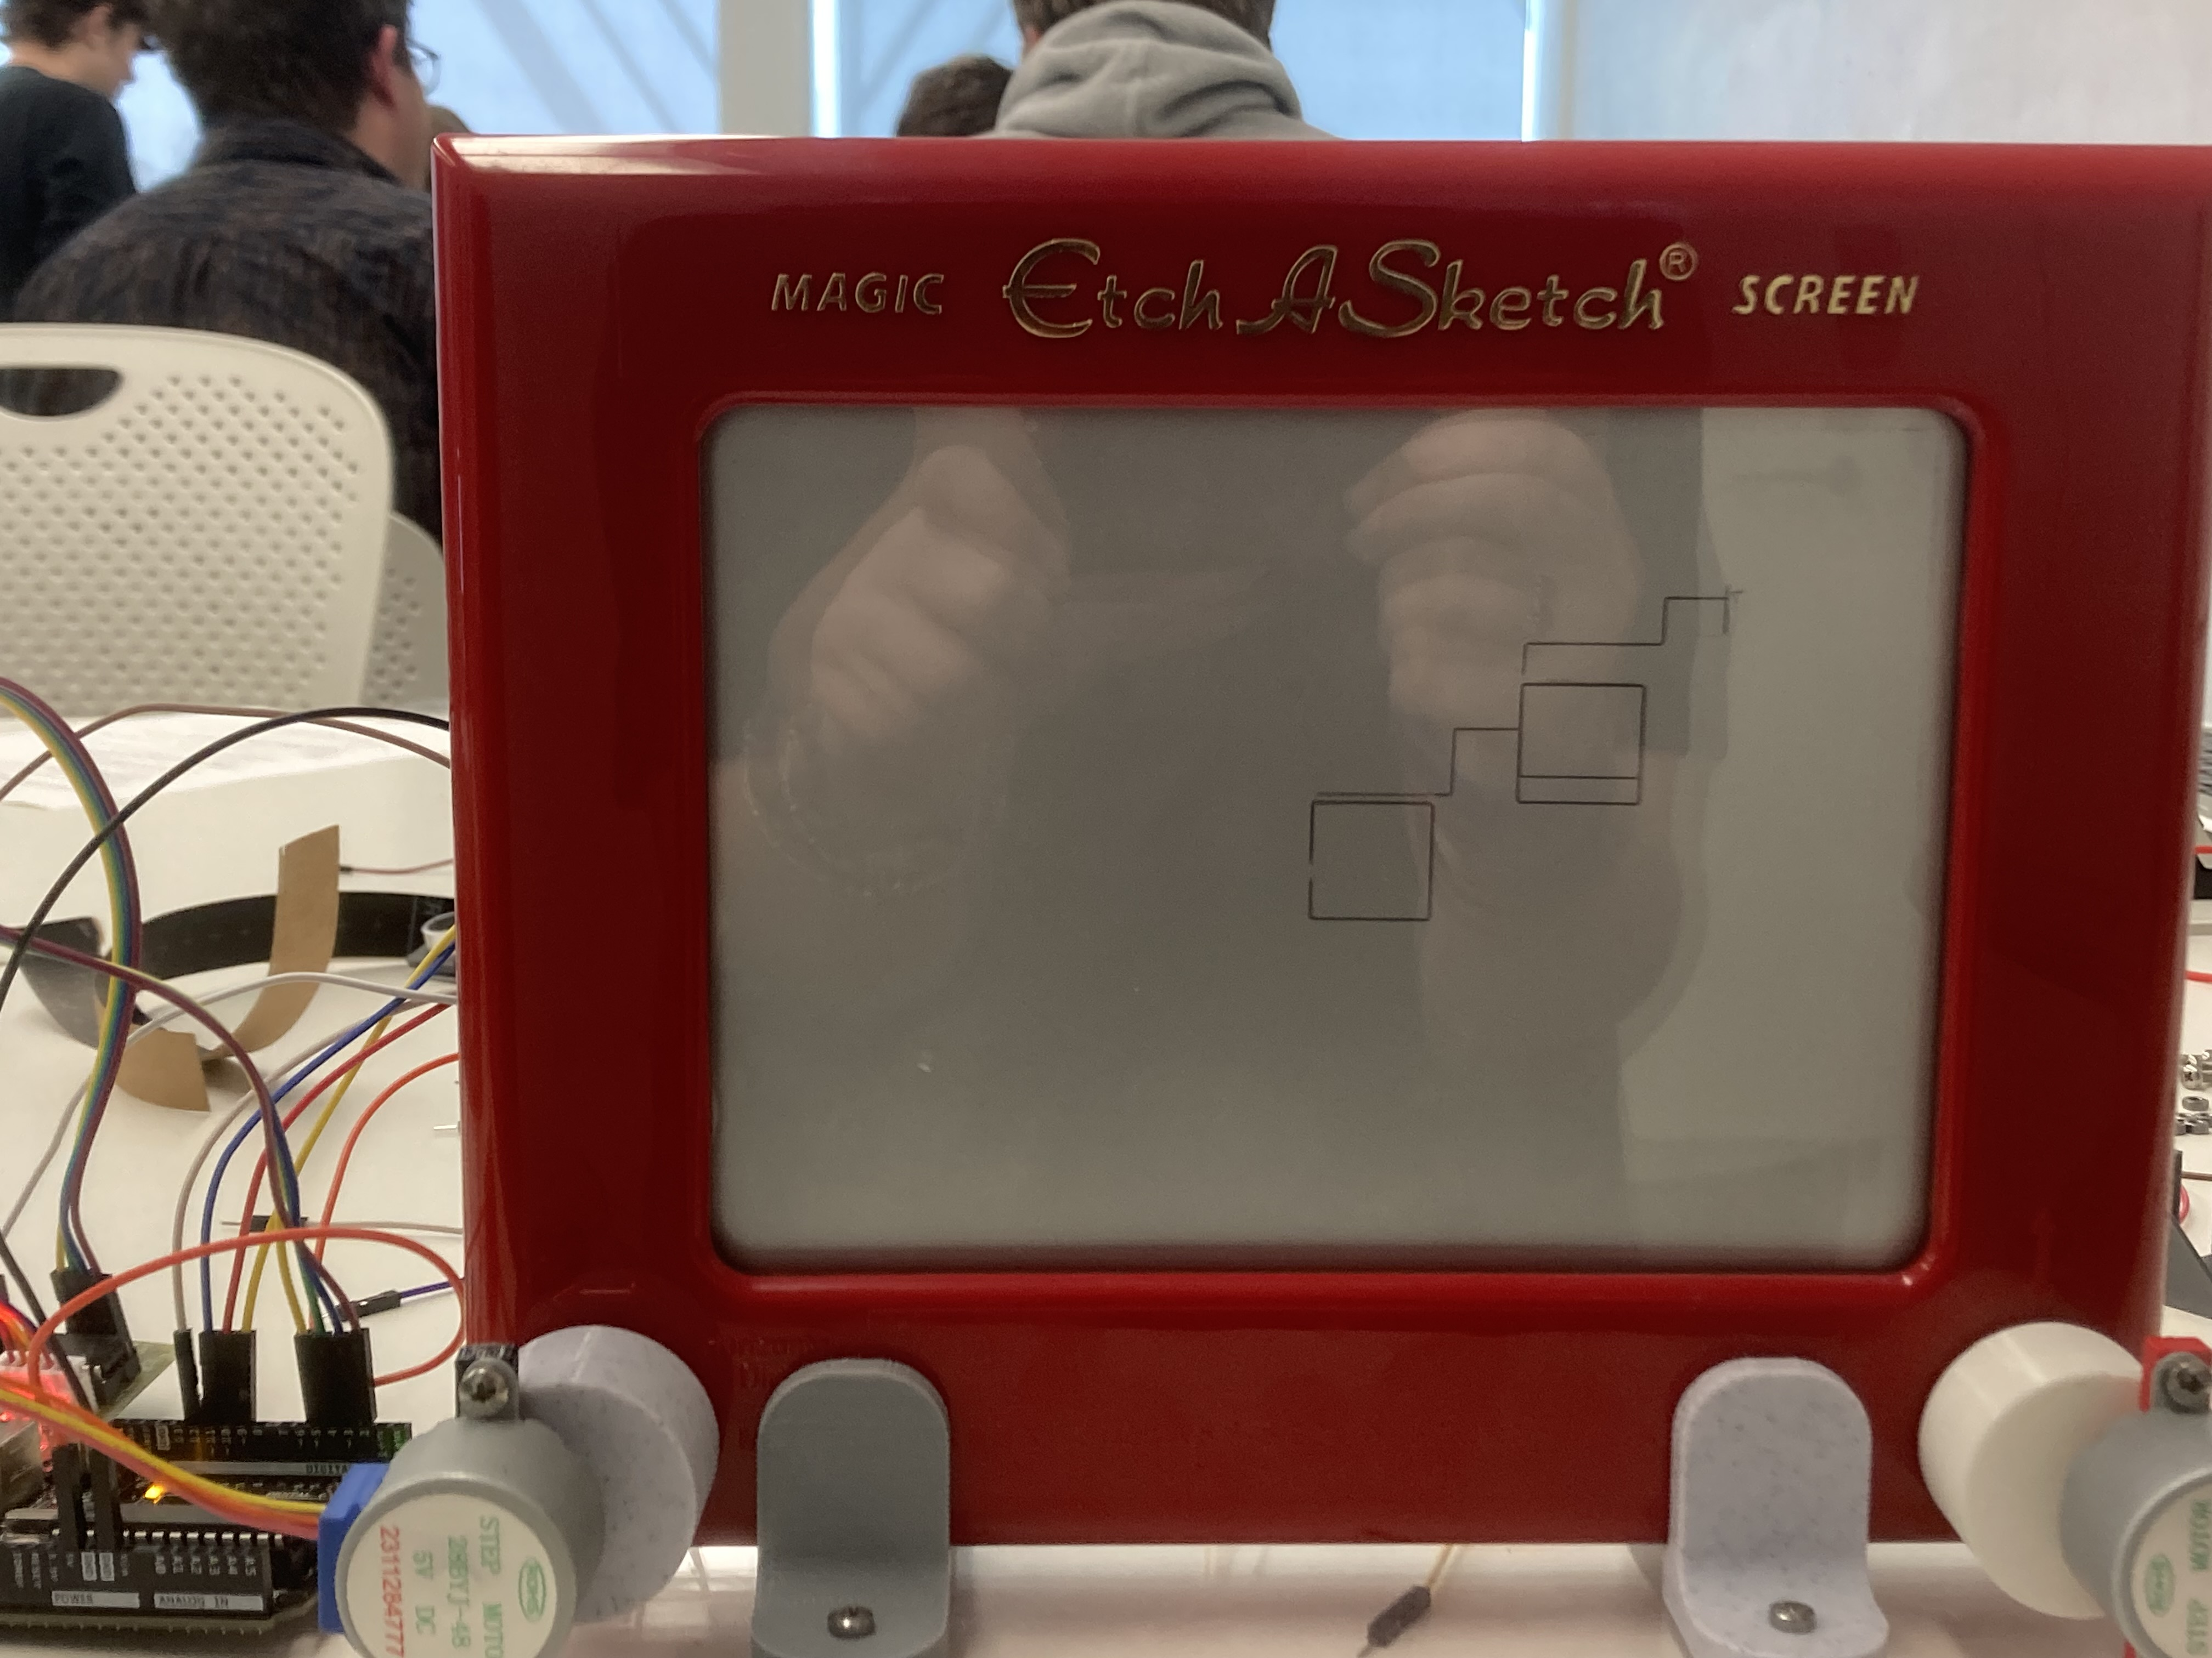
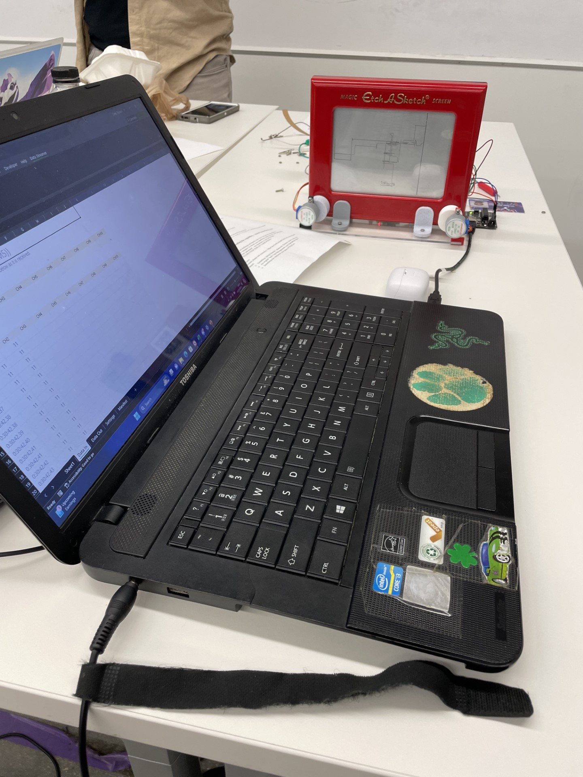
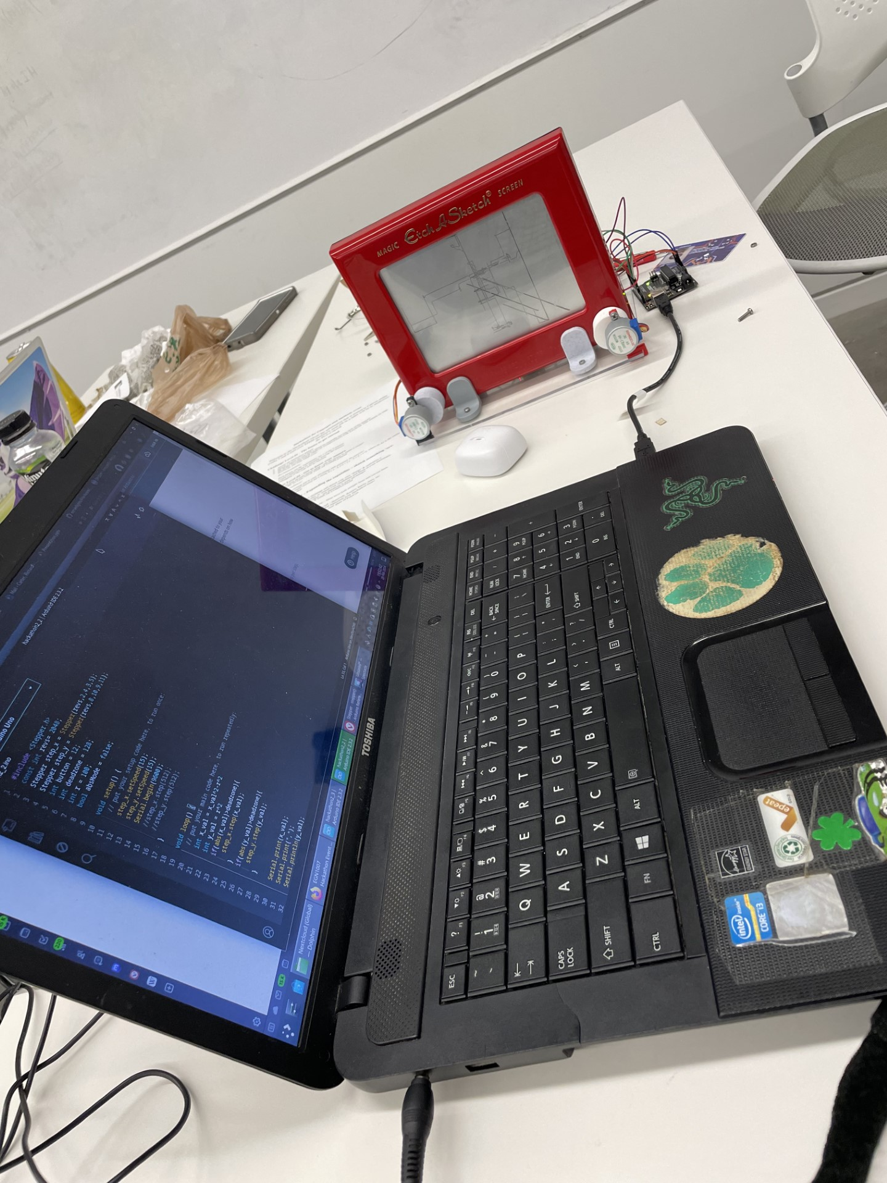
Timeline
Challenge 1 Stage Completed: 5:00pm
Challenge 2 Stage Completed: 7:16pm
Challenge 3 Stage Completed: 7:44pm

Slide 3
Team Dynamics
Ash Ryan: General assistance and recorder
Alexander Washington: Mechanical assembling and electrical
Richard Carter: Primary coder
William Carroll: Mechanical assembling and electrical
One important occurrence during this project was our talk at the beginning. It was quickly decided who would be designated to what.
The second occurrence that further proved who played what role in our team was when one of our motor chips stopped working. Alexander and William worked on figuring out if something was wrong with the wiring, Richard checked over the code, and Ash wrote about the experience under the "Challenges" slide.

Slide 4
Challenges
What was most difficult?
What was EASIEST?
During challenge one, we had issues with the motor causing us to believe we didn't have enough voltage. We figured out that our stepper mounts were not properly connected, and once fixed the code successfully ran.
When our code and wiring was corrected, it was easy to create shapes using the joystick.
Sometime during the process between challenge one and two, one of the stepper motors stopped running. We tried various options, eventually discovering it was an issue with the code.
Assembling the board parts and wiring was easy, a part of issues with the motors.

Slide 5
Our Experience
While our experience during this project was frustrating at times due to the motors and other issues we came across along the way, it was unique in the sense that it was a way to replicate how a project may go during an actual job. You not only don't get to choose who you work with during a job but may encounter unseen challenges as well. Both were experienced by us during this semester's Hackathon. In the end, we were proud that we were able to complete the project and work as a team doing so.
If we had to choose a theme song for our team after this event, it would be "Trying" by midwxst. We felt this was accurate to how we felt during this event, especially with the song's name.

