Slide 1
Goosebot BMS Board
Richard Carter
4/21/2026

Slide 2
Introduction
Battery Management systems are used to control power delivered by battery-powered devices
Goosebots do not presently have such circuitry
The design shown here aims to provide this circuit.

Slide 3
Materials
Item | Quantity
Arduino Nano | 1
Buck Converter | 1
MOSFET (IRF3205) | 2
7 Segment Display | 1
Opamp (LM358) | 1
Resistor (1Ω) | 1
Resistors (220Ω) | 3
Resistor (1KΩ) | 1
Resistor (2KΩ) | 1

Slide 4
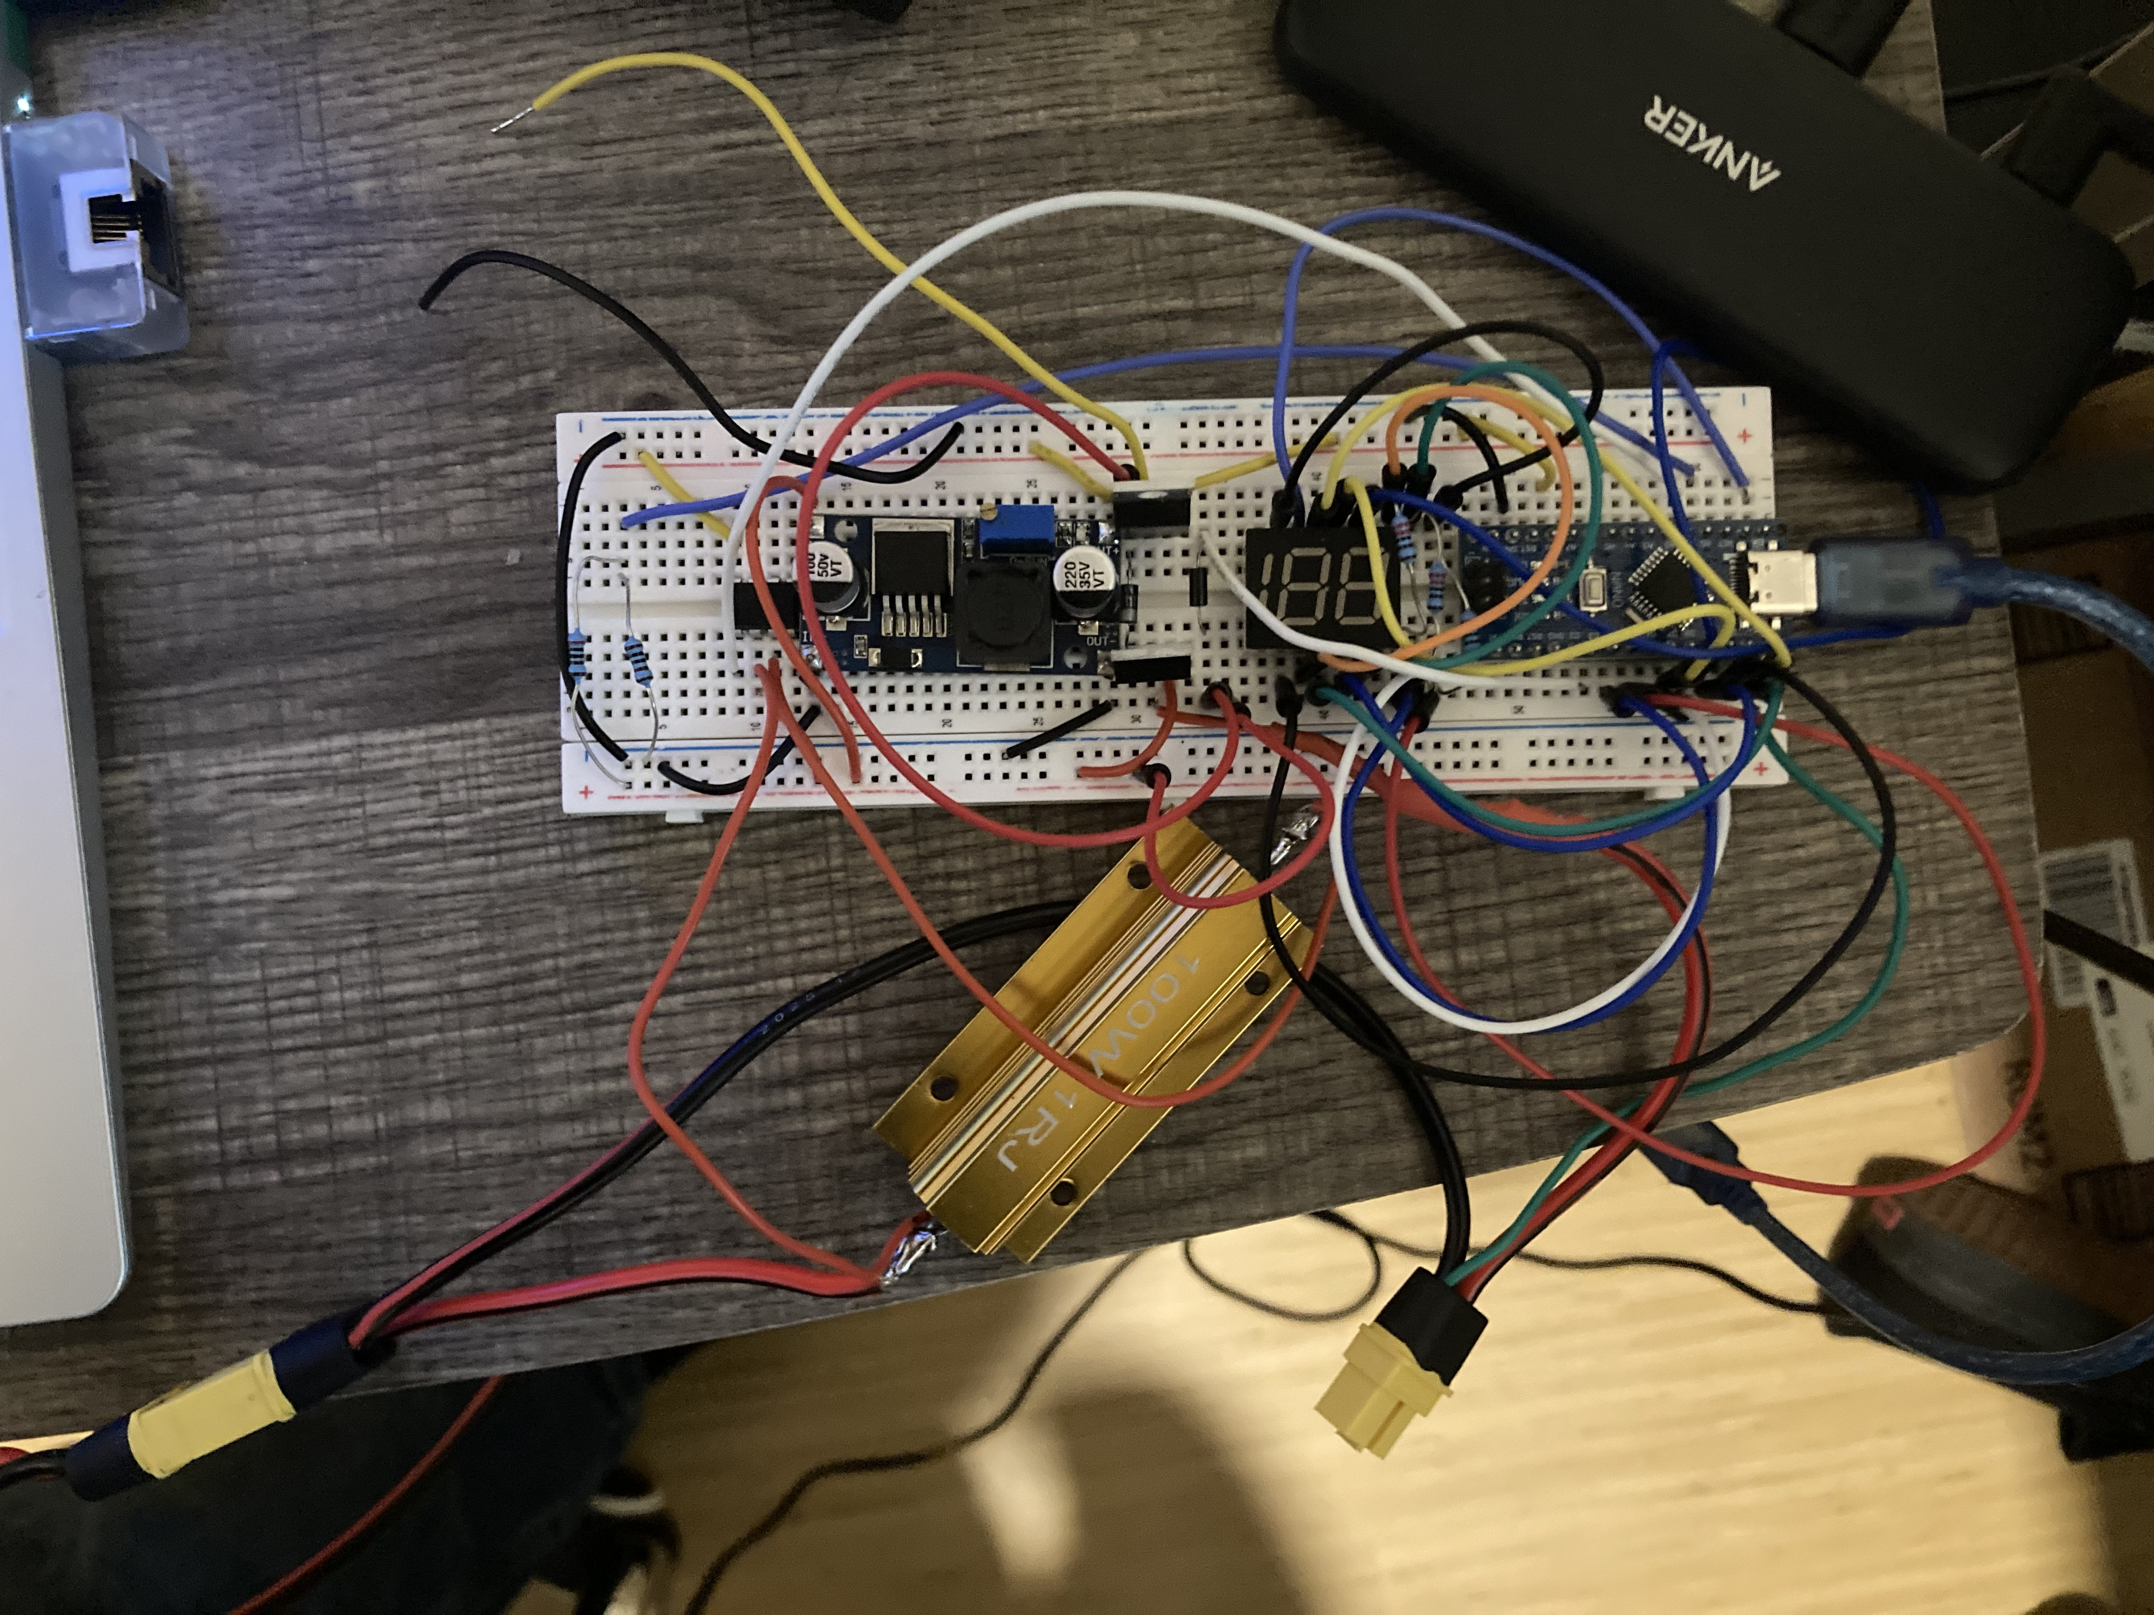
Design
Design powered by Arduino Nano
Voltage measured by voltage divider
7 segment display to communicate state of charge

Slide 5
Testing Method
To simulate batteries, a DC supply was connected to the input
Testing on actual Goosebots could not be done in time
Voltage was varied from 13V to 9V
Switching behavior, state of charge display and Arduino serial ports were monitored.

Slide 6
Testing
Core functionality (voltage measurement) worked largely as expected
Automatic shut-off did not work, MOSFETS were not properly switched.
Future iterations may need a MOSFET gate driver.
Input Voltage (V) | Arduino Reported Voltage (V) | Reported State of Charge (%)
9.95 | 9.60 | 0
11.6 | 11.2 | 49
13.0 | 13.13 | 100
State Of Charge vs. Voltage
Input Voltage (V) | Output Voltage (V) | Arduino pin voltage (V)
11.5 | 7.936 | 4.835
9.88 | 8.339 | 0.98
Automatic shut-off behavior

Slide 7
Conclusion
Voltage monitoring and computer communication was successfully achieved
Some elements were not functional
Current monitoring not fully built in software
Battery shutoff functionality was not working

Slide 8
Thank you!

