Slide 1

TALENT · SOCIAL MEDIA · ONLYFANS
AS Talent Agency
AS Superpowers — a premium worldwide OnlyFans agency
We manage talent, social media and OnlyFans, around the clock —
so creators can focus on what they do best.
astalentagency.com
OnlyFans · Instagram · TikTok · X
Notes:
Cover. AS Talent Agency — full-service creator management: talent, social, OnlyFans, 24/7.

Slide 2

WHO WE ARE
Who we are
AS Talent is a leading OnlyFans marketing and management agency. For 3+ years we have helped creators unlock their potential and multiply their income. We run the entire business — from strategy and social media to fan communication — while the creator focuses on content.
“No two creators
are alike.”
Personalized strategy
We never ship template solutions — the strategy is built around each creator’s brand and goals.
A tailored game plan for every creator — no two are alike.
Full-cycle management
Turnkey: content, social, chatting and analytics.
“I get much more free time and income — they put so much effort in their work.”
Global roster
We work with top models and influencers worldwide.
— Valentine, AS creator
AS TALENT AGENCY
02 / 14
Notes:
Who we are: full-cycle agency, 3+ years, personalized approach, global roster.

Slide 3
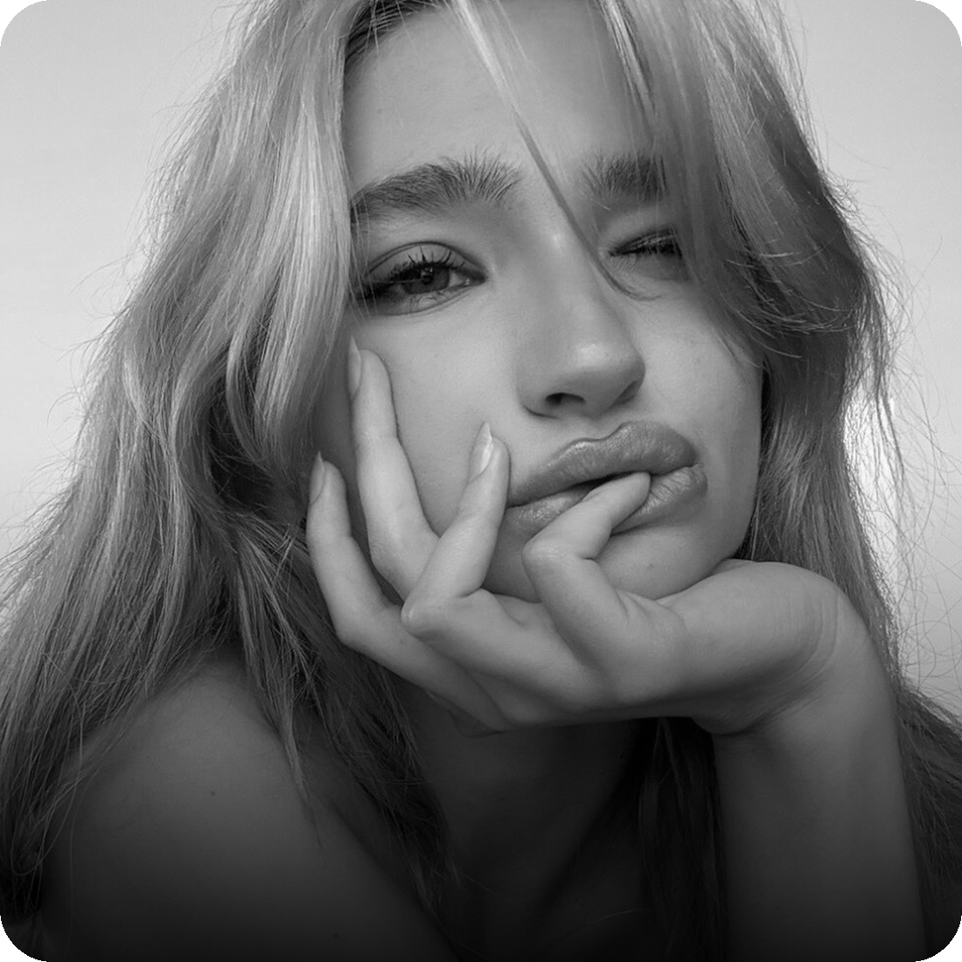
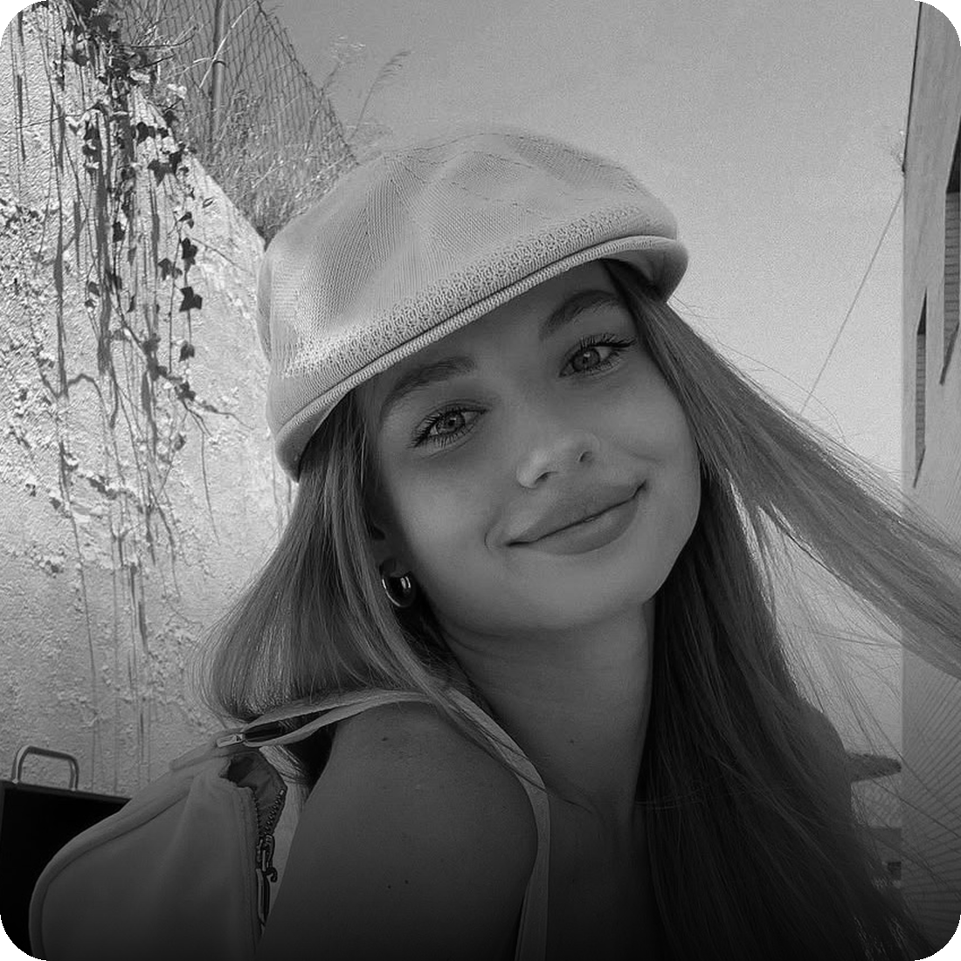
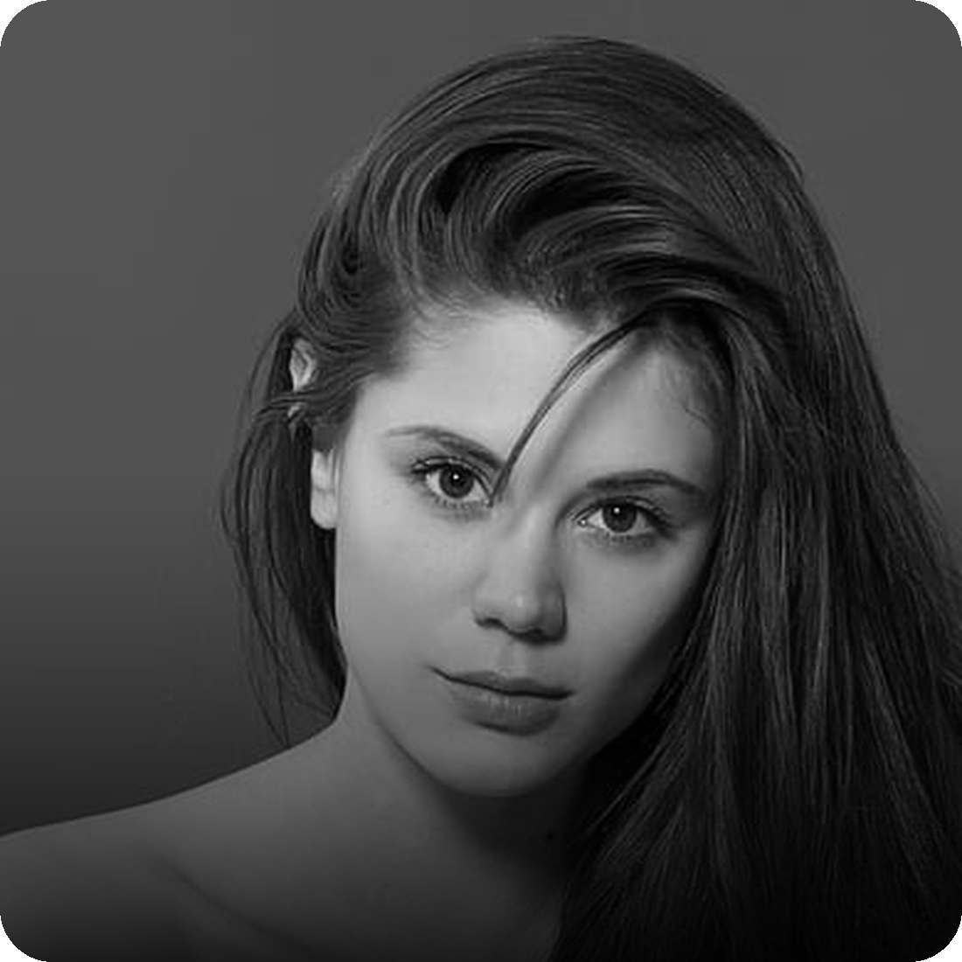
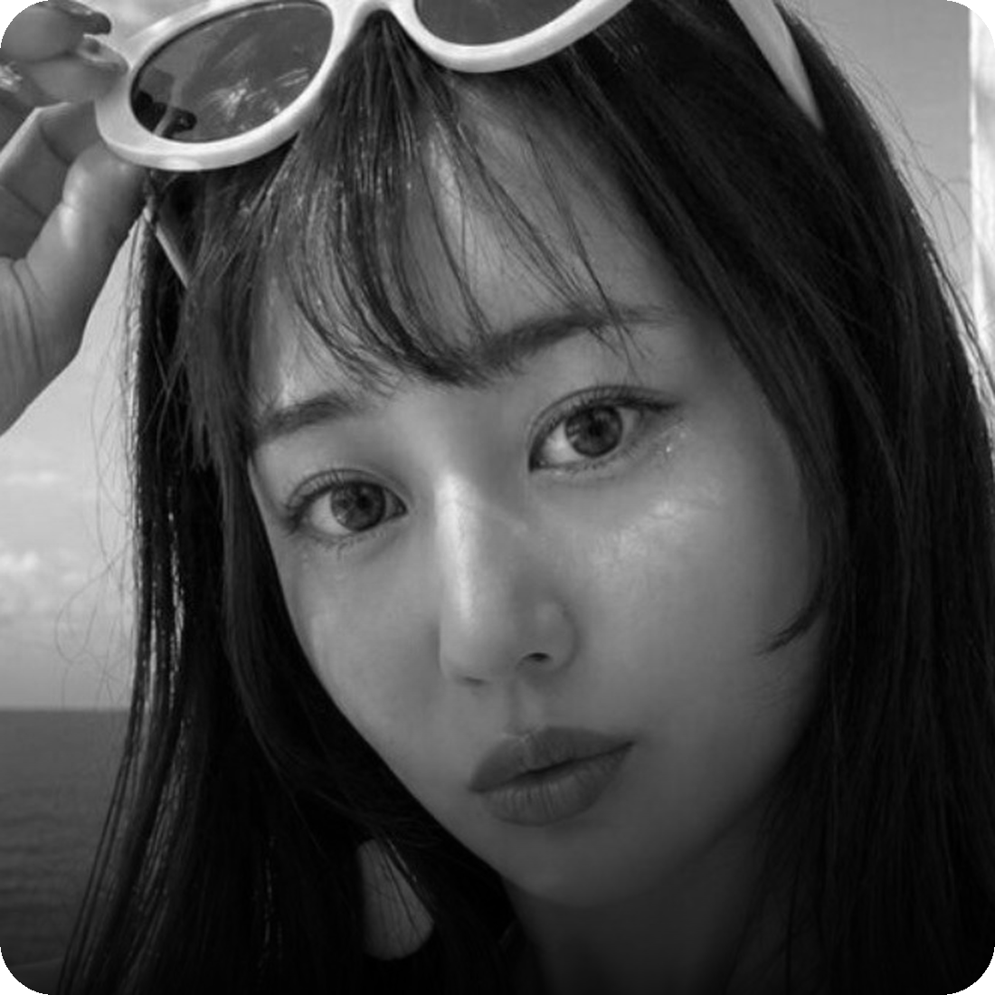
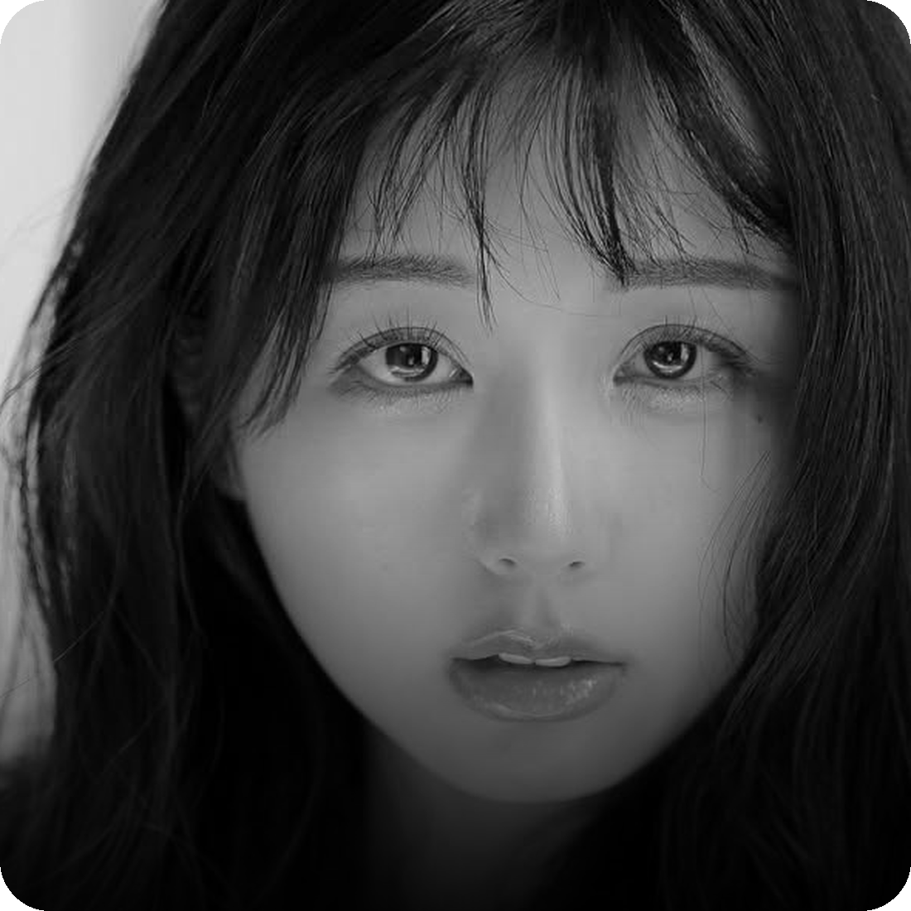
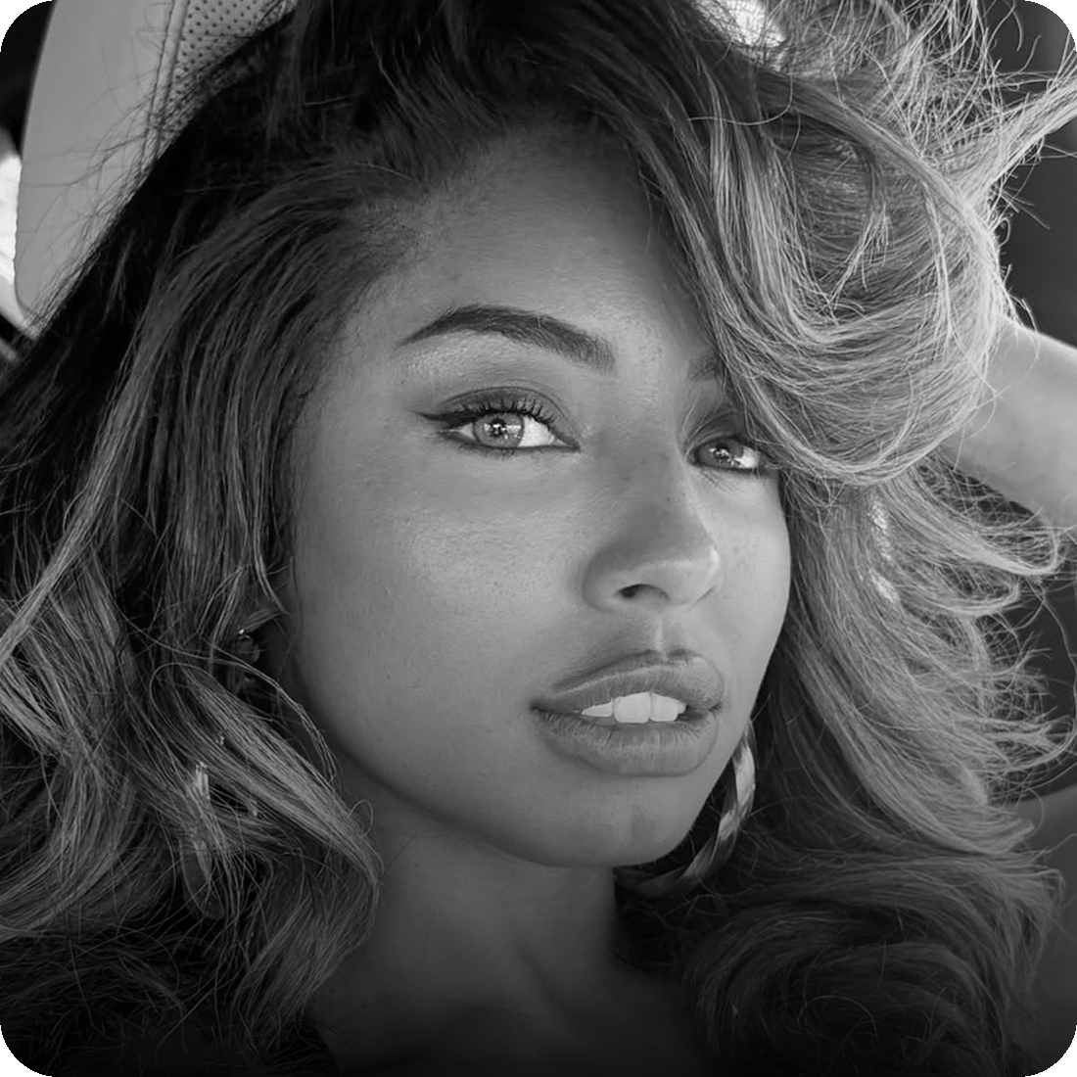
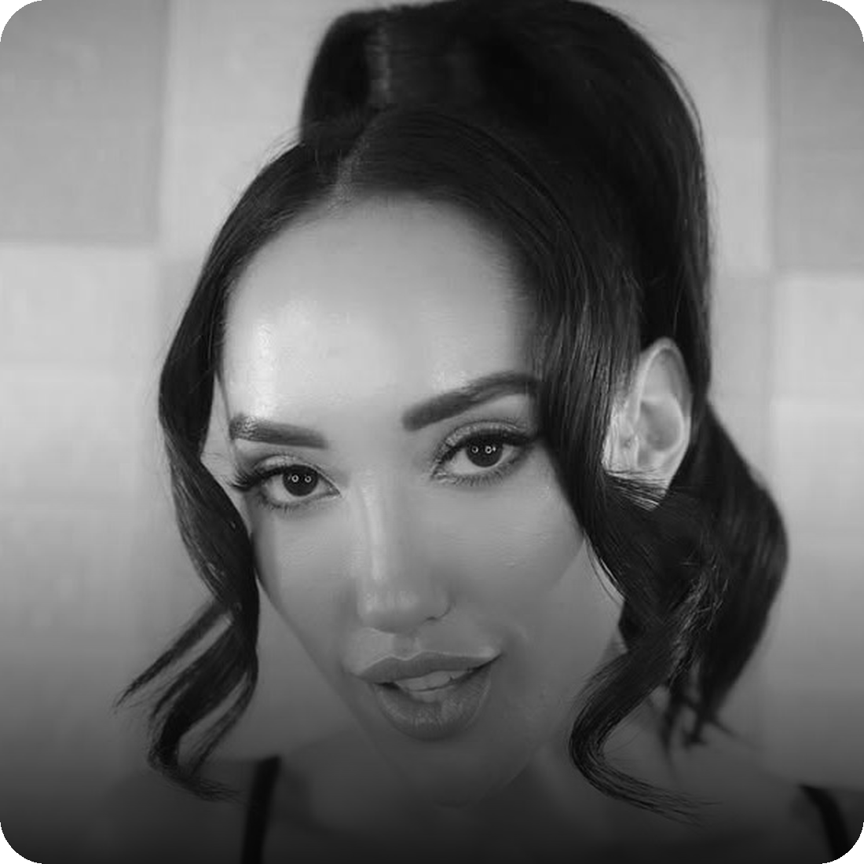
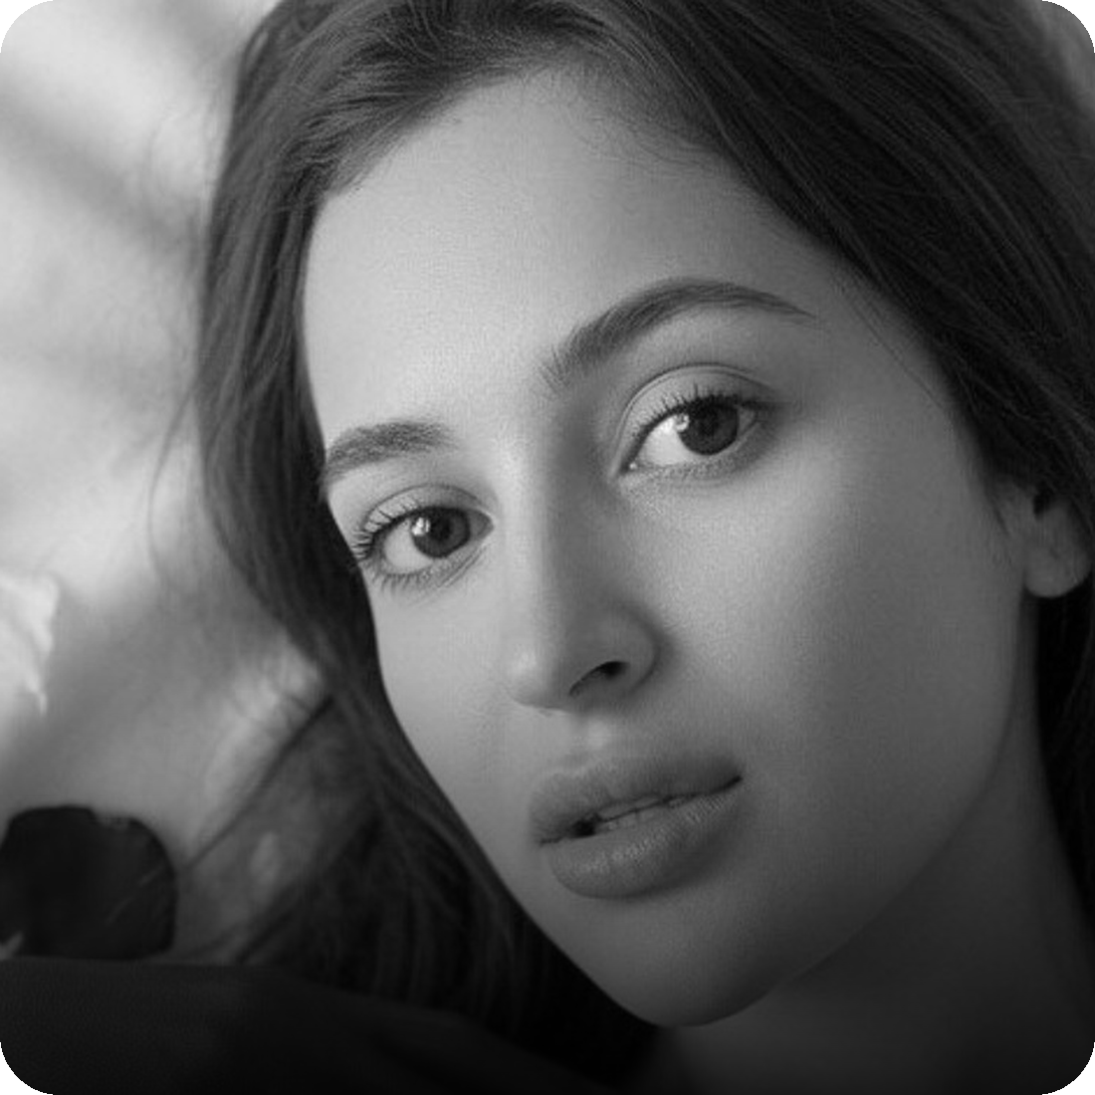
OUR TALENT
The Roster
FEATURED SELECTION
Part of a 120-creator roster
Elizabeth Anokhina
Elizabeth Vasilenko
Little Caprice
Macca
45M FOLLOWERS
10.5M FOLLOWERS
11M FOLLOWERS
1.5M FOLLOWERS
Kuri Emi
Qimmah Russo
Chloe Amour
Zlata Sharvarok
2.5M FOLLOWERS
5M FOLLOWERS
2.4M FOLLOWERS
1M FOLLOWERS
Notes:
Featured selection from a 150+ creator roster. All active on OnlyFans, Instagram, TikTok and X.

Slide 4
WHAT WE DO
What we do
01
02
03
OnlyFans Account Management
Model Marketing
Profit Growth
Account audit, strategy, performance and chat-quality monitoring with real-time metrics.
Viral content and collaborations across a 50M+ follower network, on every platform.
Revenue strategies, profit maximization and cash-flow organization — while you stay creative.
24/7 Chatting & Sales
Content Houses
Analytics & Reporting
AS TALENT AGENCY
04 / 14
Notes:
Three core services plus supporting capabilities.

Slide 5
PLATFORMS
Where we grow you
OnlyFans
Instagram
TikTok
Core monetization: subscriptions, PPV and tips.
Brand funnel: Reels, stories and audience growth.
Top-of-funnel reach and viral discovery.
X (Twitter)
Reddit
Fansly & more
NSFW-friendly promo and warm inbound traffic.
Targeted community traffic straight to your page.
Secondary platforms and backup accounts.
AS TALENT AGENCY
05 / 14
Notes:
Platforms we manage and the role each plays in the funnel.

Slide 6
FULL SERVICE
What's included
✓
Account setup & optimization
✓
Social media growth
✓
Content strategy & scheduling
✓
Paid promo & shoutouts
✓
24/7 chatting & sales
✓
Analytics & weekly reporting
✓
PPV & upsell campaigns
✓
Persona & brand development
✓
Fan retention & win-back
✓
Compliance & account safety
AS TALENT AGENCY
06 / 14
Notes:
Everything included in full-service management.

Slide 7
BY THE NUMBERS
By the numbers
$13M
120
150+
50M+
Agency revenue
Creators managed
Staff worldwide
Combined reach
3 years operating · offices in the USA, Dubai, Poland & Cyprus
“I get much more free time and income — they put so much effort in their work.”
— Valentine, AS creator
AS TALENT AGENCY
07 / 14
Notes:
Key numbers and social proof.

Slide 8
RESULTS
What growth looks like
From a first OnlyFans launch to scaling an established page — we grow creators at every stage.
Fresh launch
$0 → $38k / mo
in 4 months
New to OnlyFans · ~400k on Instagram
Scaling up
$50k → $101k / mo
2× in 3 months
Established creator, already earning
Individual results; not a guarantee.
AS TALENT AGENCY
08 / 14
Notes:
Range of outcomes: launching a fresh creator from zero and scaling an established one.

Slide 9
HOW WE WORK
How we work
1
2
3
4
Onboarding
→
Strategy
→
Content & Social
→
Growth & Retention
We learn the creator, brand and goals, and assign a dedicated manager.
We build a personalized growth and monetization plan.
Content plan, shoots, and running Instagram, TikTok and X.
Chatting, sales, upsells, analytics and scaling.
AS TALENT AGENCY
09 / 14
Notes:
Four-step process: onboarding, strategy, content & social, growth & retention.

Slide 10
THE TEAM
Behind the scenes
150+ specialists across the USA, Dubai, Poland and Cyprus.
Account Managers
OnlyFans Chatters
Social Media Managers
Own the strategy and day-to-day for each creator.
Convert and retain fans with 24/7 sales.
Grow Instagram, TikTok and X audiences.
Content Producers
Marketing & Traffic
Data Analysts
Plan, shoot and edit premium content.
Paid promo, shoutouts and funnels.
Track performance and optimize revenue.
AS TALENT AGENCY
10 / 14
Notes:
Roles that make full-service management work.

Slide 11
PARTNERSHIP
How we partner
01
02
03
Performance-based
No upfront cost
Flexible & confidential
We earn when you earn — our commission is tied directly to your results.
No setup or subscription fees. We invest in your growth from day one.
Custom terms, exclusivity options and full discretion, always.
Commission is tailored to your tier and platform mix. Ask us for a custom proposal.
AS TALENT AGENCY
11 / 14
Notes:
Partnership model: performance-based, no upfront, flexible and confidential.

Slide 12
WHY AS TALENT
Why AS Talent
✓
Personalized approach
✓
Expert marketing
✓
Extensive support
A tailored strategy and dedicated manager for every creator.
Viral content across a 50M+ follower network.
A full team on your account, available 24/7.
✓
Lucrative earnings
✓
Collaborations
✓
Global reach
Revenue and profit maximization, done for you.
Cross-promotion across our worldwide talent pool.
Offices in the USA, Dubai, Poland & Cyprus.
AS TALENT AGENCY
12 / 14
Notes:
Why AS Talent — key advantages.

Slide 13

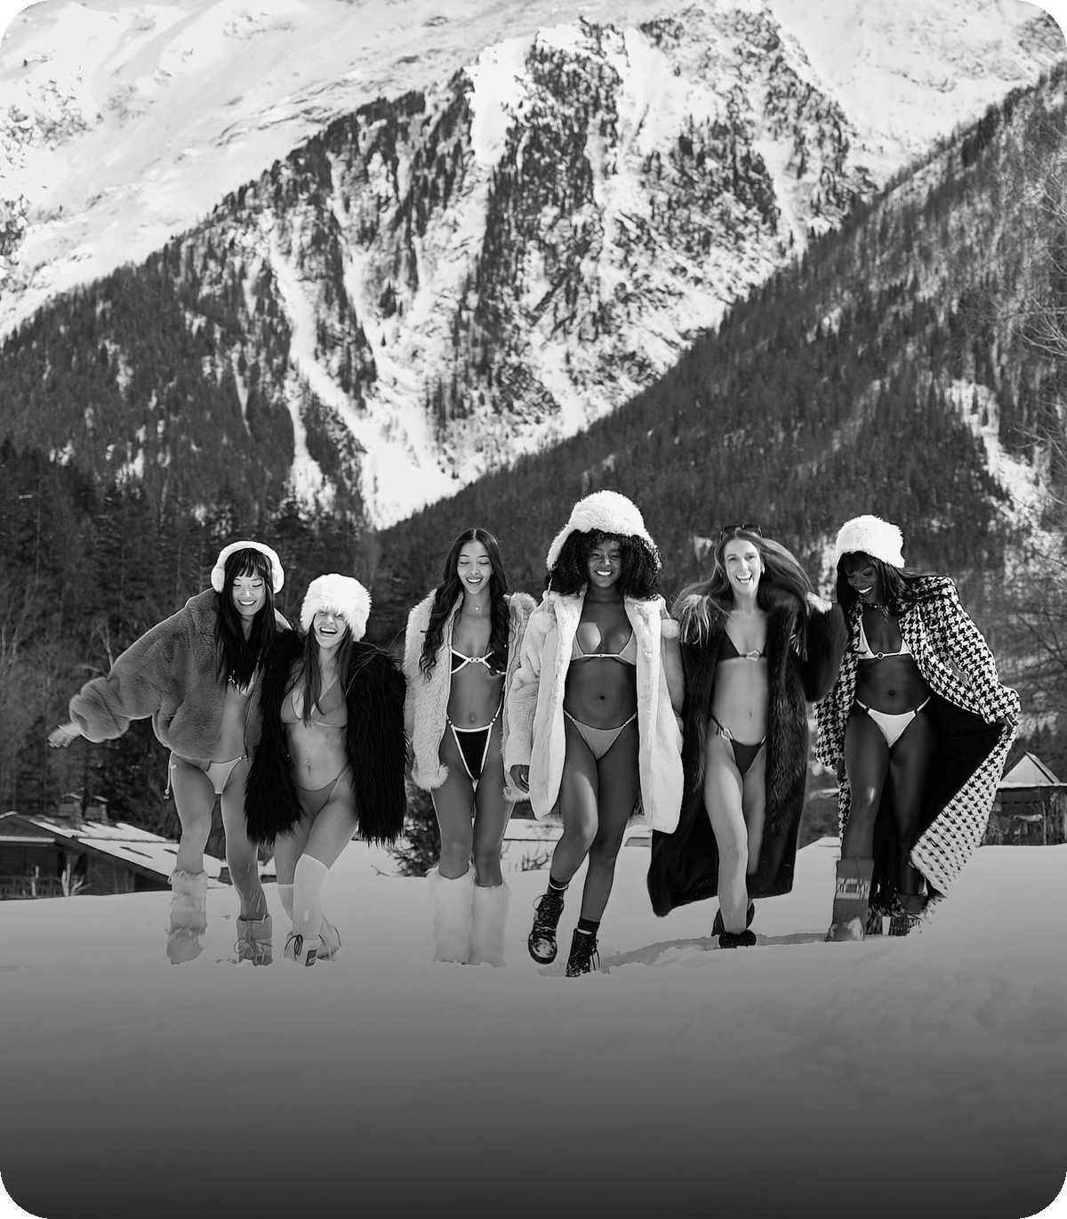
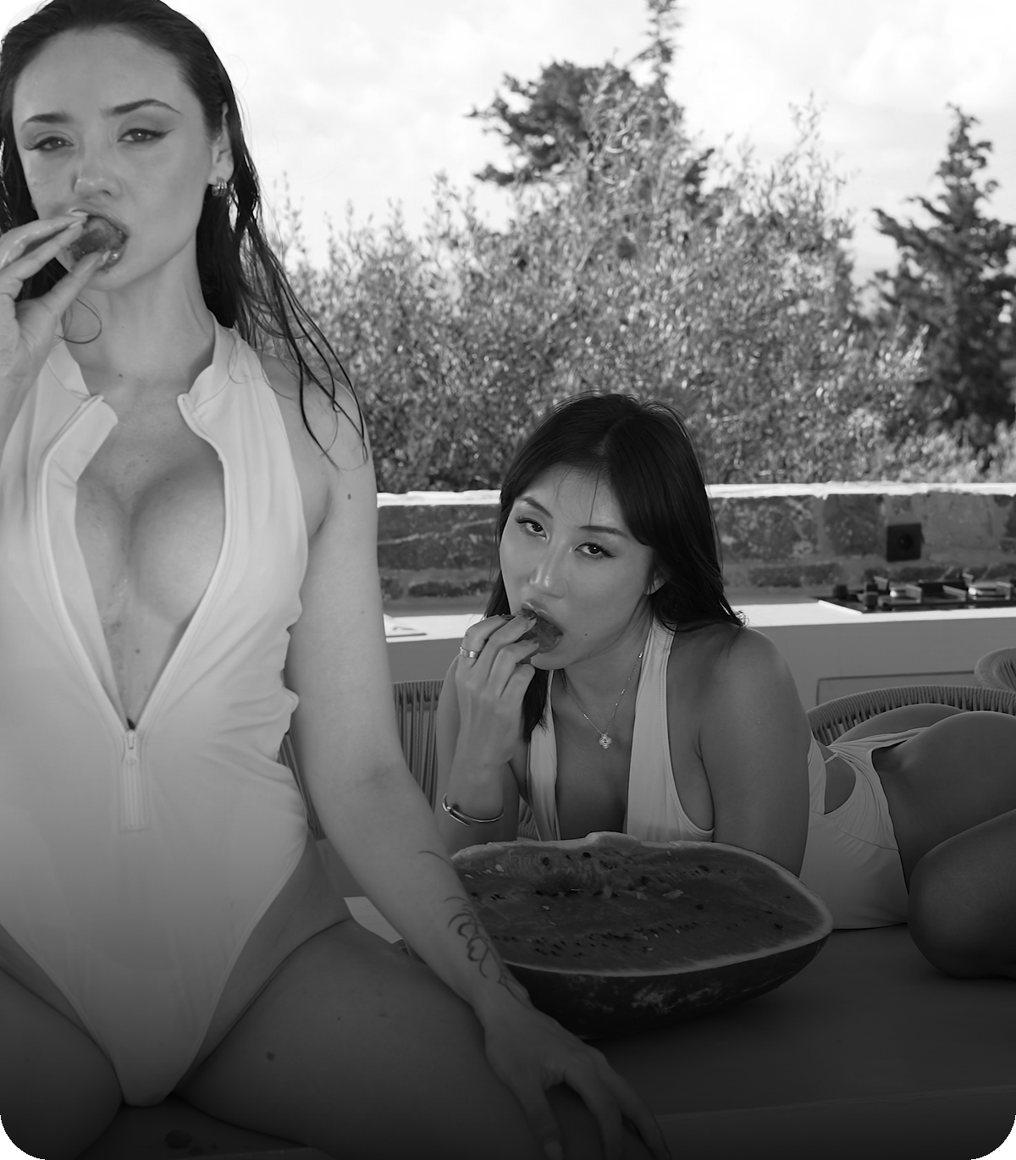
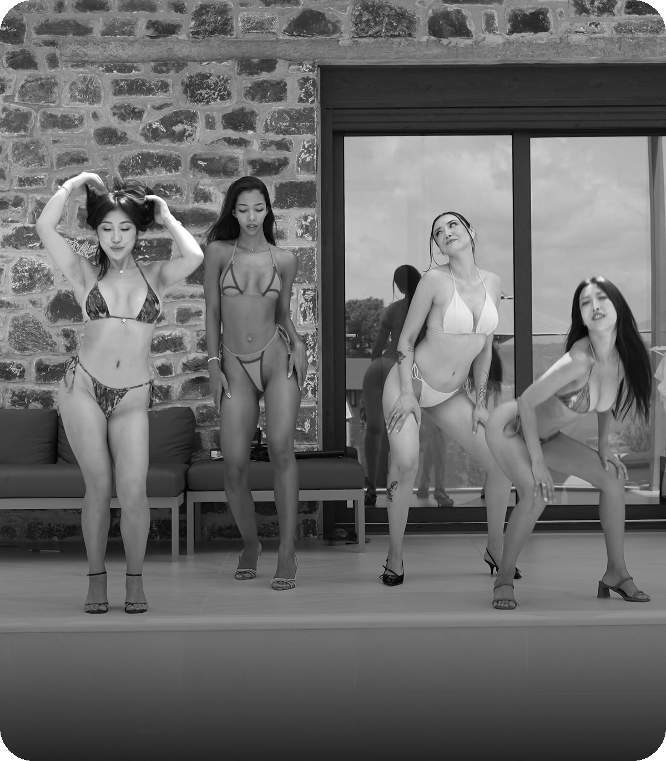
CONTENT HOUSES
Inside our content houses
From coastal villas to alpine sets — real production locations, shot by our in-house crew.
Coastal villa
Alpine set
Poolside villa
Group shoots
INFINITY POOL · SEA VIEWS
ON-LOCATION EDITORIAL
FULL PRODUCTION CREW
MULTI-CREATOR SETS
AS TALENT AGENCY
13 / 14
Notes:
Real production locations from our content houses: coastal, alpine, poolside, group sets.

Slide 14

LET'S TALK
Unlock your true
potential.
Join AS Talent Agency and grow with a team that lives on your results.
TELEGRAM
WHATSAPP
INSTAGRAM
@AS_Agency
+1 (646) 596 6014
@as.talentagency
astalentagency.com · AS@ADSTARS.CLUB
Notes:
Contacts: Telegram @AS_Agency, WhatsApp +1 646 596 6014, Instagram @as.talentagency, AS@ADSTARS.CLUB, astalentagency.com

