Slide 1
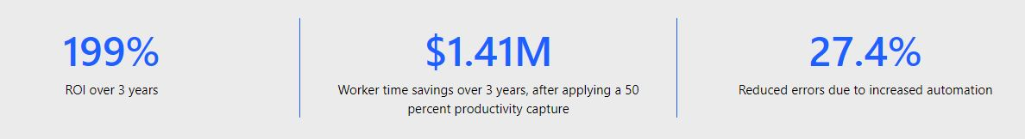
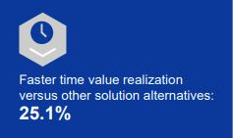
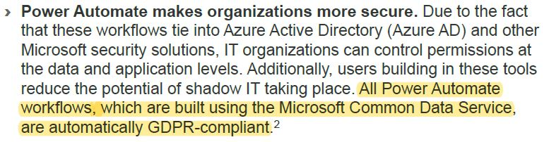


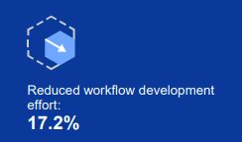

Powerful/Impressive Statistics
Key assumptions: 10,000 employees | 30,000 help-desk tickets | 1,000 new hires
Source: McKee, 2020
Notes:
Hello, everyone and I am very excited to talk with you today about my passion…..mixing technology with operations!
Throughout my 25+ years in the pharmaceutical industry, I have learned that change (and how you adapt to/react to change) is one of the few items that remained constant. Throughout the years…I have learned and gained a unique ability and understanding when it comes to combining technology with operations….my niche so-to-speak.
Let’s take a moment and review these very powerful and impressive stats and know these can be yours!

Slide 2

Business Process Automation
“Driving automation and efficiency by combining operations and technology expertise.”
Notes:
For the next 30 mins, lets discuss how a Business Process Automation strategy will help start/futher CompanyA’s journey to such intriguing numbers!

Slide 3
Objectives
Utilize existing technology/processes and in-house applications
Automate time-consuming, repetitive tasks; allowing workers to focus on high-value tasks that cannot be automated
Increase workforce productivity
Decrease roadblocks/challenges related to working across time zones
Overcome gap between technology and business with automated solutions
Reduce email communications
Notes:
Work with users, management, and IT to utilize the company’s existing technology in coordination with their in-house applications and processes to automate time-consuming tasks.
CompanyA will gain increased workforce productivity, decreased number of roadblocks/challenges from working across time zones, and reduced email communications.

Slide 4


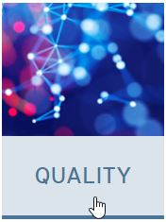

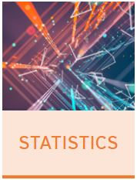
Introduction - CompanyA
Perfectly positioned for:
Fully embracing digital acceleration
Continually striving for digital operation excellence and resiliency
Committed to:
Big-picture thinking
Targeted problem-solving
Innovative solutions
Key collaborations
Source: CompanyA, 2021
Notes:
Each of you watching or attending this presentation live these words everyday so we will not spend a lot of time on this slide. However, these items were included to provide a rekindling of the company’s strategic position and commitment to innovation.

Slide 5

Introduction – Why Business Process Automation?
Agency mandates for electronic submissions/dossiers
Significant rise in technology within Regulatory Operations/Submissions
Increased amount of data and strategic data analyses
Encourages cross-department communication
Outlines clear accountability/ownership of processes
Repeatable/repetitive tasks done quickly without human intervention
Reduces possibility of manual errors
Provides insights into potential bottlenecks
Notes:
Customers demand great customer service, quality, and speed of service….and….they are very willing to go elsewhere if not happy.
The speed and efficiency of process handling affects how well your organization can operate and meet the needs of customers and employees.
BPA ensures the management of structured processes from initiation through execution.

Slide 6

Background – What is BPA?
BPA = Business Process Automation
Applies technology to manipulate existing software to complete a process
Implements configurations that automate manual and repetitive tasks
Supports knowledge workers
Automates the routine, ensuring the right people follow the right workflow
Provides transparency of full, end-to-end processes
Reduces touchpoints in current processes
Notes:
BPA, in simplest form, is automation of business processes; it leverages technology and supports knowledge workers in satisfying the needs of colleagues, management, and customers.
EXAMPLES of reducing touchpoints….
where users need to manually copy/upload files
create a new submission record
update an existing record’s lifecycle state
send standardized emails

Slide 7

Background – How will BPA help CompanyA?
Allows communication to become more self-serving for local and global workers
Decreases time zone delays
Minimizes rework
Produces more real-time data for improved data analyses
Provides extraordinary support to customers
Utilizes and embraces global company resources

Slide 8
Innovation Opportunity – Problems/Need
Spend less time on repeatable, time-intensive tasks
Utilize automation technology, coordinating with document/submission management & ERP apps
Enable internal/external customers to become more self-serving (locally & across time zones)
Increase visibility of project statuses and/or collected data
Produce standardized visualizations/dashboards with real-time updates
Rapid training for staff on new/revised processes

Slide 9

Innovation Opportunity - Goals
Interview users, prioritize and finalize wants/needs list
Involve local & global subject matter experts in design & testing
Discuss KPIs with all involved
Train local users before production roll-out
Train remaining users within 4 weeks
Work with IT on SP landing page
Work with IT on information needed for creation of Teams site
Produce standardized visualizations/dashboards
Integrate sales training with functional training
Monitor KPIs for 6 weeks after roll-out & last training session
Complete phased approach to solution
Implement monthly updates for 6 weeks then transition to quarterly updates
Train company admin/super user(s) to own, manage, or update solution
Notes:
Interview user base, prioritizing and finalizing wants/needs list within 2 weeks of project start date
Involve local & global subject matter experts in design and testing of solution, including documentation
Interview management, IT, and users, discussing key performance indicators (KPIs) for solution
Train local RegOps/RegSubm users on solution before production roll-out
Train remaining RegOps/RegSubm users within 4 weeks after roll-out
Work with IT regarding SP landing page and information needed for creation of Teams site
Produce standardized visualizations/dashboards
Integrate sales training with functional training on solution
Monitor agreed-upon KPIs for 6 weeks following initial roll-out and last training session
Complete phased approach to solution
Implement monthly updates for 6 weeks then transition to quarterly updates
Train company admin/super user(s) to own, manage, or update solution

Slide 10


















Technology Integration
Utilize existing company technologies
Microsoft 365 Suite
Dynamics 365
Software A
Software B
Software C
Notes:
Utilize existing company technologies:
SharePoint
Microsoft 365 Suite
Microsoft Power Platform
Consists of 3 MS technologies
Power BI (insights on data or business)
Power Apps (interface between user and data)
Power Automate (handles task automation)
Provides users a ‘low-code’ or ‘no-code’ experience
Provides non-technical users ability to create, automate, and analyze data themselves
Minimizes the burden on IT department to help them focus on higher value targets
Software A
Dynamics 365/Software B

Slide 11
Operational Environment – Initial Phase
Focus on low hanging fruit within Regulatory Operations/Submissions
Utilize existing operational environment (technology, permissions, licensing)
Expert User/Liaison will need:
Access to test/dev environment
Test users/groups created covering various permission levels
IT resource for questions, ensuring workflow generalization is completed in most efficient manner for applying to various clients/projects
To determine PowerBI licensing/server setup for sharing of interactive visualizations/dashboards
Notes:
Representation from…
Finance
Management
MS365 Admins/Licensing
…to determine PowerBI licensing/server setup so sharing of interactive visualizations/dashboards are possible

Slide 12
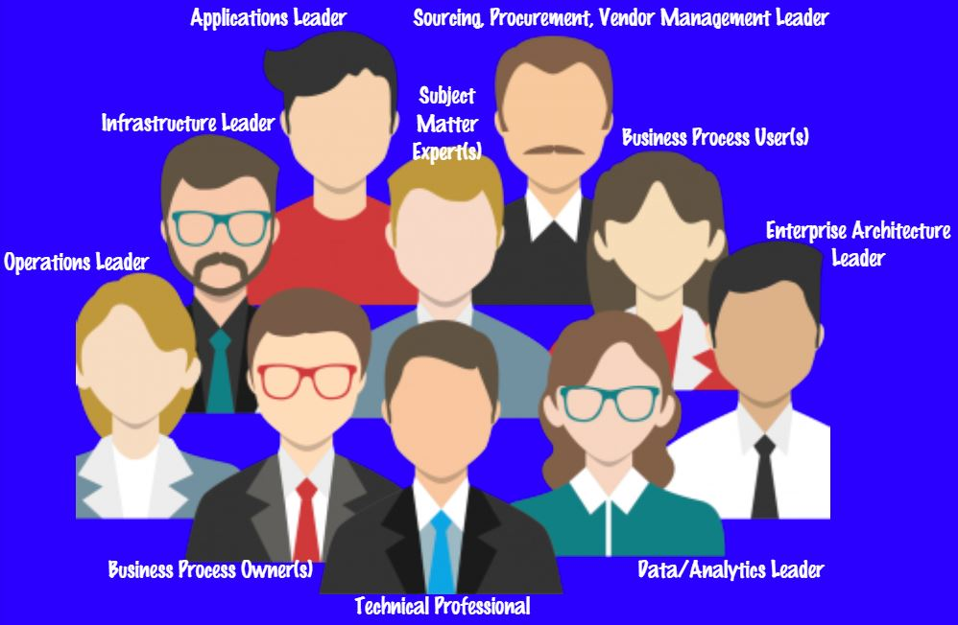
Operational Environment – Later Phase(s)
Further discuss data compliance and security
Confirm existing IT technologies and infrastructure will handle volume of data calls/processing
IT to determine best placement within cloud storage of Power Automate flow files for efficiencies and appropriate access
Review existing backup / maintenance procedures, confirming least amount of interruption across time zones
Expand to include interactions with external applications and process owners
Expand to include interactions with external groups

Slide 13
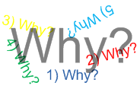
Why Embrace/Fund?
Leading technological innovation and CompanyA just go together
Decreased operation costs
Process efficiencies, reducing time spent on routine and repetitive work
Increased utilization of company resources and expertise
Provide better work/life balance for employees as their time/effort are spent on high-value work activities
Better view of project statuses for managers, leaders, workers, and clients
Dashboards and project status powered by real-time data
Provide new service/tool offering to clients
Creation of new revenue stream

Slide 14

Summary
Digital transformation is here to stay
Leaders are revolutionizing business processes by incorporating & implementing…Automation, Machine Learning, and AI technologies
BPA brings increased productivity, improved quality, reduction of repetitive, time-consuming tasks, and enhanced ROI
Automation tools allow work processes and team communication to become more self-serving for local/global workforce and leaders
Notes:
Digital transformation is here to stay……more prevalent due to events from this last year
Organizational Leaders who incorporate and implement automation, machine learning, and artificial intelligence (AI) technologies are revolutionizing business processes
BPA will bring increased productivity, improved quality, reduction of repetitive, time-consuming tasks, and enhanced ROI
Automation tools allow work processes and team communication to become more self-serving for local/global workforce and leaders
The next two slides are included to give you an idea of what comes next, modeling business processes into diagrams can be very frustrating process but please remember….it is a VERY IMPORTANT step on this journey.

Slide 15
Next Steps – Process Maps
Signed Proposal to Archive of Submissions (High-level)
Pre-Publishing Process (Detailed)
Start from receipt of files through loading into eDMS
Include all touch points/hand-offs and reviews
Publishing Process (Detailed)
Start from assigning files through sending to client
Include all touch points/hand-offs and reviews
Submittal/Archive Process (Detailed)
Notes:
Diagraming business processes, especially complicated ones, can be time-consuming and frustrating; however, this collaborative exercise helps improve the efficiency and productivity of employees and the happiness of customers.
Why are they needed?
A picture tells a thousand words
Everyone gets on same page
Quickly find issues
Find repetitive tasks or activities
Be sure to include:
How process works from start to finish
Who and what steps are involved
What other processes may be connected

Slide 16
Next Steps – Analyze Process Maps
Analyze Process Maps for…
Bottlenecks
Repetitive tasks or activities
Exceptions to the process/activity
Multiple ways to perform a task or activity

Slide 17

Thank You!
Christine Baxter Business Technology/Process Consultant christine.baxter@baxtersllc.consulting
Notes:
Thank you for your time and attention today!
If you have any questions or would like to discuss any of these ideas further, please send me an email so we can set up a meeting.
Thanks again!

Slide 18
References
Gartner. (2021, April 28). Gartner forecasts worldwide hyperautomation-enabling software market to reach nearly $600 billion by 2022. Retrieved from gartner.com: https://www.gartner.com/en/newsroom/press-releases/2021-04-28-gartner-forecasts- worldwide-hyperautomation-enabling-software-market-to-reach-nearly-6
Microsoft. (2020). Microsoft Power Platform | Using data-driven insights to prepare your business for what comes next.
CompanyA. (2021). About CompanyA - a global presence with local reach. Retrieved from www.CompanyA.com: https://www.CompanyA.com/about-CompanyA/
Everteam. (2016). Your business process automation cheat sheet. Retrieved from https://www.slideshare.net/EVERTEAM/your-business-process-automation-cheat-sheet?from_action=save

