Slide 1
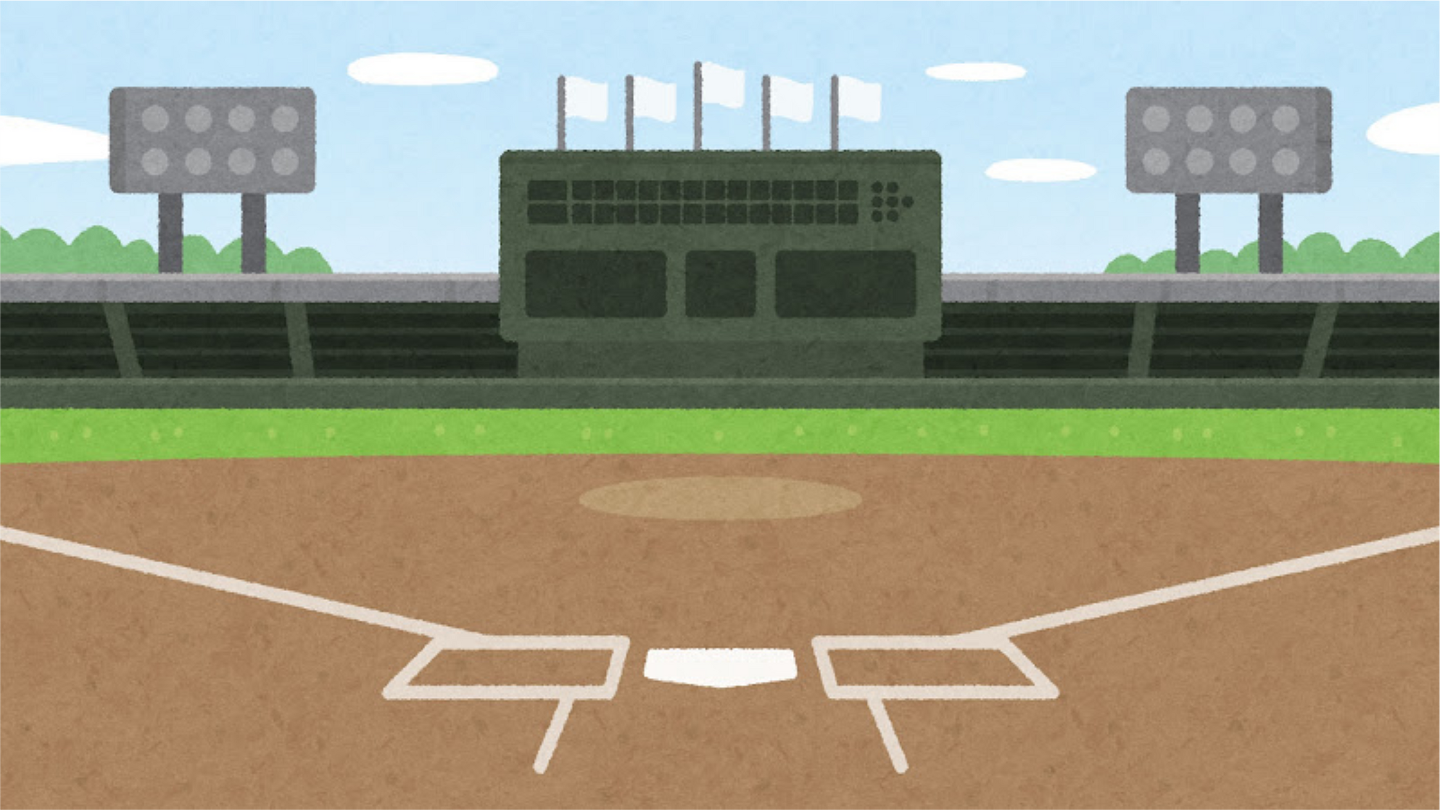


DO UMPIRE EJECTIONS IN THE MLB AFFECT WIN PERCENTAGES?
Bryan Ayala-Rivera
11/25/2025
Notes:
Hello everyone my name is Bryan Ayala-Rivera.
I am a part-time DEN Student and full time USC employee.
I am also a huge baseball fan and love the Dodgers so I wanted my project to look at data in Major League Baseball.
My final project presentation looks to answer the question Do MLB Umpire Ejections Affect Win Percentages?

Slide 2
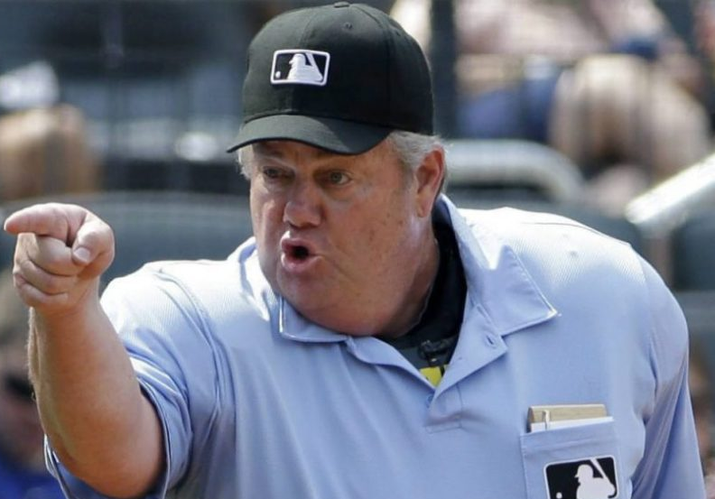
INTRODUCTION
  What is an MLB Umpire?
    The official who enforces rules during a baseball game
  What is an ejection?
    being "ejected" means a player, coach, or manager is forced to leave the game for unsportsmanlike conduct, arguing calls, or breaking rules. Under the discretion of the umpire.
    The ejectee is replaced by a player/coach/manager for the rest of the game
  Question: Do Umpire Ejections Affect Win Percentages for a Major League Baseball Team?
Notes:
Joe West
-umpire who officiated from 1976 to 2021
-reputation for being difficult or arrogant
-short fuse, with a tendency to eject players and managers
Main point about ejections
-ejections can be given out by an umpire at any time in a game
-ejections cannot be challenged, umpires have the final say

Slide 3
DATA SOURCES
  Retrosheets - https://www.retrosheet.org/eject.htm
    Csv file
    ejections from 1889-2024
    19,000+ data points – umpire, person ejected, reason for ejection, etc
  UmpScorecard – url here
    Csv file from Kaggle – used api to access
    18,000+ data points
    Data from 2015-2022
    Data on umpire performance/accuracy
  Statsapi.mlb.com
    Access to MLB data, schedule, weather, etc

Slide 4
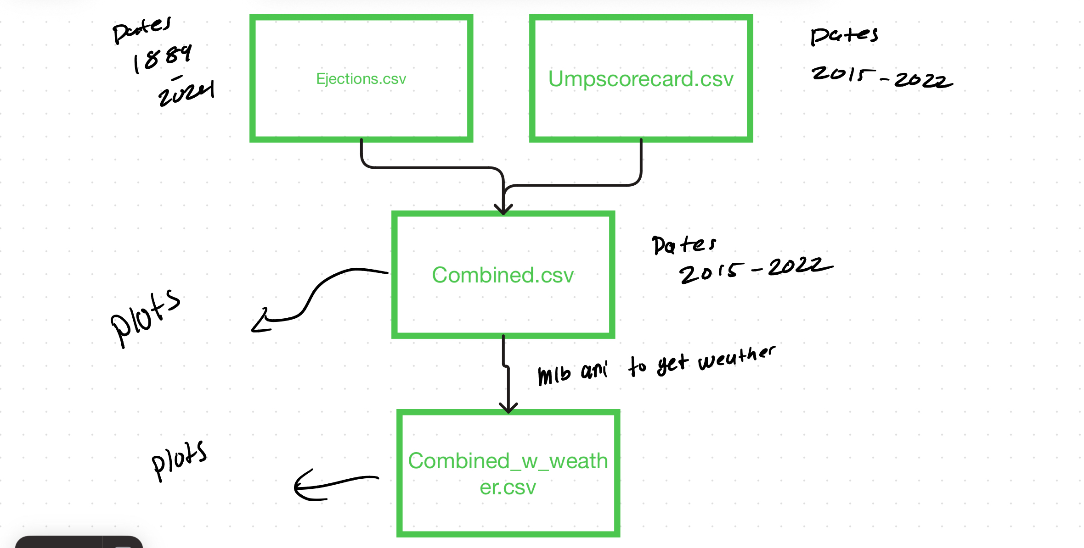
SUMMARY – Process

Slide 5
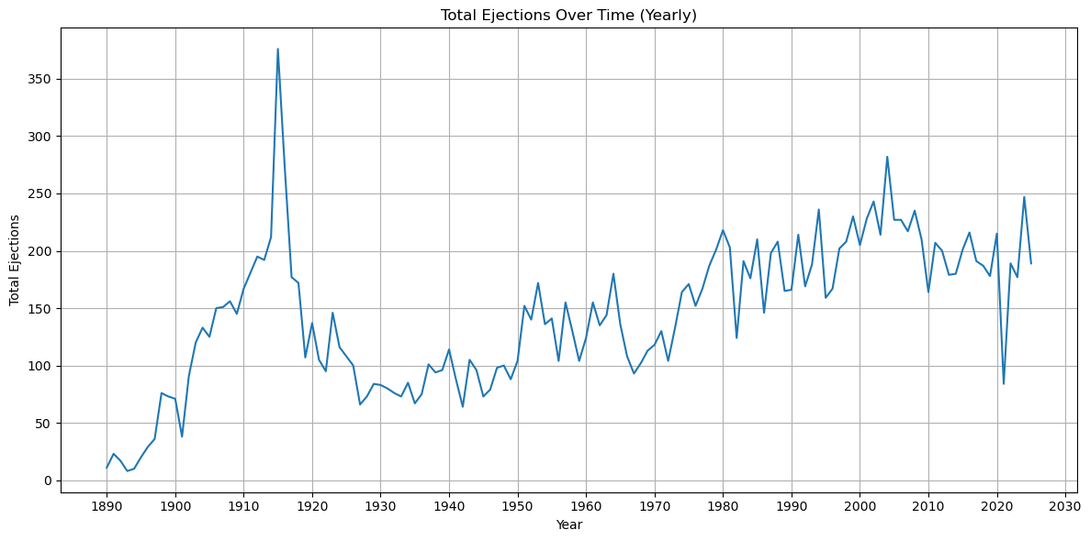
SUMMARY – ejections over the years
Total ejections over time from Retrosheets data from 1889-2024
Spike in ejections from 1910-1920 from “dead-ball” era, where they would use one ball for the entire game, leading to lots of arguments/ejections
Drop in ejections in 2020 due to COVID
2015-2022 highlighted part has data from Umpscorecard – 586 ejections
Notes:
"Dead-ball" Era Rules: The "dead-ball" era (roughly 1900–1920) featured a single ball being used for an entire game, which became scuffed, soft, and dirty, making it difficult for batters to hit. Pitchers were also allowed to doctor the ball (e.g., the spitball), further frustrating hitters and creating an environment where players felt the need to constantly argue calls and the condition of the ball.
Babe Ruth 1914-1935
2020 – drop in ejections due to COVID
See a steady rise in ejections as more games play on
Overlap for UMPSCORE CARD 2015-2022

Slide 6
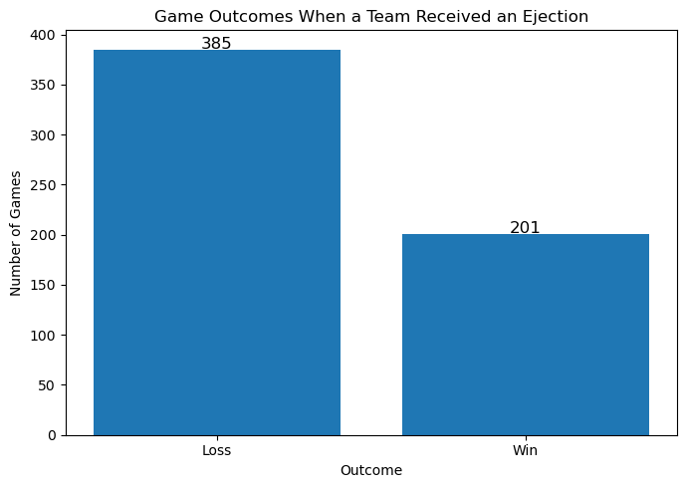
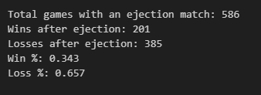
SUMMARY
    Combined data from retrosheets csv and umpscorecard csv from 2015 -2022
    586 ejections
    Teams that got an ejection lost 65.7% of the time

Slide 7
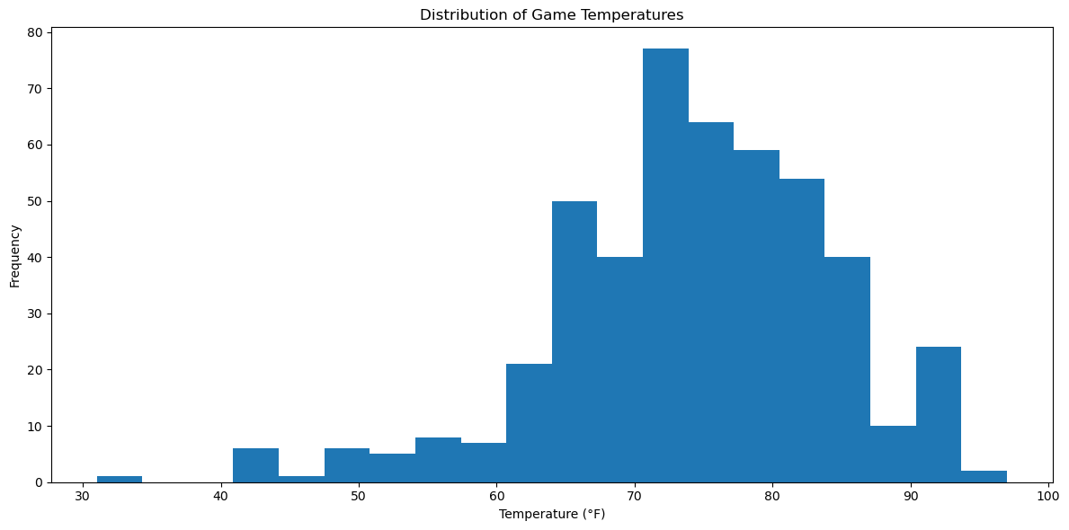
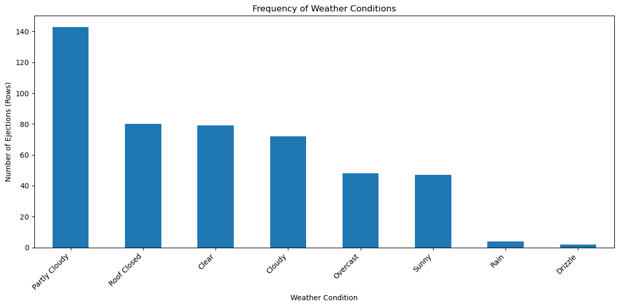
SUMMARY
    Used date and game location to get weather data using MLB API
    Most ejections occurred when the weather was partly cloudy
    Temperature was around 70F

Slide 8
CHALLENGES
    Baseball generates a lot of data - overwhelming
      Each team plays 162 games a season
      30 teams
      2430 games played in a season
    Getting my data sets to work with one another
      Retrosheets gameID was different format from MLB game ID format, so figuring out a method to convert took time
    Learning to use Python this semester
      Overall had fun learning through the struggles!

Slide 9
THANK YOU
Questions?

