Slide 1
Vehicle Accident Analysis in UK (2005 – 2015)
By: Bailey Thompson, Edgard Mercado, Megan Gray

Slide 2
Overview
Dataset was acquired from Kaggle.com and is Accident Data acquired by UK police force from 2005 to 2015.
https://www.kaggle.com/silicon99/dft-accident-data#Accidents0515.csv
Data includes types of roadways, accident severity, casualties, light cond, etc.

Slide 3
Questions…
How many accidents occur each year?
How many casualties occur each year?
What counties have the most accidents?
Which type of roads contain the highest number of accidents?
Which types of vehicles have the highest number of accidents and worst severity?
Is there a particular day of the week with a higher number of accidents?
Does higher amount of horsepower correlate to higher risk of accidents?
How does age and sex affect risk of accident and severity?
Do bigger vehicles correlate to higher rate of casualties/severity?
Does purpose of trip affect risk of accident?
Do lighting conditions have an effect on accidents and severity?
Which type of vehicle maneuvers cause the most accidents?
How do different types of intersections effect risk of accident and severity?
Notes:
Those in italics and bold are the ones that we have definitively answered and have graphics for.

Slide 4
Step 1: Cleaning the Datasets
First we needed to review the basic stats for the provided 3 csv files.
Then we needed to check each dataframe for missing values and remove to create a final clean dataframe.
We found that 2 of the 3 csv files had no missing values, but the Accidents0515.csv needed to be cleaned of 129,511 rows of data that had missing values.
CSV File | # of Rows | # of Columns
Accidents0515.csv | 1,780,653 | 32
Vehicles0515.csv | 3,004,425 | 22
Casualties0515.csv | 2,216,720 | 15

Slide 5
Step 2: Compile the Data
 | Accident Data | Vehicles | Casualty
1 | Accident_Index | Accident_Index | Accident_Index
2 | Longitude | Vehicle_Reference | Vehicle_Reference
3 | Latitude | Vehicle_Type | Casualty_Reference
4 | Accident_Severity | Vehicle_Manoeuvre | Casualty_Class
5 | Number_of_Vehicles | Junction_Location | Sex_of_Casualty
6 | Number_of_Casualties | Journey_Purpose_of_Driver | Age_of_Casualty
7 | Date | Sex_of_Driver | Casualty_Severity
8 | Light_Conditions | Age_of_Driver | Casualty_Type
9 | Weather_Conditions | Engine_Capacity_(CC)
10 | Road_Surface_Conditions
11 | Special_Conditions_at_Site
12 | Local_Authority_(Highway)
Of the 67 columns of data between the 3 Datasets, we extracted 27 columns for our analysis
We were able to merge all three datasets based on the Accident Index column
Notes:
Step 2: Compile the Data
After cleaning the data – we needed to extract and combine what data we needed from each CSV file.

Slide 6
Step 3: We begin analyzing…

Slide 7
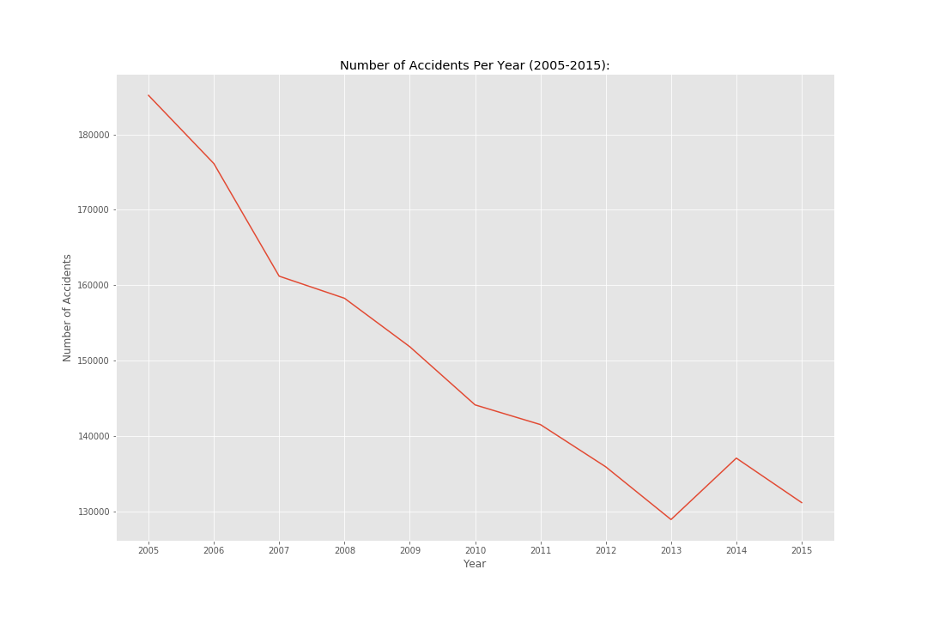
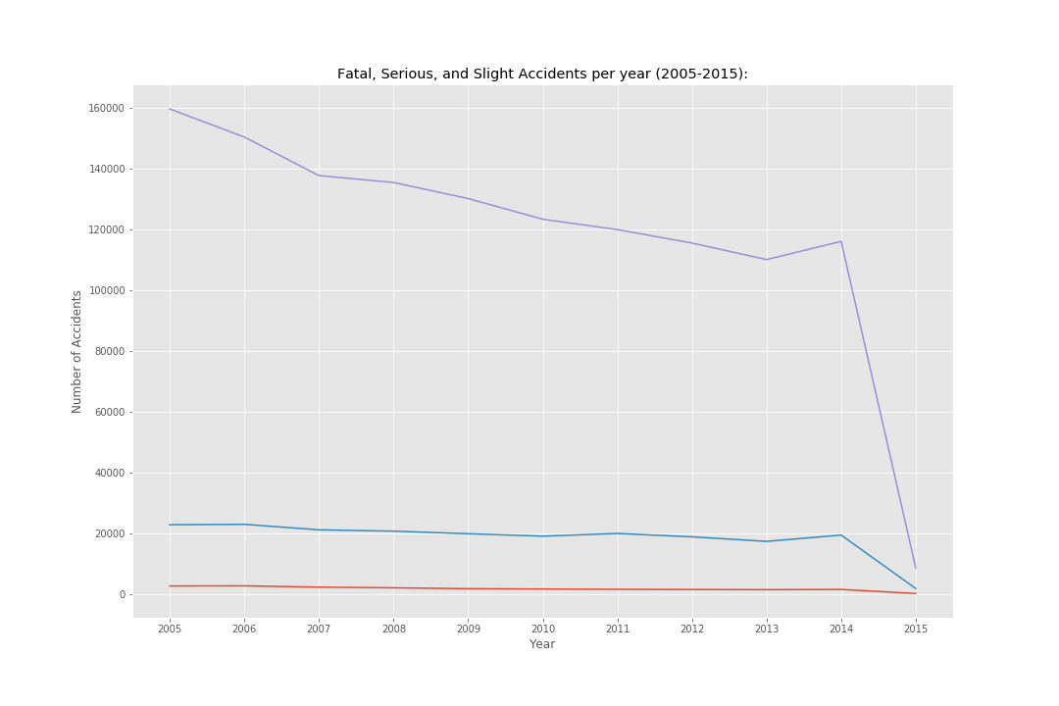
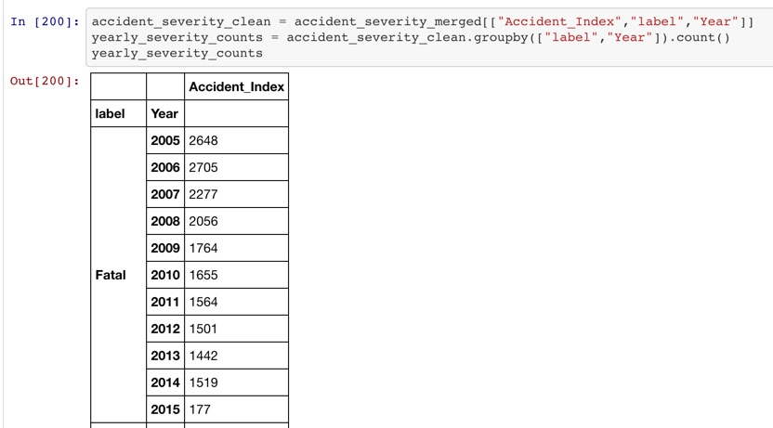
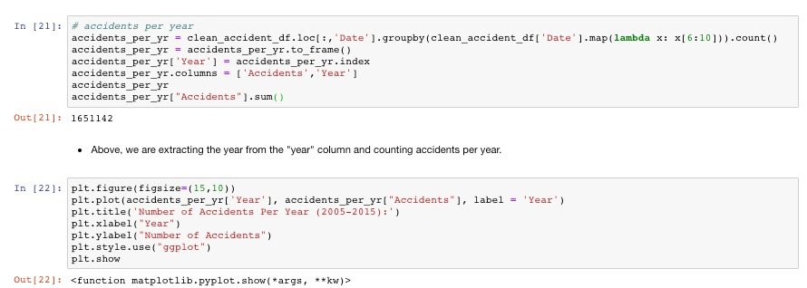
How many casualties occur each year?
How many accidents occur each year?
Notes:
A few other observations

Slide 8
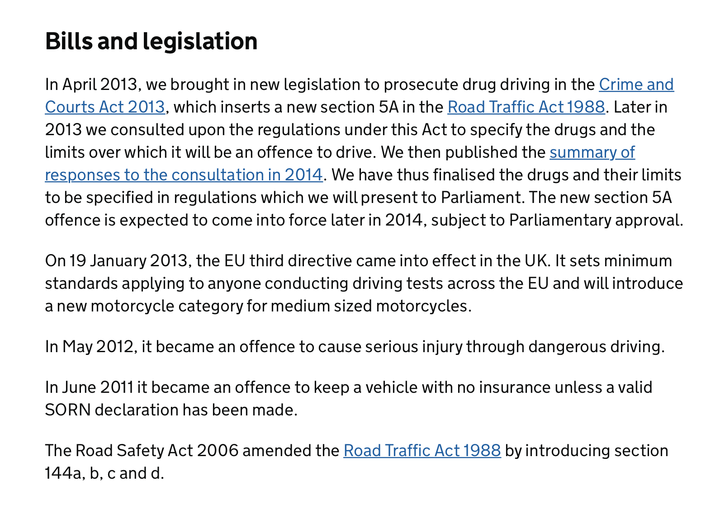

Slide 9
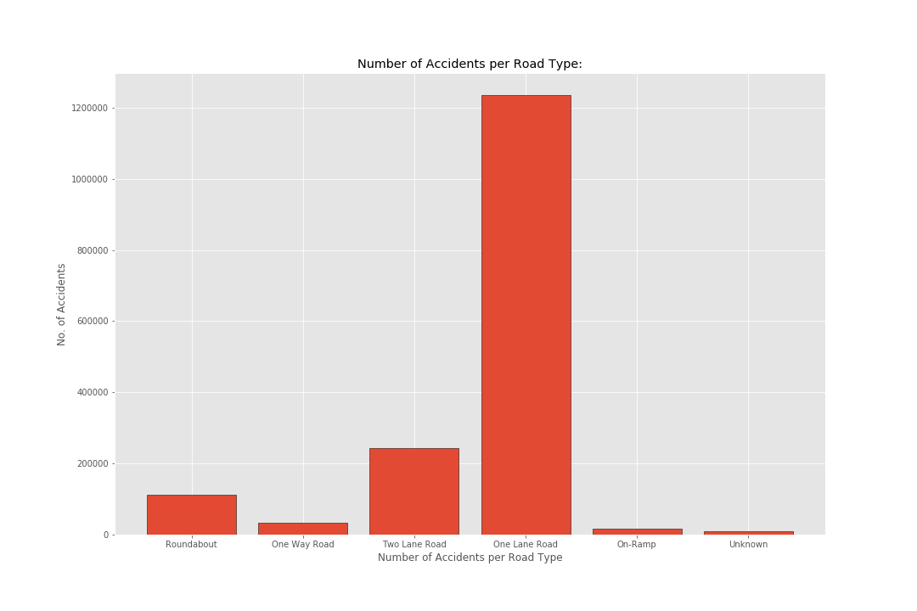
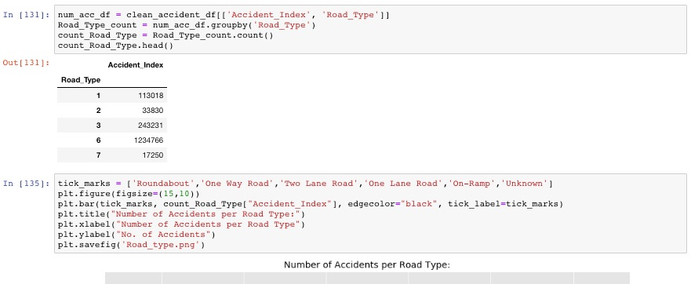
Which type of roads contain the highest number of accidents?
Notes:
Which type of roads contain the highest number of accidents?

Slide 10
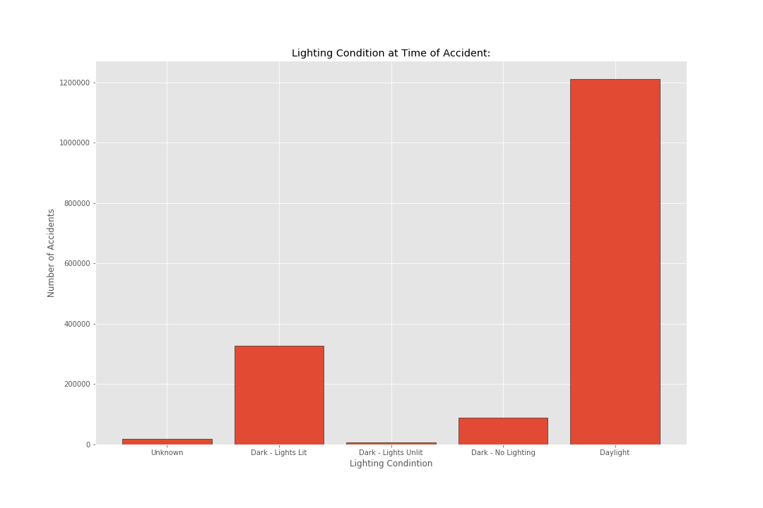
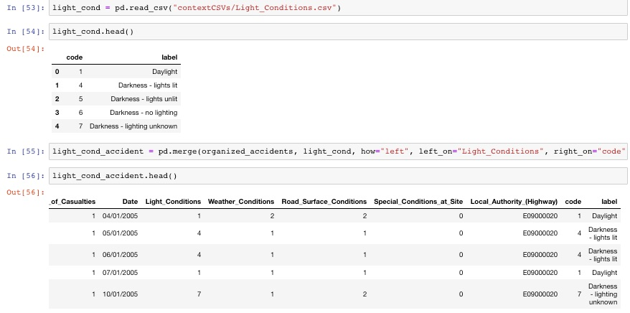
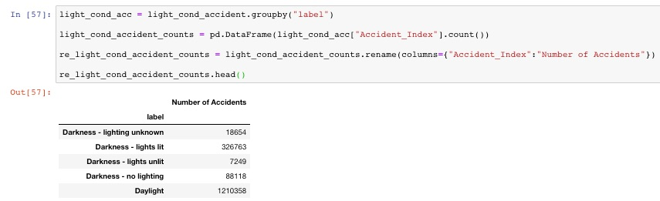
Do lighting conditions have an effect on accidents and severity?
Notes:
Do lighting conditions have an effect on accidents and severity?

Slide 11
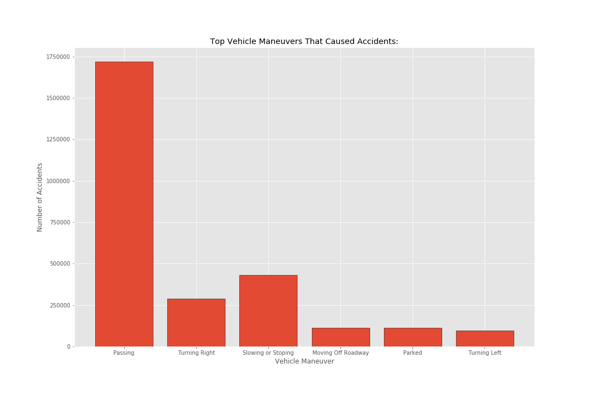
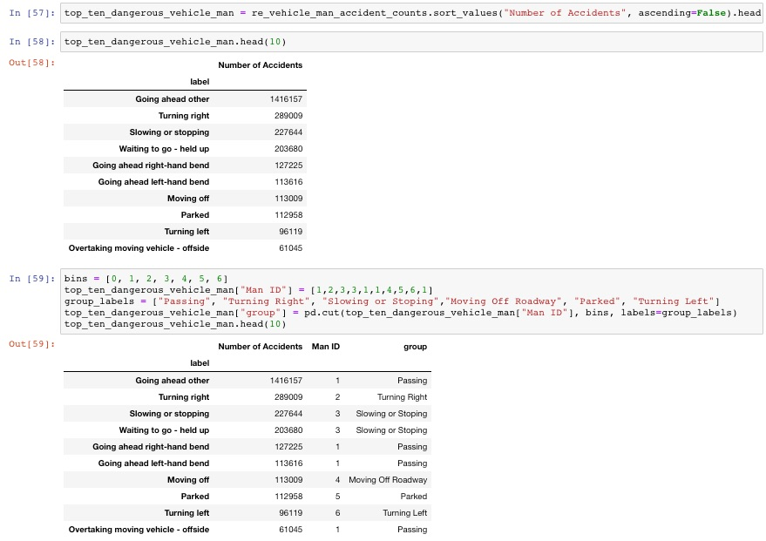
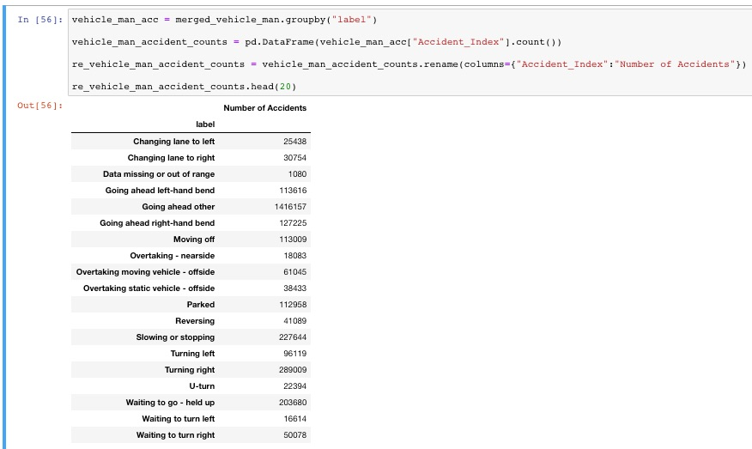
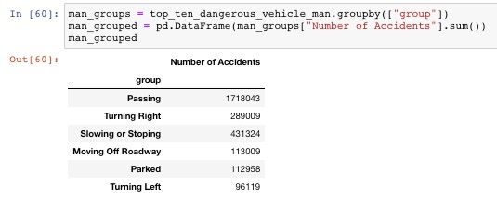
Which type of vehicle maneuvers cause the most accidents?
Notes:
Which type of vehicle maneuvers cause the most accidents?

Slide 12
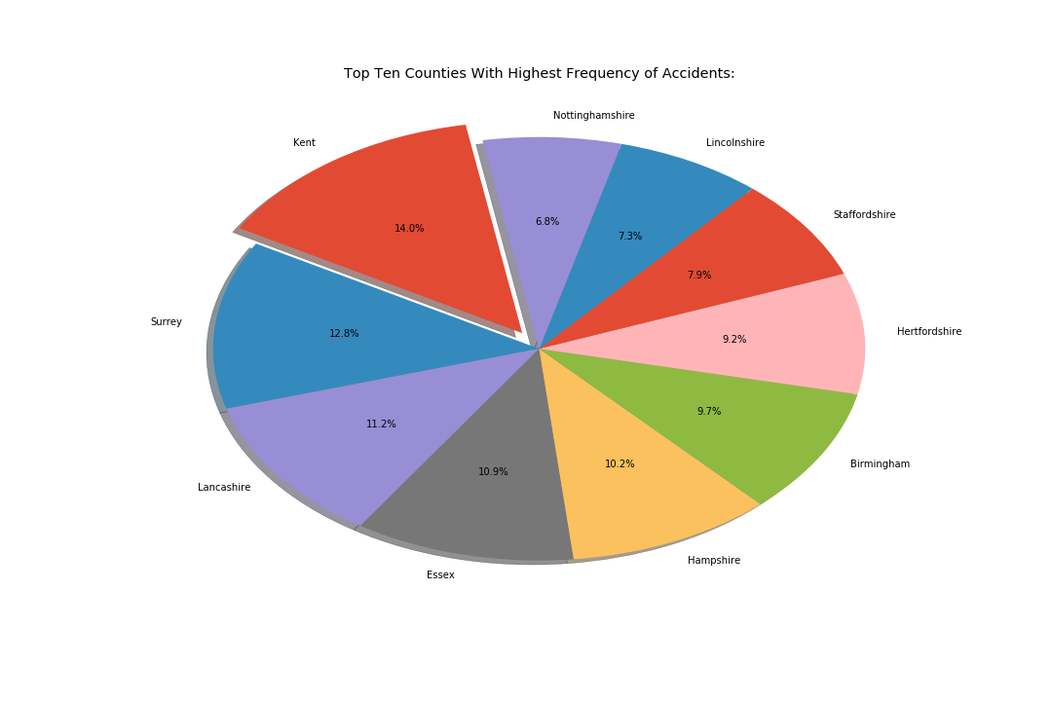
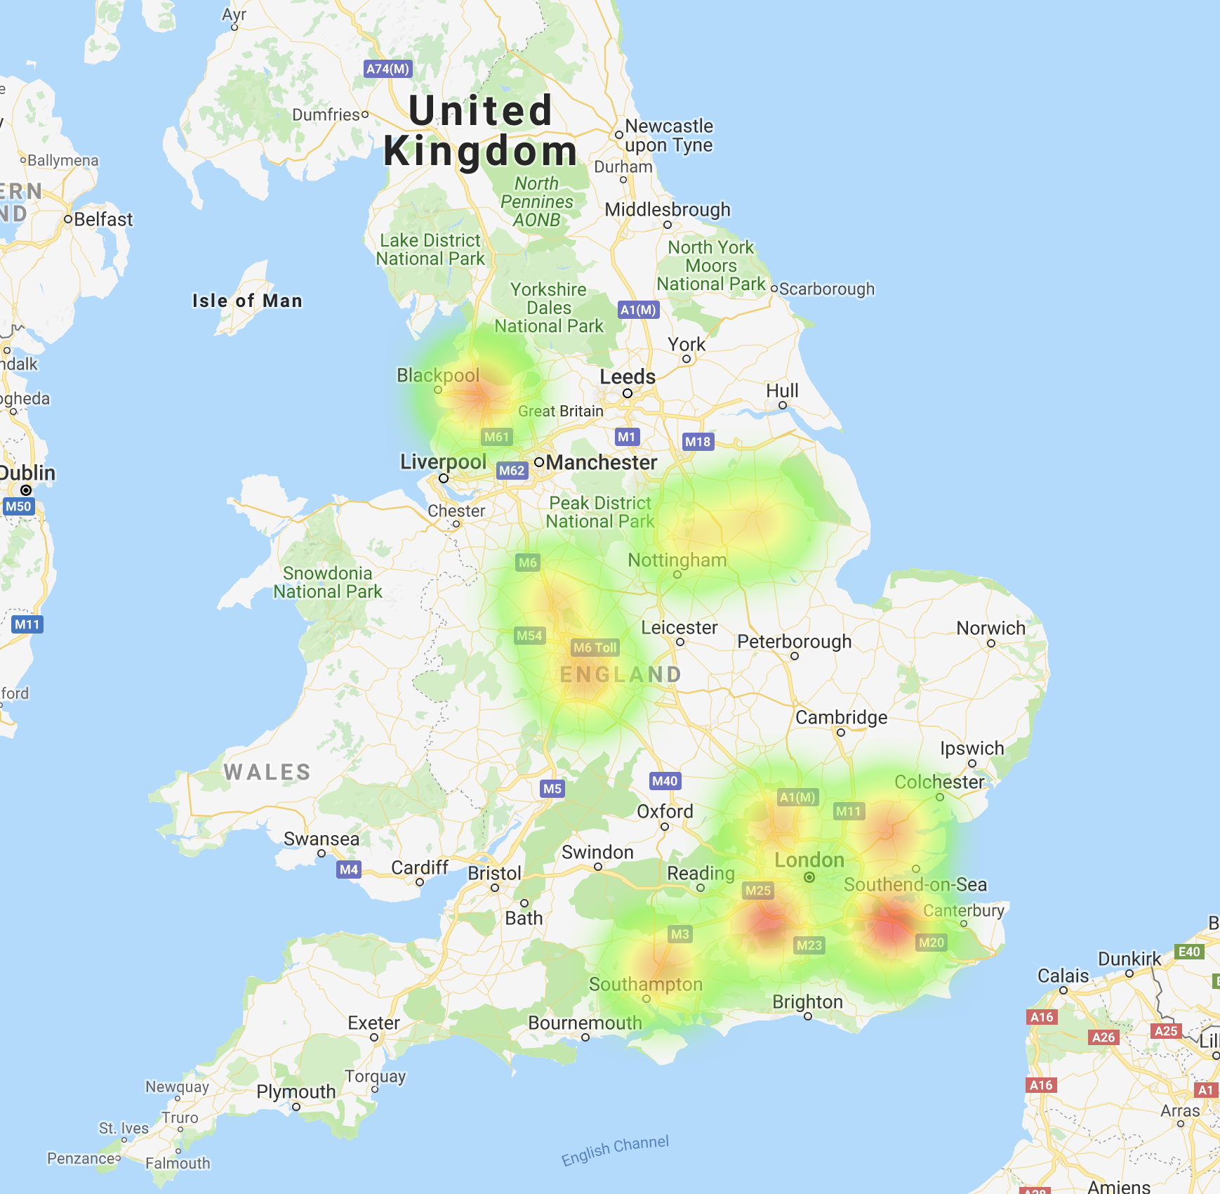
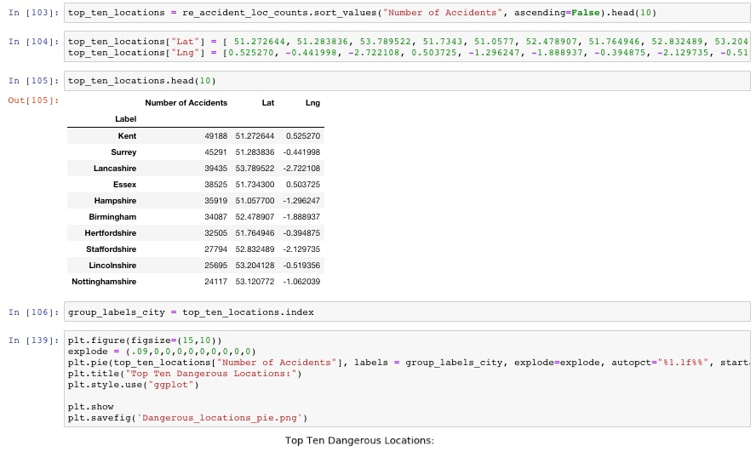
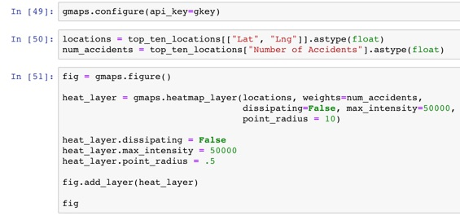
What counties have the most accidents?

Slide 13
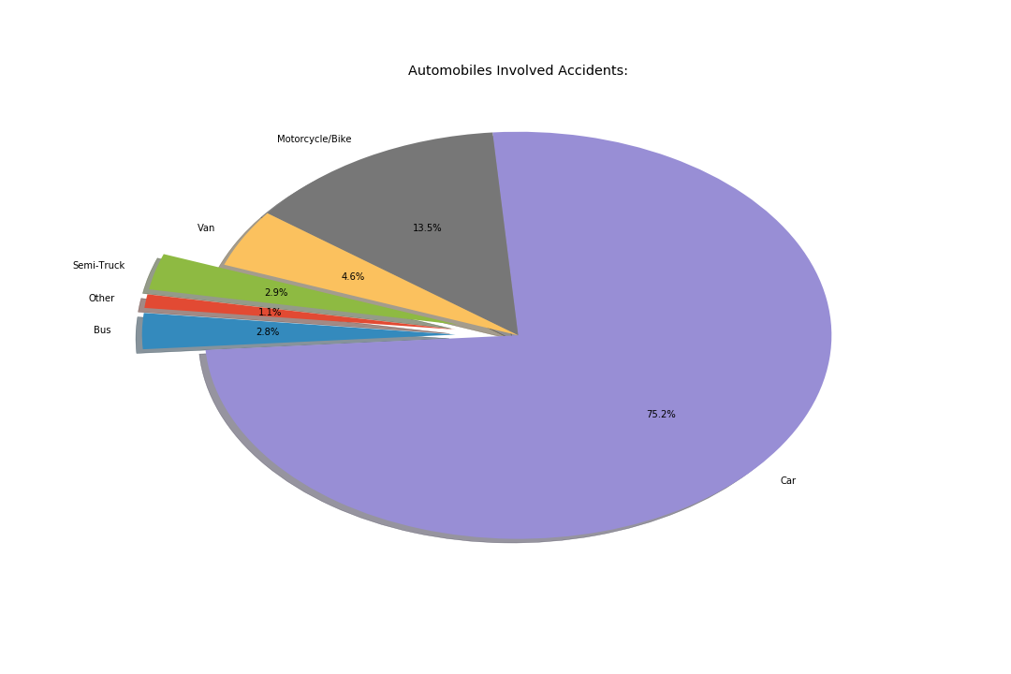
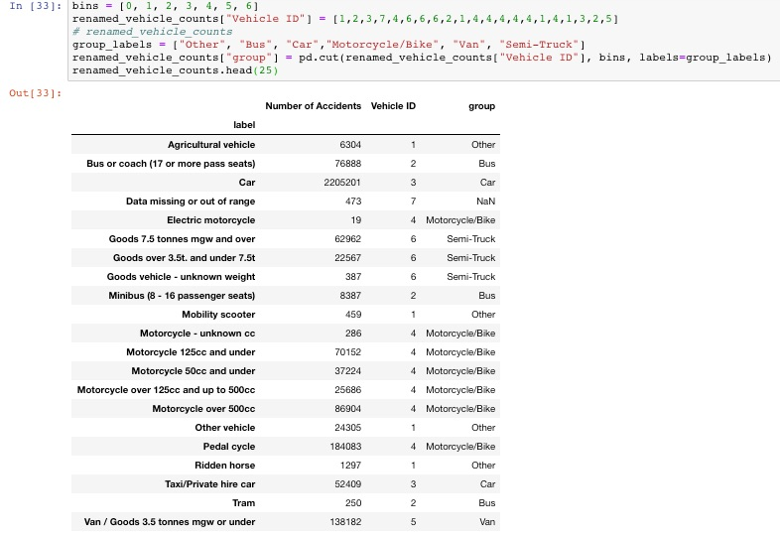
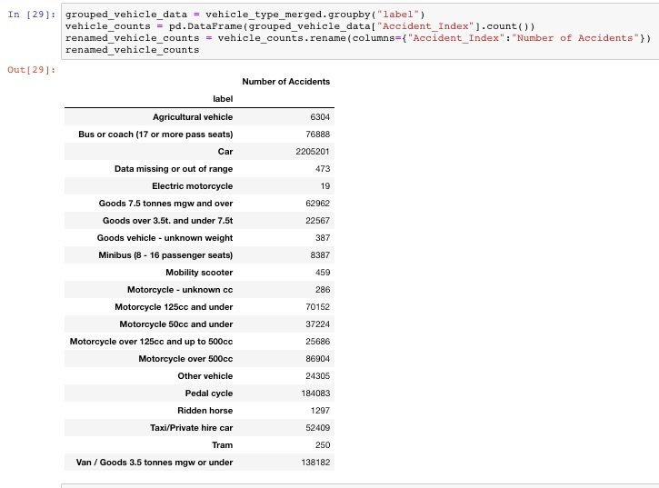
Which types of vehicles have the highest number of accidents and worst severity?
Notes:
Which types of vehicles have the highest number of accidents and worst severity?

Slide 14
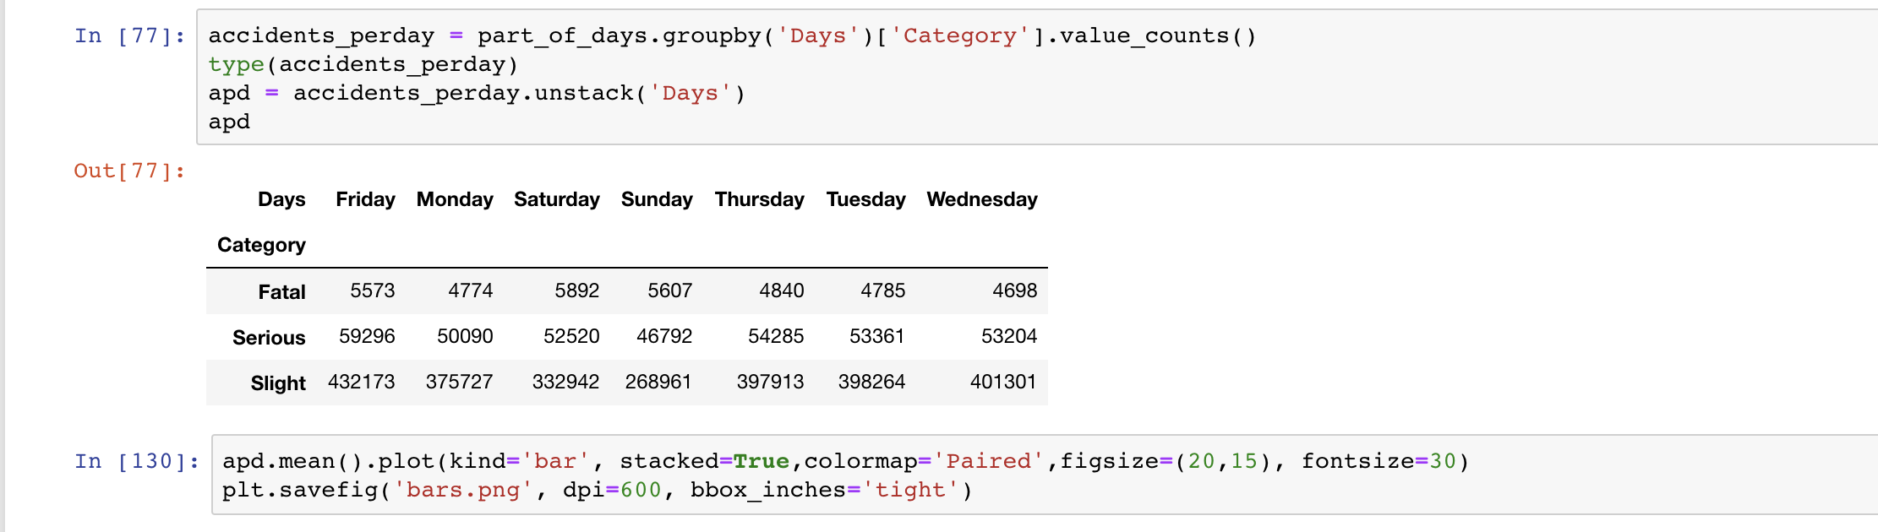
Is there a particular day of the week and time with a higher number of accidents?
Notes:
Is there a particular day of the week and time with a higher number of accidents?

Slide 15
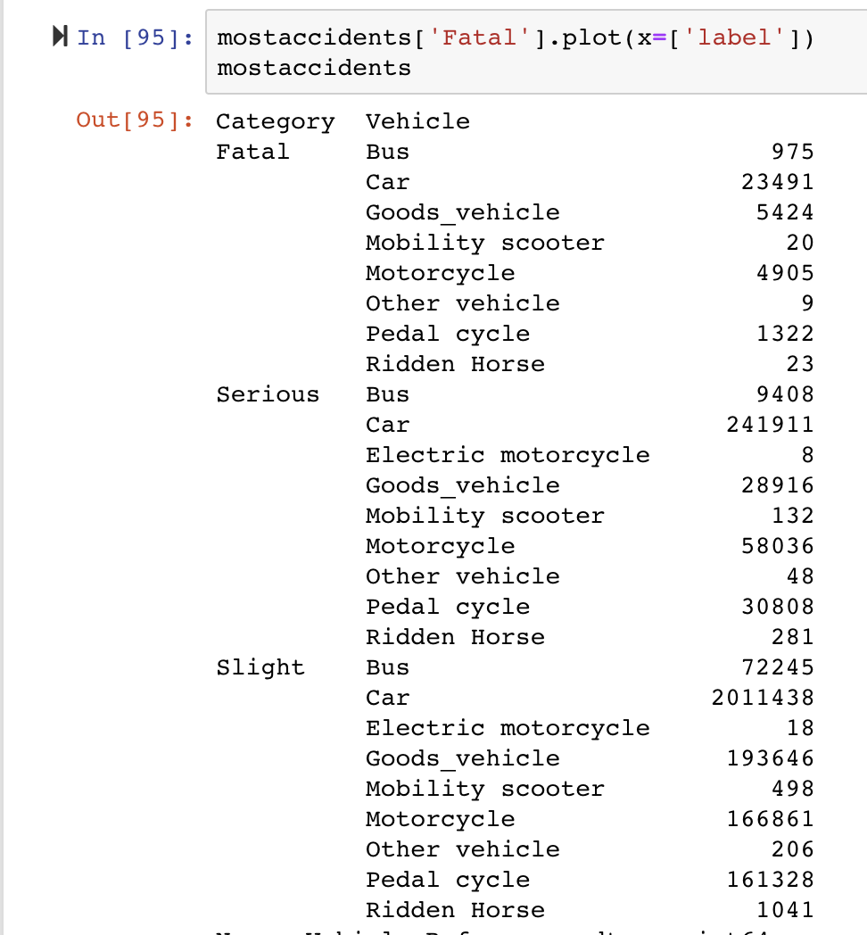
Which types of vehicles have the highest number of accidents and worst severity?
Notes:
Does higher horsepower capacity correlate to higher risk of accidents?

Slide 16
Summary
Significant drop in # of accidents from 2005 to 2015
Possibly correlated to speed cameras being installed nationwide in 2000
Significant drop in # of fatalities after 2014
Possibly correlated to policy changes for DUIs and prosecutions
Most accidents happen when passing
One lane roads are where most accidents occur.
There is no correlation for light conditions and accidents.

Slide 17
Thank you!! Any Questions?

