Slide 1
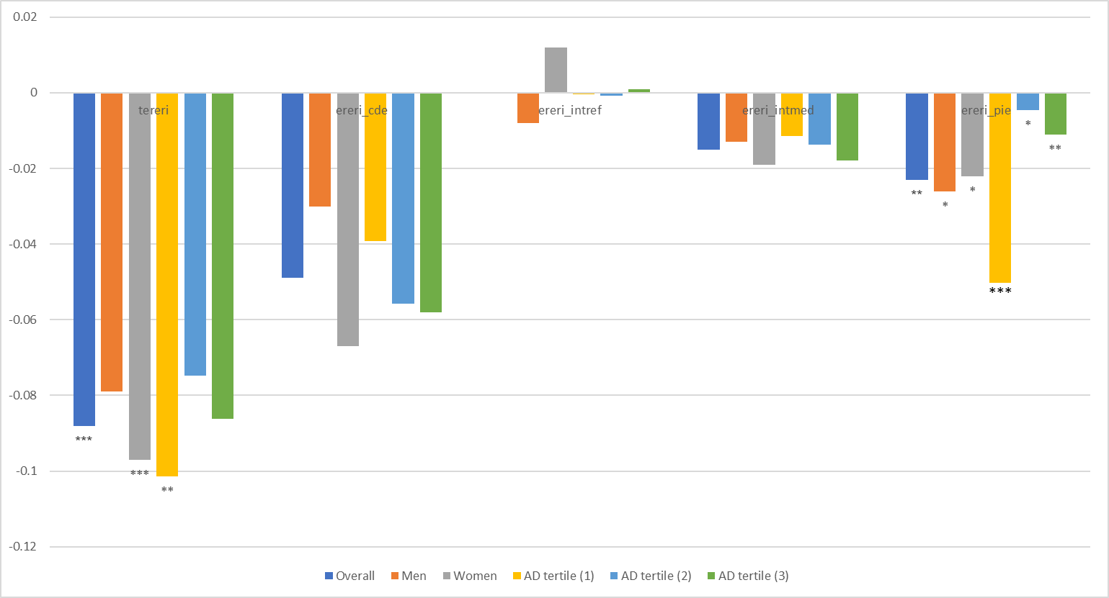
FIGURE S3.
(A) FAmean vs. PC1
 | Overall | Men | Women | AD tertile (1) | AD tertile (2) | AD tertile (3)
tereri | -0.088 | -0.079 | -0.097 | -0.1014 | -0.0747 | -0.0861
ereri_cde | -0.049 | -0.03 | -0.067 | -0.0393 | -0.0557 | -0.058
ereri_intref | -0.0001 | -0.008 | 0.012 | -0.0004 | -0.0007 | 0.001
ereri_intmed | -0.015 | -0.013 | -0.019 | -0.0114 | -0.0138 | -0.018
ereri_pie | -0.023 | -0.026 | -0.022 | -0.0502 | -0.0045 | -0.011
*P<0.05; **P<0.010; ***P<0.001

Slide 2
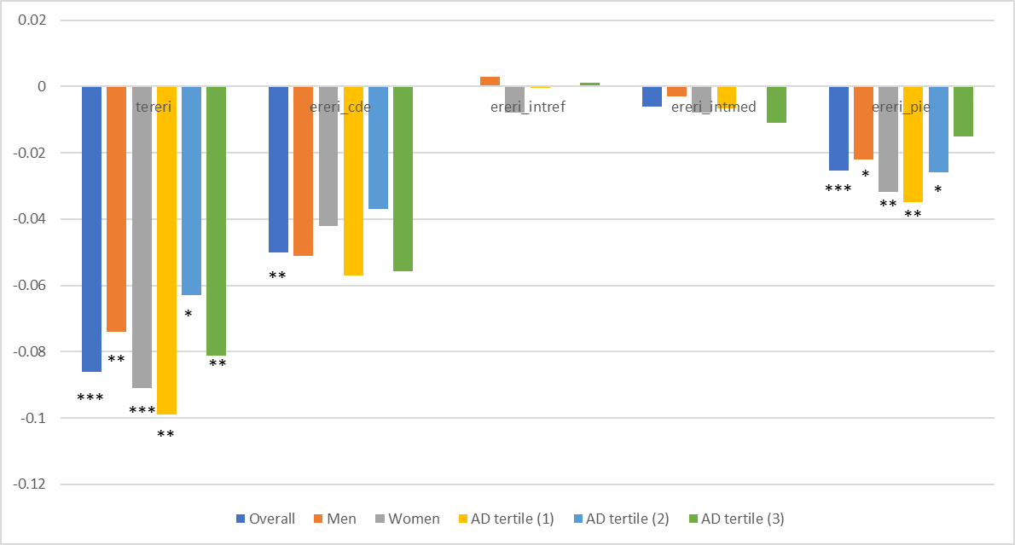
(B) FAmean vs. PC2
 | Overall | Men | Women | AD tertile (1) | AD tertile (2) | AD tertile (3)
tereri | -0.086 | -0.074 | -0.091 | -0.099 | -0.063 | -0.0813
ereri_cde | -0.05 | -0.051 | -0.042 | -0.057 | -0.037 | -0.0557
ereri_intref | 0 | 0.003 | -0.008 | -0.0004 | 0 | 0.001
ereri_intmed | -0.006 | -0.003 | -0.008 | -0.0065 | 0 | -0.011
ereri_pie | -0.0255 | -0.022 | -0.0319 | -0.035 | -0.026 | -0.015
*P<0.05; **P<0.010; ***P<0.001

Slide 3
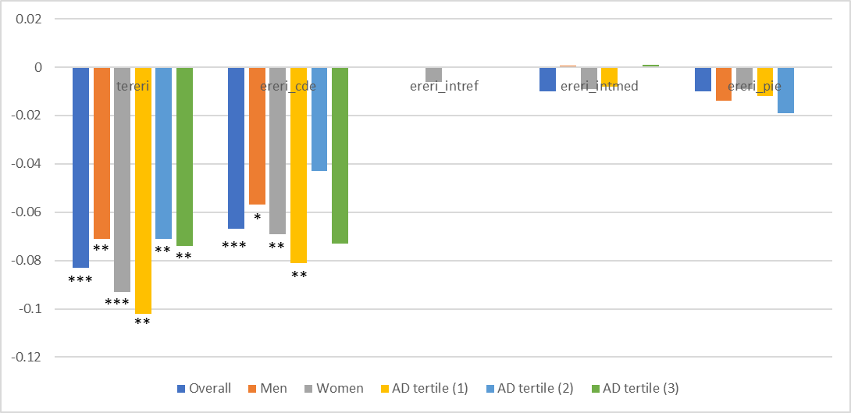
(C) FAmean vs. PC3
 | Overall | Men | Women | AD tertile (1) | AD tertile (2) | AD tertile (3)
tereri | -0.083 | -0.071 | -0.093 | -0.102 | -0.071 | -0.074
ereri_cde | -0.067 | -0.057 | -0.069 | -0.081 | -0.043 | -0.073
ereri_intref | 0.0000 | -0.0004 | -0.006 | -0.0004 | 0.0000 | 0.0000
ereri_intmed | -0.01007 | 0.0006 | -0.009 | -0.008 | 0.0000 | 0.0009
ereri_pie | -0.01 | -0.014 | -0.009 | -0.012 | -0.019 | 0.0004
*P<0.05; **P<0.010; ***P<0.001

Slide 4
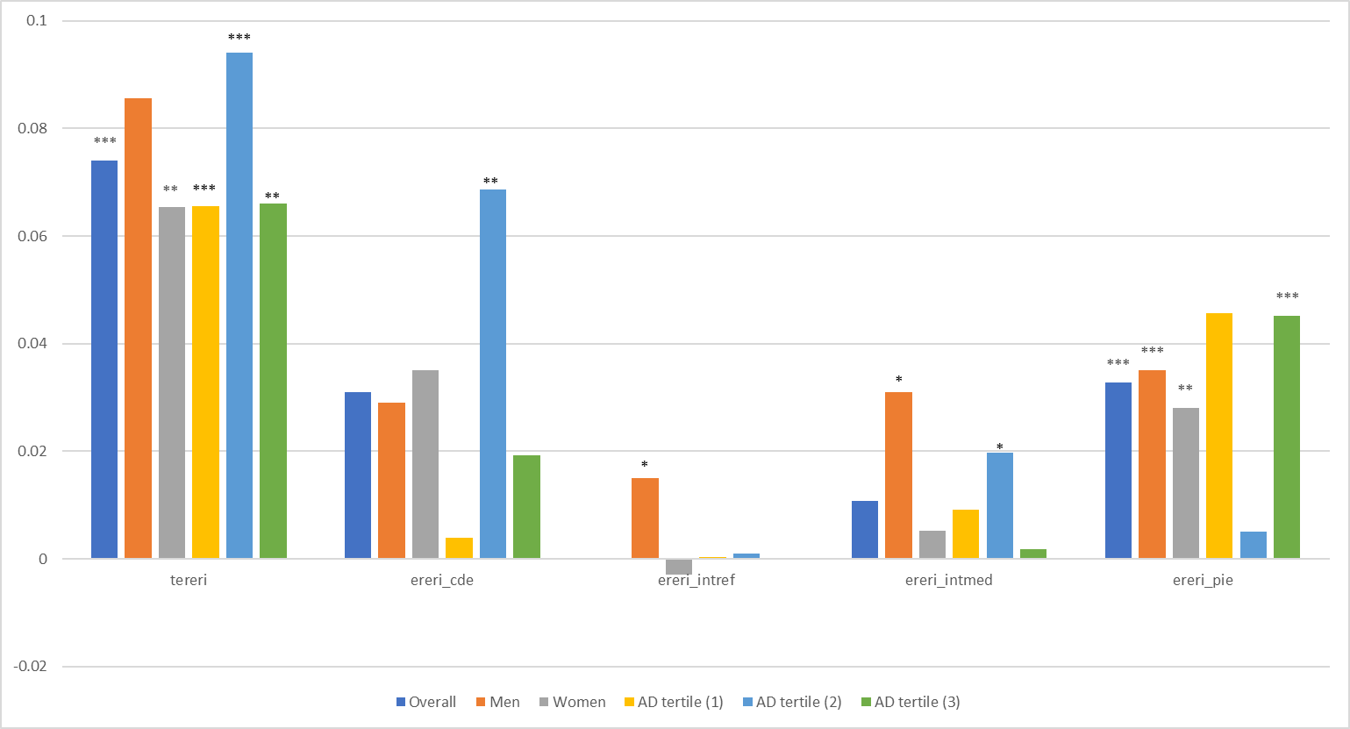
(D) ODmean vs. PC1
 | Overall | Men | Women | AD tertile (1) | AD tertile (2) | AD tertile (3)
tereri | 0.074 | 0.0856 | 0.0654 | 0.0655 | 0.094 | 0.0661
ereri_cde | 0.031 | 0.029 | 0.035 | 0.004 | 0.0686 | 0.0193
ereri_intref | 0 | 0.015 | -0.003 | 0.0003 | 0.00099 | -0.0001
ereri_intmed | 0.0107 | 0.031 | 0.0053 | 0.0091 | 0.0197 | 0.0018
ereri_pie | 0.0327 | 0.035 | 0.028 | 0.0457 | 0.0051 | 0.0452
*P<0.05; **P<0.010; ***P<0.001

Slide 5
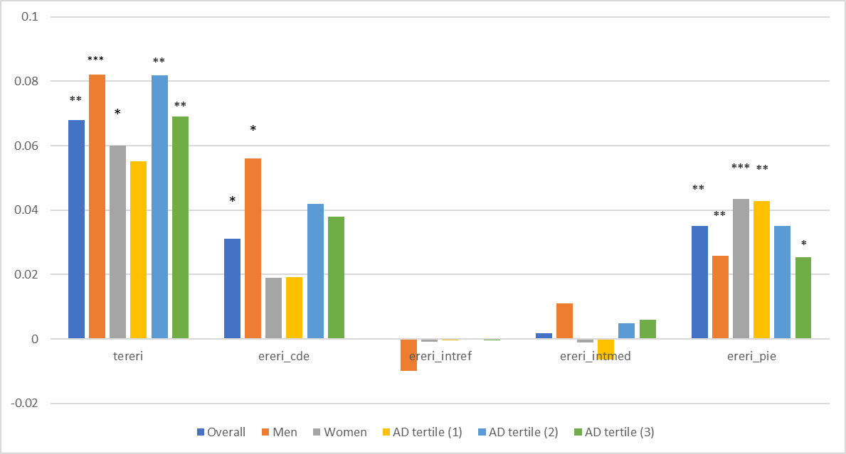
(E) ODmean vs. PC2
 | Overall | Men | Women | AD tertile (1) | AD tertile (2) | AD tertile (3)
tereri | 0.068 | 0.0821 | 0.0600 | 0.0551 | 0.0819 | 0.069
ereri_cde | 0.031 | 0.056 | 0.019 | 0.0192 | 0.042 | 0.038
ereri_intref | 0 | -0.01 | -0.0009 | -0.0004 | 0.0002 | -0.0005
ereri_intmed | 0.0018 | 0.011 | -0.001 | -0.0065 | 0.0048 | 0.00598
ereri_pie | 0.0351 | 0.0259 | 0.0434 | 0.0428 | 0.035 | 0.0253
*P<0.05; **P<0.010; ***P<0.001

Slide 6
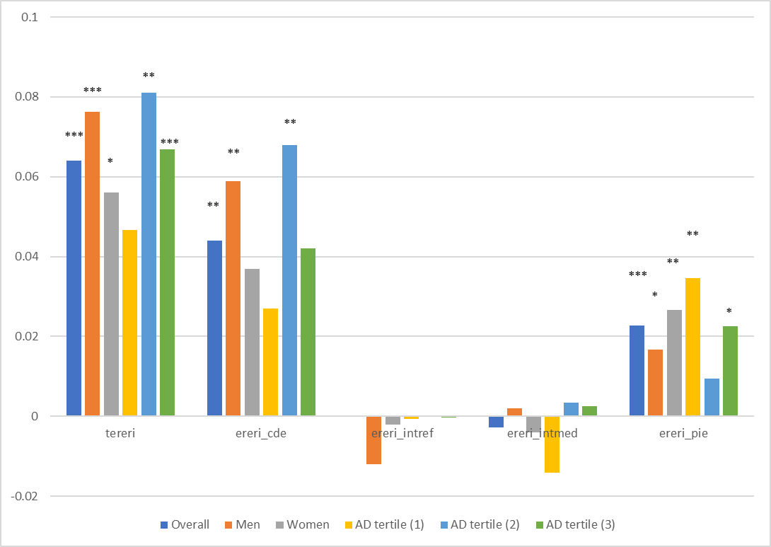
(F) ODmean vs. PC3
 | Overall | Men | Women | AD tertile (1) | AD tertile (2) | AD tertile (3)
tereri | 0.064 | 0.0763 | 0.056 | 0.0467 | 0.081 | 0.0668
ereri_cde | 0.044 | 0.0589 | 0.037 | 0.027 | 0.068 | 0.042
ereri_intref | 0 | -0.012 | -0.002 | -0.0007 | 0.0003 | -0.00026
ereri_intmed | -0.0027 | 0.002 | -0.004 | -0.0142 | 0.0035 | 0.0025
ereri_pie | 0.0228 | 0.0168 | 0.0266 | 0.0346 | 0.0094 | 0.0226
*P<0.05; **P<0.010; ***P<0.001

