Slide 1
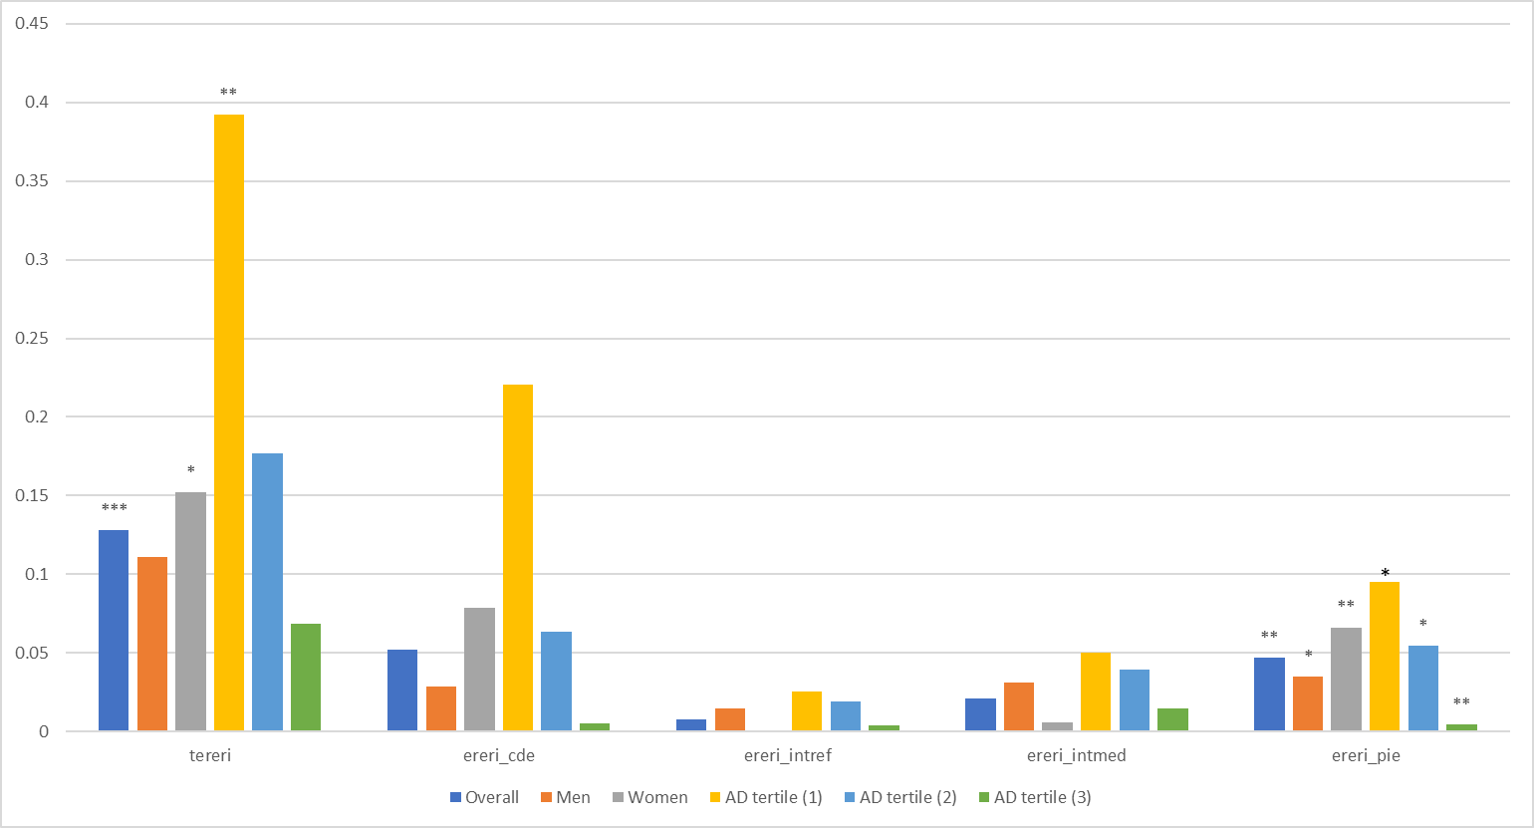
FIGURE S3.
(A)
*
*
*
*
 | Overall | Men | Women | AD tertile (1) | AD tertile (2) | AD tertile (3)
tereri | 0.128 | 0.111 | 0.152 | 0.3919 | 0.1768 | 0.0686
ereri_cde | 0.052 | 0.029 | 0.079 | 0.2204 | 0.0633 | 0.0054
ereri_intref | 0.008 | 0.015 | 0.0007 | 0.0257 | 0.0194 | 0.0043
ereri_intmed | 0.021 | 0.031 | 0.0058 | 0.0503 | 0.0397 | 0.0147
ereri_pie | 0.047 | 0.035 | 0.0663 | 0.0955 | 0.0544 | 0.00441
*P<0.05; **P<0.010; ***P<0.001

Slide 2
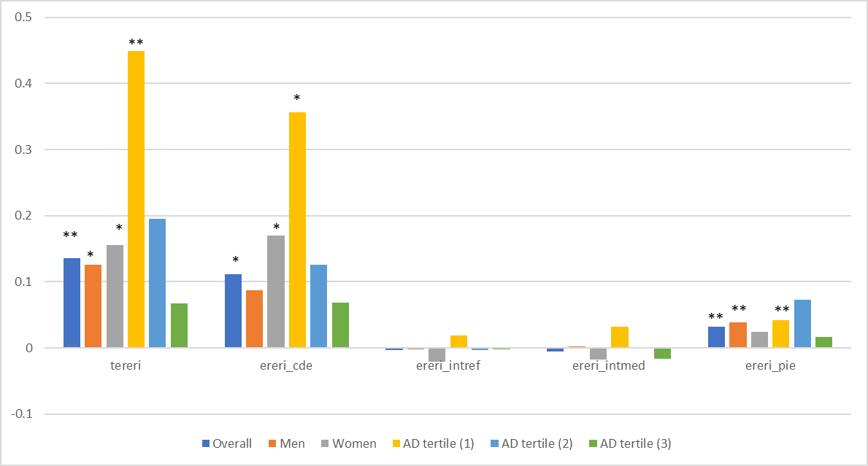
(B)
 | Overall | Men | Women | AD tertile (1) | AD tertile (2) | AD tertile (3)
tereri | 0.136 | 0.126 | 0.1554 | 0.4484 | 0.1953 | 0.0674
ereri_cde | 0.1119 | 0.087 | 0.17 | 0.3565 | 0.1259 | 0.0685
ereri_intref | -0.0029 | -0.0018 | -0.021 | 0.0183 | -0.0033 | -0.0019
ereri_intmed | -0.005 | 0.002 | -0.018 | 0.0317 | 0.0002 | -0.0164
ereri_pie | 0.0319 | 0.0388 | 0.0247 | 0.0419 | 0.07244 | 0.0171
*P<0.05; **P<0.010; ***P<0.001

