Slide 1
Information Visualization
Term Project
Beket Bayemirov, Alibi Yeslambek

Slide 2
Demo
https://www.youtube.com/watch?v=iOSPGSYP1M4
https://drive.google.com/file/d/150SKNT_oBBTEFzzig5N1P45ZDVlpFWLh/view

Slide 3
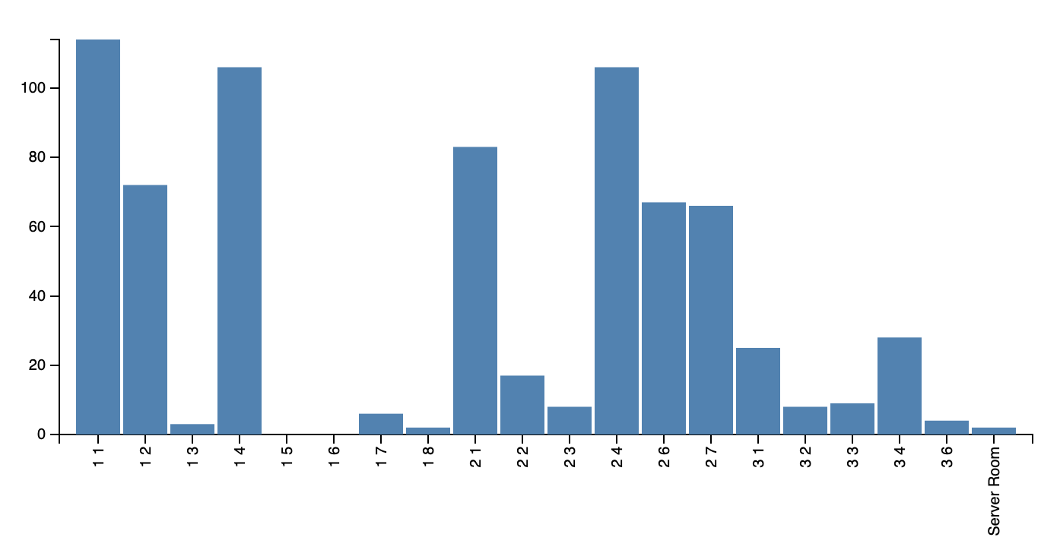
Human population by zones

Slide 4
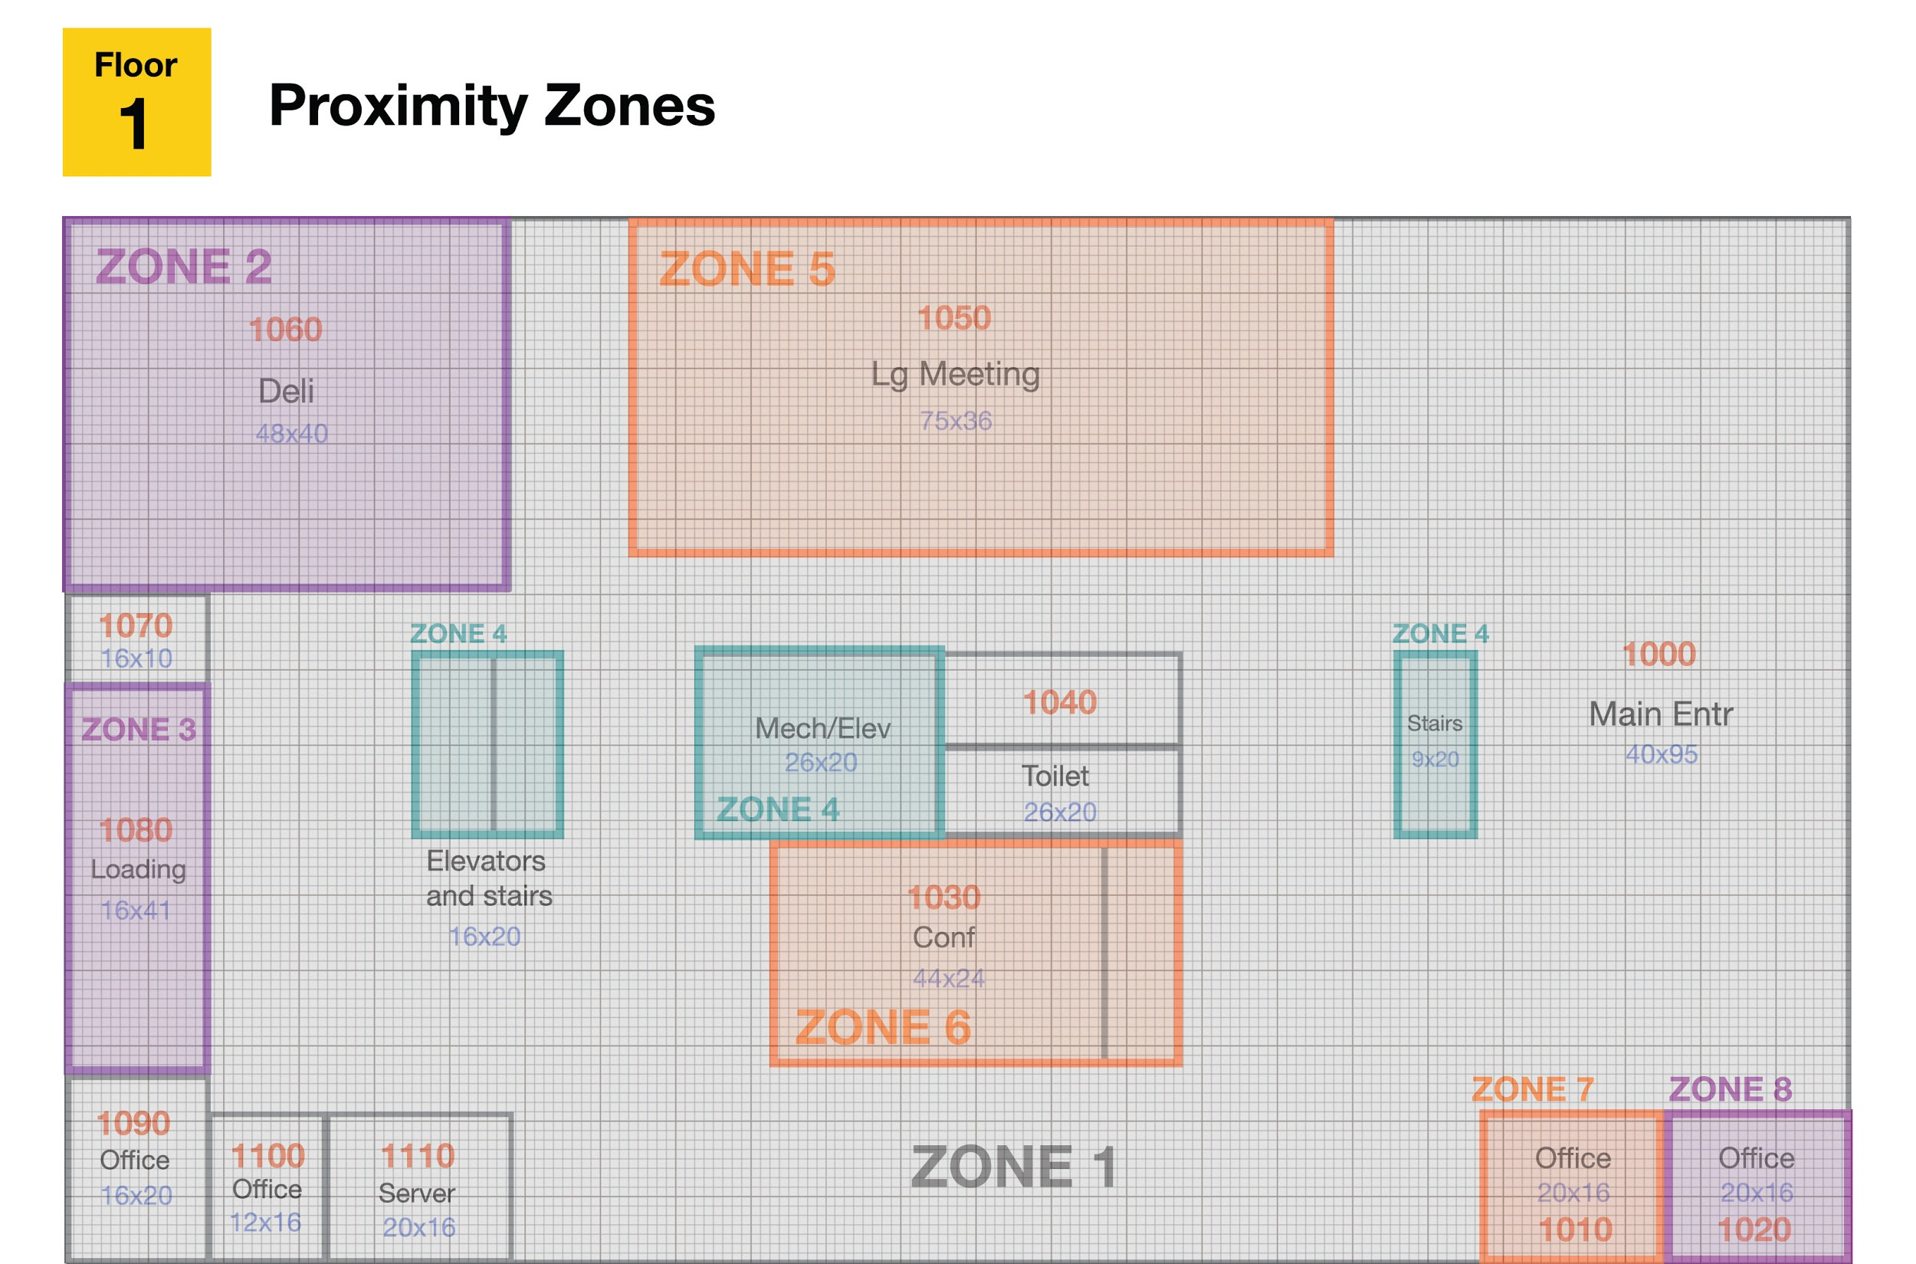
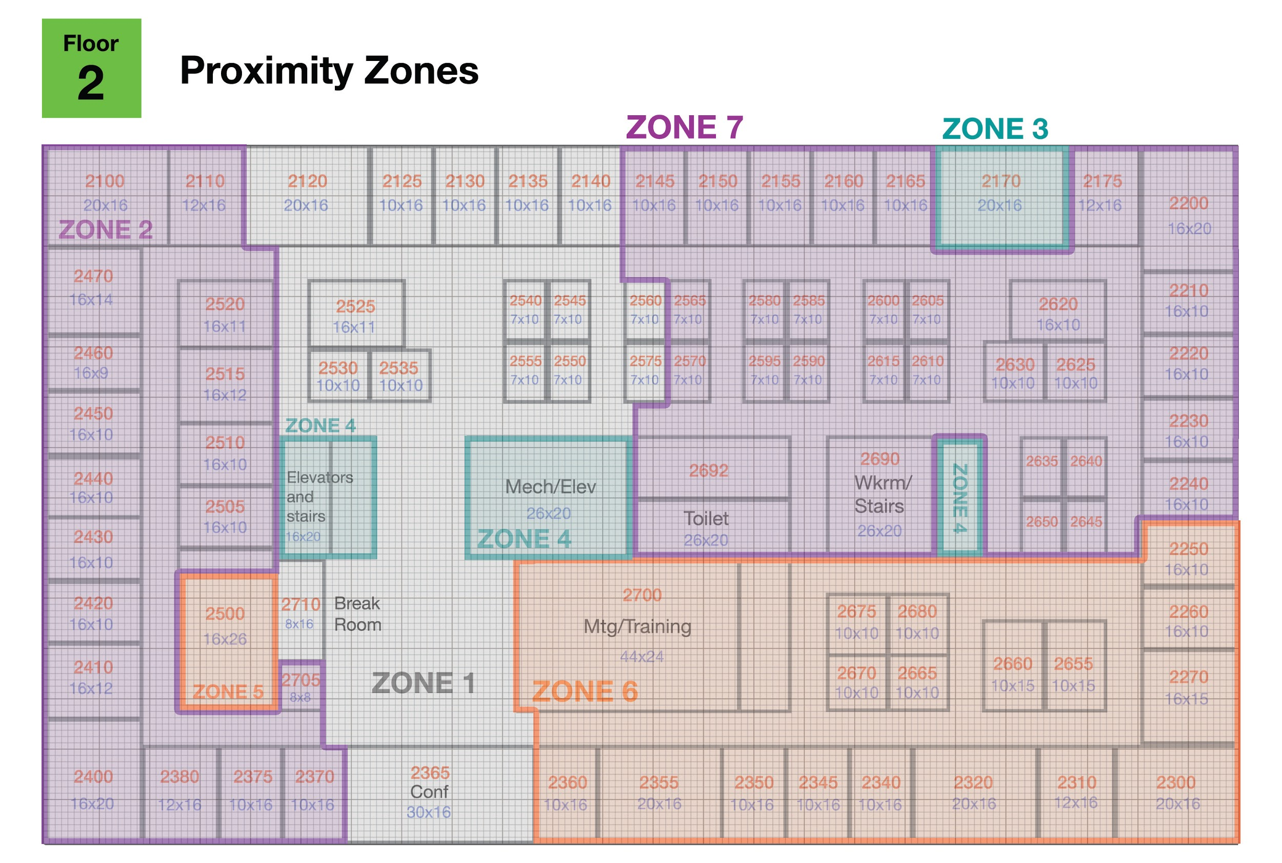
Human population by zones: Top vs Least visited
1_1 -> Entrance(hallway)
1_2 -> Deli (cafeteria)
1_4 -> Elevators (People go to 2nd, 3rd floor)
2_1 -> hallway(everyone goes through after stairs/elevator)
2_4 -> Elevators
2_7 -> Many Offices + Restroom
Least visited zones: 1_3, 1_5, 1_6, 1_7, 1_8
Reason: Lack of office rooms in the firsts floor. First floor usually used by buildings as a reception and etc.

Slide 5
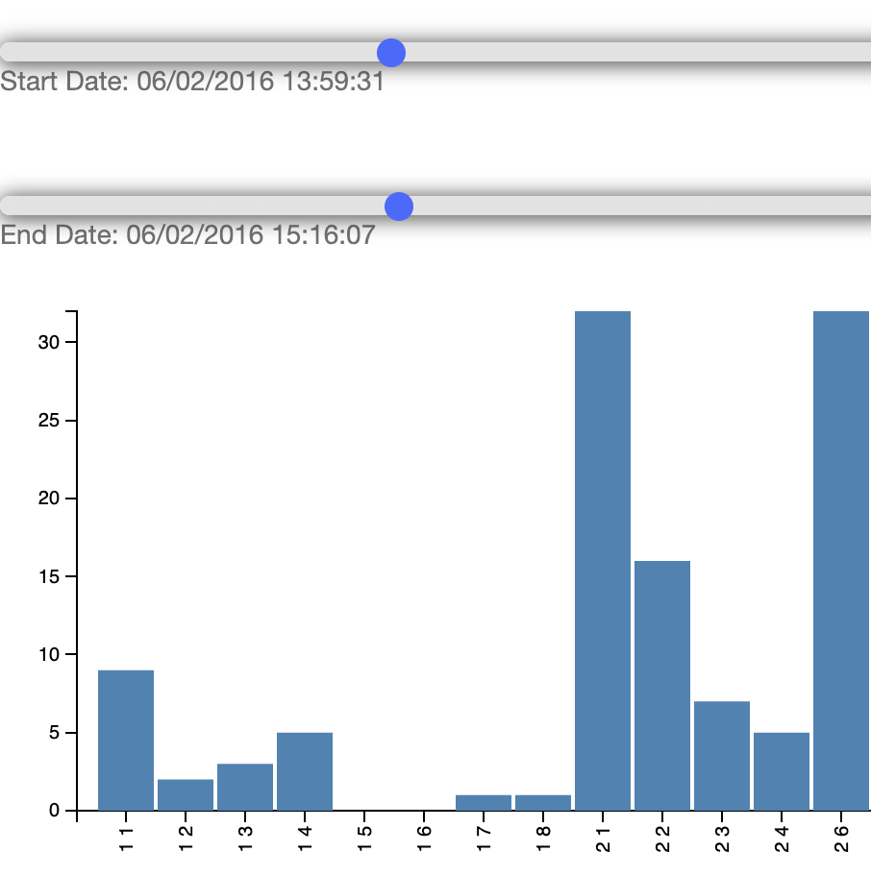
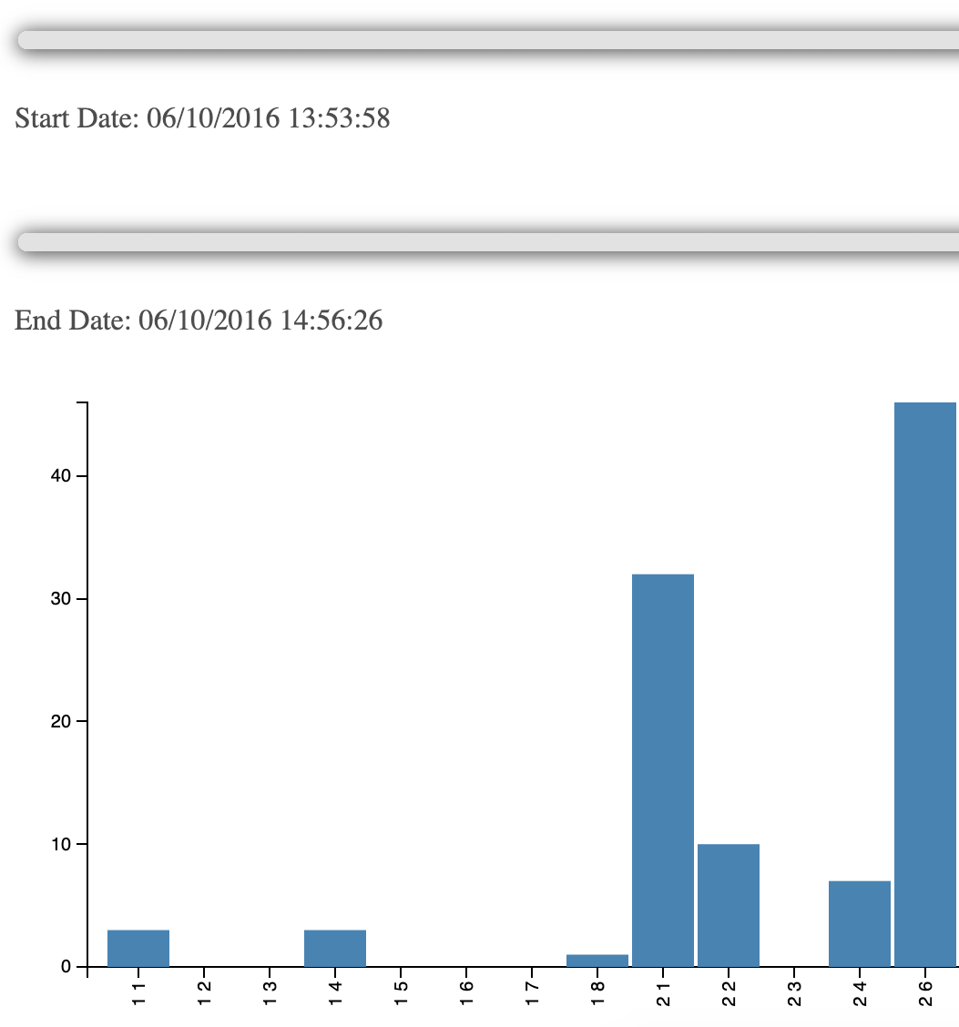
Daily meetings 2-3pm

Slide 6
About 30 people come after 4pm

Slide 7
Staff's movement patterns

Slide 8
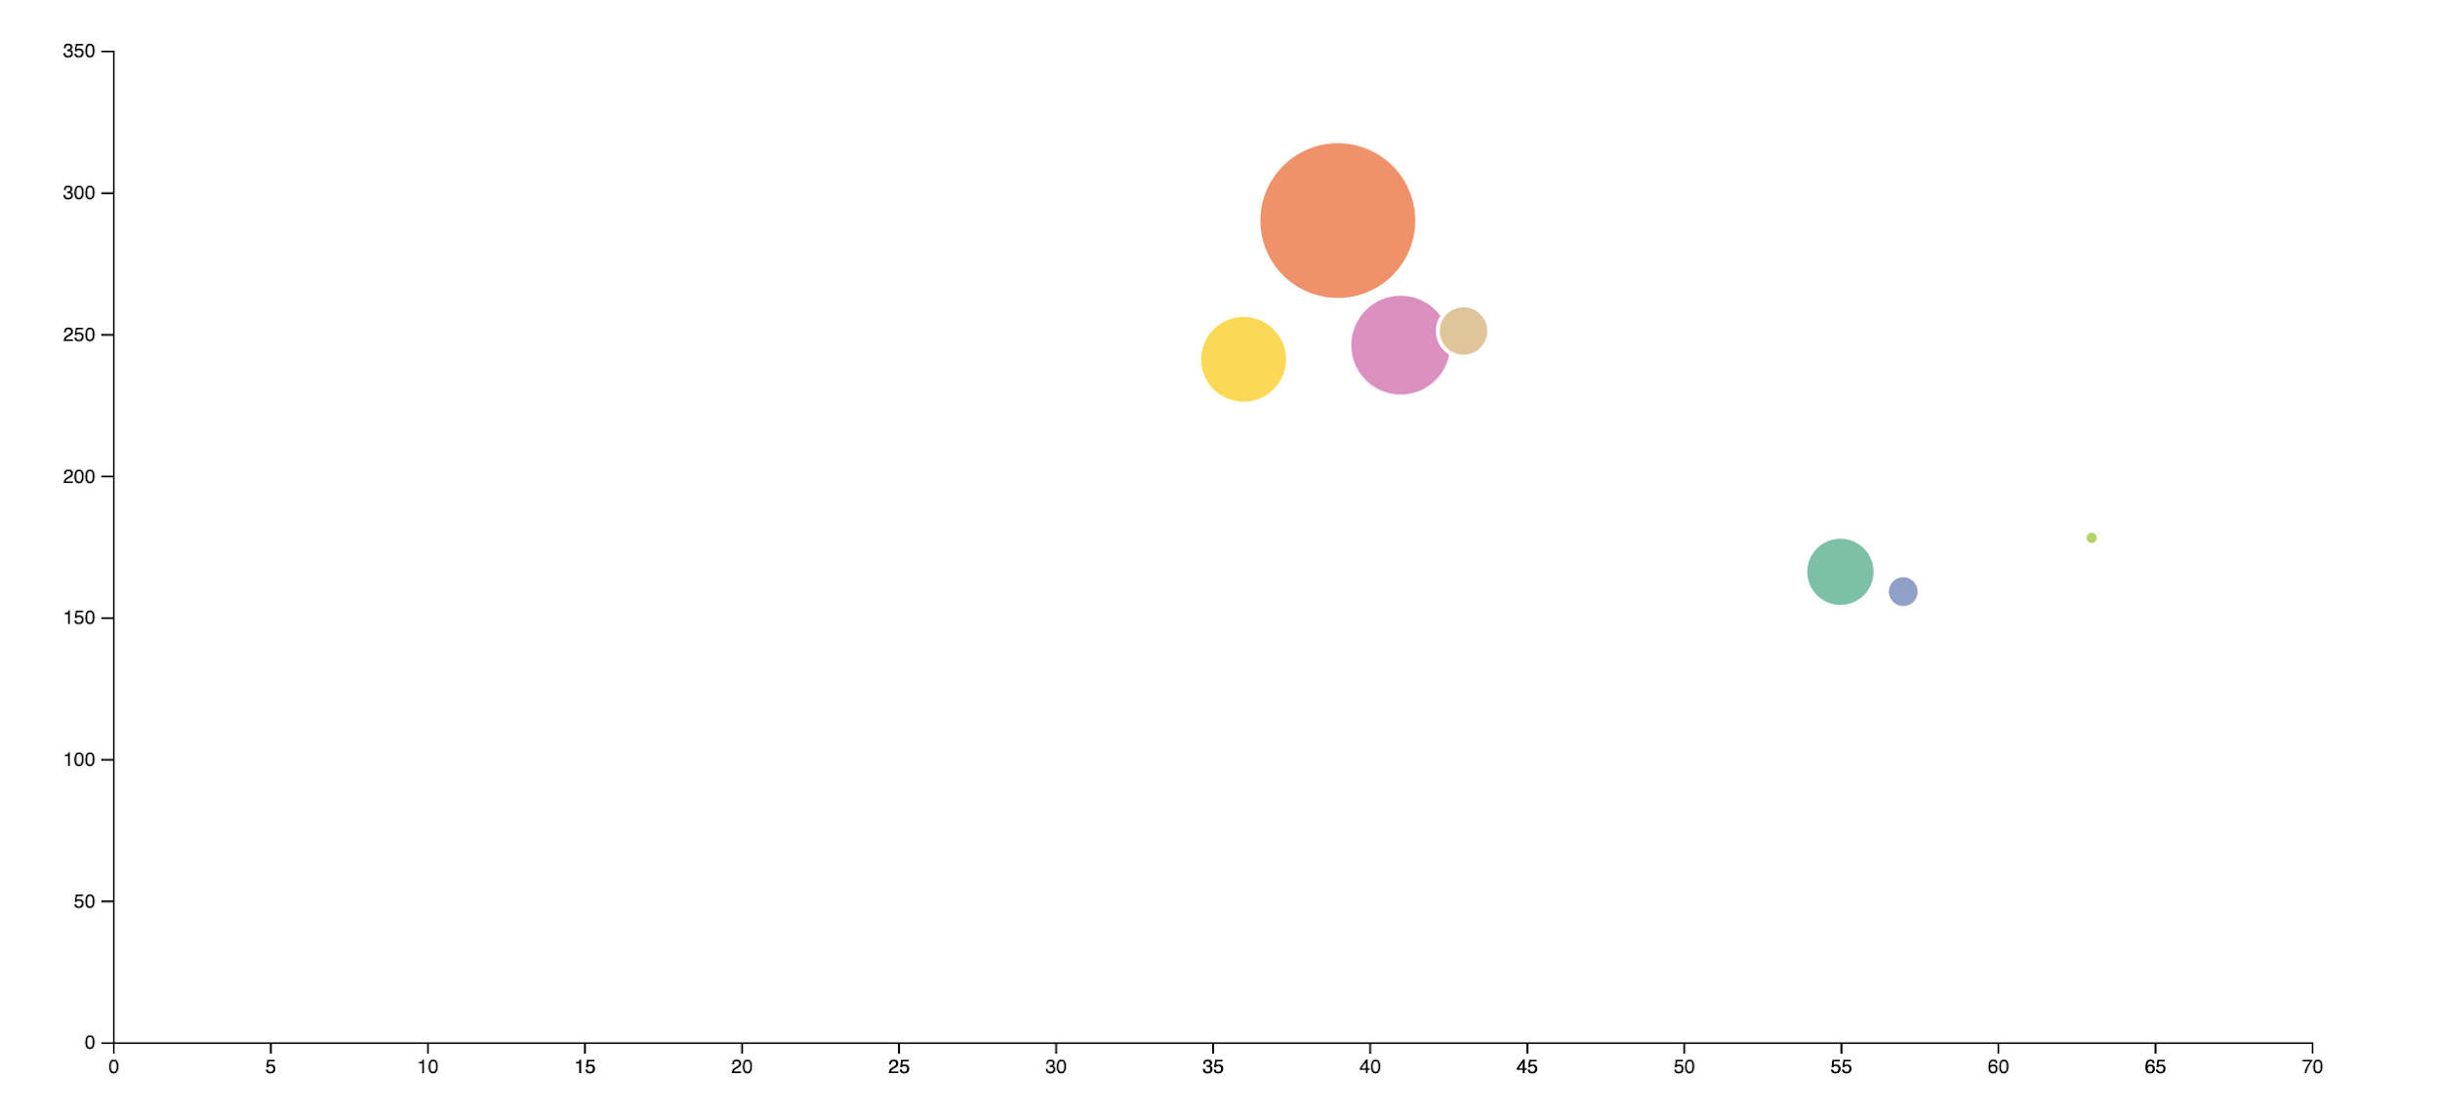
Zone changes OVER Floor changes

Slide 9
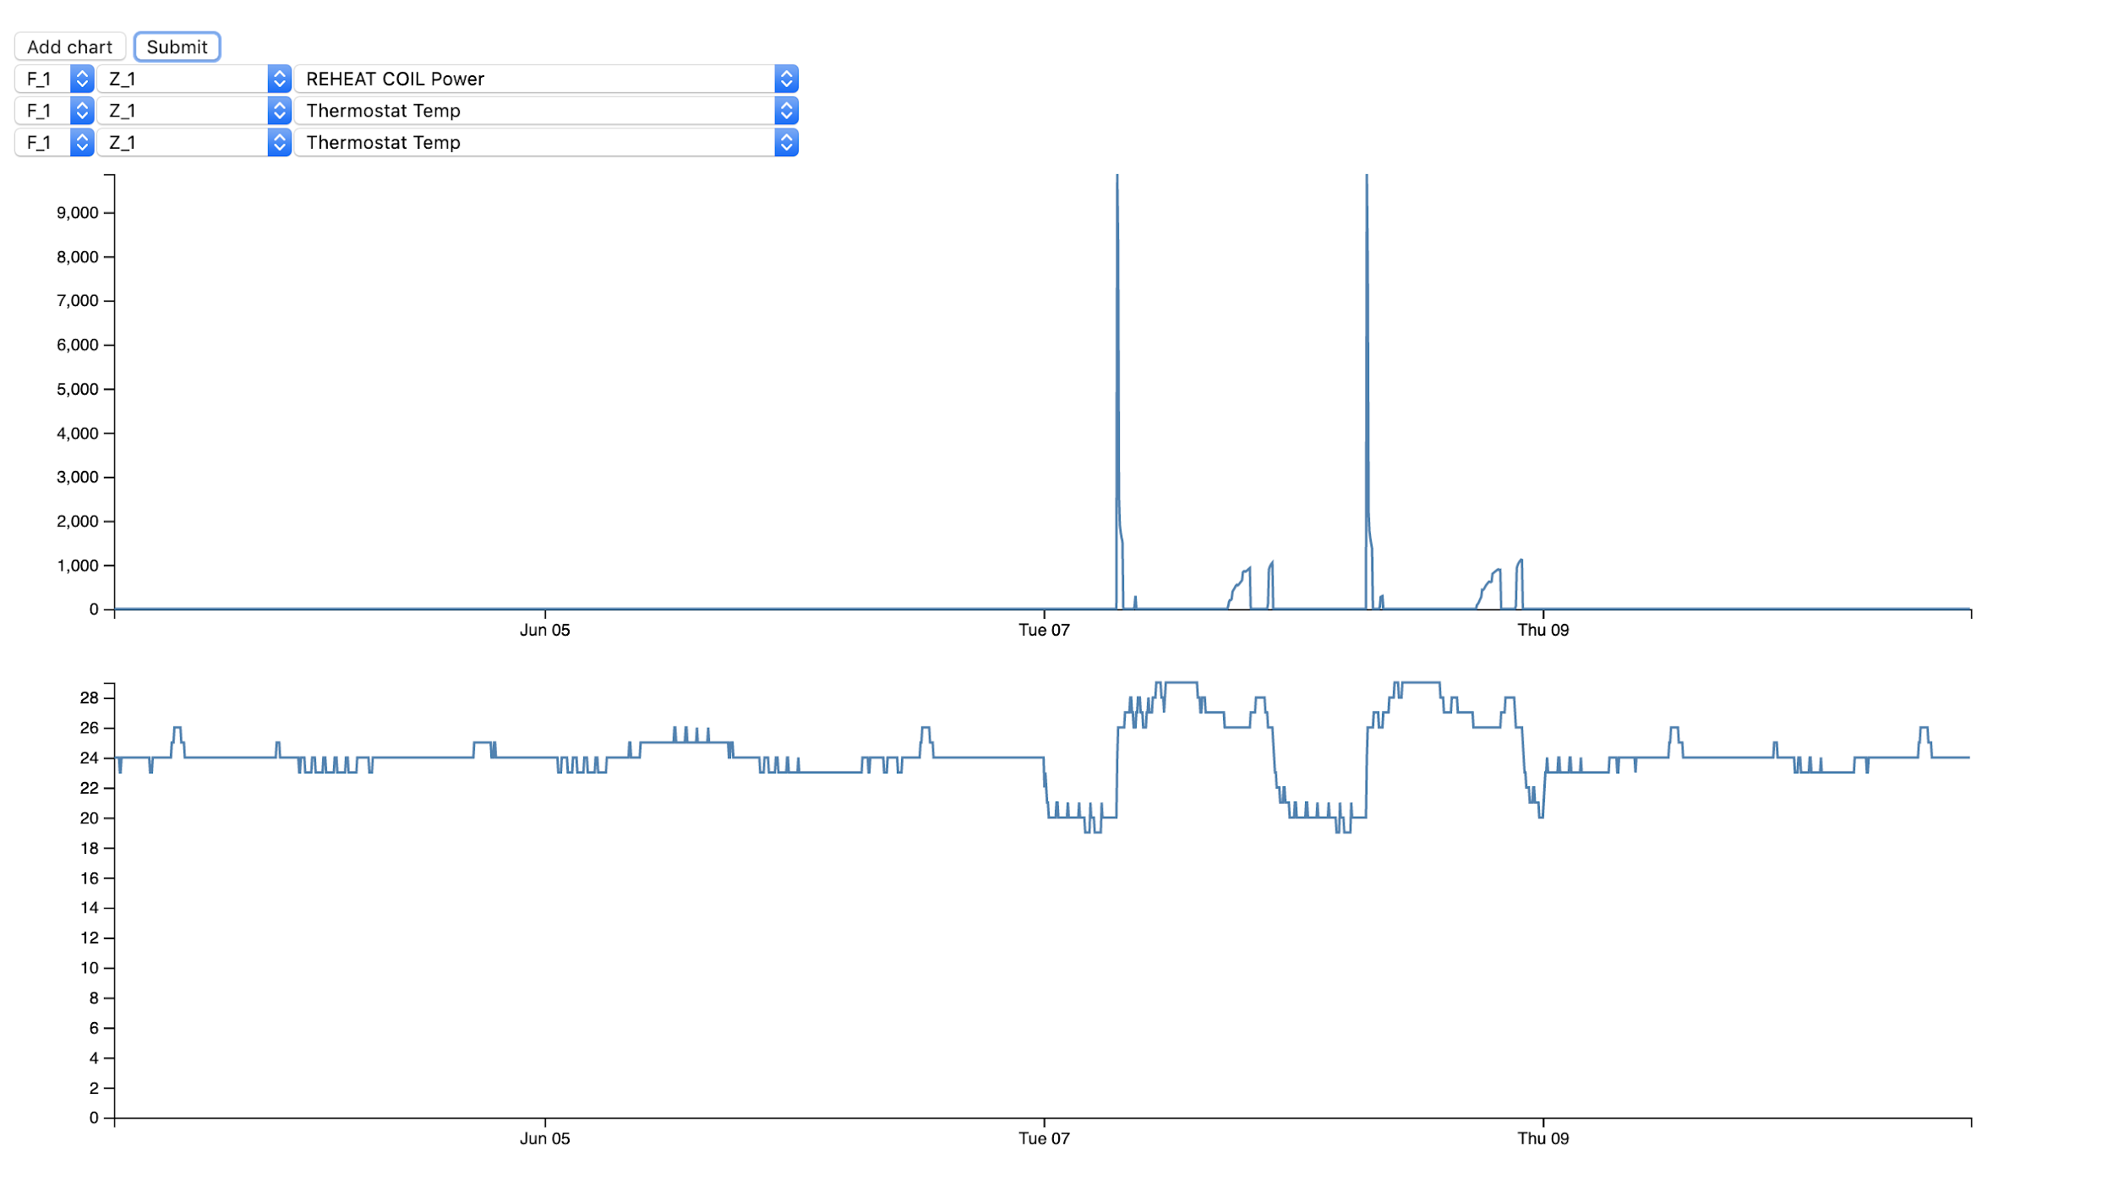
Stats Anomaly

Slide 10
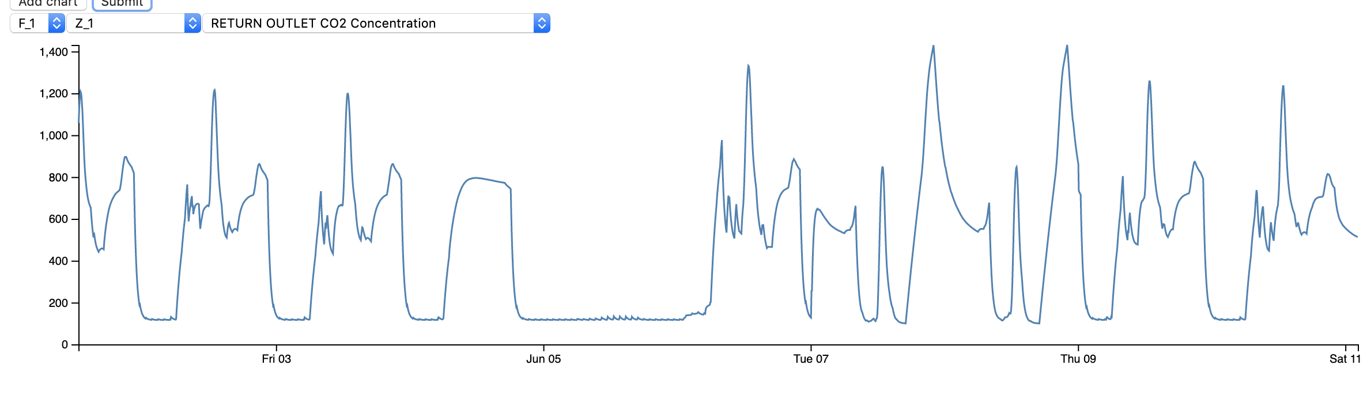
(F1_Z1) Deli pattern of CO2

Slide 11
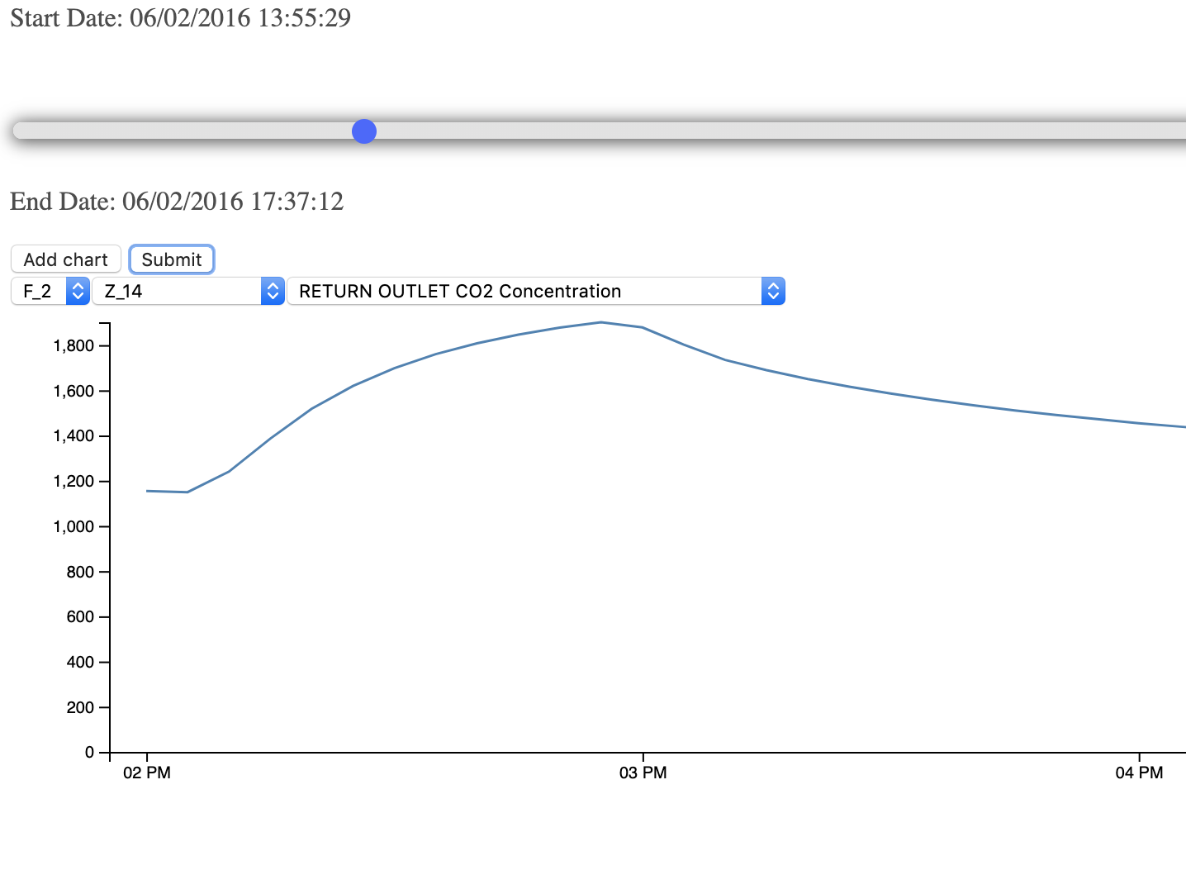
People amount vs CO2 relationship in conference room (prox_2_1=energy_2_14)

Slide 12
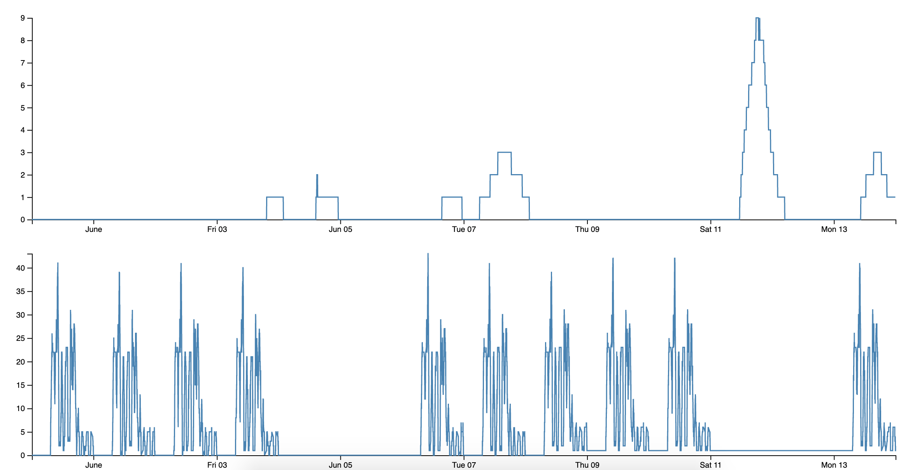
Hazium VS People concentration
Hazium
People
Engineering zone 2F
Notes:
Engineering zone, on the 2nd floor

Slide 13
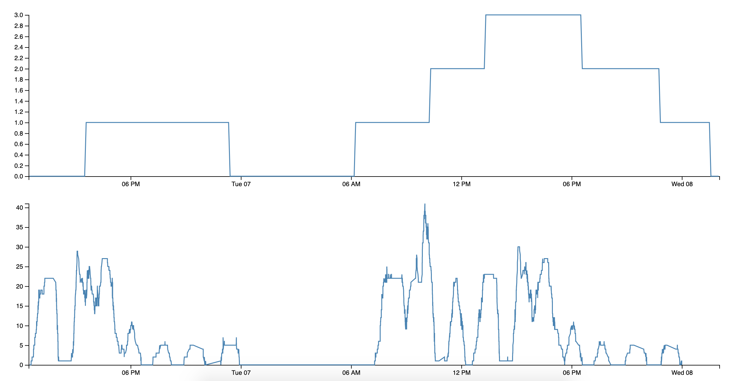
Hazium VS People concentration
Hazium
People
June 8: 40 people during Hazium increase
Notes:
40 people at 8th June where affected by Hazium

Slide 14
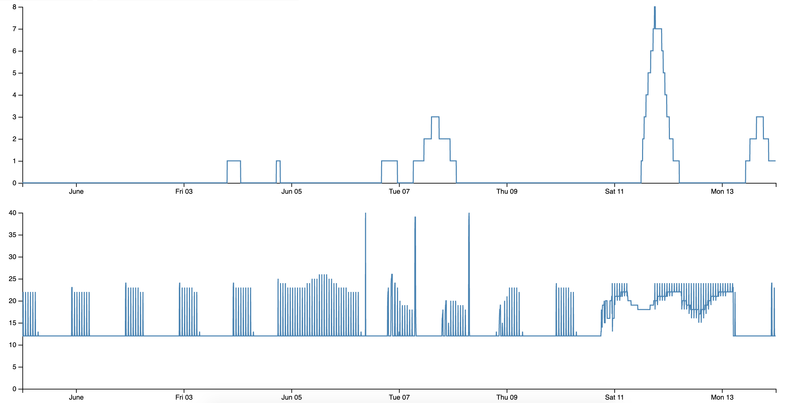
Hazium & Inlet Temperature (Air Density) correlation
Notes:
Supply Inlet temperature was applied to hazium (Density of the air)

Slide 15
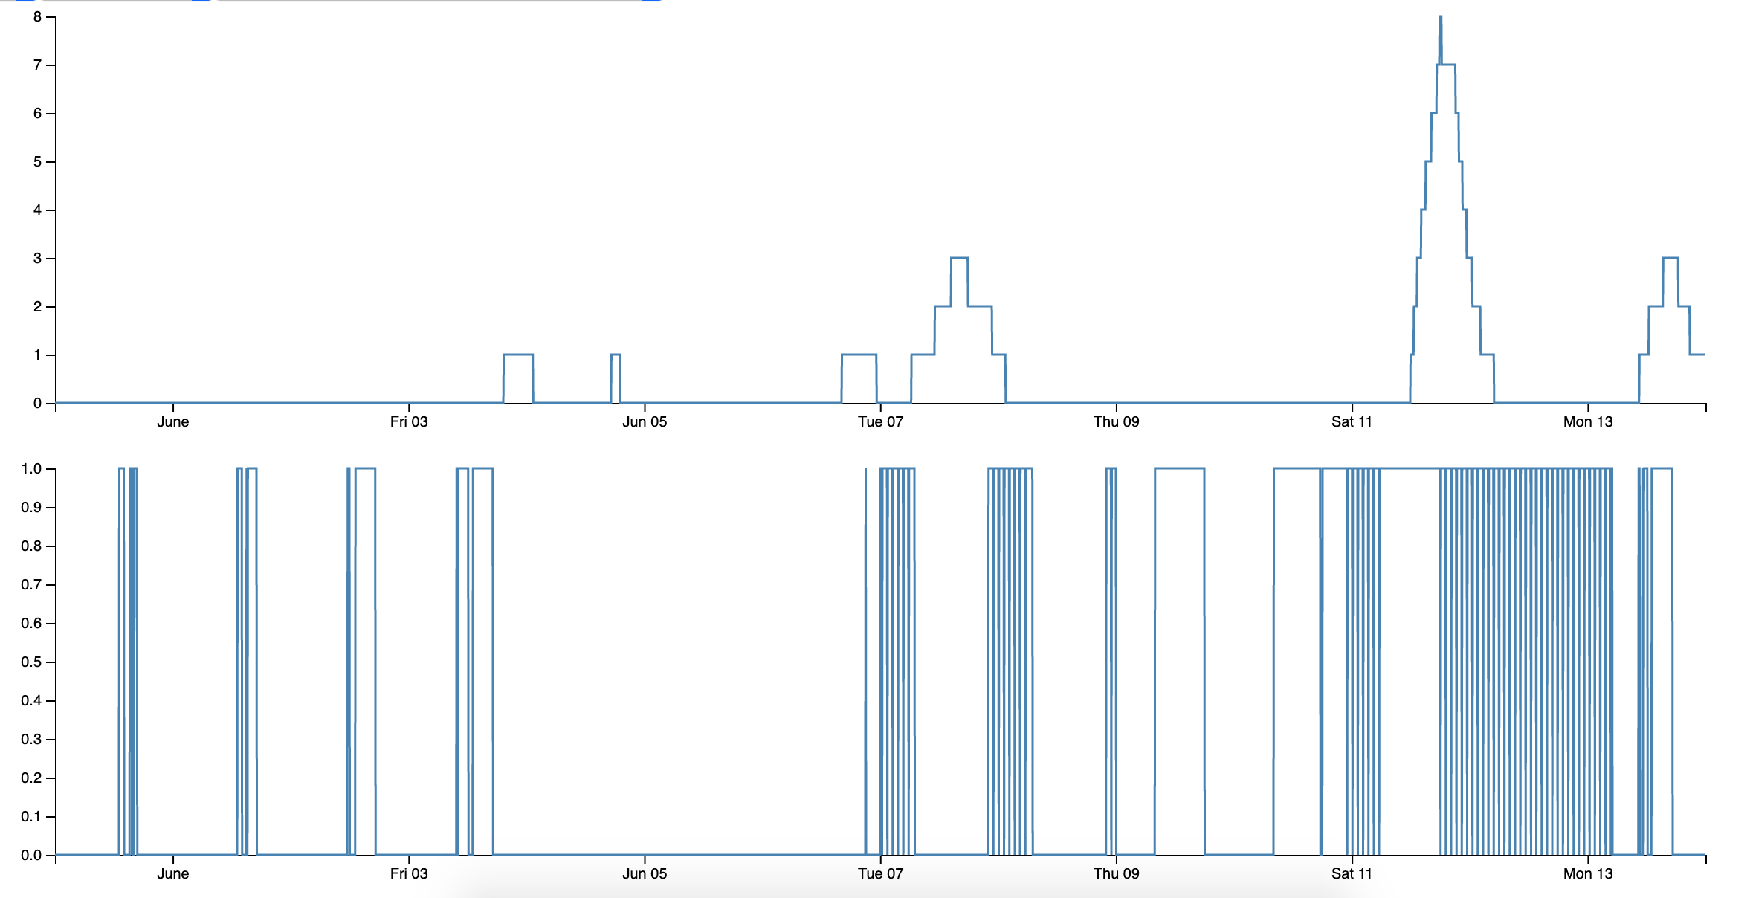
Hazium VS Air flow
Notes:
Air mass flow rate / max air mass flow rate

