Slide 1
SAST Triage — $/M Token Cost Comparison
Workload: 7,154 in + 1,041 out tokens/triage · Phase 3C ship · Jun 2026
Category | Segment | Vendor | Model | $/M in | $/M out | $/M blended | $/triage
Managed API | Bedrock FM | Bedrock | Ministral 8B | $0.150 | $0.150 | $0.150 | $0.00123
Managed API | Bedrock FM | Bedrock | Qwen3.5-9B* (hypothetical) | $0.180 | $0.180 | $0.180 | $0.00148
Self-host | — | AWS VPC | EC2 g6e spot + vLLM + LoRA | derived* | derived* | $0.195 | $0.00160
Managed API | Bedrock FM | Bedrock | Qwen3 32B | $0.154 | $0.618 | $0.213 | $0.00175
Self-host | — | AWS VPC | EC2 g6e on-demand + vLLM + LoRA | derived* | derived* | $0.852 | $0.00698
Self-host | — | AWS VPC | SageMaker ml.g6e BYOC + LoRA | derived* | derived* | $1.19 | $0.00977
Managed API | Frontier | Anthropic | Claude Haiku 4.5 | $1.00 | $5.00 | $1.51 | $0.0124
Self-host | — | Bedrock CMI | Bedrock Custom Model Import · 1 CMU | derived* | derived* | $1.73 | $0.0142
Managed API | Frontier | Google | Gemini 2.5 Pro | $1.25 | $10.0 | $2.36 | $0.0194
Managed API | Frontier | Google | Gemini 3.5 Flash | $1.50 | $9.00 | $2.45 | $0.0201
Managed API | Frontier | Anthropic | Claude Sonnet 5 (intro) | $2.00 | $10.0 | $3.02 | $0.0247
Self-host | — | Bedrock CMI | Bedrock Custom Model Import · 2 CMU | derived* | derived* | $3.45 | $0.0283
Managed API | Frontier | OpenAI | GPT-5.4 | $2.50 | $15.0 | $4.09 | $0.0335
Managed API | Frontier | Anthropic | Claude Opus 4.8 | $5.00 | $25.0 | $7.54 | $0.0618
Managed API | Frontier | OpenAI | GPT-5.5 | $5.00 | $30.0 | $8.18 | $0.0670

Slide 2
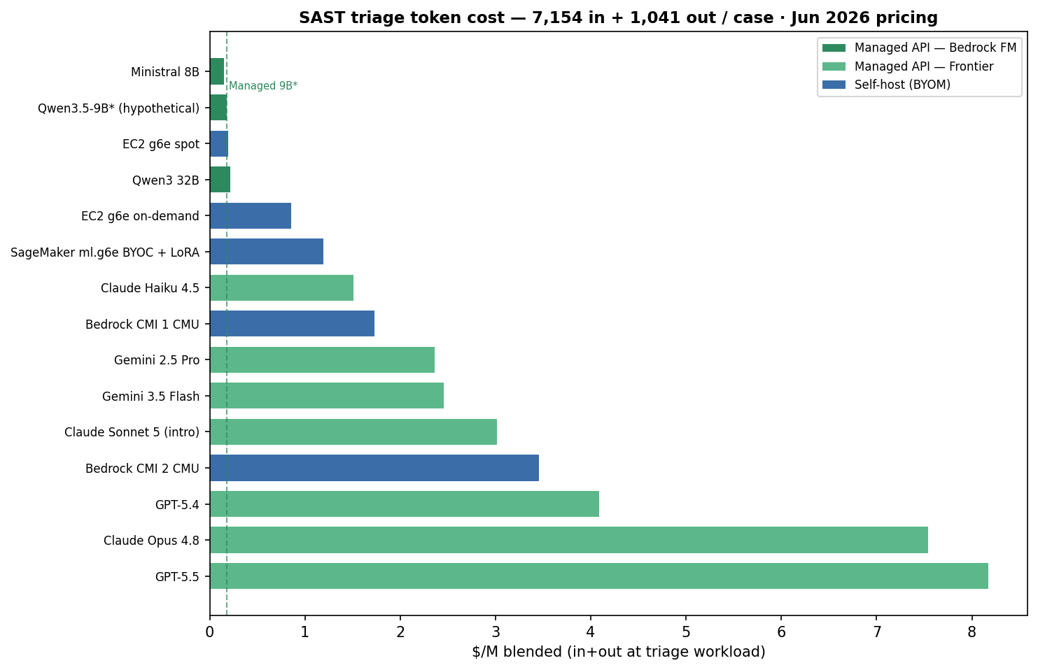
Graphic — $/M blended by deployment option
Green = Managed API (Bedrock FM + Frontier) · Blue = Self-host BYOM with custom LoRA

Slide 3
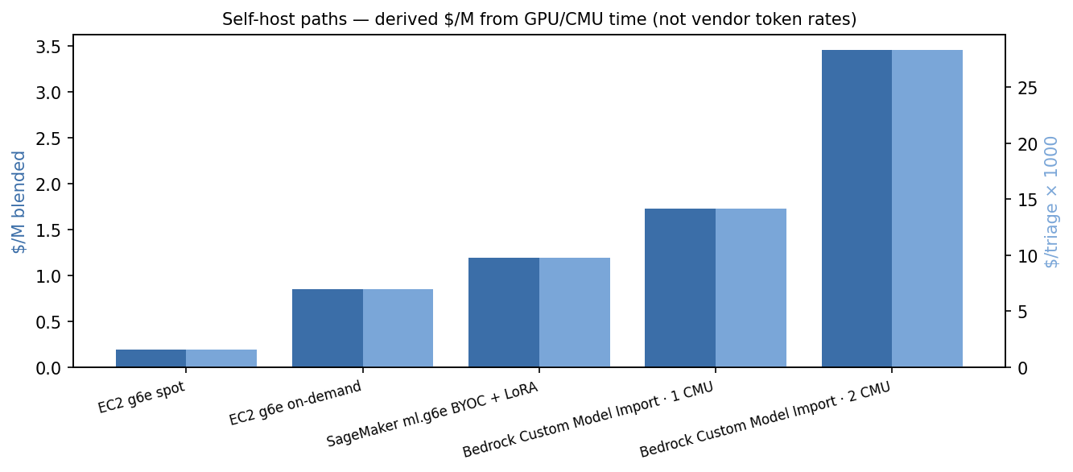
Graphic — Self-host derived rates
* $/M in/out are derived from GPU $/hr or CMU $/min ÷ token throughput — see formula below
VPC: $/triage = (13.5s ÷ 3600) × GPU_$/hr → $/M blended = $/triage ÷ (8,195 ÷ 1M)
Bedrock CMI: $/triage = CMUs × $0.05718/min × 60 × active_hrs → same blended formula
Derived $/M_in = $/triage ÷ (7,154 ÷ 1M) · Derived $/M_out = $/triage ÷ (1,041 ÷ 1M)

