Slide 1
Pfizer Presentation
MBAJ Finance 2.0 – Team 3b

Slide 2
TABLE OF CONTENTS
Executive Summary
Company Overview
Market / Industry Overview
Historical and Projected Financials
Investment Opportunity
Valuation Analysis
Investment Considerations
Recommendation
Appendix

Slide 3
EXECUTIVE SUMMARY
There is an LBO opportunity to acquire Pfizer, the world’s largest researched-based biopharmaceutical company, which discovers, develops, manufactures and markets a broad portfolio that spans the entire spectrum of human and animal health products
The industry has grown 2.0% over the last 5 years, and Pfizer’s main competitors include Merck, Amgen and Johnson & Johnson
There is an opportunity to acquire the firm at a 10.0x valuation, however, we do NOT recommend making this investment due to low growth projections, high capex costs and the logistical difficulty of raising enough capital to execute and LBO

Slide 4
COMPANY OVERVIEW
Pfizer is the world’s largest researched-based biopharmaceutical company, which discovers, develops, manufactures and markets a broad portfolio that spans the entire spectrum of human and animal health products
Pfizer has 5 operating segments:
Primary Care – human prescription pharmaceutical products primarily prescribed by primary-care physicians
Specialty Care and Oncology – (i) human prescription pharmaceutical products primarily prescribed by physicians who are specialists (Specialty Care) and (ii) addressing oncology and oncology-related illnesses (Oncology)
Established Products and Emerging Markets – (i) human prescription pharmaceutical products that have lost patent protection or marketing exclusivity in certain countries and/or regions and (ii) products focusing on emerging markets
Animal Health – products and services to prevent and treat disease in livestock and companion animals
Consumer Healthcare – non-prescription products for therapeutic categories including dietary supplements, pain management, respiratory and personal care
In 2011, Pfizer decided to explore strategic alternatives for its Animal Health and Nutrition business, resulting in the spin-off IPO of Zoetis in early 2013 and the sale of its Nutrition business to Nestlé for $11.85 bn
With less focus on Animal Care division, Pfizer can focus on its more profitable divisions and on strengthening its portfolio with pipeline development and acquisitions

Slide 5
INDUSTRY OVERVIEW
Industry Landscape 2014:
Revenue: $163.5 bn
Profit $33.4 bn
5 year Growth: 2.0%
Major Players:
Merck
Market Share 9.8%
Focus: pharma, animal health, consumer care and alliances
Major events:
Acquired: Schering-Plough and Smart Cells (2009)
Sold: 50% of Consumer Healthcare JV to J&J (2009)
Amgen
Market Share: 8.0%
Focus: biotechnology company – nephrology, supportive cancer and inflammatory medicines
Major events:
Acquired: Bergamo (2011), Micromet (2012), Onyx (2013)
Significantly bolstered oncology footprint domestically and abroad
Patent: Obtained 16 yr extension for top selling Enebrel (2012)
Johnson & Johnson
Market Share: 8.0%
Focus: pharma, consumer, medical devices
Major events: purchased Pfizer’s Consumer Healthcare

Slide 6
INDUSTRY OVERVIEW
Trends
Patent Cliff in 2012: A Move to Efficiency
Increased closure of manufacturing facilities
Workforce employment on a steady decline the past 5 years
Advances in chain reactor designs = increased research efforts
E-prescribing- increases prescription accuracy while reducing demand for tier 2 and 3 drugs (brand name pharma)
High Regulatory Costs
Prescription Drug User Fee Act renewed in 2012: collects fees from pharma to fund reviews of drug marketing ($2.0M per drug)
Patient Protection and Affordable Care Act
Pro: improves insurance coverage which will increase buyer base for the industry
Con: annual fee continues to rise and is proportional to company’s market share
Growth Prospects
Increased Medicare and Medicaid; 2014 expects increased coverage >> increased demand for brand prescriptions
Generating Antibiotic Incentives Now Act - $27B opportunity for drug development in antibiotic resistant strains of bacteria

Slide 7
HISTORICAL AND PROJECTED FINANCIALS
Pfizer expects slow growth in the near term while focusing its efforts on human care products following its spin-off of Zoelis
In the last twelve months, the company has been feeling the impact from the loss of its patent for Lipitor, but sales have picked up in the last 6 months compared to previous year 1H
Sales are expected to increase slowly, at 1% for the next 3 years due to:
Regulatory hurdles
Declining primary care sales (31% decline in 2012)
Generic competition in the Lipitor space
After year 4, sales growth expected to reach 4% per year, reaching to $68.2 billion and generate an EBITDA of $29.0 billion

Slide 8
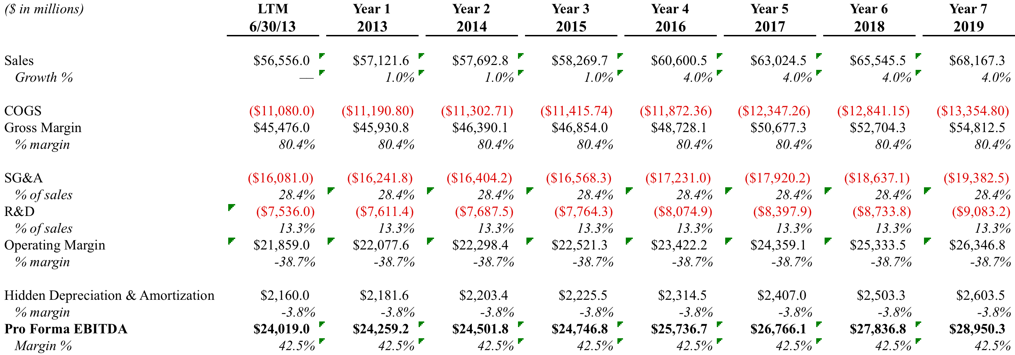
HISTORICAL AND PROJECTED FINANCIALS

Slide 9
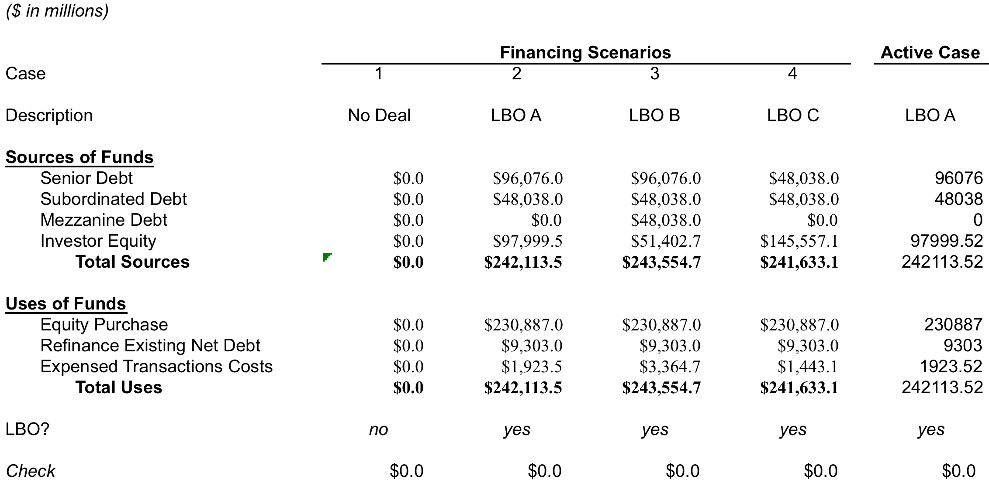
INVESTMENT Opportunity
We have the opportunity to invest $98 bn in a LBO acquisition of Pfizer at a $231 bn valuation (10.0x EBITDA)

Slide 10
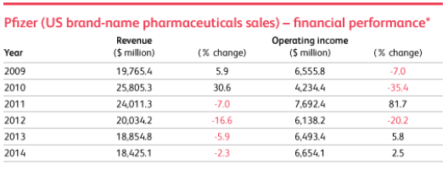
VALUATION ANALYSIS
We analyzed an LBO opportunity of Pfizer at a 10x valuation

Slide 11
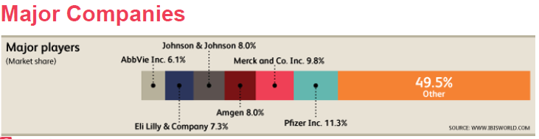
VALUATION ANALYSIS
Current position
Pfizer Inc. is the world’s largest pharmaceutical company in terms of prescription sales revenue. The New York City-based company generated some 59 billion U.S. dollars of total revenue in 2012. Based on net income, Pfizer is also at the top globally. As of 2012, Pfizer had a market value that exceeded 170 billion U.S. dollars

Slide 12
VALUATION ANALYSIS
Future Challenges
Pfizer's best-selling drugs such as Lipitor, Effexor, face some hurdles in the near term, and will have a significant negative impact on Pfizer's future revenue.
Lipitor lost 59% of its worldwide sales--and 81% in the U.S. From $9.577 billion in 2011, Lipitor faded to $3.948 in 2012.
With a combined $17B or 25% of Pfizer's total sales in 2011, have indeed experienced a decline of over $7B revenue (or -40%). The revenue from these drugs will continue declining to $5.6B in 2016.
Major Drugs industry saw Revenue decrease just by -3.48%, Pfizer announced -8.52% year on year sales decline in the first quarter, to $ 11.35 billions, and underperformed the 9.75% Revenue growth in the Healthcare sector.
Comparing company's Revenue to the forth quarter results, sales were lower by -16.26% . On the annual basis, average annual sales growth for Pfizer is 2.7%, while S & P 500's including only Businesses with the first quarter Results, average yearly sales growth is 2.74% over the past five years.

Slide 13
VALUATION ANALYSIS
Growth Opportunities
Pfizer's results show that shrinkage can be a positive thing. After all, the market loves the fact that Pfizer sold off its nutrition business, and that it's spinning off its animal health operation, Zoetis, beginning with an IPO at the end of this week. Indeed, analysts would like to see CEO Ian Read continue hiving off divisions--namely consumer health and generics. They pounce on any hints to that effect.
Pfizer can highlight its newer products: Lyrica, with 13% growth worldwide to $4.158 billion. Prevnar/Prevenar 13, with 2% growth to $3.718 billion. Sutent, with 4% growth to $1.236 billion. And so on. More importantly, perhaps, it can cite the newly approved Eliquis, which promises to become the anticoagulant to beat, and Xeljanz, a first-in-class rheumatoid arthritis remedy. Maybe these will help reverse Pfizer's pharma sales decline.

Slide 14
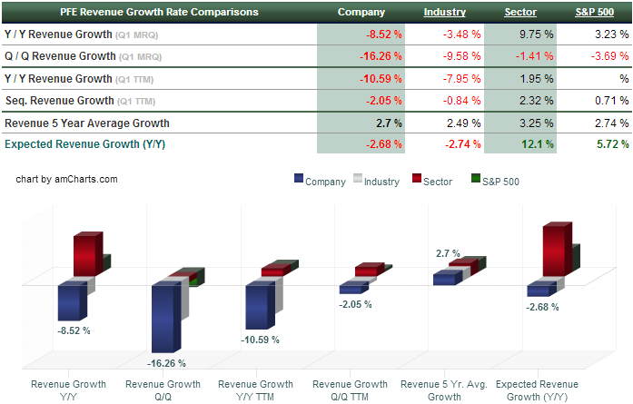
VALUATION ANALYSIS

Slide 15
RECOMMENDATION
We do NOT recommend making the investment in Pfizer
Logistically not feasible
A deal of this magnitude would require a considerable number of PE firms to put together enough equity. This is not attractive from an investors standpoint because it exposes all parties to a number of firms with varied investment strategies that are unknown and possibly undesirable.
Growth prospects are low industry wide
Research reports reflect an industry marred by high regulatory challenges, generic competition and projected growth of a mere 2% for the next 5 years.
To maintain dominance, capital expenditures are incredibly high for the pharmaceutical industry
FDA requires considerable fees to approve drugs, research and development can take up to 20% of revenues and only 2 out of 10 drugs will generate enough revenue to justify the expense need to develop the drug according to Pharmaceutical Research and Manufacturers of America (PhRMA).

Slide 16
APPENDIX

Slide 17
Team
Pfizer is led by a very experienced team
Ian C. Read – CEO and Chairman of the Board
Joined Pfizer in 1978, working in Latin America through 1995
Various executive positions, previously President of Pharmaceutical Operations prior to being named CEO in 2010
Olivier Brandicourt – President, Emerging Markets and Established Products
Previously President of Primary Care, Specialty Care and international units
Mikael Dolsten – President, Worldwide Research and Development
Former President of Wyath Research, joining Pfizer in 2009
Geno Germano –President, Specialty Care and Oncology
Joined Pfizer from Wyeth Pharmaceuticals, where he had a 25 year career
John Young –President, Primary Care
Joined Pfizer in 1987, and has served Pfizer in various executive roles

