Slide 1
Bayesian methods in epidemiological research
Jonas Björk, Lund universitY. 5 FEBRUARY 2016.

Slide 2
Bayesian methods in epidemiological research
What is Epidemiology?
Why are Bayesian methods so seldom used in Epidemiology?
Illustrative examples
Risk assessment
Prevalence and effect estimation
Subgroup analysis
Meta-analysis
Conclusions
How do we promote Bayesian methods in Epidemiology?

Slide 3
The Field of Epidemiology
1. What is Epidemiology?
The study of occurrence, determinants and consequences of disease
Both chronic and infectious diseases
Determinants (both risk and preventive factors)
Environmental
Life-style
Genetics
Social
...

Slide 4
The Field of Epidemiology (cont.)
1. What is Epidemiology?
Cardiovascular epidemiology
Genetic epidemiology
Social epidemiology
Clinical epidemiology
Cancer epidemiology
Life-course epidemiology
Occupational epidemiology
Environmental epidemiology
Nutrional epidemiology
Infectious disease epidemiology
...

Slide 5
The Field of Epidemiology (cont.)
1. What is Epidemiology?
Observational studies
Samples usually not random
Multiple inference
Multiple risk factors
Multiple subgroups
Plauged by multiple sources of bias
Selection bias
Confounding
Information bias (inaccurate measurements)
Suitable arena for
Bayesian methods?

Slide 6
Bayesian methods are still not commonly used in Epidemiology. Why?
1. What is Epidemiology?
”Too subjective”
”Not compatible with EBM (Evidence-based Medicine)”
”Complex analyses that require specialised skills and software”
”Benefit unclear”
Not part of the generally accepted STROBE-guidelines for epidemiological reserach

Slide 7
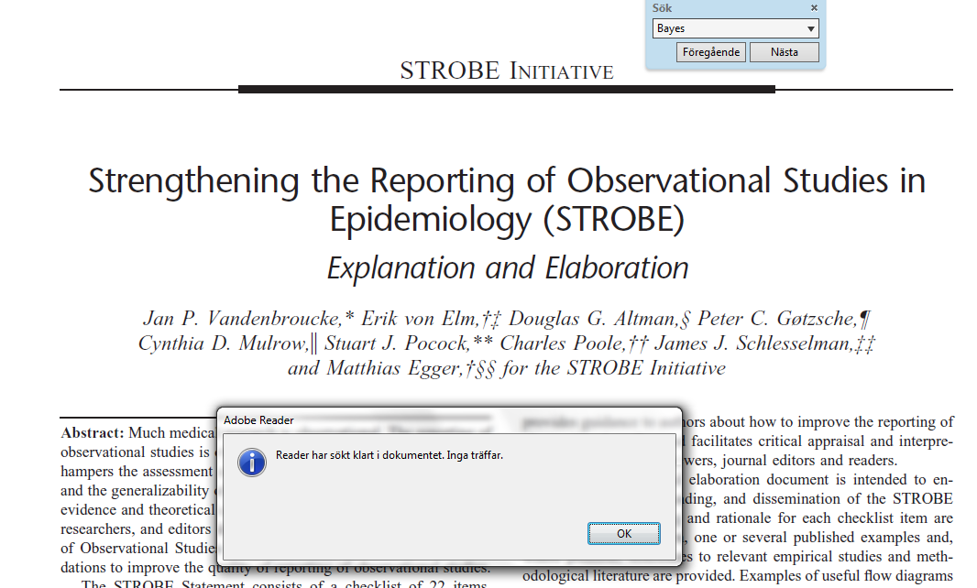
STROBE – guidelines (2007)
1. What is Epidemiology?
”Bayes” is not mentioned at all in the 31 page long document
Published in 2007 – situation much the same since then

Slide 8
A Bayesian perspective does not always require complex methods
1. What is Epidemiology?
Simplistic methods often yield sufficient accuracy (?) for practical purposes
Information-weighted averaging
Data-augmentation (prior as a separate stratum)
”Furthermore, I have yet to see MCMC* make a scientifically meaningful difference in everyday epidemiological problems, even with small or sparse data sets” * = Markov-Chain Monte Carlo
(Greenland S, Int Jrn Epi 2006;35:765-775, p. 774)

Slide 9
Bayesian methods in epidemiological research (and practice)
2. Illustrative examples
Risk assessments with/without complete data at hand
Prevalence and effect estimation (e.g. relative risks)
Mostly usefil for initital (statistically uncertain) studies
Consistency checks of prior beliefs vs. data
Subgroup analysis
Correction (smoothing) for overestimation of heterogeneity
Genetic epidemiology – (e.g. FPRP; False Positive Report Probability)
Spatial epidemiology
Bias assessment (e.g. in meta-analyses)
Reverse-Bayes analysis
...

Slide 10
Risk assessment for individual patients
2a. Risk assessment
Information flow
Pat.
Simple application of Bayes theorem and empirical Bayes (to handle missing data)
Pat.
(Björk et al. Jrn Clin Epi 2012)

Slide 11
A Bayesian approach to prevalence estimation – Example
2b. Prevalence and effect estimation
Suppose we plan to investigate the prevalence of chronic widespread pain (WSP) in the general population
Based on experience, and results from other countries, we would guess that the prevalence is about 10%, and it is unlikely that it is above 20%:
Best prior guess: 10%
Credibility interval: 0 – 20%

Slide 12
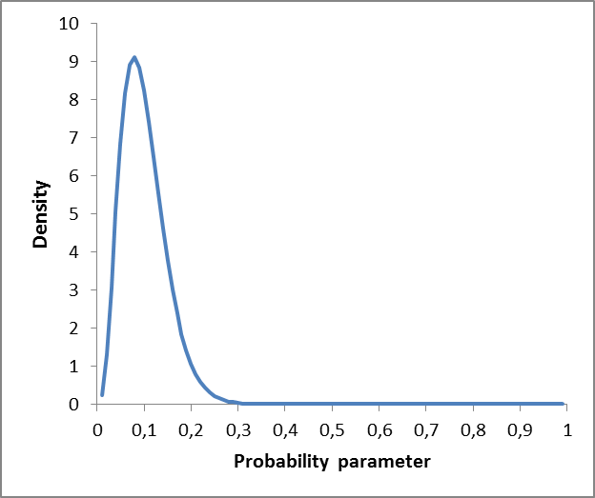
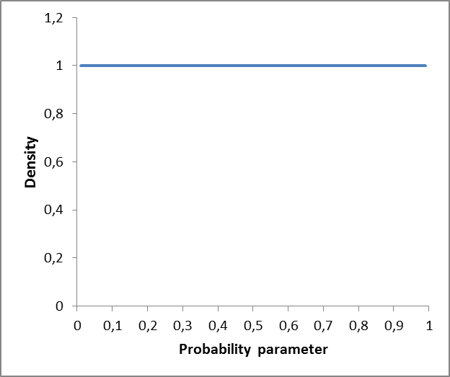
Prior belief represented by the beta distribution
2b. Prevalence and effect estimation
(Non-informative prior)
α = 4, β = 36
α = 1, β = 1

Slide 13
Prior belief vs. sample size
2b. Prevalence and effect estimation
Based on experience, and results from other countries, we would guess that the prevalence is about 10%, and it is unlikely that it is above 20%
The prior belief above corresponds to a sample size of ~ 40
α = 4, β = 36
Disease status | Frequency
Case | 4 (10%)
Non-case | 36 (90%)
Total | 40

Slide 14
Small study (n=20) including clinical examinations, e.g. at a primary health care
2b. Prevalence and effect estimation
Prior belief: Beta(4; 36) Prevalence 10%, 95% CI 0.7 – 19%
Data: n = 20, a= 7 with WSP Prevalence 35%, 95% CI 14 – 56%
Posterior belief: Beta(4+7,36+13)=Beta(11,49) Prevalence 18%, 95% CI 8 – 28%
Test for consistency (prior vs. data) p = 0.03 (Fisher’s exact test)

Slide 15
WSP - General population survey
2b. Prevalence and effect estimation
(Updated) Prior belief: Beta(4+7; 36+13) Prevalence 18%, 95% CI 8 – 28%
Data: n = 4371, a= 246 with WSP (Grimby-Ekman et al. 2015) Prevalence 5.6%, 95% CI 4.9 – 6.3%
Posterior belief: Beta(11+246,49+4125)=Beta(257,4174) Prevalence 5.8%, 95% CI 5.1 – 6.5%
Test for consistency (prior vs. data) p < 0.001 (Fisher’s exact test)

Slide 16
A Bayesian approach to effect estimation – Example
2b. Prevalence and effect estimation
The association between residential magnetic fields and childhood leukemia received much attention in 1980-90s
RR (OR) = 3.5, 95% CI (0.80 – 15) (Savitz et al. 1988)
Prior belief: Strong field effect (RR>4) seems unlikely Normal prior for ln(RR): N(0, ½) 95% CI: ¼ to 4 (Greenland, Int Jrn Epi 2006)
 | Exposed | Unexposed
Case | 3 | 33
Control | 5 | 193

Slide 17
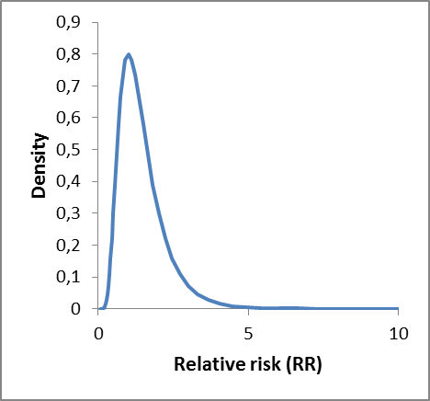
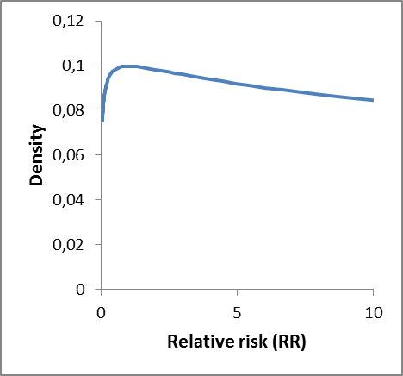
Prior belief represented by the normal distribution
2b. Prevalence and effect estimation
(Non-informative normal prior)
RR = 1, Var(ln RR) = 1/2
RR = 1, Var(ln RR) = 4

Slide 18
Prior belief vs. sample size
2b. Prevalence and effect estimation
Strong field effect (RR > 4) seem unlikely
Assuming a rare disease (large Ns), and an equal no. of cases ascertained in each group
RR = 1, Var(ln RR) = 1/2
The prior belief above corresponds to a study with a = 2/ Var(ln RR) = 2 / 0.5 = 4 cases in each group
Disease status | Exposed | Unexposed
Case | a₁ = 4 | a₂ = 4
Total | N | N
(Greenland, Int Jrn Epi 2006)

Slide 19
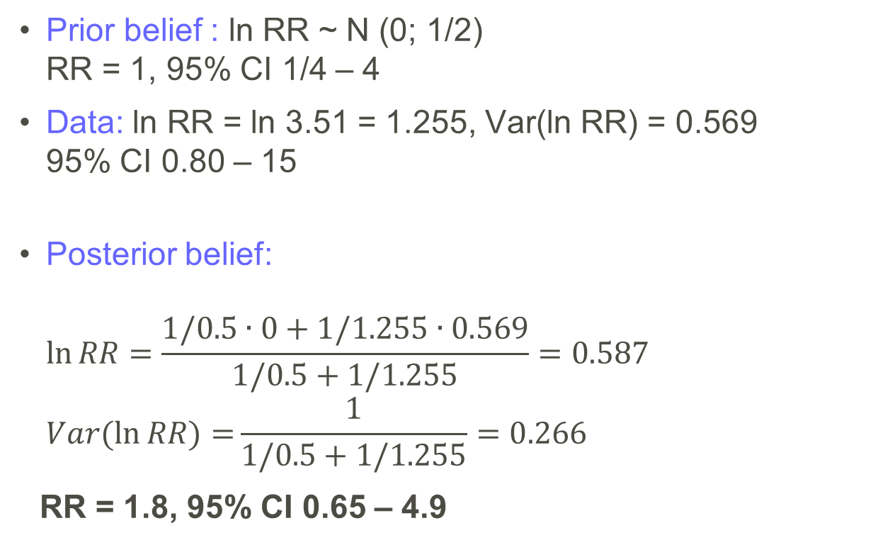
A Bayesian approach to effect estimation – Example (cont.)
2b. Prevalence and effect estimation
Prior belief : ln RR ~ N (0; 1/2) RR = 1, 95% CI 1/4 – 4
Data: ln RR = ln 3.51 = 1.255, Var(ln RR) = 0.569 95% CI 0.80 – 15
Posterior belief: $\ln{RR}=\frac{1/0.5∙0+1/1.255∙0.569}{1/0.5+1/1.255}=0.587$ $Var(\ln{RR)=}\frac{1}{1/0.5+1/1.255}=0.266$
RR = 1.8, 95% CI 0.65 – 4.9
Test for consistency
p = 0.22 (Z-test)
(Greenland, Int Jrn Epi 2006)

Slide 20
Subgroup analysis - overestimation of heterogeneity A simple simulated example
2c. Subgroup analysis
Case-control study
5 subgroups, 200 cases and 200 controls in each
Exposure prevalence 15% among controls
True RR(OR) = 1.4
No heterogeneity → Variance(ln OR across groups) = 0
Truth

Slide 21
Overestimation of heterogeneity A simple simulated example (cont.)
2c. Subgroup analysis
1000 simulated studies
Median Variance(ln OR) = 0.0434, Q1 – Q3: 0.0259 to 0.0641
Truth
Median (example)
Q3 (25% most extreme; ex.)

Slide 22
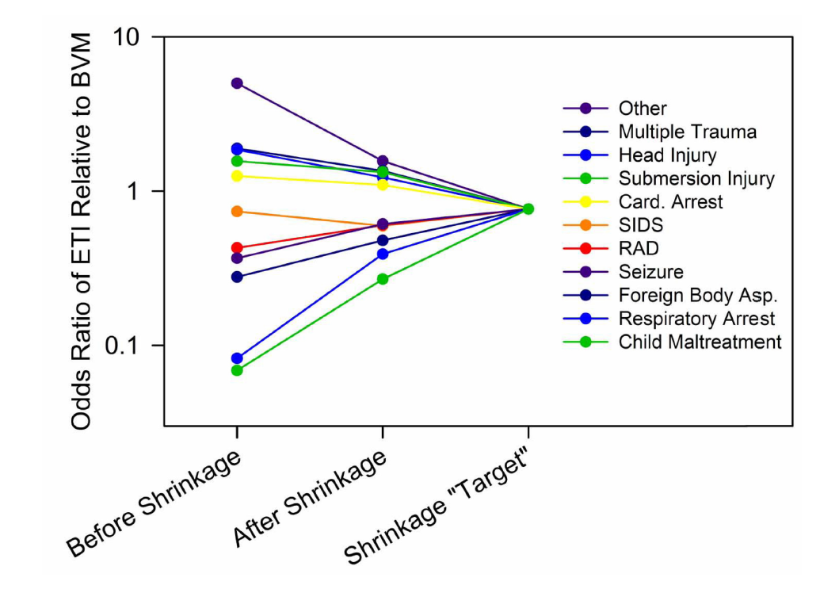
Correcting for overestimation of heterogeneity using Empirical Bayes
2c. Subgroup analysis
(Lipsky et al., Ann Emerg Med 2010)
Corrects for overestimation of heterogeneity
Overall estimation error decreased
Bias for specific subgroups introduced
More suitable for secondary subgroup analyses

Slide 23
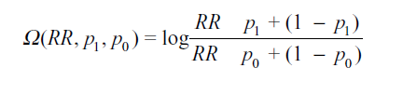
Bayesian perspective in meta-analysis
2d. Meta-analysis
Statin use is associated with lower fracture risk in observational studies, but not in randomized trials
Unmeasured confounding U (healthy-user bias)?
Selection bias (prevalent rather than incident cases)?
Use of health preventive services (e.g. influenca vaccination) could possibly be used as a proxy for U
×
Bias factor
~ Prior distribution
×
Parameters required for Ω can be assessed using empirical data Reverse-Bayes analysis also an option - how large must Ω be in order to explain the association?
(McCandless, Epidemiology 2012)

Slide 24
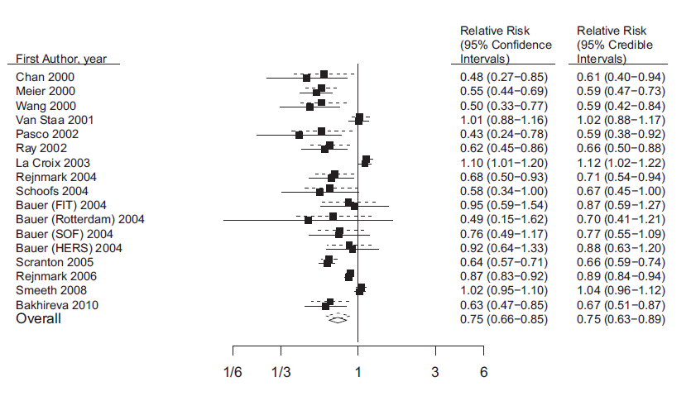
Bayesian perspective in meta-analysis (cont.)
2d. Meta-analysis
With bias correction Ω
Statin use and fracture risk
(McCandless, Epidemiology 2012)

Slide 25
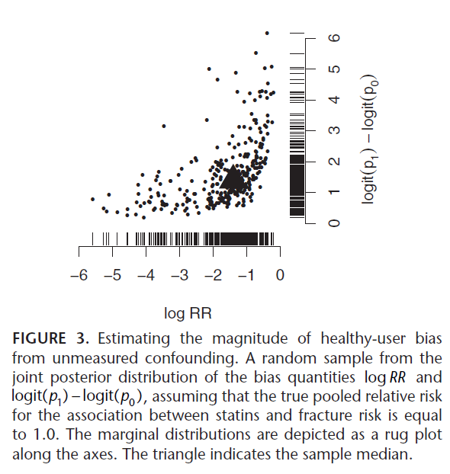
Bayesian perspective in meta-analysis (cont.)
2d. Meta-analysis
Reverse-Bayes analysis – unmeasured confounding
The unmeasured confounder U must
- reduce fracture risk with 75%
- be about 4 times more frequent
among statin users
to completely explain
the observed assocation
(McCandless, Epidemiology 2012)

Slide 26
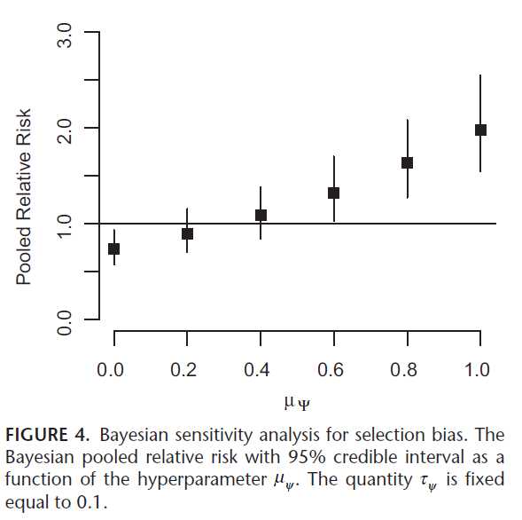
Bayesian perspective in meta-analysis (cont.)
2d. Meta-analysis
Assessing the impact of selection bias ᴪ
Moderate amounts of selection bias, typically of
those observed in some studies,
could eliminate the association
(McCandless, Epidemiology 2012)

Slide 27
How can Bayesian perspectives be promoted in epidemiological research?
3. Conclusions
Show the benefits -attack the obstacles
Continue publishing illustrative examples
Guideline work
Best practice for reporting Bayesian analysis in Epidemiology
Structured methods for assessing prior beliefs (Johnson et al. Jrn Clin Epidemol 2010)
Analytical methods
Accuracy of simplistic methods (?)
Availability of more advanced methods (when needed)
Methodological development

