Slide 1

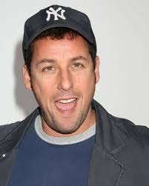


Bayesian Benefits for the Pragmatic Researcher
Eric-Jan
Wagenmakers

Slide 2
Outline
Bayesian inference
Bayesian parameter estimation
Example: Bob's IQ
Bayesian hypothesis testing
Example: digits of π
Example: Adam Sandler

Slide 3
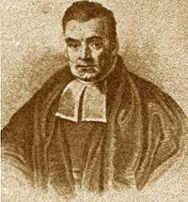
Bayesian Inference
in a Nutshell
In Bayesian inference, uncertainty or degree of belief is quantified by probability.
Prior beliefs are updated by means of the data to yield posterior beliefs.
Belief updates are governed by relative predictive success.

Slide 4
Outline
Bayesian inference
Bayesian parameter estimation
Example: Bob's IQ
Bayesian hypothesis testing
Example: digits of π
Example: Adam Sandler

Slide 5
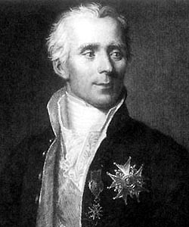
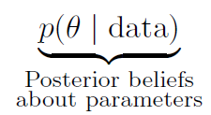
Bayesian
Parameter Estimation

Slide 6
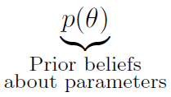
Bayesian
Parameter Estimation

Slide 7
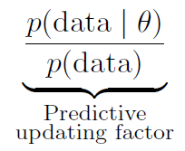
Bayesian
Parameter Estimation

Slide 8
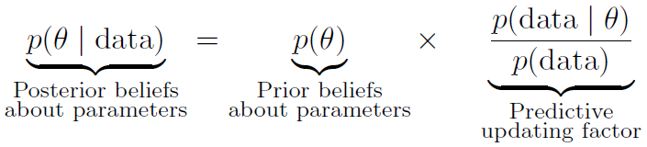
Bayesian
Parameter Estimation

Slide 9
Advantages of Bayesian Parameter Estimation
Beliefs about plausible values are reallocated according to relative predictive success.
Beliefs are updated coherently when new data come in.
Estimates can incorporate important earlier information.
Researchers are able to address questions that are practically relevant.

Slide 10
Outline
Bayesian inference
Bayesian parameter estimation
Example: Bob's IQ
Bayesian hypothesis testing
Example: digits of π
Example: Adam Sandler

Slide 11
Bob is a Killer
“Florida Bob” has murdered his wife and faces the death sentence.
The defence argues that Bob is cannot be held fully responsible because he is intellectually disabled: his IQ is presumably lower than 70.
The judge rules that three IQ test be administered. The results:{73, 67, 79}.
What can we conclude?

Slide 12
Background Knowledge
and Assumptions
Based on the literature, we know that inmates classified as intellectually disabled have an IQ ~ N(75, σ=12). We use this to quantify our prior uncertainty about Bob's IQ.
Based on the literature, we assign the reliability of an IQ test (SD) a uniform prior from 5 to 15 points.

Slide 13
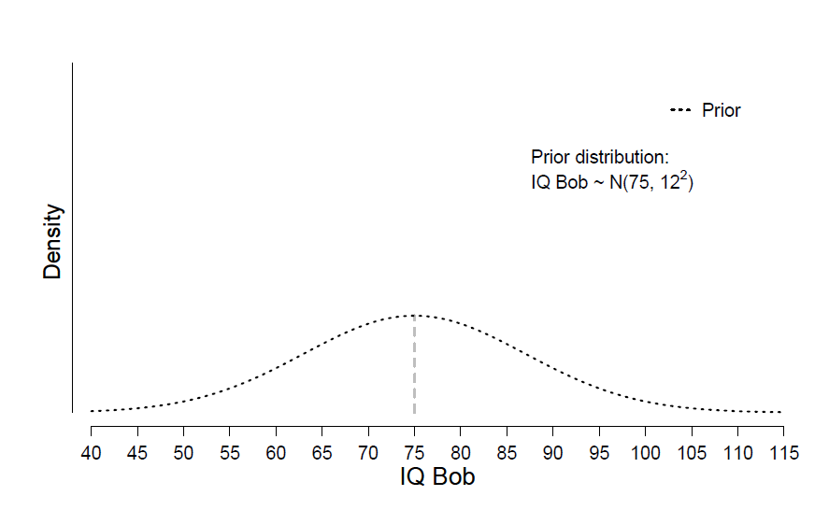

Slide 14
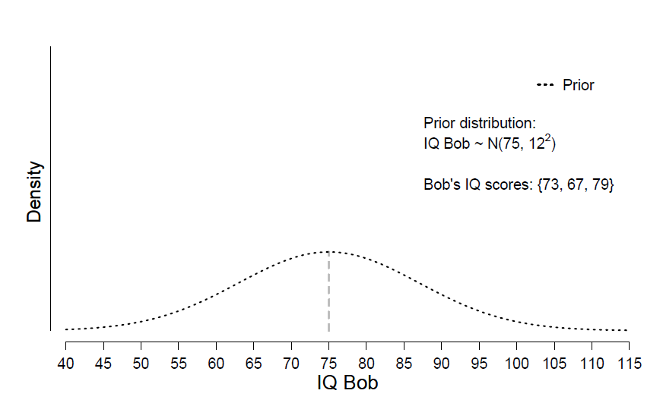

Slide 15
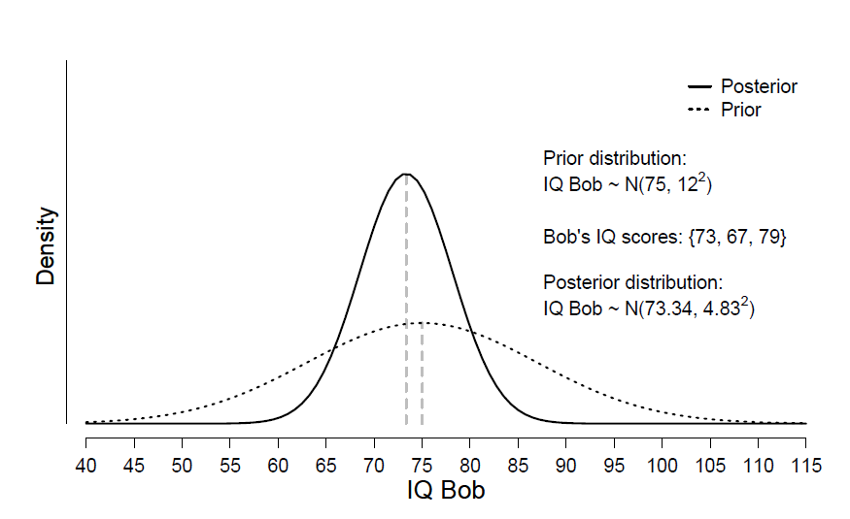

Slide 16
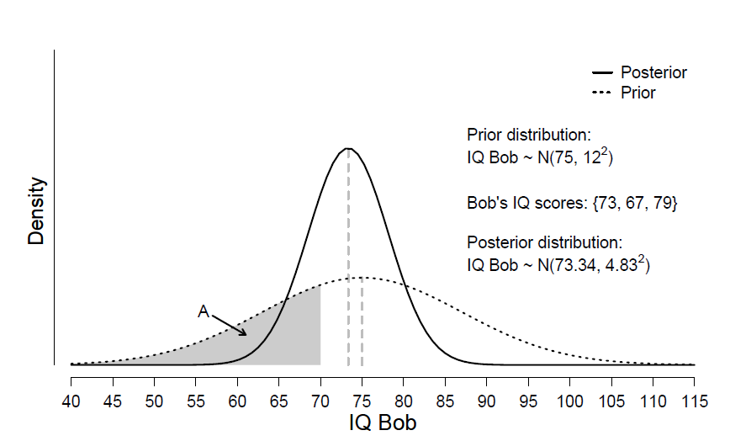

Slide 17
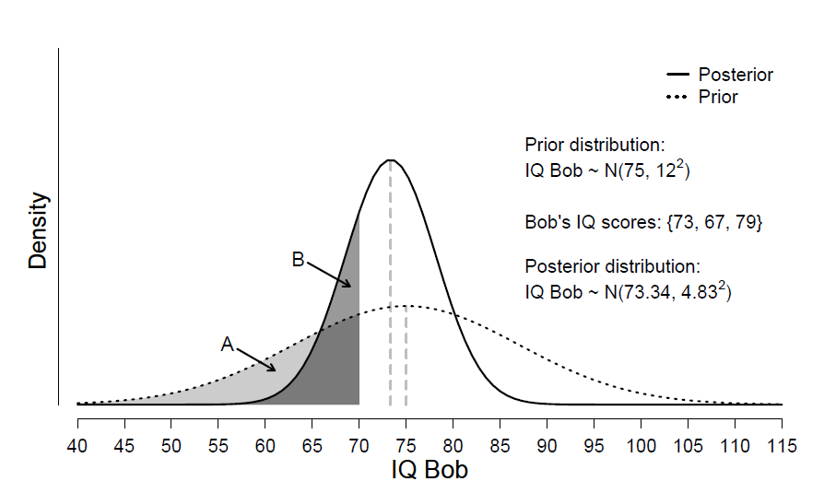

Slide 18
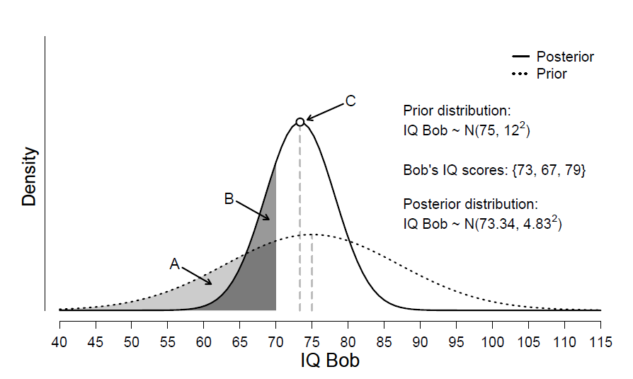

Slide 19
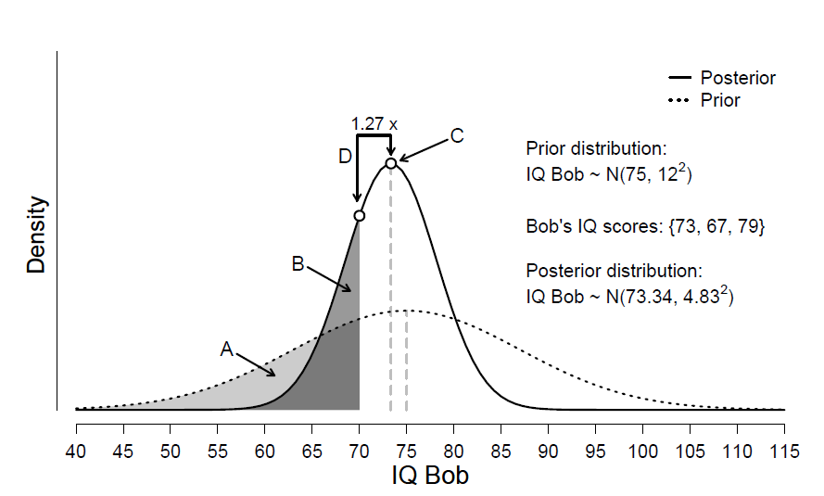

Slide 20
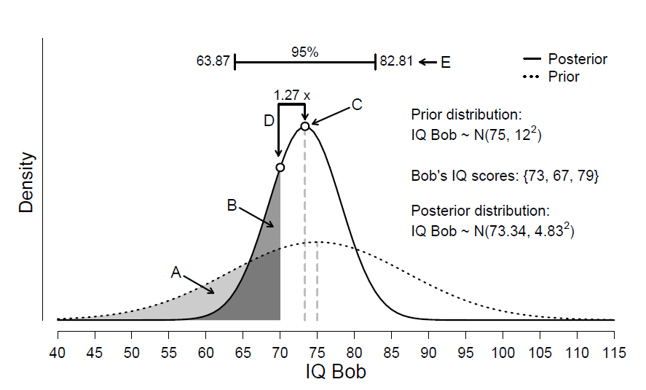
Statements A-E cannot be made within the traditional statistical framework!

Slide 21
Outline
Bayesian inference
Bayesian parameter estimation
Example: Bob's IQ
Bayesian hypothesis testing
Example: digits of π
Example: Adam Sandler

Slide 22
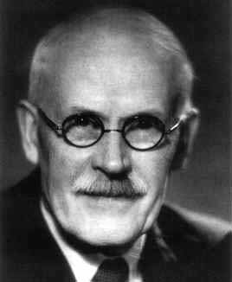
Bayesian Hypothesis Test
Suppose we have two models, H₀ and H₁.
Which model is better supported by the data?
The model that predicted the data best!
The ratio of predictive performance is known as the Bayes factor (Jeffreys, 1961).

Slide 23
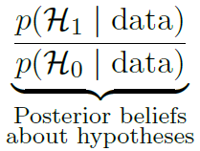
Bayesian Hypothesis Test

Slide 24
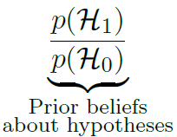
Bayesian Hypothesis Test

Slide 25
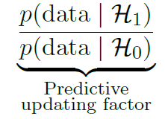
Bayesian Hypothesis Test

Slide 26
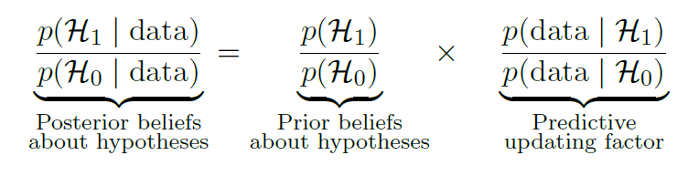
Bayesian Hypothesis Test

Slide 27
Guidelines for Interpretation
of the Bayes Factor
BF Evidence
1 – 3 Anecdotal
3 – 10 Moderate
10 – 30 Strong
30 – 100 Very strong
>100 Extreme

Slide 28




Visual Interpretation
of the Bayes Factor

Slide 29

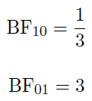
Visual Interpretation
of the Bayes Factor

Slide 30

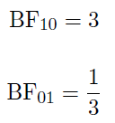
Visual Interpretation
of the Bayes Factor

Slide 31
Advantages of
the Bayes Factor
Quantifies evidence instead of forcing an all-or-none decision.
Discriminates “evidence of absence” from “absence of evidence”.
Allows evidence to be monitored as data accumulate.
Applies to data from the real world, for which no sampling plan can be articulated.

Slide 32
Outline
Bayesian inference
Bayesian parameter estimation
Example: Bob's IQ
Bayesian hypothesis testing
Example: digits of π
Example: Adam Sandler

Slide 33
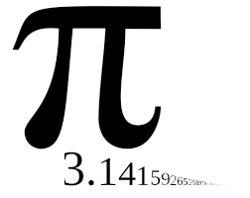
Is π Normal?
Mathematicians have long conjectured that the decimal expansion of π is normal, that is, every subsequence occurs equally often.
Here we focus on a simpler problem: does every digit in the decimal expansion of π occur equally often?

Slide 34
Is π Normal?
Note: there is no sampling plan. We want to monitor the evidence as, with increases in computer power, more and more digits become available for inspection.
Note: Each digit of π is like a participant from an infinitely large population.

Slide 35
Is π Normal?
We have available 100 million digits.
We compute a Bayes factor using a multinomial model with 10 rates.

Slide 36
Is π Normal?
H0: all multinomial rates equal 1/10.
H1: the multinomial rates are Dirichlet distributed.
  Option 1 (a=1) : all combinations of values are equally likely;
  Option 2 (a=50): the rates are similar.

Slide 37
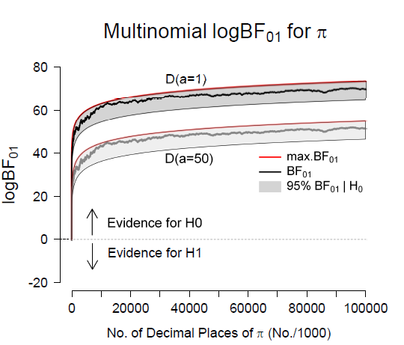



Slide 38
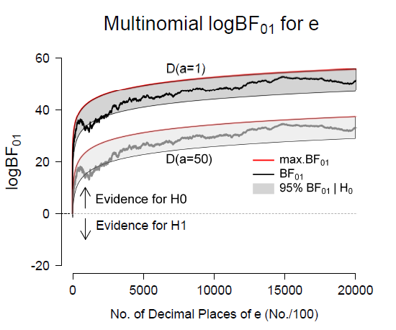



Slide 39
Outline
Bayesian inference
Bayesian parameter estimation
Example: Bob's IQ
Bayesian hypothesis testing
Example: digits of π
Example: Adam Sandler

Slide 40

AWESOME-O
Southpark episode 166.
Eric Cartman pretends to be a robot, the A.W.E.S.O.M.-O 4000.

Slide 41
AWESOME-O
Hollywood movie-producers kidnap the robot and force it to generate profitable movie ideas.
The A.W.E.S.O.M.-O 4000 generates more than 2,000 silly movie ideas, 800 of which star Adam Sandler.

Slide 42
Southpark Hypothesis (Implied)
General: “Adam Sandler movies are profitable regardless of their quality”
Specific: “For Adam Sandler movies, box office success does not correlate with freshness ratings on Rotten Tomatoes”

Slide 43



Richard Morey
Jeff Rouder
BayesFactor package in R

Slide 44


Slide 45
A Fresh Way to Learn Bayesian Statistics
jasp-stats.org
August 22 & August 23, 2016
University of Amsterdam

Slide 46

Sixth Annual JAGS and WinBUGS Workshop
Bayesian Modeling for Cognitive Science
http://bayescourse.socsci.uva.nl/
August 15 - August 19, 2016
University of Amsterdam

Slide 49

Do Horizontal Saccades Improve Recall?

Slide 50
The Paradigm
People first study a list of words for later recall.
After study, they either:
  Stare at a dot for 30 seconds, or
  Make horizontal saccades for 30 seconds
Finally, they engage in free recall.

Slide 51
The Standard Result
Horizontal saccades improve recall.
[Explanation: saccades heighten interhemispheric interaction.]

Slide 52
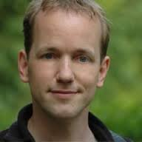
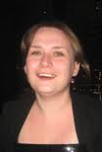
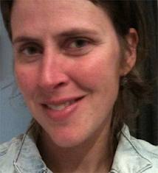
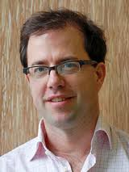
Skeptics and Proponents
Hedderik
van Rijn
Dora
Matzke
Sander
Nieuwenhuis
Heleen Slagter
Me

Slide 53
Do Eye-Movements
Help Memory?
Skeptics tried to replicate the result and failed twice.
Skeptics issued a challenge to the Proponents.
Skeptics and Proponents agreed on a prototypical and diagnostic experiment.
Skeptics and Proponents preregistered the experiment, the intended data analysis, and the rules for determining the winner.

Slide 54
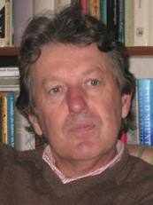
Do Eye-Movements
Help Memory?
Data were accumulated until they strongly supported either Skeptics or Proponents (BF > 10).
An impartial referee oversaw the proceedings.
Maurits
van der Molen

Slide 55
Example: Do Horizontal Saccades Improve Memory?
Let's demonstrate:
  How to run a Bayesian t-test in JASP;
  How to interpret the output;
  How to conduct a sequential analysis;
  How to assess the robustness of the result.

Slide 56
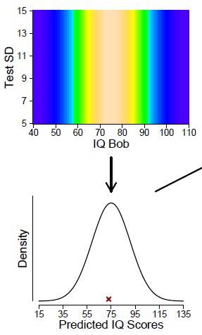

Slide 57
