Slide 1
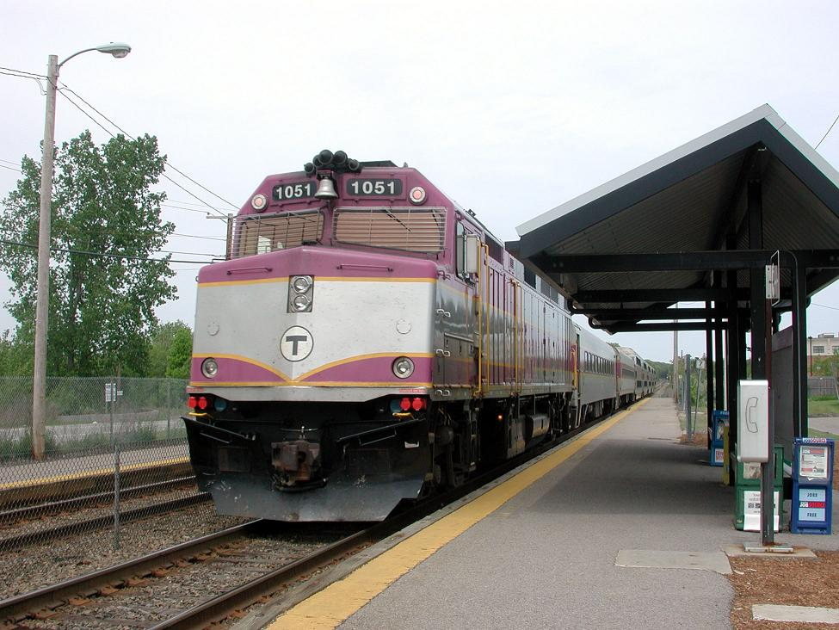
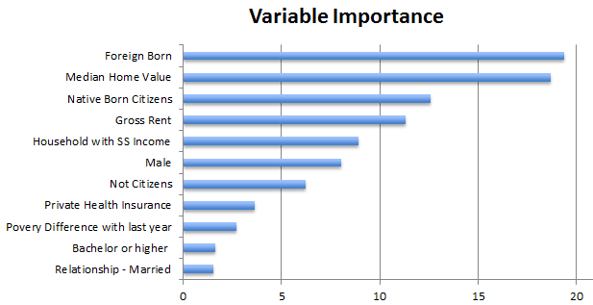









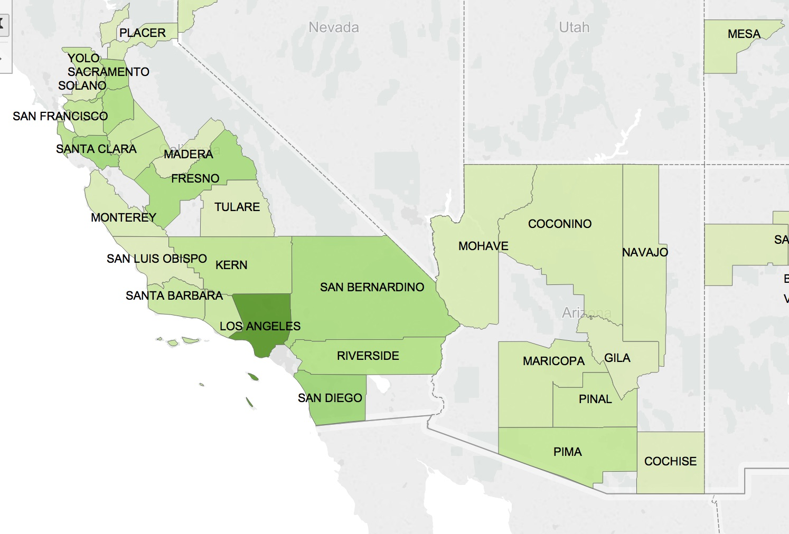
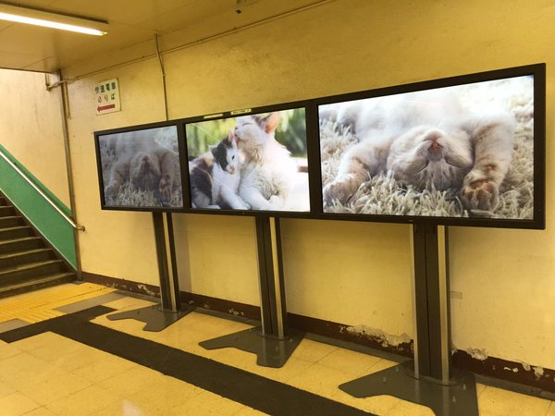
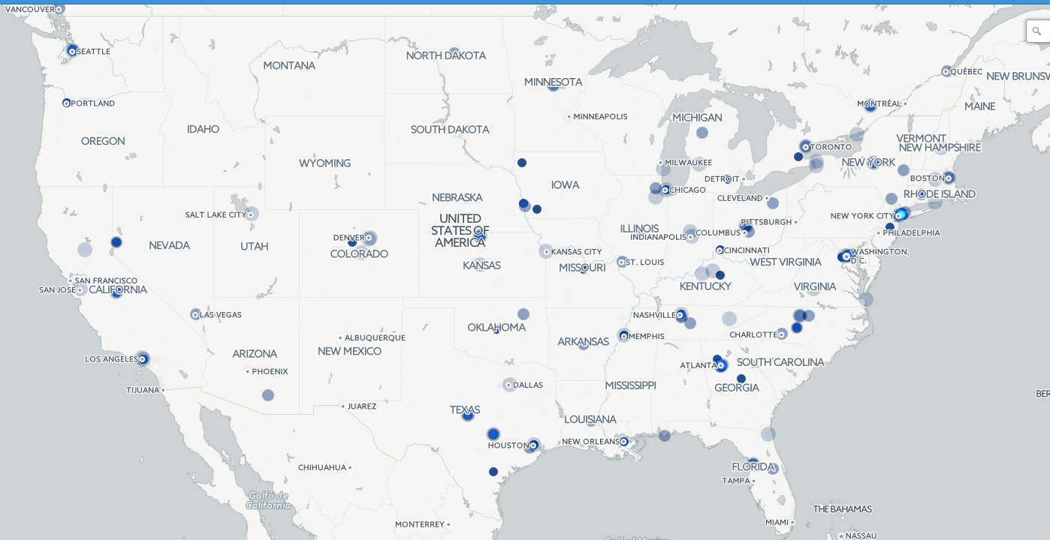
Save a Life, Save a Millions Dollars, Make a Difference
Steps towards Preventing Railway Suicides
Data Sources
Decision Tree Models
Labor
Tweets
Health
Housing
&
Relationship
Economy
300 Railway suicides
1% of all Suicides per Year in US
$2-3 million - Cost per suicide
MODEL
Suicide
Methodology
Community Awareness
Next Steps
Identify the prompt data, create data dictionary
Research railway suicides (trends, causes, history)
Identify additional sources of data
Retrieve data at the county level; merge with the prompt data
Build base models - use R to find coefficients
Poster/sign Campaigns
Counseling Services
Personnel Training
Installation of Barriers
Blue Lights & Calming Stations
Psychiatric services & railway must talk
Spread the word
Suicide dashboards
Whitepapers, and articles
Measure preventative actions
Get funding to study impact of various preventative measures
Live dashboard and tweets
Data McDataface Team, UC Berkeley

