Slide 1
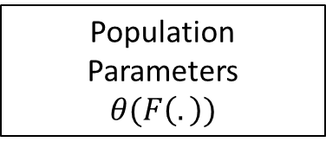
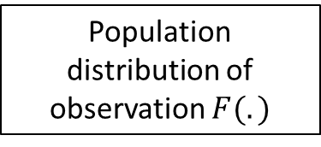

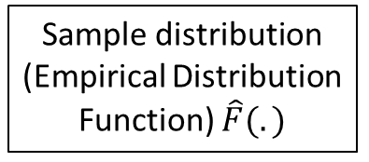
Population distribution of observation $F(.)$
Algebra/Calculus
Population Parameters
$$θ(F\left(.\right))$$
Assumptions
Interpretation
Causal
Approximation
Identification Framework/ Assumption
Sample
Consistency
Estimation Framework/ Assumption
Sample distribution (Empirical Distribution Function) $\hat{F}(.)$
Estimator $θ(\hat{F}\left(.\right))$
Algebra

