Slide 1
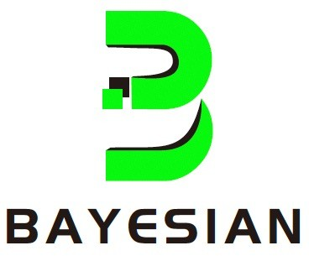
BDCP - Decentralized Computation Network

Slide 2
AGENDA
BDCP
DFL
IPFS
MQTT
Bayes Network
Blockchain
Completed Modules
Code Structure
Demo
Future Work
Conclusion

Slide 3
BDCP
What IS BDCP
Bayes Decentralized Computation Protocol (BDCP) The next generation supercomputing infrastructure for W3
Public Block Chain
Bayes network communication protocol (MQTT)
Data storage and management (IPFS)
Machine learning training server (DFL)
Bayes network nodes management (BayesStack)

Slide 4
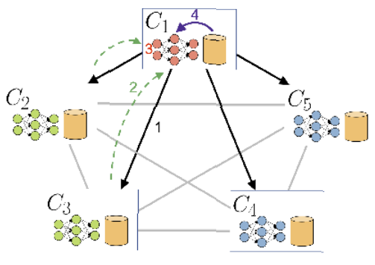
Decentralized Federated Learning
Collaborative Training: Models are trained across devices, aggregating local updates.
Privacy-Preserving: Raw data stays on devices; only model updates are shared.
Reduced Communication: Transmits minimal data, lowering communication overhead.
Robust Architecture: System remains operational even if some devices are unavailable.
Scalability: Concurrent training across numerous devices enhances scalability.
Security: Distributed nature reduces the risk of a single point of failure or successful attacks.

Slide 5

IPFS
Decentralized peer-to-peer file system to store and access data.
Reducing the need for centralized storage.
Models can be stored in IPFS and can be retrieved using Hash.

Slide 6

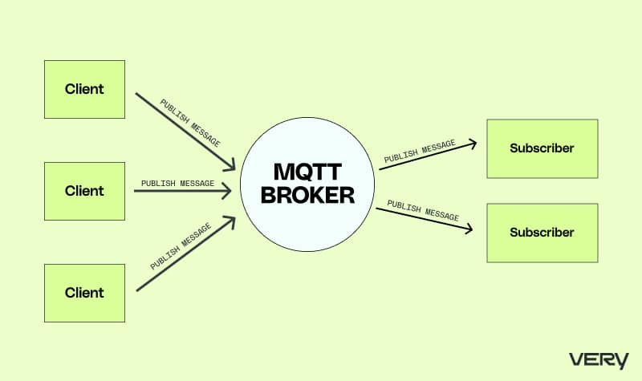
MQTT
Lightweight Protocol
Publish/Subscribe Model
Quality of Service (QoS)
Retained Messages
Last Will and Testament:
Security:
Low Bandwidth Overhead
Scalability

Slide 7
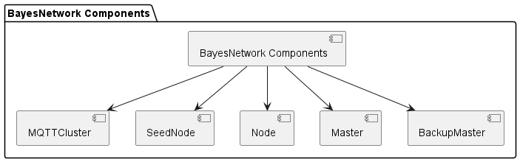
Bayes Network
Characteristics:
Different types of Node
SeedNode, Node, Master, BackupMaster.
Bayes Network Initialization
It should start the network with a "Seed" node.
Node Assignment:
Node assignment using Bayes Network Algorithm.
Node Transformation:
Track the Network Status:

Slide 8
Public Blockchain
To keep track of all transaction in ledger.
The smart contract coordinates with the FL task, distributing rewards and penalizing bad actors.
The metric used for rewarding workers based on performance considers factors such as model accuracy, consistency, precision and recall on the unseen test dataset.

Slide 9



Completed Modules
MQTT Implementation:
Ensure seamless communication using the MQTT protocol, optimizing efficiency and reliability.
Database and REST API Implementation:
UI integration with a well-designed database schema.
Implement RESTful APIs for smooth data exchange.
Integrate with Decentralized Federated Learning (DFL) for secure data storage.
DFL:
Implement collaborative features in MLOperations, fostering seamless teamwork within the federated learning structure.
User Interface:
Implementation of Admin and Network Node Interfaces.
Integrate with MLFlow for streamlined tracking and management of machine learning experiments.
IPFS:
Used for Modal Storage

Slide 10
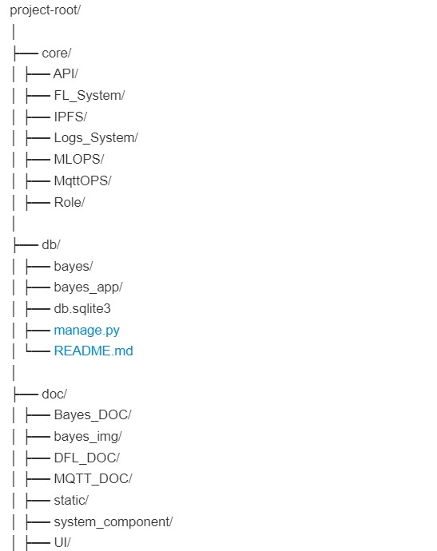
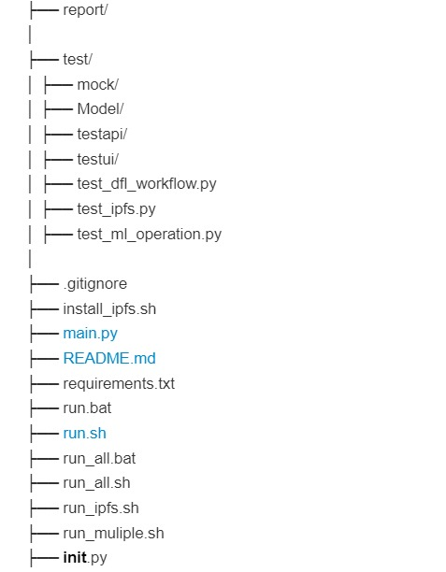
Code Structure

Slide 11
Demo

Slide 12
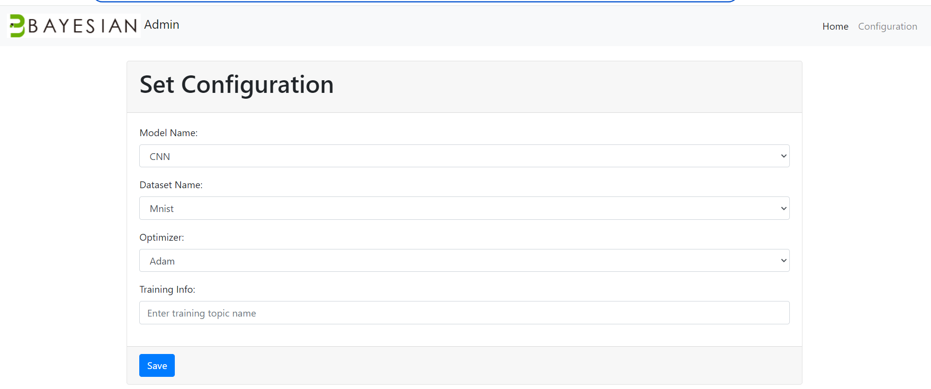
Aggregator Side

Slide 13
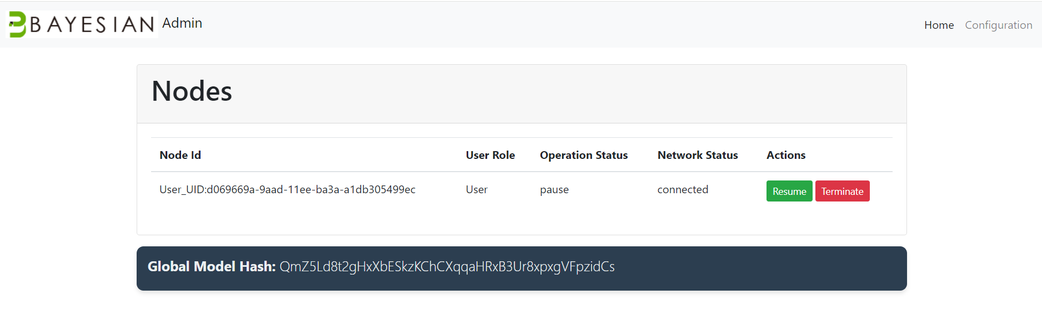
Aggregator Side

Slide 14
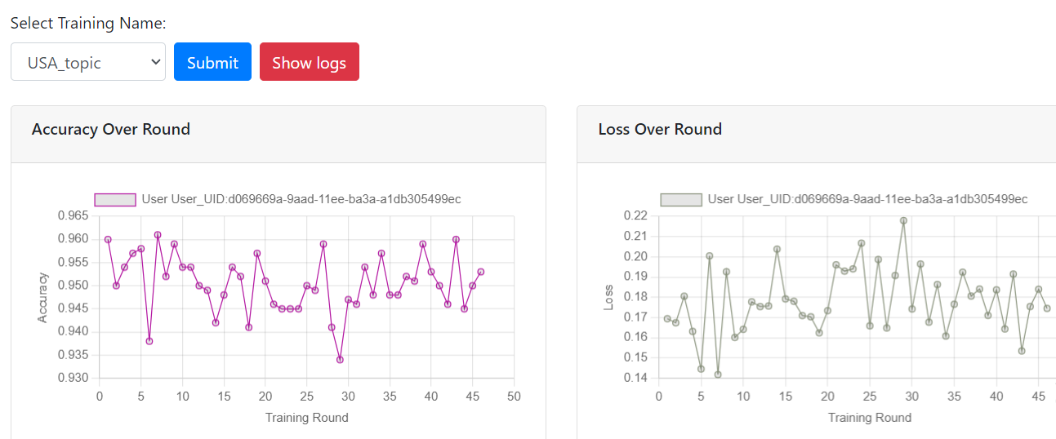
Aggregator Side

Slide 15
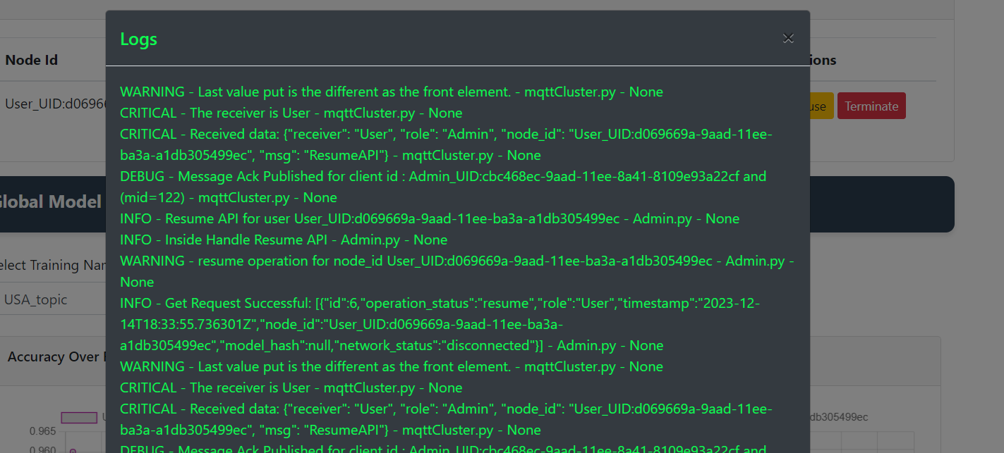
Aggregator Side

Slide 16
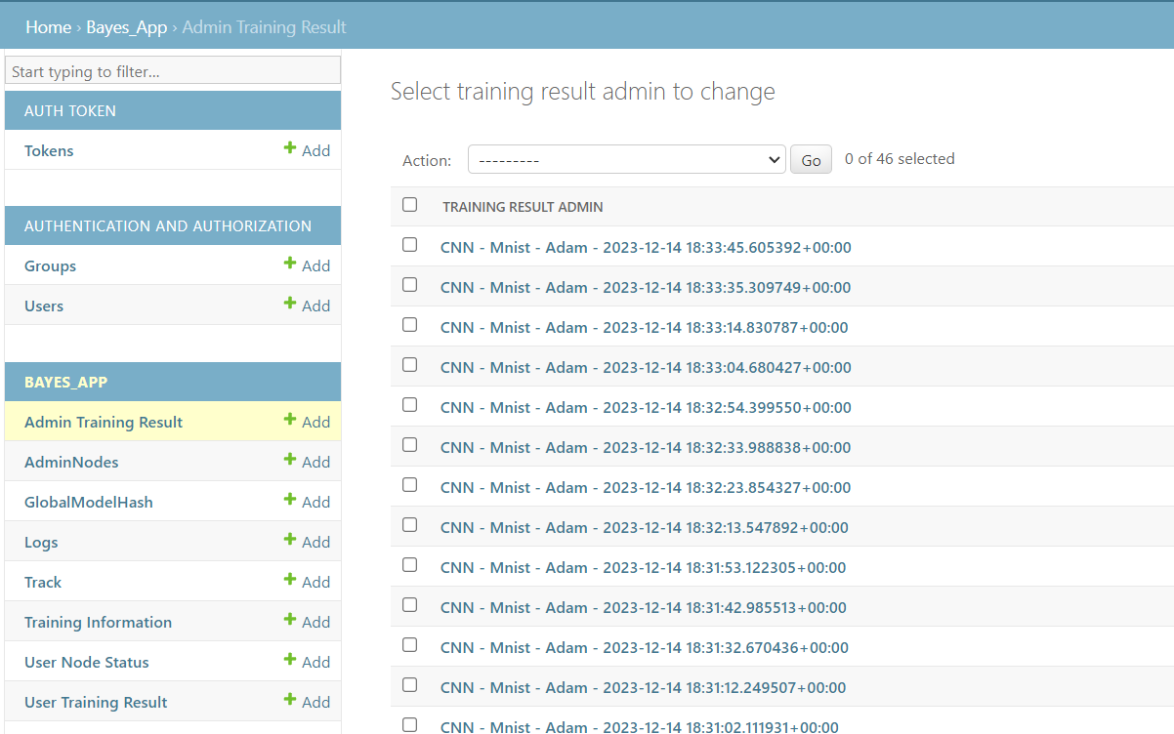
Local Database

Slide 17
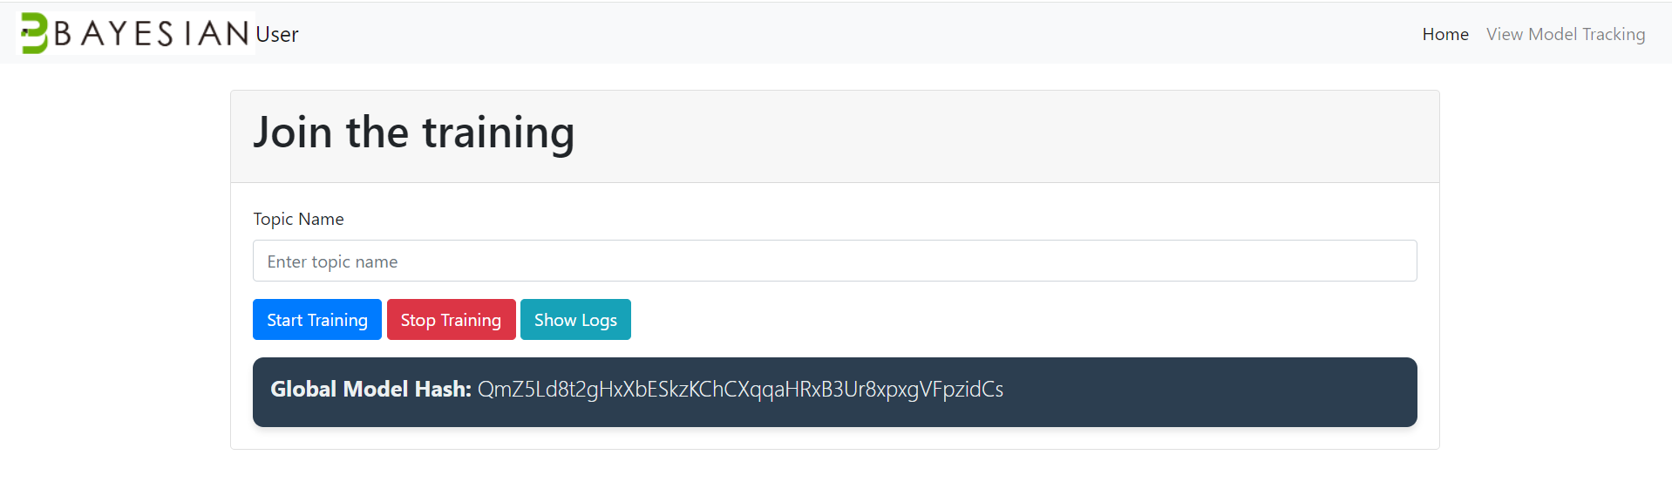
User Side

Slide 18
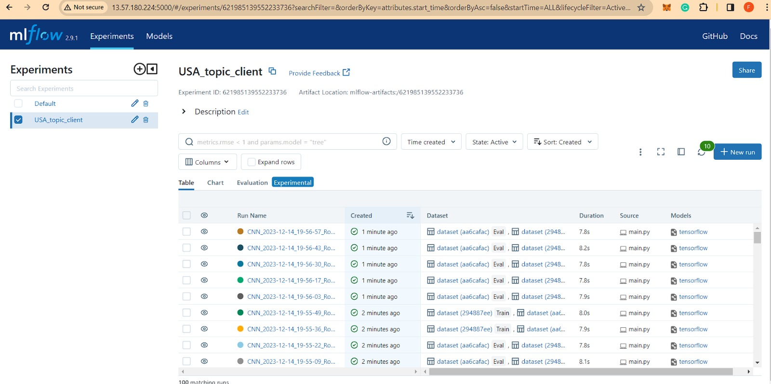
User Side (Model Tracking)

Slide 19
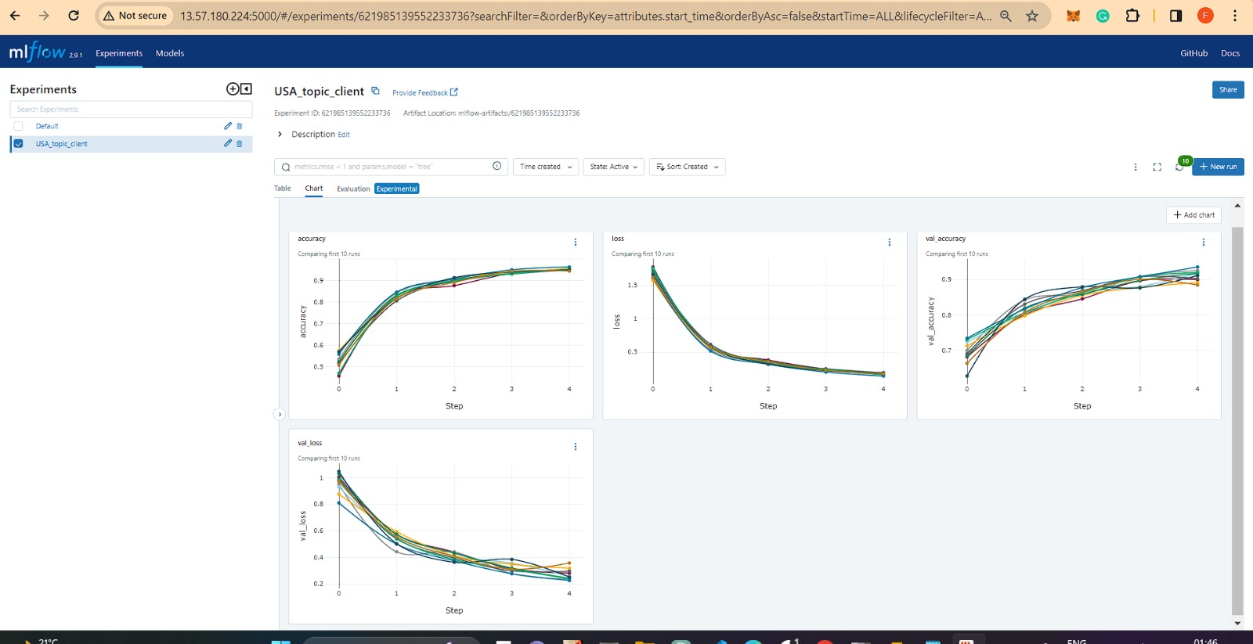

Slide 20
Future Work
Support Multiple training
Support Multiple ML Models inorder to solve new use case.
Implement feature to use personal real dataset for training
Continuous testing and improvement.
Implement Bayes Network.
Implement features that accommodate the addition of new nodes with minimal disruption.
Enhanced overall system performance.
Implement Blockchain for rewarding and penalization.

Slide 21
Conclusion
Highlighted BDCP Architechture
Implemented:
🚀 MQTT for Decentralized Messaging
🤖 DFL for Collaborative Model Training
🌐 REST APIs for Efficient Data Retrieval and Storage in Local Database
💾 Local Database for Log Maintenance, Metrics Storage, and Node Status
💻 UI – GUI for Interaction with DFL
Delivered a Comprehensive and Integrated System.

Slide 22
References
MQTT : https://docs.google.com/document/d/1wuRxQ__StTGaFzEbMuyN8dx_xTziZhylEo4JPU5--us/edit?usp=sharing DFL: https://docs.google.com/document/d/1b8QLVbW0ohSBJRgPNvnXyEEJeUmg3WhJPdCNsx1nUMs/edit
Bayes Network: https://docs.google.com/document/d/1U6hjHVsPYvNxl7pAvix3HMC5BdBTAG_zKiPHkG_6F4s/edit
Database: https://docs.google.com/spreadsheets/d/1pC501WFgTW3bbo_lra5GMaIwsEXZyeVcIqvowLQaPik/edit?usp=sharing
Rest API : https://docs.google.com/spreadsheets/d/1pC501WFgTW3bbo_lra5GMaIwsEXZyeVcIqvowLQaPik/edit#gid=892841854
Implementation Plan: https://docs.google.com/document/d/182Pl9xciBPAbu3yEXC6hVgPasQdqae2OOzCp2uNwQsY/edit?usp=sharing

Slide 23
Questions and Discussion
Open floor for any questions or discussions.

Slide 24
Thank You
Contact us : solutions@bayes.global

