Slide 1
Overview of Inference Algorithms for Bayesian Networks
Wei Sun, PhD
Assistant Research Professor
SEOR Dept. & C4I Center
George Mason University, 2009

Slide 2
Outline
Bayesian network and its properties
Probabilistic inference for Bayesian networks
Inference algorithm overview
Junction tree algorithm review
Current research

Slide 3
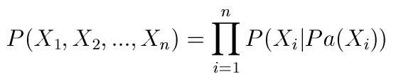
Definition of BN
A Bayesian network is a directed, acyclic graph consisting of nodes and arcs:
  Nodes: variables
  Arcs: probabilistic dependence relationships.
  Parameters: for each node, there is a conditional probability distribution (CPD).
CPD of X_{i}: P(X_{i}|Pa(X_{i})) where Pa(X_{i}) represents all parents of X_{i}
  Discrete: CPD is typically represented as a table, also called CPT.
  Continuous: CPD involves functions, such as P(X_{i}|Pa(X_{i})) = f(Pa(X_{i}), w), where w is a random noise.
Joint distribution of variables in BN is

Slide 4
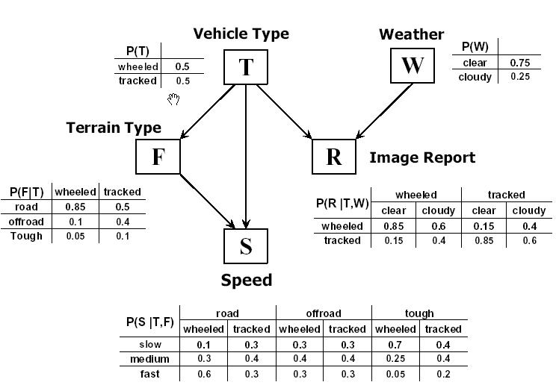

Bayesian Network Example
Vehicle Identification

Slide 5

Probabilistic Inference in BN
Task: find the posterior distributions of query nodes given evidence.
  Bayes’ Rule:
Both exact and approximate inference using BNs are NP-hard. Tractable inference algorithms exist only for special classes of BNs.

Slide 6
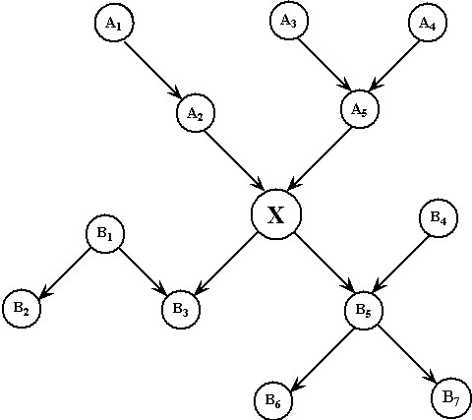
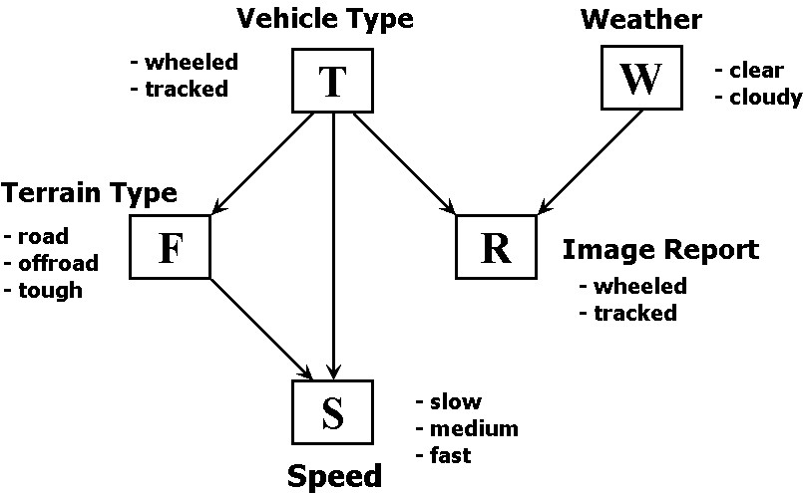
Classify BNs by Network Structure
Singly-connected networks
(a.k.a. polytree)
Multiply - connected networks

Slide 7
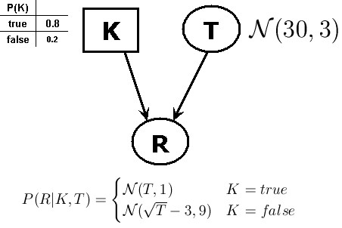
Classify BNs by Node Types
Node types
  Discrete: conditional probability distribution is usually represented as a table.
  Continuous: Gaussian or non-Gaussian distribution; conditional probability distribution is specified using functions:
    P(X_{i}|Pa(X_{i})) = f(Pa(X_{i}), w) where w is a random noise; the function could be linear/nonlinear.
  Hybrid model: mixed discrete and continuous variables.

Slide 8
Conditional Linear Gaussian (CLG)
CLG – Conditional Linear Gaussian model is the simplest hybrid Bayesian networks:
  All continuous variable are Gaussian
  The functional relationships between continuous variables and their parents are linear.
  No continuous parent for any discrete node.
Given any assignment of all discrete variables in CLG, it represents a multivariate Gaussian distribution.

Slide 9
Conditional Hybrid Model (CHM)
The conditional hybrid model (CHM) is a special hybrid BN:
  No continuous parent for any discrete node.
  Continuous variable can be arbitrary.
  The functional relationships between variables can be arbitrary nonlinear.
Only difference between CHM and general hybrid BN is the restriction that there is no continuous parent for any discrete node.

Slide 10
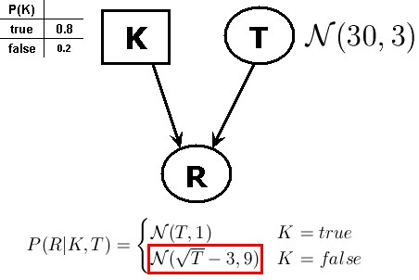
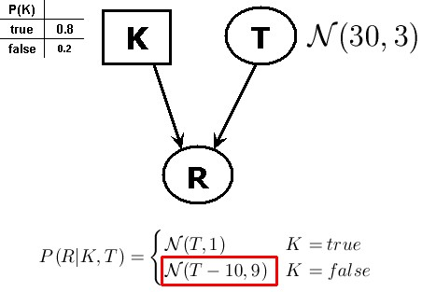
Examples of CHM and CLG
Conditional Hybrid Model (CHM)
CLG model

Slide 11
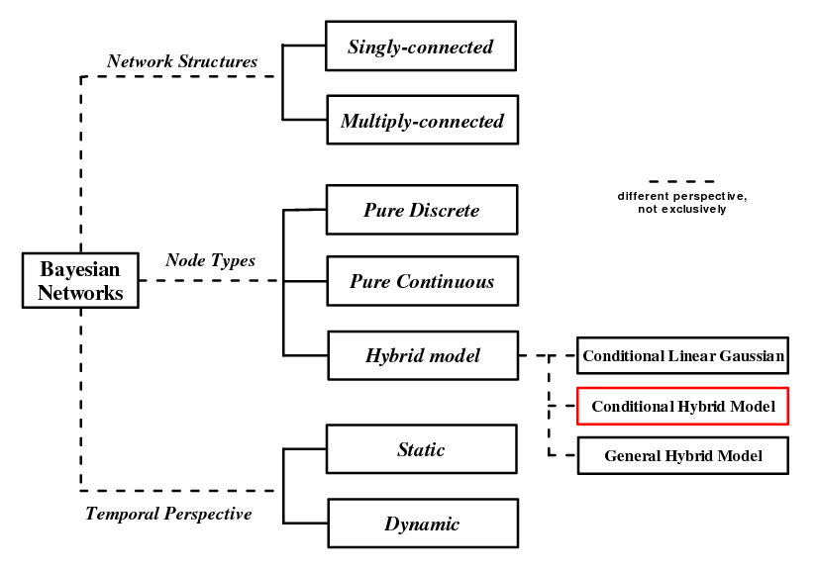
Taxonomy of BNs
Research Focus

Slide 12
Inference Algorithms Review - 1
Exact Inference
  Pearl’s message passing algorithm (MP) [Pearl88]
    In MP, messages (probabilities/likelihood) propagate between variables. After finite number of iterations, each node has its correct beliefs.
    It only works for pure discrete or pure Gaussian and singly-connected network (inference is done in linear time).
  Clique tree (a.k.a. Junction tree) [LS88,SS90,HD96] and related algorithms
    Includes variable elimination, arc reversal, symbolic probabilistic inference (SPI).
    It only works on pure discrete or pure Gaussian networks or simple CLGs
    For CLGs, clique tree algorithm is also called Lauritzen’s algorithm [Lau92]. It returns the correct mean and variance of the posterior distributions for continuous variables even though the true distribution might be Gaussian mixture.
    It does not work for general hybrid model and is intractable for complicated CLGs.

Slide 13
Inference Algorithms Review - 2
Approximate Inference
  Model simplification
    Discretization, linearization, arc removal etc.
    Performance degradation could be significant.
  Sampling method
    Logic sampling [Hen88]
    Likelihood weighting [FC89]
    Adaptive Importance Sampling (AIS-BN) [CD00], EPIS-BN [YD03], Cutset sampling [BD06]
      Performs well in case of unlikely evidence, but only work for pure discrete networks
    Markov chain Monte Carlo.
  Loopy propagation [MWJ99]: use Pearl’s message passing algorithm for networks with loops. This become a popular topic recently.
    For pure discrete or pure Gaussian networks with loops, it usually converges to approximate answers in several iterations.
    For hybrid model, message representation and integration are issues.
      Numerical hybrid loopy propagation [YD06], computational intensive.
      Conditioned hybrid message passing [SC07], exponential complexity on the size of interface nodes.

Slide 14
Junction Tree Algorithm
JT is the most popular exact inference algorithm for Bayesian networks.
  v1: JT for discrete network [LS89]
  v2: JT for CLG, also called Lauritzen’s algorithm [Lau92] - extension of JT v1.
Junction tree property:
  if node S appears in both clique U and V, then node S is in all cliques on the path between U and V. Junction property guarantees the correctness of message propagation.
Restriction:
  For pure discrete or simple CLG only
  Complexity depends on the size of the biggest clique.

Slide 15
Junction Tree for CLG
Graph transformation – construct Junction tree from the original DAG
  DAG -> Undirected graph
  Moralization, triangulation, and decomposition.
  Clique identification and connection for building a tree
Local message passing to propagate beliefs in the tree
  Clique potential and separator
  Initialization
  Evidence entering and absorption
  Marginalization

Slide 16
JT Moralization, Triangulation
Moralization – to marry the parents: link nodes if they have common child.
Triangulation – any chordless cycle has at most 3 nodes.
F
W
F
W
B
B
E
E
T
T
C
D
C
D

Slide 17
JT Decomposition (for CLG only)
Any path between two discrete nodes that containing only continuous nodes is forbidden
– we have to link these two discrete nodes to make the graph strongly decomposable.
F
W
B
E
T
C
D

Slide 18
Clique and Junction Tree
Clique is a maximal and complete cluster of nodes (subset of variables) – if node S has link to all of nodes in clique U, node S belongs to clique U.
Clique tree is not unique.
BFE
WFE
WED
F
W
B
BC
WT
E
T
BED
C
D

Slide 19
Local Message Passing in JT
Next time.

Slide 20
Current Research
about Direct Message Passing Algotithm

Slide 21
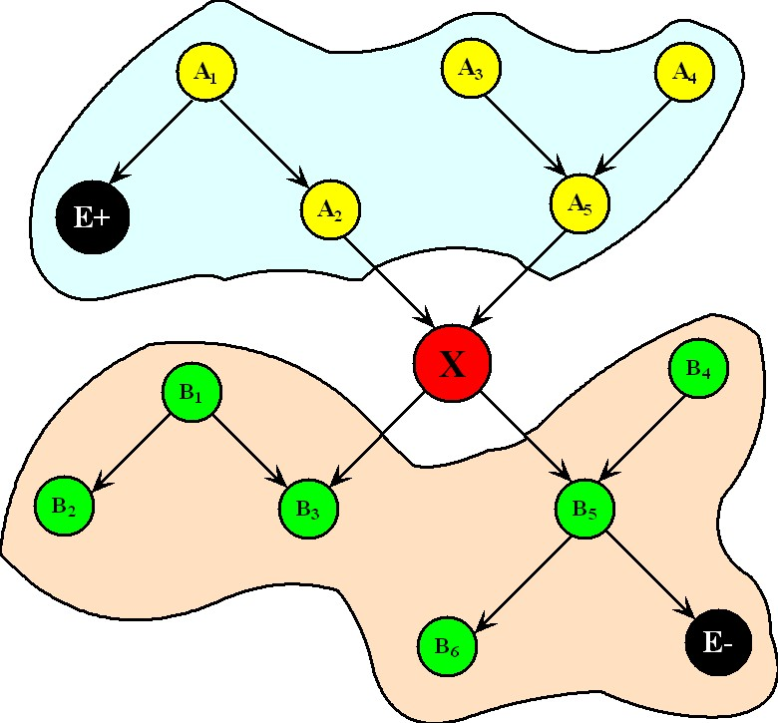




Pearl’s Message Passing Algorithm
In polytree, any node d-separate the sub-network above it from the sub-network below it. For a typical node X in a polytree, evidence can be divided into two exclusive sets, and processed separately:
Define messages and messages as:
Multiply-connected network may not be partitioned into two separate sub-networks by a node.
Then the belief of node X is:

Slide 22
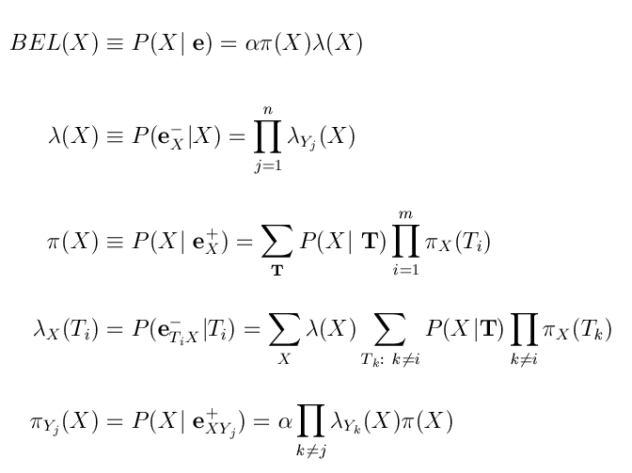
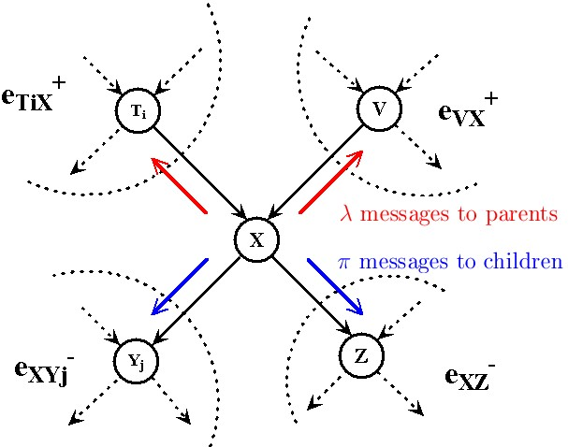
Pearl’s Message Passing in BNs
In message passing algorithm, each node maintains Lambda message and Pi message for itself. Also it sends Lambda message to every parent it has and Pi message to its children.
After finite-number iterations of message passing, every node obtains its correct belief.
For polytree, MP returns exact belief;
For networks with loop, MP is called loopy propagation that often gives good approximation to posterior distributions.

Slide 23
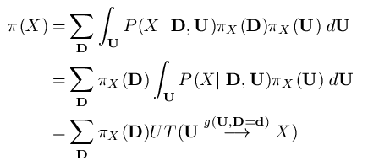
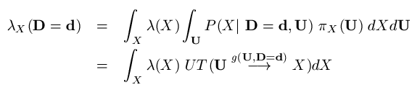
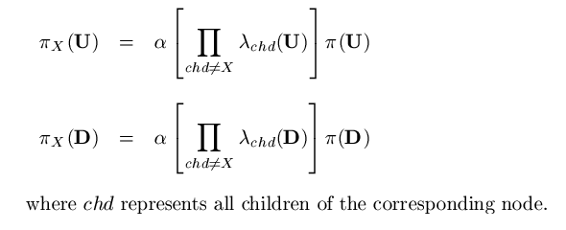
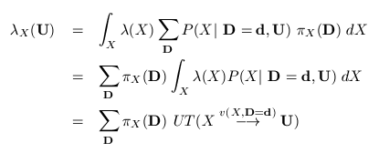
Unscented Hybrid Loopy Propagation
D
U
Weighted sum of continuous message.
where is the function specified in CPD of X.
X
Non-negative constant.
Weighted sum of continuous message.
where is the inverse function.
Complexity is reduced significantly! Only depends on the size of discrete parents in local CPD.

Slide 24
A
U
X
B
Y
C
W
Z

