Slide 1
Direct Message Passing for Hybrid Bayesian Networks
Wei Sun, PhD
Assistant Research Professor
SFL, C4I Center, SEOR Dept.
George Mason University, 2009

Slide 2
Outline
Inference for hybrid Bayesian networks
Message passing algorithm
Direct message passing between discrete and continuous variables
Gaussian mixture reduction
Issues

Slide 3



Hybrid Bayesian Networks
Type
Continuous
features
Discrete
features
speed
Type1
Class 2
…
frequency
category
0.36589…
location
Both DISCRETE and CONTINUOUS variables are involved in a hybrid model.

Slide 4
Hybrid Bayesian Networks – Cont.
The simplest hybrid BN model – Conditional Linear Gaussian (CLG)
  no discrete child for continuous parent.
  Linear relationship between continuous variables.
  Clique Tree algorithm provides exact solution.
General hybrid BNs
  arbitrary continuous densities and arbitrary functional relationships between continuous variables.
  No exact algorithm in general.
  Approximate methods include discretization, simulation, conditional loopy propagation, etc.

Slide 5
Innovation
Message passing between pure discrete variables or between pure continuous variables is well defined. But it is an open issue to exchange messages between heterogeneous variables.
In this paper, we unify the message passing framework to exchange information between arbitrary variables.
  Provides exact solutions for polytree CLG, with full density estimations, v.s. Clique Tree algorithm provides only first two moments. Both have same complexity.
  Integrates unscented transformation to provide approximate solution for nonlinear non-Gaussian models.
  Uses Gaussian mixture (GM) to represent continuous messages.
  May apply GM reduction techniques to make the algorithm scalable.

Slide 6
Why Message Passing
Local, distributed, less computations.

Slide 7
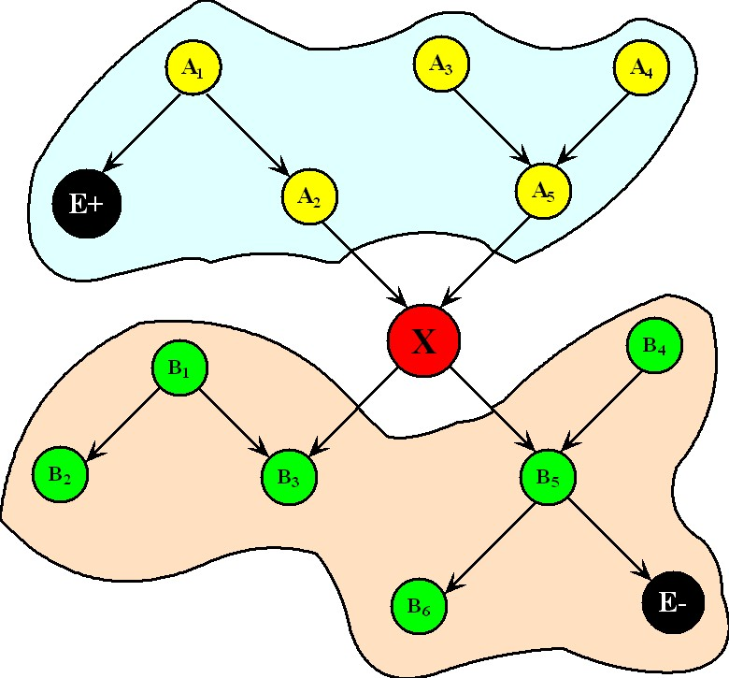




Message Passing in Polytree
In polytree, any node d-separate the sub-network above it from the sub-network below it. For a typical node X in a polytree, evidence can be divided into two exclusive sets, and processed separately:
Define messages and messages as:
Multiply-connected network may not be partitioned into two separate sub-networks by a node.
Then the belief of node X is:

Slide 8
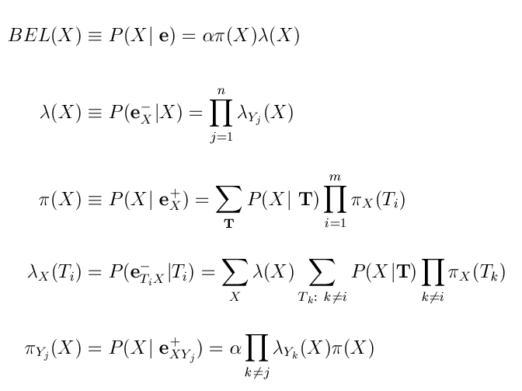
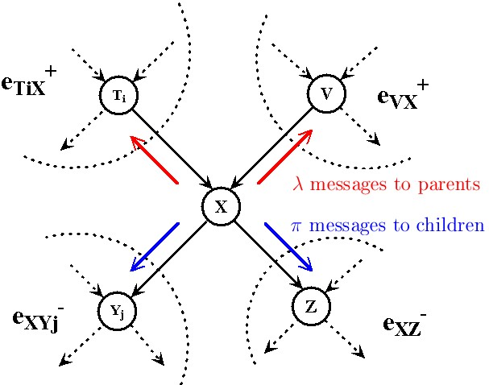
Message Passing in Polytree – Cont
In message passing algorithm, each node maintains Lambda value and Pi value for itself. Also it sends Lambda message to its parent and Pi message to its child.
After finite-number iterations of message passing, every node obtains its correct belief.
For polytree, MP returns exact belief;
For networks with loop, MP is called loopy propagation that often gives good approximation to posterior distributions.

Slide 9
Message Passing in Hybrid Networks
For continuous variable, messages are represented by Gaussian mixture (GM).
Each state of discrete parent introduces A Gaussian component in continuous message.
Unscented transformation is used to compute continuous message when function relationship defined in CPD (Conditional Probability Distribution) is nonlinear.
When messages propagate, size of GM increased exponentially. Error-bounded GM reduction technique maintains the scalability of the algorithm.

Slide 10
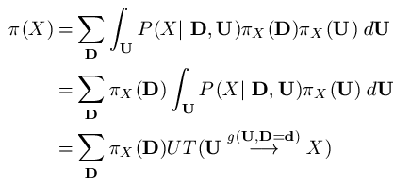
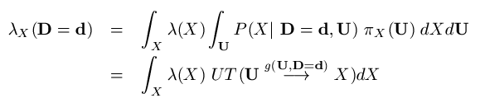
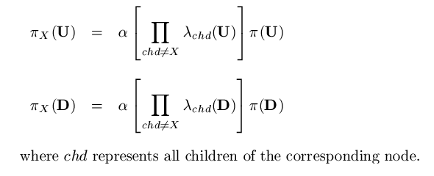
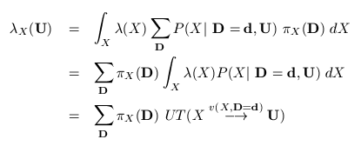
Direct Passing between Disc. & Cont.
D
U
X
Gaussian mixture with discrete pi message as mixing prior,
and is the function specified in CPD of X.
A continuous node with both
discrete and continuous parents.
Non-negative constant.
Gaussian mixture with discrete pi message as mixing prior,
and is the inverse of function defined in CPD of X.
Message exchanged directly between discrete and continuous nodes, Size of GM increased when
messages propagate. Need GM reduction technique to maintain scalability.

Slide 11
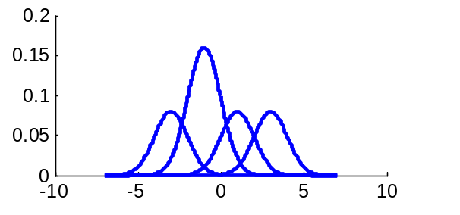
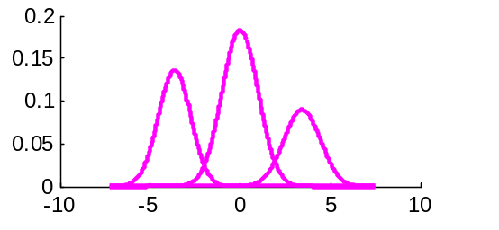
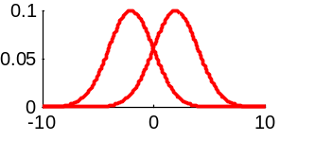
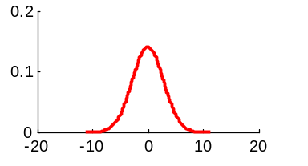
Complexity
Exploding??
U
T
A
B
X
W
Z
Y

Slide 12
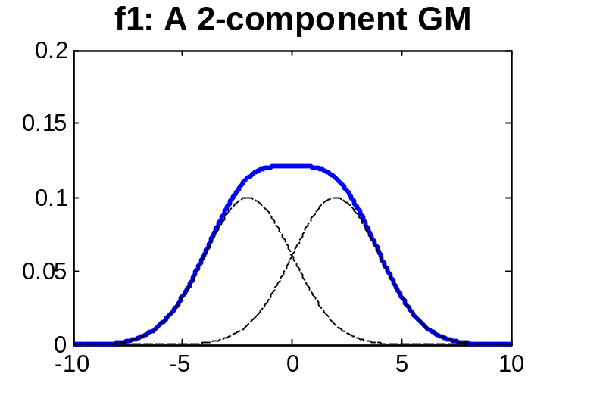
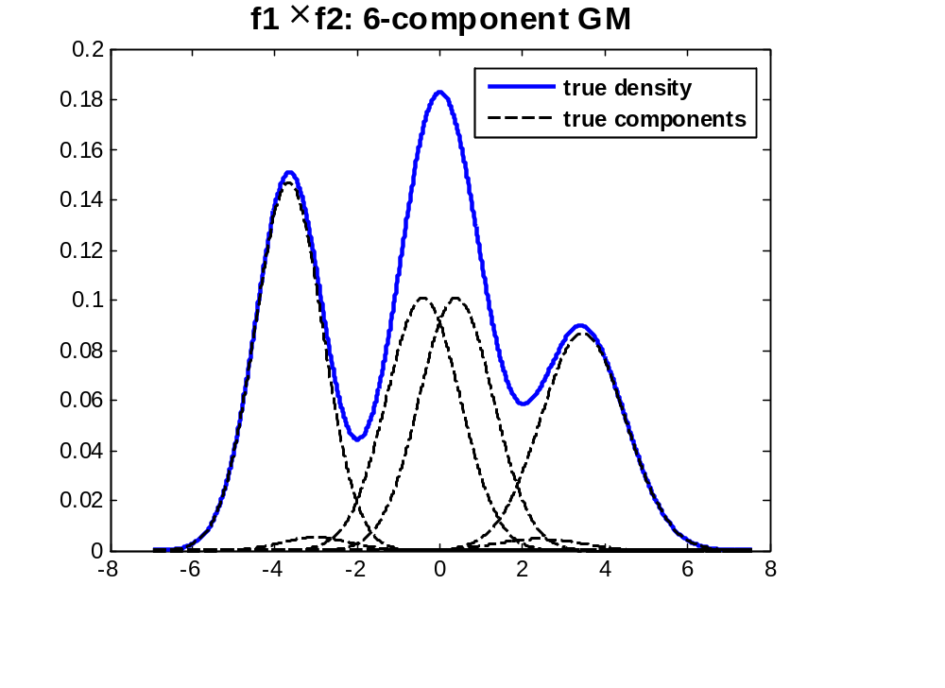
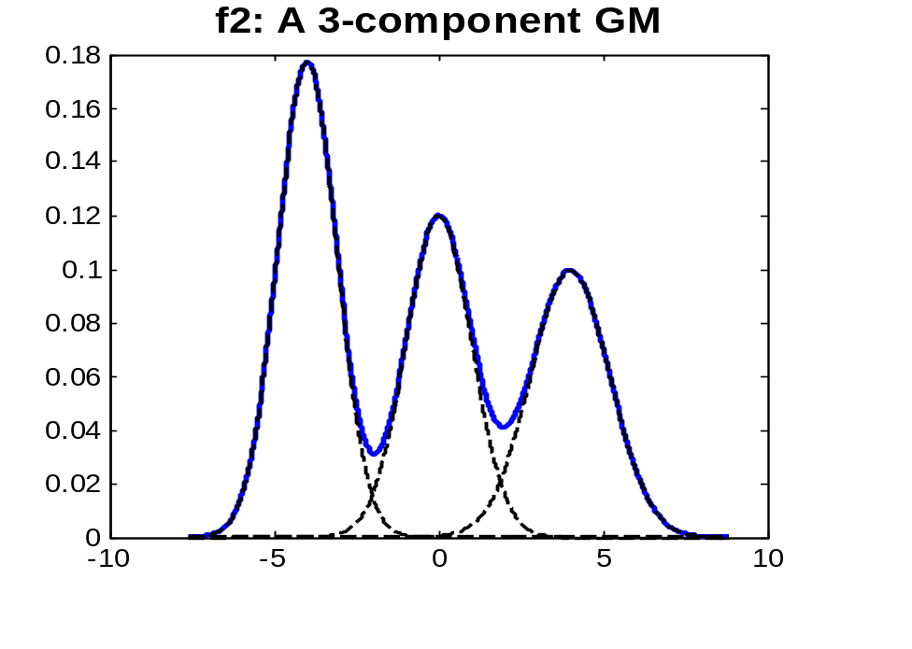
Scalability - Gaussian Mixture Reduction

Slide 13
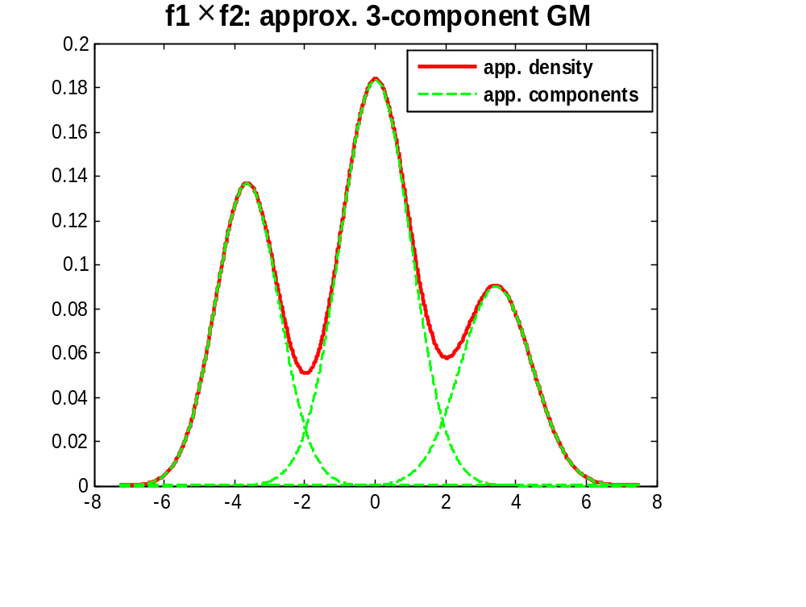
Gaussian Mixture Reduction – Cont.
Normalized integrated square error = 0.45%

Slide 14
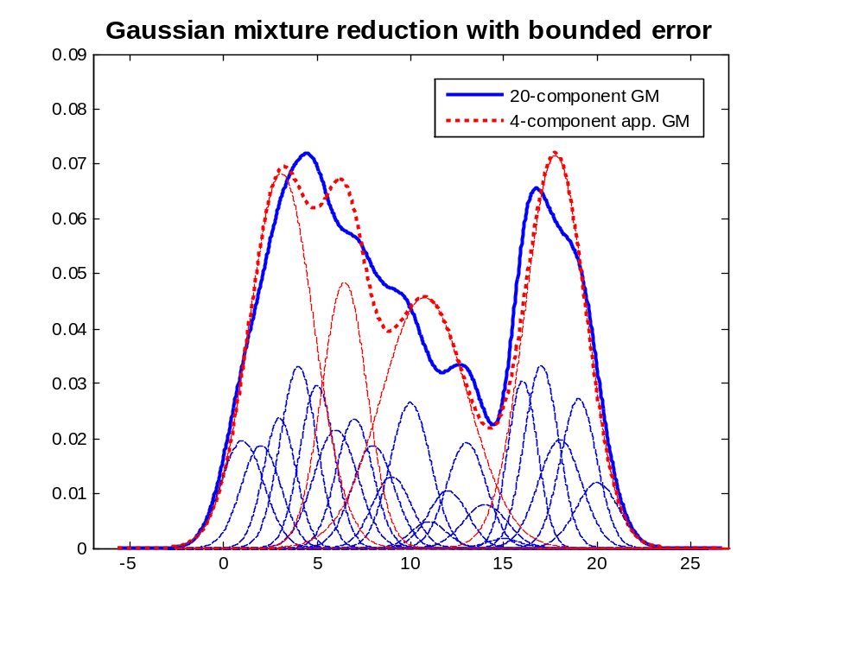
Example – 4-comp. GM to 20-comp. GM
NISE < 1%

Slide 15
Scalability - Error Propagation
Approximate messages propagate, and so do the errors. We can have each approximation bounded. However, total errors after propagations is very difficult to estimate.
Ongoing research:
  having each GM reduction bounded with small error, we aim to have total approximation errors are still bounded, at least empirically.

Slide 16
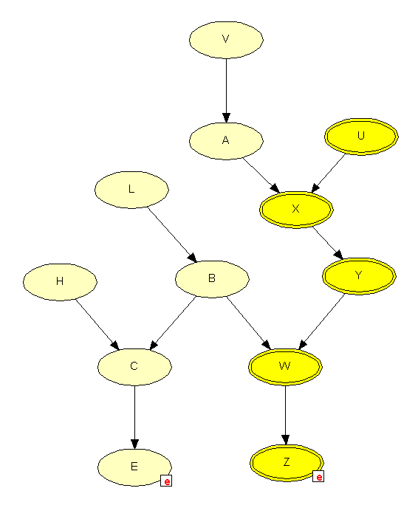
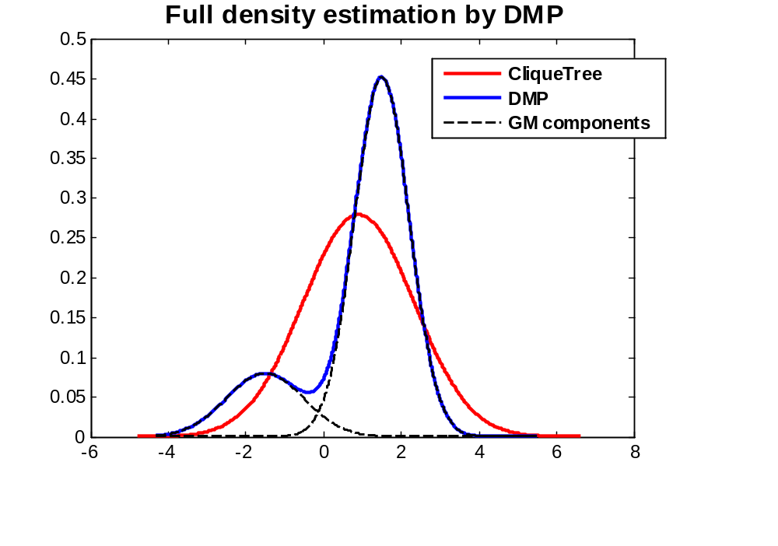
Numerical Experiments – Polytree CLG
DMP v.s. Clique Tree
Both have same complexity.
Both provide exact solution for polytree.
DMP provides full density estimation,
while CT provides only the first two
moments for continuous variables.
Poly12CLG – a polytree BN model

Slide 17
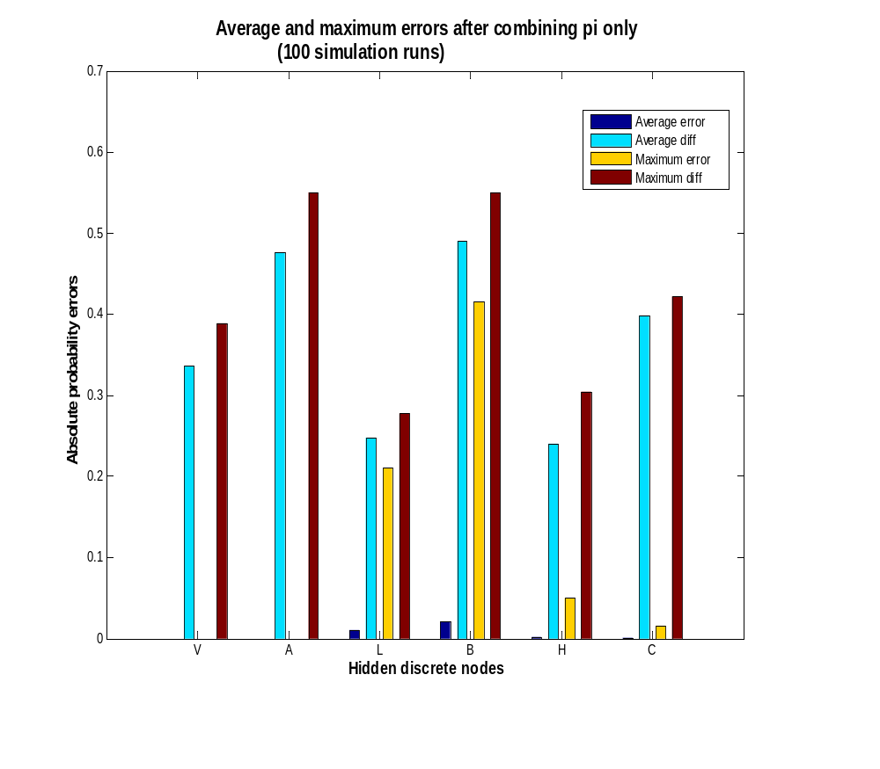
Numerical Experiments – Polytree CLG, with GM Reduction
Poly12CLG – a polytree BN model
GM pi value -> single Gaussian approx.

Slide 18
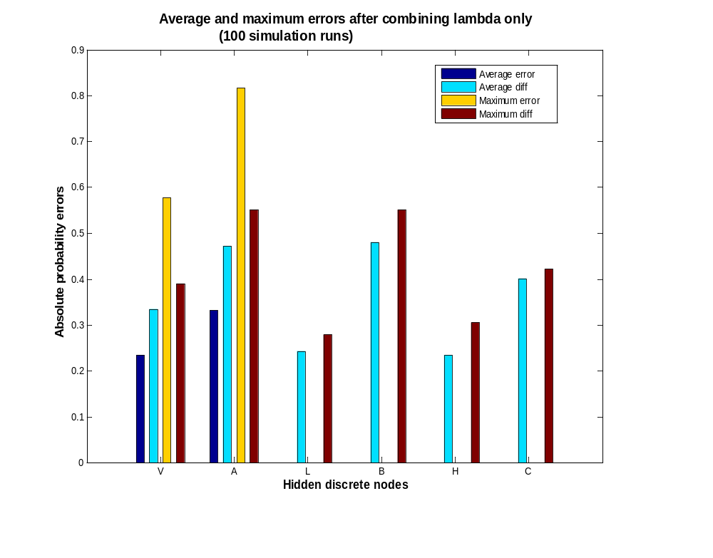
Numerical Experiments – Polytree CLG, with GM Reduction
Poly12CLG – a polytree BN model
GM lambda message -> single Gaussian approx.

Slide 19
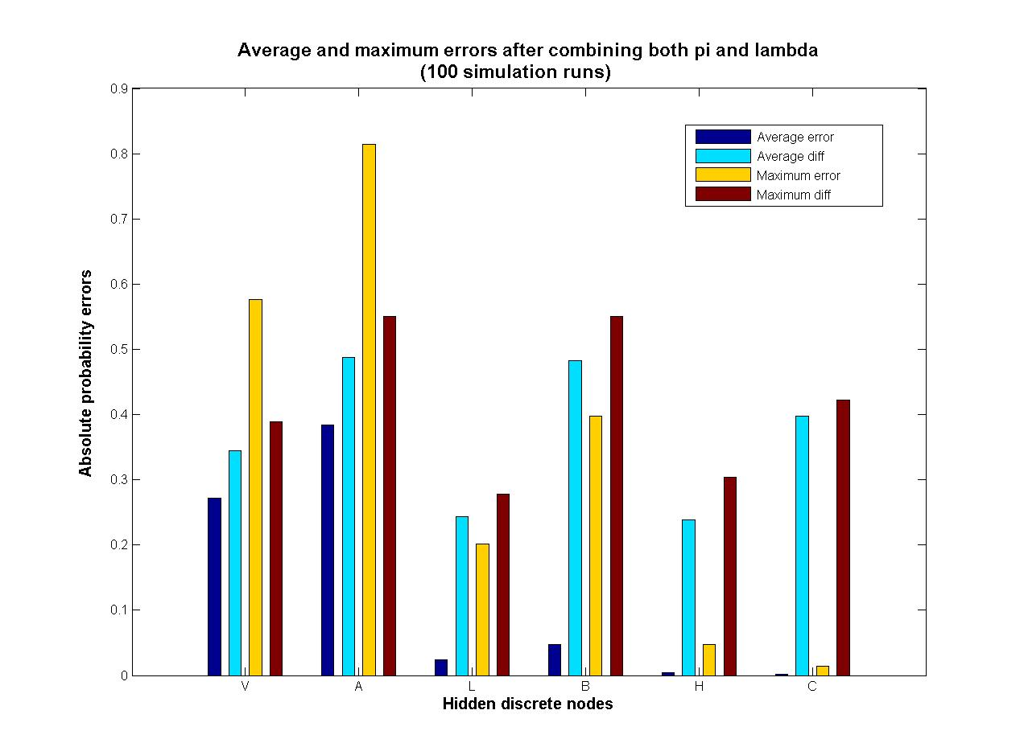
Numerical Experiments – Polytree CLG, with GM Reduction
Poly12CLG – a polytree BN model
GM pi and lambda message -> single Gaussian approx.

Slide 20
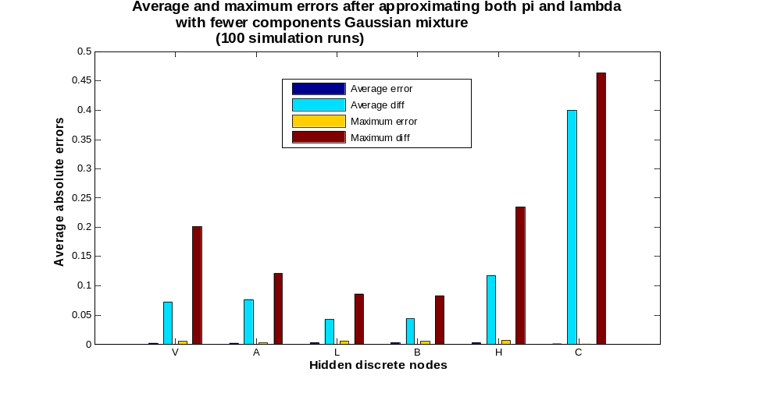
Reduce GM under Bounded Error
Each GM reduction has bounded error < 5%,
then the inference performance improved significantly.

Slide 21
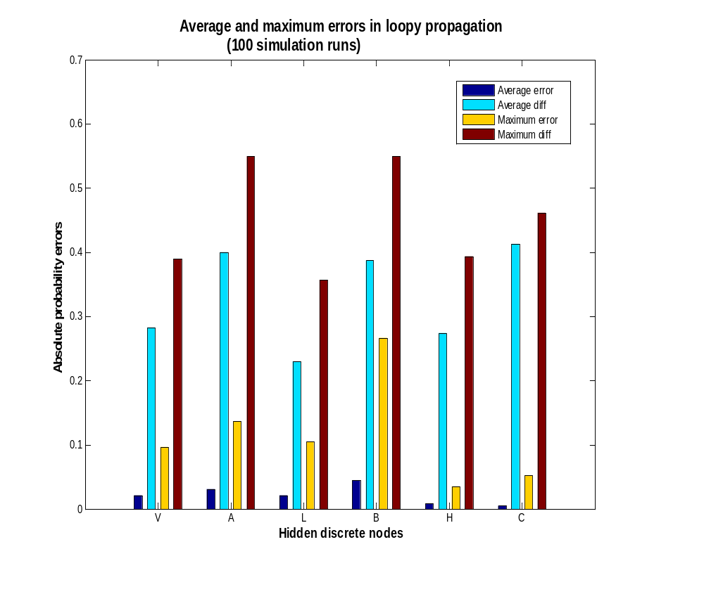
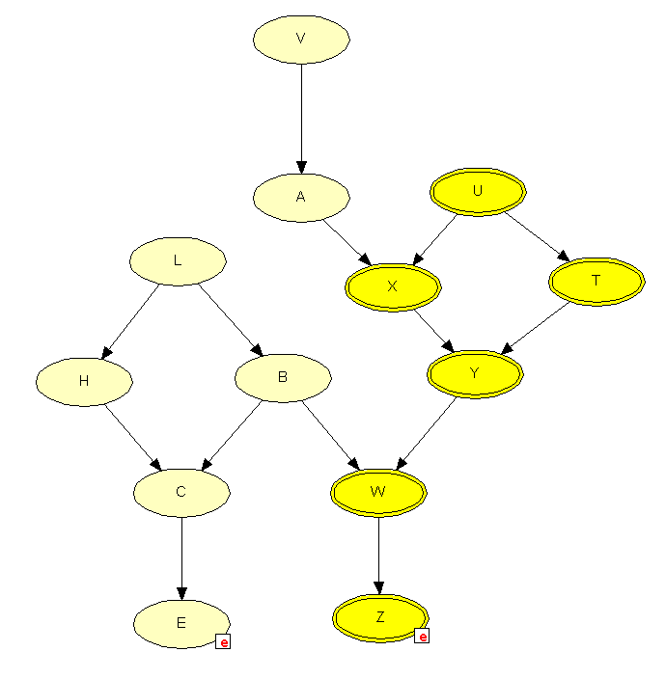
Numerical Experiments – Network with loops
Errors are from 1% to 5% due to loopy propagation.
Loop13CLG – a BN model with loops

Slide 22
Empirical Insights
Combining pi does not affect network ‘above’;
Combining lambda does not affect network ‘below’;
Approximation errors due to GM reduction diminish for discrete nodes further away from the discrete parent nodes.
Loopy propagation usually provides accurate estimations.

Slide 23
Summary & Future Research
DMP provides an alternative algorithm for efficient inference in hybrid BNs:
  Exact for polytree model
  Full density estimations
  Same complexity as Clique Tree
  Scalable in trading off accuracy with computational complexity
  Distributed algorithm, local computations only

Slide 24


Slide 25
A₁
A₂
A₃
…
A_{n}
T
Y₁
Y₂
Y₃
Y_{n}
E

Slide 26

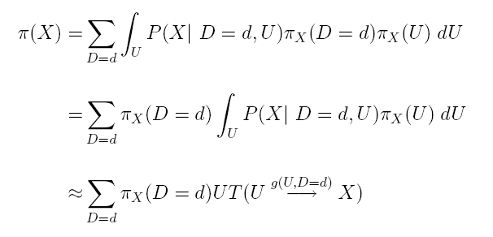
Pi Value of A Cont. Node with both Disc. & Cont. Parents
Pi value of a continuous node is essentially a distribution transformed by the function defined in CPD of this node, with input distributions as all of pi messages sent from its parents.
With both discrete and continuous parents, pi value of the continuous node can be represented by a Gaussian mixture.
D
U
X
Gaussian mixture with discrete pi message as mixing prior,
and is the function specified in CPD of X.

Slide 27




Lambda Value of A Cont. Node
Lambda value of a continuous node is a product of all lambda messages sent from its children.
Lambda message sending to a continuous node is definitely a continuous message in the form of Gaussian mixture because only continuous child is allowed for continuous node.
Product of Gaussian mixture will be a Gaussian mixture with exponentially increased size.
X

Slide 28



Pi Message Sending to Cont. node from Disc. Parent
Pi message sending to a continuous node ‘X’ from its discrete parent is the product of pi value of the discrete parent and all of lambda messages sending to this discrete parent from all children except ‘X’.
Lambda message sending to discrete node from its child is always a discrete vector.
Pi value of discrete node is always a discrete distribution.
Pi message sending to a continuous node from its discrete parent is a discrete vector, representing the discrete parent’s state probabilities.
D
U
X

Slide 29

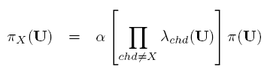
Pi Message Sending to Cont. node from Cont. Parent
Pi message sending to a continuous node ‘X’ from its continuous parent is the product of pi value of the continuous parent and all of lambda messages sending to the continuous parent from all children except ‘X’.
Lambda message sending to a continuous node from its child is always a continuous message, represented by GM.
Pi value of a continuous node is always a continuous distribution, also represented by GM.
Pi message sending to a continuous node from its continuous parent is a continuous message, represented by a GM.
D
U
X

Slide 30
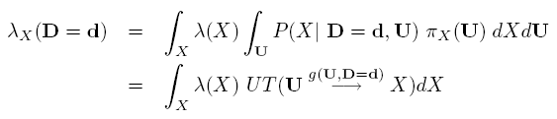
Lambda Message Sending to Disc. Parent from Cont. node
Given each state of discrete parent, a function is defined between continuous node and its continuous parent.
For each state of discrete parent, lambda message sent from a continuous node is a integration of two continuous distributions (both represented by GM), resulting in a non-negative constant.
D
U
X

Slide 31
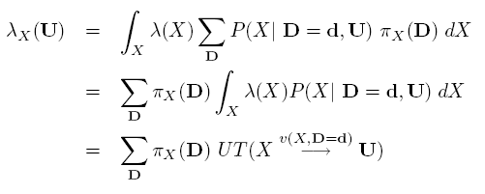
Lambda Message Sending to Cont. Parent from Cont. Node
D
U
Lambda message sending from a continuous node to its continuous parent is a Gaussian mixture using the pi message sending to it from its discrete parent as the mixing prior.
Pi message sending to continuous node from its discrete parent is a discrete vector, serving as the mixing prior.
X

Slide 32


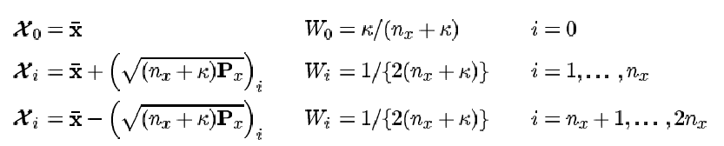
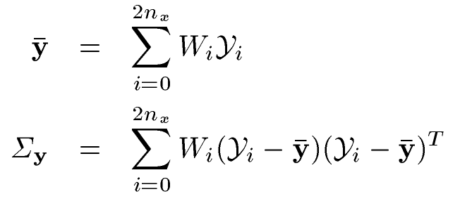

Unscented Transformation
Unscented transformation (UT) is a deterministic sampling method
  UT approximates the first two moments of a continuous random variable transformed via an arbitrary nonlinear function.
  UT is based on the principle that it is easier to approximate a probability distribution than a nonlinear function.
deterministic sample points are chosen and propagated via the original function.
Where is the dimension of X, is a scaling parameter.
UT keeps the original function unchanged and results are exact for linear function.

Slide 33

Why Message Passing
Local
Distributed
Less computations

