Slide 1

Convergence Study of Message Passing In Arbitrary Continuous Bayesian Networks
SPIE 08 @ Orlando
Wei Sun and KC Chang
George Mason University
wsun@gmu.edu
kchang@gmu.edu
March 2008

Slide 2
Outline
Bayesian Network & Probabilistic Inference
Message Passing Algorithm Review
Unscented Message Passing for Arbitrary Continuous Bayesian Network
Numerical Experiments and Convergence Study
Summary

Slide 3
Bayesian Network and Its Inference Problems
Bayesian network (BN) is an useful probabilistic model in statistics, artificial intelligence, machine learning
  Conditional independence
  Efficient modeling with visualization, modularity, causal logic, etc.
  Joint probability distribution is represented by the product of Conditional probability distributions (CPDs)
BN inference is NP-hard in general.
  Tractable inference algorithms exist only for special classes of BNs
  Approximate inference is in general feasible: simulation, model simplification, loopy belief propagation, etc. However, how good the performance of approximate methods is?

Slide 4
Inference for Arbitrary Bayesian Networks
When the continuous random variables are involved, their distributions could be non-Gaussian, and their dependence relationships could be nonlinear. It is well known that there is NO EXACT SOLUTION generally in these cases. (It may be feasible for some special cases with exponential distributions.)
An approximate inference method - loopy belief propagation is a good candidate in handling continuous variables.
KEY ISSUES: continuous messages representations and manipulations.
We propose a continuous version of loopy propagation algorithm and investigate its convergence performance. Unscented transformation plays important role in our algorithm and so it is called “Unscented Message Passing”.

Slide 5
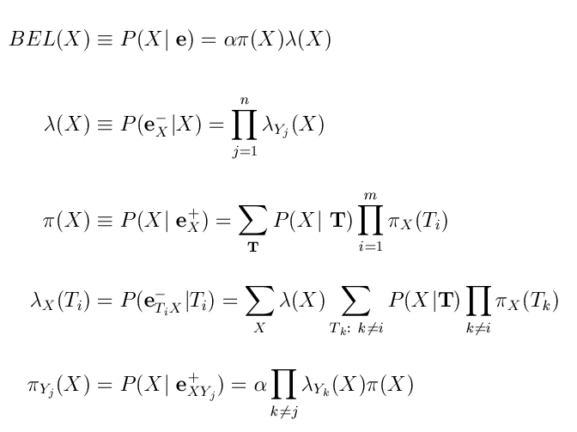
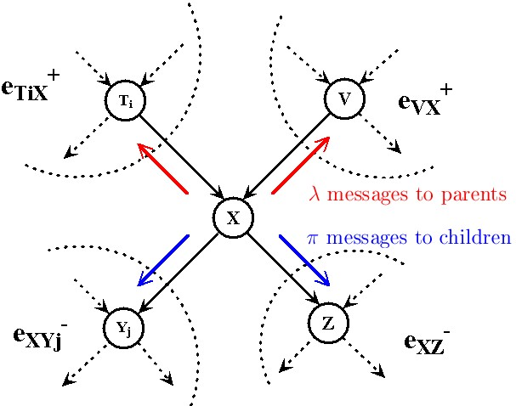
Pearl’s Message Passing in BNs
In message passing algorithm, each node maintains Lambda message and Pi message for itself. Also it sends Lambda message to every parent it has and Pi message to its children.
After finite-number iterations of message passing, every node obtains its correct belief.
For polytree, MP returns exact belief;
For networks with loop, MP is called loopy propagation that still could give good approximation of posterior distribution.
J. Pearl. “Probabilistic Reasoning in Intelligent Systems: Networks of Plausible Inference.” Morgan Kauffman, San Mateo, 1988.

Slide 6
Message Passing in Arbitrary Continuous BN
Message is represented by MEAN and VARIANCE regardless of the distribution.
Message propagations between continuous variables are equivalent to fusing multiple estimates and estimating functional transformation of distributions.
Unscented transformation uses deterministic sampling scheme to obtain good estimates of the first two moments of continuous random variable subject to an nonlinear function transformation.

Slide 7


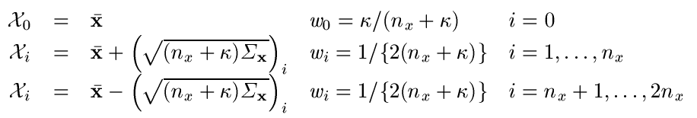

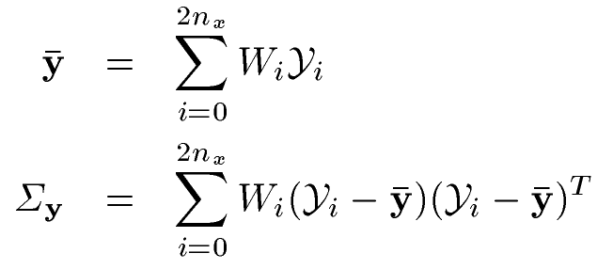


Unscented Transformation (UT)
Unscented transformation is a deterministic sampling method
  Approximate the first two moments of a continuous random variable transformed via an arbitrary nonlinear function.
  UT bases on the principle that it is easier to approximate a probability distribution than a nonlinear function.
deterministic sample points are chosen and propagated via the nonlinear function.
S.J. Julier, J.K. Uhlman. “A General Method for Approximating Non-linear Transformations of Probability Distribution”. Tech. Report, RRG, Univ. of Oxford, 1996.

Slide 8
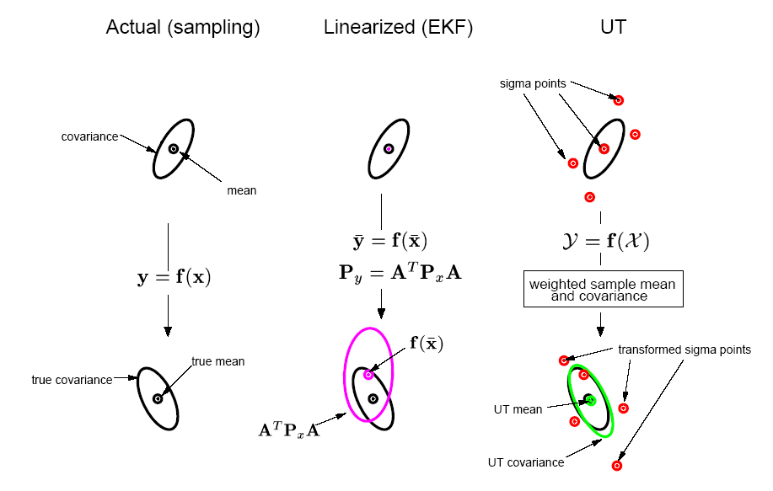
Unscented Transformation Example
A cloud of 5000 samples drawn from a Gaussian prior is propagated through an arbitrary highly nonlinear function and the true posterior sample mean and covariance are calculated, which can be regarded as a ground truth of the two approaches, EKF and UT.

Slide 9
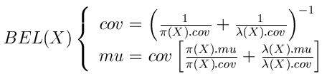
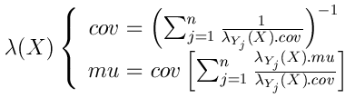

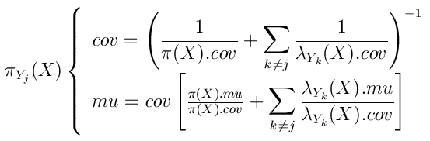
Unscented Message Passing (UMP-BN)
(For arbitrary continuous BN)
Conventional Pearl’s Equations
Derived generalized Equations to
handle continuous variables.

Slide 10
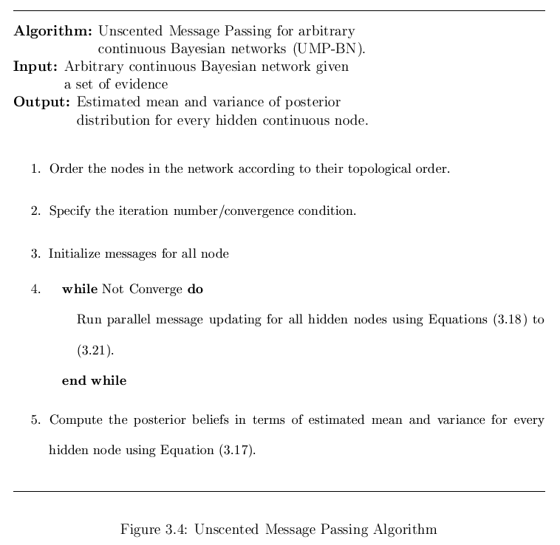
UMP-BN Algorithm

Slide 11
UMP-BN: Numerical Experiments
Linear Gaussian
  Randomly generated CPDs, linear relationships
Nonlinear Gaussian
  Purposely specified nonlinear relationships
  No exact benchmark, using brute force likelihood weighting (20-million sample size) to provide the approximate true.
Convergence Study
  Converge or not
  How many iterations using message passing

Slide 12
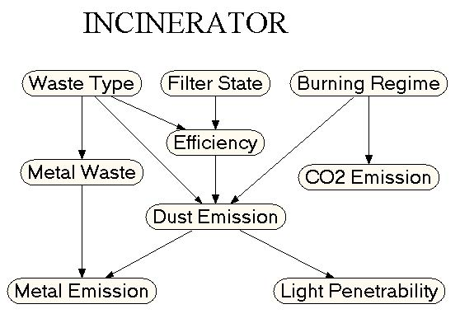
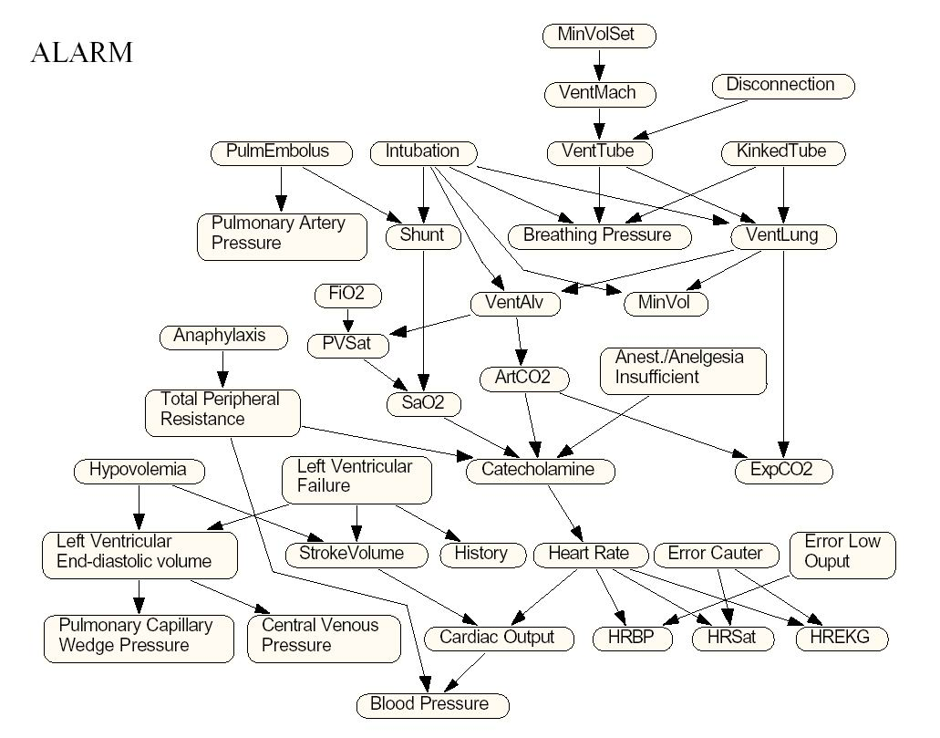
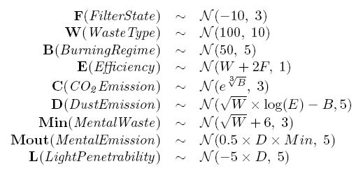
UMP-BN: Experimental Models

Slide 13
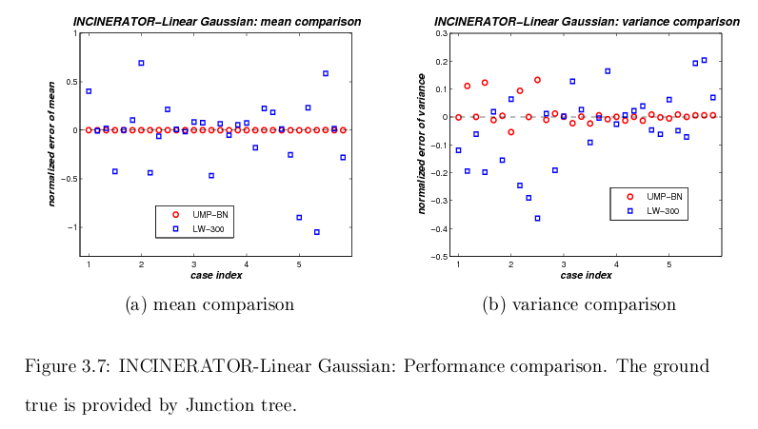
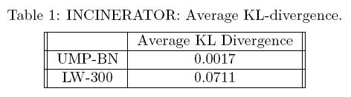
Numerical Results - 1

Slide 14
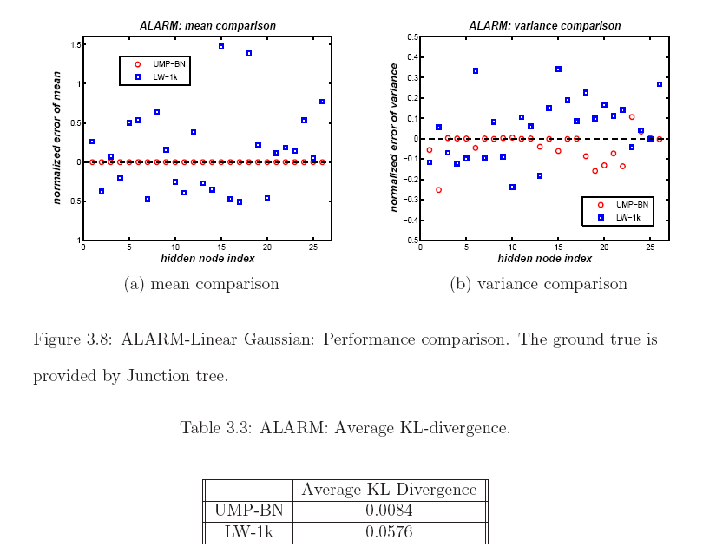
Numerical Results - 2

Slide 15
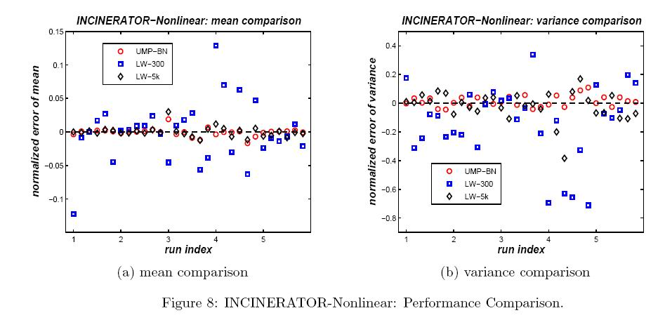
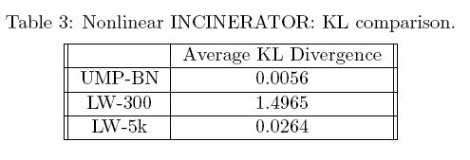
Numerical Results - 3

Slide 16
Convergence
It converges in all of the numerical experiments.
Linear Gaussian:
  Incinerator: 9.8 iterations on average
  Alarm: 15.5 iterations on average
Nonlinear Gaussian:
  Incinerator: 10 iteration with the specified nonlinear functions

Slide 17
Summary and Future Work
Unscented Message Passing (UMP) provides a good alternative algorithm for belief propagation for arbitrary continuous Bayesian networks.
In our limited simulation cases, UMP always converges and it converges within small number of iterations. Theoretically, the complexity of loopy based algorithm depends on the size of loops and the so-called induced width of the networks.
Further sampling based on UMP results could give estimates of the underlying distributions efficiently.

