Slide 1
Detecting Potential Safety Issues in Large Clinical or Observational Trials by Bayesian Screening
A. Lawrence Gould
Merck Research Laboratories
October 26, 2018
goulda@merck.com
Gould, A.L. Unified screening for potential adverse event risk and other associations. Statistics in Medicine 2018:37:2667-2689

Slide 2
INTRODUCTION

Slide 3
Safety vs Efficacy Analyses
EFFICACY
Protocol identifies primary efficacy hypotheses, efficacy variables, & analysis strategy
Changes to variables/analyses after unblinding can undermine credibility of efficacy conclusions
SAFETY (current practice)
‘Safe’ if no significant differences in incidence of ‘important’ adverse events
Conclusion driven by variables not identified as primary in protocol using analyses not described a priori, including post-unblinded ad hoc analyses

Slide 4
Issues with Standard Testing/Screening Approaches
For Efficacy, need only a suitably adjusted significant finding – no finding implies no efficacy
BUT For Safety:
A significant finding does not
imply lack of safety – difference
might be clinically immaterial
Outcomes generate hypotheses
(what is Type 1 error?)
Relevant for safety? A single
difference may signal a potential
tolerability/toxicity problem
No significant findings for safety does not imply safety (can’t prove a negative)
Many tests ⇒ multiplicity correction to avoid Type 1 error inflation
Reduces no. of
'significant' findings

Slide 5
ICH E9 Guideline (Sec 6.4)
“In most trials the safety and tolerability implications are best addressed by
applying descriptive statistical methods to the data,
supplemented by calculation of confidence intervals wherever this aids interpretation.”
“use of confidence intervals is preferred to hypothesis testing... imprecision often arising from low frequencies of occurrence is clearly demonstrated.”
Interpret ‘statistically significant’ findings carefully if no multiplicity adjustment

Slide 6
Two Dimensions of Safety Evaluation
Screening
Choose between two distributions of treatment effect
“Medically Unimportant” and “Medically Important”
Quantification
Attribute to any measure of treatment effect a probability of a larger or smaller value
Not the same – could have high probability that
Effect is real (diff > 0, ratio or odds ratio > 1) and
Effect is from the “Medically Unimportant” rather than “Medically Important” distribution
By the way... not concerned here with detailed analyses of specific relationships of interest -- just looking for potential issues to follow up

Slide 7
Screening Context: Safety Triage
Tier 1 AEs
Tier 2 AEs
Tier 3 AEs
Events with
a priori questions
Treat like efficacy - hypotheses defined
No defined hypotheses -- use screening
Summarize only - no defined hypotheses, too rare for statistics
Events not identified
a priori, and not “rare”
Rare events not
identified a priori

Slide 8
PREVIOUS WORK

Slide 9
Mehrotra & Heyse (SMMR2004)
Adjust for multiplicity using FDR to avoid false positives, keep sensitivity to detect important differences
Group AEs into defined subsets, eg body systems
Groupings need to be defined in study plan/protocol
2-step process
Disregard AEs with very small incidence
Flag remaining AEs with significant P values after applying ‘Double FDR’ procedure
FDR to the P values for body systems
FDR separately within body systems to indiv AEs
Flag AE if FDR_{BS} < α/2 & FDR_{AE|BS} < α

Slide 10
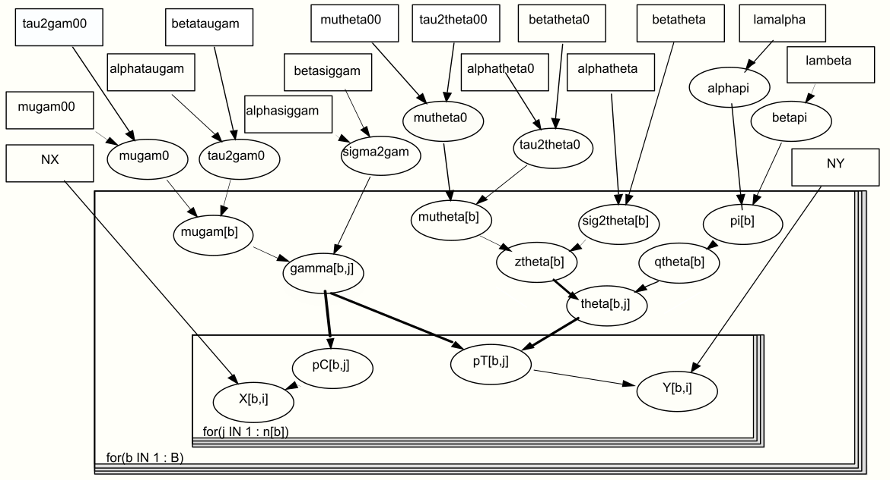
Berry & Berry (Bcs2004)
3-Level hierarchical mixture model
Posterior dist’n of θ = log odds ratio is the basis for inference

Slide 11
BAYESIAN SCREENING

Slide 12
Underlying Principles
No such thing as a true “zero difference” in reality
More realistic: “indifference” zone of small, essentially zero, differences
Widely applied in equivalence, noninferiority, and bioequivalence testing
Hypothesis testing in safety screening not relevant
No hypotheses!
Observed data determine tests
Large samples can make clinically meaningless differences ‘significant’
Multiplicity implications different from efficacy
“Sentinel” events such as death, blood dyscrasias, & serious hypersensitivity are followed up anyway ⇒ important events captured regardless of approach

Slide 13
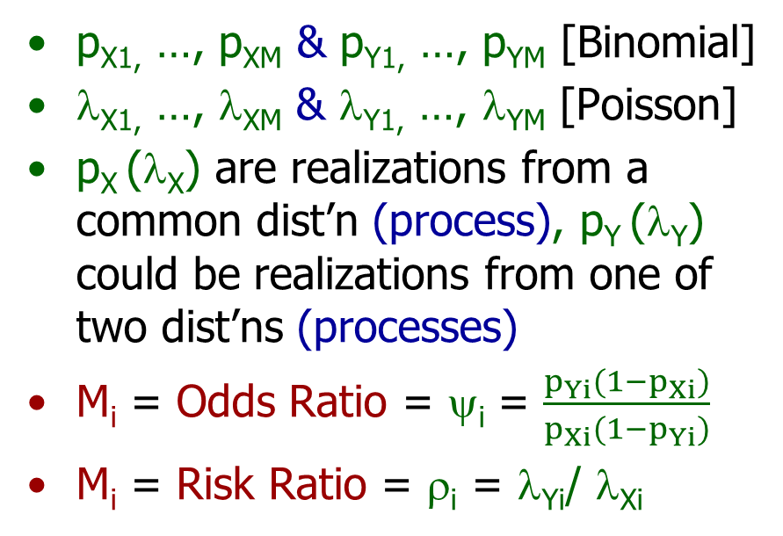
Outline of Method
Event counts X₁, …, X_{M}
(ctl) and Y₁, …, Y_{M} (test)
from Binomial or Poisson
Express group difference
by appropriate metric
Assume M_{i} values arise from one of two distns (processes)
p_{X1,} …, p_{XM} & p_{Y1,} …, p_{YM} [Binomial]
λ_{X1,} …, λ_{XM} & λ_{Y1,} …, λ_{YM} [Poisson]
p_{X} (λ_{X}) are realizations from a common dist’n (process), p_{Y} (λ_{Y}) could be realizations from one of two dist’ns (processes)
M_{i} = Odds Ratio = ψ_{i} = $\frac{p_{Yi}(1−p_{Xi})}{p_{Xi}(1−p_{Yi})}$
M_{i} = Risk Ratio = ρ_{i} = λ_{Yi}/ λ_{Xi}
For each i, calculate P_{i} = P_{post}(Same process) [= p_{SP} in tables]
Decide “Same Process” if P_{i} > ω

Slide 14
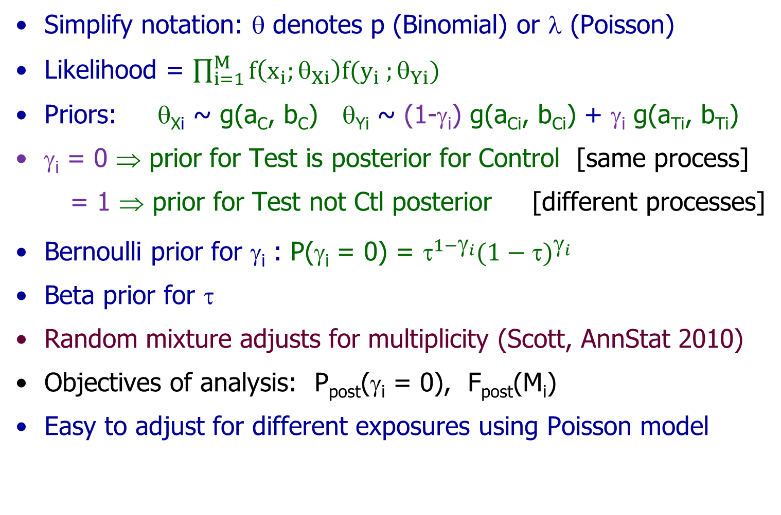
Bayesian Formulation
Simplify notation: θ denotes p (Binomial) or λ (Poisson)
Likelihood = $\prod_{i=1}^{M}{f\left(x_{i};θ_{Xi}\right)f(y_{i} ;θ_{Yi})}$
Priors: θ_{Xi} ~ g(a_{C}, b_{C}) θ_{Yi} ~ (1-γ_{i}) g(a_{Ci}, b_{Ci}) + γ_{i} g(a_{Ti}, b_{Ti})
γ_{i} = 0 ⇒ prior for Test is posterior for Control [same process]
= 1 ⇒ prior for Test not Ctl posterior [different processes]
Bernoulli prior for γ_{i} : P(γ_{i} = 0) = $^{1−_{i}}{(1−)}^{_{i}}$
Beta prior for τ
Random mixture adjusts for multiplicity (Scott, AnnStat 2010)
Objectives of analysis: P_{post}(γ_{i} = 0), F_{post}(M_{i})
Easy to adjust for different exposures using Poisson model

Slide 15
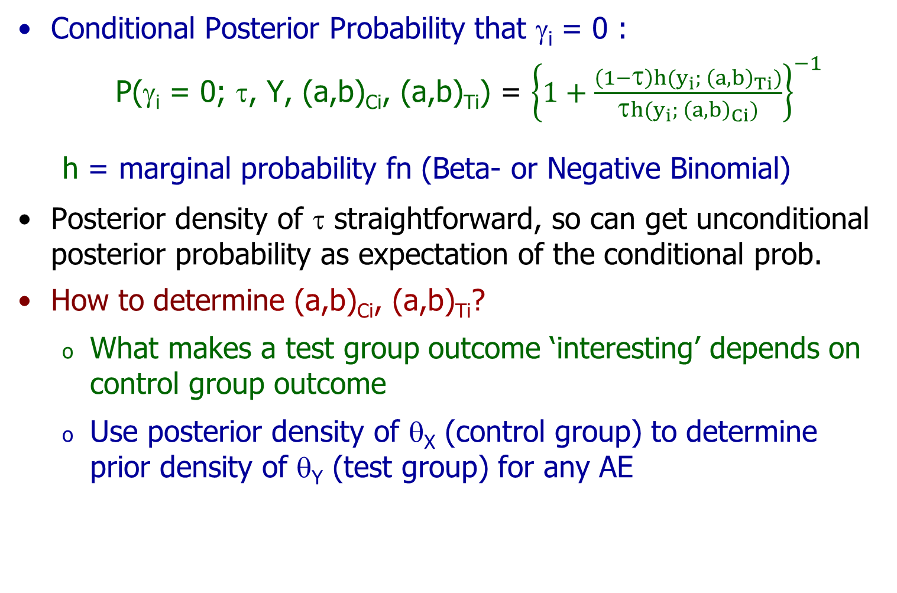
Posterior Probabilities
Conditional Posterior Probability that γ_{i} = 0 :
P(γ_{i} = 0; τ, Y, (a,b)_{Ci}, (a,b)_{Ti}) = ${\left\{1+\frac{\left(1−τ\right)h(y_{i}; {\left(a,b\right)}_{Ti})}{τh(y_{i}; {\left(a,b\right)}_{Ci})}\right\}}^{−1}$
h = marginal probability fn (Beta- or Negative Binomial)
Posterior density of τ straightforward, so can get unconditional posterior probability as expectation of the conditional prob.
How to determine (a,b)_{Ci}, (a,b)_{Ti}?
What makes a test group outcome ‘interesting’ depends on control group outcome
Use posterior density of θ_{X} (control group) to determine prior density of θ_{Y} (test group) for any AE
December 9, 2016 Bayes Screening for Adverse Events

Slide 16
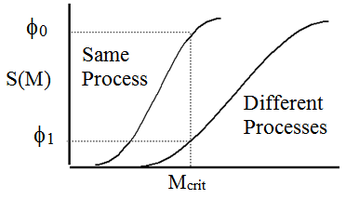
Choosing the Prior Parameters
Screening process defined by φ₀, φ₁, & M_{crit}
F_{M}(m) = prior cdf of M, depends on (a,b)
If same process, then
F_{M}(m_{i}) = F_{M} (m_{i}, (a,b)_{Ci}, (a,b)_{Ci})
F_{M}(m)
Require F_{M} (m_{crit}, (a,b)_{Ci}, (a,b)_{Ci}) ≥ φ₀
If different processes, then F_{M} (m_{i}) = F_{M} (m_{i}, (a,b)_{Ti}, (a,b)_{Ci})
Require F_{M} (m_{crit}, (a,b)_{Ti}, (a,b)_{Ci}) ≤ φ₁
Need additional condition for uniqueness:
Assume (a,b)_{Ci} such that E_{post}(θ_{i} ; (a,b)_{Ci} ) = x_{Ci} or x_{Ci} /n_{Ci}
Take b_{Ti} = b_{Ci} [arbitrary, but convenient]

Slide 17
Diagnostic Properties
For i-th event count pair, given ω,
D_{i} = 0 if P_{post}(γ_{i} = 0) > ω
D_{i} = 1 P_{post}(γ_{i} = 0) < ω
Given φ₀, φ₁, ω, (a,b)_{Ci} , (a,b)_{Ti} , & true value of γ_{i},
P(D_{i} = 1) = probability of (x, y) pairs for which D_{i} = 1
P(D_{i} = 0; γ_{i} = 0) = Specificity
P(D_{i} = 1; γ_{i} = 1) = Sensitivity
P(γ_{i} = 1; D_{i} = 0) = MDR (Missed Discovery Rate)
P(γ_{i} = 0; D_{i} = 1) = FDR
All of these can be calculated easily

Slide 18
Relationships Among Diagnostic Properties
Sensitivity & Specificity do not depend on prevalence
But FDR and MDR do depend on prevalence
Rare
Common
Rare
Common
Rare
Common
Rare
Common
Rare
Common
Rare
Common

Slide 19
Example 1 (Mehrotra & Heyse SMMR2004)

Slide 20
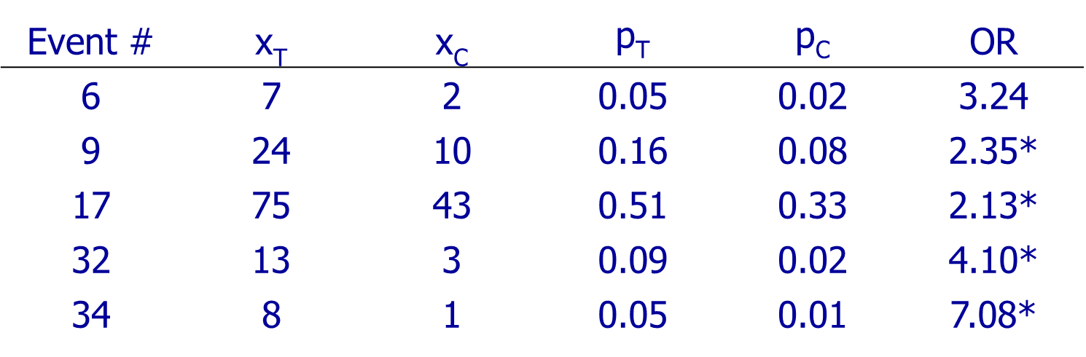
Excerpted Data
Adverse events from a study of a vaccine
Star identifies events with unadjusted p < 0.05
Only event 17 remained ‘significant’ after applying M&H
double FDR adjustment keeping FDR at 1% or less
Many more events, but none with ‘interesting’ odds ratios

Slide 21
Summary of Calculations
Findings with M* = 2 or 4 (p_{SP} only), φ₀ = 0.99, φ₁ = 0.15
p_{SP} = p(Same Process)
 |  |  |  | p_{SP} | p_{SP} | Posterior probability that OR <
Evnt | x_{T} | x_{C} | OR | (M*=2) | (M*=4) | 1 | 1.3 | 1.5 | 2
6 | 7 | 2 | 3.24 | 0.08 | 0.59 | 0.04 | 0.06 | 0.08 | 0.22
9 | 24 | 10 | 2.35 | 0.03 | 0.99 | 0.01 | 0.02 | 0.04 | 0.17
17 | 75 | 43 | 2.13 | 0.03 | > 0.99 | 0.01 | 0.03 | 0.04 | 0.17
32 | 13 | 3 | 4.10 | 0.01 | 0.08 | < 0.01 | 0.01 | 0.02 | 0.16
34 | 8 | 1 | 7.08 | 0.01 | 0.01 | < 0.01 | 0.01 | 0.02 | 0.16
Picked up rare events with large odds ratio values
Setting M* = 4 caused most events to pass the screen (because 2 is closer to 1 than to 4)
Magnitude of elevation not very high, put p_{SP} in context

Slide 22
Diagnostic Properties (1)
M & H control group data defined control gp parameters for Dx
Test gp params assumed to have true OR = 2
Dx properties depend on setting of tuning parameters
Sensitivity and FDR ↑ with φ₀ and ω
φ₀ = 0.99 |  |  | Sens |  |  | Spec |  |  | MDR |  |  | FDR
 |  |  | ω |  |  | ω |  |  | ω |  |  | ω
OR* | φ₁ | 0.01 | 0.1 | 0.2 | 0.01 | 0.1 | 0.2 | 0.01 | 0.1 | 0.2 | 0.01 | 0.1 | 0.2
2 | 0.05 | 0.86 | 0.89 | 0.89 | 0.76 | 0.71 | 0.68 | 0.12 | 0.11 | 0.10 | 0.27 | 0.31 | 0.32
2 | 0.15 | 0.87 | 0.90 | 0.91 | 0.77 | 0.70 | 0.68 | 0.12 | 0.11 | 0.10 | 0.25 | 0.29 | 0.31
2 | 0.25 | 0.87 | 0.90 | 0.91 | 0.77 | 0.70 | 0.67 | 0.13 | 0.11 | 0.11 | 0.23 | 0.27 | 0.29
4 | 0.05 | 0.72 | 0.75 | 0.76 | 0.83 | 0.80 | 0.79 | 0.05 | 0.04 | 0.04 | 0.63 | 0.66 | 0.67
4 | 0.15 | 0.75 | 0.79 | 0.80 | 0.82 | 0.78 | 0.76 | 0.07 | 0.06 | 0.06 | 0.52 | 0.55 | 0.57
4 | 0.25 | 0.76 | 0.80 | 0.82 | 0.81 | 0.77 | 0.75 | 0.08 | 0.07 | 0.07 | 0.46 | 0.50 | 0.51

Slide 23
Diagnostic Properties (2)
M & H control group data defined control gp parameters for Dx
Test gp params assumed to have true OR = 4
Dx properties depend on setting of tuning parameters
Sensitivity and FDR ↑ with φ₀ and ω
φ₀ = 0.99 |  |  | Sens |  |  | Spec |  |  | MDR |  |  | FDR
 |  |  | ω |  |  | ω |  |  | ω |  |  | ω
OR* | φ₁ | 0.01 | 0.1 | 0.2 | 0.01 | 0.1 | 0.2 | 0.01 | 0.1 | 0.2 | 0.01 | 0.1 | 0.2
2 | 0.05 | 0.96 | 0.97 | 0.97 | 0.76 | 0.71 | 0.68 | 0.04 | 0.04 | 0.03 | 0.25 | 0.29 | 0.30
2 | 0.15 | 0.96 | 0.97 | 0.97 | 0.77 | 0.70 | 0.68 | 0.04 | 0.03 | 0.03 | 0.23 | 0.27 | 0.29
2 | 0.25 | 0.96 | 0.97 | 0.98 | 0.77 | 0.70 | 0.67 | 0.04 | 0.03 | 0.03 | 0.21 | 0.26 | 0.27
4 | 0.05 | 0.86 | 0.88 | 0.89 | 0.83 | 0.80 | 0.79 | 0.02 | 0.02 | 0.02 | 0.59 | 0.62 | 0.63
4 | 0.15 | 0.88 | 0.91 | 0.91 | 0.82 | 0.78 | 0.76 | 0.03 | 0.03 | 0.03 | 0.48 | 0.52 | 0.53
4 | 0.25 | 0.89 | 0.92 | 0.93 | 0.81 | 0.77 | 0.75 | 0.04 | 0.03 | 0.03 | 0.43 | 0.46 | 0.48

Slide 24
Example 2 Large Vaccine Trial

Slide 25
Selected Screening Results
> 900 AEs reported in large vaccine trial
317 reported >2 times
Many duplicate event count pairs
is posterior median
Screen identified about 30 events
OR_{crit} = |  | 2 | φ₀ | 0.95 | 0.95 | 0.95 | 0.99 | 0.99 | 0.99
n_{C} = | n_{T} = |  | φ₁ | 0.05 | 0.1 | 0.2 | 0.05 | 0.1 | 0.2
363 | 734 | Odds |  | 0.87 | 0.87 | 0.86 | 0.86 | 0.85 | 0.84
x_{C} | x_{T} | Ratio |  | p_{SP} | p_{SP} | p_{SP} | p_{SP} | p_{SP} | p_{SP}
0 | 9 | 12 |  | 0.01 | 0.01 | 0.02 | 0.01 | 0.01 | 0.02
0 | 5 | 7 |  | 0.22 | 0.23 | 0.26 | 0.19 | 0.21 | 0.24
1 | 11 | 5.1 |  | 0.06 | 0.06 | 0.08 | 0.03 | 0.04 | 0.05
1 | 10 | 4.7 |  | 0.12 | 0.12 | 0.13 | 0.07 | 0.08 | 0.09
2 | 15 | 3.4 |  | 0.08 | 0.07 | 0.08 | 0.03 | 0.03 | 0.04
3 | 16 | 2.8 |  | 0.45 | 0.34 | 0.27 | 0.2 | 0.17 | 0.15
7 | 37 | 2.7 |  | 0.07 | 0.05 | 0.04 | 0.01 | 0.01 | 0.01
6 | 30 | 2.5 |  | 0.23 | 0.15 | 0.11 | 0.04 | 0.03 | 0.02
5 | 24 | 2.4 |  | 0.45 | 0.31 | 0.22 | 0.14 | 0.10 | 0.08
107 | 361 | 2.3 |  | 0.15 | 0.07 | 0 | 0 | 0 | 0
OR_{crit} = |  | 4 |  | p_{SP} | p_{SP} | p_{SP} | p_{SP} | p_{SP} | p_{SP}
0 | 9 | 12 |  | 0.05 | 0.05 | 0.05 | 0.01 | 0.01 | 0.01
0 | 8 | 11 |  | 0.14 | 0.12 | 0.11 | 0.03 | 0.03 | 0.02
64 | 293 | 3.11 |  | 1 | 1 | 0.93 | 1 | 0.95 | 0.51
107 | 361 | 2.32 |  | 1 | 1 | 1 | 1 | 1 | 1

Slide 26
Diagnostic Properties
Future trial of 400 pats in ctl, 800 on test, binom model
P(OR < 2) no more than 0.1 or 0.05 when different processes generate event rates for test
Parameters for future data same as for current data
 |  | φ₀ | 0.90 |  |  |  | 0.99
 | ω | φ₁ | 0.05 | 0.1 | 0.2 | 0.3 | 0.05 | 0.1 | 0.2 | 0.3
Sens | 0.001 |  | 0.85 | 0.85 | 0.84 | 0.82 | 0.92 | 0.92 | 0.93 | 0.93
 | 0.01 |  | 0.88 | 0.88 | 0.88 | 0.87 | 0.93 | 0.93 | 0.94 | 0.94
 | 0.05 |  | 0.89 | 0.90 | 0.91 | 0.91 | 0.94 | 0.94 | 0.95 | 0.95
 | 0.1 |  | 0.90 | 0.91 | 0.92 | 0.92 | 0.94 | 0.94 | 0.95 | 0.95
Spec | 0.001 |  | 0.83 | 0.83 | 0.84 | 0.86 | 0.78 | 0.78 | 0.79 | 0.79
 | 0.01 |  | 0.79 | 0.80 | 0.80 | 0.82 | 0.75 | 0.75 | 0.75 | 0.75
 | 0.05 |  | 0.77 | 0.77 | 0.77 | 0.77 | 0.73 | 0.73 | 0.73 | 0.73
 | 0.1 |  | 0.76 | 0.76 | 0.75 | 0.76 | 0.72 | 0.72 | 0.71 | 0.72
FDR | 0.001 |  | 0.63 | 0.60 | 0.56 | 0.50 | 0.59 | 0.57 | 0.55 | 0.52
 | 0.01 |  | 0.66 | 0.63 | 0.60 | 0.56 | 0.62 | 0.60 | 0.58 | 0.56
 | 0.05 |  | 0.67 | 0.66 | 0.63 | 0.60 | 0.63 | 0.62 | 0.60 | 0.58
 | 0.1 |  | 0.68 | 0.67 | 0.65 | 0.61 | 0.64 | 0.63 | 0.61 | 0.59
MDR | 0.001 |  | 0.02 | 0.02 | 0.03 | 0.03 | 0.02 | 0.02 | 0.02 | 0.02
 | 0.01 |  | 0.02 | 0.02 | 0.02 | 0.03 | 0.02 | 0.02 | 0.02 | 0.02
 | 0.05 |  | 0.02 | 0.02 | 0.02 | 0.02 | 0.01 | 0.01 | 0.01 | 0.02
 | 0.1 |  | 0.02 | 0.02 | 0.02 | 0.02 | 0.01 | 0.01 | 0.01 | 0.01

Slide 27
DISCUSSION

Slide 28
Perspective
Purpose
Likelihood that same process generates the test and control group event rates
Quantify the degree of risk increase, if any
If the alternative process distribution is sufficiently separated from the control group process distn, then likelihood of equal processes can be high even if the observed OR > 1
OK for a screening process
Minnows will slip through the net if we’re looking for whales
What constitute reasonable values for the screening process parameters needs further study
Quantifying risk helps avoid missing big problems

Slide 29
Value of Screening vs Hypothesis Testing
Screening directly addresses
the problem of characterizing
findings that need followup
Control group finding defines
an ‘interesting’ treatment
group effect
Important safety differences between treatments always need to be followed up, regardless of ‘significance’
Diagnostic properties can be expressed analytically –
Robustness to assumed & true choices of (a,b)_{C} and (a,b)_{T}
No hypotheses specified ⇒ no hypothesis testing, little/no opportunity for misinterpreting the findings
CONCLUSION: Bayesian screening a viable & useful alternative to hypothesis testing for evaluating safety in clinical trials
Can bring medical and
regulatory considerations
into safety evaluation
Can make the label reflect
clinical reality and reduce
the risk of statistical artifacts

Slide 30
Finally…
Method is superficially similar to simultaneous testing methods based on mixture models (q statistics, pFDR) – but there are some differences
In Bayesian context, look for posterior distribution of π₀ as a model parameter, not point estimate of fraction of p-values corresponding to ‘true’ null hypotheses
q-value & FDR-limiting approaches look to control number of false discoveries – important in context, but not for safety
Control of FDR is not a key objective
Generalizes to more complex screening cases
Possibly use to identify features (eg, gene sequences) affected differently by test and control treatment treatments

