Slide 1

Nonclinical Statistics Bayesian solutions @ AZ
Steven Novick
July, 2019
novicks@medimmune.com

Slide 2

Brief Bio
Ph.D. in Statistics from North Carolina State Univ. (2000)
99% classical/frequentist training
Schering-Plough (now Merck): 2000-2002, nonclinical
GSK 2002 – 2015, nonclinical, some clinical
AZ 2015 – present, Director, nonclinical statistics

Slide 3

https://community.amstat.org/biop/home
ASA-BIOP

Slide 4

https://community.amstat.org/biop/events/ncb/index
ASA-BIOP

Slide 5
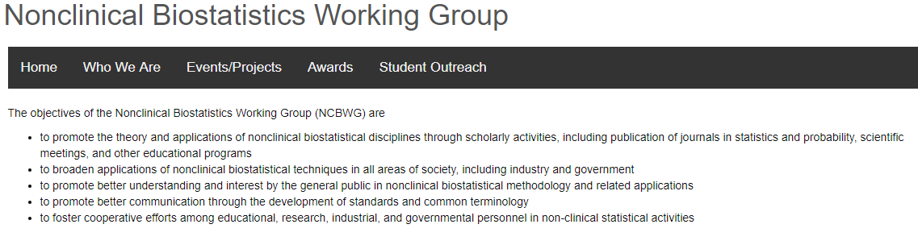
https://community.amstat.org/biop/workinggroups/ncbwg/index
ASA-BIOP
Work streams, coming soon:
Issues with p-values in nonclinical settings
Stan Altan & John Peterson
Bayesian statistics in nonclinical areas
Paul Faya

Slide 6
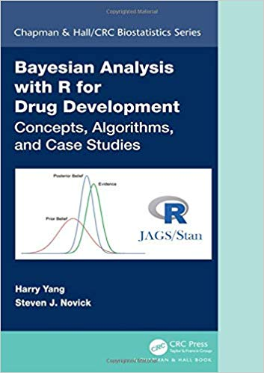
Bayesian credentials
Book: Bayesian Analysis with R for Drug Development
14 Bayesian or fiducial inference publications in peer-reviewed statistics journals since 2012
Chapter in upcoming book: Bayesian Methods in Pharmaceutical Research
Teach hands-on internal course:
JAGS, Stan
Yet, I have a lot to learn…

Slide 7
It’s ok to use frequentist methods
There are many situations in nonclinical statistical R&D for which Bayesian methods do not add value.
Bayesian inference may yield same conclusion as frequentist inference. Frequentist method often runs faster on computer.
Prior adds little value
Distribution of test statistic is well-known
Examples
Calibrated concentration using standard curves
Comparison of means of novel treatments with/without variance components

Slide 8
Bayesian methods can be more useful
Bayesian inference can be used to solve intractable frequentist problems
With small sample sizes, Bayesian inference is exact.
Calculation of complex probabilities
Pr( A is true & B is true & C is false )
Predictive inference is simple, regardless of the data distribution.
Prior may add value, allowing for either smaller sample size or higher power to make decision.

Slide 9
Examples: Nonclinical Biostats @ AZ
Preclinical drug discovery: Mouse survival
Bioassay: robustness
CMC: Bridging study

Slide 10
Disclaimer and other info
The examples have all been published in statistical journals (which are listed).
In some cases, the data and/or code are available with the publication. I am not providing data or computer code with these examples.
In real practice, when warranted, I do use informative priors. In these examples, I use vague or vaguely-informative priors.

Slide 11
Example #1
Animal oncology study
Survival analysis

Slide 12
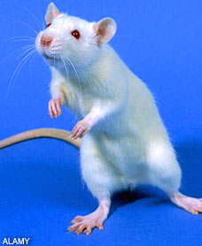
Animal oncology studies
Typically in mice or rats
Goals:
Reduce/delay tumor growth with chemotherapy and novel drug substances
Monotherapy or in combination.
Determine which treatments work “best”.

Slide 13
Oncology double-combination
60 syngeneic mice with tumors
6 Treatments (10 mice/trt)
3 monotherapy treatment groups: A, B, C
3 combinations: (A+B), (A+C), (B+C)
Tumor volume measured at baseline (day 10) and every 3-4 days until day 84.
Total # days = 74
Animal removed from study if Tumor Size > 2000 mm³ , severely ulcerating tumors, or > 20% loss in body weight.

Slide 14
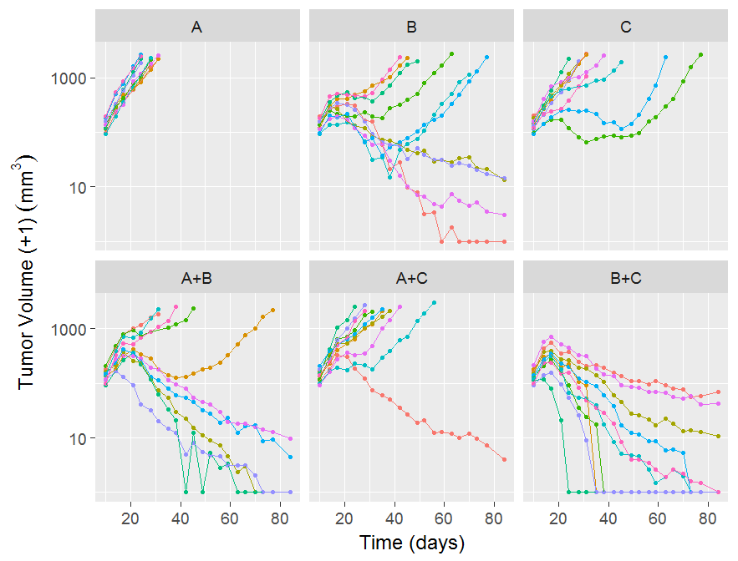
Tumor growth profiles
Cannot compare tumor volumes on the last day

Slide 15
Survival modeling
Model the time to an “event”.
For example, event:
Tumor volume > 2,000 mm³
Tumor ulcerates
Survival = have not experienced the event
Efficacy is defined through the probability of survival at time t.

Slide 16
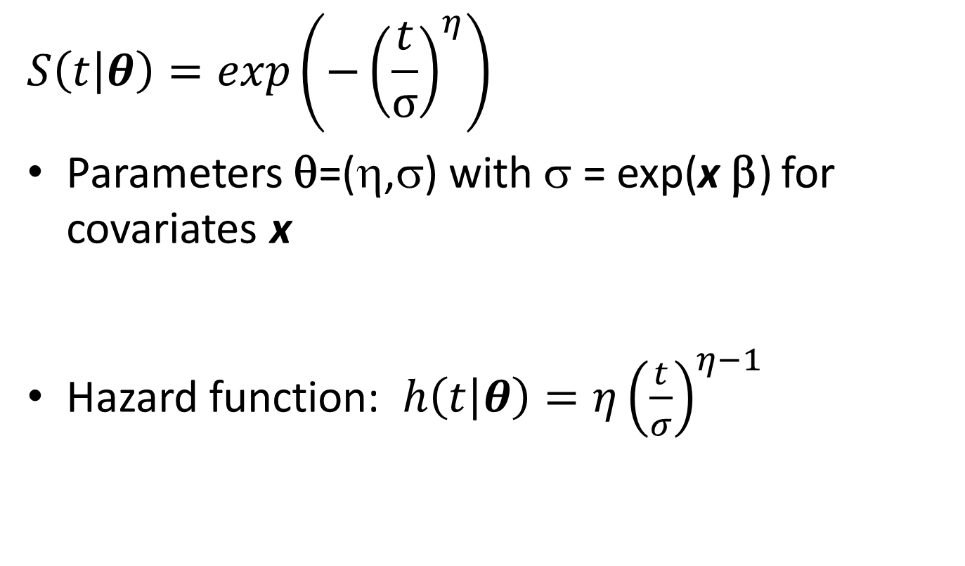
Weibull survival model
$$S\left(t | θ\right)=exp\left(−{\left(\frac{t}{σ}\right)}^{η}\right)$$
Parameters θ=(η,σ) with σ = exp(x β) for covariates x
Hazard function: $h\left(t | θ\right)=η{\left(\frac{t}{σ}\right)}^{η−1}$

Slide 17
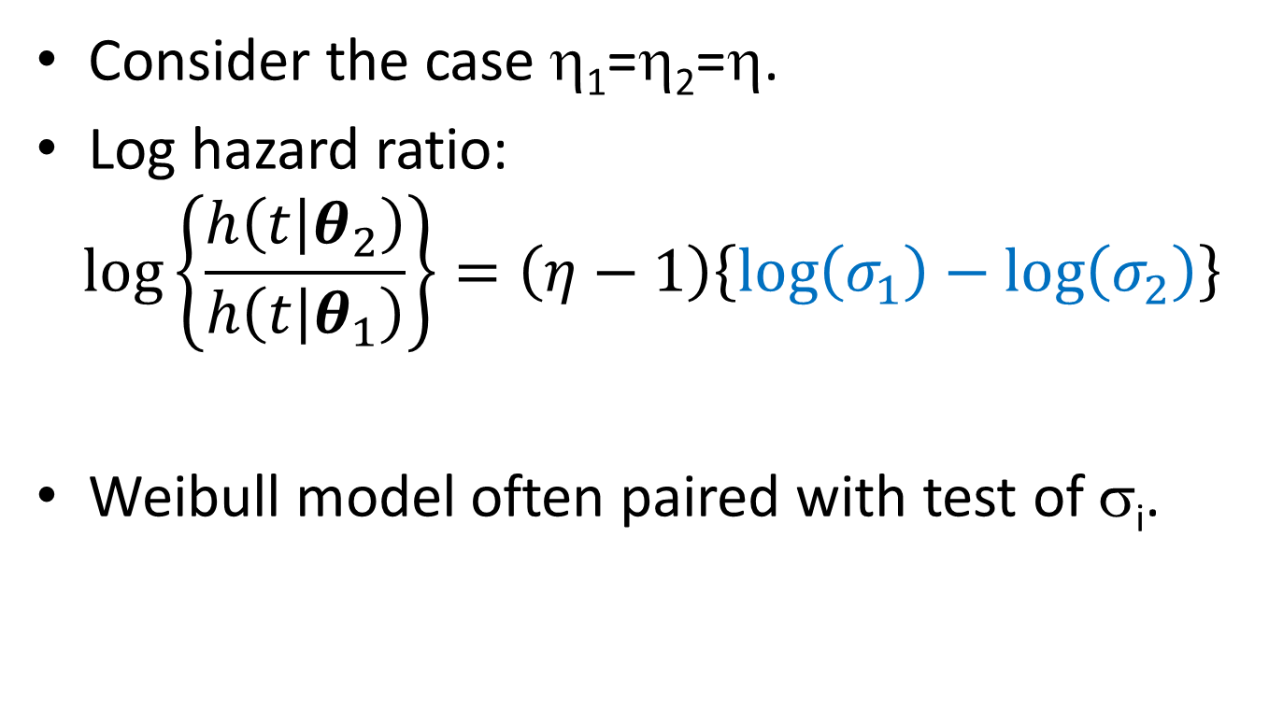
Consider the case η₁=η₂=η.
Log hazard ratio:
$$\log\left\{\frac{h\left(t | θ_{2}\right)}{h\left(t | θ_{1}\right)}\right\}=\left(η−1\right)\left\{\log\left(σ_{1}\right)−\log\left(σ_{2}\right)\right\}$$
Weibull model often paired with test of σ_{i}.

Slide 18
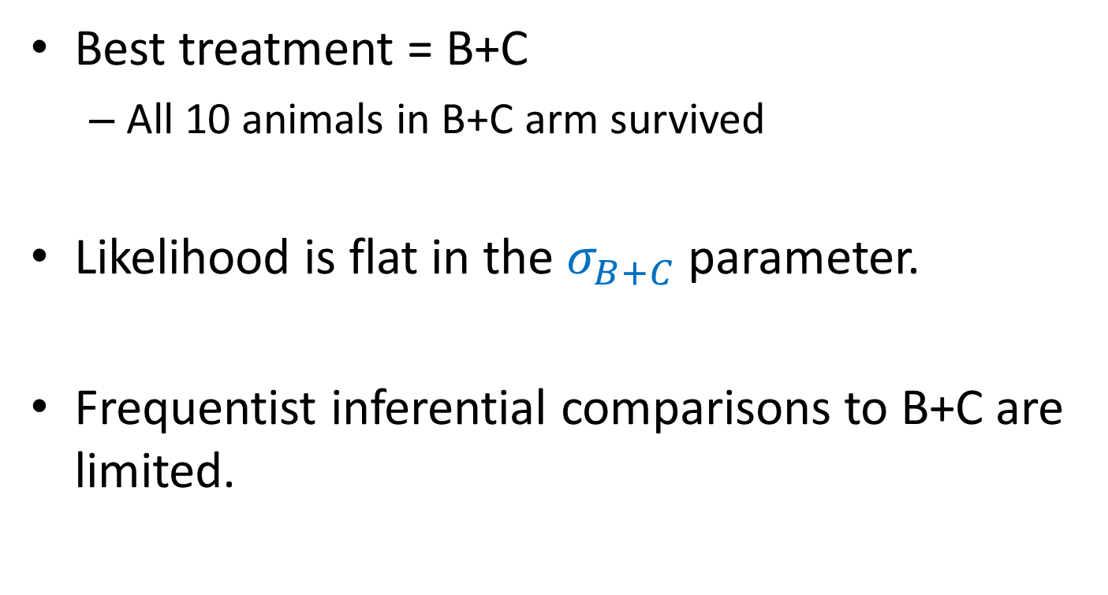
Problem with likelihood
Best treatment = B+C
All 10 animals in B+C arm survived
Likelihood is flat in the $σ_{B+C}$ parameter.
Frequentist inferential comparisons to B+C are limited.

Slide 19
Weibull Survival Likelihood
Trt | Est | SE
A | 2.89 | 0.15
B | 4.34 | 0.19
C | 3.54 | 0.15
A+B | 4.41 | 0.21
A+C | 3.61 | 0.16
B+C | 13.80 | 4160
Cannot compare hazards with B+C
log(σ)

Slide 20
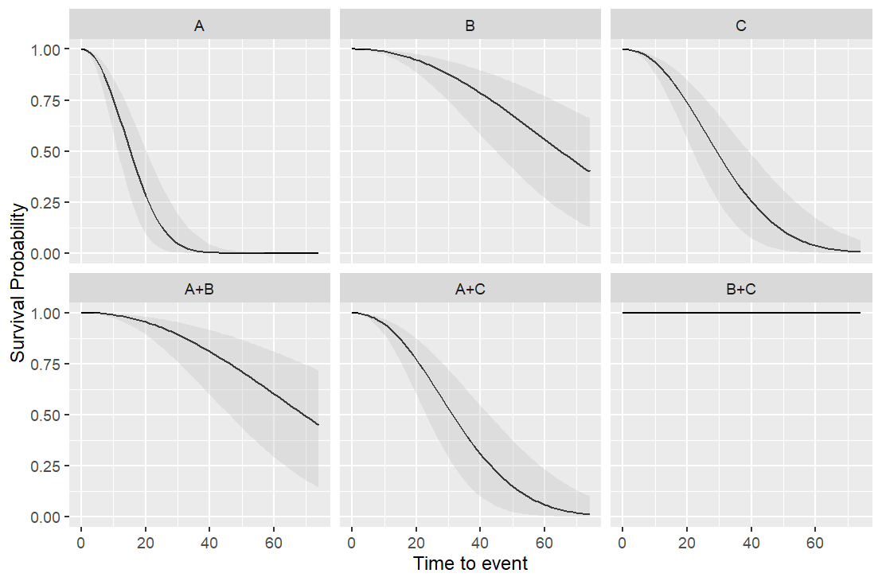
Weibull survival with 95% Confidence bands
Apparent ranking: {A} < {C, A+C} < {B, A+B} < {B+C}

Slide 21
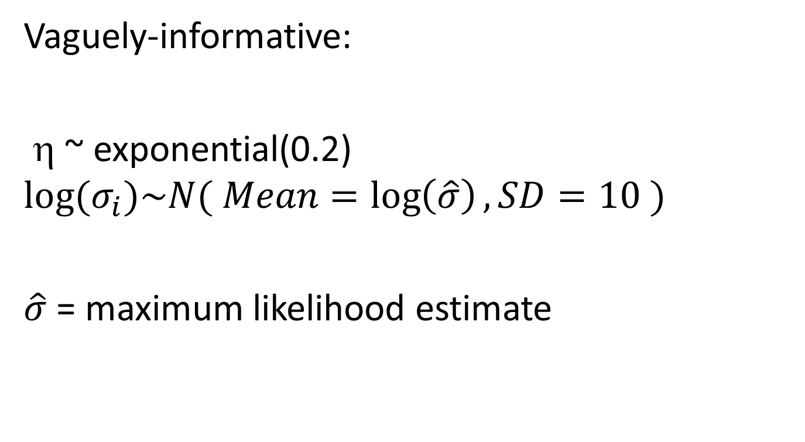
Prior distribution
Vaguely-informative:
η ~ exponential(0.2)
$$log⁡(σ_{i})\sim N( Mean=\log\left(\hat{σ}\right), SD=10 )$$
$\hat{σ}$ = maximum likelihood estimate
Some Bayesians may not like centering the distribution at the MLE; however, the SD is so large as to prevent the MLE from having impact. This is purely for MCMC convergence.
This prevents the distribution for B+C from extending unrealistically.

Slide 22
Weibull Survival Posterior
Trt | Median | SD
A | 2.90 | 0.17
B | 4.39 | 0.22
C | 3.54 | 0.17
A+B | 4.46 | 0.24
A+C | 3.62 | 0.17
B+C | 16.42 | 7.5
log(σ)

Slide 23
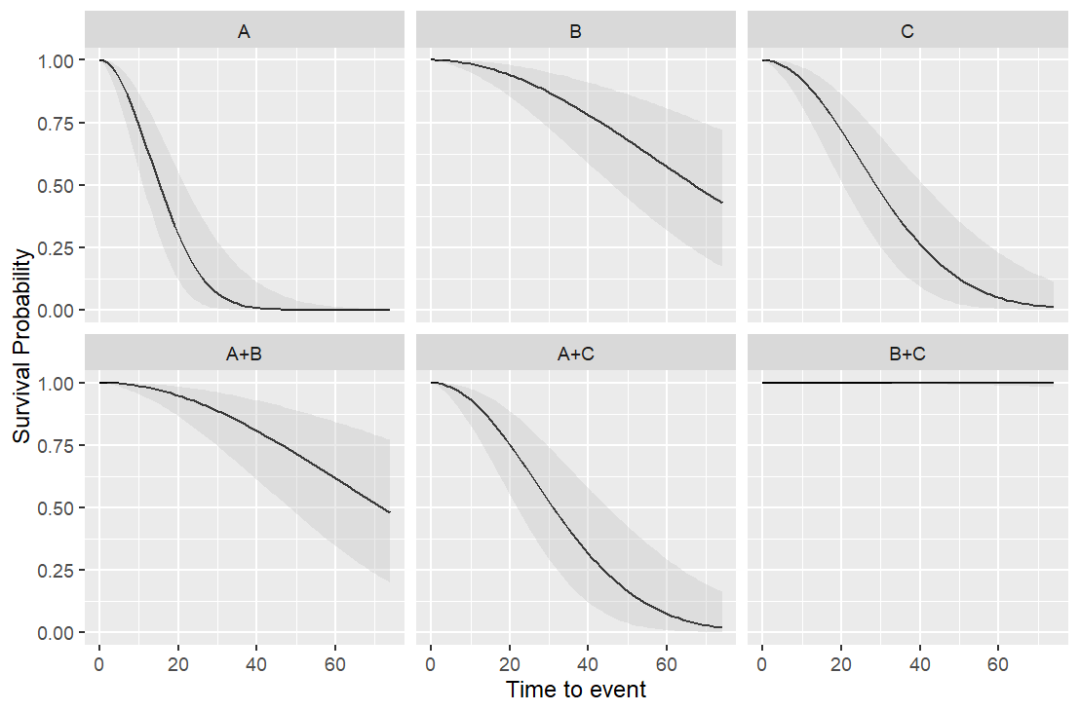
Weibull Model with 95% Credible bands

Slide 24
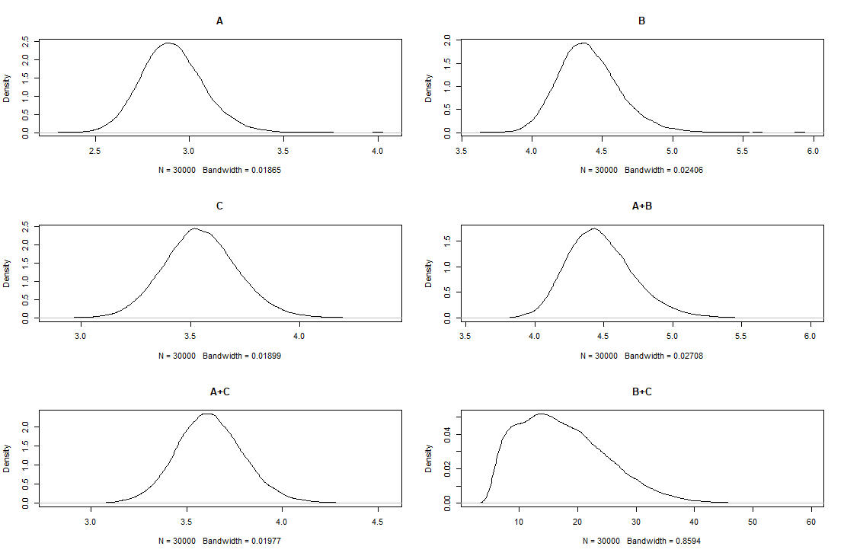
Posterior of log(σ) is skewed to the right*
Notes:
* Since the prior distribution was only vaguely informative, this implies that the true distribution of the likelihood estimates of log(σ) are also skewed to the right. Thus, the asymptotic normal-distribution approximation used in the likelihood analysis may not be valid.

Slide 25
Hazard ratio testing
Pr( σ_{j} > σ_{i} | data )
 | Prob |  |  | Prob
B > A | 1.00 |  | A+B > C | 1.00
C > A | 0.99 |  | A+C > C | 0.63
A+B > A | 1.00 |  | B+C > C | 1.00
A+C > A | 1.00 |  | A+C > A+B | 0.00
B+C > A | 1.00 |  | B+C > A+B | 1.00
C > B | 0.00 |  | B+C > A+C | 1.00
A+B > B | 0.59
A+C > B | 0.00
B+C > B | 1.00
Apparent ranking: {A} < {C, A+C} < {B, A+B} < {B+C}

Slide 26
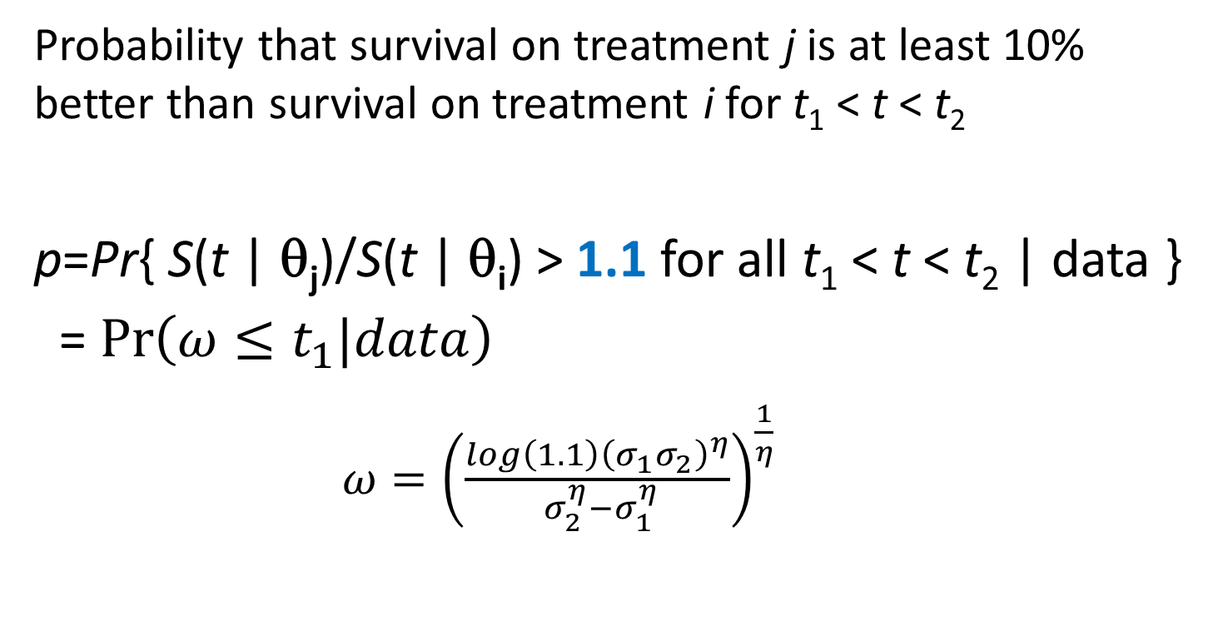
Try this with your likelihood
Probability that survival on treatment j is at least 10% better than survival on treatment i for t₁ < t < t₂
p=Pr{ S(t | θ_{j})/S(t | θ_{i}) > 1.1 for all t₁ < t < t₂ | data }
= $\operatorname{Pr}\left(ω≤t_{1}|data\right)$
${ω=\left(\frac{log\left(1.1\right){\left(σ_{1}σ_{2}\right)}^{η}}{ σ_{2}^{η}−σ_{1}^{η}}\right)}^{\frac{1}{η}}$
Steven J. Novick, Kris Sachsenmeier, Ching Ching Leow, Lorin Roskos & Harry Yang (2018) A Novel Bayesian Method for Efficacy Assessment in Animal Oncology Studies, Statistics in Biopharmaceutical Research, 10:3, 151-157, DOI: 10.1080/19466315.2018.1424649

Slide 27
Posterior probability that survival is at least 10% larger for 50 < t < 74 days (latter 1/3 of study times)
 | Prob |  |  | Prob
B > A | 1.00 |  | A+B > C | 1.00
C > A | 0.99 |  | A+C > C | 0.59
A+B > A | 1.00 |  | B+C > C | 1.00
A+C > A | 1.00 |  | A+C > A+B | 0.00
B+C > A | 1.00 |  | B+C > A+B | 0.99
C > B | 0.00 |  | B+C > A+C | 1.00
A+B > B | 0.41
A+C > B | 0.00
B+C > B | 1.00

Slide 28
Example #2
Bioassay robustness study

Slide 29
Our goal
Desire: Consistent, high-quality manufacture of a monoclonal antibody (mAb) drug
Goal: determine a design space (high-quality operating zone) for % purity and % fragments
This requires bivariate optimization.
Notes:
Monoclonal antibody drugs are treatments that enlist natural immune system functions to fight a disease (e.g., cancer, virus).
One factor in the immune system is the work of antibodies. An antibody attaches itself to a specific molecule (antigen) on the surface of a problematic cell. When an antibody binds to the antigen, it serves as a flag to attract disease-fighting molecules or as a trigger that promotes cell destruction by other immune system processes. Monoclonal antibodies are laboratory-produced molecules engineered to serve as substitute antibodies that can restore, enhance or mimic the immune system's attack on cancer cells. They are designed to bind to antigens that are generally more numerous on the surface of cancer cells than healthy cells. (https://www.mayoclinic.org/diseases-conditions/cancer/in-depth/monoclonal-antibody/art-20047808)
Humanized monoclonal antibody: A type of antibody made in the laboratory by combining a human antibody with a small part of a mouse or rat monoclonal antibody. The mouse or rat part of the antibody binds to the target antigen, and the human part makes it less likely to be destroyed by the body's immune system.

Slide 30
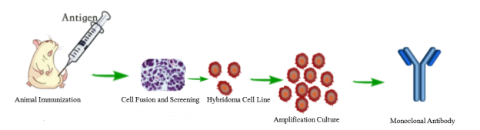
Steps to obtain humanized mAb

Slide 31
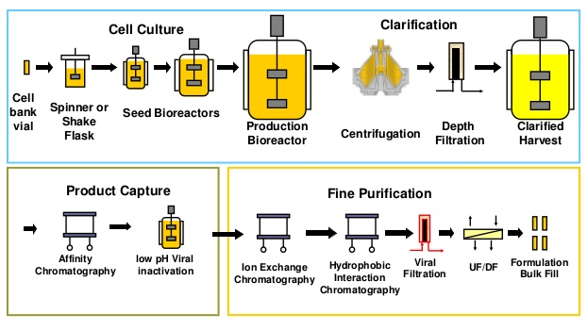
Manufacturing: Amplification and purification of mAb

Slide 32
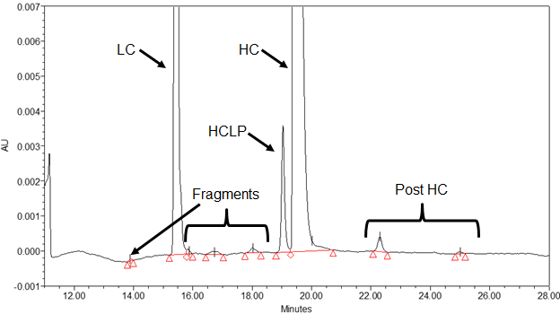
Measuring %Purity of drug substance
Bioassay: sodium-dodecyl sulfate capillary electrophoresis (CE-SDS) reducing assay
Notes:
Human immunoglobulins (IgG) consist of two identical glycosylated heavy chains (HC) and two identical light chains (LC). In the reducing assay, a substance (typically 2-ME or DTT) is used to break disulfide bridges, permitting better separation in CE-SDS gels. LCs are typically held together by one disulfide bond and HCs are held together by two or more bonds. We measure LC and HC separately, but add them together for LC+HC. We also measure fragments of LC and HC. Finally, we measure post-HC, which are likely HC=HC or HC=LC that remain bonded.
HCLP = heavy-chain leading peak, common in mAb. HCLP may be inactive and added with fragments and post-HC (impurities) or possibly active and combined with LC and HC (purity).

Slide 33
Measurements from CE-SDS bioassay
Y₁ = % LC + HC = % Purity
Y₂ = % Fragments
Y₃ = % Post-HC
Note that Y₁+Y₂+Y₃ = 100%
We want %Purity ≥ 97% and %Fragments ≤ 1.5%

Slide 34
Manufacturing parameters that affect %purity
Bioassay developers top three manufacturing parameters that affect % purity.
Sample buffer pH: 6 – 8
Heating temperature (ºC): 60 – 80
Heating time (minutes): 6 - 10

Slide 35
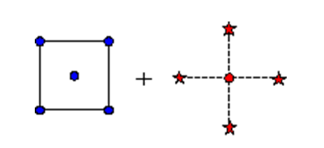
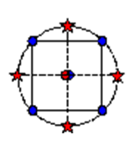
Experimental Design
Central Composite Design
=
Factorial
Star Points

Slide 36
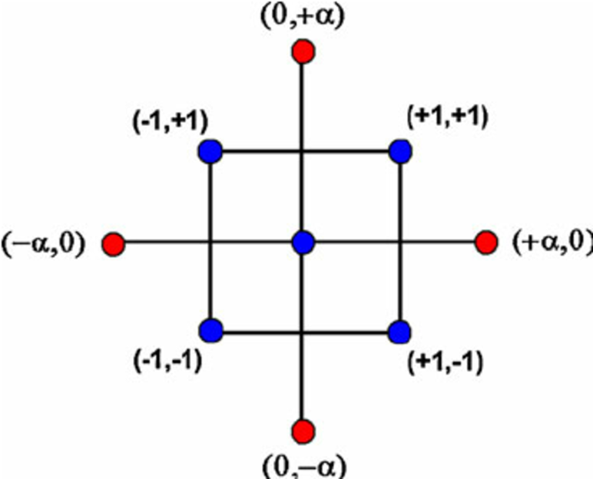
Central Composite Design

Slide 37
Central Composite Design
Run | X₁ | X₂
1 | -1 | -1 | Factorial
2 | -1 | +1
3 | +1 | -1
4 | +1 | +1
5 | 0 | -α | Stars
6 | -α | 0
7 | 0 | +α
8 | +α | 0
9 | 0 | 0 | Center
Y
y₁
Y₂
. . .
y₉
Center point is usually replicated

Slide 38
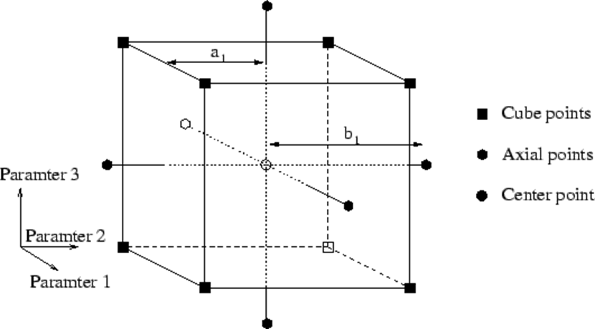
Central Composite Design in 3-D
Factorial
Star points
Center points

Slide 39
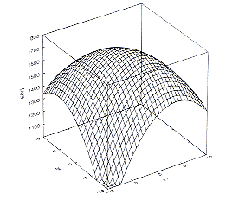
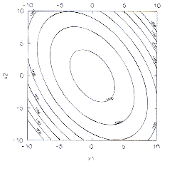
Quadratic response surface model
$$Y=a_{0}+a_{1}X_{1}+a_{2}X_{2}+a_{11}X_{1}^{2}+a_{22}X_{2}^{2}+a_{12}X_{1}X_{2}+error$$
Linear Terms
Interaction
Quadratic Terms
Y
X₂
Design space
X₂
X₁
X₁

Slide 40
Experimental Design: Each run repeated 3 times independently
Run | Sample Buffer pH | Heating Temperature | Heating Time
1 | 6.5 | 65 | 7 | Factorial
2 | 7.5 | 65 | 7
3 | 6.5 | 75 | 7
4 | 7.5 | 75 | 7
5 | 6.5 | 65 | 9
6 | 7.5 | 65 | 9
7 | 6.5 | 75 | 9
8 | 7.5 | 75 | 9
9 | 6 | 70 | 8 | Stars
10 | 7 | 60 | 8
11 | 7 | 70 | 6
12 | 7 | 70 | 8
13 | 8 | 70 | 8
14 | 7 | 80 | 8
15 | 7 | 70 | 10
16 | 7 | 70 | 8 | Center

Slide 41
What about purity?
Thresholds: %Purity ≥ 97%, %Fragments ≤ 1.5%
We wish to estimate the predictive probability
Pr( % Purity ≥ 97% and %Fragments ≤ 1.5% )
As recommended by Lonardo, et al (2017), we make the following transformations.
Z₁ = ln( [% Fragments] / [% (HC+LC)] )
Z₂ = ln( [% (Post HC)] / [% (HC+LC)] )
Lonardo, A, Saxena, P, and Srivastava (2017), A. “A new analysis class to ensure accurate and precision monoclonal antibody CQA estimation and control”, Biotechnology and Bioengineering, 114(9), 2001-2010.

Slide 42
Inverse transformation for Z₁ and Z₂?
Z₁ = ln( [% Fragments] / [% (HC+LC)] )
Z₂ = ln( [% (Post HC)] / [% (HC+LC)] )
The inverse transformations are:
% (HC+LC) = 1/(1+exp(Z₁)+exp(Z₂))
% Fragments = exp(Z₁)/(1+exp(Z₁)+exp(Z₂))
% (Post HC) = exp(Z₂)/(1+exp(Z₁)+exp(Z₂))

Slide 43
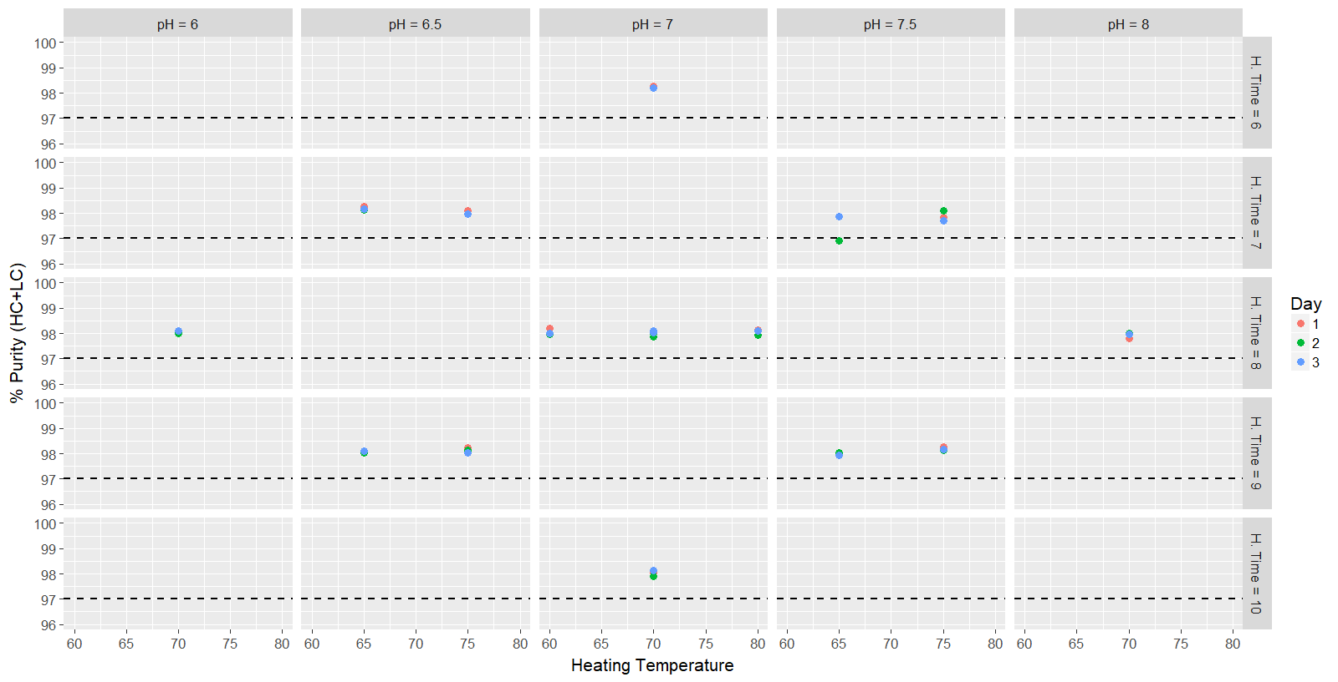

Slide 44
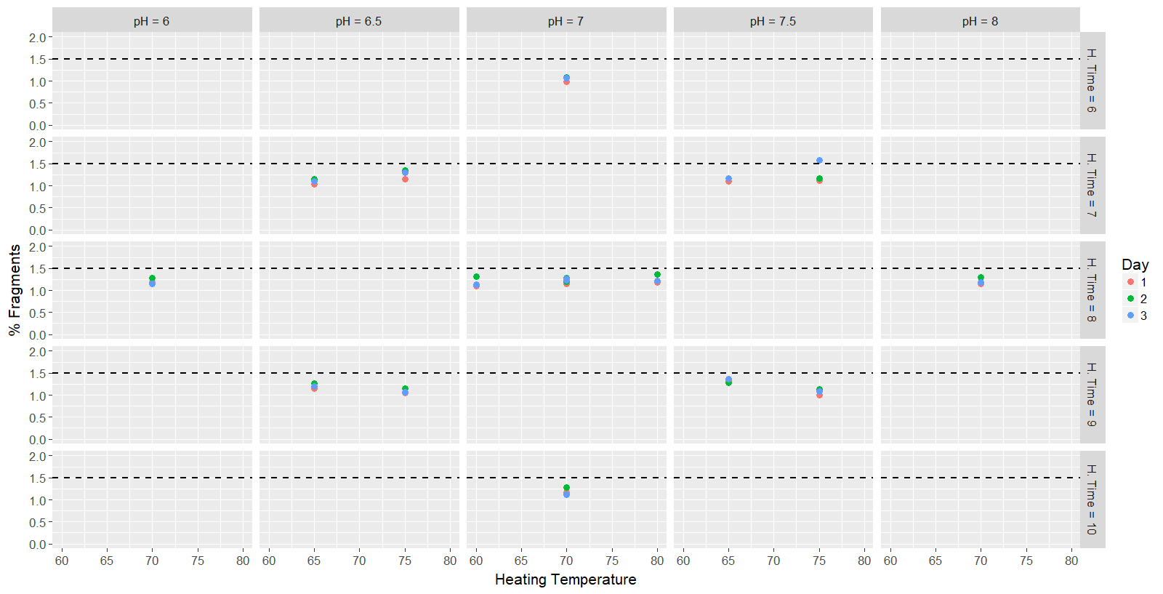

Slide 45
Typical frequentist approach
Fit quadratic RSM to Z₁
Fit quadratic RSM to Z₂
Calculate mean of Z₁ and Z₂ (and hence, Y₁, Y₂, and Y₃) and possible 95% Cis.
Create overlapping contour plots where the mean of Z₁ and mean of Z₂ (or the mean of Y₁, Y₂, and Y₃) are in an acceptable zone.
Could involve 95% confidence intervals

Slide 46
Bivariate quadratic model
We fit a quadratic response surface model simultaneously to (Z₁, Z₂).
We jointly estimated quadatric RSM parameters for Z₁ and Z₂ as well as the 2x2 variance-covariance matrix V.
Vague priors for RSM parameters
Vaguely-informative Inverse-Wishart prior for V
Using Bayesian statistical methods, we can estimate the probability
Pr( % Purity ≥ 97% and %Fragments ≤ 1.5% | data)
This would be very difficult with frequentist tools!

Slide 47
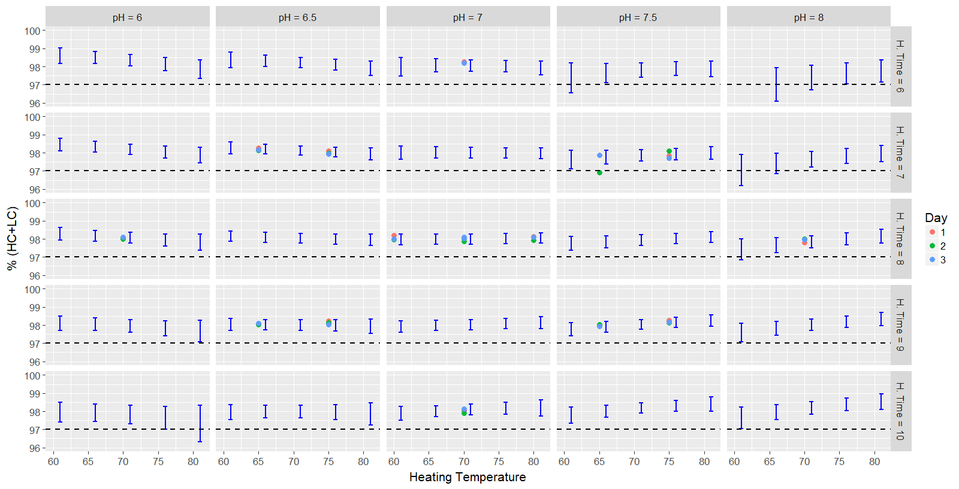
%Purity with 95% posterior prediction intervals

Slide 48
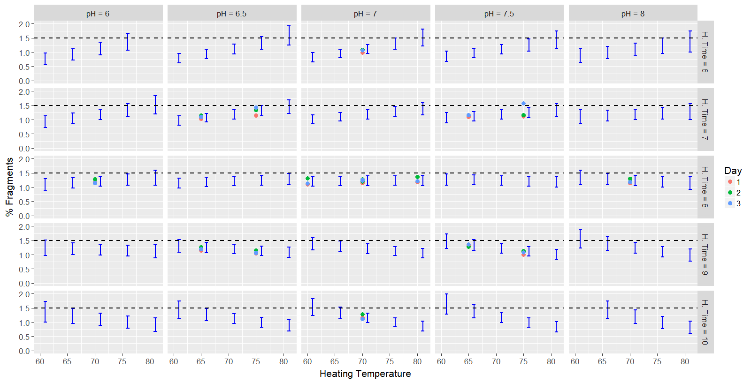
Fragments with 95% posterior prediction intervals

Slide 49
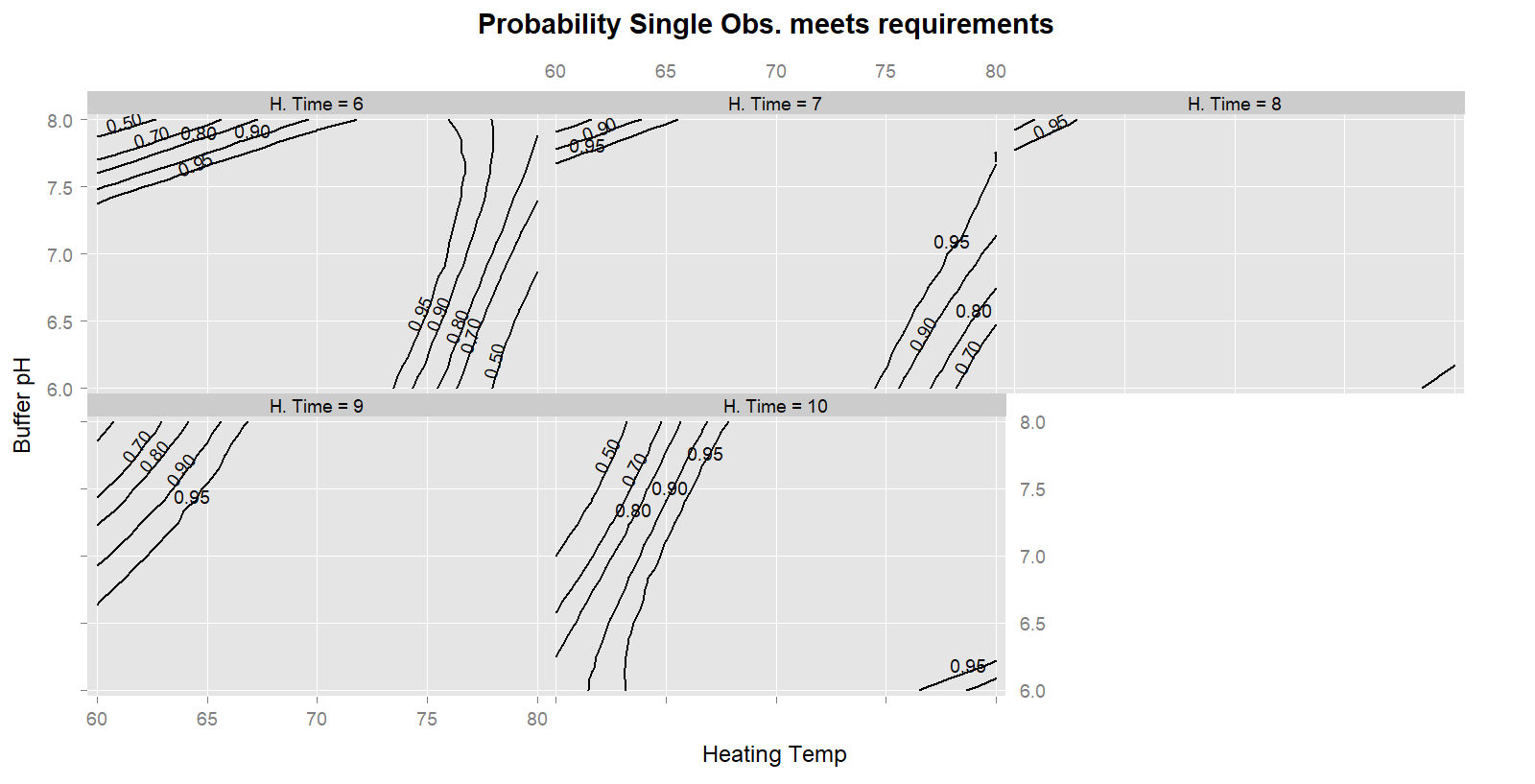
Probability that
%Purity ≥ 97%
%Fragments ≤ 1.5%

Slide 50
Example #3
Bridging study

Slide 51
Bridging study
In biopharmaceutical settings, methods and processes often undergo changes thanks to advances in technology.
Lower costs, increased efficiency, improved quality
Changes may directly or indirectly affect the safety, efficacy, or quality of drug substance or drug product.
Regulatory guidelines require demonstration of comparability before and post the change (FDA CFR 610.9(c), ICH Q5E, EMEA, 2007).

Slide 52
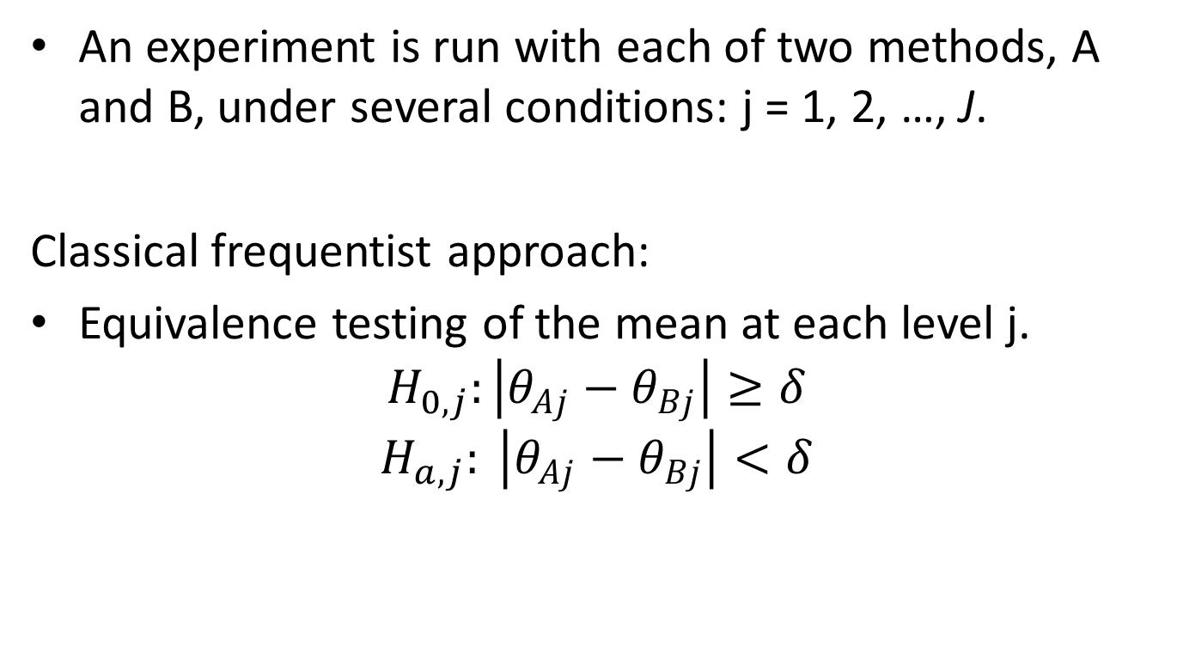
Classical bridging study
An experiment is run with each of two methods, A and B, under several conditions: j = 1, 2, …, J.
Classical frequentist approach:
Equivalence testing of the mean at each level j.
$$H_{0,j}:\left|θ_{Aj}−θ_{Bj}\right|≥δ$$
$$H_{a,j}: \left|θ_{Aj}−θ_{Bj}\right|<δ$$

Slide 53
Example data
Relative potency assay.
5 levels: 60%, 77, 100, 130, and 167%
Six independent runs per assay.
Relative potency is analyzed on log scale.
Testing limit: δ=log(1.3)

Slide 54
Bridging study data
Method | Assay Run | 60 | 77 | 100 | 130 | 167
HTRF Assay (A) | 1 | 51 | 67 | 90 | 130 | 153
 | 2 | 50 | 76 | 97 | 124 | 176
 | 3 | 55 | 70 | 99 | 142 | 157
 | 4 | 61 | 78 | 107 | 134 | 172
 | 5 | 60 | 75 | 101 | 126 | 160
 | 6 | 65 | 82 | 104 | 135 | 174
AP1 Reporter Gene Bioassay (B) | 1 | 64 | 71 | 95 | 127 | 151
 | 2 | 65 | 75 | 99 | 120 | 160
 | 3 | 66 | 87 | 106 | 138 | 180
 | 4 | 69 | 85 | 109 | 126 | 146
 | 5 | 55 | 76 | 95 | 135 | 155
 | 6 | 68 | 72 | 105 | 145 | 179
Lingmin Zeng, Steven Novick, Binbing Yu & Harry Yang (2019) General Framework for Equivalence Testing over a Range of Linear Outcomes with CMC Applications, Statistics in Biopharmaceutical Research, 11:2, 182-190, DOI: 10.1080/19466315.2018.1470029

Slide 55
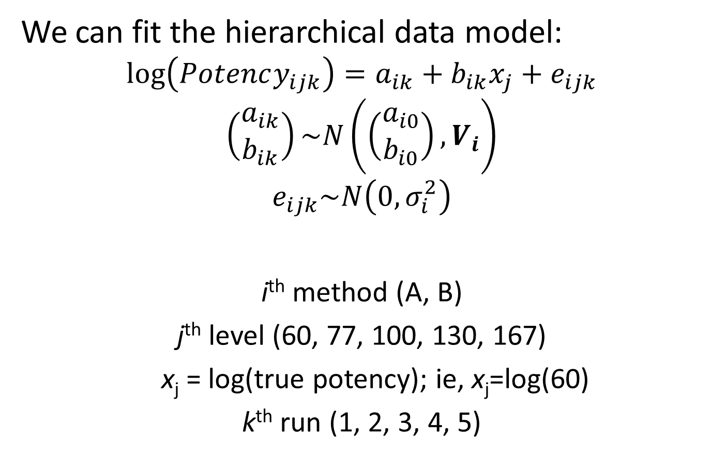
Potency assays are generally linear
We can fit the hierarchical data model:
$$\log\left(Potency_{ijk}\right)=a_{ik}+b_{ik}x_{j}+e_{ijk}$$
$$\left(\begin{matrix}a_{ik} \\ b_{ik}\end{matrix}\right)\sim N\left(\left(\begin{matrix}a_{i0} \\ b_{i0}\end{matrix}\right), V_{i}\right)$$
$$e_{ijk}\sim N\left(0, σ_{i}^{2}\right)$$
i^{th} method (A, B)
j^{th} level (60, 77, 100, 130, 167)
x_{j} = log(true potency); ie, x_{j}=log(60)
k^{th} run (1, 2, 3, 4, 5)

Slide 56
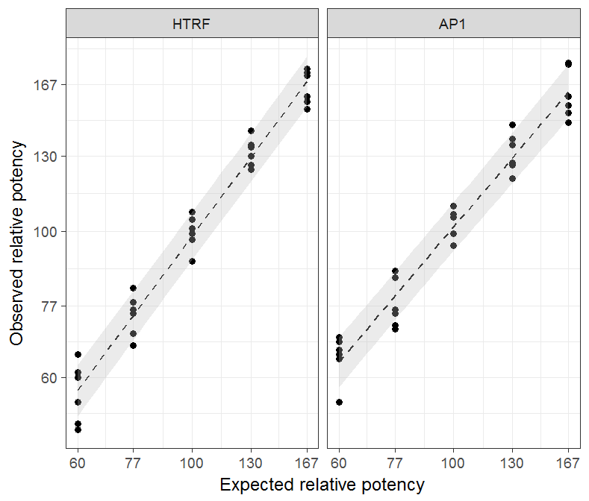
Linear fits with 95% credible intervals

Slide 57
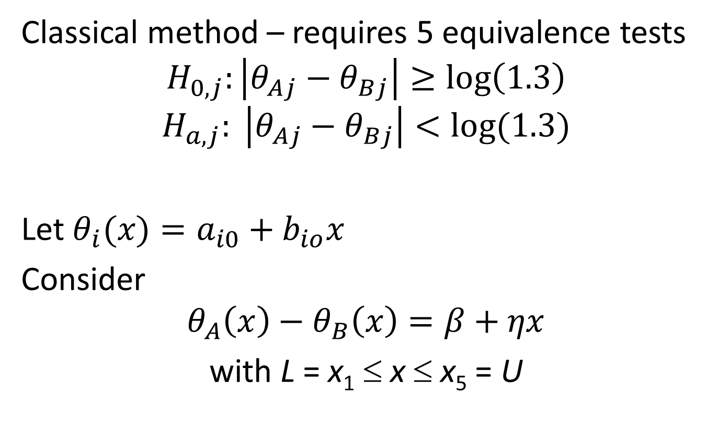
Better hypotheses
Classical method – requires 5 equivalence tests
$$H_{0,j}:\left|θ_{Aj}−θ_{Bj}\right|≥\log\left(1.3\right)$$
$$H_{a,j}: \left|θ_{Aj}−θ_{Bj}\right|<log⁡(1.3)$$
Let $θ_{i}(x)=a_{i0}+b_{io}x$
Consider
$$θ_{A}\left(x\right)−θ_{B}\left(x\right)=β+ηx$$
with L = x₁ ≤ x ≤ x₅ = U

Slide 58
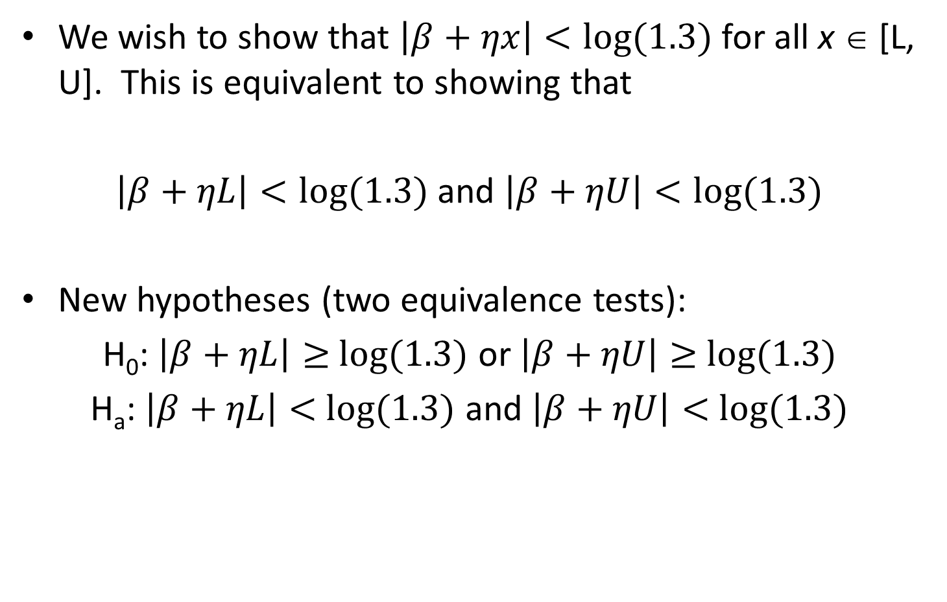
We wish to show that $\left|β+ηx\right|<log⁡(1.3)$ for all x ∈ [L, U]. This is equivalent to showing that
$\left|β+ηL\right|<log⁡(1.3)$ and $\left|β+ηU\right|<log⁡(1.3)$
New hypotheses (two equivalence tests):
H₀: $\left|β+ηL\right|≥$ $log⁡(1.3)$ or $\left|β+ηU\right|≥$ $log⁡(1.3)$
H_{a}: $\left|β+ηL\right|<$ $log⁡(1.3)$ and $\left|β+ηU\right|<$ $log⁡(1.3)$

Slide 59
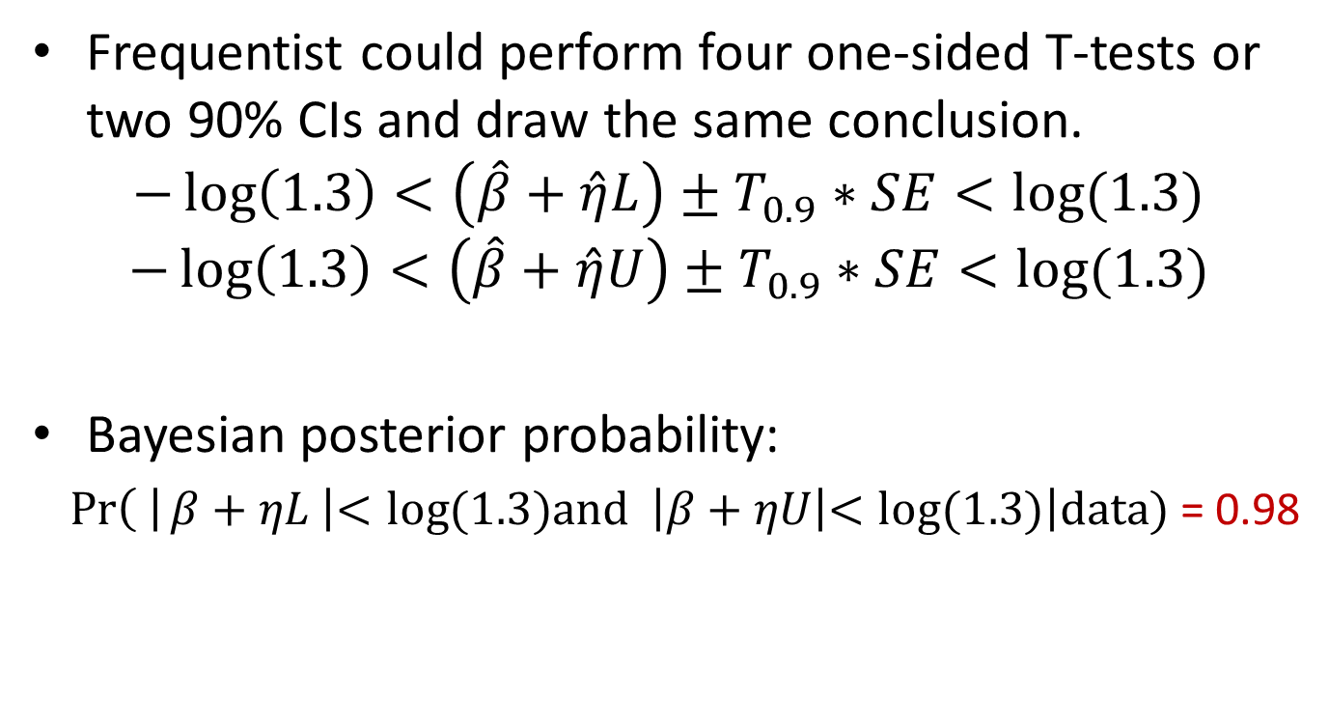
Bayesian or frequentist method
Frequentist could perform four one-sided T-tests or two 90% CIs and draw the same conclusion.
$$−\log\left(1.3\right)<\left(\hat{β}+\hat{η}L\right)±T_{0.9}∗SE<log⁡(1.3)$$
$$−\log\left(1.3\right)<\left(\hat{β}+\hat{η}U\right)±T_{0.9}∗SE<log⁡(1.3)$$
Bayesian posterior probability:
$\operatorname{Pr}\left( \right|β+ηL \left|<log⁡(1.3)and \right|β+ηU\left|<log⁡(1.3)\right|data)$ = 0.98

Slide 60
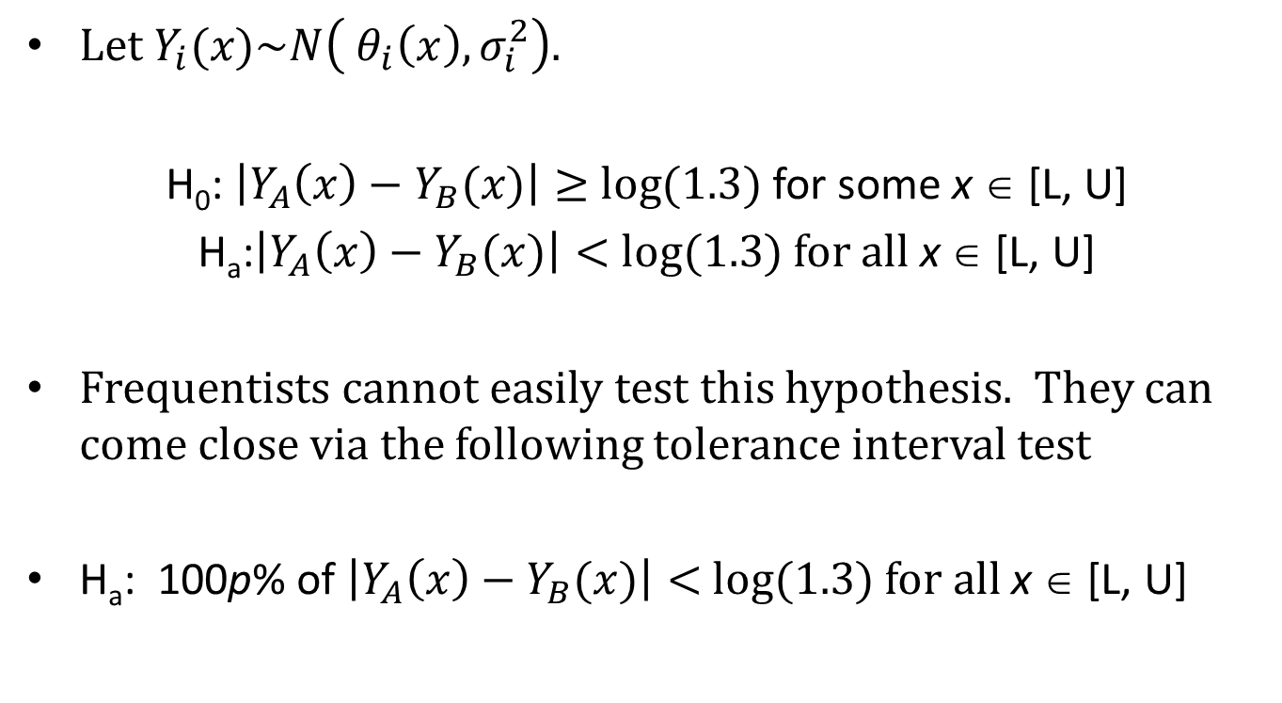
Bayes: Total error approach
Let $Y_{i}(x)\sim N\left( θ_{i}\left(x\right), σ_{i}^{2}\right)$.
H₀: $\left|Y_{A}\left(x\right)−Y_{B}(x)\right|≥$ $log⁡(1.3)$ for some x ∈ [L, U]
H_{a}:$\left|Y_{A}\left(x\right)−Y_{B}(x)\right|<$ $log⁡(1.3)$ for all x ∈ [L, U]
Frequentists cannot easily test this hypothesis. They can come close via the following tolerance interval test
H_{a}: 100p% of $\left|Y_{A}\left(x\right)−Y_{B}(x)\right|<$ $log⁡(1.3)$ for all x ∈ [L, U]

Slide 61
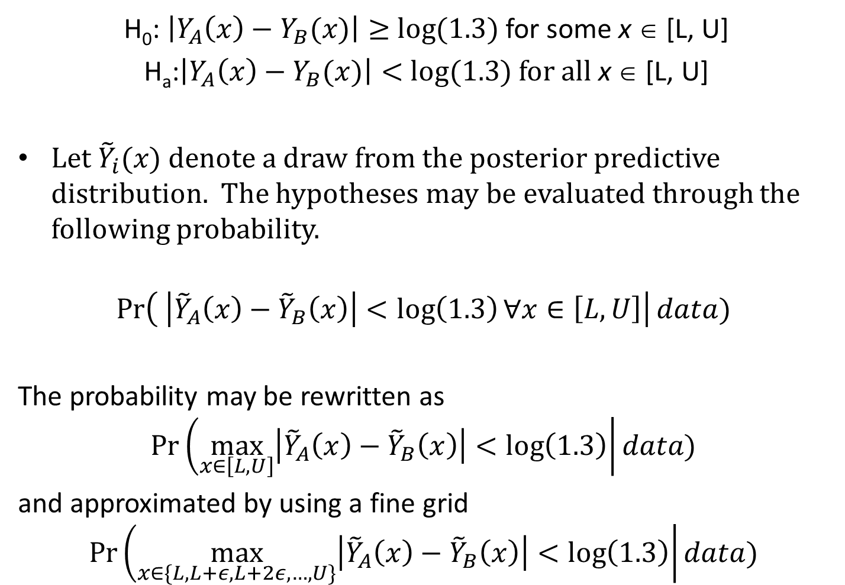
H₀: $\left|Y_{A}\left(x\right)−Y_{B}(x)\right|≥$ $log⁡(1.3)$ for some x ∈ [L, U]
H_{a}:$\left|Y_{A}\left(x\right)−Y_{B}(x)\right|<$ $log⁡(1.3)$ for all x ∈ [L, U]
Let ${\tilde{Y}}_{i}(x)$ denote a draw from the posterior predictive distribution. The hypotheses may be evaluated through the following probability.
$$\operatorname{Pr}\left( \left|{\tilde{Y}}_{A}\left(x\right)−{\tilde{Y}}_{B}\left(x\right)\right|<\log\left(1.3\right)∀x∈\left[L,U\right]\right|data)$$
The probability may be rewritten as
$$\operatorname{Pr}\left(\max_{x∈\left[L,U\right]}\left|{\tilde{Y}}_{A}\left(x\right)−{\tilde{Y}}_{B}\left(x\right)\right|<\log\left(1.3\right)\right|data)$$
and approximated by using a fine grid
$$\operatorname{Pr}\left(\max_{x∈\{L, L+ε, L+2ε, …, U\}}\left|{\tilde{Y}}_{A}\left(x\right)−{\tilde{Y}}_{B}\left(x\right)\right|<\log\left(1.3\right)\right|data)$$

Slide 62
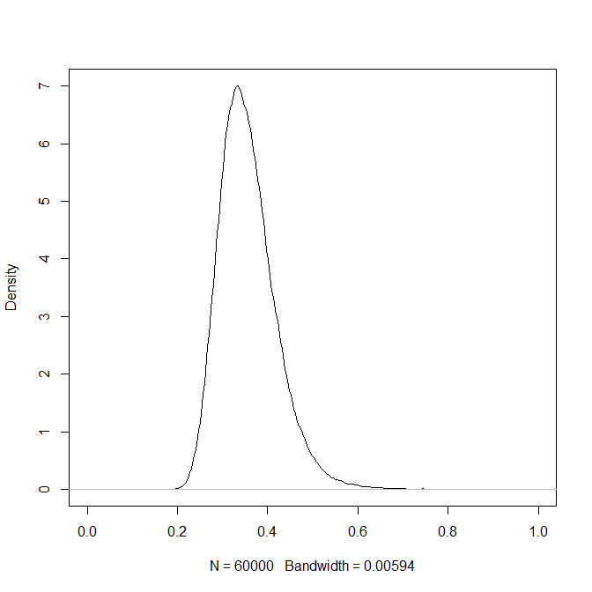
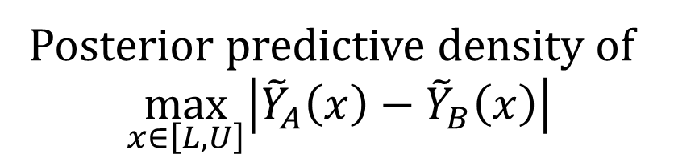
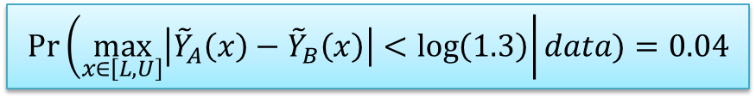
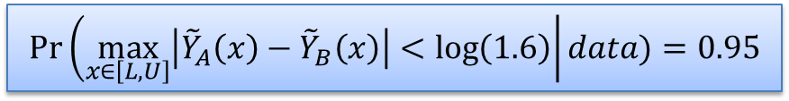
Posterior predictive density of
$$\max_{x∈\left[L,U\right]}\left|{\tilde{Y}}_{A}\left(x\right)−{\tilde{Y}}_{B}\left(x\right)\right|$$
log(1.3)
log(1.6)
95% quantile = 0.47
exp(95% quantile) = 1.6
$$\operatorname{Pr}\left(\max_{x∈\left[L,U\right]}\left|{\tilde{Y}}_{A}\left(x\right)−{\tilde{Y}}_{B}\left(x\right)\right|<\log\left(1.6\right)\right|data)=0.95$$
$$\operatorname{Pr}\left(\max_{x∈\left[L,U\right]}\left|{\tilde{Y}}_{A}\left(x\right)−{\tilde{Y}}_{B}\left(x\right)\right|<\log\left(1.3\right)\right|data)=0.04$$

Slide 63
Summary
Bayesian methods
Have an important function inside nonclinical biostatistics
Facilitate direct testing of hypotheses
Allow exploration of more interesting hypotheses
Ergo, permit better scientific/business decisions

Slide 64


