Slide 1
Leveraging External Evidence in Medical Device Decision-Making CDRH/OCEA/DCEA 2 (Division of Biostatistics) Ram Tiwari, Ph.D. DIA BSWG KOL Presentation, November 20, 2020

Slide 2
Outline
CDRH Re-organization/Division Re-Org
Background
MDIC External Evidence Methods Framework
Examples of approved devices using external evidence
Power Prior and Composite Likelihood Methods
Propensity-score integrated methods
Comments; and Q&A

Slide 3
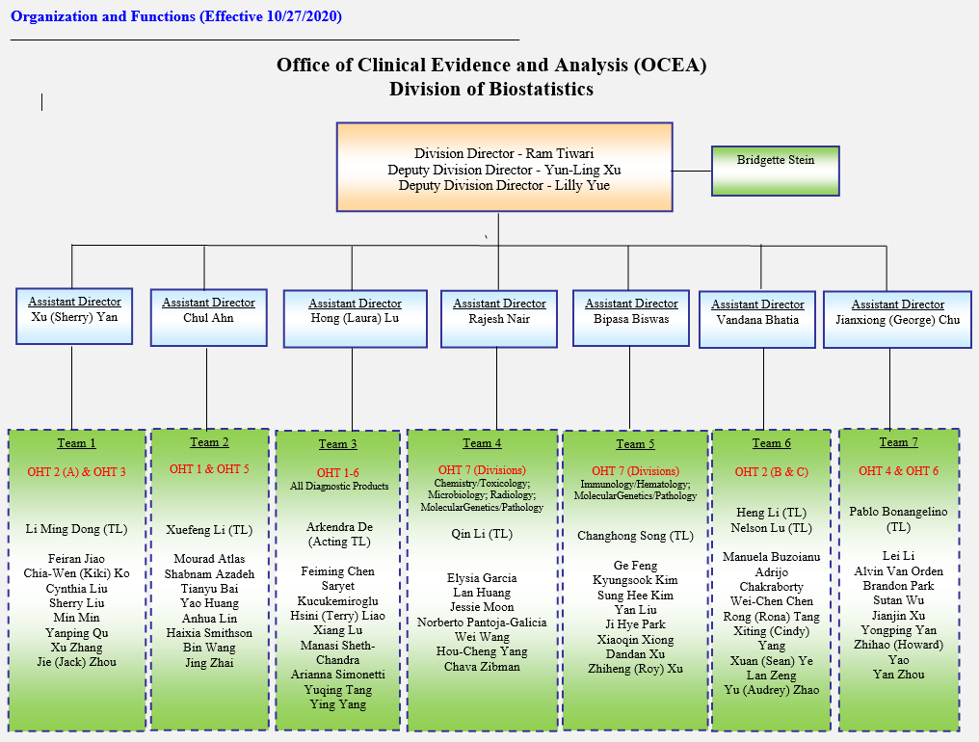

Slide 4
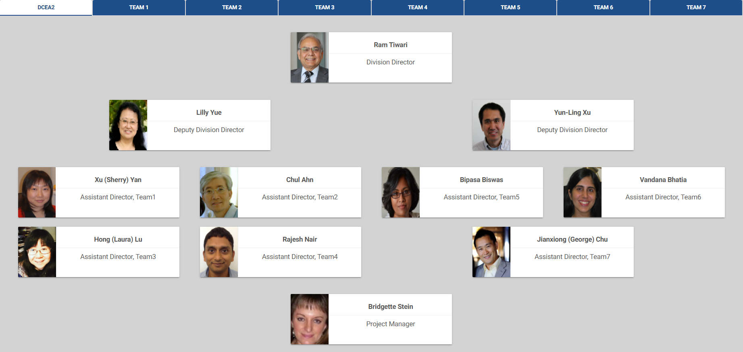

Slide 5
CDRH Streamlining Clinical Data Generation
Over the past decade, CDRH has implemented processes and collaborated externally to streamline and support innovation as part of clinical evidence generation:
Develop legislative, policy, and guidances
Improve regulatory efficiency and predictability
Develop MDIC EFS clinical trial site network
Collaborate on in silico Clinical Trials
Support real-world data collection and analysis
Create the NEST coordinating center

Slide 6




Context for Real-World Evidence
FDA Reauthorization Act (FDARA) including MDUFA IV commitment to use of real-world evidence to support device pre/postmarket decisions
21st Century Cures Act
National Evaluation System for health Technology (NEST)
Guidance issued to clarify how RWE may be used to support regulatory decisions
Notes:
With the enactment of the 21st Century Cures Act, FDA’s MDUFA IV Commitments and CDRH strategic priorities, FDA committed to evaluating the potential use of RWD, to help support the approval of a new indication of medical product and to help support or satisfy post-approval study requirements.
In 2017, FDA issued final guidance to describe how real-world evidence may be used to support pre- and postmarket regulatory decision making and the factors the Agency and industry should use to determine whether or not real-world evidence is fit-for-purpose to support a particular pre- or postmarket decision.
The guidance defines:
Real-World Data (RWD) as data relating to patient health status and/or the delivery of health care routinely collected from a variety of sources.

Slide 7
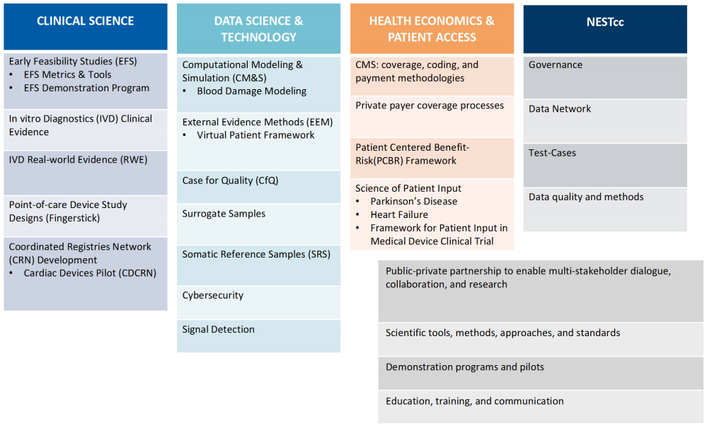
Collaborations with Medical Device Innovation Consortium (MDIC)

Slide 8
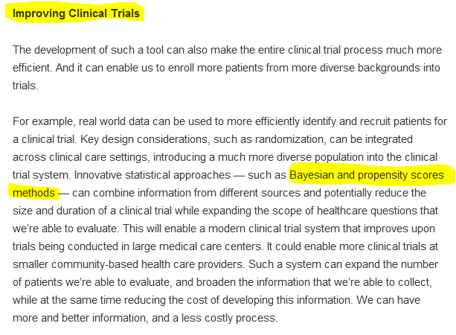
FDA Voice by Former Commissioner Scott Gottlieb, M.D.
Notes:
Former FDA commissioner Dr. Scott Gotlieb, blog discusses using innovative statistical approaches such as Bayesian and Propensity score methodology to combine information from different sources
https://blogs.fda.gov/fdavoice/index.php/2018/07/fda-budget-matters-a-cross-cutting-data-enterprise-for-real-world-evidence

Slide 9
External Evidence Methods (EEM) Program
Program launched formally in April 2019 (Executives & Fellows workshop)
Aims to establish a predictable pathway for use of external evidence in pre-market submissions
Develop an EEM Framework
MDIC EEM survey – June 2020
Notes:
Former FDA commissioner Dr. Scott Gotlieb, blog discusses using innovative statistical approaches such as Bayesian and Propensity score methodology to combine information from different sources
https://blogs.fda.gov/fdavoice/index.php/2018/07/fda-budget-matters-a-cross-cutting-data-enterprise-for-real-world-evidence

Slide 10
EEM Framework: Scope
Categorize different sources of external data
Catalog existing statistical methods for leveraging external data
Include examples to illustrate use of statistical methodology
Identify gaps in application and development of statistical methods
Notes:
Former FDA commissioner Dr. Scott Gotlieb, blog discusses using innovative statistical approaches such as Bayesian and Propensity score methodology to combine information from different sources
https://blogs.fda.gov/fdavoice/index.php/2018/07/fda-budget-matters-a-cross-cutting-data-enterprise-for-real-world-evidence

Slide 11
External Evidence Methods (EEM) Project
Project launched formally in April 2019 (Executives & Fellows workshop)
Builds & expands on the success of Virtual Patient Project
Aims to establish a more predictable pathway for use of EEM
Ultimately, reducing time and cost to answer important questions

Slide 12
Definition
External Data
Data external to the planned clinical study (from alternative sources)
External Evidence
Clinical evidence generated by appropriate analysis of external data

Slide 13
External Data Sources
RWD sources
Historical clinical studies
Patient registries
Healthcare claims databases
+
Laboratory test data
Electronic Health Records (EHRs)
…
Computational Modeling
& Simulations

Slide 14
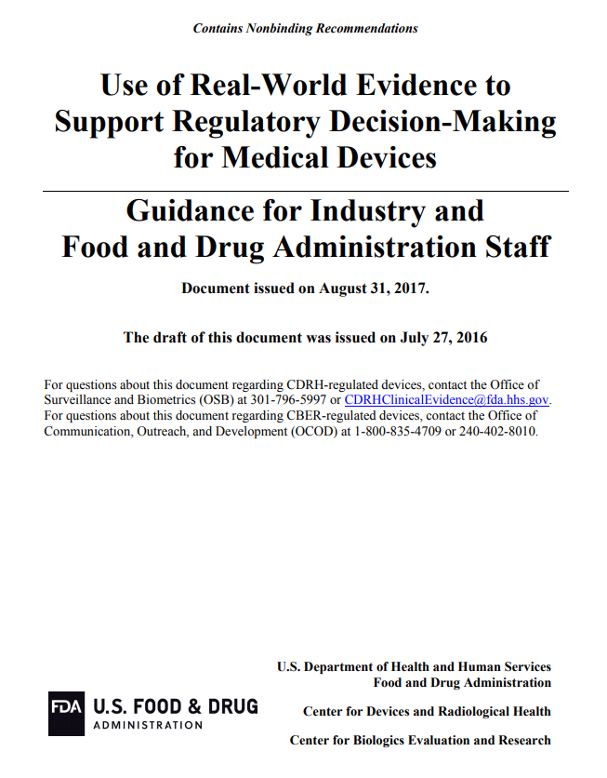
FDA/CDRH & CBER
RWE Guidance
Aug. 31, 2017

Slide 15
Publications and Guidance RWD/RWE in regulatory decision making
•Guidance: Submitting Documents Utilizing Real-World Data and Real-World Evidence to FDA for Drugs and Biologics
•Guidance: Use of Real-World Evidence to Support Regulatory Decision-Making for Medical Devices
•Guidance: Use of Electronic Health Records in Clinical Investigations
•Framework for FDA’s Real-World Evidence Program
•Real-World Evidence — What Is It and What Can It Tell Us?
•Accelerating development of scientific evidence for medical products within the existing US regulatory framework
https://www.fda.gov/science-research/science-and-research-special-topics/real-world-evidence

Slide 16
External Data Source for Regulatory Decision-making
Data Quality
Relevance
Reliability
Data Access
Patient-level RWD
Design
Prospective Study
Notes:
Under the right conditions, data derived from such real world sources can be leveraged to provide valid scientific evidence and support regulatory decisions. This is possible if underlying RWD has been accurately and reliably captured. Clinical judgement is paramount in assessing data quality.
There may be inherent bias that could limit the value of RWD for drawing causal inferences between medical device exposures and outcomes.
**Today we focus on statistical methodology for prospective investigational study where to mitigate potential bias, it is important to have
access to patient-level RWD and
carefully design the study in prospective manner.
==========================
regardless of whether the RWD are already collected (retrospective) or if they are to be collected in the future (prospective design), it is important that a study protocol and analysis plan be created prior to accessing, retrieving, and analyzing RWD.

Slide 17
Potential use of External data
To generate hypotheses to be tested in a prospective clinical study
To establish Performance Goal (PG) or Objective Performance Criteria (OPC)
As supplementary data and provide additional information
To construct investigational device arm and/or control arm
To augment a investigational device arm and/or control arm

Slide 18
Statistical Methods for generating External Evidence
Include:
Propensity score methods
Bayesian hierarchical models
Bayesian Commensurate-Prior method
Bayesian Power-Prior methods
Bayesian dynamic power-prior methods
Propensity score-integrated power-prior methods
Propensity score-integrated composite likelihood method
…

Slide 19
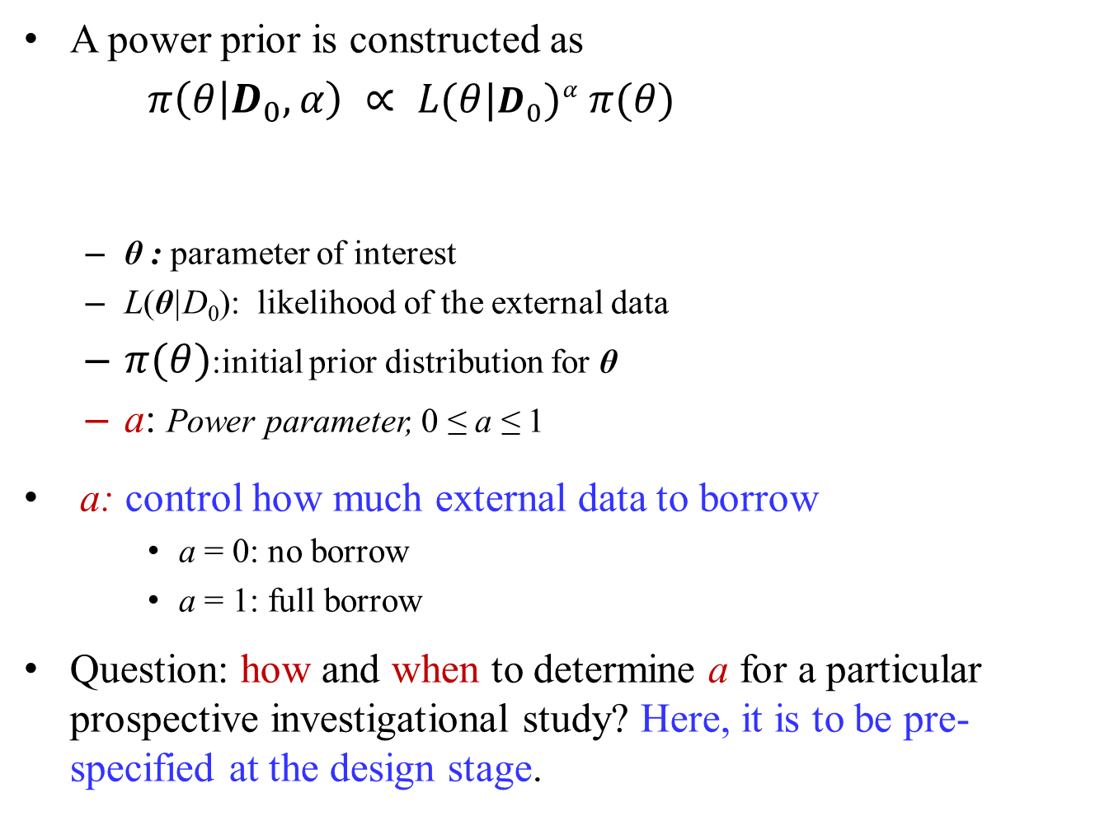
Bayesian Power Prior

Slide 20
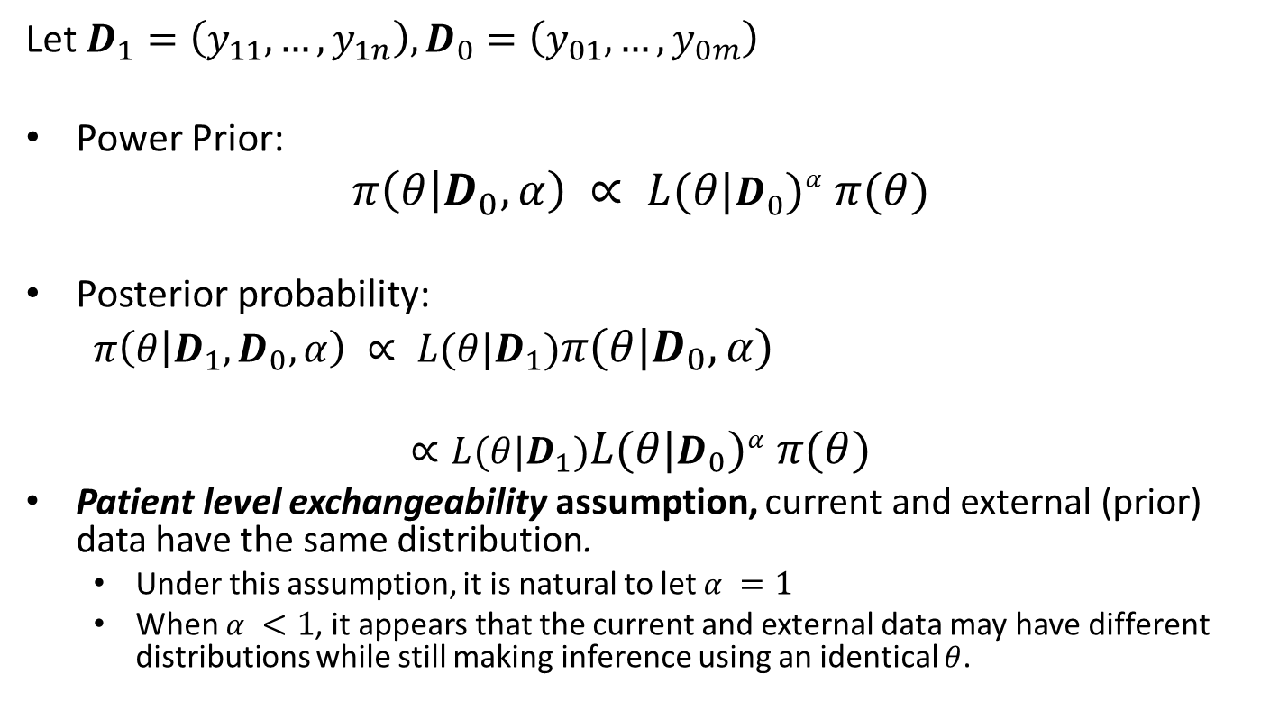
Bayesian Power Prior

Slide 21
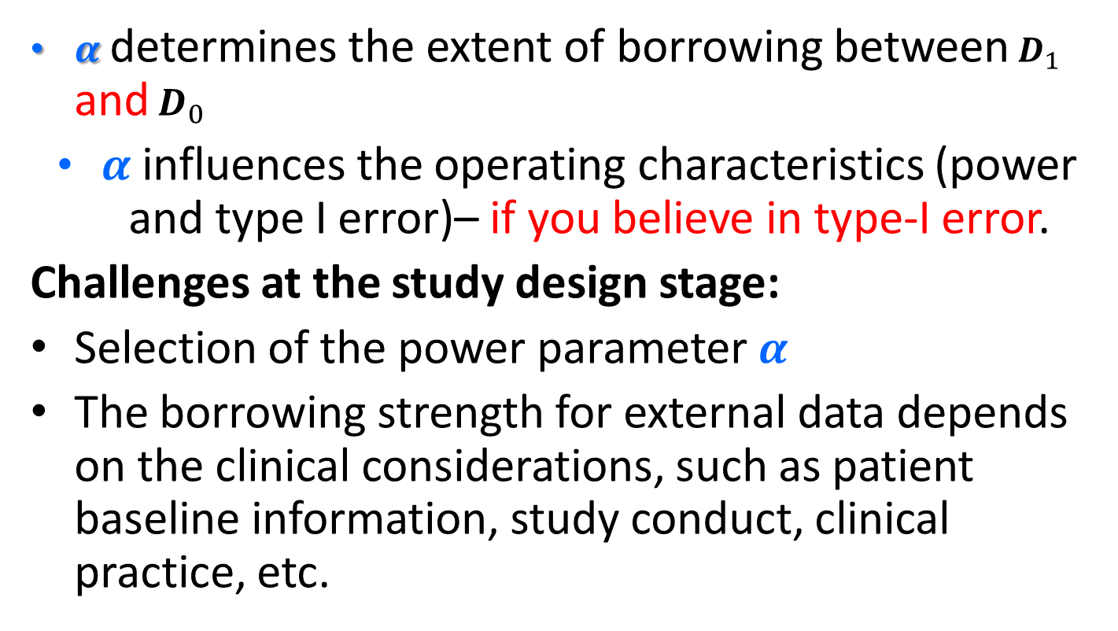
Power Prior

Slide 22
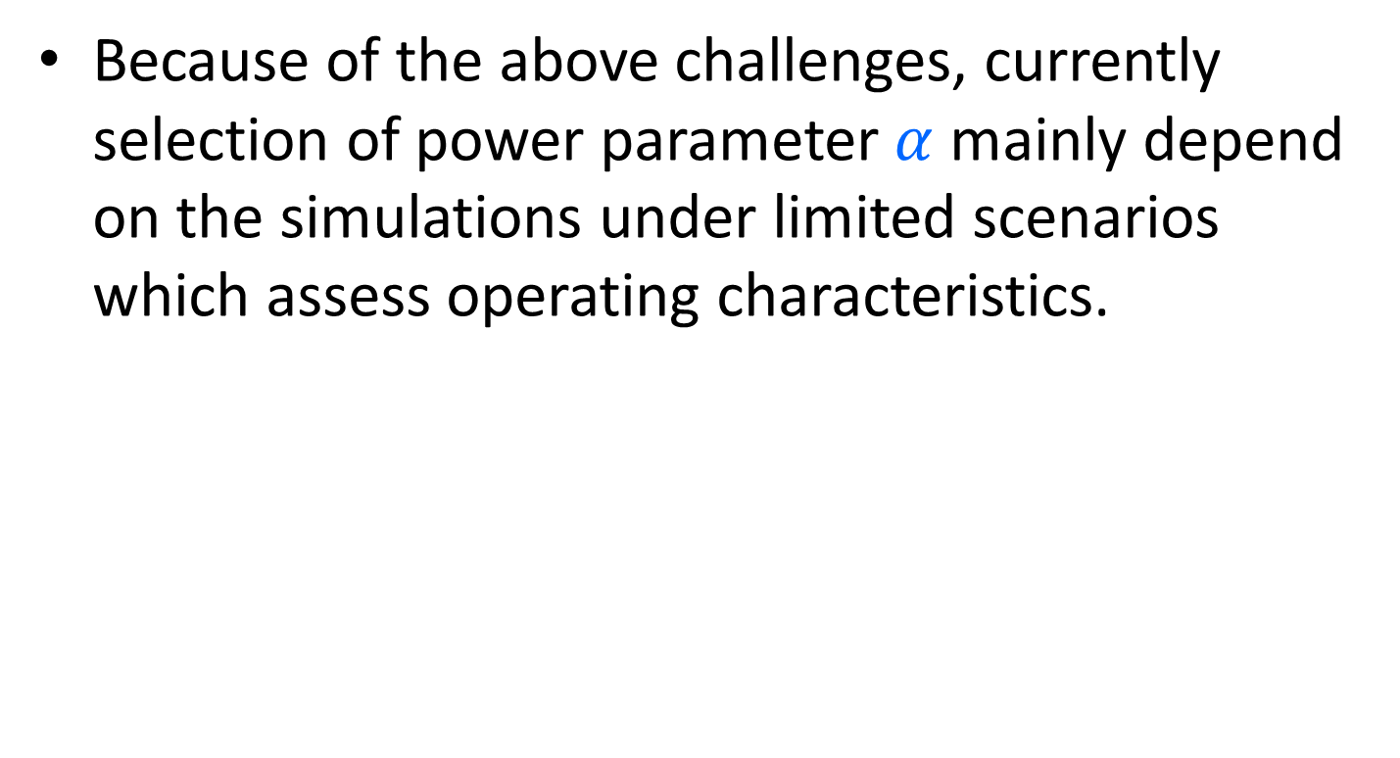
Current Regulatory Practice

Slide 24
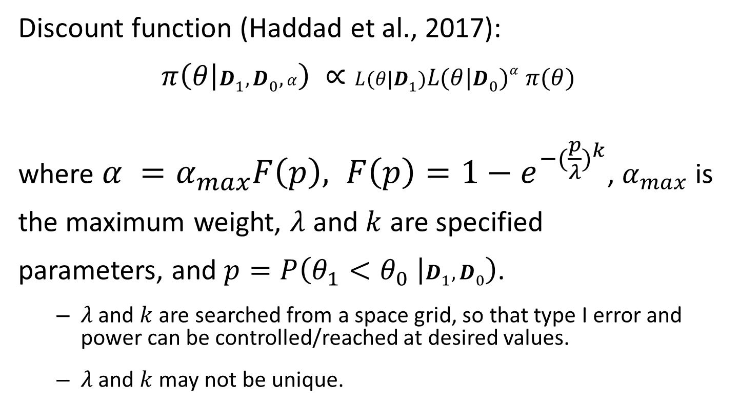
MDIC Approach
Notes:
𝜆 and 𝑘 are specified such that the type I error and power can be reached at desired values.

Slide 25
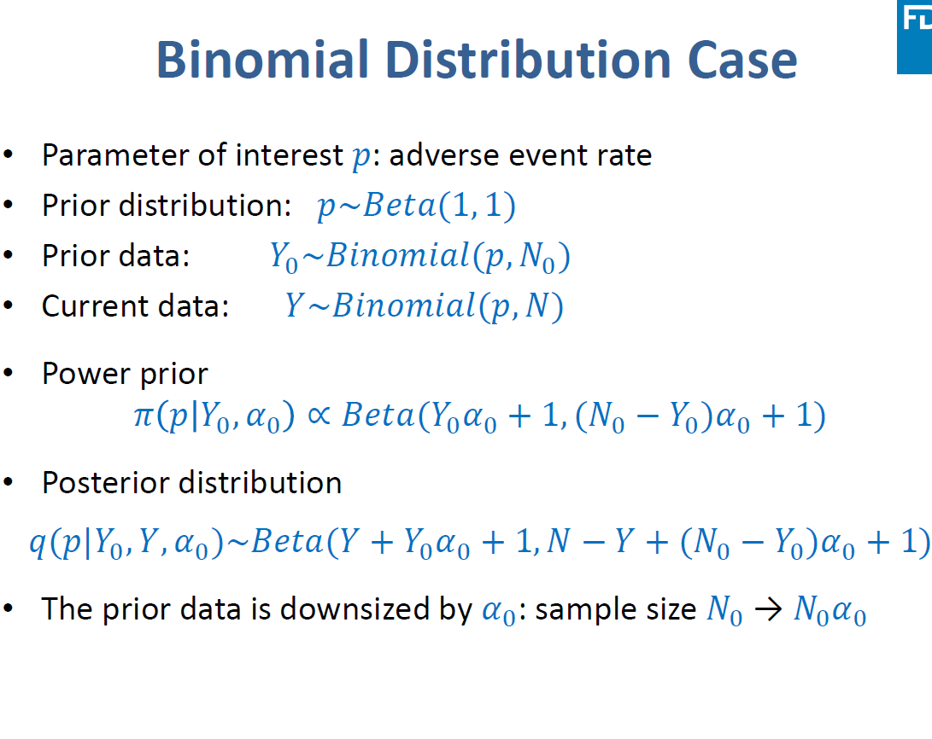

Slide 26
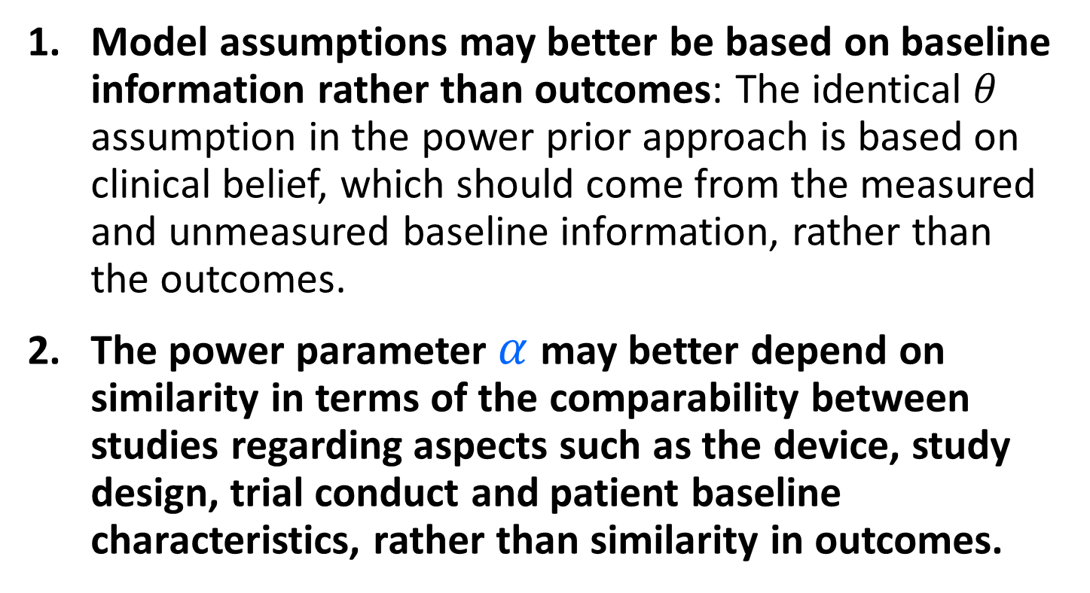
Statistical Issues

Slide 27
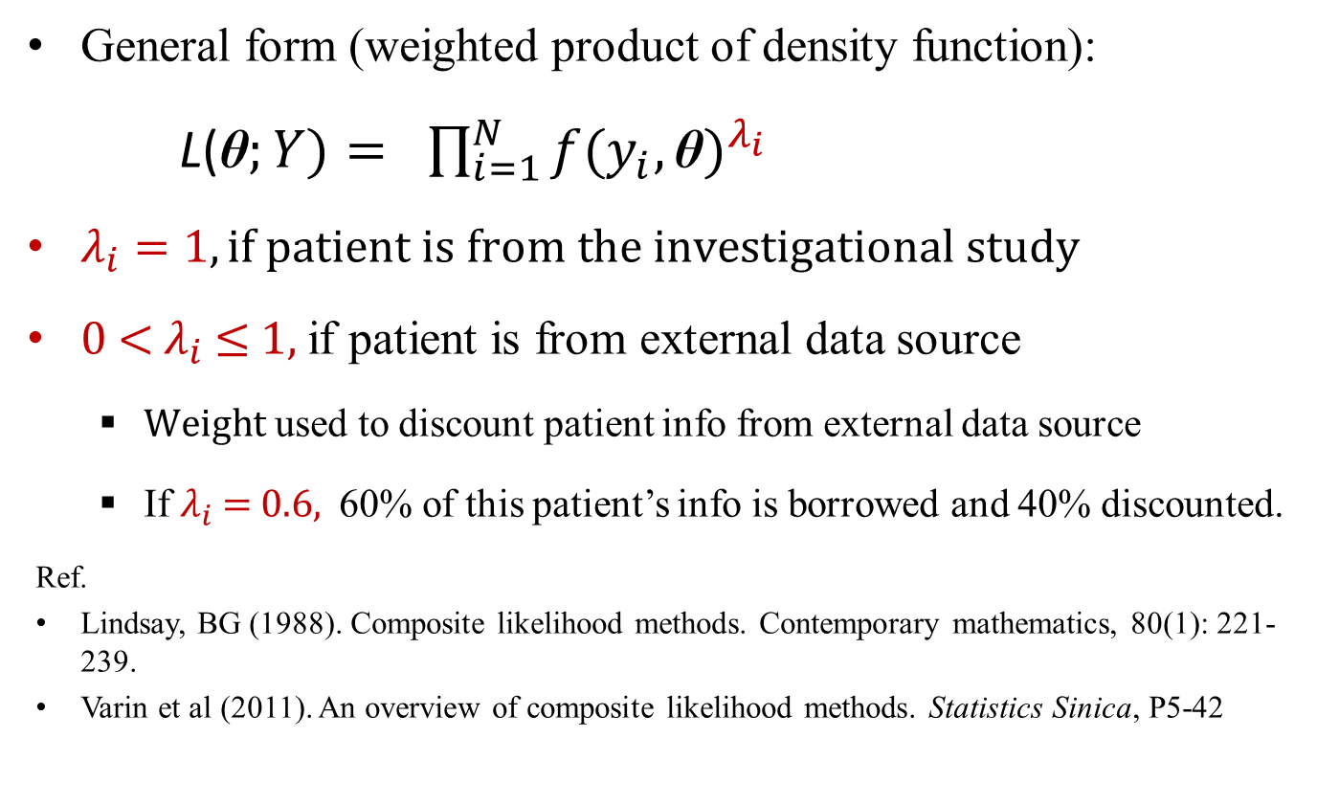
Composite Likelihood Function

Slide 28
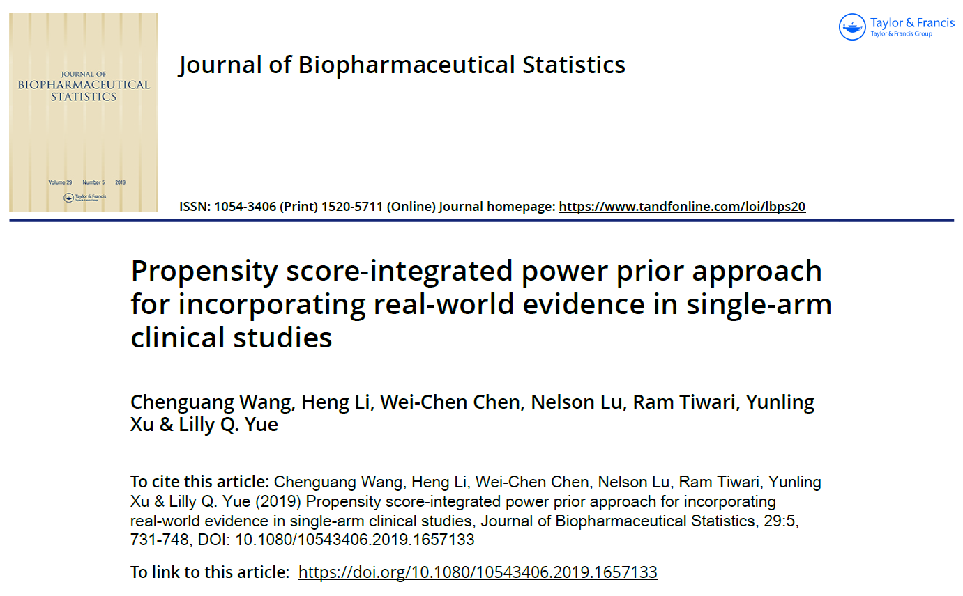
DBS RWD/RWE Publications

Slide 29

DBS RWD/RWE Publications

Slide 30
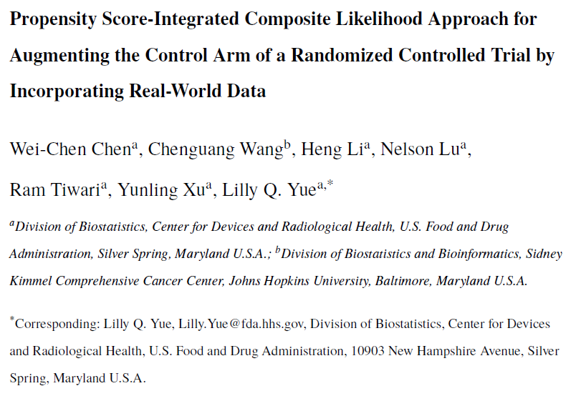
DBS RWD/RWE Publications

Slide 31
Examples
P100047 – HeartWare (Approved November 2012)
External data Source – Prospective registry data
External data Utilized to – Construct control arm
Device approval: First generation device
Statistical method: Propensity score methodology
P140031/S10 – Edwards Lifesciences (Approved June 2015)
External data Source – Patient-level data from historical clinical study
External data Utilized to – Construct control arm
Device approval: 2nd or later generation device; Label expansion
Propensity score stratification was implemented
P140010/S15 – Medtronic (Approved Sept 2016)
External data Source – Patient-level data from historical clinical study and Existing Registry data
External data Utilized to – Construct investigational device and control arm
Device approval: Modification of an approved or cleared device; Label expansion
Propensity score stratification was implemented
Notes:
Let’s get back to our example and see how this is done. In this example submission and in many other similar submissions where control arm is constructed using RWD, similar steps are followed.
Sapien 3 N ---
The sponsor first submitted an IDE study proposal for their second-generation device. They proposed to conduct a non-randomized study, using the control arm in a previous randomized controlled trial for their first-generation device as the historical control arm for the proposed study. They planned to enroll patients prospectively into the investigational device arm. The protocol provided details of how propensity score design will be implemented.

Slide 32
Examples of Approved Medical-Device Submissions
P070015/S128 – Abbott Vascular (Approved Sept 2015)
External data Source – Patient-level data from historical clinical study and Retrospective Registry data
External data Utilized to – Construct and Augment investigational device arm
Device approval: 2nd or later generation device; Label expansion
Bayesian hierarchical model was utilized to analyze the primary endpoint
P970003/S207 – Cyberonics (approved June 2017) (LivaNova)
External data Source – Patient-level data from historical clinical studies
External data Utilized – Construct and Augment investigational device arm
Bayesian hierarchical model was used.
P170030 – Biotronik (Approved Feb 2019)
External data Source – Patient-level data from historical clinical studies
External data Utilized to – Augment both investigational device and control arm
Bayesian hierarchical model was used
K191173 – Abbott Vascular (Cleared July 2019)
External data Source – Registry Data
External data Utilized to – Construct investigational device arm
Device Approval: 2nd or later generation device; Label expansion
A performance goal (PG) derived from the performance of similar devices in the same anatomy
Notes:
Let’s get back to our example and see how this is done. In this example submission and in many other similar submissions where control arm is constructed using RWD, similar steps are followed.
Sapien 3 N ---
The sponsor first submitted an IDE study proposal for their second-generation device. They proposed to conduct a non-randomized study, using the control arm in a previous randomized controlled trial for their first-generation device as the historical control arm for the proposed study. They planned to enroll patients prospectively into the investigational device arm. The protocol provided details of how propensity score design will be implemented.

Slide 33
Propensity Score
Propensity score (PS) is the probability that a patient receives investigational device(S3) (rather than control (C)) conditioning on observed baseline covariates.
 |  | Baseline Covariates
Pt # | Trt | Age | Sex | NYHA | Prior PCI | …
1 | S3
2 | S3
3 | S3
… | …
1 | C
2 | C
… | …
Pt # | Trt | PS
1 | S3 | 0.2
2 | S3 | 0.5
3 | S3 | 0.13
… | …
1 | C | 0.48
2 | C | 0.1
… | …
Build Model
Notes:
What is Propensity score? Make the definition specific…
In a study consisting of two treatment groups A and B, a patient’s propensity score is defined as the probability that a patient receives treatment group A rather than treatment group B, conditioning on a collection of baseline covariates.
For example, given a list of key baseline covariates age, gender, NYHA, Prior PCI, Ejection Fraction,… that are observed both for investigational device arm and historical control arm, a logistic regression model is build to estimate the propensity score for each patient.

Slide 34
Propensity Score Design
Simultaneously balance many observed covariates between two treatment groups.
It is critical propensity score design be conducted with no outcome data in sight; using a two-stage outcome-free design design”).
Notes:
The goal is that once Propensity score is estimated, it serves as a balancing score, that is to say, among patients with the same value of propensity score, the two treatment groups are balanced with respect to those baseline covariates. This in turn helps mitigate bias caused by imbalance of observed covariates.
Outcome data is often available when utilizing RWD. To ensure objectivity of study design and interpretability of study results it is critical that propensity score design be conducted with no outcome data in sight; It can done by using a two-stage outcome-free design proposed by our division. I am happy to report that is implemented and has become a routine practice in medical device clinical studies.
-----
Now how this goal is achieved, is an iterative process that cannot be prespecified and there is not a uniquely correct solution. You build the model then assess covariate balance and if you are not happy with the degree of balance achieved you repeat the process again and rebuild the model.

Slide 35
PS Design Protocol
Identified an independent statistician to conduct propensity score design
Outcome-free: stipulated in the protocol that the statistician who will conduct propensity score design would not have access to outcome data before the design is finalized
Notes:
In the protocol it was pre-specified that the PS design will be implemented in an outcome free manner. Sponsor identifying an independent statistician and provided FDA assurance that those who conduct propensity score design would not have access to outcome data before the design is finalized.

Slide 36
PS Design Implementation
Treatment arm patients enrolled
Baseline covariate data cleaned & locked
Covariate data sent to Independent statistician
The independent statistician
Ran PS modeling
Assessed covariate balance
The independent statistician then submitted the PS design to FDA and Sponsor
Notes:
As soon as all the patients were enrolled into the investigational device arm, the sponsor cleanly and locked the baseline covariate data and submitted to the independent statistician. The independent statistician then - Ran PS modeling; Examined PS distributions; Formed PS strata; and Assessed covariate balance – and did this in an iterative process until he was satisfied with the covariate balance.
Independent statistician then sends a report to the sponsor and FDA. Upon receiving the green light from FDA and the sponsor, the PS model was shared by the independent statistician. Once outcome data becomes available for the investigational device arm, based on agreed upon study design outcome analysis is initiated.

Slide 37
Today’s Focus
Streamline clinical evidence using Propensity score-based methods in prospective investigational study
1. To construct control group using External Data
2. To augment clinical study using External Data
Propensity Score-Integrated Approaches

Slide 38
Propensity Score-Integrated Approaches PS + PP; PS + CL
PS -> Study design
PP and CL -> Outcome data analysis
There is a discounting parameter α in the formulation.
α controls how much info. to borrow from a patient.
α = 0
α = 1
α = 0.6
No borrow
Full borrow
40% discounted
60% borrow
Notes:
In the application of the methods,
Propensity score is for study design
Power prior or composite likelihood is for outcome data analysis.
In the formulation of power prior or composite likelihood, there is a discounting parameter, α.
The little α plays a big role – controls how much info. to borrow from a patient:
α = 0 means no borrow.
α = 1 implies full borrow, i.e., 100% info. is borrowed. In the case Vandana talked about, 100% info. was borrowed from each patient selected from RWD.
If α = 0.60: 60% borrow, i.e., 60% info. is borrowed, and 40% info is discounted.

Slide 39
A Statistical and Regulatory Question
For a prospective investigational study,
How and when to determine α,
To maintain
The study objectivity, given that some outcome data in external data source(s) may already exist before the investigational study design begins;
The creditability of the investigational study results;
The consistency, transparency and predictability of regulatory decision-making.
Notes:
A critical question to ask in our regulatory reviews is
How and when to determine α for a prospective investigational study:
To ensure the study objectivity when outcome data in RWD source may already exist before the prospective study design even begins, as the availability of outcome data presents an opportunity for data dredging;
To ensure the creditability of investigational study results and then the consistency, transparency and predictability of regulatory decision-making.

Slide 40
PS-Integrated Approaches: Study Design Using PS
Re-Define PS as the conditional probability of being in the investigational study, given patient baseline covariates.
Use PS to design an investigational study leveraging external data:
Select comparable patients from external data source;
Determine the discounting parameter (α) to be used to down-weight information of these patients from external data, when necessary.
Incorporate the two-stage design -> The selection and determination are based on patient baseline covariates only: Outcome free.
Notes:
Now, we use the PS-Integrated Approaches and the two-stage design discussed by Vandana to handle this challenge.
Today, we are going to concentrate on study design using PS.
Please note we now have two data sources from the patients enrolled in the prospective study and patients selected from RWD, respectively. So, we define the PS as conditional probability of coming from the prospective study, given patient baseline covariates.
Then, we use the PS to design an investigational study leveraging RWD with two purposes:
#1. Select comparable patients from RWD source in terms of patient characteriscs, i.e., patient baseline covariates;
#2. Determine the weights used to down-weight information of these patients from RWD when necessary based on clinical and regulatory considerations.
By incorporating the two-stage design framework, the patient selection and weight determination are based on patient baseline covariates only, which is outcome free, to ensure the creditability of study results.

Slide 41
How to Select Comparable Patients from External Data?
“Comparable” patients?
“Similar”
Patients borrowed from External Data source have
similar patient characteristics
i.e., similar distribution of observed baseline covariates
to those patients prospectively enrolled in the investigational study.

Slide 42



How to Select Comparable Patients?
RWD Source
1). Inclusion/Exclusion criteria
Potentials
2). PS
PS is summary of overserved baseline covariates.
If a group of patients have similar PS, then they have similar baseline covariate distributions.
Finals

Slide 43
An Illustrative Example
An investigational study was planned to seek approval for indication expansion of an approved device.
Plenty of off-label use data were captured in a patient registry.
Based on clinical and statistical evaluations, the registry was thought relevant to the prospective study with adequate reliability.
Planned to conduct a single-arm investigational study and borrow some data from the registry to save sample size in the prospective investigational study.

Slide 44
Study Design -1st Stage
Primary endpoint: one-year adverse event.
Parameter of interest: θ, proportion of patients who experienced adverse event(s) within the one-year period.
Associated hypothesis testing:
Ho : θ ≥ 36% vs: Ha : θ < 36% (PG)
Study success criterion:
Posterior probability of θ being less than 0.36 is greater than 0.95; or
p-value < 0.05 in frequentist setting.
17 baseline covariates were identified based on prior clinical knowledge.
Agreed upon by FDA & Sponsor

Slide 45
Study Design - 1st Stage (cont.)
Sample size determination
• Assume θ = 0.30
Set: power = 80%; significance level = 0.05
Then, N = 380
• Based on clinical decision (case-by-case basis), proposed to
• Enroll 290 patients in the prospective investigational study
• Borrow 90 patients from the registry
25% Saving
Clinical and Regulatory Decision
Case-by-Case Basis

Slide 46
Study Design – 2nd Stage
After 290 patients were prospectively enrolled, 941 registry patients were selected, based on the inclusion/exclusion criteria and PS modeling,
However, 90 registry patients were planned to borrow!
Options:
Further selection of 90 registry patients; Each one contributes 100% info
(α =1).
Leverage all 941 registry patients; Each one contributes 100% info
(α =1)
Leverage all 941 registry patients; Each one contributes partial info.
(α <1) such that the nominal number of patients to borrow: 90.
Notes:
Within each stratum, registry patients and prospectively enrolled patients are more similar in terms of observed covariates than they are overall. Borrowing of registry patients is then carried out within each stratum to make it more justified. For example, in the 1st PS stratum, 281 registry patients are available to borrow, and in the 5th stratum, 109 registry patients are available.
The number of registry patients and prospectively enrolled patients are displayed in this table.

Slide 47
Study Design – 2nd Stage (cont.)
Clinical decision made:
Include all 941 registry patients; Each one contributes partial info. (α <1)
such that the nominal number of patients to borrow is 90.
α could be same or different for the 941 patients.
Question:
How to determine the discounting parameter α for each registry patient?
Partial? How much? Depending on what?
Notes:
Within each stratum, registry patients and prospectively enrolled patients are more similar in terms of observed covariates than they are overall. Borrowing of registry patients is then carried out within each stratum to make it more justified. For example, in the 1st PS stratum, 281 registry patients are available to borrow, and in the 5th stratum, 109 registry patients are available.
The number of registry patients and prospectively enrolled patients are displayed in this table.

Slide 48
Study Design – 2nd Stage (cont.)
How to determine α?
Step 1. All patients (290 + 941) were grouped into 5 propensity score strata, with the same number of prospectively enrolled patients in each propensity score stratum.
Sample Size in PS Strata
1 2 3 4 5 Total
Prosp. Study (n) 58 58 58 58 58 290
Registry (n) 281 210 154 187 109 941
-> Within PS stratum, patients are more similar -- > Borrowing within PS stratum.
Notes:
Within each stratum, registry patients and prospectively enrolled patients are more similar in terms of observed covariates than they are overall. Borrowing of registry patients is then carried out within each stratum to make it more justified. For example, in the 1st PS stratum, 281 registry patients are available to borrow, and in the 5th stratum, 109 registry patients are available.
The number of registry patients and prospectively enrolled patients are displayed in this table.

Slide 49
Study Design – 2nd Stage (cont.)
Step 2. Allocate 90 patients into 5 PS strata.
Split 90 patients into 5 PS strata, proportional to the similarity of registry patients and the prospectively enrolled patients in terms of baseline covariates.
The similarity is measured by an overlapping coefficient, the overlapping area of propensity score distributions of the two patient groups.
Similarity re. Baseline Covariates
Registry Patients
V.S.
Prospectively Enrolled Patients
Similarity re. PS
Overlapping Area of PS distributions

Slide 50
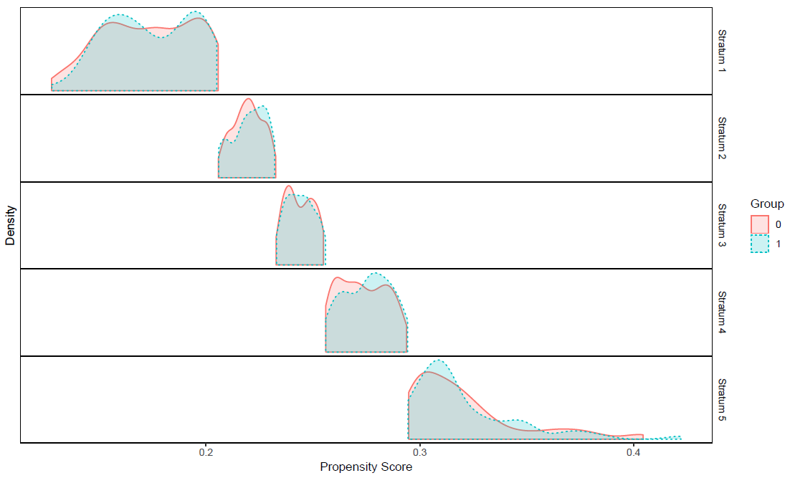
Propensity Score Distribution
Notes:
The overlapping coefficient in each stratum is displayed in this Table.

Slide 51
Study Design – 2nd Stage (cont.)
PS Stratum
1 2 3 4 5 Total
Prosp. Study (n) 58 58 58 58 58 290
Registry (n) 281 210 154 187 109 941
Overlap Coeff 0.87 0.78 0.86 0.84 0.77

Slide 52
Study Design – 2nd Stage (cont.)
Step 3. Standardize the overlapping coefficients
PS Stratum
1 2 3 4 5 Total
Prosp. Study (n) 58 58 58 58 58 290
Registry (n) 281 210 154 187 109 941
Overlap Coeff 0.87 0.78 0.86 0.84 0.77
Std. Overlap Coef. 21% 19% 21% 20% 19% 100%
Notes:
The overlapping coefficients are then standardized so that they add up to 1.

Slide 53
Study Design – 2nd Stage (cont.)
Step 4. Allocate the 90 patients into PS strata.
PS Stratum
1 2 3 4 5 Total
Current Study (n) 58 58 58 58 58 290
Registry (n) 281 210 154 187 109 941
Overlap Coeff 0.87 0.78 0.86 0.84 0.77
Std. Overlap Coef. 21% 19% 21% 20% 19% 100%
Patients Borrowed 19 17 19 18 17 90
(90 x 21% =19) (90 x 19% = 17)
The nominal number of registry patients to be borrowed in each PS stratum is proportional to its standardized overlapping coefficient.
Notes:
The standardized overlapping coefficients times the total number of patients to be borrowed (90) determine the nominal number of patients to be borrowed in each stratum (E.g., in the first PS stratum, 90 x 21% = 19).

Slide 54
Study Design – 2nd Stage (cont.)
Step 5. Determine α, i.e., how much to borrow from each registry patient.
PS Stratum
1 2 3 4 5 Total
Prosp. Study (n) 58 58 58 58 58 290
Registry (n) 281 210 154 187 109 941
Patients Borr. (n) 19 17 19 18 17 90
α for regi. pt. 0.07 0.08 0.12 0.10 0.15
(19/281 = 0.07)
The info to be borrowed from each registry patient depends on how many registry patients in that PS stratum.

Slide 55
Study Design – 2nd Stage (cont.)
Study design is finished:
PS Stratum
1 2 3 4 5 Total
Prosp. Study (n) 58 58 58 58 58 290
Registry (n) 281 210 154 187 109 941
α for regi. Pt. 0.07 0.08 0.12 0.10 0.15
We know
How much info each registry patient could contribute.
The PS stratum each patient would belong to.
Study operating characteristics: 80% power; 5% Type I error rate.

Slide 56
Outcome Data Analysis
When outcome data available, based on the PS study design:
PS Stratum
1 2 3 4 5 Total
Current Study (n) 58 58 58 58 58 290
Registry (n) 281 210 154 187 109 941
α 0.07 0.08 0.12 0.10 0.15
Apply the power prior or composite likelihood approach within each PS stratum → stratum-specific analysis results.
Combine these results → an overall analysis result.

Slide 57
Outcome Data Analysis (cont.)
PP -
The posterior probability of θ < 36%: 96.9%.
CL -
Maximum likelihood estimate of θ: 31%,
p -value = 0.01.
The pre-specified study criterion is met from a statistical point of view.

Slide 58
Study Design Summary
The study design
Intuitive and easy to implement
Outcome free and separated from outcome analysis
All design activities were blinded to outcome data
The total number of registry patients to borrow
Propensity score modeling
The number of registry patients to borrow in each stratum
The determination of the weights used to down-weight registry patient info.
Straightforward to extend to RCT with control arm augmented from RWD source.

Slide 59
PS-Integrated Approaches - Reference
Wang, C., Li, H., Chen, W., Lu, N., Tiwari, R., Xu, Y., Yue, L.*. (2019). Propensity Score-Integrated Power Prior Approach for Incorporating Real-World Evidence in Single-Arm Clinical Studies. Journal of Biopharmaceutical Statistics, 29 (5),731-748.
Wang, C., Lu, N. Chen, W., Li, H. Tiwari, R., Xu, Y., Yue, L.*. Propensity Score-Integrated Composite Likelihood Approach for Incorporating Real-World Evidence in Single-Arm Clinical Studies. Journal of Biopharmaceutical Statistics. http://dx.doi.org/10.1080/10543406.2019.1684309.
Chen, W., Wang, C., Li, H., Lu, N. Tiwari, R., Xu, Y., Yue, L.*. Propensity Score-Integrated Composite Likelihood Approach for Augmenting the Control Arm of a Randomized Controlled Trial by Incorporating Real-World Data. Journal of Biopharmaceutical Statistics. https://doi.org/10.1080/10543406.2020.1730877).
Li, H., Chen, W-C., Lu, N., Wang, C., Tiwari, R., Xu, Y., Yue, L.Q. (2020). Novel Statistical Approaches and Applications in Leveraging Real-World Data in Regulatory Clinical Studies, Health Services and Outcomes Research Methodology, http://link.springer.com/article/10.1007/s10742-020-00218-4
*: Contact Lilly Yue: Lilly.Yue@fda.hhs.gov

Slide 60
Estimand

Slide 61
Pairwise PS-based stratification with two External Data Sources

Slide 62
A Similarity Measure

Slide 63
Fully Bayesian Approach

Slide 64
Acknowledgments
DBS RWE Research Group
CDRH/OCEA / DBS
Wei-Chen Chen, Ph.D.
Heng Li, Ph.D.
Nelson Lu, Ph.D.
Changhong Song, Ph.D.
Ram Tiwari, Ph.D.
Yunling Xu, Ph.D.
Lilly Yue, Ph.D.
JHU: Chenguang Wang, Ph.D.

Slide 65
Concluding Remarks
High quality External Data have potential to play an important role to support regulatory decisions.
Novel statistical methodology can help streamline clinical evidence generation in TPLC for medical devices.
Propensity score-based approaches can be applied to incorporate External Data for prospective investigational clinical studies in both pre-market and post-market settings
Propensity score methodology used to construct a control group from External Data in a comparative study.
Propensity score-integrated approaches used to augment prospective clinical studies (1-arm or 2-arm) with External Data.

Slide 66
Additional References
Li, H., Mukhi, V., Lu, N., Xu, Y., Yue, L. (2016). A Note on Good Practice of Objective Propensity Score Design for Premarket Nonrandomized Medical Device Studies with an Example, Statistics in Biopharmaceutical Research. 8, 282-286.
Lu, N., Xu, Y. & Yue, L.Q. (2019) Some considerations on design and analysis plan on a nonrandomized comparative study utilizing propensity score methodology for medical device premarket evaluation. Statistics in Biopharmaceutical Research https://doi.org/10.1080/19466315.2019.1647873.
Lu, N., Xu, Y., and Yue, L.Q. (2019) Some statistical considerations in design and analysis for nonrandomized comparative studies using existing data as controls for medical device premarket evaluation. A chapter in book “Contemporary Biostatistics with Biopharmaceutical Application”, Springer Nature, 271-284.
Lu, N., Xu, Y. & Yue, L.Q. (2019) Good statistical practice in utilizing real world data in a comparative study for premarket evaluation of medical devices. Journal of Biopharmaceutical Statistics, 29(4), 580-591.
Lu, N., Xu, Y. & Yue, L.Q. (2018) Premarket applications: registries. Encyclopedia of Biopharmaceutical Statistics, Fourth Edition. Taylor & Francis, New York
Xu, Y., Lu, N., Yue, L.Q., Tiwari, R. (2019). A Study Design for Augmenting the Control Group in a Randomized Controlled Trial: A Quality Process for Interaction Among Stakeholders. Therapeutic Innovation & Regulatory Science.
Chen, M.H. and Ibrahim J.G. (2000). Power prior distributions for regression models. Stat. Science 15 (1), 46-60.

Slide 67
Additional References (Cont.)
Yue, L.Q. (2018). Leveraging real-world evidence derived from patient registries for pre-market medical device regulatory decision-making, Statistics in Biopharmaceutical Research, 10(2), 98-103.
Yue, L.Q. and Li, H. (2018) Propensity Score: Methodology and Application to Clinical Studies. In S.C. Chow ed. Encyclopedia of Biopharmaceutical Statistics 4th Edition, Chapman and Hall/CRC.
Yue, L., Campbell, G., Lu, N., Xu, Y., and Zuckerman, B. (2016). Utilizing National and International Registries to Enhance Pre-Market Medical Device Regulatory Evaluation, Journal of Biopharmaceutical Statistics, 26 (6), 1136-1145.
Yue, L.Q., Lu, N. and Xu, Y. (2014). Designing Pre-market Observational Comparative Studies Using Existing Data as Controls: Challenges and Opportunities, Journal of Biopharmaceutical Statistics, 24(5), 994-1010.

Slide 68
Thank You!

Slide 69
Discussion Question
How can we support you with use of EEM Framework in clinical evidence generation for regulatory decision-making?
Notes:
What can we do to provide support?

