Slide 1
Use of Bayesian Hierarchical Models in the Presentation of Subgroup Analyses*
Mark Rothmann
U.S. Food and Drug Administration
DIA Bayesian Scientific Working Group Webinar Series
November 19, 2021

Slide 2
Disclaimer
* The views expressed in this talk are those of the speaker and not necessarily those of the FDA

Slide 3
Outline
Drug Trials Snapshots (DTS)
Heterogeneous Treatment Effects
Different Perspectives
Story
Shrinkage Estimation
Bayesian Hierarchical Models
Examples
Concluding Remarks

Slide 4

Drug Trials Snapshots

Slide 5
FDASIA 2012 Section 907
SEC. 907. REPORTING OF INCLUSION OF DEMOGRAPHIC SUBGROUPS IN CLINICAL TRIALS AND DATA ANALYSIS IN APPLICATIONS FOR DRUGS, BIOLOGICS, AND DEVICES.
(1) IN GENERAL.—Not later than 1 year after the date of enactment of this Act, the Secretary, acting through the Commissioner, shall publish on the Internet web site of the Food and Drug Administration a report, consistent with the regulations of the Food and Drug Administration pertaining to the protection of sponsors’ confidential commercial information as of the date of enactment of this Act, addressing the extent to which clinical trial participation and the inclusion of safety and effectiveness data by demographic subgroups including sex, age, race, and ethnicity, is included in applications submitted to the Food and Drug Administration, and shall provide such publication to Congress

Slide 6
FDA ACTION PLAN TO ENHANCE THE COLLECTION AND AVAILABILITY OF DEMOGRAPHIC SUBGROUP DATA

Slide 7
Message from Margaret A. Hamburg, M.D., Commissioner of Food and Drugs (continue)
… Advances in science are also playing an increasingly important role in deepening our understanding of how patients within various subgroups respond to medical products. … an action plan outlining “recommendations for improving the completeness and quality of analyses of data on demographic subgroups in summaries of product safety and effectiveness data … .”

Slide 8
Purpose of DTS
Provide consumers and healthcare professionals with information about who participated in clinical trials that supported the FDA approval of new drugs (NMEs and original biologics).
Provide information on study design.
Highlight potential differences in efficacy and safety results among gender, race, and age subgroups.
Increase transparency.

Slide 9
Snapshots are not a PI
Drug Trials Snapshot Intended for public Consumer-friendly Language Focus on subgroup data and analyses Links to PI and reviews in Drugs@FDA Published on fda.gov 30 days after drug approval | Package Insert Intended for Physicians Technical Language Comprehensive Resource for drug information No links to reviews Finalized with drug approval

Slide 10
Another difference between snapshots and package inserts
Drug Trials Snapshots | Package Inserts
Subgroup analyses, interpretations and conclusions are those of FDA | Negotiated between FDA and sponsor

Slide 11
Audience
Should consider audience when constructing a DTS
What is the effect someone like me can expect>
Increase usage of subgroup analysis in Safety
treatment-related adverse events can be more frequent as age increases

Slide 12
Heterogeneous Treatment Effects (HTE)

Slide 13
Treatment effects vary across subgroups of a factor
Factor an effect modifier or
Factor associated/correlated with one or more effect modifiers

Slide 14
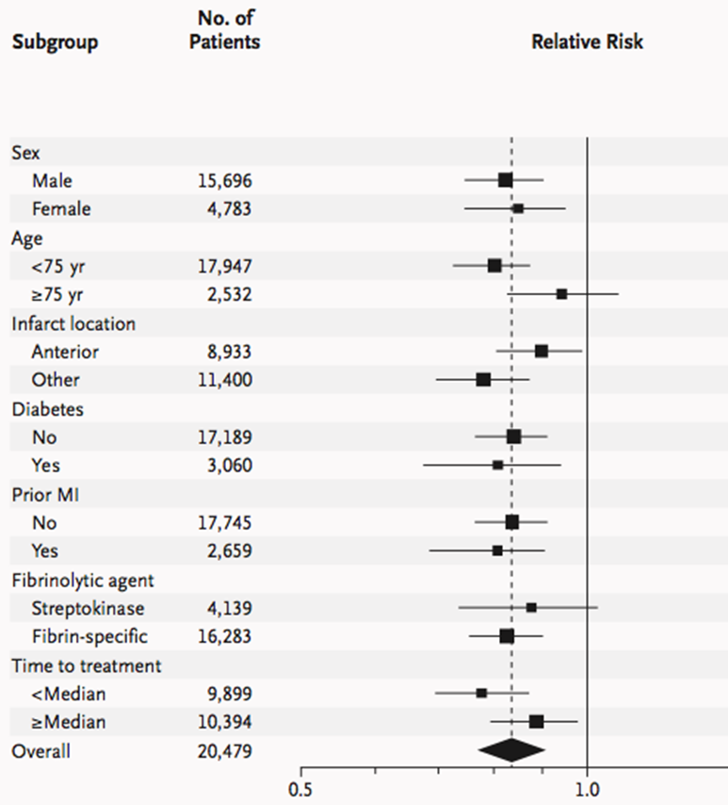
Conventional subgroup analysis (1 of 3)

Slide 15
Conventional subgroup analysis (2 of 3)
Subject to random highs and random lows
Estimated treatment effects vary more than underlying treatment effects
Analysis are typically univariate or marginal - one subgrouping variable at a time
Possibly confounded by correlation between subgrouping variables
If sex and age are correlated, the difference in treatment efficacy between men and women may be confounded by age
Groenwold (2009) - Aspirin’s effect on stroke was larger in women, but women were older

Slide 16
Conventional subgroup analysis (3 of 3)
Assume treatment effect equal across subgroups (unless compelling evidence that they differ). When estimating treatment effect in interested subgroup
Equal relevancy of outcomes for patient outside interested subgroup outcome and patient in interested subgroup
Under this assumption analysis (estimation of treatment effect) is simple, easy
OR use only data from patients in interested subgroup to estimate the treatment effect for interested subgroup
Patient outside interested subgroup outcome provides no information (no relevancy)
Under this assumption analysis (estimation of treatment effect) is simple, easy

Slide 17
Recent Symposiums and Workshops co-sponsored by FDA on Heterogeneous Treatment Effects
Nov 28, 2018, Symposium of Assessing and Communicating Heterogeneity of Treatment Effects for Patient Subpopulations: Challenges and Opportunities
Agenda, Slides and Recording at https://www.jhsph.edu/research/centers-and-institutes/center-of-excellence-in-regulatory-science-and-innovation/news-and-events/Critical-Issues-in-Heterogeneity-of-Treatment-Effect.html
Nov 30 - Dec 1, 2020, Workshop on Heterogeneity of Treatment Effects in Clinical Trials: Methods and Innovations
Agenda and Recording at https://mrctcenter.org/news-events/heterogeneity-of-treatment-effects-in-clinical-trials-methods-and-innovations/#1602863324215-1289c9d5-a82a

Slide 18
Some messages from the session
Symposium of Assessing and Communicating Heterogeneity of Treatment Effects for Patient Subpopulations: Challenges and Opportunities
We can do more or better at understanding heterogeneous treatment effects
Have used shrinkage estimation for some drug trial snapshots
More complicated/better models could include factors known to affect the treatment effect
Doable (somewhere) in some settings to have a repository of data to be used to provide individual patient advice which can account for patient preferences, patient demographics and medical history

Slide 19
Some Topics/Questions of interest
Workshop on Heterogeneity of Treatment Effects in Clinical Trials: Methods and Innovations
Representation in clinical trials
What can a patient like me expect?
Is there consistency of treatment effect?
If there is a benefit overall, where may there not be benefit?
Difference in using subgroup analyses to make a claim vs. individual patient treatment decisions
How do overall results affect how we view subgroup results?

Slide 20
Different Perspectives/ Frameworks

Slide 21
Different subgroup analyses perspectives/frameworks
L1: Actual (signed) differences in treatment effects vs
L2: Variability in treatment effects

Slide 22
Testing for differences in effects
Consider two subgroups (e.g., one factor with two levels)
Interest in order/direction of effects and the difference in effects
Zero difference in effects is at a key (central) location
|
0
Treatment effect larger in
Subgroup 2 than in Subgroup 1
Treatment effect larger in
Subgroup 1 than in Subgroup 2

Slide 23
Estimating treatment effects across subgroups
No difference in effects is at an extreme location (i.e., τ² = 0)
|
0
τ² = 0
100% borrowing
Less Borrowing

Slide 24
Story

Slide 25
Introductory Paragraph from the Impact Story
When evaluating drug treatments, determining how and to what extent a drug works in different patient subgroups can be addressed by statistical approaches that make use of results from every subgroup when understanding the treatment effect for a given subgroup.
using-innovative-statistical-approaches-provide-most-reliable-treatment-outcomes

Slide 26
Treatment Decisions
Physicians make treatment decisions on past experience with patients

Slide 27
New Drug
Sex may or may not be an effect modifier
No other factor is considered as a possible effect modifier
Physician has experience on the use of the new drug and outcomes in 2 males and 2 females
The next patient, a female, is prescribed the new drug from that physician. What can she expect?
Probably use information from all four previous patients.
Outcomes from females may be more relevant than the outcomes from males.

Slide 28
As Previous Experience Grows
Observe the outcomes from more and more males and females
The relevancy of the results from males in what the next female can expect. Depends on
How similar the results from males are to the results from females
How much data on females

Slide 29
Shrinkage Estimation from Bayesian Hierarchical Models Works this Way
Data from a subject in the given subgroup are more relevant than data from a subject outside that subgroup
The relevancy goes to zero as the number of subjects in the subgroup of interest goes to infinity
The data decide how much borrowing is done
Depends on ratio of variability within subgroup to variability between subgroup
Less borrowing when within subgroup variability decreases (its sample size increases)

Slide 30
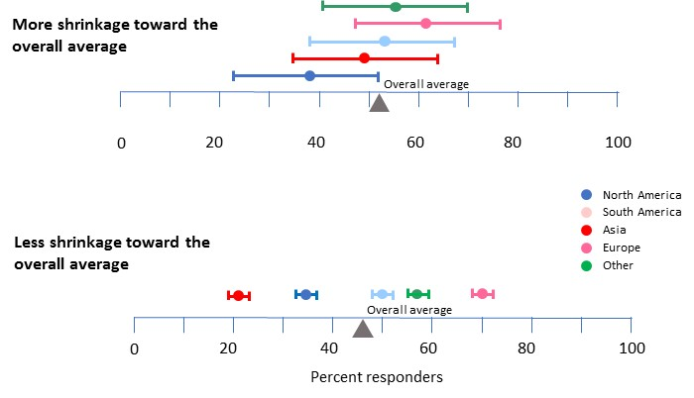
How much shrinkage/borrowing

Slide 31
Shrinkage Estimation

Slide 32
What is Shrinkage Estimation?
A shrinkage estimate of a parameter for a subgroup
a weighted average of sample estimate and overall estimate (stratified by subgroup).
Could be a posterior mean in a Bayesian setting
Sample estimate is “shrunk” towards the overall estimate

Slide 33
Amount of Borrowing
|
|
|
Sample estimate
Shrinkage estimate
Overall
estimate
No borrowing
Some borrowing
100% borrowing

Slide 34
Two components of variability in sample estimates across subgroups
The total variability in the sample estimates is sum of
the within subgroup variability of the sample estimator and
the across subgroups variability in the underlying/true parameter values

Slide 35
Purpose of Shrinkage Estimation
To address within study/subgroup variability in the estimation
Obtain estimates where unaccounted variability is across studies/subgroups variability
Collection of shrinkage estimates tends to be closer to the collection of true subgroup effects than the sample estimates

Slide 36
Importance of shrinkage in estimation
Greater precision
narrower 95% CIs
Quantitatively addresses random highs and random lows
Lipsky, A. M., Gausche-Hill, M., Vienna, M., Lewis, R. J. (2010). The importance of "shrinkage" in subgroup analyses. Annals of Emergency Medicine. Jun;55(6):544-552
Pennello G., Rothmann M., Bayesian Subgroup Analysis with Hierarchical Models, in Biopharmaceutical Applied Statistics Symposium Volume 2: Biostatistical Analysis of Clinical Trials, Eds. Karl E. Peace, Ding-Geng Chen, Sandeep Menon, Springer

Slide 37
Model for Shrinkage Estimation
Do Shrinkage Estimation through Bayesian Hierarchical Models

Slide 38
Bayesian Hierarchical Models

Slide 39
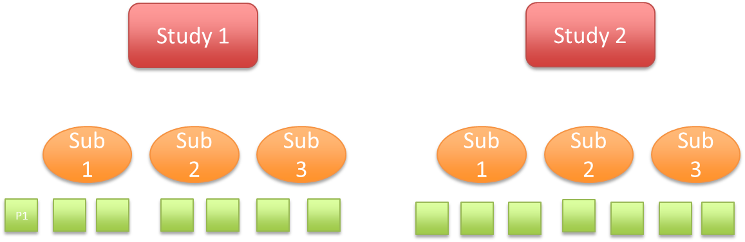
Hierarchical Models
Statistical model written in multiple levels (hierarchical form).

Slide 40
Linking
Treatment effects (e.g., across studies, subgroups, products in the same class) are linked. This linking of the parameters makes their estimation linked.

Slide 41
Exchangeability – a starting point
Subgroups treatment effects are exchangeable if possible orderings of treatment effects are considered equally likely a priori (i.e., before seeing data)
This is fair, not favoring any subgroup treatment effects over any other
Joint prior distribution of subgroup treatment effects is exchangeable
Very unlikely that the joint posterior distribution will be exchangeable

Slide 42
Common choice for a model
Treatment effects drawn randomly from the same distribution implies that treatment effects are exchangeable

Slide 43
Exchangeability
Exchangeability of subgroup treatment effects not always a correct assumption.
Drug expected to be more effective in subgroup of cancer patients who exhibit molecular target than subgroup of patients without target.
Shrinkage analysis incorrectly assuming exchangeability still accounts for a component of variability

Slide 44
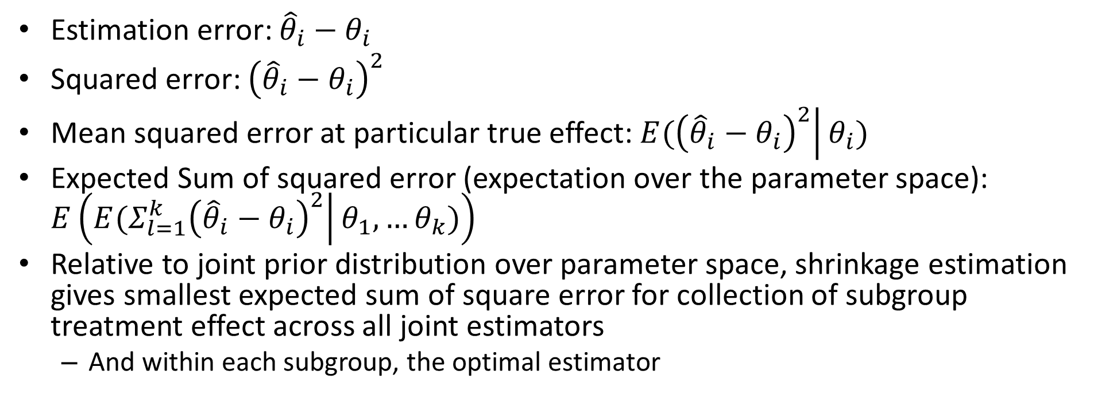
Smallest Expected Mean Square Error
Estimation error: ${\hat{θ}}_{i}−θ_{i}$
Squared error: ${\left({\hat{θ}}_{i}−θ_{i}\right)}^{2}$
Mean squared error at particular true effect:$E(\left.{\left({\hat{θ}}_{i}−θ_{i}\right)}^{2}\right|θ_{i})$
Expected Sum of squared error (expectation over the parameter space): $E\left(E(\left.{Σ_{l=1}^{k}\left({\hat{θ}}_{i}−θ_{i}\right)}^{2}\right|θ_{1},…θ_{k})\right)$
Relative to joint prior distribution over parameter space, shrinkage estimation gives smallest expected sum of square error for collection of subgroup treatment effect across all joint estimators
And within each subgroup, the optimal estimator

Slide 45

Example

Slide 46
LEADER trial
Cardiovascular outcome trial
Liraglutide vs. placebo
Time to first major adverse cardiac event
Rule out a hazard ratio greater than 1.3
Overall Result: HR =0.87 95% CI (0.78, 0.97)

Slide 47
Subgroup Analyses
Region | Results
 | HR (95% CI)
Asia | 0.62 (0.37, 1.04)
Europe | 0.82 (0.68, 0.98)
North America | 1.01 (0.83, 1.22)
The Rest of The World | 0.83 (0.68, 1.03)

Slide 48
Modeling Assumptions
1/τ² is distributed Gamma (.001, .001)
μ is distributed Normal mean 0, variance 16
μ_{i} is distribution Normal mean μ, variance τ² i =1, 2,3 ,4
For i = 1, 2,3, 4 Y_{i} represents the observed subgroup log hazard ratio
Y_{i} is distributed Normal mean μ_{i} variance σ_{i}² where
σ₁² = 0.0688, σ₂² = 0.0088, σ₃² = 0.0094 and σ₄² = 0.114

Slide 49
Defines Joint Prior Distribution
1/τ² is distributed Gamma (.001, .001)
μ is distributed Normal mean 0, variance 16
μ_{i} is distribution Normal mean μ, variance τ² i =1, 2,3 ,4
For i = 1, 2,3, 4 Y_{i} represents the observed subgroup log hazard ratio
Y_{i} is distributed Normal mean μ_{i} variance σ_{i}² where
σ₁² = 0.0688, σ₂² = 0.0088, σ₃² = 0.0094 and σ₄² = 0.114

Slide 50
FDA Shrinkage Analysis
 | Sample estimate |  |  | Bayes Shrinkage estimate
Region | HR | 95% CI |  | HR | 95% CI
Asia | 0.622 | (0.372, 1.040) |  | 0.803 | (0.591, 1.089)
Europe | 0.815 | (0.678, 0.979) |  | 0.836 | (0.715, 0.978)
North America | 1.010 | (0.835, 1.220) |  | 0.936 | (0.786, 1.115)
The Rest of the World | 0.833 | (0.676, 1.027) |  | 0.847 | (0.716, 1.003)

Slide 51
FDA Shrinkage Analysis
 | Sample estimate |  |  | Bayes Shrinkage estimate
Region | HR | 95% CI |  | HR | 95% CI
Asia | 0.622 | (0.372, 1.040) |  | 0.803 | (0.591, 1.089)
Europe | 0.815 | (0.678, 0.979) |  | 0.836 | (0.715, 0.978)
North America | 1.010 | (0.835, 1.220) |  | 0.936 | (0.786, 1.115)
The Rest of the World | 0.833 | (0.676, 1.027) |  | 0.847 | (0.716, 1.003)

Slide 52
FDA Shrinkage Analysis
 | Sample estimate |  |  | Bayes Shrinkage estimate
Region | HR | 95% CI |  | HR | 95% CI
Asia | 0.622 | (0.372, 1.040) |  | 0.803 | (0.591, 1.089)
Europe | 0.815 | (0.678, 0.979) |  | 0.836 | (0.715, 0.978)
North America | 1.010 | (0.835, 1.220) |  | 0.936 | (0.786, 1.115)
The Rest of the World | 0.833 | (0.676, 1.027) |  | 0.847 | (0.716, 1.003)

Slide 53
Example - ACR20 response

Slide 54
Bayesian hierarchical model assumptions
For i = 1, …, k, Yi represents the estimated difference in ACR20 response in a subgroup level i, assume Yi approximately N(μi, σi²) where
σi² are the estimated CMH weighted variance of the difference in ACR20 in subgroup level I
μi ~ N(μ, τ²)
μ ~ N(0, ω²), 1/τ2 ~ Gamma(0.001, 0.001)
ω was chosen to be 4

Slide 55
Shrinkage Estimates
for Treatment Difference

Slide 56
Concluding Remarks

Slide 57
Other models
A one-way hierarchical model that also accounts for an effect modifier
Rothmann, M., Applying Hierarchical Models When Evaluating Treatment Effects Across Regions presented at 2018 ASA Biopharmaceutical Section Regulatory-Industry Statistics Workshop
A multi-way hierarchical model
Example from the SOLVD trial in “Bayesian analysis of heterogeneous treatment effects for patient-centered outcomes research” by Henderson, Louis, Wang and Varadhan

Slide 58
Let’s Do Things Better
Greater precision
narrower 95% CIs
Addresses random highs and random lows
95% CIs have 95% coverage after the data are known
When exchangeability assumptions do not hold, can possibly do even better

Slide 59
Chapter from a new book
Pennello G., Rothmann M., Bayesian Subgroup Analysis with Hierarchical Models, in Biopharmaceutical Applied Statistics Symposium Volume 2: Biostatistical Analysis of Clinical Trials, Eds. Karl E. Peace, Ding-Geng Chen, Sandeep Menon, Springer

Slide 60
Thank You!
Questions!

