Slide 1

Use of external data in randomized clinical trials
Global Drug Development
Analytics
Heinz Schmidli and Marius Thomas
DIA Bayesian WG webinar
January 21, 2022

Slide 2
Disclaimer
The views and opinions expressed in this presentation and on the slides are solely those of the presenter and not necessarily those of Novartis. Novartis does not guarantee the accuracy or reliability of the information provided herein.

Slide 3
Acknowledgements
Beat Neuenschwander, Sebastian Weber, Dieter A. Häring
Sandro Gsteiger, Satrajit Roychoudhury
Anthony O’Hagan, David Spiegelhalter

Slide 4
Outline
Bayesian meta-analytic-predictive (MAP) approach
Case study: RCT in ankylosing spondylitis
Robustness to prior-data conflict
Case study: NEOS trial in pediatric multiple sclerosis
Conclusions

Slide 5
Borrowing strength from trial-external information
Target clinical trial
RCT comparing test treatment vs control
Target clinical trial provides data that may be combined with trial-external information to provide stronger evidence for decision making
Trial-external information often available from diverse sources
Historical/ongoing clinical trials
Methodology
Bayesian meta-analytic-predictive (MAP) approach

Slide 6
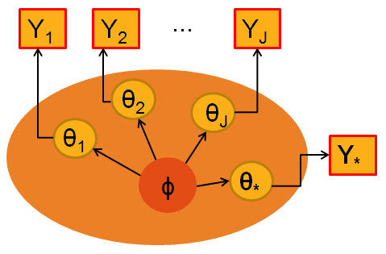
Meta-analytic-predictive (MAP) approach
Source data
p(Y_{j} | θ_{j} ) j=1,...,J
Bayesian inference on unknowns θ* (θ₁, ... , θ_{J} , ϕ )
Target data
p(Y* | θ* )
Hierarchical/meta-analytic model to link parameters (hyper-parameter ϕ)
p( θ*, θ₁, ... , θ_{J} | ϕ )
Prior for hyper-parameter: p( ϕ )

Slide 7
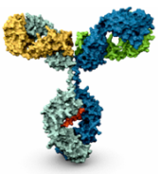
Use of historical controls
Disease
Ankylosing spondylitis
Test treatment
Secukinumab (monoclonal antibody)
Endpoint
Binary: response at week 6
Traditional clinical trial design
Secukinumab (n=24) vs. Placebo (n=24)
Fisher’s exact test
However: 8 similar historical placebo-controlled clinical trials with different test treatments
Could this historical placebo information be used?

Slide 8
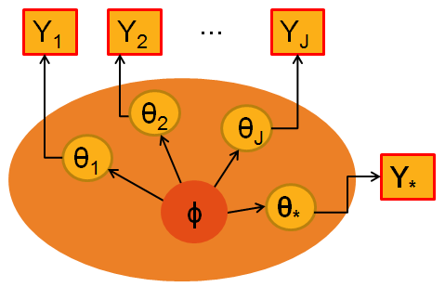
Use of historical controls
J=8 historical placebo-controlled trials
# responders on placebo
Y_{j} ~ Binomial(π_{j}, n_{j})
θ_{j} = logit(π_{j})
Planned clinical trial
# responders on placebo
Y* ~ Binomial(π*, n*)
θ* = logit(π*)
Simplest hierarchical model to link parameters
θ*, θ₁, ... , θ_{J} | μ,τ ~ N(μ,τ² )
Spiegelhalter et al. (2004)
Neuenschwander et al. (2010)
Schmidli et al. (2014)
Mean μ
Between-trial standard deviation τ

Slide 9
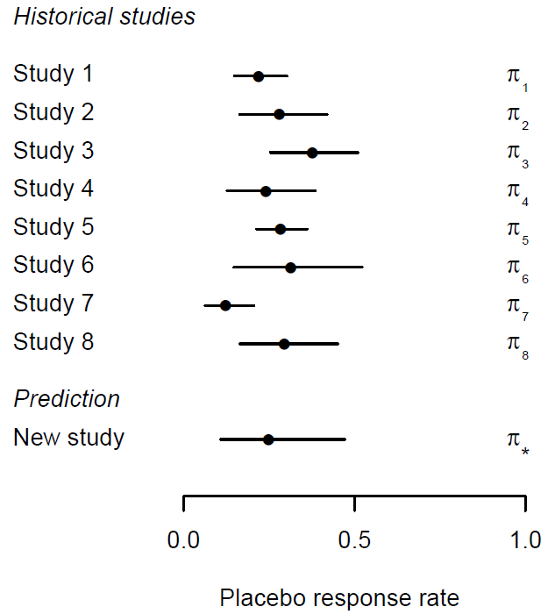
Use of historical controls
Placebo group
Meta-analytic-predictive (MAP)
θ_{j} = logit(π_{j})
θ* = logit(π*)
θ*, θ₁, ... , θ_{J} | μ,τ ~ N(μ,τ² )
Prior information for Placebo in new study p_{MAP}(θ*)

Slide 10
Use of historical controls
Bayesian primary analysis
Prior Placebo Derived from 8 historical trials (N=533), using a
Meta-Analytic-Predictive (MAP) approach, approximated as
Beta(11,32) worth 43=11+32 patients
Prior Test Treatment Weakly informative
Beta(0.5,1) worth 1.5=0.5+1 patients
Design:
Secukinumab (n=24) vs. Placebo (n=6)
Results:
14/23 Secukinumab vs. 1/6 Placebo, p(δ >0 | data) > 99.8%
Baeten et al. (2013) Lancet

Slide 11
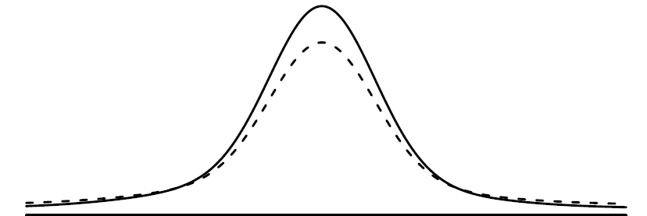
Robustness
Prior p_{MAP}(θ*) derived from historical placebo considered to be relevant, however “... think it possible that you may be mistaken.” Cromwell
Robust prior p_{Robust}(θ*) = (1-ε) p_{MAP}(θ*) + ε p_{Vague}(θ*)
Mixture of prior derived from historical trials and vague prior
Value ε chosen to reflect scepticism on relevance of historical data
Robust priors are heavy-tailed, and hence discarded in case of clear prior-data conflict O'Hagan and Pericchi (2012), Schmidli et al. (2014)
Solid line: p(θ*)
Dashed line: p_{Robust}(θ*) with ε=0.2

Slide 12
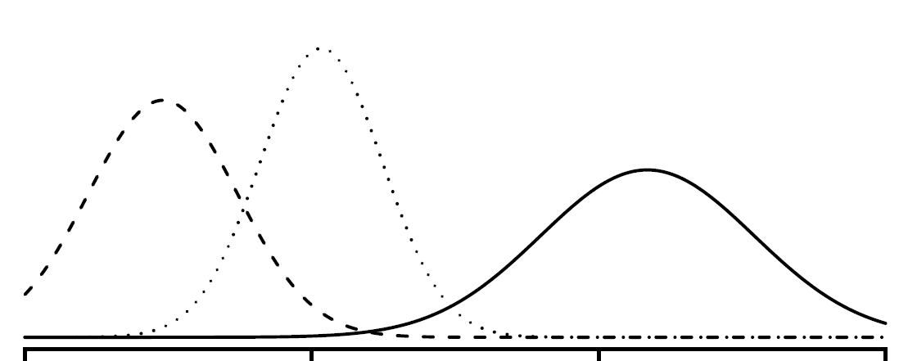
Robustness – hypothetical scenario
Conjugate prior Posterior Conflicting Likelihood
θ*
"Bayesian - One who, vaguely expecting a horse and catching a glimpse of a donkey, strongly concludes he has seen a mule". Stephen Senn

Slide 13
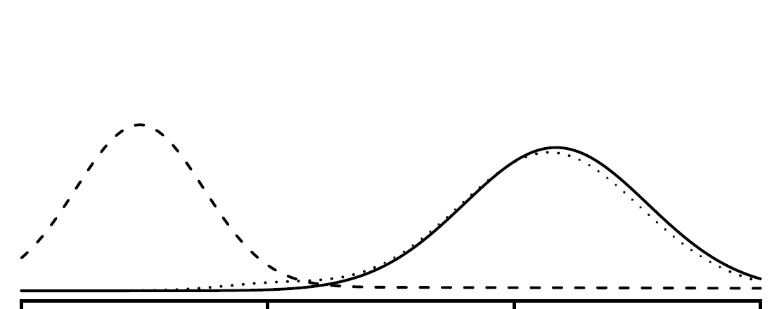

Robustness – hypothetical scenario
Robust prior Posterior / Conflicting Likelihood
Robust prior essentially discarded in case of clear prior-data conflict

Slide 14
Software implementation
R package RBesT: R Bayesian Evidence Synthesis Tools
https://CRAN.R-project.org/package=RBesT Weber et al. (2021)
Implements robust Bayesian meta-analytic-predictive approach
Derive (robust) MAP prior
Asses prior effective sample size (ESS) Neuenschwander et al. (2020)
Evaluate operating characteristics
Bayesian analysis
Vignettes on specific applications
Getting started with RBesT (binary) Ankylosing spondylitis

Slide 15
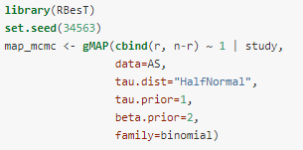
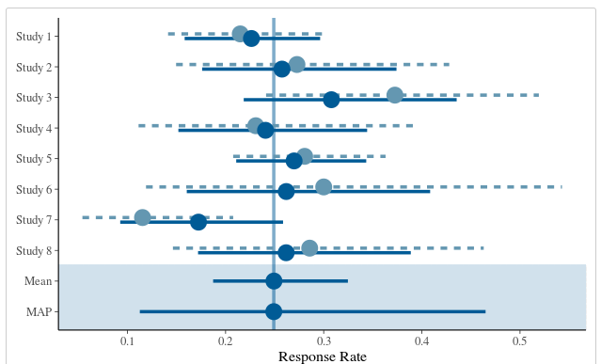
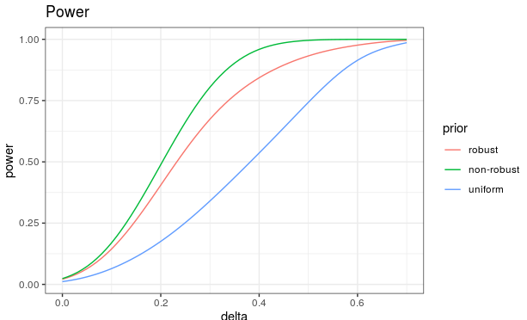
Software implementation

Slide 16

NEOS (NCT04926818): An innovative, efficient trial design in pediatric MS

Slide 17
Background
Pediatric MS is rare: Only ~3-5% of MS cases start in childhood or adolescence^{1,2}
Vulnerable population: Children with MS show higher disease activity (2-3 time higher relapse frequency compared to adults)³, lose brain volume from the onset (i.e. no true remission)⁴, and have worse long-term prognosis, i.e. disabled at younger age⁵
High unmet need: ~20 approved therapies in adults, pediatric patients only 1 approved based on randomized controlled trials in the US (Gilenya, based on only successful trial so far, PARADIGMS)
¹ Ghezzi et al. (1997) Multiple sclerosis in childhood: clinical features of 149 cases. Multiple Sclerosis Journal
² Chitnis T et al. (2009) Demographics of pediatric-onset multiple sclerosis in an MS center population from the Northeastern United States. Multiple Sclerosis Journal
³ Gorman et al., 2009 Increased relapse rate in pediatric-onset compared with adultonset multiple sclerosis. Arch Neurol 2009; 66: 54-9.
⁴ Arnold et al., 2019 Effect of fingolimod on MRI outcomes in patients with paediatric-onset multiple sclerosis: results from the phase 3 PARADIGMS study. Neurology, Neurosurgery & Psychiatry
⁵ Renoux et al. (2007) Natural history of multiple sclerosis with childhood onset. N Engl J Med 2007; 356: 2603-13.

Slide 18
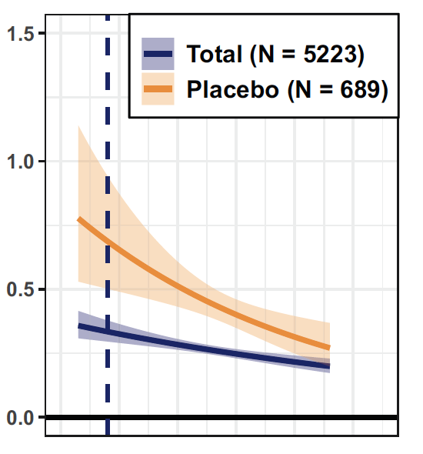
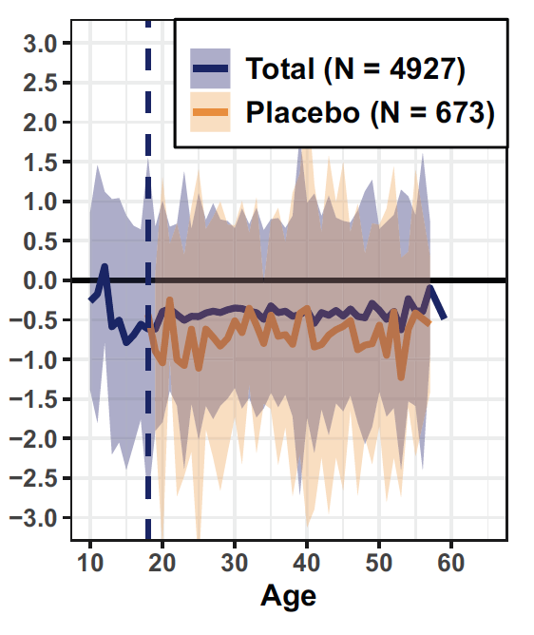

Pediatric MS Key facts
Biological processes involved in MS are largely shared across age span¹
Higher relapse rates than adults but also stronger relative effect size
Irreversible brain volume and loss of neurons from the start (=no true remission)
Brain volume change %
Relapses per year
¹ Waubant et al. Neurology 2019.
Figures from Dahlke et al. (2021) Characterization of MS phenotypes across the age span. Multiple Sclerosis Journal. Total refers to active and placebo treated patients.

Slide 19
Challenging recruitment with competitive trial landscape and rarity of pediatric MS population makes feasibility a key concern
Fingolimod approved in US in pediatric MS
PARADIGMS enrolment re-opened for 10-12 year olds
 | n | 2013 | 2014 | 2015 | 2016 | 2017 | 2018 | 2019 | 2020 | 2021 | 2022 | 2023 | 2024
PARADIGMS NCT01892722 | 215 / 30
TERIKIDS NCT02201108 | 165
CONNECT NCT02283853 | 156
LEMKIDS NCT03368664 | 50
DMF, Peginterferon vs. IFN NCT03870763 | 260
Peginterferon efficacy RCT NCT03958877 | 142
Ocrelizumab PK study NCT04075266 | 36
Phase 1 Metformin NCT04121468 | 30
Ocrelizumab (confirmatory)* | NK
Evobrutinib* | NK
Ponesimod* | NK
Ozanimod* | NK
GNbAC1* | NK
Approval
Enrolment completed
Enrolment ongoing*
Enrolment upcoming
*Estimated
NK = Not Known
Today

Slide 20
NEOS trial summary
2-year double-blind, triple-dummy Phase 3 study in pediatric MS to establish the efficacy and safety 2 novel MS treatments :
New test drug 1: Kesimpta (ofatumumab): first fully human anti-CD20 monoclonal antibody treatment, approved worldwide in adults
New test drug 2: Mayzent (siponimod): S1P modulator, approved worldwide in adults
Non-inferiority design vs active control Gilenya (fingolimod):
Active control: Gilenya (fingolimod): Approved treatment for pediatric MS; reduced relapse rates vs interferon beta-1a by 82% in a randomized double-blind clinical trial (PARADIGMS¹)
Active control avoids placebo or low efficacy comparator, minimizing the risk of MS relapses, which can be associated with irreversible disability
Primary endpoint: Annualized relapse rate (ARR), analyzed via negative binomial model (standard phase 3 endpoint in MS)
¹PARADIGMS is so far the only successfully completed RCT to confirm the efficacy of a DMT in pediatric MS.

Slide 21
Can we extrapolate from adults to children in MS?
Extrapolation from adult patients from the TRANSFORMS study in year 2010. Predictions of relapse rates at age 15.3 (the mean age of the PARADIGMS study) from a negative binomial model with age x treatment interaction (the model was built in year 2010).
Projections |  | Between-treatment comparison
Treatment | Adjusted ARR (95% CI) | % rate reduction | ARR ratio (95% CI) | P-value
IFNß-1a N=431 | 0.667 | 81.7% | 0.183 | <.001
FTY720 N=429 | 0.122
K=0.824
Model contained all FAS patients from TRANSFORMS, including 420 on FTY 1.25 mg. Shown here are only FTY 0.5mg and IFN beta-1a

Slide 22
Can we extrapolate from adults to children in MS?
Extrapolation from adult patients from the TRANSFORMS study in year 2010. Predictions of relapse rates at age 15.3 (the mean age of the PARADIGMS study) from a negative binomial model with age x treatment interaction (the model was built in year 2010).
Projections |  | Between-treatment comparison
Treatment | Adjusted ARR (95% CI) | % rate reduction | ARR ratio (95% CI) | P-value
IFNß-1a N=431 | 0.667 | 81.7% | 0.183 | <.001
FTY720 N=429 | 0.122
K=0.824
Model contained all FAS patients from TRANSFORMS, including 420 on FTY 1.25 mg. Shown here are only FTY 0.5mg and IFN beta-1a
Observed primary results from PARADIGMS (FTYD2311) in year 2017
Treatment | Adjusted ARR (95% CI) | % rate reduction | ARR ratio (95% CI) | P-value
IFNß-1a N=107 | 0.675 (0.515,0.885) | 81.9% | 0.181 (0.108,0.303) | <.001
FTY720 N=107 | 0.122 (0.078,0.192)
Gilenya: 25 relapses in 180 patient-years: ARR=0.14
IFN: 120 relapses in 163 patient-years: ARR=0.73
K=0.835
Model contained all FAS patients from PARADIGMS which included an FTY and an IFN beta-1a arm

Slide 23
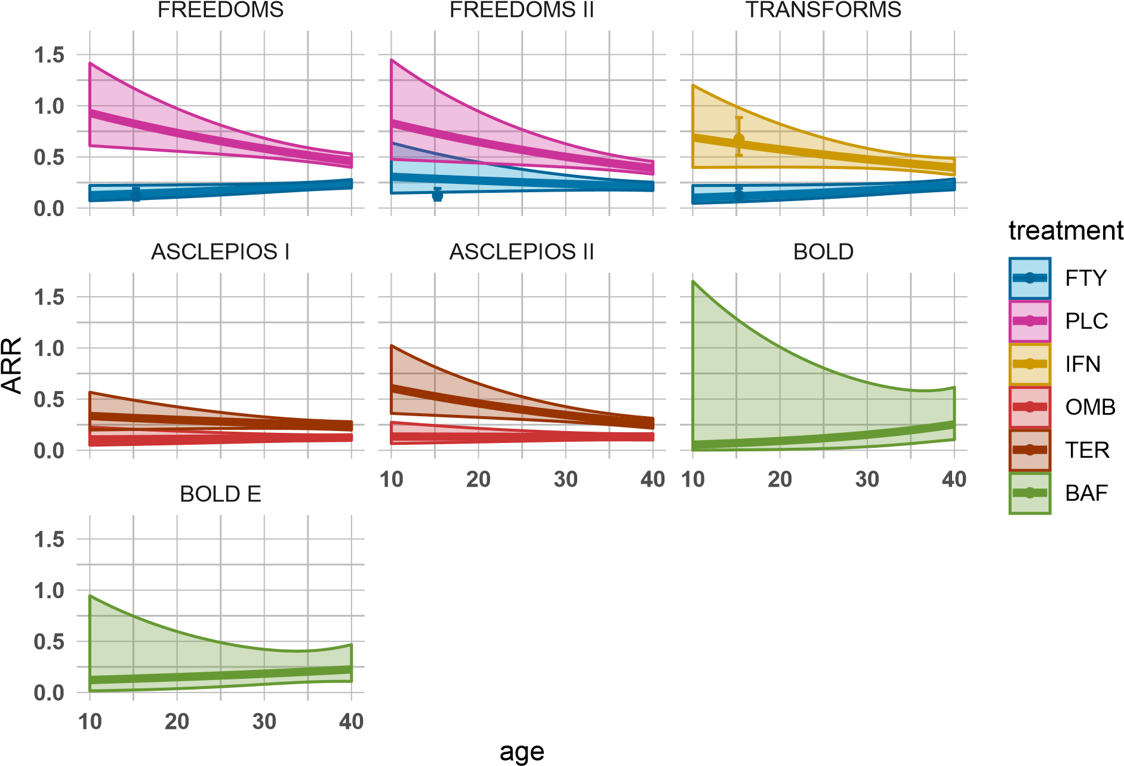
Phase 3 data in adults with MS is typically available at the start of a new pediatric study and can be leveraged
Extrapolation from adult phase 3 data to pediatric patients for placebo and different DMTs
Relapse frequency is strongly age dependent in untreated patients or under low efficacy treatment.
Age-dependent extrapolation from adults to pediatric MS patients should be considered to inform new trial design options
PARADIGMS
Lines and confidence boundaries are based on negative binomial models of relapse rates, extrapolated from trials in adults to pediatric patients. N refers to the sample size of the trials in adults. The point estimates and confidence intervals represent the observed ARR in children in PARADIGMS.

Slide 24
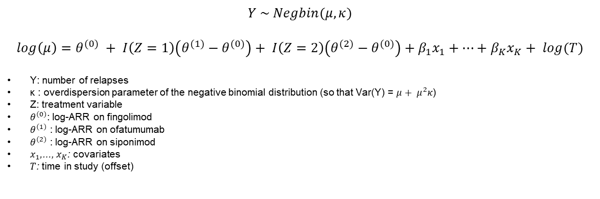
Primary analysis model
$$Y \sim Negbin(μ, κ)$$
$$log\left(μ\right)=θ^{(0)} + I\left(Z=1\right)\left(θ^{(1)}−θ^{(0)}\right)+ I\left(Z=2\right)\left(θ^{(2)}−θ^{(0)}\right)+β_{1}x_{1}+…+β_{K}x_{K}+ log(T)$$
Y: number of relapses
κ : overdispersion parameter of the negative binomial distribution (so that Var(Y) = $μ+ μ^{2}κ$)
Z: treatment variable
$θ^{(0)}$: log-ARR on fingolimod
$θ^{(1)}$ : log-ARR on ofatumumab
$θ^{(2)}$ : log-ARR on siponimod
$x_{1}$,..., $x_{K}$: covariates
$T$: time in study (offset)
Relapse data is available from 4 historical studies for comparator fingolimod (3 in adults, 1 in children), 2 adult studies for ofatumumab, 2 adult studies for siponimod
Historical data for each study consists of (extrapolated) log-ARR and standard error estimates for each study
Meta-analytic predictive approach is used to prospectively define priors for the log-ARR in the new study

Slide 25
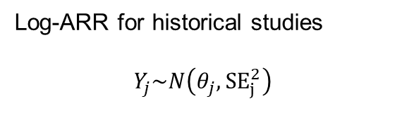
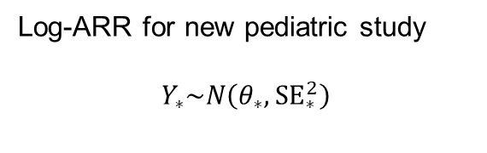
Incorporating historical data
Log-ARR for historical studies
$$Y_{j}\sim N\left(θ_{j}, {SE}_{j}^{2}\right)$$
Log-ARR for new pediatric study
$$Y_{∗}\sim N\left(θ_{∗}, {SE}_{∗}^{2}\right)$$
Simplest hierarchical model to link parameters
θ*, θ₁, ... , θ_{J} | μ,τ ~ N(μ,τ² )
Spiegelhalter et al. (2004)
Neuenschwander et al. (2010)
Schmidli et al. (2014)
Mean μ
Between-trial standard deviation τ

Slide 26
Protecting against prior-data conflicts
Extrapolation from adults accurate and consistent, however limited data from pediatric trials available (in particular none for ofatumumab and siponimod)
Exchangeability assumption can be relaxed by adding vague, weakly-informative components to the MAP mixture¹ :
p_{Robust}(θ*) = (1-ε) p_{MAP}(θ*) + ε p_{Vague}(θ*)
Mixture weight ε chosen to reflect skepticism on relevance of source data
Robust priors are heavy-tailed, and hence informative part is discarded in case of prior-data conflicts
Use ε = 0.2 for fingolimod and ε = 0.5 for ofatumumab and siponimod to reflect lack of pediatric data for the investigational drugs
¹ Schmidli H, Gsteiger S, Roychoudhury S, et al (2014). Robust meta‐analytic‐predictive priors in clinical trials with historical control information. Biometrics; 70(4): 1023-1032.

Slide 27
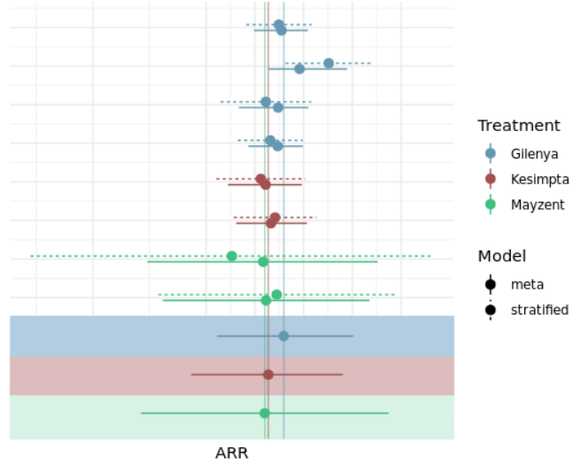
Bayesian study design is efficient and robust
Extrapolated ARR estimates from individual studies and derived MAP-priors
Meta-analytic predictive approach allows robust incorporation of historical data from adults
Reduction in required sample size: prior information is worth approx. 90 patients
Allows for an efficient study design with adequate power that is also scientifically robust (i.e. type I error rates are controlled for relevant scenarios)
Historical studies
MAP priors

Slide 28
CID pilot program and HA interactions
OMB standalone study design proposal was accepted for FDA’s Complex Innovative Designs Pilot program:
Goal of the program is to facilitate novel innovative designs
Main topics for discussion with regulators:
Choice of non-inferiority margin
Extrapolation from adults (age-dependent disease activity levels is MS):
Accuracy of extrapolation model predictions
Covariates to take into account
Bayesian priors:
Weight given to the informative component of the prior
Type I error rate control
Impact of double-use of historical information for NI-margin and priors

Slide 29
Key modifications on study design based on HA feedback
Non-inferiority margin, after discounting, changed to 2.0 (instead of 3.0) with additional upper limit of the ARR (0.3) on test drugs to conclude non-inferiority vs fingolimod; as a consequence sample size increased from 50 to 60 patients per arm
Key secondary analysis added to compare test treatments versus historical interferon data (based on a meta-analysis of historical studies)
Ofatumumab and siponimod studies were combined into one design based on recommendation from FDA and EMA
Tipping point sensitivity analysis prespecified to assess robustness of conclusions from Bayesian analysis under different weights to prior information; i.e. from pre-spedified weight to a «no borrowing» strategy (frequentist design)
Final study design was accepted by both FDA and EMA/PDCO

Slide 30
Conclusions
Bayesian designs that borrow strength from trial-external data are
Scientifically robust
Ethical / minimize burden and risk
Efficient
Feasible
NEOS uses robust meta-analytic approach to robustly incorporate historical data
Partial extrapolation leverages historical data from large Phase 3 adult trials
Critical to reduce sample size in a rare disease setting with vulnerable population
Accepted by FDA/EMA
First patient recruited into the study in October 2021

Slide 31
References
Neuenschwander B, Capkun-Niggli G, Branson M, Spiegelhalter DJ (2010) Summarizing historical information on controls in clinical trials. Clin Trials 7(1):5-18.
Neuenschwander B, Weber S, Schmidli H, O’Hagan A (2020) Predictively consistent prior effective sample sizes (with discussion). Biometrics 76(2): 578-605.
O'Hagan A, Pericchi L (2012) Bayesian heavy-tailed models and conflict resolution: a review. Braz J Prob Stat 26, 372-401.
Pocock S (1976) The combination of randomized and historical controls in clinical trials. J Chron Dis 29, 175-188.
Schmidli H, Häring DA, Thomas M, Cassidy A, Weber S, Bretz F (2020) Beyond randomized clinical trials: Use of external controls. Clinical Pharmacology & Therapeutics 107(4), 806-816.
Schmidli H, Gsteiger S, Roychoudhury S, O'Hagan A, Spiegelhalter D, Neuenschwander B. (2014) Robust meta‐analytic‐predictive priors in clinical trials with historical control information. Biometrics 70(4), 1023-1032.
Spiegelhalter DJ, Abrams KR, Myles JP (2004) Bayesian Approaches to Clinical trials and Health-Care Evaluation. Chichester: John Wiley and Sons.
Weber S, Li Y, Seaman J, Kakizume T, Schmidli H (2021) Applying Meta-Analytic Predictive Priors with the R Bayesian evidence synthesis tools. J Stat Software 100(19), 1–32.

