Slide 1

The Epistemological Superiority of Bayesian Inference over Frequentist Inference Inferring What is Likely To Be True
DIA Bayesian Statistics Working Group
26 August 2022

Slide 2
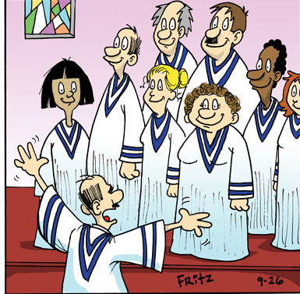
Background
Perspective
My journey into Bayesian thinking
Never took a Bayesian class
Never did a Bayesian analysis
What can I possibly say to this august group?

Slide 3
Objectives
Tell stories
Give examples
Help with communication/teaching
Even a few new ideas

Slide 4
Part 0
Some History

Slide 5
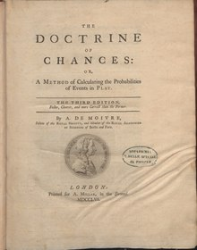
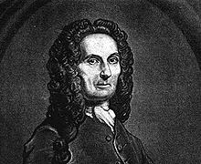

History
Abraham de Moivre
Know the “model” (i.e., truth)
Coin, dice, etc.
Probability ≡ Frequency of events
When N is infinite
1711, 1718, …

Slide 6
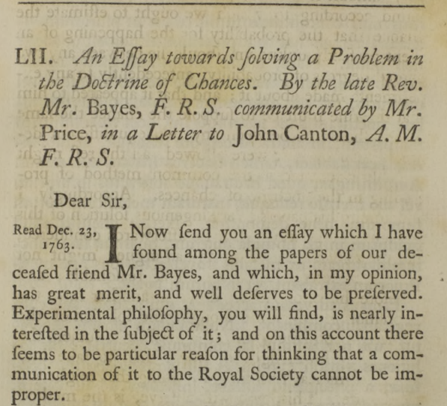
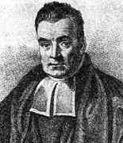
History
??
Rev. Thomas Bayes, FRS

Slide 7
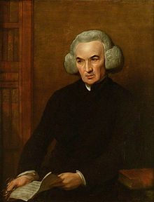
History
“But I know of no person who has shown how to deduce the solution of the converse problem to this; namely, the number of times an unknown event has happened and failed being given, to find the chance that the probability of its happening should lie somewhere between any two named degrees of probability.”
Rev. Richard Price, FRS

Slide 8
Part 1
The First
Story on
My Journey

Slide 9



Thought Experiment
10% Probability
IF I WIN
$300,000,000
90% Probability

Slide 10
Thought Experiment
How likely are you to receive a share of the winnings?
90% likely
50% likely
Small likelihood
Very, very small likelihood
10% Probability
IF I WIN
$300,000,000
90% Probability

Slide 11
Conditional Probability
Example of Conditional Probability
The key word is IF
Very low probability of winning (odds: 1:292,301,338)
Solution:
Pr (you receive a share)
= Pr (I choose to share IF I win) * Pr (I win)
= .90 * 0.0000000034211
= 0.00000000307901
Unconditional
Conditional

Slide 12
Conditional Probability
Pr(study success) ≈ “Bayesian Power”
Probability is hard!
Conditional probability
is even harder!!
(despite the simple example just given)
What about other Bayesian concepts?

Slide 13
Part 2
My Thought
Experiment on
My Journey

Slide 14

Another Thought Experiment
10,000 Coins
Problem
I draw out one coin.
I will flip it repeatedly and tell you the result.
You tell me when you decide whether I have the Biased Coin or not.
9,999 Fair Coins (H/T)
1 Biased Coin (H/H)

Slide 15
The Bet
Number of Flips | Result | Biased Coin?
Number of Flips | Result | Biased Coin?
1
H
Y or N
11
H
Y or N
2
H
Y or N
12
H
Y or N
3
H
Y or N
13
H
Y or N
4
H
Y or N
14
H
Y or N
5
H
Y or N
15
H
Y or N
6
H
Y or N
16
H
Y or N
7
H
Y or N
17
H
Y or N
8
H
Y or N
18
H
Y or N
9
H
Y or N
19
H
Y or N
10
H
Y or N
20
H
Y or N

Slide 16
A Problem of Inference
Decision Rule: See N consecutive H’s
H₀: Coin is fair
pr(heads) = 0.50
H_{a}: Coin is biased
pr(heads) = 1.00
Reject H₀ with a p-value < 0.001 !
Highly likely I have selected the biased coin !
pr[N consecutive heads | fair coin] = (0.50)^{N}
N is your choice (based on your risk)
Defines the significance level of the test
Suppose n=10 consecutive H’s are observed
pr[n consecutive heads | fair coin] = (0.50)¹⁰ = 0.0009766
Defines the significance level of the data
or the p-value

Slide 17
A Problem of Inference
NHST* ≅ proof by contradiction
We want H_{a} to be true**
or
We want to evaluate
pr(H_{a} is true | observed data) ≡
pr(H₀ is false | observed data)
*Null Hypothesis Significance Testing
** Except in equivalence testing

Slide 18
A Problem of Inference
Question of Interest
How many consecutive H’s are needed to bet that I selected the Biased Coin?
What is the pr(I pulled the biased coin)?
or
When is pr(biased coin | n) > 0.50?

Slide 19
A Problem of Inference
pr(bias coin selected | n consecutive heads observed) = pr(H_{a}|n).
Bayes Theorem
[as formulated by LaPlace (1812)]
pr(H_{a}|n) = pr(n|H_{a}) p(H_{a}) / [ pr(n|H_{a}) p(H_{a}) + pr(n|H₀) p(H₀) ]
= 1 * (1/10,000) / [ 1* (1/10,000) + (.5^{n} * (9999/10,000) ]
pr[biased coin | 10 consecutive heads] = 0.093
Highly unlikely I have selected the biased coin !
Don’t make the bet !

Slide 20
A Problem of Inference
How did we get
into this mess?

Slide 21
Two Perspectives
What is the probability of seeing N consecutive heads IF I have a fair coin?
Frequentist Approach
What is the probability that I selected the biased coin IF I observe N consecutive heads … [from a coin randomly drawn from a bag of 9,999 fair coins and 1 biased coin]?
Bayesian Approach

Slide 22
Frequentists Results
Number of Flips | Result | p-value
1 | H | 0.500000000
2 | H | 0.250000000
3 | H | 0.125000000
4 | H | 0.062500000
5 | H | 0.031250000
6 | H
7 | H
8 | H
9 | H
10 | H
Number of Flips | Result | p-value
11 | H
12 | H
13 | H
14 | H
15 | H
16 | H
17 | H
18 | H
19 | H
20 | H
0.000488281
0.000244141
0.000122070
0.000061035
0.000030518
0.015625000
0.000015259
0.007812500
0.000007629
0.003906250
0.000003815
0.001953125
0.000001907
0.000976563
0.000000954

Slide 23
Frequentists Results
Pr (13 consecutive H’s with a fair coin) = 0.000122070
≅ 1.2/10,000
Pr (Pull the 1 biased coin from the bag) = 1/10,000
Pr (14 consecutive H’s with a fair coin) = 0.000061035
≅ 0.6/10,000
More Likely
Less Likely

Slide 24
Frequentists Results
P-value is conditional on H₀ being true.
P-value = Pr(reject H₀ | H₀ is true)
Recall the Lottery Example
Pr (you receive a share)
= Pr (I choose to share IF I win) * Pr (I win)
What’s Pr(H₀ is true)?
9,999/10,000
More on this later !!

Slide 25
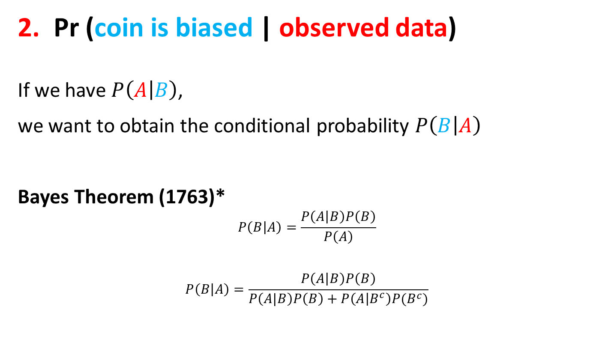
Two Perspectives
Pr (coin is biased | observed data)
If we have $P\left(A | B\right)$,
we want to obtain the conditional probability $P\left(B | A\right)$
Bayes Theorem (1763)*
$$P\left(B | A\right)=\frac{P\left(A | B\right)P\left(B\right)}{P\left(A\right)}$$
$$P\left(B | A\right)=\frac{P\left(A | B\right)P\left(B\right)}{P\left(A|B\right)P\left(B\right)+P\left(A | B^{c}\right)P(B^{c})}$$
*As formulated by Laplace (1812)

Slide 26
Bayesian Results
Number of Flips | Result | Pr(Biased Coin)
1 | H | 0.000200
Some Observations
We started with 1/10,000 chance of pulling the biased coin.
With one small piece of evidence (i.e. a single H), we have a little greater probability that I have pulled the biased coin (i.e. 2/10,000).

Slide 27
Bayesian Results
Number of Flips | Result | Pr(Biased Coin)
1 | H | 0.000200
2 | H
3 | H
4 | H
5 | H
6 | H
7 | H
8 | H
9 | H
10 | H
Number of Flips | Result | Pr(Biased Coin)
11 | H
12 | H
13 | H
14 | H
15 | H
16 | H
17 | H
18 | H
19 | H
20 | H
0.170001
0.000400
0.290600
0.000799
0.450333
0.001598
0.621006
0.003190
0.766198
0.006360
0.867624
0.012639
0.929121
0.024968
0.963258
0.048711
0.981285
0.092897
0.990554

Slide 28
Bayesian Results
Pr (Biased coin | 13 consecutive H’s) = 0.450333
≅ 45%
Even odds for the bet = Pr(biased coin) = 50%
Pr (Biased coin | 14 consecutive H’s) = 0.621006
≅ 62%
Less Likely to Win Bet
More Likely to Win Bet

Slide 29
A Problem of Inference
Problem
I draw out one coin.
I will flip it repeatedly and tell you the result.
You tell me when you decide whether I have the Biased Coin or not.
100 Coins
99 Fair Coins (H/T)
1 Biased Coin (H/H)

Slide 30
The Results
Number of Flips | Result | Biased Coin?
1 | H
2 | H
3 | H
4 | H
5 | H
6 | H
7 | H
8 | H
9 | H
10 | H
Number of Flips | Result | Biased Coin?
11 | H
12 | H
13 | H
14 | H
15 | H
16 | H
17 | H
18 | H
19 | H
20 | H

Slide 31
The Results
Number of Flips | Prior = 1/10,000 Pr(Biased Coin) | Prior = 1/100 Pr(Biased Coin)
1 | 0.000200 | 0.019802
2 | 0.000400
3 | 0.000799
4 | 0.001598
5 | 0.003190
6 | 0.006360
7 | 0.012639
8 | 0.024963
9 | 0.048711
10 | 0.092897
Number of Flips | Prior = 1/10,000 Pr(Biased Coin) | Prior = 1/100 Pr(Biased Coin)
11 | 0.170001
12 | 0.290600
13 | 0.450333
14 | 0.621006
15 | 0.766198
16 | 0.867624
17 | 0.929121
18 | 0.963258
19 | 0.981285
20 | 0.990554
~2/100

Slide 32
The Results
Number of Flips | Prior = 1/10,000 Pr(Biased Coin) | Prior = 1/100 Pr(Biased Coin)
1 | 0.000200 | 0.019802
2 | 0.000400 | 0.038835
3 | 0.000799 | 0.074766
4 | 0.001598 | 0.139130
5 | 0.003190 | 0.244275
6 | 0.006360 | 0.392638
7 | 0.012639 | 0.563877
8 | 0.024963 | 0.721127
9 | 0.048711 | 0.837971
10 | 0.092897 | 0.911843
Number of Flips | Prior = 1/10,000 Pr(Biased Coin) | Prior = 1/100 Pr(Biased Coin)
11 | 0.170001
12 | 0.290600
13 | 0.450333
14 | 0.621006
15 | 0.766198
16 | 0.867624
17 | 0.929121
18 | 0.963258
19 | 0.981285
20 | 0.990554

Slide 33
The Results
Number of Flips | Prior = 1/10,000 Pr(Biased Coin) | Prior = 1/100 Pr(Biased Coin)
1 | 0.000200 | 0.019802
2 | 0.000400 | 0.038835
3 | 0.000799 | 0.074766
4 | 0.001598 | 0.139130
5 | 0.003190 | 0.244275
6 | 0.006360 | 0.392638
7 | 0.012639 | 0.563877
8 | 0.024963 | 0.721127
9 | 0.048711 | 0.837971
10 | 0.092897 | 0.911843
Number of Flips | Prior = 1/10,000 Pr(Biased Coin) | Prior = 1/100 Pr(Biased Coin)
11 | 0.170001 | 0.953889
12 | 0.290600 | 0.976400
13 | 0.450333 | 0.988059
14 | 0.621006 | 0.993994
15 | 0.766198 | 0.996988
16 | 0.867624 | 0.998492
17 | 0.929121 | 0.999245
18 | 0.963258 | 0.999622
19 | 0.981285 | 0.999811
20 | 0.990554 | 0.999906

Slide 34
The Results
# of Flips | p-value | Prior = 1/10,000 Pr(Biased Coin) | Prior = 1/100 Pr(Biased Coin)
1 | 0.500000 | 0.000200 | 0.019802
2 | 0.250000 | 0.000400 | 0.038835
3 | 0.125000 | 0.000799 | 0.074766
4 | 0.062500 | 0.001598 | 0.139130
5 | 0.031250 | 0.003190 | 0.244275
6 | 0.015625 | 0.006360 | 0.392638
7 | 0.0078125 | 0.012639 | 0.563877
8 | 0.0039063 | 0.024963 | 0.721127
9 | 0.0019531 | 0.048711 | 0.837971
10 | 0.0009766 | 0.092897 | 0.911843
# of Flips | p-value | Prior = 1/10,000 Pr(Biased Coin) | Prior = 1/100 Pr(Biased Coin)
11 | 0.0004882 | 0.170001 | 0.953889
12 | 0.0002441 | 0.290600 | 0.976400
13 | 0.0001220 | 0.450333 | 0.988059
14 | 0.0000610 | 0.621006 | 0.993994
15 | 0.0000305 | 0.766198 | 0.996988
16 | 0.0000153 | 0.867624 | 0.998492
17 | 0.0000076 | 0.929121 | 0.999245
18 | 0.0000038 | 0.963258 | 0.999622
19 | 0.0000019 | 0.981285 | 0.999811
20 | 0.0000010 | 0.990554 | 0.999906
Note: The p-value never changes
regardless of your prior knowledge!!!!

Slide 35
VERY Important Lesson
For the SAME DATA
(i.e., evidence),
you arrive at
DIFFERENT CONCLUSIONS
(i.e., decisions)
based on your
PRIOR KNOWLEDGE!

Slide 36
Coin in Bag Summary
Cannot interpret a p-value in isolation
Need to know prior belief
about H₀ (or H_{a})
p-value = pr(T > c | H₀ is true)
Conditional probability
Test Statistic
How likely is this?
critical value

Slide 37
Coin in Bag Summary
Frequentist ⇨ pr(Data|H₀)
Bayesian ⇨ pr(H₀|Data)
as different as
Pr(cloudy | rain)
Pr (rain | cloudy)

Slide 38
A Problem of Inference
Traditionally, statisticians have been “selling”
Pr(data|hypothesis) [i.e., the p-value]
to scientists who have fully adopted its use and (almost) uniformly use p<0.05 as the gold standard …
when what they/we REALLY want is
Pr(hypothesis|data) [“Bayesian” probability]
to quantify the likelihood of a hypothesis !!!!!!
The first great “bait and switch” that statistican have pulled on scientists

Slide 39
Part 3
Another Story on
My Journey

Slide 40
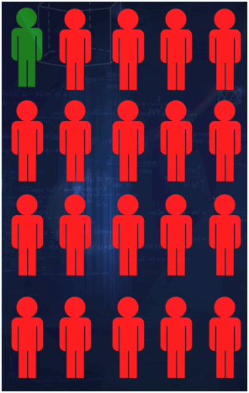
Another Thought Experiment
5% of Population have ALK gene

Slide 41
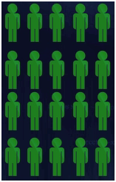

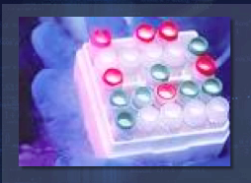
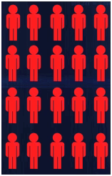
Patients
95%
Sensitivity
Diagnostic Test
95% Specificity
1 +
19 -’s

Slide 42

Individual Patient
ALK(-)?
Diagnostic Test
+
Sample
Result
ALK(+)?
Pr(Patient is ALK+) = ?

Slide 43
Diagnostic Decision-Making
Developing/Designing the “Assay”
Conditional Probability
Patient Characteristic
Positive
Negative
True Positive
95%
(Sensitivity)
False Positive
5%
Positive
Diagnostic Test
False Negative
5%
True Negative
95%
(Specificity)
Negative
Prob ( diagnostic test is positive IF the patient has the characteristic)

Slide 44
Diagnostic Decision-Making
Interpreting an Observed Result
Conditional Probability
Patient Characteristic
(Unknown Truth)
Observed
↓
Positive
Negative
Positive Predictive Value
Positive
True Positive
95%
False Positive
5%
Diagnostic Test
False Negative
5%
True Negative
95%
Negative Predictive Value
Negative
Prob (patient has the characteristic IF the diagnostic test is positive )

Slide 45
Diagnostic Decision-Making
Underlying Prevalence for ALK gene is 5%
Have the ALK Gene
Positive (5%)
Negative (95%)
95
95
50%
TP
TP + FP
Positive
True Positive
95%
False Positive
5%
Positive Predictive Value
Diagnostic Test
5
1805
99.7%
TN
TN + FN
Negative
False Negative
5%
True Negative
95%
Negative Predictive Value
100
1900
2000

Slide 46
Diagnostic Decision-Making
With a great diagnostic test, but a low prevalence,
There is a 50/50 chance you have the ALK gene!
But wait … what if we re-test?
Think of all the false positives with COVID
Think of diagnostic testing
X-ray ⇨ CT Scan ⇨ Needle Biopsy
Each step – more expensive, time-consuming, invasive
But, identifying higher prevalence population!

Slide 47
Diagnostic Decision-Making
With a great diagnostic test, but a low prevalence
There is a 50/50 you have the ALK gene!
But wait … what if we re-test?
Repeat the ALK test on all patients who tested positive
Prevalence is now 50%
Let’s rework the diagnostic test 2x2 table

Slide 48
Diagnostic Decision-Making
Prevalence of ALK in patients who tested positive is 50%
Have the ALK Gene
Positive (50%)
Negative (50%)
950
50
95%
Positive
True Positive
95%
False Positive
5%
Positive Predictive Value
Diagnostic Test
50
950
95%
Negative
False Negative
5%
True Negative
95%
Negative Predictive Value
1000
1000
2000

Slide 49
Diagnostic Decision-Making
KEY MESSAGES
Sensitivity and Specificity are the focus of assay design and development
Sensitivity ≡ Power; 1-Specificity ≡ α
The Positive (Negative) Predictive Values are the focus of interpreting results (assay outputs)
Everyone knows this
PPV is what matters to physicians and patients

Slide 50
Diagnostic Decision-Making
KEY MESSAGES
PPV (NPV) is dependent on the underlying PREVALENCE of the characteristic of interest (e.g., disease/marker status)
PREVALENCE is the “prior.”
PPV ≡ Bayes Formula (slides 19, 25) !!!

Slide 51
The Clinical Trial Analogy
The diagnostic test is the clinical trial
The patient characteristic is whether the treatment meets its Critical Success Factors (unknown truth)
Sensitivity and (1-Specificity) are analogous to “power” and “significance level” of the hypothesis test for the CT
The PPV (NPV) is “Bayesian posterior probability” that the treatment meets (fails) the CSF
THE PPV (NPV) ARE DEPENDENT ON THE PRIOR PROBABILITY OF THE TREATMENT MEETING THE CSF

Slide 52
The Clinical Trial Analogy
Entering Ph 2 ⇒ Pr(drug meets CSFs) = 20%
Meets CSFs
“Prior”
Unknown →
Moderately Rigorous Ph 2 Trial Design
Yes (20%)
No (80%)
True Positive 80%
(“Power” for a
Ph 2 Trial)
False Positive 10%
(“Significance Level” for Ph 2)
320
160
Positive Predictive Value
Positive
66.7%
CT Result
“Posterior”
80
1440
94.7%
Negative
False Negative
20%
True Negative
90%
Negative Predictive Value
↑
Observed
400
1600
2000

Slide 53
Conclusion on Inference
If we all understand PPV is the proper metric for evaluating the likelihood of a (unknown) condition to be present/true using a diagnostic test …
and …
A clinical trial is a direct analogy to a diagnostic test …
then …
Why do we not routinely use the Bayesian Posterior Probability to interpret a clinical trial result ?!?!?!?!
We Should !!!

Slide 54
PAUSE

Slide 55
Part 4
How do we get
out of this mess?

Slide 56
A Path Forward
Three Inferential Questions*
What does the data say?
A p-value is a partial/poor answer.
What do I believe?
This requires incorporation of prior information.
What do I decide?
This requires a utility function.
*Royall, R. M. (1997), Statistical Evidence: A Likelihood Paradigm, volume 71 of Monographs on Statistics and Applied Probability. London: Chapman & Hall.

Slide 57
A Path Forward
Question 1 – What do the data say?
A p-value is only part of the story.
Scientists (everyone!) wants this.
Frequentist
PRIOR KNOWLEDGE
NEW
EXPERIMENT
UPDATED BELIEF
Prior Probability
H₀ is False
New Evidence
(e.g., p-value)
Posterior Probability
H₀ is False
Think: pr(I get money from the lottery).

Slide 58
A Path Forward
Question 2 – What do I believe?
Let p₀ be the prior probability that H₀ is false.
Let p=p-value from the test of H₀ from the current experiment.
The Bayes Factor Bound is
BFB=1/[-e*p*ln(p)] (p < 1/e).
The upper bound on the posterior probability that H₀ is false (p₁) given the observed data is
p₁ ≤ {1 + [(1-p₀)/p₀] / BFB }⁻¹.
posterior
prior
data
Thomas Sellke, M. J Bayarri & James O Berger (2001) Calibration of p Values for Testing Precise Null Hypotheses, The American Statistician, 55:1, 62-71.

Slide 59
Another Thought Experiment
Suppose there are 100 potential predictive biomarkers that could be important for a new treatment.
100 hypothesis tests, one for each biomarker
Observed p-value = 0.0001 for one biomarker test
Bonferroni adjusted p-value ≤ 100 * 0.0001 = 0.01
EUREKA! We have discovered a novel biomarker-defined subgroup.

Slide 60
Another Thought Experiment
ARE YOU SURE?
Suppose further our prior belief is
pr(finding a predictive biomarker)
= pr(at least one H₀ is false) = 0.20
Prior all H₀ are true (none are predictive) = 0.80
Uniform prior per biomarker = 0.20/100 = 0.002

Slide 61
Another Thought Experiment
ARE YOU SURE?
p₀ = 0.002 (uniform prior across 100 biomarkers)
p = 0.0001 (from hypothesis test)
Recall Bonferroni adjusted p = 0.01
p₁ ≤ {1 + [(1-p₀)/p₀] × [-e × p × ln(p)] }⁻¹
Bayesian posterior pr(H₀ is false) ≤ 0.44.
Berger J.O., Wang X., Shen L. (2014). A Bayesian approach to subgroup identification. J Biopharm Stat, 24(1), 110-29.

Slide 62
Real Examples
Dalcetrapib (CETP inhibitor)
AnalytixThinking.Blog: Genetic Subgroups and CV Disease
Fluvoxamine for COVID-9
Blog 19: We Won’t Get Fooled Again, Again
Blog 20: I Am (Probably) Wrong, Maybe
AnalytixThinking.Blog

Slide 63
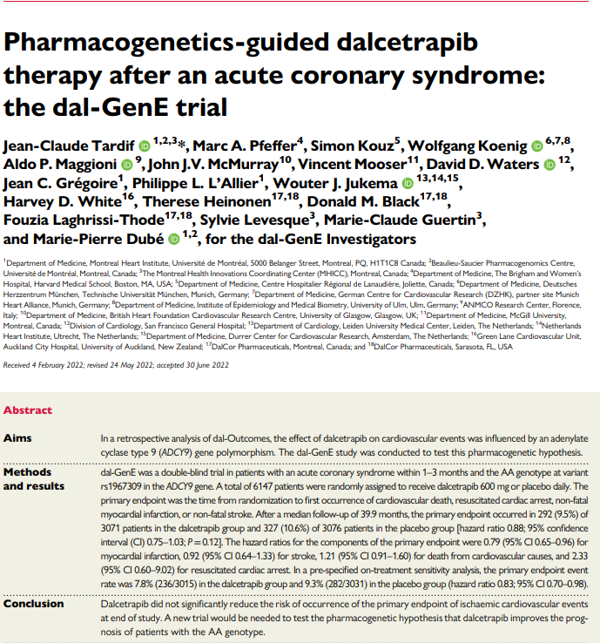
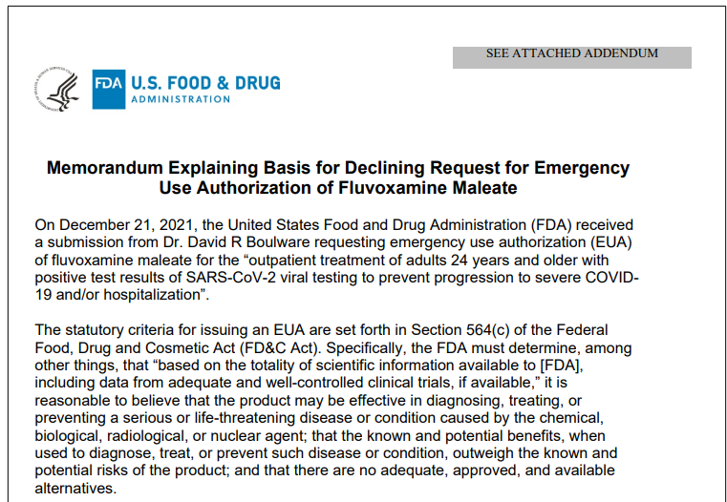
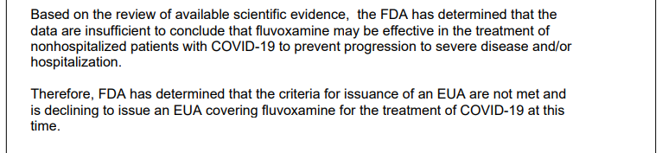
Real Examples - Recent Outcomes
.
.
.
May 6, 2022
July 21, 2022

Slide 64
A Path Forward
A p-value is literally only part of the story!
BAYESIAN INFERENCE
Frequentist
PRIOR KNOWLEDGE
NEW
EXPERIMENT
UPDATED BELIEF
Prior Probability
H₀ is False
New Evidence
(e.g., p-value)
Posterior Probability
H₀ is False
BFB=1/[-e*p*ln(p)]
p₁ ≤ {1 + [(1-p₀)/p₀] / BFB }⁻¹.

Slide 65
Subgroup Identification
“Always use Bayesian thinking when assessing clinical trial results so you can quantify how believable the results are.”
Steve Ruberg
Your Run-of-the-Mill Bayesian Statistician

Slide 66
A Path Forward
Further investigation of
P-values
AnalytixThinking.Blog
No. 7: What does p< 0.05 mean anyway?

Slide 67
A Path Forward
Prior | p-value | Posterior (upper bound) | Increase (post – prior)
0.1 | 0.05 | 0.214 | 0.114
0.2 | 0.05 | 0.380 | 0.180
0.3 | 0.05 | 0.513 | 0.213
0.4 | 0.05 | 0.621 | 0.221
0.5 | 0.05 | 0.711 | 0.211
0.6 | 0.05 | 0.787 | 0.187
0.7 | 0.05 | 0.851 | 0.151
A p-value = 0.05 is not very strong evidence against the null hypothesis!

Slide 68
A Path Forward
Prior | p-value | Posterior (upper bound) | Increase (post – prior)
0.1 | 0.05 | 0.214 | 0.114
0.2 | 0.05 | 0.380 | 0.180
0.3 | 0.05 | 0.513 | 0.213
0.4 | 0.05 | 0.621 | 0.221
0.5 | 0.05 | 0.711 | 0.211
0.6 | 0.05 | 0.787 | 0.187
0.7 | 0.05 | 0.851 | 0.151
A p-value = 0.05 might be enough evidence against the null hypothesis.

Slide 69
A Path Forward
Prior | p-value | Posterior (upper bound) | Increase (post – prior)
0.1 | 0.05 | 0.214 | 0.114
0.2 | 0.05 | 0.380 | 0.180
0.3 | 0.05 | 0.513 | 0.213
0.4 | 0.05 | 0.621 | 0.221
0.5 | 0.05 | 0.711 | 0.211
0.6 | 0.05 | 0.787 | 0.187
0.7 | 0.05 | 0.851 | 0.151
A p-value = 0.05 does not move the “evidentiary needle” very much!

Slide 70
Part 5
Probability of a False Positive Finding

Slide 71
Pr (False Positive)
P-value is conditional on H₀ being true.
P-value = Pr(reject H₀ | H₀ is true)
Recall the Lottery Example
Pr (you receive a share)
= Pr (I choose to share IF I win) * Pr (I win)
What’s Pr(H₀ is true)?
9,999/10,000
More on this later !!

Slide 72
Pr (False Positive)
Pr(reject H₀ | H₀ is true)
Designing experiment = significance level
α-level, false positive rate
After data is collected = significance level
Smallest p-value for which we would have rejected the null hypothesis

Slide 73
Pr (False Positive)
P-value as evidence (Fisher, 1925, 1926)
“The value for which p=0.05 … is to be considered significant or not.”
P-value as decision-maker (Neyman-Pearson, 1933)
Balance Type 1 and Type 2 errors using sample size
P-value as both (Lehman, 1986, p. 70).
“It is then good practice to determine not only whether the hypothesis is accepted or rejected at the given significance level, but also to determine the smallest significance level â = â(x), the significance probability or p-value, at which the hypothesis would be rejected for the given observation.”

Slide 74
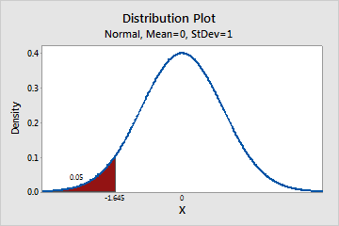
A Problem of Inference
HYPOTHESIS,
EXPERIMENT
TEST
STAT
TEST SIZE
REJECTION REGION
DESIGN
?
?
DATA
?
COMPUTE TEST
STAT
ANALYSIS
RUN MODEL
P-VALUE
A 1-1 and onto mapping via an inverse probability function.*
*Kuffner, T. A., Walker, S. G. (2019) “Why are p-Values Controversial?”, The American Statistician, 73(1), 1-3.

Slide 75
Pr (False Positive)
Conflating
the significance level
of the test (α)
with
the significance level
of the data (p-value)
The “silent hybrid solution” (Gigerenzer, 1989).

Slide 76
Pr (False Positive)
Philosophical Practical Question
Design an experiment and accompanying suitable statistical test with a significance level of α=0.05.
Conduct the experiment and observe p=0.01.
Reject the null hypothesis - “a positive finding.”
What is the probability that this is a false positive finding?

Slide 77
Pr (False Positive)
Pr(false positive finding) =
Pr(H₀ is true | p=0.01) =
1 – Pr(H₀ is false | p=0.01)
This is the REAL question of interest!
This is decidedly a Bayesian formulation.
1 – Pr(H₀ is false | p=0.01)
hypothesis
data
(test statistic)

Slide 78
Pr (False Positive)
Pr(H₀ is true)
Pr(H₀ is false)
0.70
0.025
0.30
0
T
0
1.96
Prior Distribution of Effect
Significance level of the test = α = Pr(Reject H₀ | H₀ is true)
Significance level of the test = α = Pr(Reject H₀ | H₀ is true) * Pr(H₀ is true)
= 0.025 * 0.70
= 0.0175

Slide 79
Pr (False Positive)
Pr(H₀) is true)
Pr(H₀) is false)
0.70
0.0357
0.30
0
T
0
1.80
Significance level of the test = α = Pr(Reject H₀ | H₀ is true) * Pr(H₀ is true)
= X * 0.70
= 0.025

Slide 80
Pr (False Positive)
WOW!
Difficult to reconcile Frequentist approach and Bayesian approach.
e.g., “frequentist properties of Bayesian methods”
Frequentist: pr(H₀ is true) = 1.
Bayesian: pr(H₀ is true) < 1.

Slide 81
Epistemology How do we know what we know?
Part 6
e·pis·te·mol·o·gy /əˌpistəˈmäləjē/
noun
PHILOSOPHY
The theory of knowledge, especially with regard to its methods, validity, and scope. Epistemology is the investigation of what distinguishes justified belief from opinion.
believe
believe
>
>
Statistics is the science of discerning what is likely to be true.

Slide 82
Epistemology (1)
ICH-E9
“The extent to which the procedures in the protocol are followed and the primary analysis is planned a priori will contribute to the degree of confidence in the final results and conclusions of the trial.”

Slide 83
Epistemology (1)
ICH-E9
“The extent to which the procedures in the protocol are followed and the primary analysis is planned a priori will contribute to the degree of confidence in the final results and conclusions of the trial.”
Where do we focus?
PRIOR KNOWLEDGE
NEW
EXPERIMENT
UPDATED
BELIEF
Prior Probability
H₀ is False
New Evidence
(e.g., p-value)
Posterior Probability
H₀ is False

Slide 84
Epistemology
Frequentist: compute p-value and then do post hoc assessment of how it fits into other evidence
What critical value could we have used?
Is it consistent with previous findings?
Subject to bias!!
Bayesian: Quantify belief a priori and build that into a pre-specified analysis
Statisticians advocate pre-specification (ICH-E9)

Slide 85
Epistemology (2)
A p-value is no more than the ultimate test statistic scaled to the interval (0, 1).¹
A p-value is a “precise” answer² to the wrong question – pr(Data|Hypothesis).
A p-value is a poor answer to one of the three important questions of inference.
¹Kuffner, T. A., Walker, S. G. Why are p-values controversial? The Amer. Statist. 73, 1-3 (2019).
²Frequentists require models and assumptions.

Slide 86
Epistemology (2)
A Bayesian probability is a “vague” answer* to the right question.
A Bayesian probability is what scientists – indeed all of us – want: pr(Hypothesis|Data).
Report the upper bound on the posterior probability of the null hypothesis being false
Using (at a minimum) a point prior for that hypothesis and the BFB.
*Vague in the sense of requiring a subjective prior.

Slide 87
Epistemology (3)
Significance level and power are important elements of study design (Frequentist)
Positive and negative predictive value are the most appropriate measures for interpretation of study outcomes (Bayesian)
We know this for diagnostics tests. Why not for clinical trials?!
Bayesian perspective answers the question of interest.

Slide 88
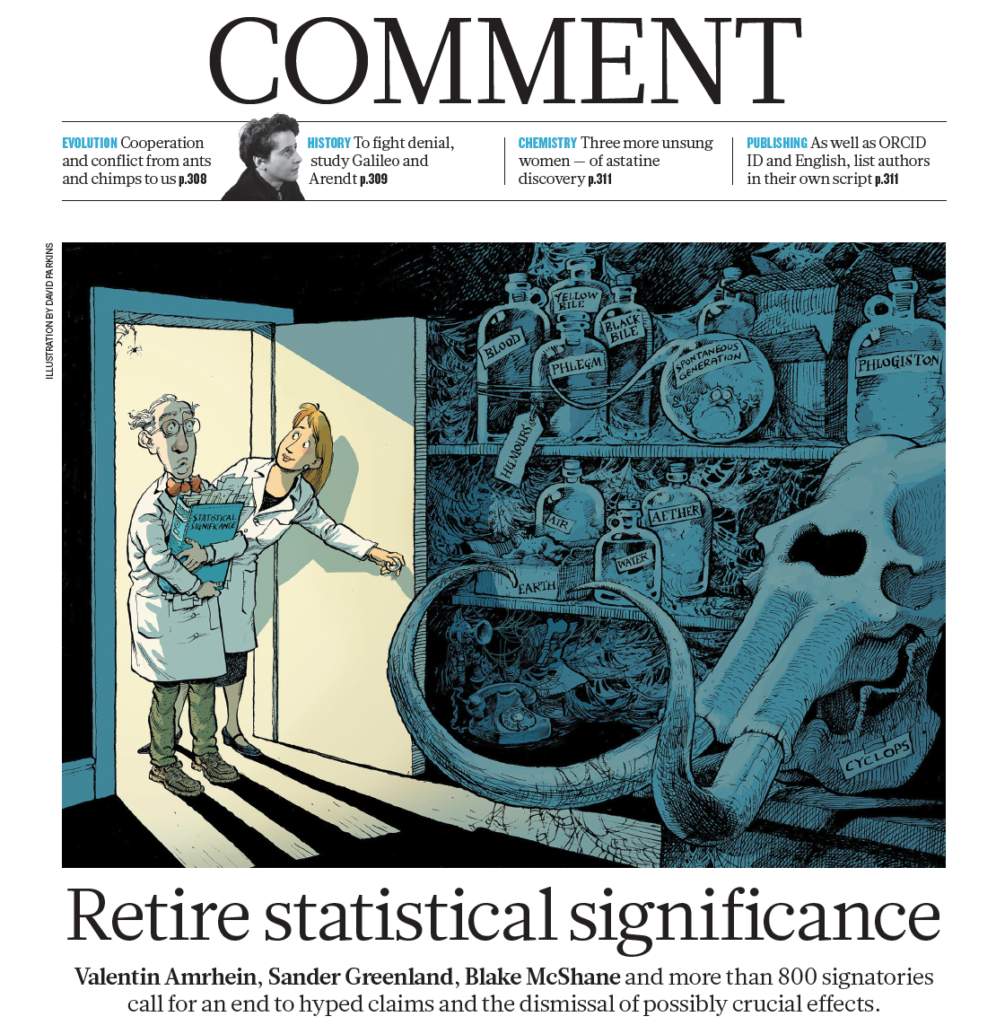
Epistemology (4)
nature 20 March 2019
Statistical Scientists
should convey on a regular basis
the likelihood (probability, odds)
that a
hypothesis (state of nature, theory)
is true or false.

Slide 89
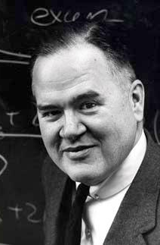
Epistemology (5)
“The most important maxim for data analysis to heed, and one which many statisticians seem to have shunned, is this: Far better an approximate answer to the right question, which is often vague, than an exact answer to the wrong question, which can always be made precise.”
John Tukey
The Future of Data Analysis
The Ann of Math Stat (1962, pp. 13-14)

Slide 90
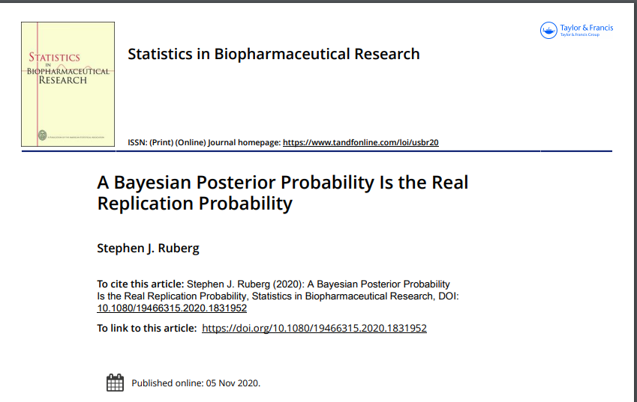
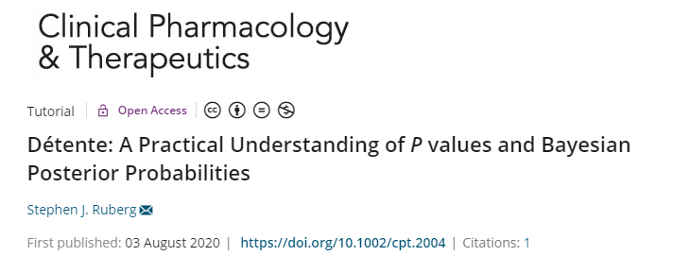
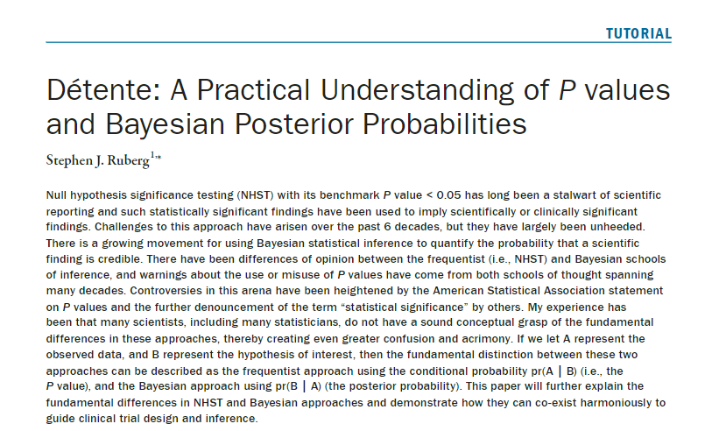
Extra Reading

Slide 91
Thank You
Pr(I thank you) = 0.9999… = 1
Pr(you thank me) = …
Posterior Distribution
Of Thanks
?
0
Mother Theresa Gratitude Scale

