Slide 1

NEOS: A Bayesian non-inferiority trial design in pediatric multiple sclerosis in the FDA Complex Innovative Designs Pilot Program
Marius Thomas & Dieter A Häring
DIA Bayesian Scientific Working Group KOL Series
November 18th 2022

Slide 2
Content
NEOS as an example of a Bayesian phase 3 trial
Our experience on key factors for developing a complex innovative trial design

Slide 3
Background
Pediatric MS is rare: Only ~3-5% of MS cases start in childhood or adolescence^{1,2}
Vulnerable population: Children with MS show higher disease activity (2-3 time higher relapse frequency compared to adults)³, lose brain volume from the onset (i.e. no true remission)⁴, and have worse long-term prognosis, i.e. disabled at younger age⁵
High unmet need: ~20 approved therapies in adults, pediatric patients only 1 approved based on randomized controlled trials in the US (Gilenya, based on only successful trial so far, PARADIGMS)
¹ Ghezzi et al. (1997) Multiple sclerosis in childhood: clinical features of 149 cases. Multiple Sclerosis Journal
² Chitnis T et al. (2009) Demographics of pediatric-onset multiple sclerosis in an MS center population from the Northeastern United States. Multiple Sclerosis Journal
³ Gorman et al., 2009 Increased relapse rate in pediatric-onset compared with adultonset multiple sclerosis. Arch Neurol 2009; 66: 54-9.
⁴ Arnold et al., 2019 Effect of fingolimod on MRI outcomes in patients with paediatric-onset multiple sclerosis: results from the phase 3 PARADIGMS study. Neurology, Neurosurgery & Psychiatry
⁵ Renoux et al. (2007) Natural history of multiple sclerosis with childhood onset. N Engl J Med 2007; 356: 2603-13.

Slide 4
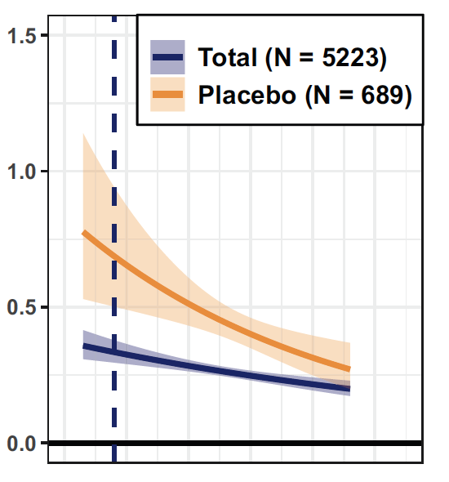
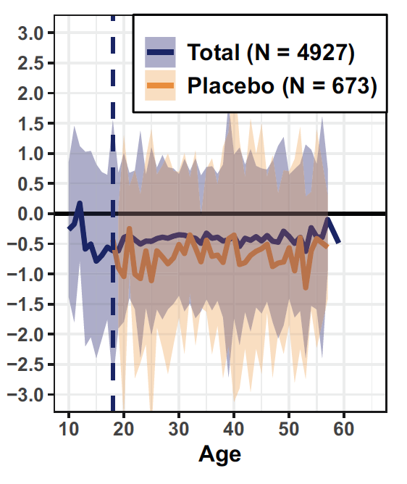

Pediatric MS - Key facts
Biological processes involved in MS are largely shared across age span¹
Higher relapse rates than adults but also stronger relative effect size
Irreversible brain volume and loss of neurons from the start (=no true remission)
Brain volume change %
Relapses per year
¹ Waubant et al. Neurology 2019.
Figures from Dahlke et al. (2021) Characterization of MS phenotypes across the age span. Multiple Sclerosis Journal. Total refers to active and placebo treated patients.

Slide 5
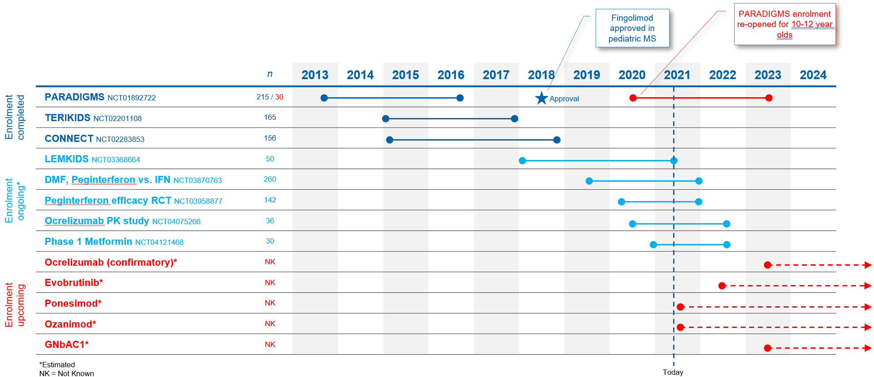
Challenging recruitment with competitive trial landscape and rarity of pediatric MS population makes feasibility a key concern

Slide 6
NEOS trial summary
2-year double-blind, triple-dummy Phase 3 study in pediatric MS to establish the efficacy and safety 2 novel MS treatments:
New test drug 1: Kesimpta (ofatumumab): first fully human anti-CD20 monoclonal antibody treatment, approved worldwide in adults
New test drug 2: Mayzent (siponimod): S1P modulator, approved worldwide in adults
Primary endpoint: Annualized relapse rate (ARR) analyzed via negative binomial model (standard phase 3 endpoint in MS)
Non-inferiority design vs active control Gilenya (fingolimod):
Active control: Gilenya (fingolimod): Approved treatment for pediatric MS; reduced relapse rates vs interferon beta-1a by 82% in a randomized double-blind clinical trial (PARADIGMS¹)
Active control avoids placebo or low efficacy comparator, minimizing the risk of MS relapses, which can be associated with irreversible disability
Interim analysis when all patients have reached one year of follow-up:
Potential to reduce double-blind part of the study by one year if both test drugs are non-inferior to fingolimod; high chance of early stopping if both new treatments are similarly efficacious to Gilenya and if pediatric data is consistent with Bayesian priors
¹ Chitnis et al. Trial of fingolimod versus interferon beta-1a in pediatric multiple sclerosis. N Engl J Med 2018

Slide 7
Non-inferiority
Non-inferiority
Extrapolation
Robust dynamic borrowing
Simulation study
Regulatory interactions
Our experience with CIDs

Slide 8
Motivation for non-inferiority design
PARADIGMS results:
Pediatric MS patients experienced more clinical relapses and lost significantly more brain tissue when treated with Interferon beta-1a vs Gilenya.
Clinical relapses and associated neurological symptoms
Interferon beta-1a: 120 clinical relapses (107 patients)
Gilenya: 25 clinical relapses (107 patients)
Brain volume loss:
Interferon beta-1a: 0.80 %/yr
Gilenya: 0.48 %/yr
Conclusion: Avoid low efficacy drug in next pediatric study
¹ Chitnis et al. Trial of fingolimod versus interferon beta-1a in pediatric multiple sclerosis. N Engl J Med 2018
² Arnold et al. (2020) Effect of fingolimod on MRI outcomes in patients with paediatric-onset multiple sclerosis: results from the phase 3 PARADIGMS study. Multiple Sclerosis Journal

Slide 9
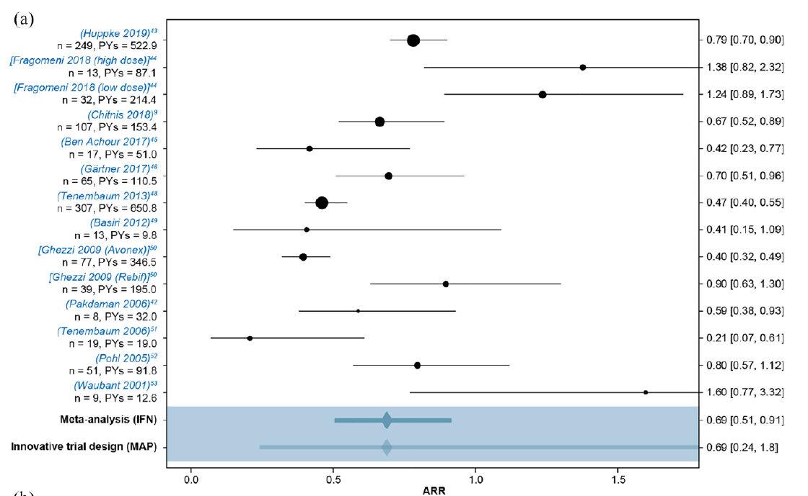
Systematic literature review of relapse rates in pediatric MS
¹ Graves et al. (2021) Improving pediatric multiple sclerosis interventional phase III study design:
a meta-analysis. Therapeutic Advances in Neurological Disorders

Slide 10
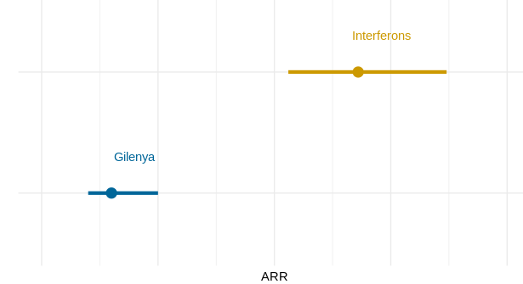
Showing non-inferiority to Gilenya strongly implies superiority over Interferon beta-1a or placebo
Estimated ARR based on meta-analysis of historical studies
Similar efficacy to Gilenya strongly suggests superiority over IFN
Patients on interferons (or untreated patients) have much higher relapse rates than with more modern DMTs such as Gilenya.
Showing non-inferiority (NI-margin of 2.0¹) against a tested highly efficacious treatment and superiority over historical IFN in an indirect comparison avoids the use of placebo or low efficacy comparators
¹ If non-inferiority of a new test drug can be demonstrated vs Gilenya, the probability that the new drug is more efficacious than IFN beta-1a is >99% (based on the historical data).

Slide 11
Extrapolation from adult phase 3 data to pediatric patients
Non-inferiority
Extrapolation
Robust dynamic borrowing
Simulation study
Regulatory interactions
Our experience with CIDs

Slide 12
Phase 3 data in adults with MS is typically available at the start of a new pediatric study. Can it be leveraged?
Pediatric age range: 10-17 years of age (waiver for <10 years)
Adult age range: 18-55 years of age
Biological processes involved in MS are largely shared across age span (Waubant, 2019)
Extrapolation from adult patients from the TRANSFORMS phase 3 study
Predictions of relapse rates at age 15.3 (the mean age of the PARADIGMS study) from a negative binomial model with age x treatment interaction (the model was built in year 2010).
Projections |  | Between-treatment comparison
Treatment | Adjusted ARR | % rate reduction | ARR ratio | P-value
IFNß-1a N=431 | 0.667 | 81.7% | 0.183 | <.001
FTY720 N=429 | 0.122

Slide 13
Phase 3 data in adults with MS is typically available at the start of a new pediatric study. Can it be leveraged?
Pediatric age range: 10-17 years of age (waiver for <10 years)
Adult age range: 18-55 years of age
Biological processes involved in MS are largely shared across age span (Waubant, 2019)
Extrapolation from adult patients from the TRANSFORMS phase 3 study
Observed results in PARADIGMS
in pediatric patients in year 2017.
Predictions of relapse rates at age 15.3 (the mean age of the PARADIGMS study) from a negative binomial model with age x treatment interaction (the model was built in year 2010).
Projections |  | Between-treatment comparison
Treatment | Adjusted ARR | % rate reduction | ARR ratio | P-value
IFNß-1a N=431 | 0.667 | 81.7% | 0.183 | <.001
FTY720 N=429 | 0.122
Treatment | Adjusted ARR (95% CI) | % rate reduction | ARR ratio (95% CI) | P-value
IFNß-1a N=107 | 0.675 (0.515,0.885) | 81.9% | 0.181 (0.108,0.303) | <.001
FTY720 N=107 | 0.122 (0.078,0.192)

Slide 14
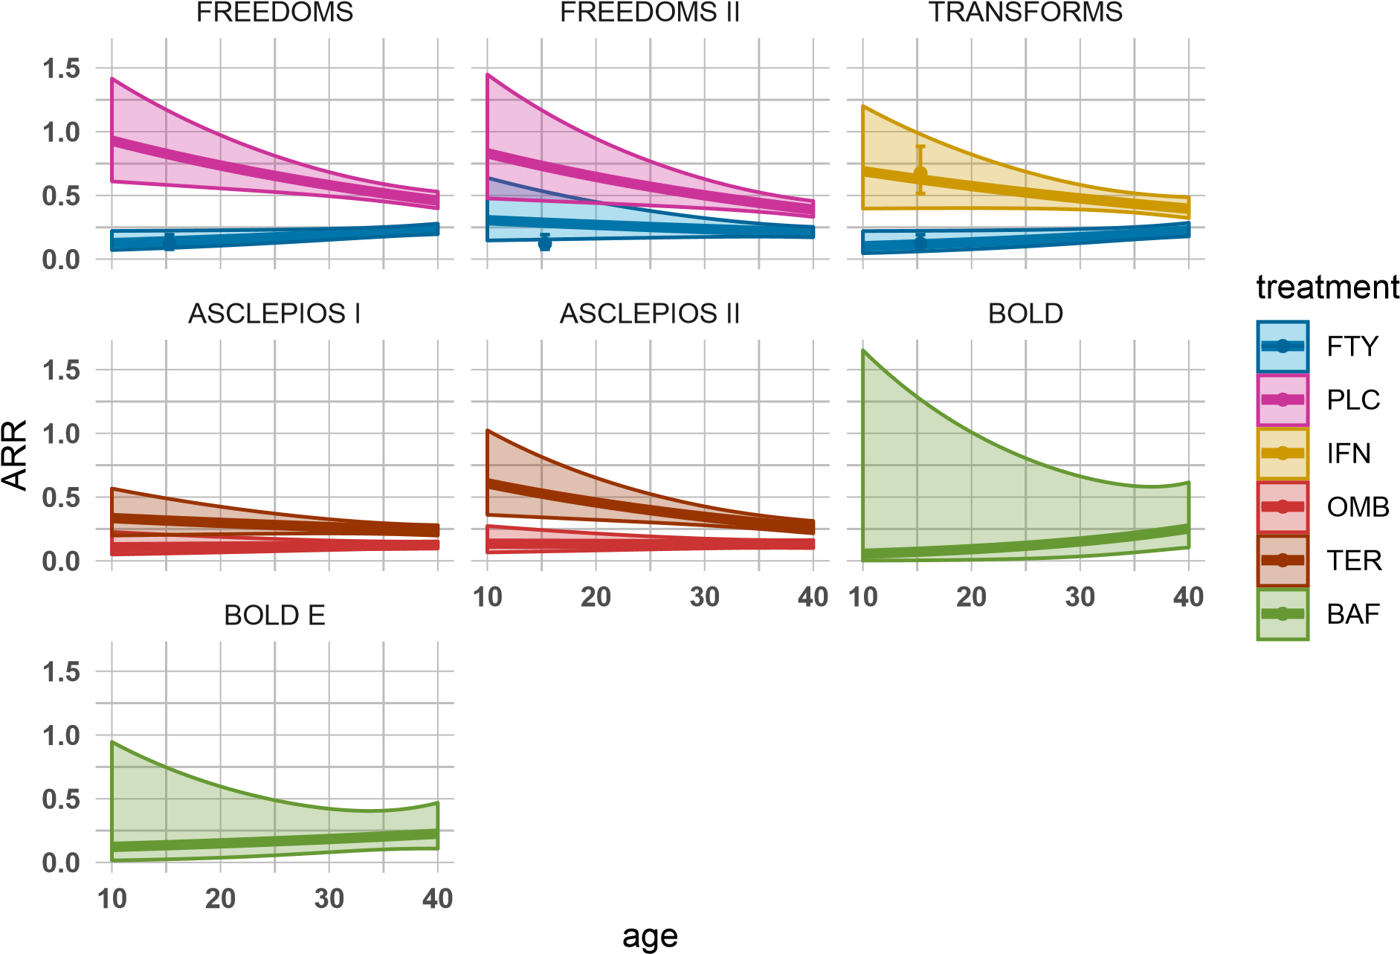
Phase 3 data in adults with MS is typically available at the start of a new pediatric study and can be leveraged
Extrapolation from adult to pediatric patients is possible with high accuracy
PARADIGMS
Age dependent relapse rates in adults
Relapse frequency is strongly age dependent in untreated patients or under low efficacy treatment.
Pediatric data is compatibe with extrapolation from adults
Age-dependent extrapolation from adults to pediatric MS patients can be done and should be considered to inform new trial design options
Lines and confidence boundaries are based on negative binomial models of relapse rates, extrapolated from trials in adults to pediatric patients. N refers to the sample size of the trials in adults. The point estimates and confidence intervals represent the observed ARR in children in PARADIGMS.

Slide 15
Incorporating historical data
Non-inferiority
Extrapolation
Robust dynamic borrowing
Simulation study
Regulatory interactions
Our experience with CIDs

Slide 16
NEOS Bayesian design
Primary analysis model: Bayesian negative binomial model with informative priors for ARRs of the three treatments
Relapse data is available from 4 historical studies for comparator Gilenya (3 in adults, 1 in children), 2 adult studies for Kesimpta, 2 adult studies for Mayzent
Historical data for each study consists of (extrapolated) log-ARR and standard error estimates for each study
Meta-analytic predictive approach is used to prospectively define priors for the ARR in the new study

Slide 17
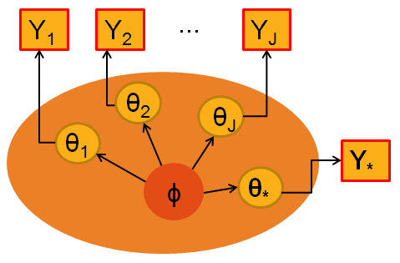
Incorporating historical data via meta-analytic predictive approach ^{1, 2}
Source data models
p(Y_{j} | θ_{j} ) j=1,...,J
Target data model for planned trial
p(Y* | θ* )
Meta-analytic model to link parameters (hyper-parameter ϕ): p( θ*, θ₁, ... ,θ_{J} | ϕ )
MAP-prior for new study: p_{MAP}(θ*) = p(θ* | Y₁ , ..., Y_{J})
Parameters from different studies are linked through hierarchical model
Takes between-trial heterogeneity into account
¹ Spiegelhalter, D. J., Abrams, K. R., & Myles, J. P. (2004). Bayesian approaches to clinical trials and health-care evaluation (Vol. 13). John Wiley & Sons.
² Neuenschwander B, Capkun-Niggli G, Roychoudhury S, et al (2010). Summarizing historical information on controls in clinical trials. Clin Trials; 7(1): 5-18.

Slide 18
Prior-data conflict potential issue with Bayesian design
Extrapolation from adults accurate and consistent, however limited data from pediatric trials available (in particular none for ofatumumab and siponimod)
Possibility that exchangeability assumptions does not hold and as a result a prior-data conflict occurs, has to be considered:

Slide 19
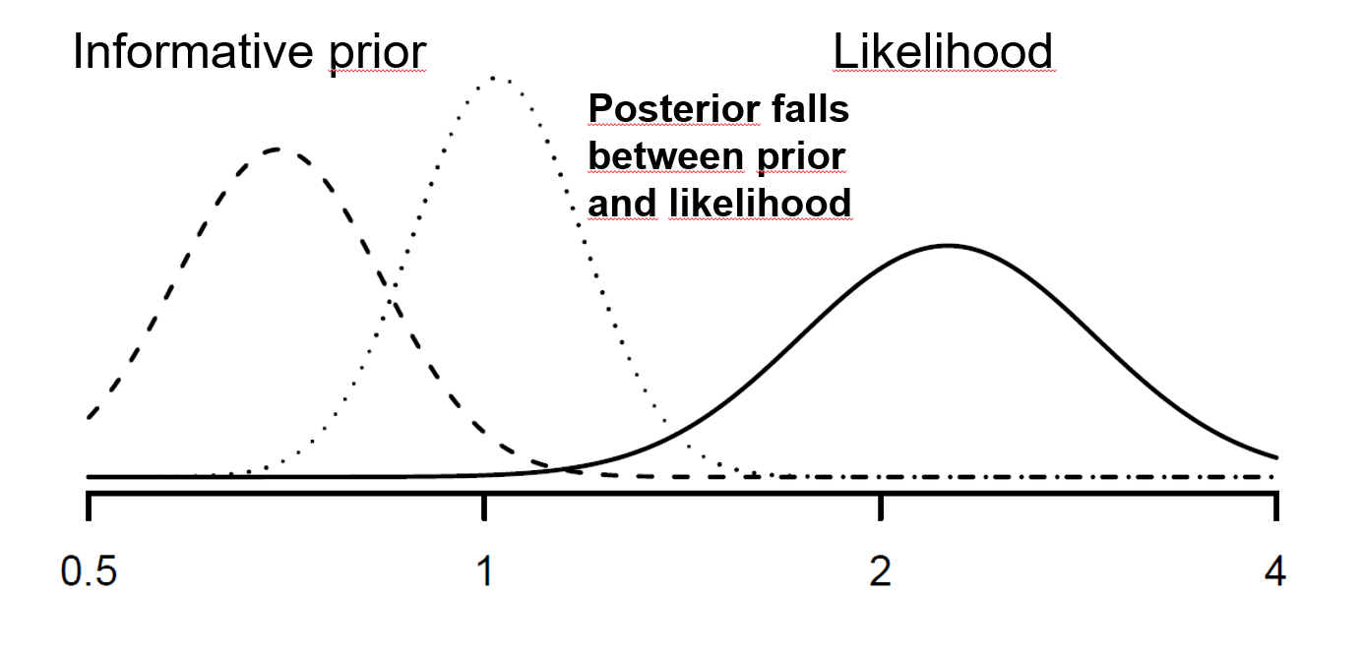
Prior-data conflict potential issue with Bayesian design
Extrapolation from adults accurate and consistent, however limited data from pediatric trials available (in particular none for ofatumumab and siponimod)
Possibility that exchangeability assumptions does not hold and as a result a prior-data conflict occurs, has to be considered:

Slide 20
Protecting against prior-data conflicts
Exchangeability assumption can be relaxed by adding vague, weakly-informative components to the MAP mixture¹ :
p_{Robust}(θ*) = (1-ε) p_{MAP}(θ*) + ε p_{Vague}(θ*)
Mixture weight ε chosen to reflect skepticism on relevance of source data
Robust priors are heavy-tailed, and hence informative part is discarded in case of prior-data conflicts
Use ε = 0.2 for Gilenya (because data from adults and pediatric patients available) and ε = 0.5 for Kesimpta and Mayzent (because only data from adults available) to reflect lack of pediatric data for the investigational drugs
¹ Schmidli H, Gsteiger S, Roychoudhury S, et al (2014). Robust meta‐analytic‐predictive priors in clinical trials with historical control information. Biometrics; 70(4): 1023-1032.

Slide 21
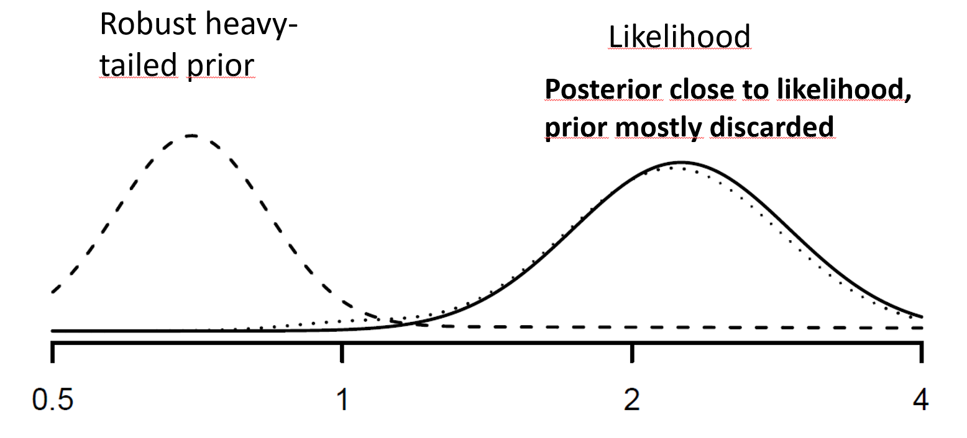
Prior-data conflict with robust prior; dynamic borrowing

Slide 22
Simulation study to understand operating characteristics
Non-inferiority
Extrapolation
Robust dynamic borrowing
Simulation study
Regulatory interactions
Our experience with CIDs

Slide 23
Simulation studies to understand operating characteristics
Complex innovative design requires simulations to understand behaviour of design under different assumptions and compare to alternatives
Simulation studies were used extensively during planning and HA discussions:
Investigate frequentist operating characteristics of proposed design versus alternatives: Type I error rates, Power and Bias and RMSE of treatment effect estimates
Determine required sample size to achieve desired power under main scenarios
Impact of interim analysis on type I error/power
Modifications of design (timing of interim analysis, study duration, additional success criteria)
Impact of double-use of historical information for NI-margin and Bayesian priors
Final simulation report focusing on operating characteristics of final design for all primary and sensitivity analyses:
Comprehensive document including simulation results for final design under wide range of scenarios
Documents the considered scenarios, metrics and other necessary details on simulations
Discusses operating characteristics for key scenarios
Report and codes to reproduce simulations shared with FDA with final protocol submission

Slide 24
Simulation scenarios for final report
Simulations focused on primary endpoint, annualized relapse rate (ARR)
Different scenarios investigated for ARR on fingolimod (control) and ARR-ratio of two test treatments versus fingolimod:
ARR on fingolimod: 0.05, 0.25, 0.5, 0.75, 0.95 - quantiles of MAP-prior distribution to reflect range of plausible and extreme values
ARR-ratio of test treatments versus fingolimod (control): 0.8, 1 and 2 (null scenario)
25 different combinations for the three treatments investigated in simulations (10 null scenarios where at least one treatment inferior to fingolimod, 15 under alternative with both treatments non-inferior)
All simulations performed using prior weights for primary analysis and all 10 sensitivity analyses
Baseline covariates and adjustment in model were included upon HA requests for final simulation report
Impact of other parameters (Dispersion, recruitment rate) was investigated in some initial simulations but had limited impact within plausible range and was kept fixed for main simulation report

Slide 25
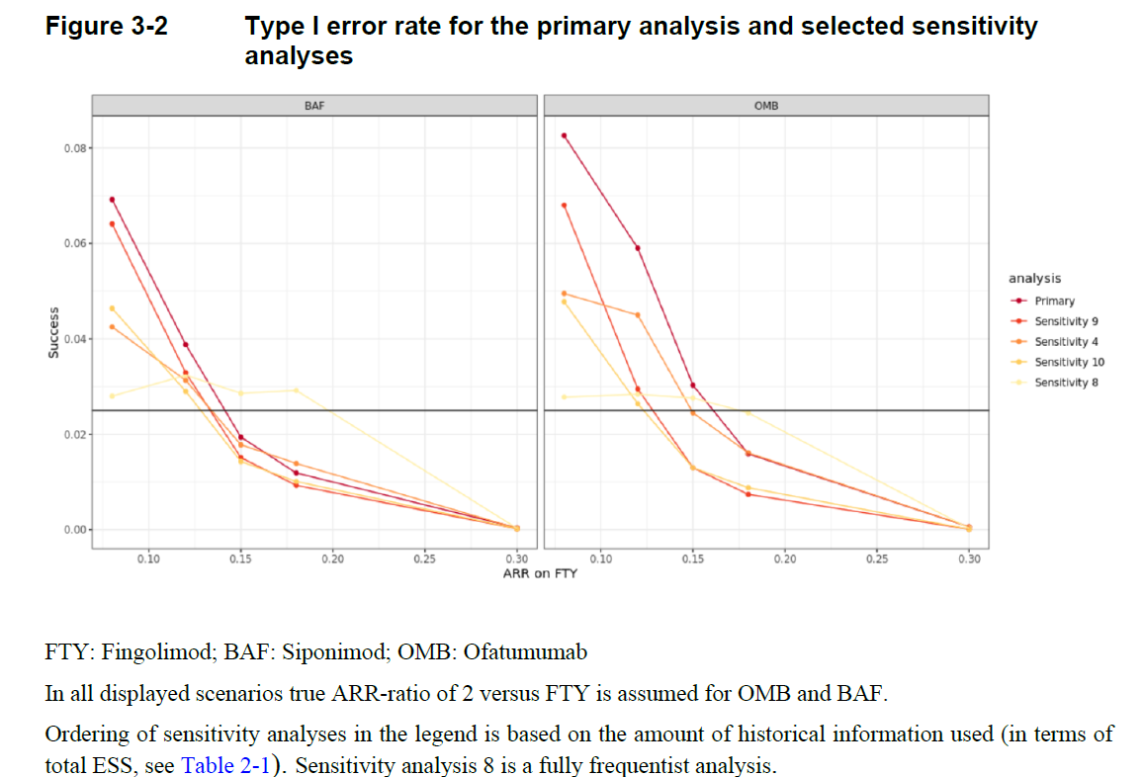
Simulation results: Type I error rate
Nominal type I error rate of one sided 0.025 is only inflated in lower ARR range
Controlled for higher ARR which are more clinically relevant
Inflation of type I error rates for low ARR acceptable as even in null scenarios test treatments would still be clearly superior to interferons/placebo

Slide 26
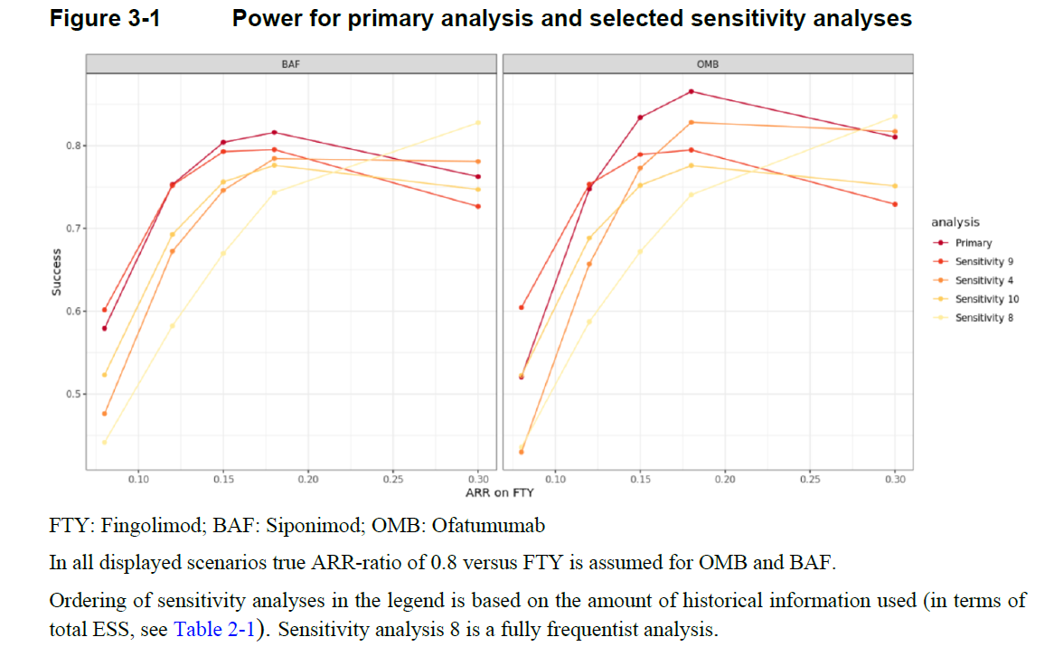
Simulation results: Power
Large increases in power versus freq. Design in almost all considered scenarios
Main advantage of the Bayesian design, adequately powered with lower sample size; 80% power for main scenarios can be achieved with 180 patients

Slide 27
The path to innovation
Standard RCT Demonstrate superiority vs placebo or inferior active control
Extrapolation from adults to pediatric patients¹
Disease biology is similar, but children relapse more frequently.
+ Similar power with less N compared to trials in adults
Non-inferiority design vs highly efficacious control drug
Specify NI-margin so that non-inferiority clearly demonstrate superiority over interferons or placebo
+ Avoids placebo or low efficacy controls
Bayesian design
Robust integration of prior knowledge about test medication (e.g. from Phase 3 trials) into the new trial in ped. MS²
+ Allows to leverage prior knowledge about the disease and drug; early stopping
¹Schmidli et al., (2020) Beyond Randomized Clinical Trials: Use of External Controls. Clinical pharmacology & Therapeutics.
²Schmidli et al., (2014) Robust meta‐analytic‐predictive priors in clinical trials with historical control information. Biometrics.

Slide 28
Regulatory interactions
Non-inferiority
Extrapolation
Robust dynamic borrowing
Simulation study
Regulatory interactions
Our experience with CIDs

Slide 29
Health authority interactions and timelines
2020
2021-2026
FDA strongly encourages a combined trial, EMA concurs:
Follow-up discussions with focus on Bayesian design elements with FDA
2019
Two CID F2F meetings
2017-2018
Proposed Kesimpta Bayesian non-inferiority design accepted for FDA’s Complex Innovative Designs (CID) Pilot program
Initially two separate studies planned:
Discussions with HAs on proposed studies:
NEOS study:
Final protocol in Jan 2021
Initial proposal for Mayzent is a open-label superiority study vs interferon
Based on HA discussion similar Bayesian non-inferiority design as for Kesimpta is proposed for Mayzent
NEOS design (combined Kesimpta and Mayzent design) accepted by US FDA
Discussion on NEOS design with SAWP in EU: Design and PIP modification accepted by EMA/PDCO
Study initiated in Oct 2021
LPLV planned for 2026

Slide 30
Summary of regulatory feedback: Reaching global alignment for non-standard design features can be a challenge
Topic | FDA CID discussions | EMA (PDCO and SAWP)
Extrapolation | Concerns about extrapolation models relying on «unverifiable assumptions» Exploration and discussion of (all) other possible prognostic or effect modifying factors required | No specific concerns
NI-margin | Proposed margin of 3¹ too large (some discounting is required) Lack of pediatric data to assess between-trial variability Systematic literature review and meta-analysis requested to have a comprehensive understanding all potentially relevant prior knowledge | Initially proposed NI-margin of 3 was discussed as large but finally accepted for Kesimpta PIP by PDCO based on scientific and feasibility considerations
Bayesian design | «Bayesian framework may be useful» Concerns about double-use of historical information in Bayesian non-inferiority design Extensive simulations requested to understand operating characteristics under all conditions | Bayesian design not accepted for initial Kesimpta PIP SAWP primarily concerned with lack of type I error control and subjectivity of weight given to historical information
Interim analysis | An interim analysis for efficacy stopping is endorsed | Interim analyis not accepted for initial PIP Concerns related to inadequate assessment of long-term safety Interim analysis not endorsed by SAWP due to adding another level of complexity to already complex design

Slide 31
Key modifications on study design based on HA feedback
Non-inferiority margin, after discounting, changed to 2.0 (instead of 3.0) with additional upper limit of the ARR (0.3) on test drugs to conclude non-inferiority vs Gilenya
Key secondary analysis added to compare test treatments versus historical interferon data (based on a meta-analysis of historical studies)
Kesimpta and Mayzent studies were combined into one design based on recommendation from FDA and EMA
Tipping point sensitivity analysis prespecified to assess robustness of conclusions from Bayesian analysis under different weights to prior information; i.e. from pre-spedified weight to a «no borrowing» strategy (frequentist design)
Final study design was accepted by both FDA and EMA/PDCO

Slide 32
Key modifications on study design based on HA feedback
The Bayesian non-inferiority design integrates our prior knowledge about MS and offers efficacious treatment to all participants
Bayesian design offers reduction in sample size (by 30%) and in trial duration (by 1 year). If prior information is consistent with newly collected information from the pediatric trial there is a high likelihood that the study can be stopped at the interim analysis one year ahead of plan
F2F Discussions within pilot program helpful to align on innovative design features
NEOS design was accepted by EMA/PDCO and US FDA and is currently recruiting.

Slide 33
Our experience with CIDs and proposed guiding principles
Non-inferiority
Extrapolation
Robust dynamic borrowing
Simulation study
Regulatory interactions
Our experience with CIDs

Slide 34


Stakeholder view on innovative study design and goals may differ – alignment needed to reach agreement
Patient
Minimize risk (adverse events, low efficacy drugs)
Provide access to tested drugs (highly efficacious, safe, easy to use)
Sponsor
Regulator
Bring efficacious and safe medications to patients as efficiently as possible (faster, lower sample size)
Minimize erroneous decisions (type I & II errors)
Caution: «no shortcuts»
Fairness between competing sponsors
Design

Slide 35
Innovation breaks with established tradition
Innovation deviates from «gold standard» in at least one dimension
Simulations help in discussions of subjective components of innovation
Advantages of the novel design vs. a standard RCT? (e.g. patient burden vs sample size)
Weight given to historical data, e.g. Bayesian priors? (e.g. disease similarity)
When is type-I error inflation acceptable, if ever?
Simulations can help in aligning different stakeholders
Stakeholders want to optimize different aspects of trials
Simulations («what if?») can help in aligning them for the particular use case and in the specific clinical context
ability of innovation is defined by the clinical context, «no one size fits all»
Collaboration between statisticians and clinicians is essential (sponsor, regulator)
Simulations help understanding the operating characteristics of innovative design features
Acceptability of innovation influenced by the clinical context, «no one size fits all»
Collaboration between statisticians and clinicians is essential (sponsor, regulator)

Slide 36
Example: Type I error rates
Statistical finding
Type I error rate is inflated when relapse rates on trial are very low (<0.15).
Clinical context
Interpretation of type I error: If relapses are rare, one may incorrectly conclude that the test treatment is non-inferior to the active control treatment.
However, historically, pediatric patients always relapsed at high (ARR>0.5) frequency (systematic literature review and meta-analysis)
Type I error rate inflation is deemed acceptable in the specific clinical context:
If patients relapse infrequently in the new RCT (on test and control drug) efficacy is very strongly implied (vs historical control).

Slide 37
Understanding operating characteristics under clinically plausible settings of parameters Before and After the study
Prior to study (simulations):
Understand operating characteristics through simulations
No cherry picking: Not only the «per-protocol scenario» but all other plausible scenarios should be covered.
Need to take plausibility of scenarios into account when assessing results
After the study (sensitivity analyses):
Sensitivity analyses
Tipping point analyses (across clinically plausible parameters)

Slide 38
Conclusion: Proposed guiding principles for CIDs
Common objective of a study (patients, sponsors, regulators):
Test the efficacy and safety of a new drug efficiently and with low burden to patients, without loss of scientific rigor to make new tested therapeutic options available.
Proposed success factors for an innovative trial design:
Understand and articulate advantage of innovative trial features over default solution
Inovative design features should be preferred over standard trial options (only) if they have objective advantages.
Simulations prior to the trial conduct help to understand and clearly articulate these advantages.
Design options and regulatory decisions should be explainable and supportable by all stakeholders
Clinical & statistical sucess criterion should be predefined in confirmatory trials (per-protocol scenario)
Simulations provide understanding of operating characteristics under other plausible conditions than the per-protocol assumptions, i.e. «no cherry picking», and help in aligning different stakeholders
Simulations help in understanding and limiting the chance of erroneous regulatory decisions
Power considerations: type II errors are particularly severe in pediatric & rare indications, «typically one shot on target
Type-I error: comprehensive understanding (not necessarily control) of type I error required based on simulations
Bias: Assess possible sources and quantitative impact of bias under clinically plausible scenarios
Tipping point analyses help understanding results after the trial; e.g. robustness of results with less weight to Bayesian pri

Slide 39
Thank you

