Slide 2

stanova Overview
Factors are transformed into numerical variables in regression/ANOVA models using contrast coding scheme
Factor with k levels transformed into k – 1 contrast variables
No 1-to-1 mapping exists between contrast variables and factor levels
stanova back-transforms results from contrast variables to factor levels
Contrast coding schemes for Bayesian models involving interactions should be orthogonal and orthonormal
Orthogonal contrasts ensure intercept corresponds to (unweighted) grand mean
Orthonormal contrasts ensure marginal prior is same for all factor levels
stanova per default uses orthonormal priors developed by Rouder, Morey, Speckman, & Pronvince (2012, JMP)
Script for talk available at:
http://singmann.org/download/r/stanova_mathpsych2020.html
http://singmann.org/download/r/stanova_mathpsych2020.Rmd

Slide 3
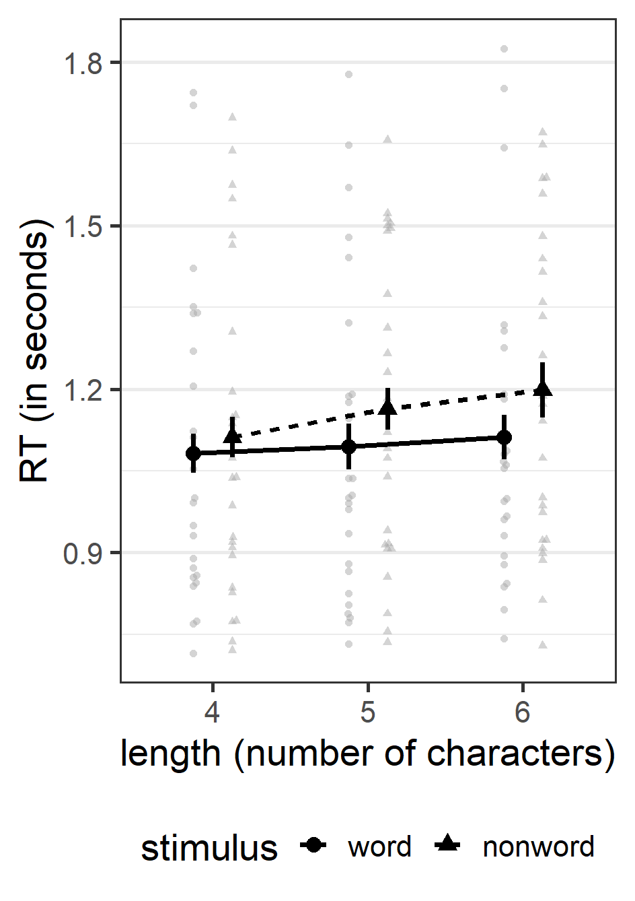
Example Data
Lexical decision response times from 25 participants
Words (e.g., yell, latter) and nonwords (e.g., aied, roiled)
Stimuli differed in length from 4 to 6 characters
Fully within-participants design
Data available in R:
Points in background show individual participant mean RTs
Error bars show 95% within-subjects confidence intervals
data("fhch2010", package = "afex")
Freeman, E., Heathcote, A., Chalmers, K., & Hockley, W. (2010). Item effects in recognition memory for words. Journal of Memory and Language, 62(1), 1–18.

Slide 4
Example Data
Lexical decision response times from 25 participants
Words (e.g., yell, latter) and nonwords (e.g., aied, roiled)
Stimuli differed in length from 4 to 6 characters
Fully within-participants design
Data available in R:
Points in background show individual participant mean RTs
Error bars show 95% within-subjects confidence intervals
 | 4 | 5 | 6
word | 1.08 | 1.09 | 1.11
nonword | 1.11 | 1.16 | 1.20
data("fhch2010", package = "afex")
Freeman, E., Heathcote, A., Chalmers, K., & Hockley, W. (2010). Item effects in recognition memory for words. Journal of Memory and Language, 62(1), 1–18.

Slide 5
library("rstanarm") # Bayesian regression modelling using Stan
m_def <- stan_lmer(rt ~ length*stimulus + (length*stimulus | id),
fhch)
summary(m_def, pars = "(Intercept)", regex_pars = c("^length",
"^stimulus"), digits = 2)
## [...]
## Estimates:
## mean sd 10% 50% 90%
## (Intercept) 1.08 0.06 1.01 1.08 1.15
## length5 0.01 0.02 -0.02 0.01 0.04
## length6 0.03 0.02 0.00 0.03 0.06
## stimulusnonword 0.03 0.03 -0.01 0.03 0.07
## length5:stimulusnonword 0.04 0.03 -0.01 0.04 0.08
## length6:stimulusnonword 0.06 0.03 0.01 0.06 0.10
## [...]

Slide 6
library("rstanarm") # Bayesian regression modelling using Stan
m_def <- stan_lmer(rt ~ length*stimulus + (length*stimulus | id),
fhch)
summary(m_def, pars = "(Intercept)", regex_pars = c("^length",
"^stimulus"), digits = 2)
## [...]
## Estimates:
## mean sd 10% 50% 90%
## (Intercept) 1.08 0.06 1.01 1.08 1.15
## length5 0.01 0.02 -0.02 0.01 0.04
## length6 0.03 0.02 0.00 0.03 0.06
## stimulusnonword 0.03 0.03 -0.01 0.03 0.07
## length5:stimulusnonword 0.04 0.03 -0.01 0.04 0.08
## length6:stimulusnonword 0.06 0.03 0.01 0.06 0.10
## [...]
 | 4 | 5 | 6
word | 1.08 | 1.09 | 1.11 | 1.10
nonword | 1.11 | 1.16 | 1.20 | 1.16
 | 1.10 | 1.13 | 1.16 | 1.13

Slide 7
library("rstanarm") # Bayesian regression modelling using Stan
m_def <- stan_lmer(rt ~ length*stimulus + (length*stimulus | id),
fhch)
summary(m_def, pars = "(Intercept)", regex_pars = c("^length",
"^stimulus"), digits = 2)
## [...]
## Estimates:
## mean sd 10% 50% 90%
## (Intercept) 1.08 0.06 1.01 1.08 1.15
## length5 0.01 0.02 -0.02 0.01 0.04
## length6 0.03 0.02 0.00 0.03 0.06
## stimulusnonword 0.03 0.03 -0.01 0.03 0.07
## length5:stimulusnonword 0.04 0.03 -0.01 0.04 0.08
## length6:stimulusnonword 0.06 0.03 0.01 0.06 0.10
## [...]
 | 4 | 5 | 6
word | 1.08 | 1.09 | 1.11 | 1.10
nonword | 1.11 | 1.16 | 1.20 | 1.16
 | 1.10 | 1.13 | 1.16 | 1.13

Slide 8
library("rstanarm") # Bayesian regression modelling using Stan
m_def <- stan_lmer(rt ~ length*stimulus + (length*stimulus | id),
fhch)
summary(m_def, pars = "(Intercept)", regex_pars = c("^length",
"^stimulus"), digits = 2)
## [...]
## Estimates:
## mean sd 10% 50% 90%
## (Intercept) 1.08 0.06 1.01 1.08 1.15
## length5 0.01 0.02 -0.02 0.01 0.04
## length6 0.03 0.02 0.00 0.03 0.06
## stimulusnonword 0.03 0.03 -0.01 0.03 0.07
## length5:stimulusnonword 0.04 0.03 -0.01 0.04 0.08
## length6:stimulusnonword 0.06 0.03 0.01 0.06 0.10
## [...]
 | 4 | 5 | 6
word | 1.08 | 1.09 | 1.11 | 1.10
nonword | 1.11 | 1.16 | 1.20 | 1.16
 | 1.10 | 1.13 | 1.16 | 1.13

Slide 9
library("rstanarm") # Bayesian regression modelling using Stan
m_def <- stan_lmer(rt ~ length*stimulus + (length*stimulus | id),
fhch)
summary(m_def, pars = "(Intercept)", regex_pars = c("^length",
"^stimulus"), digits = 2)
## [...]
## Estimates:
## mean sd 10% 50% 90%
## (Intercept) 1.08 0.06 1.01 1.08 1.15
## length5 0.01 0.02 -0.02 0.01 0.04
## length6 0.03 0.02 0.00 0.03 0.06
## stimulusnonword 0.03 0.03 -0.01 0.03 0.07
## length5:stimulusnonword 0.04 0.03 -0.01 0.04 0.08
## length6:stimulusnonword 0.06 0.03 0.01 0.06 0.10
## [...]
 | 4 | 5 | 6
word | 1.08 | 1.09 | 1.11 | 1.10
nonword | 1.11 | 1.16 | 1.20 | 1.16
 | 1.10 | 1.13 | 1.16 | 1.13

Slide 10
afex::set_sum_contrasts() # uses orthogonal sum contrasts globally
m_sum <- stan_lmer(rt ~ length*stimulus + (length*stimulus | id), fhch)
summary(m_sum, pars = "(Intercept)", regex_pars = c("^length", "^stimulus"), digits = 3)
## [...]
## Estimates:
## mean sd 10% 50% 90%
## (Intercept) 1.13 0.05 1.06 1.13 1.20
## length1 -0.03 0.01 -0.04 -0.03 -0.02
## length2 0.00 0.01 -0.01 0.00 0.01
## stimulus1 -0.03 0.01 -0.05 -0.03 -0.01
## length1:stimulus1 0.02 0.01 0.00 0.02 0.03
## length2:stimulus1 0.00 0.01 -0.02 0.00 0.01
## [...]
 | 4 | 5 | 6
word | 1.08 | 1.09 | 1.11 | 1.10
nonword | 1.11 | 1.16 | 1.20 | 1.16
 | 1.10 | 1.13 | 1.16 | 1.13

Slide 11
afex::set_sum_contrasts() # uses orthogonal sum contrasts globally
m_sum <- stan_lmer(rt ~ length*stimulus + (length*stimulus | id), fhch)
summary(m_sum, pars = "(Intercept)", regex_pars = c("^length", "^stimulus"), digits = 3)
## [...]
## Estimates:
## mean sd 10% 50% 90%
## (Intercept) 1.13 0.05 1.06 1.13 1.20
## length1 -0.03 0.01 -0.04 -0.03 -0.02
## length2 0.00 0.01 -0.01 0.00 0.01
## stimulus1 -0.03 0.01 -0.05 -0.03 -0.01
## length1:stimulus1 0.02 0.01 0.00 0.02 0.03
## length2:stimulus1 0.00 0.01 -0.02 0.00 0.01
## [...]
 | 4 | 5 | 6
word | 1.08 | 1.09 | 1.11 | 1.10
nonword | 1.11 | 1.16 | 1.20 | 1.16
 | 1.10 | 1.13 | 1.16 | 1.13

Slide 12
afex::set_sum_contrasts() # uses orthogonal sum contrasts globally
m_sum <- stan_lmer(rt ~ length*stimulus + (length*stimulus | id), fhch)
summary(m_sum, pars = "(Intercept)", regex_pars = c("^length", "^stimulus"), digits = 3)
## [...]
## Estimates:
## mean sd 10% 50% 90%
## (Intercept) 1.13 0.05 1.06 1.13 1.20
## length1 -0.03 0.01 -0.04 -0.03 -0.02
## length2 0.00 0.01 -0.01 0.00 0.01
## stimulus1 -0.03 0.01 -0.05 -0.03 -0.01
## length1:stimulus1 0.02 0.01 0.00 0.02 0.03
## length2:stimulus1 0.00 0.01 -0.02 0.00 0.01
## [...]
 | 4 | 5 | 6
word | 1.08 | 1.09 | 1.11 | 1.10
nonword | 1.11 | 1.16 | 1.20 | 1.16
 | 1.10 | 1.13 | 1.16 | 1.13

Slide 13
Model Matrices: length
Treatment contrasts
contr.treatment
Sum contrasts (orthogonal)
contr.sum
length | (Intercept) | length5 | length6
4 | 1 | 0 | 0
5 | 1 | 1 | 0
6 | 1 | 0 | 1
length | (Intercept) | length1 | length2
4 | 1 | 1 | 0
5 | 1 | 0 | 1
6 | 1 | -1 | -1
Orthonormal contrasts (Rouder et al., 2012, JMP)
contr.bayes
length | (Intercept) | length1 | length2
4 | 1 | 0 | 0.816
5 | 1 | -0.707 | -0.408
6 | 1 | 0.707 | -0.408

Slide 14
m_stanova <- stanova_lmer(rt ~ length*stimulus + (length*stimulus|id), fhch)
summary(m_stanova, digits = 2)
## [...]
## Estimate Intercept:
## Variable Mean MAD_SD 5% 50% 95% rhat ess_bulk ess_tail
## 1 (Intercept) 1.13 0.05 1.04 1.12 1.21 1.01 372.52 727.74
##
## Estimates 'length' - difference from intercept:
## Variable Mean MAD_SD 5% 50% 95%
## 1 length 4 -0.03 0.01 -0.05 -0.03 -0.01
## 2 length 5 0.00 0.01 -0.01 0.00 0.02
## 3 length 6 0.03 0.01 0.01 0.03 0.05
##
## Estimates 'stimulus' - difference from intercept:
## Variable Mean MAD_SD 5% 50% 95%
## 1 stimulus word -0.03 0.01 -0.05 -0.03 -0.01
## 2 stimulus nonword 0.03 0.01 0.01 0.03 0.05
##
## Estimates 'length:stimulus' - difference from intercept:
## Variable Mean MAD_SD 5% 50% 95%
## 1 length 4, stimulus word -0.05 0.02 -0.08 -0.05 -0.02
## 2 length 5, stimulus word -0.03 0.02 -0.07 -0.03 0.00
## 3 length 6, stimulus word -0.01 0.02 -0.05 -0.01 0.02
## 4 length 4, stimulus nonword -0.02 0.02 -0.05 -0.02 0.02
## 5 length 5, stimulus nonword 0.04 0.02 0.00 0.04 0.07
## 6 length 6, stimulus nonword 0.07 0.02 0.03 0.07 0.11

Slide 15
summary(m_stanova, diff_intercept = FALSE, digits = 2)
## [...]
## Estimate Intercept:
## Variable Mean MAD_SD 5% 50% 95%
## 1 (Intercept) 1.13 0.05 1.04 1.12 1.21
##
## Estimates 'length' - marginal means:
## Variable Mean MAD_SD 5% 50% 95%
## 1 length 4 1.10 0.05 1.01 1.09 1.18
## 2 length 5 1.13 0.05 1.04 1.13 1.22
## 3 length 6 1.15 0.05 1.07 1.15 1.24
##
## Estimates 'stimulus' - marginal means:
## Variable Mean MAD_SD 5% 50% 95%
## 1 stimulus word 1.10 0.05 1.01 1.09 1.18
## 2 stimulus nonword 1.16 0.05 1.07 1.16 1.25
##
## Estimates 'length:stimulus' - marginal means:
## Variable Mean MAD_SD 5% 50% 95%
## 1 length 4, stimulus word 1.08 0.05 0.99 1.08 1.17
## 2 length 5, stimulus word 1.09 0.05 1.00 1.09 1.19
## 3 length 6, stimulus word 1.11 0.06 1.02 1.11 1.21
## 4 length 4, stimulus nonword 1.11 0.06 1.02 1.11 1.21
## 5 length 5, stimulus nonword 1.16 0.06 1.07 1.16 1.26
## 6 length 6, stimulus nonword 1.20 0.06 1.11 1.20 1.29

Slide 16
Take Home Messages
R’s default contrasts (contr.treatment) are not orthogonal:
Intercept: Mean of first design cell
Main effects are simple effects
Orthogonal sum contrasts (i.e., contr.sum):
Intercept: (unweighted) grand mean
Main effects are average/marginal effects
For factors with > 2 levels, marginal prior more diffuse on last level compared to previous levels
stanova uses orthonormal contrasts (Rouder et al., 2012)
Intercept: (unweighted) grand mean
Main effects are average/marginal effects
Marginal prior is same on all factor levels
stanova features
stanova(..., model_fun) allows fitting any rstanarm function (e.g., model_fun = "glm").
summary() back-transforms results to factor levels
stanova_samples() returns samples back-transformed to factor levels.
Fully compatible with R package ecosystem: emmeans, tidybayes, bayesplot, …

Slide 17
Installation
Not yet on CRAN, only GitHub:
Currently, stanova only works with emmeans version 1.4.7 or older.
After installation attach once per R session:
install.packages("devtools")
devtools::install_github("bayesstuff/stanova")
devtools::install_version("emmeans", version = "1.4.7",
upgrade = "never")
library("stanova")

Slide 18
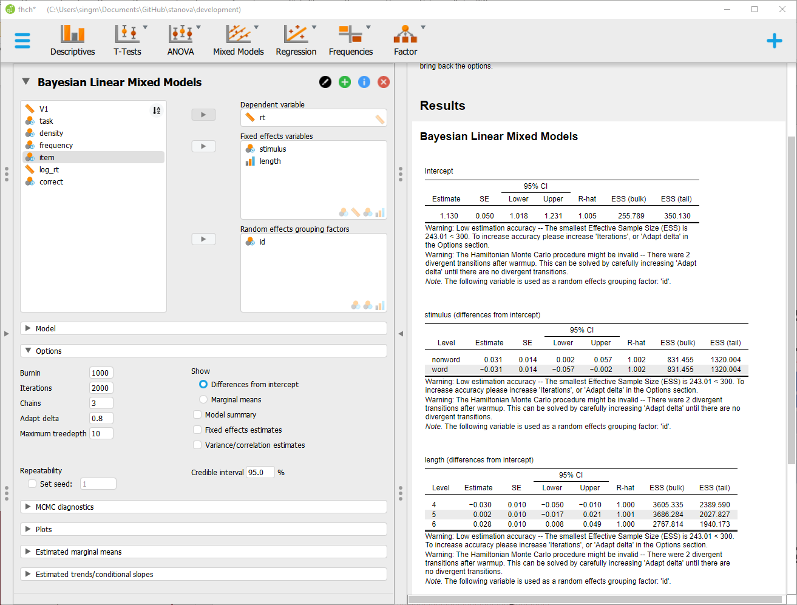

Slide 19
afex::set_sum_contrasts() # uses orthogonal sum contrasts globally
m_sum <- stan_lmer(rt ~ length*stimulus + (length*stimulus | id), fhch)
summary(m_sum, pars = "(Intercept)", regex_pars = c("^length", "^stimulus"), digits = 3)
## [...]
## Estimates:
## mean sd 10% 50% 90%
## (Intercept) 1.13 0.05 1.06 1.13 1.20
## length1 -0.03 0.01 -0.04 -0.03 -0.02
## length2 0.00 0.01 -0.01 0.00 0.01
## stimulus1 -0.03 0.01 -0.05 -0.03 -0.01
## length1:stimulus1 0.02 0.01 0.00 0.02 0.03
## length2:stimulus1 0.00 0.01 -0.02 0.00 0.01
## [...]
 | 4 | 5 | 6
word | 1.08 | 1.09 | 1.11 | 1.10
nonword | 1.11 | 1.16 | 1.20 | 1.16
 | 1.10 | 1.13 | 1.16 | 1.13

