Slide 1
Chapter 1
Introduction

Slide 2
Preview
What is international economics about?
International trade topics
Gains from trade, explaining patterns of trade, effects of government policies on trade
International finance topics
Balance of payments, exchange rate determination, international policy coordination and capital markets
International trade versus finance

Slide 3
What Is International Economics About?
International economics is about how nations interact through:
trade of goods and services, flows of money, and investment.
International economics is an old subject, but continues to grow in importance as countries become tied more to the international economy.
Nations are now more closely linked than ever before.

Slide 4
What Is International Economics About? (cont.)
U.S. exports and imports as shares of gross domestic product have been on a long-term upward trend.
International trade has roughly tripled in importance compared to the economy as a whole in the past 50 years.
Both imports and exports fell in 2009 due to the recession.

Slide 5
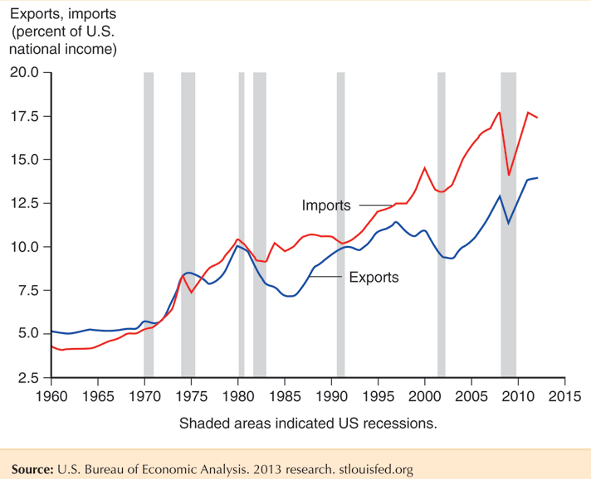
Fig. 1-1: Exports and Imports as a Percentage of U.S. National Income

Slide 6
What Is International Economics About? (cont.)
Compared to the United States, other countries are even more tied to international trade.
Their imports and exports as a share of GDP are substantially higher.
The United States, due to its size and diversity of resources, relies less on international trade than almost any other country.

Slide 7
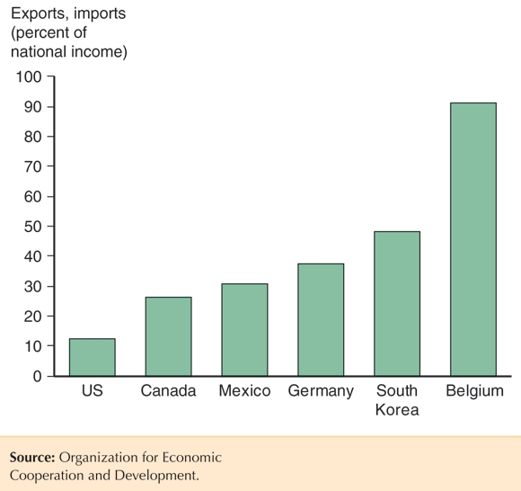
Fig. 1-2: Average of Exports and Imports as Percentage of National Income in 2011

Slide 8
Gains from Trade
That there are gains from trade is probably the most important insight in international economics.
Countries selling goods and services to each other almost always generates mutual benefits.
When a buyer and a seller engage in a voluntary transaction, both can be made better off.
Norwegian consumers import oranges that they would have a hard time producing.

Slide 9
Gains from Trade (cont.)
How could a country that is the most (least) efficient producer of everything gain from trade?
Countries use finite resources to produce what they are most productive at (compared to their other production choices), then trade those products for goods and services that they want to consume.
Countries can specialize in production, while consuming many goods and services through trade.

Slide 10
Gains from Trade (cont.)
Trade benefits countries by allowing them to export goods made with relatively abundant resources and imports goods made with relatively scarce resources.
When countries specialize, they may be more efficient due to larger-scale production.
Countries may also gain by trading current resources for future resources (international borrowing and lending) and due to international migration.

Slide 11
Gains from Trade (cont.)
Trade is predicted to benefit countries as a whole in several ways, but trade may harm particular groups within a country.
International trade can harm the owners of resources that are used relatively intensively in industries that compete with imports.
Trade may therefore affect the distribution of income within a country.

Slide 12
Patterns of Trade
The pattern of trade describes who sells what to whom.
Differences in climate and resources explain why Brazil exports coffee and Saudi Arabia exports oil.
But why does Japan export automobiles, while the U.S. exports aircraft?
Why some countries export certain products can stem from differences in:
Labor productivity
Relative supplies of capital, labor and land and their use in the production of different goods and services

Slide 13
Effects of Government Policies on Trade
Policy makers affect the amount of trade through
tariffs: a tax on imports or exports,
quotas: a quantity restriction on imports or exports,
export subsidies: a payment to producers that export,
or through other regulations (ex., product specifications) that exclude foreign products from the market, but still allow domestic products.
What are the costs and benefits of these policies?

Slide 14
The Effects of Government Policies on Trade (cont.)
If a government restricts trade, what are the costs if foreign governments respond likewise?
Trade policies are often chosen to cater to special interest groups, rather than to maximize national welfare.
Governments tend to adopt tariffs, then negotiate them down in exchange for reduction in trade barriers of other countries.

Slide 15
International Finance Topics
Exchanging risky assets such as stocks and bonds can benefit all countries by diversification that reduces the variability of income – another source of gains from trade.
Most international trade involves monetary transactions.
Many monetary events have important consequences for international trade.

Slide 16
Balance of Payments
Governments measure the value of exports and imports, as well as the value of financial assets that flow into and out of their countries.
Trade deficits, where countries import more than they export in value, may be offset by net inflows of financial assets.
The official settlements balance, or the balance of payments, measures the balance of funds that central banks use for official international payments.
All three values are measured in the government’s national income accounts.

Slide 17
Exchange Rate Determination
Exchange rates are an important financial issue for most governments.
Exchange rates measure how much domestic currency can be exchanged for foreign currency and thus affect:
how much goods denominated in foreign currency (imports) cost in the domestic country.
how much goods denominated in domestic currency (exports) cost in foreign markets.
Some exchange rates change continually (float) while others are fixed for periods of time.

Slide 18
International Policy Coordination
In an integrated economy, one country’s economic policies usually affect other countries as well, leading to the need for some degree of policy coordination.
Depends on type of exchange rate regime.
Capital markets, where money is exchanged for promises to pay in the future, have special concerns in an international setting:
Currency fluctuations can alter the value paid.
Countries, especially developing ones, might default on debt.

Slide 19
The International Capital Market
Capital markets are arrangements by which individuals and firms exchange money now for promises to pay in the future.
International capital markets cope with special regulations that countries impose on foreign investments
Special risks of currency fluctuations and national default;
Sometimes offer opportunities to evade regulations placed on domestic markets.

Slide 20
International Trade Versus Finance
International trade focuses on transactions involving movement of goods and services across nations.
International trade theory (Econ/Trade Chapters 2–8) and policy (Econ/Trade Chapters 9–12)
International finance focuses on financial or monetary transactions across nations.
International monetary theory (Econ Chapters 13–18/Finance Chapters 2-7) and policy (Econ Chapters 19–22/Finance Chapters 8-11)

