Slide 1
Chapter 2
World Trade: An Overview

Slide 2
Preview
Largest trading partners of the United States
Gravity model:
influence of an economy’s size on trade
Distance, barriers, borders and other trade impediments
Globalization: then and now
Changing composition of trade
Service outsourcing

Slide 3
Who Trades with Whom?
More than 30% of world output is sold across national borders.
The 5 largest trading partners with the U.S. in 2012 were Canada, China, Mexico, Japan, and Germany.
The largest 15 trading partners with the U.S. accounted for 69% of the value of U.S. trade in 2012.

Slide 4
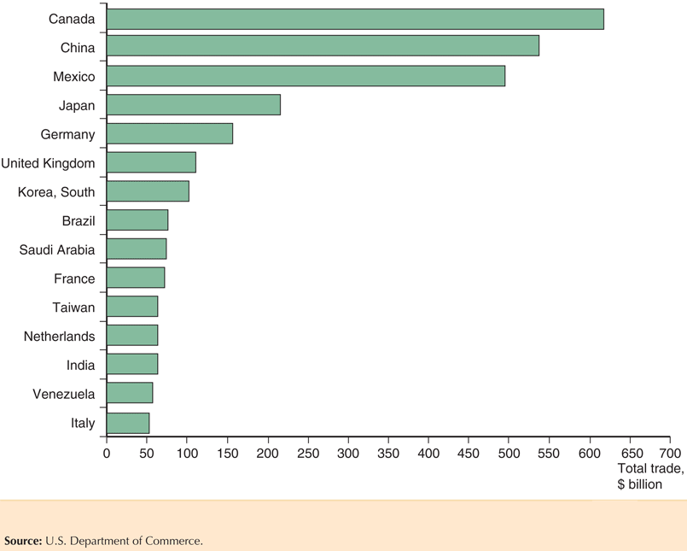
Fig. 2-1: Total U.S. Trade with Major Partners, 2012

Slide 5
Size Matters: The Gravity Model
3 of the top 10 trading partners with the U.S. in 2012 were also the 3 largest European economies: Germany, the United Kingdom, and France.
Why does the United States trade more with these European countries than with others?
These countries have the largest gross domestic product (GDP), the value of goods and services produced in an economy, in Europe.
Each European country’s share of U.S. trade with Europe is roughly equal to its share of European GDP.

Slide 6
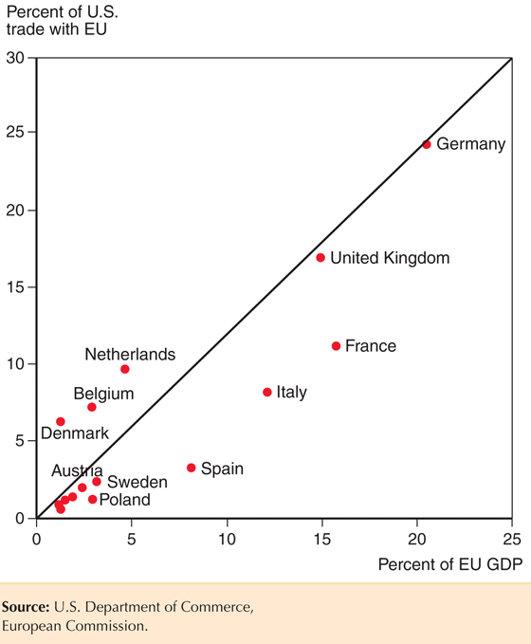
Fig. 2-2: The Size of European Economies, and the Value of Their Trade with the United States

Slide 7
Size Matters: The Gravity Model (cont.)
The size of an economy is directly related to the volume of imports and exports.
Larger economies produce more goods and services, so they have more to sell in the export market.
Larger economies generate more income from the goods and services sold, so they are able to buy more imports.
Trade between any two countries is larger, the larger is either country.

Slide 8
Size Matters: The Gravity Model (cont.)
The gravity model assumes that size and distance are important for trade in the following way:
T_{ij} = A x Y_{i} x Y_{j} /D_{ij}
where
T_{ij} is the value of trade between country i and country j
A is a constant
Y_{i} the GDP of country I, Y_{j} is the GDP of country j
D_{ij} is the distance between country i and country j
Or more generally
T_{ij} = A x Y_{i}ª x Y_{j}^{b} /D_{ij}^{c}
where a, b, and c are allowed to differ from 1.

Slide 9
Using the Gravity Model: Looking for Anomalies
A gravity model fits the data on U.S. trade with European countries well but not perfectly.
The Netherlands, Belgium and Ireland trade much more with the United States than predicted by a gravity model.
Ireland has strong cultural affinity due to common language and history of migration.
The Netherlands and Belgium have transport cost advantages due to their location.

Slide 10
Impediments to Trade: Distance, Barriers, and Borders
Other things besides size matter for trade:
Distance between markets influences transportation costs and therefore the cost of imports and exports.
Cultural affinity: close cultural ties, such as a common language, usually lead to strong economic ties.
Geography: ocean harbors and a lack of mountain barriers make transportation and trade easier.
Multinational corporations: corporations spread across different nations import and export many goods between their divisions.
Borders: crossing borders involves formalities that take time, often different currencies need to be exchanged, and perhaps monetary costs like tariffs reduce trade.

Slide 11
Impediments to Trade: Distance, Barriers, and Borders (cont.)
Estimates of the effect of distance from the gravity model predict that a 1% increase in the distance between countries is associated with a decrease in the volume of trade of 0.7% to 1%.
Besides distance, borders increase the cost and time needed to trade.
Trade agreements between countries are intended to reduce the formalities and tariffs needed to cross borders, and therefore to increase trade.

Slide 12
Impediments to Trade: Distance, Barriers, and Borders (cont.)
The U.S. signed a free trade agreement with Mexico and Canada in 1994, the North American Free Trade Agreement (NAFTA).
Because of NAFTA and because Mexico and Canada are close to the U.S., the amount of trade between the U.S. and its northern and southern neighbors as a fraction of GDP is larger than between the U.S. and European countries.
Canada’s economy is roughly the same size as Spain’s (around 10% of EU GDP) but Canada trades as much with the United States as does all of Europe.

Slide 13
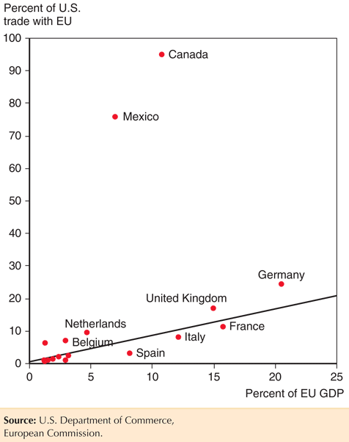
Fig. 2-3: Economic Size and Trade with the United States

Slide 14
Impediments to Trade: Distance, Barriers, and Borders (cont.)
Yet even with a free trade agreement between the U.S. and Canada, which use a common language, the border between these countries still seems to be associated with a reduction in trade.
Data shows that there is much more trade between pairs of Canadian provinces than between Canadian provinces and U.S. states, even when holding distance constant.
Estimates indicate that the U.S.-Canadian border deters trade as much as if the countries were 1,500-2,500 miles apart.

Slide 15
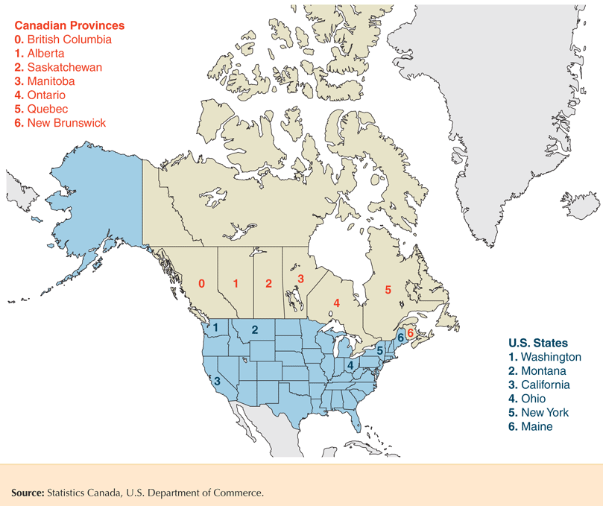
Fig. 2-4: Canadian Provinces and U.S. States that Trade with British Columbia

Slide 16
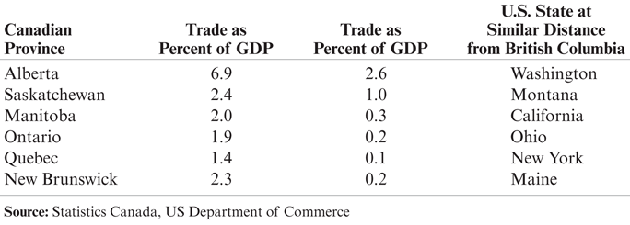
Table 2-1: Trade with British Columbia, as Percent of GDP, 2009

Slide 17
The Changing Pattern of World Trade: Has the World Gotten Smaller?
The negative effect of distance on trade according to the gravity models is significant, but has grown smaller over time due to modern transportation and communication.
Technologies that have increased trade:
Wheels, sails, compasses, railroads, telegraph, steam power, automobiles, telephones, airplanes, computers, fax machines, Internet, fiber optics, personal digital assistants, GPS satellites…

Slide 18
The Changing Pattern of World Trade: Has the World Gotten Smaller? (cont.)
Political factors, such as wars, can change trade patterns much more than innovations in transportation and communication.
World trade grew rapidly from 1870 to 1913.
Then it suffered a sharp decline due to the two world wars and the Great Depression.
It started to recover around 1945 but did not recover fully until around 1970.
Since 1970, world trade as a fraction of world GDP has achieved unprecedented heights.
Vertical disintegration of production has contributed to the rise in the value of world trade through extensive cross-shipping of components.

Slide 19
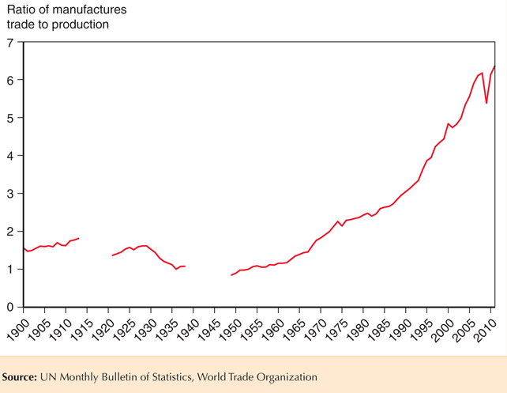
Fig. 2-5: The Fall and Rise of World Trade

Slide 20
What Do We Trade?
What kinds of products do nations trade now, and how does this composition compare to trade in the past?
Today, most (about 53%) of the volume of trade is in manufactured products such as automobiles, computers, and clothing.
Services such as shipping, insurance, legal fees, and spending by tourists account for about 20% of the volume of trade.
Mineral products (ex., petroleum, coal, copper) remain an important part of world trade at 19%
Agricultural products are a relatively small (8%) part of trade.

Slide 21
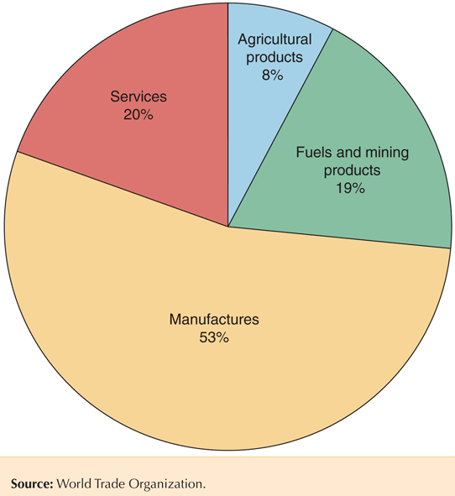
Fig. 2-6: The Composition of World Trade, 2011

Slide 22
What Do We Trade? (cont.)
In the past, a large fraction of the volume of trade came from agricultural and mineral products.
In 1910, Britain mainly imported agricultural and mineral products, although manufactured products still represented most of the volume of exports.
In 1910, the U.S. mainly imported and exported agricultural products and mineral products.
In 2002, manufactured products made up most of the volume of imports and exports for both countries.

Slide 23
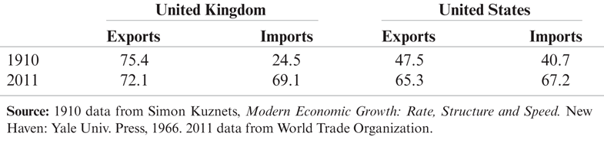
Table 2-2: Manufactured Goods as a Percent of Merchandise Trade

Slide 24
What Do We Trade? (cont.)
Low- and middle-income countries have also changed the composition of their trade.
In 2001, about 65% of exports from low- and middle-income countries were manufactured products, and only 10% of exports were agricultural products.
In 1960, about 58% of exports from low- and middle-income countries were agricultural products and only 12% of exports were manufactured products.
More than 90 percent of the exports of China, the largest developing country and a rapidly growing force in world trade, consist of manufactured goods.

Slide 25
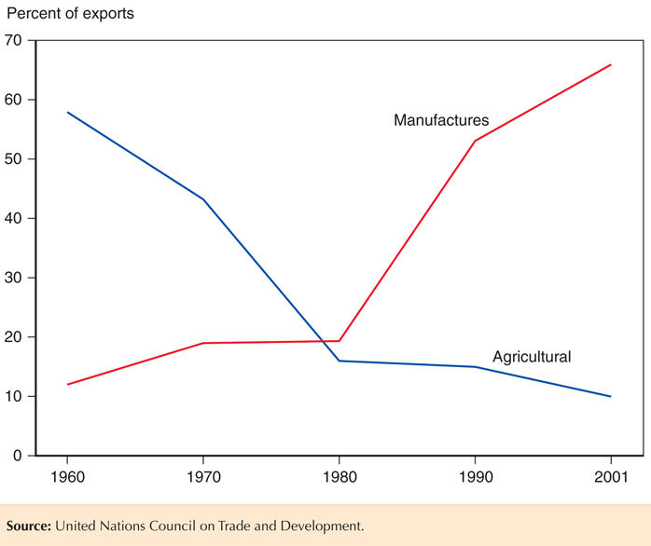
Fig. 2-7: The Changing Composition of Developing-Country Exports

Slide 26
Service Outsourcing
Service outsourcing (or offshoring) occurs when a firm that provides services moves its operations to a foreign location.
Service outsourcing can occur for services that can be transmitted electronically.
A firm may move its customer service centers whose telephone calls can be transmitted electronically to a foreign location.
Other services may not lend themselves to being performed remotely.

Slide 27
Service Outsourcing (cont.)
Service outsourcing is currently not a significant part of trade.
Some jobs are “tradable” and thus have the potential to be outsourced.
Most jobs (about 60%) need to be done close to the customer, making them nontradable.

Slide 28
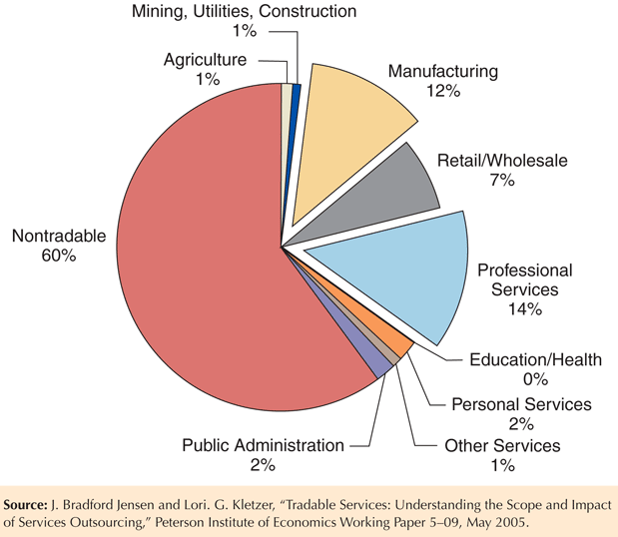
Fig. 2-8: Tradable Industries’ Share of Employment

Slide 29
Summary
The 5 largest trading partners with the U.S. are Canada, China, Mexico, Japan, and Germany.
The largest economies in the EU undertake the largest fraction of the total trade between the EU and the U.S.
The gravity model predicts that the volume of trade is directly related to the GDP of each trading partner and is inversely related to the distance between them.

Slide 30
Summary (cont.)
Besides size and distance, culture, geography, multinational corporations, and the existence of borders influence trade.
Modern transportation and communication have increased trade, but political factors have influenced trade more in history.
Today, most trade is in manufactured goods, while historically agricultural and mineral products made up most of trade.

